Slide 1
Chapter 1, 2, 3,4
Learning Objectives
a. Understand the basics of Linear regression
b. Understand and interpret slope and coefficients of linear regression
c. Understand and interpret correlation coefficient, Multiple R square
d. Understand Regression and ANOVA, t tests and its significance
e. Understand regression plots
f. Understand Multicollinearity problem

Slide 2
Chapter 1 – Introduction to Regression
Contents
Application of regression
What are predictors?
What is response?
Identification of problem
Prediction of response based on predictors
Predictors are known
Regression within the umbrella of machine learning
Supervised learning

Slide 3
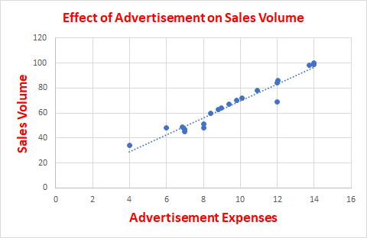
Chapter 1 Introduction to Regression
Linear regression is a mathematical technique for finding the straight line that best fits the values of a linear function, plotted on a scatter graph as data points. - Business Dictionary*
Response variable (aka dependent or outcome or target) is the variable of focus in a research study.
Predictor variable (aka independent or explanatory) is the variable that explains the variation in the response variable and it might affect the response variable.
For example, the response variable is volume of Sales in thousands on a given day in an online stores and the predictor variable is the advertisement expenses.
Focus of the regression analysis is on the relationship between a response variable and one or more predictor variables. To be more specific, this helps one to understand how the typical value of the response variable changes when any one of the predictor variables is varies, keeping other predictor variables constant.
Reference:
http://www.businessdictionary.com/definition/linear-regression.html
https://en.wikipedia.org/wiki/Regression_analysis

Slide 4
Chapter 1 Introduction to Regression
Application of regression
Primary uses for regression in business:
1) Forecasting - to predict events that have yet to occur. For example, number of people who will subscribe to a cell phone services, number of people who will watch a particular TV program
2) Optimization of business process. For example it is important for a cell phone company to know the relationship between the number of calls made to the call center by customers and number of customers churned

Slide 5
Chapter 1 Introduction to Regression
Identification of problem
Before doing the regression analysis, one must review the literature to develop a deep understanding of the relevant variables, their relationships, and the expected coefficient signs and effect magnitude.
Refer http://statisticsbyjim.com/regression/regression-analysis-tips/ for more details.
To determine the response variable, Pedhazur* suggests that the variable have acceptable measurement qualities (i.e., reliability and validity).
Goal of the model selection is to minimize the number of predictors which account for the maximum variance in the response variable.
Refer https://www.ncbi.nlm.nih.gov/pmc/articles/PMC2845248/#B15 for more details.
Reference:
* Pedhazur EJ. Multiple Regression in Behavioral Research. 3rd. ed. Fort Worth, TX: Harcourt Brace College Publishers; 1997.

Slide 6
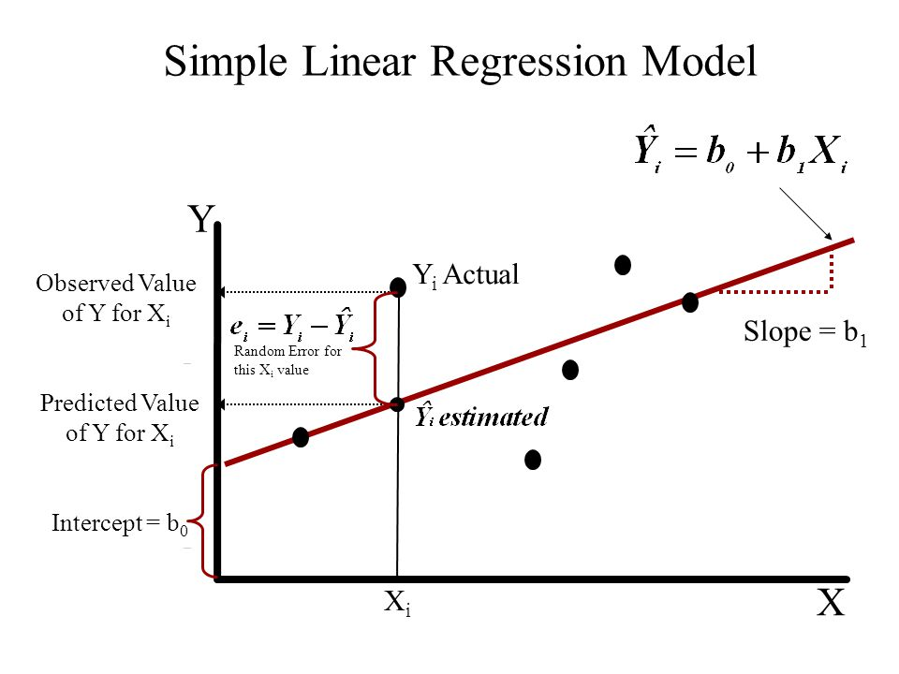
Chapter 1 Introduction to Regression
Prediction of response based on predictors
Simple Linear Regression (SLR)
It is a statistical model in which there is only one predictor variable and one response variable.
Let (X_{i}, Y_{i}) where i is ranging from 1 to n be a dataset of n observations.
Then the regression equation can be written as
Y_{i} = β₀ + β₁X_{i} + ε_{i}, where
Y_{i} is the i^{th} observation of the response variable in the sample
X_{i} is the i^{th} observation of the predictor variable in the sample
ε_{i} is the random error or residuals
β₀, β₁ are the regression parameters or regression coefficients

Slide 7
Chapter 1 Introduction to Regression
Prediction of response based on predictors
Simple Linear Regression (SLR) - continued
Note:
The relationship is not a mathematical model relationship and hence the error term.
The linearity condition is defined with respect to the regression coefficients and not with respect to the predictor variables. Thus Y_{i} = β₀ + β_{1log(}X_{i)} + ε_{i} is a linear model but relationship between Y and X is not linear.
Regression calculates the most likely outcome based on a trend of one or more known independent variables and the impact of changing one of the independent variables.

Slide 8
Chapter 1 Introduction to Regression
Regression within the umbrella of machine learning
Regression and classification are branded under the same umbrella of supervised machine learning.
Both utilize known datasets to make predictions.
In supervised learning, an algorithm is employed to learn the mapping function from X (input) to Y (output), Y = f(X).
The objective is to approximate the mapping function, f as accurately as possible so that we can predict output variable, Y for a new input X as close as possible to the actual value.
The response variable in the regression is continuous numerical variable and for classification it is categorical.
In machine learning, regression algorithms attempt to estimate the mapping function, f from the predictor variables (X) to continuous numerical response variable, Y
Supervised learning is used to predict a certain target variable from a model you trained with known data.
Regression is a kind of supervised learning where you predict numerical variable in interval scale.

Slide 9
Chapter 1
Summary
The main objective of regression is to establish the existence of a relationship between an target (response) variable and explanatory (predictor) variables.
Before doing the regression analysis, one must review the literature to develop a deep understanding of the relevant variables, their relationships, and the expected coefficient signs and effect magnitude.
In machine learning, regression algorithms attempt to estimate the mapping function, f from the predictor variables (X) to continuous numerical response variable, Y
Linear regression implies that the relationship between the response variable and the regression parameters (β0, β1) is linear.
Reference
1. Business Statistics – a first course – Davind M. Levine, Kathryn A. Szabat, David F Stephan and Dr P K Viswanathan Chapter 12

Slide 10
Chapter 2 – Simple Linear Regression
Contents
Continuous Response, Single Predictor
From correlation to regression
Limitation of correlation
Scatterplot: visualization of dependency
Scatterplots for various correlation values
Fitting a regression line: Model, Error
Value of intercept and slope: Interpretation
Value of multiple R-square
Correlation coefficient & R-square
Sign of correlation coefficient and regression slope
Fitted values, predicted value of response for a new X
Scope of regression

Slide 11
Chapter 2 – Simple Linear Regression
Continuous Response, Single Predictor
Simple Linear Regression (SLR) is a statistical method that allows us to summarize and study relationships between two continuous numerical variables, wherein
a) one variable being the predictor variable, x and
b) the other being the response variable, y.
We call this as simple linear regression because it concerns the study of only one predictor variable.

Slide 12
Chapter 2 – Simple Linear Regression
From correlation to regression
Regression and correlation analysis techniques are employed to study the relationships between variables.
Regression is used to predict the value of one variable based on the value of a different variable.
Correlation is a measure of the strength of a relationship between variables.
Limitation of correlation
Correlation does not mean causation.
Correlation can suggest there is a relationship between two variables but it cannot prove that one variable causes a change in another variable. For example, the correlation might suggest that there is a relationship between sales quantity of a new product and price of the new product. But it cannot suggest how the price of the new product will cause changes in sales quantity.

Slide 13
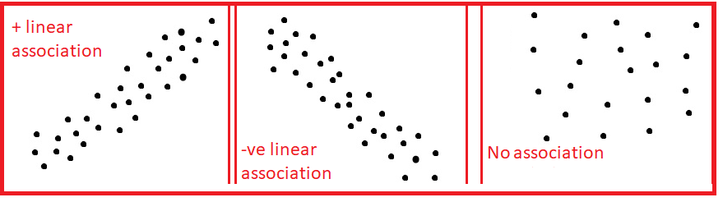
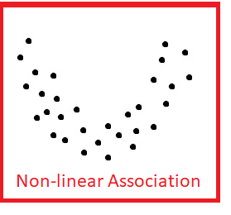
Chapter 2 – Simple Linear Regression
Scatterplot: visualization of dependency
A scatter plot is a plot of two variables that will reveal the relationship (linear or non-linear) between two variables.
It is useful for assessing the strength of the relationship and to find if there are any outliers in the data.

Slide 14
Chapter 2 – Simple Linear Regression
Scatterplots for various correlation values
Correlation Coefficient: 1
Correlation Coefficient: -1
Correlation Coefficient: 0.011

Slide 15
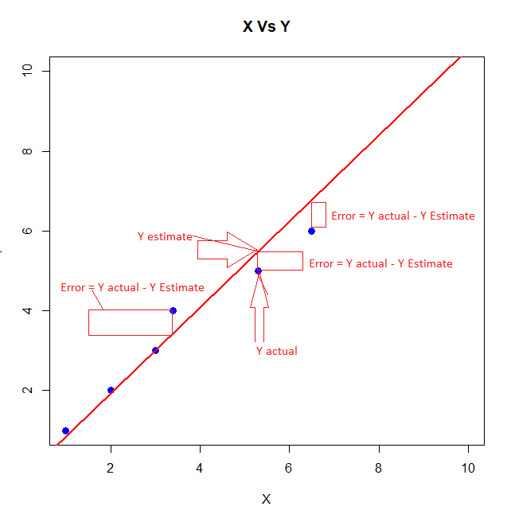
Chapter 2 – Simple Linear Regression
Fitting a regression line: Model, Error
Linear regression consists of finding the best fitting straight line through the points.
Regression line is the red diagonal line in the figure and consists of the predicted score on Y for each possible value of X.
The error of prediction for a point is the value of the actual observation minus the estimated value which is on the line.
Regression line: Y' = β₀ + β₁X, where Y' is the predicted Y, β₁ is the slope and β₀ is the Y intercept and Y – Y’ is the error in prediction

Slide 16
Chapter 2 – Simple Linear Regression
Fitting a regression line: Model, Error - Example
Obtain a regression equation between hours studied and marks scored data given below:
Hours studied | 10 | 12 | 18 | 24 | 24 | 26 | 27 | 28 | 29 | 31 | 32 | 40 | 41 | 44 | 46 | 48 | 50 | 52 | 52 | 53 | 60 | 62 | 65 | 67
Marks in the examination | 43 | 45 | 53 | 55 | 56 | 60 | 64 | 69 | 70 | 75 | 77 | 79 | 73 | 78 | 78 | 79 | 81 | 82 | 84 | 87 | 89 | 90 | 94 | 100
We observe:
Correlation Coefficient to be 0.960954493
b. Scatter plot reveals a very strong positive relationship.
Let us proceed with analysis using Regression in Excel Data Analysis.

Slide 17
Chapter 2 – Simple Linear Regression
Fitting a regression line: Model, Error – Example - continued
We get the following coefficients table:
 | Coefficients | Standard Error | t Stat | P-value | Lower 95% | Upper 95%
Intercept | 38.9988127 | 2.284845422 | 17.06846876 | 3.55496E-14 | 34.26033332 | 43.73729209
Hours studied | 0.876757168 | 0.053825051 | 16.28901689 | 9.24758E-14 | 0.765130844 | 0.988383492
From the coefficients table, we observe that the p value for the coefficient for the variable, Hours Studied to be very small, 9.25e-14.
At 5% level of significance, we conclude that the coefficient for Hours Studied is statistically significant as the p value is less than 0.05 and reject the null hypothesis (H0: Coefficient of the parameter is 0).
95% Confidence interval describes the uncertainty inherent in the estimate and describes a range of values containing the true value, on each occasion, if a study were repeated infinite times. If the interval is wider, the uncertainty is greater indicating our poor knowledge about the effect of the independent variable on the dependent variable.
We also observe that the 95% confidence interval for the Hours Studied is 0.76513 to 0.98838 is not very wide and does not include 0.

Slide 18
Chapter 2 – Simple Linear Regression
Fitting a regression line: Model, Error – Example - continued
Coefficients column provides the values for regression coefficients for the regression equation.
Marks = 38.9988127 + 0.876757168 * Hours Studied.
Here, the intercept is 38.9988 and slope is 0.8768
https://www.dummies.com/education/math/statistics/how-to-calculate-a-regression-line/

Slide 19
Chapter 2 – Simple Linear Regression
Value of intercept and slope: Interpretation
Let the Regression line be y = ax + b
The y intercept is the point where the regression line crosses the y axis (where x = 0) and is denoted by b.
Here the slope is a.
These coefficient estimates (and b) reveal the relationship between the intendent variable, Hours Studied and the dependent variable, Marks. These estimates tell us the amount of increase in Marks for one hour increase in Hours Studied.
Interpret slope for the regression equation: Marks = 38.9988127 + 0.876757168 * Hours Studied.
So, for every unit (i.e.., one hour) increase in Hours Studied (holding other variables constant), an increase of 0.88 marks is predicted.

Slide 20
Chapter 2 – Simple Linear Regression
Value of intercept and slope: Interpretation
Intercept is described as the mean response when all independent variables are set to zero.
There is always uncertainty in interpreting intercepts unlike slope which is always interpretable.
This does not make sense in many situations. This intercept can be regarded as a garbage collector for the regression model for any bias that is not accounted for by the terms in the model.
Regression intercept is not worth interpreting, in general.
http://blog.minitab.com/blog/adventures-in-statistics-2/regression-analysis-how-to-interpret-the-constant-y-intercept

Slide 21
Chapter 2 – Simple Linear Regression
Value of multiple R-square
R squared (or Multiple R² for multiple linear regression) is a goodness of fit measure for linear regression models. This statistic indicates the percentage of variance in the response or dependent variable that the model explain (or independent variables explain collectively).
R squared is also called the coefficient of determination. It reveals how many data points fall within the results of the regression line.
R squared is the percentage of the response variable variation that a linear model explains.
R² = Variance explained by the model / Total variance
It lies between 0 and 100 and 0% represents the model does not explain any of the variation in the dependent variable around its mean while 100% explains all of the variation in the dependent variable around its mean.
R squared cannot determine whether the coefficient estimates are biased. So we use residual plots to check bias.
A high R² is necessary for precise predictions in addition to the requirement that the residuals are randomly scattered around 0.

Slide 22
Chapter 2 – Simple Linear Regression
Correlation coefficient & R-square
R-squared is the square of the coefficient of correlation.
For example, correlation coefficient between marks and hours studied is 0.96095.
From the regression statistics table, we observe that
R Square is 0.9234 which is same as the square of the correlation coefficient (0.96095) which is 0.9234.

Slide 23
Chapter 2 – Simple Linear Regression
10) Sign of correlation coefficient and regression slope
When we examine our Least square regression lines and corresponding values of correlation coefficient, r,
we observe sign of the correlation coefficient and slope of the regression line is same.
For example, in the marks example, we observe the sign of the correlation coefficient is positive (0.96095) and the slope of the regression line (0.8768) is also positive.
Formula for Slope
α = r(Sy / Sx) where Sx if the standard deviation of x and Sy is the standard deviation of y and r is the correlation coefficient between x and y.
Since Sy and Sx are positive, both slope, a and r, the correlation coefficient have the same sign.

Slide 24
Chapter 2 – Simple Linear Regression
11) Fitted values, predicted value of response for a new X
Regression equation is used to predict the unknown value of the response variable, y when the values of the predictor variables, X are known.
For example, you want to predict the marks of a student, who has spent 15 hours for studying the subject.
We know, the regression equation is Marks = 38.9988127 + 0.876757168 * Hours Studied.
Marks = 38.9988127 + 0.876757168 X 15 = 52.15017 or 52 Marks

Slide 25
Chapter 2 – Simple Linear Regression
Scope of regression
In Linear regression, we examine the following:
a) Does the set of independent or predictor variables predict a dependent or target or response variable?
b) Which variables in particular are significant predictors of the target variable and how they impact the target variable?
We assume that the historically observed data forms the basis for future predictions and the response and predictor variables are associated or related.

Slide 26
Chapter 2 – Simple Linear Regression
Scope of regression
Assumptions of Linear Regression
Absence of multi-collinearity
Errors between the observed and predicted values should be normally distributed. For regressions, the test of normality applies to model's residuals and not the variables themselves.
Homoscedasticity: We check heteroscedasticity using Goldfeld Quandt.
Linear and additive relationship exists between the response and predictor variables.

Slide 27
Chapter 2
Summary
Primary goal of Regression is to establish the existence of an association relationship between a dependent variable and independent variables.
In Simple Linear Regression, the number of independent variable is one.
Correlation can suggest there is a relationship between two variables and cannot prove that one variable causes a change in other variables.
We have seen how to interpret the intercept and slope of a regression line.
R² is a percentage of the variation in the dependent variable explained by the model.
R² is the square of correlation coefficient.
Sign of the correlation coefficient and slope of the regression line is same.
Reference
1. Business Statistics – a first course – Davind M. Levine, Kathryn A. Szabat, David F Stephan and Dr P K Viswanathan Chapter 12

Slide 28
Chapter 3
Contents
Regression ANOVA
Significance of t-statistics
R-square as a ratio of Reg SS & TSS
Significant t does not imply high R-square value
Residual Plots and Ideal plots

Slide 29
Chapter 3
Regression ANOVA
Two techniques for comparing two or more population means to each other are ANOVA and regression . F statistics is used to test hypotheses about relationships between predictor and response variables in both techniques.
Analysis of Variance (ANOVA) provide information about levels of variability within a regression model. This forms a basis for tests of significance.
Both ANOVA and regression techniques produce significance tests for each factor.
ANOVA tests the effect of each factor after controlling for each other, but not controlling for the interaction.
Regression technique tests the hypothesis that there is an effect of one factor when the other factor is zero (controlling for other factor and interaction).
We observe that along with coefficients for intercept and for x, there are statistical t tests for each coefficient. These are tests of the null hypothesis that the coefficient is zero.

Slide 30


Chapter 3
Regression ANOVA - continued
ANOVA table
ANOVA
Source | df | SS | MS | F | Significance F
Regression | 1 | 4882.770264 | 4882.770264 | 265.3320713 | 9.24758E-14
Residual | 22 | 404.8547364 | 18.40248802
Total | 23 | 5287.625
The first column labeled Source has three rows: Regression, Residual and Total.
The third column labeled as SS (Sum of Squares) describes the variability in the response variable, Y.
The second column has the degrees of freedom associated with SS.
The total amount of variability in the dependent variable is and named as TSS.
The error term or is the variability about the regression line and named as ESS.

Slide 31
Chapter 3
Regression ANOVA - continued
ANOVA table
Regression sum of squares (Reg SS) is the difference between TSS and RSS.
Each Sum of squares has a corresponding degrees of freedom, df associated with it.
Total df is n - 1, one less than the number of observations.
Regression df is the number of independent variables in the model. For SLR, it is 1.
Error df is the difference between total df and Regression df.
Mean Squares (MS) are the sum of squares divided by the corresponding df.
F statistic or F ratio is the ratio of SS divided by the corresponding df.
In the context of regression, the p value reported in the table gives us an overall test for the significance of our model. As p value (9.248 e-14) is less than 0.05, we reject the null hypothesis that there is no relationship between predictor and response and conclude that there is a significant relationship between the predictor and response variables.
http://www.sjsu.edu/people/fred.prochaska/courses/ScWk242Spring2013/s1/ScWk-242-Week-12-Slides---ANOVA-and-Linear-Regression.pdf

Slide 32


Chapter 3
2. Significance of t-statistics
 | Coefficients | Standard Error | t Stat | P-value
Intercept | 38.9988127 | 2.284845422 | 17.06846876 | 3.55496E-14
Hours studied | 0.876757168 | 0.053825051 | 16.28901689 | 9.24758E-14
t Tests are used to conduct hypothesis tests on the regression coefficients obtained in Simple Linear Regression.
A statistic based on the t distribution is used to test the two-sided hypothesis that the true slope, b1 equals a constant value c.
H₀: β1 = c
H₁: β1 ≠ c
Test statistic used for this test, where ^ β1 is the least square estimate of β1 and is the standard error.
Test statistic follows a t distribution with n-2 df where n is the number of observations.
We reject the null hypothesis at 5% level of significance, when the p value corresponding the t statistic < 0.05. Here P value for Hours Studied is 9.248 E-14 < 0.05 and hence we reject the null hypothesis and conclude that regression coefficient of Hours Studied is different from 0.

Slide 33
Chapter 3
3. R-square as a ratio of Regression SS & Total SS
R square is a statistical measure of how close the data are to the fitted regression line.
It is the percentage of variation of the dependent variation that is explained by a linear model.
R square = Explained variation / Total variation = Reg Sum of squares / Total Sum of Squares.
4. Significant t does not imply high R² value
R² is the proportion of variation in the dependent variable that is accounted for by the model as a whole.
P-value for a predictor variable pertains to the contribution of that predictor after the contributions of other predictors have been taken into account. It talks about what the predictor adds to the model.
While the independent variables as a whole help predict the dependent variable (e.g. high R²), the explanatory power of individual independent variables cannot be easily partitioned.

Slide 34
Chapter 3
5. Residual Plots and ideal plots
A residual plot is a graph that shows the residuals on the y axis and the independent variable on the x axis.
If the points in a residual plot are randomly spread around the x axis, a linear regression model is appropriate for the data otherwise, a non-linear model is more appropriate.
For example, in the Hours studied residual plot, we find the residuals on the y axis are spread randomly spread around the x-axis and linear model is appropriate and ideal.

Slide 35
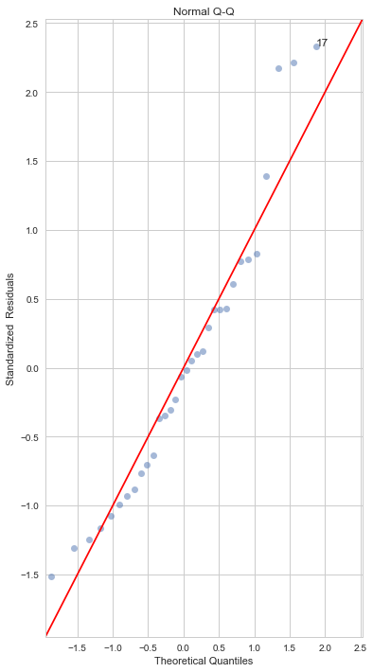
Chapter 3
5. Normal QQ Plot
This plot shows how well the distribution of residuals fit the normal distribution.
This plots the z score of the residuals against the theoretical normal quantiles.
Any thing quite off the diagonal lines may be a concern for further investigation.
QQ plot for the residuals from the regression model applied on the dataset, mtcars
which is an in-built data set about cars which contains 32 observations and 11 variables.
There are many deviations from the straight line and hence the residuals do not fit the normal distribution.

Slide 36
Chapter 3
Summary
Two techniques for comparing two or more population means to each other are ANOVA and regression.
ANOVA tests the effect of each factor after controlling for each other, but not controlling for the interaction.
Regression technique tests the hypothesis that there is an effect of one factor when the other factor is zero (controlling for other factor and interaction).
t Tests are used to conduct hypothesis tests on the regression coefficients obtained in Simple Linear Regression.
R square is the percentage of variation of the dependent variation that is explained by a linear model.
Significant t does not imply high R2 value.
A residual plot is a graph that shows the residuals on the y axis and the independent variable on the x axis.
If the points in a residual plot are randomly spread around the x axis, a linear regression model is appropriate for the data otherwise, a non-linear model is more appropriate.

Slide 37
Chapter 4
Contents
Multiple Linear Regression
Continuous Response, Multiple Predictors
Pairwise scatterplot - Advertising data
Regression with two predictors
Interpretation of regression slopes: rate of change when the other predictor is constant - Auto data
Multiple r-square: increases with additional predictor - Concrete data
Significance of t-statistics
Multicollinearity -Baseball data
What does it mean?
Possible problems: VIF, unreliable estimates

Slide 38
Chapter 4
Multiple Linear Regression - Continuous Response, Multiple Predictors
Multiple Linear Regression (MLR) is a statistical technique that establishes existence of a linear relationship between a continuous numeric dependent variable and several independent variables.
Functional form
Y_{i} = β₀ + β₁X_{1i} + β₂X_{2i} + ... + β_{k}X_{ki} + ε_{i}
where Y_{i} is the dependent variable
X₁, X₂, ... X_{k} are a group of independent variables
β₀ is a constant
β₁, β₂, …, β_{k} are partial regression coefficients corresponding to the predictor variables X₁, X₂, ... X_{k} respectively
ε_{i} is the error or residual term

Slide 39
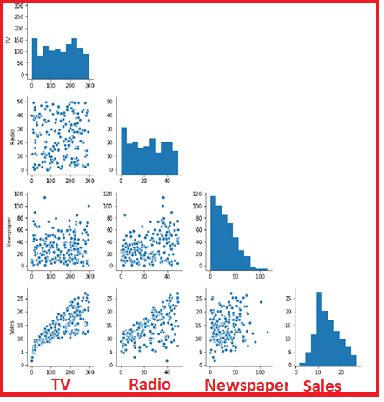
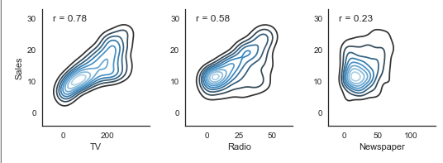
Chapter 4
2. Pairwise scatterplot - Advertising data
The pair plot contains the histogram and the scatter plot.
The histogram on the diagonal allows us to see the distribution of a single variable.
The scatter plots on the lower triangle show the relationship between the variables.
For example, the left most plot in the fourth row shows the scatter plot of TV vs Sales. This plot shows a reasonably good relationship as the correlation coefficient is 0.78.
The second plot from the left corner of the last row, shows a very moderate relationship between Radio and Sales as the correlation coefficient is 0.58
The third plot from the left corner of the last row, shows a very poor relationship between Newspaper and Sales as the correlation coefficient is 0.23.
Distribution of none of the variables is normal as evidenced by the histograms.

Slide 40
Chapter 4
3. Regression with two predictors and interpretation of regression slopes:
With two independent variables the prediction of Y is expressed by the following equation:
Y'_{i} = β₀ + β ₁X_{1i} + β₂X_{2i}
R Square | 0.121927138
Adjusted R Square | 0.120217161
Standard Error | 15.66944131
Observations | 1030
ANOVA
 | df | SS | MS | F | Significance F
Regression | 2 | 35014.44856 | 17507.22428 | 71.30340528 | 1.00679E-29
Residual | 1027 | 252160.7386 | 245.531391
Total | 1029 | 287175.1871
 | Coefficients | Standard Error | t Stat | P-value | Lower 95% | Upper 95%
Intercept | 51.21950022 | 4.864852765 | 10.52847901 | 1.0962E-24 | 41.67331364 | 60.7656868
fineagg | -0.024753691 | 0.006168193 | -4.013118448 | 6.42734E-05 | -0.036857392 | -0.012649989
age | 0.082068722 | 0.007828742 | 10.4830022 | 1.69399E-24 | 0.066706565 | 0.097430879
For example, while predicting the complete comprehensive strength of cement, let us consider only two predictor variables, Fine Aggregate and Age in days.
We have the Multiple R² = 0.1219.
The regression equation is Strength = 51.2195 - 0.02475 fineagg + 0.08207
For every unit increase in fineagg, the strength of the cement is reduced by 0.02475 kg holding age constant.
For every unit (day) increase in age, the strength of the cement is increased by 0.08207 kg holding fineagg constant.

Slide 41
Chapter 4
4. Multiple r-square: increases with additional predictor
With many independent variables the prediction of Y is expressed by the following equation:
Y'_{i} = β₀ + β ₁X_{1i} + β₂X_{2i} + … + β_{n}X_{ni}
Regression Statistics
Multiple R | 0.784550744
R Square | 0.61551987
Adjusted R Square | 0.612507293
Standard Error | 10.39914264
Observations | 1030
ANOVA
 | df | SS | MS | F | Significance F
Regression | 8 | 176762 | 22095.25 | 204.3167 | 6.3E-206
Residual | 1021 | 110413.2 | 108.1422
Total | 1029 | 287175.2
 | Coefficients | Standard Error | t Stat | P-value | Lower 95% | Upper 95%
Intercept | -23.33121358 | 26.5855 | -0.87759 | 0.380372 | -75.4997 | 28.83726
cement | 0.119804334 | 0.008489 | 14.11286 | 1.9E-41 | 0.103146 | 0.136462
slag | 0.103865809 | 0.010136 | 10.24742 | 1.6E-23 | 0.083976 | 0.123755
ash | 0.087934322 | 0.012583 | 6.988168 | 5.02E-12 | 0.063242 | 0.112626
water | -0.149918419 | 0.040177 | -3.73145 | 0.000201 | -0.22876 | -0.07108
superplastic | 0.292224595 | 0.093424 | 3.127937 | 0.00181 | 0.108899 | 0.47555
coarseagg | 0.018086215 | 0.009392 | 1.925656 | 0.054425 | -0.00034 | 0.036517
fineagg | 0.020190351 | 0.010702 | 1.886652 | 0.059491 | -0.00081 | 0.04119
age | 0.114222068 | 0.005427 | 21.04643 | 5.78E-82 | 0.103572 | 0.124872
For example, while predicting the complete comprehensive strength of cement, let us consider all eight predictor variables.
We observe that Multiple R2 = 0.6155 and it has increased from 0.1219 (for only two predictor variables).
So, multiple R² increases with additional predictor variables.

Slide 42
Chapter 4
5. Significance of t-statistics
With many independent variables the prediction of Y is expressed by the following equation:
Y'_{i} = β₀ + β ₁X_{1i} + β₂X_{2i} + … + β_{n}X_{ni}
Regression Statistics
Multiple R | 0.784550744
R Square | 0.61551987
Adjusted R Square | 0.612507293
Standard Error | 10.39914264
Observations | 1030
ANOVA
 | df | SS | MS | F | Significance F
Regression | 8 | 176762 | 22095.25 | 204.3167 | 6.3E-206
Residual | 1021 | 110413.2 | 108.1422
Total | 1029 | 287175.2
 | Coefficients | Standard Error | t Stat | P-value | Lower 95% | Upper 95%
Intercept | -23.33121358 | 26.5855 | -0.87759 | 0.380372 | -75.4997 | 28.83726
cement | 0.119804334 | 0.008489 | 14.11286 | 1.9E-41 | 0.103146 | 0.136462
slag | 0.103865809 | 0.010136 | 10.24742 | 1.6E-23 | 0.083976 | 0.123755
ash | 0.087934322 | 0.012583 | 6.988168 | 5.02E-12 | 0.063242 | 0.112626
water | -0.149918419 | 0.040177 | -3.73145 | 0.000201 | -0.22876 | -0.07108
superplastic | 0.292224595 | 0.093424 | 3.127937 | 0.00181 | 0.108899 | 0.47555
coarseagg | 0.018086215 | 0.009392 | 1.925656 | 0.054425 | -0.00034 | 0.036517
fineagg | 0.020190351 | 0.010702 | 1.886652 | 0.059491 | -0.00081 | 0.04119
age | 0.114222068 | 0.005427 | 21.04643 | 5.78E-82 | 0.103572 | 0.124872
t Tests are used to conduct hypothesis tests on the regression coefficients obtained in Simple Linear Regression.
We test the hypothesis that regression coefficient of independent variables is different from 0
From the coefficients of regression table, we observe that the following predictor variables are significant at 5% level of significance in predicting the response variable, strength since their p value < 0.05 and their coefficients are not zero:
1) cement 2) slag 3) ash 4) water 5) superplastic 6) age
The predictor variables, coarseagg and fineagg are not significant at 5% level of significance.

Slide 43

Chapter 4
6. Multicollinearity , meaning and possible problems
When the data set has a large number of independent variables, it is quite likely that some of the independent variables may be associated.
Existence of high correlation between independent variables is known as multi-collinearity.
Presence of multi-collinearity can destabilize the multiple regression model as shown below:
The standard error of estimate of a regression coefficient may be inflated resulting retaining the null hypothesis and rejecting the statistically significant predictor variable.
t statistic value is . If is inflated, t value under estimated.
The sign of the regression coefficient may be different to the actual sign.
Adding or removing a predictor variable may result in large variation in regression coefficient estimates.

Slide 44

Chapter 4
7. Variable Inflation Factor
VIF measures the magnitude of multi-collinearity.
Consider a regression model with two independent variables. We can use the correlation coefficient to calculate R^2 between the two variables.
VIF = 1 / (1 - R12^2)
The value 1 - R12^2 is called the tolerance.
sqrt (VIF) is the value by which t statistic is deflated.
So,
The threshold value for VIF is 5 while a few authors suggest 10

Slide 45
Chapter 4
Summary
1. Multiple Linear Regression (MLR) is a statistical technique that establishes existence of a linear relationship between a continuous numeric dependent variable and several independent variables.
2. The pair plot contains the histogram and the scatter plot. The histogram on the diagonal allows us to see the distribution of a single variable. The scatter plots on the lower triangle show the relationship between the variables.
3. Multiple R2 increases with additional predictor variables.
4. Using t tests, we test the hypothesis that regression coefficient of independent variables is different from 0
5. Existence of high correlation between independent variables is known as multi- collinearity. Presence of multi-collinearity can destabilize the multiple regression model.
6. VIF measures the magnitude of multi-collinearity.

