Slide 1
Chapter 1, 2
Learning Objectives
Understand the need to split the data into training and test data
Understand the principle of model validation
Understand what prediction error is
Learn to find the best model among many
Understand the basics and necessity of simple logistic regression
Understand how to interpret the results of Logistic regression

Slide 2
Chapter 1 – Explore Linear regression
Contents
Training & Test Data
Principle of model validation
Prediction error
Finding the best model among many

Slide 3
Chapter 1 – Explore Linear regression
Training & Test Data
Machine learning is a subfield of computer science that gives the computer the ability to learn without being explicitly programmed (Arthur Samuel, 1959).
To achieve this to happen, a machine needs to be trained by explicitly providing the data about predictor variables and the response variables.
The training data is used to build the model or train the model. Once trained or model is built, the machine will be able to predict the response variable for the test data without values for response variable.
Most data scientists divide their data (with values for response variable, that is historical data) into three portions: training data, cross-validation data and testing data.

Slide 4
Chapter 1 – Explore Linear regression
Training & Test Data
The training data is used to build the model and to enable the machine recognizes patterns in the data, the cross-validation data is used to ensure better accuracy and efficiency of the algorithm used to train the machine, and the test data is used to see how well the model performs to predict response variable based on unseen and new data
Some of data scientists divide their data into two portions: training data and testing data.
Train, validation and test data split ratio depends on total number of observations in the data and the actual model you are building.
If you happen to have a model with no hyper parameters or parameters difficult to tune, you may not need validation dataset too.
70:10:20 is frequently used as the Train, validation and test data split ratio.
Caveats:
1) Size of test data must be large enough to yield statistically significant results.
2) Test data is the representative of the data set as a whole.
3) Never train on the test data.

Slide 5
Chapter 1 – Explore Linear regression
2. Principle of model validation
Validation techniques in machine learning are used to get the error rate of the ML model, which can be considered as close to the true rate of the population.
Since we work with samples of data that may not be a true representative of the population requiring the use of validation techniques.
Validation techniques:
1. Re-substitution
2. Hold-out
3. K fold cross validation
4. LOOCV
5. Random sub-sampling
6. Bootstrapping

Slide 6
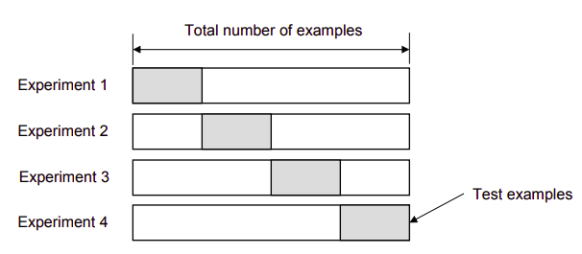
Chapter 1 – Explore Linear regression
2. Principle of model validation
Validation techniques:
Re-substitution: In this technique, all the data is used for training the model and the error rate is evaluated based on outcome vs. actual value from the same training data set. This error is called the re-substitution error.
Hold-out: is a technique where the data is split into two different data sets (train and test) datasets with equal distribution of different classes of data. This avoids re-substitution error.
K fold cross validation: is a technique where k - 1 folds are used for training and the remaining one is used for testing. The error rate is the average rate of each iteration.
K fold cross validation

Slide 7
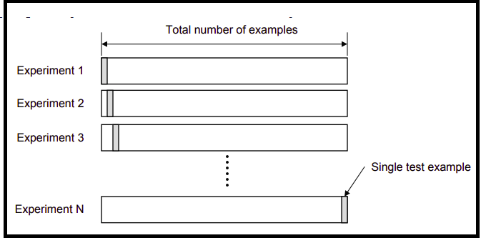
Chapter 1 – Explore Linear regression
2. Principle of model validation
Validation techniques:
4. LOOCV: is the acronym for Leave One Out Cross Validation. In this technique, all of the data except one record is used for training and one record is used for testing, This process is repeated for n times, where n is the number of observations. The error rate of the model is average of the error rate of each iteration.
LOOCV technique

Slide 8
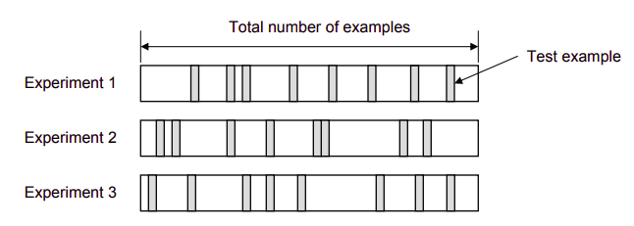
Chapter 1 – Explore Linear regression
2. Principle of model validation
Validation techniques:
5. Random sub-sampling: Here multiple sets of data are randomly chosen from the dataset and combined to form a test dataset. The remaining data forms the training dataset.

Slide 9
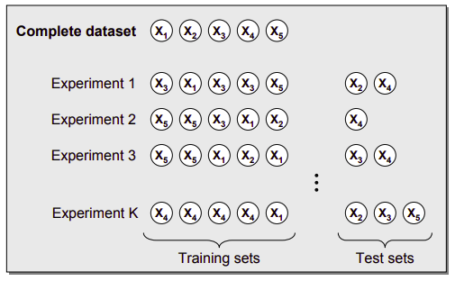
Chapter 1 – Explore Linear regression
2. Principle of model validation
Validation techniques:
6. Bootstrapping: Here, the training dataset is randomly selected with replacement. For testing, we use the records not selected are used. Size of the training data set changes from fold to fold. The error rate of the model is the average of the error rate of each item. .

Slide 10
Chapter 1 – Explore Linear regression
3. Prediction Error
A good regression model predicts values of the response variable very close to the observed response values. The difference between predicted value and observed value of a response variable is called as prediction error.
https://www.theanalysisfactor.com/assessing-the-fit-of-regression-models/
In Ordinary Least Squares (OLS) regression model, three statistics are used to evaluate the fitness of the model:
1. R squared and Adjusted R squared
2. F test
3. Root Mean Square Error (RMSE)

Slide 11
Chapter 1 – Explore Linear regression
3. Prediction Error
The above statistics are based on Total Sum of Squares (SST) and Error Sum of Squares (SSE).
SST measures how far the data are from the mean while SSE measures how far the data are from the model's predicted values.
1. R squared is obtained by dividing the difference (between SST and SSE) by SST. Adjusted R square incorporates the model's degrees of freedom. Adjusted R square is interpreted as the proportion of total variance that is explained by the model.
2. F test evaluates the null hypothesis that all regression coefficients are equal to zero versus the alternative that at least one is not. F test determines whether the proposed relationship between the dependent variable and the set of independent variables is statistically reliable
3. RMSE is the square root of the variance of the residuals. It indicates the absolute fit of the model to the data. RMSE is an absolute measure of fit. RMSE can be interpreted as the standard deviation of the unexplained variance and also has the same unit of measure as the response variable. RMSE is a good measure of how accurately the model predicts the response.

Slide 12
Chapter 1 – Explore Linear regression
4. Finding the best model among many
We have many criteria by which regression models can be compared:
1) Error measures in the estimation period: RMSE, MAPE etc.
2) Error measures in validation period: RMSE, MAPE etc.
3) Residual diagnostics and goodness of fit tests: Plots of residuals vs predicted values, plots of observed vs predicted values
Qualitative considerations: usefulness for decision making or simplicity of the model
Note:
1) There is no absolute criterion for a good value of RMSE or MAE. This depends on the units in which the variable is measured and the degree of forecasting accuracy.
2) There is no absolute standard for a good value of adjusted R square. This depends on situation.
3) When you are trading off model complexity against measure of error, use the percentage of variation in RMSE between models.
4) Measures such as Mallows Cp statistic, Akaike Information Criteria or Schwarz' Bayesian Information Criterion (BIC) imposes a heavier penalty on model complexity.

Slide 13
Chapter 1
Summary
1. The training data is used to build the model or train the model. Once trained or model is built, the machine will be able to predict the response variable for the test data without values for response variable.
2. Train, validation and test data split ratio depends on total number of observations in the data and the actual model you are building.
3. Validation techniques in machine learning are used to get the error rate of the ML model, which can be considered as close to the true rate of the population.
4. We have seen various validation techniques such as a) Re-substitution, b) Hold-out, c) K fold cross validation,
d) LOOCV, e) Random sub-sampling and f) Bootstrapping
5. A good regression model predicts values of the response variable very close to the observed response values. The difference between predicted value and observed value of a response variable is called as prediction error.
6. In Ordinary Least Squares (OLS) regression model, three statistics are used to evaluate the fitness of the model:
a. R squared and Adjusted R squared, b. F test and c. Root Mean Square Error (RMSE)
Reference
Business Statistics – a first course – Davind M. Levine, Kathryn A. Szabat, David F Stephan and Dr P K Viswanathan Chapter 12
Business Analytics – The Science of Data Driven Decision Making – U Dinesh Kumar

Slide 14
Chapter 2 Simple Logistic Regression
Contents
Problem with binary response
Non-informative scatterplot
Why logit transformation
What is odds; log odds
Odds & log odds for 2x2 table, 2xk table
Shape of logit curve - linear
S-shape of prob curve - nonlinear
Calculation of log odds using regression slope
Calculation of odds ratio using regression slope
Calculation of success probability using regression slope
Use multiple sets of x values to focus on linearity in logit and non-linearity in success probability

Slide 15
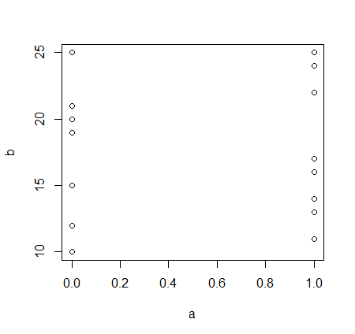
Chapter 2 Simple Logistic Regression
Problem with binary response
A common problem in models for dichotomous or binary dependent variables is ‘‘separation,’’ which occurs when one or more of a model’s covariates perfectly predict some binary outcome.
Separation raises a particularly difficult set of issues, often forcing researchers to choose between omitting clearly important covariates and undertaking post–hoc data or estimation corrections.
http://www.stat.columbia.edu/~gelman/stuff_for_blog/zorn.pdf
2) Non-informative scatterplot
Clearly scatter plot is not informative as the response variable takes only two values.

Slide 16
Chapter 2 Simple Logistic Regression
3) Why logit transformation
One of the important assumptions of linear models is that the residuals are normally distributed and the dependent variable, y have to be continuous unbounded and measured on an interval or ratio scale.
Unfortunately, binary response variable do not satisfy the above assumptions.
Logit transformation is one of the popular alternative logistic regression.
The logit function is the natural log of the odds that Y equals one of the binary classes.
It is the log of the proportion divided by one minus the proportion.
Ln [ P / ( 1 – P) ] = β₀ + β₁X₁ + β₂X₂ + … + β_{n}X_{n}
http://www.stat.columbia.edu/~gelman/stuff_for_blog/zorn.pdf

Slide 17
Chapter 2 Simple Logistic Regression
4) What is odds & log odds? Odds & log odds for 2x2 table, 2xk table
Odds
Odds of success are defined as the ratio of the probability of success over the probability of failure.
For example, let the probability of success of an event A be 0.7; then the probability of failure of Event A be 0.3. The odds of ratio = 0.7/0.3 = 2.3. That is to say that the odds of success are 2.3 to 1.
Log odds
Log odds is obtained by log transformation of the odds. Greater the odds, greater the log of odds.

Slide 18
Chapter 2 Simple Logistic Regression
4) What is odds & log odds? Odds & log odds for 2x2 table, 2xk table
 | Condition
 | Absent | Present
Group 1 | 12 | 48
Group 2 | 10 | 90
Total | 22 | 138
 | Rate | Risk Ratio | Odds | Odds Ratio | Log Odds
Group 1 | 0.8 | 0.8889 | 4 | 0.4444 | -0.8109
Group 2 | 0.9 | 9
Rate is the proportion in group with condition present
Risk Ratio = Rate[1] / Rate[2]
Odds[1] = Present[1] / Absent[1]
Odds[2] = Present[2] / Absent[2]
Odds Ratio = Odds[1] / Odds[2]
Log Odds = Natural Logarithm of Odds Ratio

Slide 19
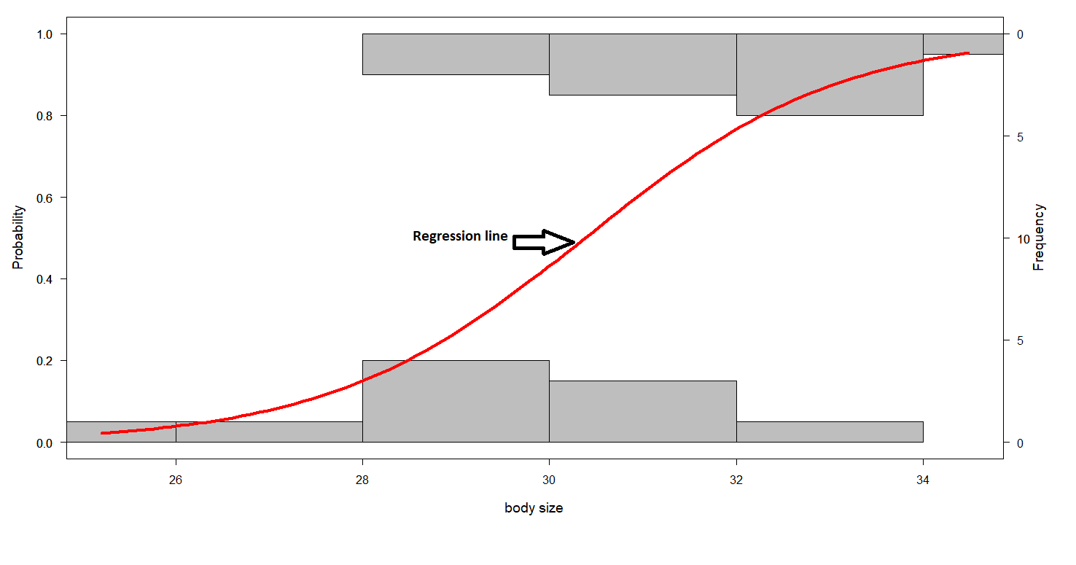
Chapter 2 Simple Logistic Regression
5) Shape of logit curve and probability curve
This is the probability curve for survival vs body size
The regression line is non-linear.
None of the observations fall on the regression line as they all fall on zeros or ones.

Slide 20
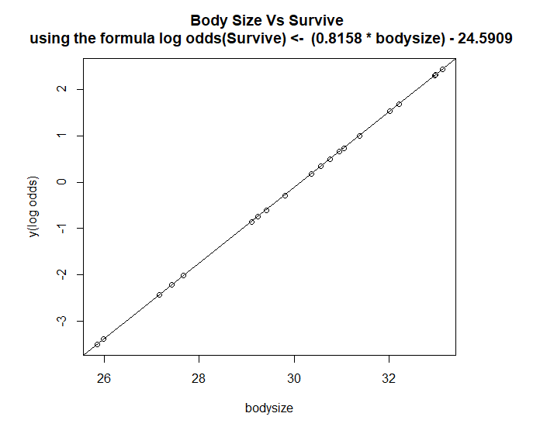
Chapter 2 Simple Logistic Regression
5) Shape of logit curve and probability curve
This is the probability curve for survival vs body size
The log odds regression line is linear.

Slide 21
Chapter 2 Simple Logistic Regression
6) Regression slope
For the logistic regression problem of predicting response variable, survive using the predictor variable, bodysize, we have arrived at the following coefficients table:
Coefficients:
Estimate Std. Error z value Pr(>|z|)
(Intercept) -24.5909 11.2187 -2.192 0.0284 *
bodysize 0.8158 0.3696 2.207 0.0273 *
Regression equation is log odds(survive) = -24.5909 + 0.8158 body size
Slope is 0.8158 and intercept is -24.5909
http://vassarstats.net/logreg1.html

Slide 22
Chapter 2 Simple Logistic Regression
Regression slope
Calculation of log odds, odds ratio and success probability
Slope is 0.8158 and intercept is -24.5909
The logistic regression coefficients give the change in the log odds of the outcome for a unit increase in the predictor variable. For every unit increase in bodysize, the log odds of being survived increases by 0.8158.
We exponentiate the coefficients and interpret them as odds-ratio.
Odds ratio for bodysize is exp(0.8158) = 2.260984. For every unit increase in bodysize, the odds of being survived increase by a factor of 2.26.
We can calculate predicted probabilities by using the formula: probability = odds / (1 + odds)
Predicted probability for bodysize = = 2.260984 / 3.260984 = 0.6933441

Slide 23
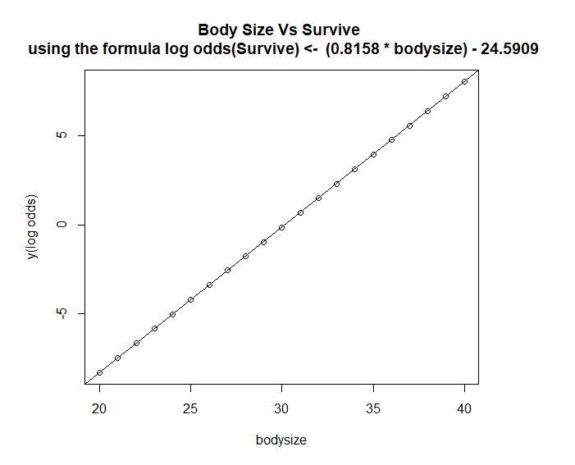
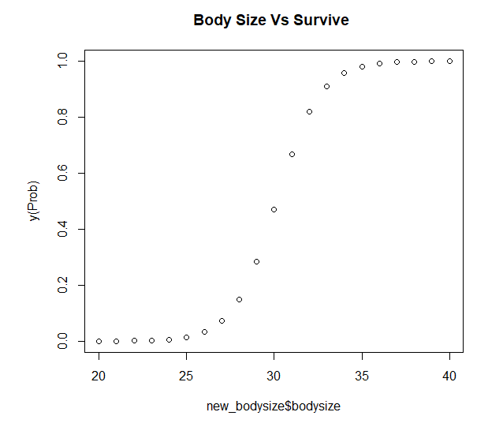
Chapter 2 Simple Logistic Regression
Use multiple sets of x values
to focus on linearity in logit and non-linearity in success probability
We use a range of bodysize (x) values from 20 to 40 to predict the response variable, Survive.

Slide 24
Chapter 2 Simple Logistic Regression
Summary
1. A common problem in models for dichotomous or binary dependent variables is separation.
2. Clearly scatter plot is not informative as the response variable takes only two values.
3. One of the important assumptions of linear models is that the residuals are normally distributed and the dependent variable, y have to be continuous unbounded and measured on an interval or ratio scale. Unfortunately, binary response variable do not satisfy the above assumptions. Hence, logit transformation is required.
4. Odds of success are defined as the ratio of the probability of success over the probability of failure.
5. Log odds is obtained by log transformation of the odds. Greater the odds, greater the log of odds.
6. We have observed that the shape of probability curve is non-linear and the shape of logit curve is linear.
7. We have seen how to identify regression slope from the coefficients table and how to calculate log odds, odds ratio and success probability.
8. We have used multiple sets of x values to focus on linearity in logit and non-linearity in success probability.

Slide 25
Chapter 2 Simple Logistic Regression
Summary
Reference
Business Statistics – a first course – Davind M. Levine, Kathryn A. Szabat, David F Stephan and Dr P K Viswanathan Chapter 12
Business Analytics – The Science of Data Driven Decision Making – U Dinesh Kumar – Chapter 10
http://vassarstats.net/logreg1.html
http://www.stat.columbia.edu/~gelman/stuff_for_blog/zorn.pdf

Slide 26
E N D

