Slide 1
Regression
Agenda
Introduction to Linear regression
Correlation vs regression
Applications of Linear regression
Assumptions of Linear regression
Two main types of Linear regression
Simple Linear regression (SLR) example

Slide 2
Regression
Introduction to Linear regression
Sir Francis Galton, a British statistician coined the term regression based on his research on hereditary properties of successive generations of sweet peas and humans. In 1886, he published an article with title, Regression towards Mediocrity in Hereditary Stature in Journal of the anthropological institute of Great Brittan and Ireland).
Linear regression is a mathematical technique to establish a relationship between two variables (predictor variable and response variable) by finding a straight line that best fits the values of a linear function.

Slide 3
Regression
Introduction to Linear regression
Scatter plots gives us an idea whether the two variables are linearly related or not. We need to find the best line that represents the scatter using linear regression.
Response variable (aka dependent or outcome or target) is the variable of focus in a research study.
Predictor variable (aka independent or explanatory) is the variable that explains the variation in the response variable and it might affect the response variable.

Slide 4
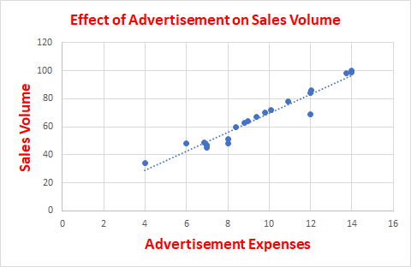
Regression
Introduction to Linear regression - continued
For example, the response variable is volume of Sales in thousands on a given day in an online stores and the predictor variable is the advertisement expenses.
Focus of the regression analysis is on the relationship between a response variable and one or more predictor variables. To be more specific, this helps one to understand how the typical value of the response variable changes when any one of the predictor variables is varies, keeping other predictor variables constant.

Slide 5
Regression
Introduction to Linear regression - continued
Identification of problem
Before doing the regression analysis, as a data scientist you must review the relevant literatures to develop a deep understanding of the business domain to know the relevant variables, their relationships.
The predictor (independent) variable is the core of the experiment and is isolated and manipulated by the researcher. A researcher must determine which variable is reliable and relevant that needs to be manipulated to generate quantifiable results.
For more details. refer https://explorable.com/research-variables/

Slide 6
Regression
Correlation vs regression
Correlation is a measure and direction of strength of a linear relationship between two variables. The Pearson's correlation coefficient or correlation coefficient which is valid only for linear relationship, denoted by r is a value that ranges between -1 and 1; -1 indicates perfect negative relationship, 1 indicates perfect positive relationship and 0 indicates no relationship.
Correlation coefficient is used to establish the presence and measure the strength of a linear relationship between the variables.
Regression gives the form of the relationship between two variables while correlation gives the degree of strength of the relationship.

Slide 7
Regression
Applications of Linear regression
Primary uses for regression in business:
Forecasting - to predict events that have yet to occur.
For example, number of people who will subscribe to a cell phone services, number of people who will watch a particular TV program
Optimization of business process.
For example it is important for a cell phone company to know the relationship between the number of calls made to the call center by customers and number of customers churned

Slide 8
Regression
Assumptions of Linear regression
Linear relationship in the coefficients and the error term
This implies that the mean of the response variable is a linear combination of the parameters (regression coefficients) and the predictor variables. Since the predictor variables are treated as fixed values, linearity is really only a restriction on the parameters.
Polynomial regression uses linear regression to fit the target variable as an arbitrary polynomial function of the predictor variables and it is too powerful to overfit the data.
Error term has a constant variance (a.k.a. homoscedasticity)
This means that different values of the response variable have the same variance in their errors regardless of the values of the predictor variables.

Slide 9
Regression
Assumptions of Linear regression - continued
Independence of errors (No auto correlation)
This assumes that the errors of the target variable are uncorrelated with each other.
Auto correlation occurs when the residuals (difference between observed and estimated values for the target variable) are not independent from each other.
One value of the error term should not predict the next value of the error term.
Normality of the residuals
The residual errors are assumed to be normally distributed.
Strictly speaking, we require normality for inference purpose. For estimating the coefficients, we require the errors to be identically and independently distributed (iid).

Slide 10
Regression
Assumptions of Linear regression - continued
Lack of perfect multi-collinearity in predictor variables
When we have two or more perfectly correlated predictor variables, we have the problem of multi-collinearity. This problem is relevant to Ordinary Least Squares method and taken care of by regularization methods such as Ridge or Lasso.
Lack of outliers in the data
Linear Regression is extremely sensitive to outliers as It affects the regression line and eventually the forecasted values.

Slide 11

Regression
Two main types of Linear regression
Simple Linear Regression (SLR)
In SLR, there is only one predictor (independent) variable X which changes result on different values for response (dependent) variable, Y.
Let Y_{t} denote the dependent variable, X1_{t} is the independent variable for the t^{th} observation. The value of Y at time t, in the sample data is determined by the linear equation:
β0, β1 are constants and εs are independent and identically distributed normal random variables with mean 0.
β0 and β1 are intercept and slope of the model.
Example: Regression equation between hours studied and marks scored
Marks = 38.9988127 + 0.876757168 * Hours Studied.

Slide 12
Regression
Two main types of Linear regression
Note:
The relationship is not a mathematical model relationship and hence the error term.
The linearity condition is defined with respect to the regression coefficients and not with respect to the predictor variables. Thus Y_{i} = β₀ + β₁log₍X_{i)} + ε_{i} is a linear model but relationship between Y and X is not linear.
Regression calculates the most likely outcome based on a trend of one or more known independent variables and the impact of changing one of the independent variables.
Simple Linear Regression (SLR) - continued

Slide 13
Regression
Two main types of Linear regression - continued
Multiple Linear Regression (MLR)
In MLR, there are more than one predictor (independent) variables X1, X2, … which change result on different values for response (dependent) variable, Y.
Let Y_{t} denote the dependent variable, X1_{t}, X2_{t} , …, Xk_{t} are the independent variable for the t^{th} observation. The value of Y at time t, in the sample data is determined by the linear equation:
β₀, β₁, … β_{k} are constants and εs are independent and identically distributed normal random variables with mean 0.
β₀ is the intercept of the model and β0, β1,β2, ...βk are regression coefficients
Example: Regression equation between hours studied, average marks scored in practice tests and marks scored in the final examination
Marks = 38.9988127 + 0.340933 * Average score in practice tests + 0.876757168 * Hours Studied.

Slide 14
Regression
Simple Linear Regression (SLR) Model building
Simple linear regression model helps us to understand how the value of a dependent variable under study changes with the values of an independent variable.
Examples include:
An e-commerce company such as Bigbasket, e-Bay, Amazon would like to understand how their revenue varies with the number of customer visits to their portal.
Banks and other financial institutions would like to understand the impact of unemployment rate on percentage of non-performing assets.
Original Equipment Manufacturers would like to understand the impact of duration of warranty on their profit.

Slide 15
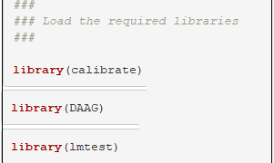

Regression
Simple Linear Regression (SLR) Model building
Steps for building a regression model
1. Data collection
Collect data from various sources for the identified problem. Data collection is a time consuming and expensive process. For the purpose of explaining the concept, consider a simple example of sales revenue of a retail company and the sales promotion expenses. We shall use R language for solving the regression problem.
Package, calibrate is used for drawing calibrated scales with tick marks on (non-orthogonal) variable vectors in scatterplots and biplots.
Package, car is used for performing cross validation
Package, lmtest is used to conduct Breush-Pagan test for checking heteroscedasticity of the residuals

Slide 16



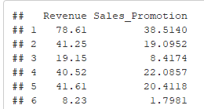
Regression
Simple Linear Regression (SLR) Model building
Steps for building a regression model - continued
Data Pre-processing
In this important step, data is checked to ensure the quality of the data for issues including, correctness, completeness, usefulness, relevance, missing data and extreme values.
We shall find out how many observations and columns are there in the data set and see first five rows of the data.
There are 50 rows and two columns in the data frame
The two column names are Revenue and Sales Promotion.

Slide 17




Regression
Simple Linear Regression (SLR) Model building
Steps for building a regression model continued
Data Pre-processing continued
We shall check for missing values and outliers using the Boxplot.
There are no missing values in the data
There are no outliers in the data. Boxplots show outliers, data points that are located outside the whiskers of the boxplot (that is outside 1.5 times the interquartile range above the upper quartile and bellow the lower quartile)

Slide 18
Regression
Simple Linear Regression (SLR) Model building
Steps for building a regression model continued
Establish a robust estimation of the models accuracy of predicting unseen data
We shall calculate the accuracy for each fold for the four folds we have created.
We shall calculate the mean of the accuracy measure, which is robust because it is less dependent on the choice of training and test sets.
Using the cv.lm() function in the DAAG package, we can do the K-Fold cross-validation.
It adds the Mean Square Error for each fold, divide by the number of observations.
By taking the square root, it gets the cross-validated standard error estimate.
Refer http://math.furman.edu/~dcs/courses/math47/R/library/DAAG/html/cv.lm.html
Perform descriptive analytics
Descriptive analytics reveals the variability in the data. We shall use
a. Boxplot to show if there are any outliers in the data; the how the quartiles are distributed.
b. Scatter plot to show any obvious relationship between the dependent and independent variables.

Slide 19
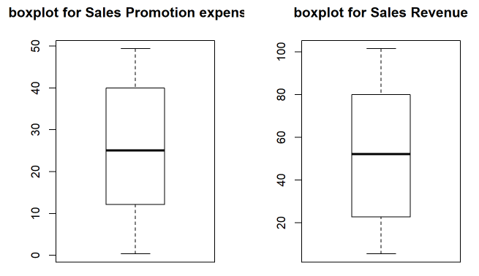

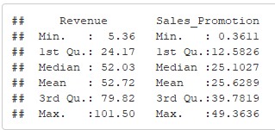
Regression
Simple Linear Regression (SLR) Model building
Steps for building a regression model continued
Perform descriptive analytics - continued
Descriptive statistics
Boxplot shows no outliers in both the variables.

Slide 20
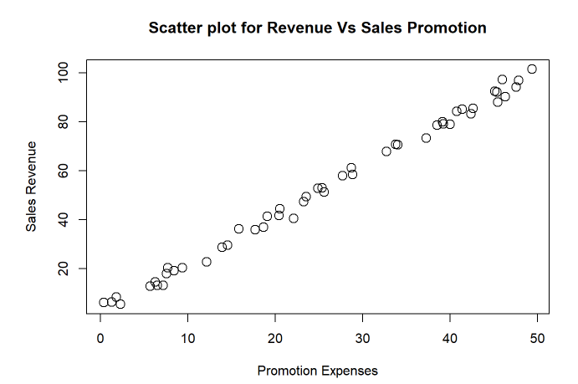

Regression
Simple Linear Regression (SLR) Model building
Steps for building a regression model continued
Perform descriptive analytics - continued
Scatter plot reveals a positive
Linear relationship. Its strength is 0.9978

Slide 21

Regression
Simple Linear Regression (SLR) Model building
Establish the functional form of relationship
In order to build a model with a good accuracy, we need to specify the correct functional form such as
Y = β₀ + β₁ X1 or log(Y) = β₀ + β₁ X1 between the dependent variable and independent variable.
Regression parameters estimation
Ordinary Least Square (OLS) fits regression line through a set of points such that it minimize the sum of the squared residual errors
Refer: https://en.wikiversity.org/wiki/Least-Squares_Method
https://cs.adelaide.edu.au/~chhshen/teaching/ML_SVR.pdf
OLS provides the Best Linear Unbiased Estimate (BLUE), E(β - β^) = 0 where β is the population parameter and β^ is the estimated parameter value from the sample.
Regularization methods not only minimize the sum of squared error of the model but also reduces the complexity of the model.

Slide 22


Regression
Simple Linear Regression (SLR) Model building
Regression parameters estimation - continued
Lasso Regression (L1 regularization): Here OLS is modified to minimize the absolute sum of the coefficients
Ridge Regression (L2 regularization): Here OLS is modified to minimize the squared absolute sum of coefficients.
The main difference between the above techniques is that Lasso shrinks the less important feature’s coefficient to zero. This results in removal of some of the features altogether. This works well for feature selection when we have many features

Slide 23
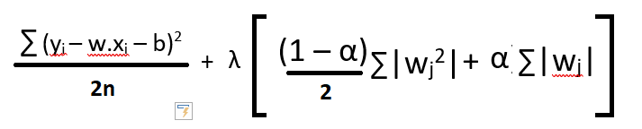
Regression
Simple Linear Regression (SLR) Model building
Regression parameters estimation - continued
ElasticNet Regression: Here OLS is modified to minimize the complexity of the regression model (magnitude and number of regression coefficients) by penalizing the model using the sum squared coefficient values (L2 norm) and sum absolute coefficient values (L1 norm).
Elastic net is basically a combination of both L1 and L2 regularization. It uses both L1 and L2 penalty term, its equation looks like:
Here, i ranges from 1 to n and j ranges from 1 to m; In addition to setting a λ, we can tune α between 0 and 1
Refer: https://hackernoon.com/an-introduction-to-ridge-lasso-and-elastic-net-regression-cca60b4b934f
https://datafai.com/2018/03/18/lasso-ridge-and-elastic-net-regularization/

Slide 24
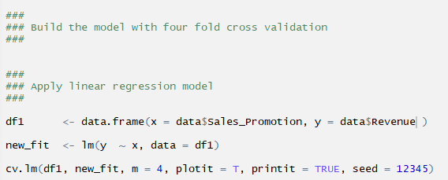
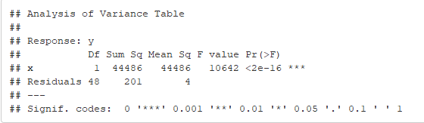
Regression
Simple Linear Regression (SLR) Model building
Estimate the Regression Parameters
Now, we estimate the model parameters using Ordinary Least Square Regression.
We are using cross validation method for validating the model.
From the Analysis of Variance table, we find that the variable, x (Sales_Promotion) is significant at 5% level of significance.

Slide 25
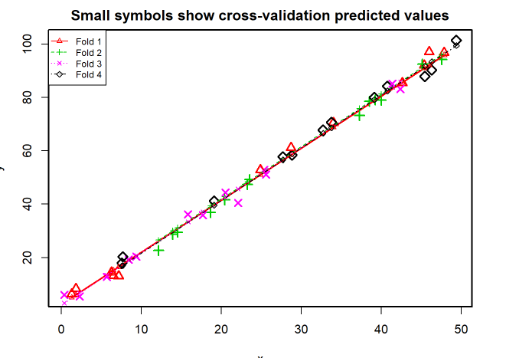
Regression
Simple Linear Regression (SLR) Model building
Estimate the Regression Parameters
Show the results of cross validation in a graph
We find that most of the predicted values in all folds overlap each other.

Slide 26

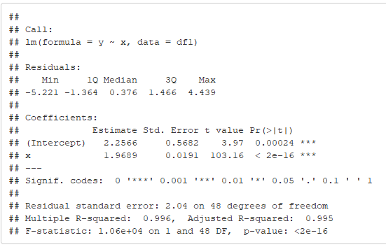
Regression
Simple Linear Regression (SLR) Model building
Estimate the Regression Parameters - continued
We observe that the overall mean square of prediction error is 4.53
Model parameters estimated: β0 = 2.2526; β1 = 1.9689 Regression equation is given as Revenue = 2.2526 + 1.9689 * Promotion Expenses Interpretation of the equation: For every one unit increase in Promotion expenses, revenue will increase at the rate of 1.9689 on the average. R square is 0.996 tells us the model explains 99.6% of the variation in the dependent variable, Revenue.

Slide 27
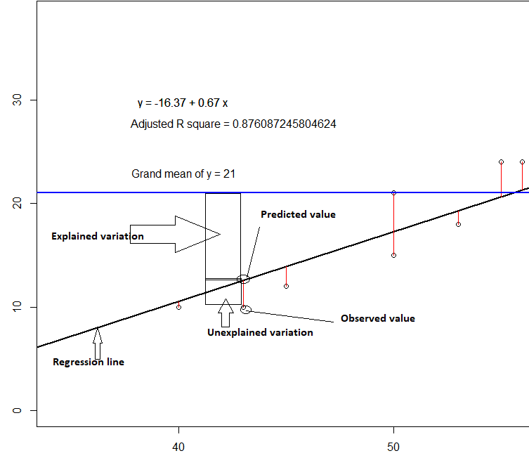
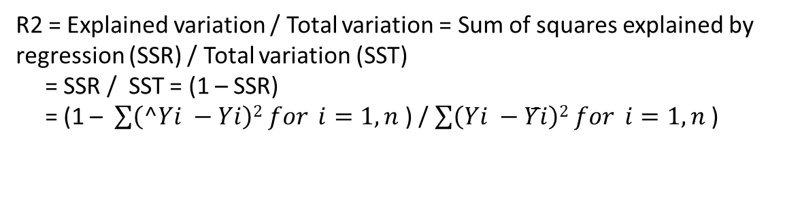
Regression
Simple Linear Regression (SLR) Model building
Estimate the Regression Parameters - continued
Coefficient of Determination
Coefficient of determination (R square) measures the percentage of variation in Y explained by the model (β₀ + β₁X), which is the primary objective of regression.
Simple linear regression equation can be re-written as
Y_{i} = (β₀ + β₁X_{i}) + ε_{i}
or
variation in Yi = Variation in Y explained by the model + variation in Y not explained by the model.
R2 = Explained variation / Total variation = Sum of squares explained by regression (SSR) / Total variation (SST)
= SSR / SST = (1 – SSR)
= (1 – $\sum{\left(^Yi −Yi\right)2 for }i=1, n$ ) / $\sum{\left(Yi −Y̅i\right)2 for }i=1, n$ )

Slide 28
Regression
Simple Linear Regression (SLR) Model building
Explained variation is the deviation of the predicted values from the mean of the observed response variable, y.
Unexplained variation is the deviation of the predicted values from the observed response variable, y.

Slide 29

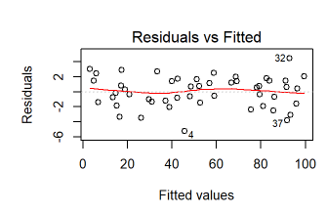
Regression
Simple Linear Regression (SLR) Model building
Validate the assumptions
Using the plot(), we generate model diagnostics plots.
Linearity of the data
Residual vs fitted plot is used to check the linear relationship assumption. A horizontal line without distinct patterns is an indication for a linear relationship.

Slide 30
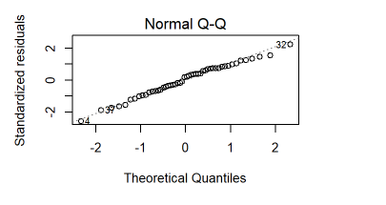
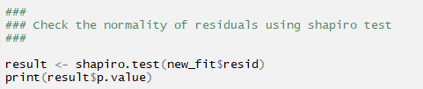

Regression
Simple Linear Regression (SLR) Model building
Validate the assumptions
2. Normality of the residuals
Normal Q-Q plot is used to examine the residuals are normally distributed. In the graphs shown, the residuals do not fall on the reference line and violates the assumption of normality of the residuals.
We shall use Shapiro test to confirm. Since the p-value > 0.05, the null hypothesis that the errors are normally distributed cannot be rejected at 5% significance level.

Slide 31
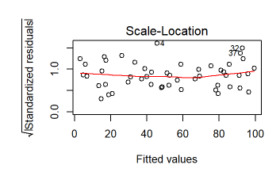
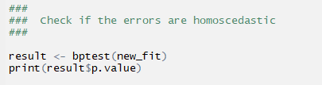

Regression
Simple Linear Regression (SLR) Model building
Validate the assumptions
3. Homogeneity of variance
This assumption is checked by examining the scale-location plot. Horizontal line with equally spread points is a good indication of homoscedasticity. Our plot also reveals homoscedasticity.
We shall use Breush-Pagan test to check for heteroscedasticity. In our case, p value > 0.05, we do not evidence to reject the null hypothesis that there is homogeneity of variance.

Slide 32
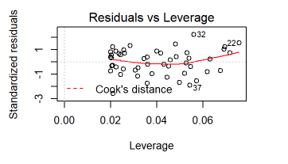
Regression
Simple Linear Regression (SLR) Model building
Validate the assumptions
4. Outliers and high leverage points
In our example, the data does not show any influential points. Cook’s distance lines (a red dashed line) are not shown on the Residuals vs Leverage plot because all points are well inside of the Cook’s distance lines.

Slide 33

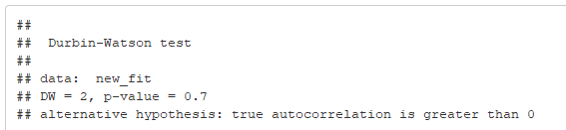
Regression
Simple Linear Regression (SLR) Model building
Validate the assumptions
Independence of errors
Null hypothesis is that there is no auto-correlation.
Since the p-value > 0.05, we do not have evidence to reject the null hypothesis and conclude that auto-correlation is not present and thus satisfying the assumptions of linear regression.

Slide 34
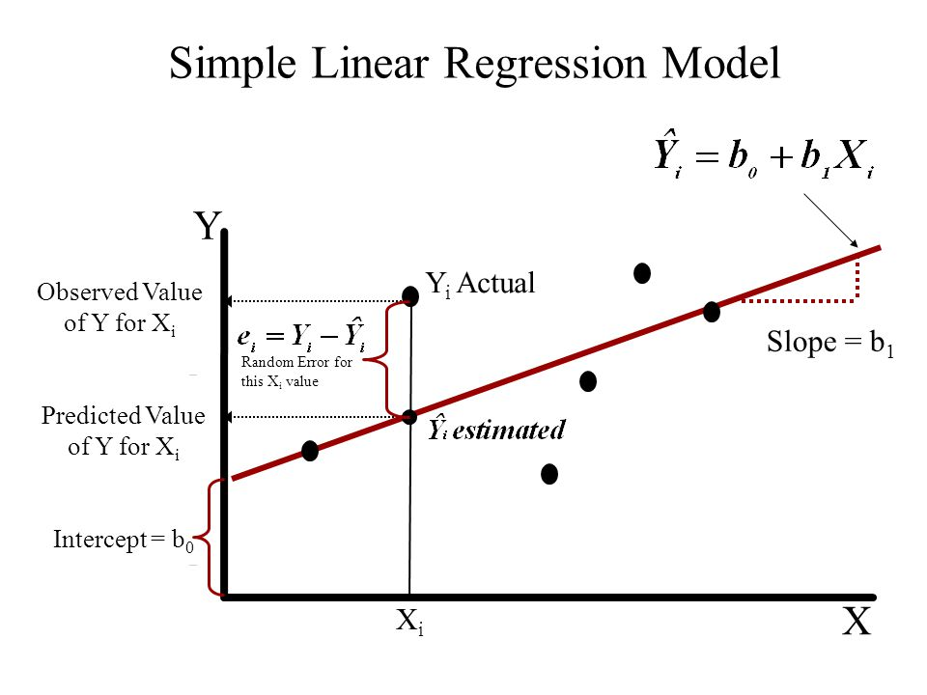
Chapter 1 Introduction to Regression
Prediction of response based on predictors
Simple Linear Regression (SLR)
It is a statistical model in which there is only one predictor variable and one response variable.
Let (X_{i}, Y_{i}) where i is ranging from 1 to n be a dataset of n observations.
Then the regression equation can be written as
Y_{i} = β₀ + β₁X_{i} + ε_{i}, where
Y_{i} is the i^{th} observation of the response variable in the sample
X_{i} is the i^{th} observation of the predictor variable in the sample
ε_{i} is the random error or residuals
β₀, β₁ are the regression parameters or regression coefficients

Slide 35
Chapter 1 Introduction to Regression
Prediction of response based on predictors
Simple Linear Regression (SLR) - continued
Note:
The relationship is not a mathematical model relationship and hence the error term.
The linearity condition is defined with respect to the regression coefficients and not with respect to the predictor variables. Thus Y_{i} = β₀ + β_{1log(}X_{i)} + ε_{i} is a linear model but relationship between Y and X is not linear.
Regression calculates the most likely outcome based on a trend of one or more known independent variables and the impact of changing one of the independent variables.

Slide 36
Chapter 1 Introduction to Regression
Regression within the umbrella of machine learning
Regression and classification are branded under the same umbrella of supervised machine learning.
Both utilize known datasets to make predictions.
In supervised learning, an algorithm is employed to learn the mapping function from X (input) to Y (output), Y = f(X).
The objective is to approximate the mapping function, f as accurately as possible so that we can predict output variable, Y for a new input X as close as possible to the actual value.
The response variable in the regression is continuous numerical variable and for classification it is categorical.
In machine learning, regression algorithms attempt to estimate the mapping function, f from the predictor variables (X) to continuous numerical response variable, Y
Supervised learning is used to predict a certain target variable from a model you trained with known data.
Regression is a kind of supervised learning where you predict numerical variable in interval scale.

Slide 37
Chapter 1
Summary
The main objective of regression is to establish the existence of a relationship between an target (response) variable and explanatory (predictor) variables.
Before doing the regression analysis, one must review the literature to develop a deep understanding of the relevant variables, their relationships, and the expected coefficient signs and effect magnitude.
In machine learning, regression algorithms attempt to estimate the mapping function, f from the predictor variables (X) to continuous numerical response variable, Y
Linear regression implies that the relationship between the response variable and the regression parameters (β0, β1) is linear.
Reference
1. Business Statistics – a first course – Davind M. Levine, Kathryn A. Szabat, David F Stephan and Dr P K Viswanathan Chapter 12

Slide 38
Chapter 2 – Simple Linear Regression
Contents
Continuous Response, Single Predictor
From correlation to regression
Limitation of correlation
Scatterplot: visualization of dependency
Scatterplots for various correlation values
Fitting a regression line: Model, Error
Value of intercept and slope: Interpretation
Value of multiple R-square
Correlation coefficient & R-square
Sign of correlation coefficient and regression slope
Fitted values, predicted value of response for a new X
Scope of regression

Slide 39
Chapter 2 – Simple Linear Regression
Continuous Response, Single Predictor
Simple Linear Regression (SLR) is a statistical method that allows us to summarize and study relationships between two continuous numerical variables, wherein
a) one variable being the predictor variable, x and
b) the other being the response variable, y.
We call this as simple linear regression because it concerns the study of only one predictor variable.

Slide 40
Chapter 2 – Simple Linear Regression
From correlation to regression
Regression and correlation analysis techniques are employed to study the relationships between variables.
Regression is used to predict the value of one variable based on the value of a different variable.
Correlation is a measure of the strength of a relationship between variables.
Limitation of correlation
Correlation does not mean causation.
Correlation can suggest there is a relationship between two variables but it cannot prove that one variable causes a change in another variable. For example, the correlation might suggest that there is a relationship between sales quantity of a new product and price of the new product. But it cannot suggest how the price of the new product will cause changes in sales quantity.

Slide 41
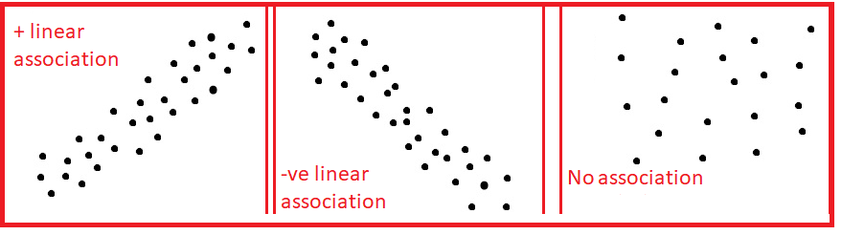
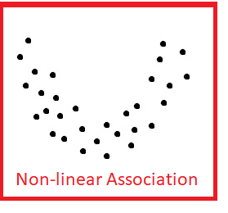
Chapter 2 – Simple Linear Regression
Scatterplot: visualization of dependency
A scatter plot is a plot of two variables that will reveal the relationship (linear or non-linear) between two variables.
It is useful for assessing the strength of the relationship and to find if there are any outliers in the data.

Slide 42
Chapter 2 – Simple Linear Regression
Scatterplots for various correlation values
Correlation Coefficient: 1
Correlation Coefficient: -1
Correlation Coefficient: 0.011

Slide 43
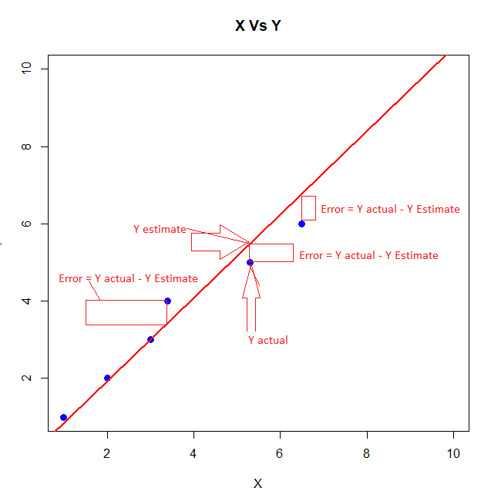
Chapter 2 – Simple Linear Regression
Fitting a regression line: Model, Error
Linear regression consists of finding the best fitting straight line through the points.
Regression line is the red diagonal line in the figure and consists of the predicted score on Y for each possible value of X.
The error of prediction for a point is the value of the actual observation minus the estimated value which is on the line.
Regression line: Y' = β₀ + β₁X, where Y' is the predicted Y, β₁ is the slope and β₀ is the Y intercept and Y – Y’ is the error in prediction

Slide 44
Chapter 2 – Simple Linear Regression
Fitting a regression line: Model, Error - Example
Obtain a regression equation between hours studied and marks scored data given below:
Hours studied | 10 | 12 | 18 | 24 | 24 | 26 | 27 | 28 | 29 | 31 | 32 | 40 | 41 | 44 | 46 | 48 | 50 | 52 | 52 | 53 | 60 | 62 | 65 | 67
Marks in the examination | 43 | 45 | 53 | 55 | 56 | 60 | 64 | 69 | 70 | 75 | 77 | 79 | 73 | 78 | 78 | 79 | 81 | 82 | 84 | 87 | 89 | 90 | 94 | 100
We observe:
Correlation Coefficient to be 0.960954493
b. Scatter plot reveals a very strong positive relationship.
Let us proceed with analysis using Regression in Excel Data Analysis.

Slide 45
Chapter 2 – Simple Linear Regression
Fitting a regression line: Model, Error – Example - continued
We get the following coefficients table:
 | Coefficients | Standard Error | t Stat | P-value | Lower 95% | Upper 95%
Intercept | 38.9988127 | 2.284845422 | 17.06846876 | 3.55496E-14 | 34.26033332 | 43.73729209
Hours studied | 0.876757168 | 0.053825051 | 16.28901689 | 9.24758E-14 | 0.765130844 | 0.988383492
From the coefficients table, we observe that the p value for the coefficient for the variable, Hours Studied to be very small, 9.25e-14.
At 5% level of significance, we conclude that the coefficient for Hours Studied is statistically significant as the p value is less than 0.05 and reject the null hypothesis (H0: Coefficient of the parameter is 0).
95% Confidence interval describes the uncertainty inherent in the estimate and describes a range of values containing the true value, on each occasion, if a study were repeated infinite times. If the interval is wider, the uncertainty is greater indicating our poor knowledge about the effect of the independent variable on the dependent variable.
We also observe that the 95% confidence interval for the Hours Studied is 0.76513 to 0.98838 is not very wide and does not include 0.

Slide 46
Chapter 2 – Simple Linear Regression
Fitting a regression line: Model, Error – Example - continued
Coefficients column provides the values for regression coefficients for the regression equation.
Marks = 38.9988127 + 0.876757168 * Hours Studied.
Here, the intercept is 38.9988 and slope is 0.8768
https://www.dummies.com/education/math/statistics/how-to-calculate-a-regression-line/

Slide 47
Chapter 2 – Simple Linear Regression
Value of intercept and slope: Interpretation
Let the Regression line be y = ax + b
The y intercept is the point where the regression line crosses the y axis (where x = 0) and is denoted by b.
Here the slope is a.
These coefficient estimates (and b) reveal the relationship between the intendent variable, Hours Studied and the dependent variable, Marks. These estimates tell us the amount of increase in Marks for one hour increase in Hours Studied.
Interpret slope for the regression equation: Marks = 38.9988127 + 0.876757168 * Hours Studied.
So, for every unit (i.e.., one hour) increase in Hours Studied (holding other variables constant), an increase of 0.88 marks is predicted.

Slide 48
Chapter 2 – Simple Linear Regression
Value of intercept and slope: Interpretation
Intercept is described as the mean response when all independent variables are set to zero.
There is always uncertainty in interpreting intercepts unlike slope which is always interpretable.
This does not make sense in many situations. This intercept can be regarded as a garbage collector for the regression model for any bias that is not accounted for by the terms in the model.
Regression intercept is not worth interpreting, in general.
http://blog.minitab.com/blog/adventures-in-statistics-2/regression-analysis-how-to-interpret-the-constant-y-intercept

Slide 49
Chapter 2 – Simple Linear Regression
Value of multiple R-square
R squared (or Multiple R² for multiple linear regression) is a goodness of fit measure for linear regression models. This statistic indicates the percentage of variance in the response or dependent variable that the model explain (or independent variables explain collectively).
R squared is also called the coefficient of determination. It reveals how many data points fall within the results of the regression line.
R squared is the percentage of the response variable variation that a linear model explains.
R² = Variance explained by the model / Total variance
It lies between 0 and 100 and 0% represents the model does not explain any of the variation in the dependent variable around its mean while 100% explains all of the variation in the dependent variable around its mean.
R squared cannot determine whether the coefficient estimates are biased. So we use residual plots to check bias.
A high R² is necessary for precise predictions in addition to the requirement that the residuals are randomly scattered around 0.

Slide 50
Chapter 2 – Simple Linear Regression
Correlation coefficient & R-square
R-squared is the square of the coefficient of correlation.
For example, correlation coefficient between marks and hours studied is 0.96095.
From the regression statistics table, we observe that
R Square is 0.9234 which is same as the square of the correlation coefficient (0.96095) which is 0.9234.

Slide 51
Chapter 2 – Simple Linear Regression
10) Sign of correlation coefficient and regression slope
When we examine our Least square regression lines and corresponding values of correlation coefficient, r,
we observe sign of the correlation coefficient and slope of the regression line is same.
For example, in the marks example, we observe the sign of the correlation coefficient is positive (0.96095) and the slope of the regression line (0.8768) is also positive.
Formula for Slope
α = r(Sy / Sx) where Sx if the standard deviation of x and Sy is the standard deviation of y and r is the correlation coefficient between x and y.
Since Sy and Sx are positive, both slope, a and r, the correlation coefficient have the same sign.

Slide 52
Chapter 2 – Simple Linear Regression
11) Fitted values, predicted value of response for a new X
Regression equation is used to predict the unknown value of the response variable, y when the values of the predictor variables, X are known.
For example, you want to predict the marks of a student, who has spent 15 hours for studying the subject.
We know, the regression equation is Marks = 38.9988127 + 0.876757168 * Hours Studied.
Marks = 38.9988127 + 0.876757168 X 15 = 52.15017 or 52 Marks

Slide 53
Chapter 2 – Simple Linear Regression
Scope of regression
In Linear regression, we examine the following:
a) Does the set of independent or predictor variables predict a dependent or target or response variable?
b) Which variables in particular are significant predictors of the target variable and how they impact the target variable?
We assume that the historically observed data forms the basis for future predictions and the response and predictor variables are associated or related.

Slide 54
Chapter 2 – Simple Linear Regression
Scope of regression
Assumptions of Linear Regression
Absence of multi-collinearity
Errors between the observed and predicted values should be normally distributed. For regressions, the test of normality applies to model's residuals and not the variables themselves.
Homoscedasticity: We check heteroscedasticity using Goldfeld Quandt.
Linear and additive relationship exists between the response and predictor variables.

Slide 55
Chapter 2
Summary
Primary goal of Regression is to establish the existence of an association relationship between a dependent variable and independent variables.
In Simple Linear Regression, the number of independent variable is one.
Correlation can suggest there is a relationship between two variables and cannot prove that one variable causes a change in other variables.
We have seen how to interpret the intercept and slope of a regression line.
R² is a percentage of the variation in the dependent variable explained by the model.
R² is the square of correlation coefficient.
Sign of the correlation coefficient and slope of the regression line is same.
Reference
1. Business Statistics – a first course – Davind M. Levine, Kathryn A. Szabat, David F Stephan and Dr P K Viswanathan Chapter 12

Slide 56
Chapter 3
Contents
Regression ANOVA
Significance of t-statistics
R-square as a ratio of Reg SS & TSS
Significant t does not imply high R-square value
Residual Plots and Ideal plots

Slide 57
Chapter 3
Regression ANOVA
Two techniques for comparing two or more population means to each other are ANOVA and regression . F statistics is used to test hypotheses about relationships between predictor and response variables in both techniques.
Analysis of Variance (ANOVA) provide information about levels of variability within a regression model. This forms a basis for tests of significance.
Both ANOVA and regression techniques produce significance tests for each factor.
ANOVA tests the effect of each factor after controlling for each other, but not controlling for the interaction.
Regression technique tests the hypothesis that there is an effect of one factor when the other factor is zero (controlling for other factor and interaction).
We observe that along with coefficients for intercept and for x, there are statistical t tests for each coefficient. These are tests of the null hypothesis that the coefficient is zero.

Slide 58


Chapter 3
Regression ANOVA - continued
ANOVA table
ANOVA
Source | df | SS | MS | F | Significance F
Regression | 1 | 4882.770264 | 4882.770264 | 265.3320713 | 9.24758E-14
Residual | 22 | 404.8547364 | 18.40248802
Total | 23 | 5287.625
The first column labeled Source has three rows: Regression, Residual and Total.
The third column labeled as SS (Sum of Squares) describes the variability in the response variable, Y.
The second column has the degrees of freedom associated with SS.
The total amount of variability in the dependent variable is and named as TSS.
The error term or is the variability about the regression line and named as ESS.

Slide 59
Chapter 3
Regression ANOVA - continued
ANOVA table
Regression sum of squares (Reg SS) is the difference between TSS and RSS.
Each Sum of squares has a corresponding degrees of freedom, df associated with it.
Total df is n - 1, one less than the number of observations.
Regression df is the number of independent variables in the model. For SLR, it is 1.
Error df is the difference between total df and Regression df.
Mean Squares (MS) are the sum of squares divided by the corresponding df.
F statistic or F ratio is the ratio of SS divided by the corresponding df.
In the context of regression, the p value reported in the table gives us an overall test for the significance of our model. As p value (9.248 e-14) is less than 0.05, we reject the null hypothesis that there is no relationship between predictor and response and conclude that there is a significant relationship between the predictor and response variables.
http://www.sjsu.edu/people/fred.prochaska/courses/ScWk242Spring2013/s1/ScWk-242-Week-12-Slides---ANOVA-and-Linear-Regression.pdf

Slide 60


Chapter 3
2. Significance of t-statistics
 | Coefficients | Standard Error | t Stat | P-value
Intercept | 38.9988127 | 2.284845422 | 17.06846876 | 3.55496E-14
Hours studied | 0.876757168 | 0.053825051 | 16.28901689 | 9.24758E-14
t Tests are used to conduct hypothesis tests on the regression coefficients obtained in Simple Linear Regression.
A statistic based on the t distribution is used to test the two-sided hypothesis that the true slope, b1 equals a constant value c.
H₀: β1 = c
H₁: β1 ≠ c
Test statistic used for this test, where ^ β1 is the least square estimate of β1 and is the standard error.
Test statistic follows a t distribution with n-2 df where n is the number of observations.
We reject the null hypothesis at 5% level of significance, when the p value corresponding the t statistic < 0.05. Here P value for Hours Studied is 9.248 E-14 < 0.05 and hence we reject the null hypothesis and conclude that regression coefficient of Hours Studied is different from 0.

Slide 61
Chapter 3
3. R-square as a ratio of Regression SS & Total SS
R square is a statistical measure of how close the data are to the fitted regression line.
It is the percentage of variation of the dependent variation that is explained by a linear model.
R square = Explained variation / Total variation = Reg Sum of squares / Total Sum of Squares.
4. Significant t does not imply high R² value
R² is the proportion of variation in the dependent variable that is accounted for by the model as a whole.
P-value for a predictor variable pertains to the contribution of that predictor after the contributions of other predictors have been taken into account. It talks about what the predictor adds to the model.
While the independent variables as a whole help predict the dependent variable (e.g. high R²), the explanatory power of individual independent variables cannot be easily partitioned.

Slide 62
Chapter 3
5. Residual Plots and ideal plots
A residual plot is a graph that shows the residuals on the y axis and the independent variable on the x axis.
If the points in a residual plot are randomly spread around the x axis, a linear regression model is appropriate for the data otherwise, a non-linear model is more appropriate.
For example, in the Hours studied residual plot, we find the residuals on the y axis are spread randomly spread around the x-axis and linear model is appropriate and ideal.

Slide 63
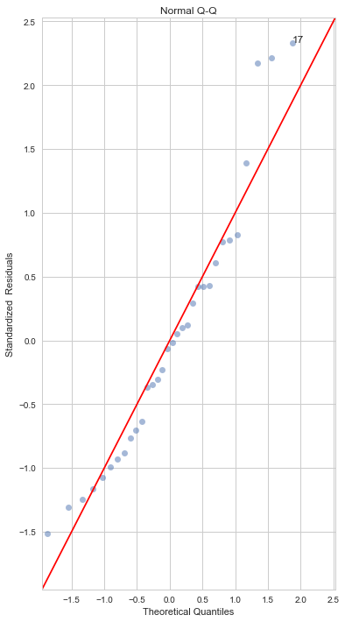
Chapter 3
5. Normal QQ Plot
This plot shows how well the distribution of residuals fit the normal distribution.
This plots the z score of the residuals against the theoretical normal quantiles.
Any thing quite off the diagonal lines may be a concern for further investigation.
QQ plot for the residuals from the regression model applied on the dataset, mtcars
which is an in-built data set about cars which contains 32 observations and 11 variables.
There are many deviations from the straight line and hence the residuals do not fit the normal distribution.

Slide 64
Chapter 3
Summary
Two techniques for comparing two or more population means to each other are ANOVA and regression.
ANOVA tests the effect of each factor after controlling for each other, but not controlling for the interaction.
Regression technique tests the hypothesis that there is an effect of one factor when the other factor is zero (controlling for other factor and interaction).
t Tests are used to conduct hypothesis tests on the regression coefficients obtained in Simple Linear Regression.
R square is the percentage of variation of the dependent variation that is explained by a linear model.
Significant t does not imply high R2 value.
A residual plot is a graph that shows the residuals on the y axis and the independent variable on the x axis.
If the points in a residual plot are randomly spread around the x axis, a linear regression model is appropriate for the data otherwise, a non-linear model is more appropriate.

Slide 65
Chapter 4
Contents
Multiple Linear Regression
Continuous Response, Multiple Predictors
Pairwise scatterplot - Advertising data
Regression with two predictors
Interpretation of regression slopes: rate of change when the other predictor is constant - Auto data
Multiple r-square: increases with additional predictor - Concrete data
Significance of t-statistics
Multicollinearity -Baseball data
What does it mean?
Possible problems: VIF, unreliable estimates

Slide 66
Chapter 4
Multiple Linear Regression - Continuous Response, Multiple Predictors
Multiple Linear Regression (MLR) is a statistical technique that establishes existence of a linear relationship between a continuous numeric dependent variable and several independent variables.
Functional form
Y_{i} = β₀ + β₁X_{1i} + β₂X_{2i} + ... + β_{k}X_{ki} + ε_{i}
where Y_{i} is the dependent variable
X₁, X₂, ... X_{k} are a group of independent variables
β₀ is a constant
β₁, β₂, …, β_{k} are partial regression coefficients corresponding to the predictor variables X₁, X₂, ... X_{k} respectively
ε_{i} is the error or residual term

Slide 67
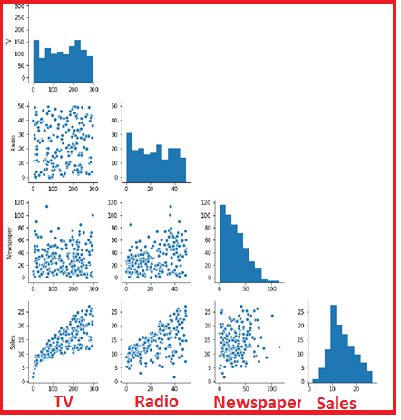
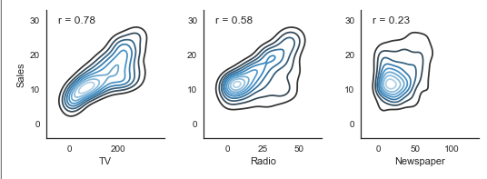
Chapter 4
2. Pairwise scatterplot - Advertising data
The pair plot contains the histogram and the scatter plot.
The histogram on the diagonal allows us to see the distribution of a single variable.
The scatter plots on the lower triangle show the relationship between the variables.
For example, the left most plot in the fourth row shows the scatter plot of TV vs Sales. This plot shows a reasonably good relationship as the correlation coefficient is 0.78.
The second plot from the left corner of the last row, shows a very moderate relationship between Radio and Sales as the correlation coefficient is 0.58
The third plot from the left corner of the last row, shows a very poor relationship between Newspaper and Sales as the correlation coefficient is 0.23.
Distribution of none of the variables is normal as evidenced by the histograms.

Slide 68
Chapter 4
3. Regression with two predictors and interpretation of regression slopes:
With two independent variables the prediction of Y is expressed by the following equation:
Y'_{i} = β₀ + β ₁X_{1i} + β₂X_{2i}
R Square | 0.121927138
Adjusted R Square | 0.120217161
Standard Error | 15.66944131
Observations | 1030
ANOVA
 | df | SS | MS | F | Significance F
Regression | 2 | 35014.44856 | 17507.22428 | 71.30340528 | 1.00679E-29
Residual | 1027 | 252160.7386 | 245.531391
Total | 1029 | 287175.1871
 | Coefficients | Standard Error | t Stat | P-value | Lower 95% | Upper 95%
Intercept | 51.21950022 | 4.864852765 | 10.52847901 | 1.0962E-24 | 41.67331364 | 60.7656868
fineagg | -0.024753691 | 0.006168193 | -4.013118448 | 6.42734E-05 | -0.036857392 | -0.012649989
age | 0.082068722 | 0.007828742 | 10.4830022 | 1.69399E-24 | 0.066706565 | 0.097430879
For example, while predicting the complete comprehensive strength of cement, let us consider only two predictor variables, Fine Aggregate and Age in days.
We have the Multiple R² = 0.1219.
The regression equation is Strength = 51.2195 - 0.02475 fineagg + 0.08207
For every unit increase in fineagg, the strength of the cement is reduced by 0.02475 kg holding age constant.
For every unit (day) increase in age, the strength of the cement is increased by 0.08207 kg holding fineagg constant.

Slide 69
Chapter 4
4. Multiple r-square: increases with additional predictor
With many independent variables the prediction of Y is expressed by the following equation:
Y'_{i} = β₀ + β ₁X_{1i} + β₂X_{2i} + … + β_{n}X_{ni}
Regression Statistics
Multiple R | 0.784550744
R Square | 0.61551987
Adjusted R Square | 0.612507293
Standard Error | 10.39914264
Observations | 1030
ANOVA
 | df | SS | MS | F | Significance F
Regression | 8 | 176762 | 22095.25 | 204.3167 | 6.3E-206
Residual | 1021 | 110413.2 | 108.1422
Total | 1029 | 287175.2
 | Coefficients | Standard Error | t Stat | P-value | Lower 95% | Upper 95%
Intercept | -23.33121358 | 26.5855 | -0.87759 | 0.380372 | -75.4997 | 28.83726
cement | 0.119804334 | 0.008489 | 14.11286 | 1.9E-41 | 0.103146 | 0.136462
slag | 0.103865809 | 0.010136 | 10.24742 | 1.6E-23 | 0.083976 | 0.123755
ash | 0.087934322 | 0.012583 | 6.988168 | 5.02E-12 | 0.063242 | 0.112626
water | -0.149918419 | 0.040177 | -3.73145 | 0.000201 | -0.22876 | -0.07108
superplastic | 0.292224595 | 0.093424 | 3.127937 | 0.00181 | 0.108899 | 0.47555
coarseagg | 0.018086215 | 0.009392 | 1.925656 | 0.054425 | -0.00034 | 0.036517
fineagg | 0.020190351 | 0.010702 | 1.886652 | 0.059491 | -0.00081 | 0.04119
age | 0.114222068 | 0.005427 | 21.04643 | 5.78E-82 | 0.103572 | 0.124872
For example, while predicting the complete comprehensive strength of cement, let us consider all eight predictor variables.
We observe that Multiple R2 = 0.6155 and it has increased from 0.1219 (for only two predictor variables).
So, multiple R² increases with additional predictor variables.

Slide 70
Chapter 4
5. Significance of t-statistics
With many independent variables the prediction of Y is expressed by the following equation:
Y'_{i} = β₀ + β ₁X_{1i} + β₂X_{2i} + … + β_{n}X_{ni}
Regression Statistics
Multiple R | 0.784550744
R Square | 0.61551987
Adjusted R Square | 0.612507293
Standard Error | 10.39914264
Observations | 1030
ANOVA
 | df | SS | MS | F | Significance F
Regression | 8 | 176762 | 22095.25 | 204.3167 | 6.3E-206
Residual | 1021 | 110413.2 | 108.1422
Total | 1029 | 287175.2
 | Coefficients | Standard Error | t Stat | P-value | Lower 95% | Upper 95%
Intercept | -23.33121358 | 26.5855 | -0.87759 | 0.380372 | -75.4997 | 28.83726
cement | 0.119804334 | 0.008489 | 14.11286 | 1.9E-41 | 0.103146 | 0.136462
slag | 0.103865809 | 0.010136 | 10.24742 | 1.6E-23 | 0.083976 | 0.123755
ash | 0.087934322 | 0.012583 | 6.988168 | 5.02E-12 | 0.063242 | 0.112626
water | -0.149918419 | 0.040177 | -3.73145 | 0.000201 | -0.22876 | -0.07108
superplastic | 0.292224595 | 0.093424 | 3.127937 | 0.00181 | 0.108899 | 0.47555
coarseagg | 0.018086215 | 0.009392 | 1.925656 | 0.054425 | -0.00034 | 0.036517
fineagg | 0.020190351 | 0.010702 | 1.886652 | 0.059491 | -0.00081 | 0.04119
age | 0.114222068 | 0.005427 | 21.04643 | 5.78E-82 | 0.103572 | 0.124872
t Tests are used to conduct hypothesis tests on the regression coefficients obtained in Simple Linear Regression.
We test the hypothesis that regression coefficient of independent variables is different from 0
From the coefficients of regression table, we observe that the following predictor variables are significant at 5% level of significance in predicting the response variable, strength since their p value < 0.05 and their coefficients are not zero:
1) cement 2) slag 3) ash 4) water 5) superplastic 6) age
The predictor variables, coarseagg and fineagg are not significant at 5% level of significance.

Slide 71

Chapter 4
6. Multicollinearity , meaning and possible problems
When the data set has a large number of independent variables, it is quite likely that some of the independent variables may be associated.
Existence of high correlation between independent variables is known as multi-collinearity.
Presence of multi-collinearity can destabilize the multiple regression model as shown below:
The standard error of estimate of a regression coefficient may be inflated resulting retaining the null hypothesis and rejecting the statistically significant predictor variable.
t statistic value is . If is inflated, t value under estimated.
The sign of the regression coefficient may be different to the actual sign.
Adding or removing a predictor variable may result in large variation in regression coefficient estimates.

Slide 72

Chapter 4
7. Variable Inflation Factor
VIF measures the magnitude of multi-collinearity.
Consider a regression model with two independent variables. We can use the correlation coefficient to calculate R^2 between the two variables.
VIF = 1 / (1 - R12^2)
The value 1 - R12^2 is called the tolerance.
sqrt (VIF) is the value by which t statistic is deflated.
So,
The threshold value for VIF is 5 while a few authors suggest 10

Slide 73
Chapter 4
Summary
1. Multiple Linear Regression (MLR) is a statistical technique that establishes existence of a linear relationship between a continuous numeric dependent variable and several independent variables.
2. The pair plot contains the histogram and the scatter plot. The histogram on the diagonal allows us to see the distribution of a single variable. The scatter plots on the lower triangle show the relationship between the variables.
3. Multiple R2 increases with additional predictor variables.
4. Using t tests, we test the hypothesis that regression coefficient of independent variables is different from 0
5. Existence of high correlation between independent variables is known as multi- collinearity. Presence of multi-collinearity can destabilize the multiple regression model.
6. VIF measures the magnitude of multi-collinearity.

