Slide 1
SAS Programming - Basics
Introduction to SAS Programming
By
PVS

Slide 2

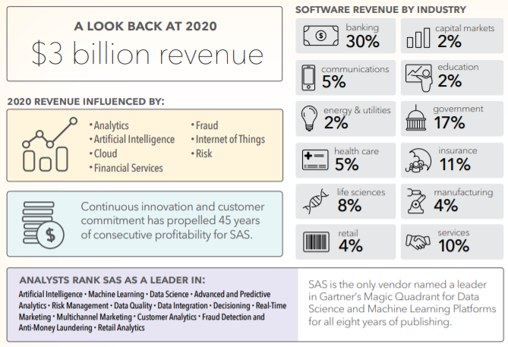
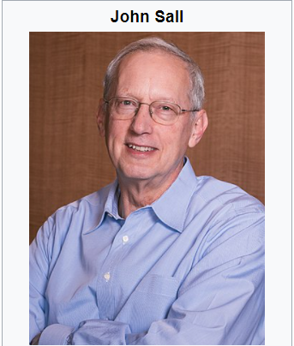
SAS Programming - Basics
1. Introduction
a. What is SAS?
Statistical Analysis System (SAS) is one of the most popular software for data analysis. It is widely used for various purposes such as data management, data mining, report writing, statistical analysis, business modeling, applications development and data warehousing.
b. SAS History
SAS was developed by Jim Goodnight and John Sall in 1970 at North Carolina State University.
Initially it was developed for Agricultural Research.
Later, it expanded to a gamut of tools to include Predictive Analytics, Data Management, Data Mining among others.

Slide 3
SAS Programming - Basics
2. SAS Modules in-built
Base SAS - Data manipulation such as filtering data, selecting, renaming or removing columns, reshaping data etc.
SAS/STAT - Runs popular statistical techniques such as Hypothesis Testing, Linear / Logistic Regression, Principal Component Analysis etc.
SAS/ACCESS - It lets you to read data from databases such as Teradata, SQL Server, Oracle, DB2 etc.
SAS/GRAPH - Create simple and complex graphs using this component
SAS/ETS - Perform time series forecasting such as ARIMA, Exponential Smoothing, Moving Average etc.
3. How to download and install SAS Software?
Ref: https://www.listendata.com/p/sas-tutorials.html

Slide 4
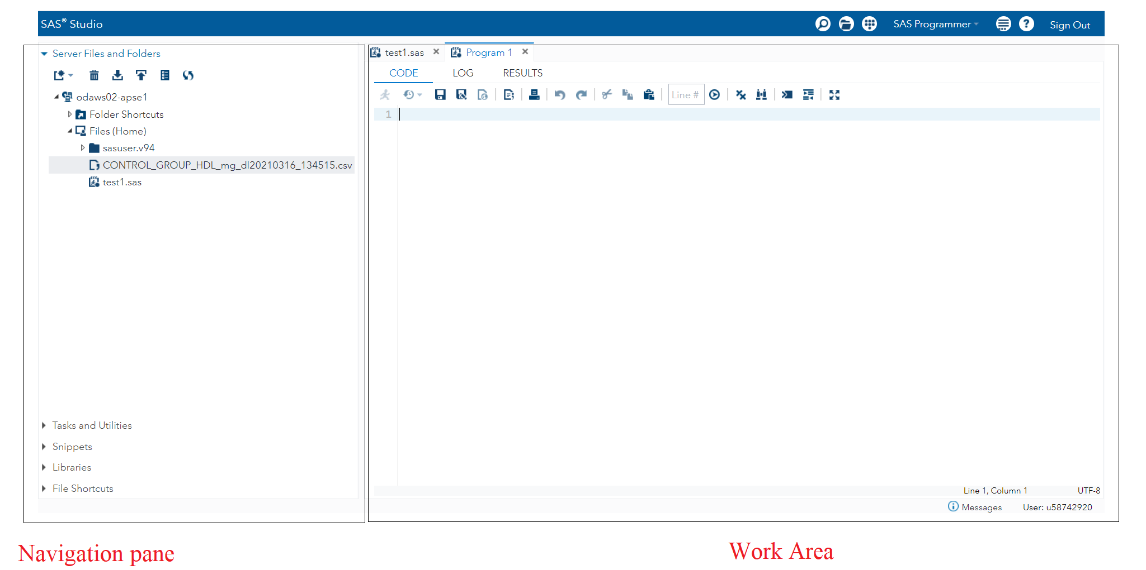
SAS Programming - Basics
4. SAS Main Window
In the left portion, you see the Navigation Pane used to navigate various programming features.
In the right portion, you see the Work Area which is used for writing the code and executing it.

Slide 5
SAS Programming - Basics
4. SAS Main Window - continued
A few important features
a. Code Autocomplete - Helps getting the corrected syntax of SAS keywords as well as provides link to the documentation for that keyword.
b. Program Execution - Done by pressing the run icon, which is the first icon from the left in the Work Area or the F3 button.
c. Program Log - Describes the errors, warnings or notes about the program execution.
d. Program Result - Show the result of code execution (as html tables by default)
e. Program Tabs - Contains features & pre-built functionalities to create and manage programs
i) Tasks - To use in-built SAS programs such as Linear Regression
ii) Snippets - To write SAS macro and generate files from the existing data set
iii) Program Libraries - To store datasets in SAS libraries such as WORK, a temporary library for a single session
iv) File Shortcuts - To access files which are stored outside the SAS environment

Slide 6
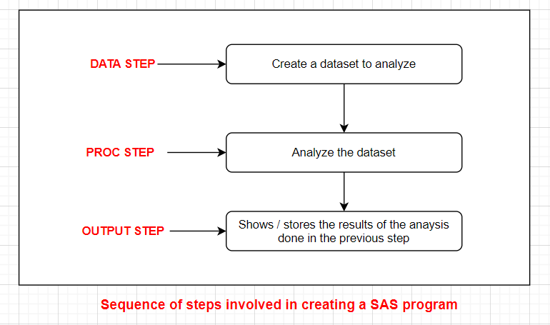
SAS Programming - Basics
5. SAS Program Structure
a. DATA step involves loading the required data set into SAS memory and identifying the variables of the data set.
b. PROC step involves invoking a SAS built-in procedure to analyse the data.
c. OUTPUT step displays the data derived from the input data sets with conditional output statements.

Slide 7
SAS Programming - Basics
5. SAS Program Structure - continued
SYNTAX for DATA | Example
DATA dataset_name; # Name of the dataset INPUT var1, var2, var3; # Define the variables in this dataset NEW_VAR; # Create new variables LABEL; # Assign labels to variables DATALINES; # Enter the data RUN; | DATA TEMP; INPUT ID $ NAME $ FBS PPBS; LABEL ID = 'Volunteer ID'; DATALINES; 1 Antony 80 130 2 Benny 90 140 3 Cyril 103 153 4 David 112 180 5 Edward 102 160 6 Fawlin 93 145 7 Gabby 70 120 8 Henry 85 140 ; RUN;

Slide 8
SAS Programming - Basics
5. SAS Program Structure - continued
SYNTAX for PROC | Example
PROC procedure_name options; # The name of the proc; RUN; | PROC MEANS; RUN;
The above example shows using the MEANS procedure to print the variable name, Count of observations, Mean, Standard deviation, Minimum and Maximum values of the numeric variables in the data set.
SYNTAX for OUTPUT | Example
PROC PRINT DATA = data_set; OPTIONS; RUN; | PROC PRINT DATA = TEMP; WHERE FBS > 100 OR PPBS > 160; RUN;

Slide 9
SAS Programming - Basics
5. SAS Program Structure - continued
You can automate saving your HTML output with an ODS HTML statement (ODS is an acronym for Output Delivery System).
There are three basic options: a) file or body, b) path & c) gpath
The file or body option specifies the name of the file to save. The path option specifies where to save that file. The gpath options determines where the graphs are saved (by default, the path location).
To save our PROC MEANS as a HTML file
ods html file = "sample1.html" path = "/home/u58742920/output";
PROC PRINT DATA = TEMP; WHERE FBS > 100 OR PPBS > 160;
RUN;
To save our PROC MEANS as a word & pdf file, use rtf & pdf file respectively instead of html file
ods rtf file = "sample1.rtf" path = "/home/u58742920/output"; At the end, write ods rtf close;
ods pdf file = "sample1.pdf" path = "/home/u58742920/output"; "; At the end, write ods pdf close;

Slide 10
SAS Programming - Basics
6. SAS Basic Syntax
SAS has rules of syntax to create the SAS programs
Three components of SAS program
1. Statements
2. Variables
3. Data sets

Slide 11
SAS Programming - Basics
6. SAS Basic Syntax - continued
6.1. Statements
A SAS statement is a series of items that may include keywords, SAS names, special characters, and operators. End of the statement is denoted by a semicolon at the end of the last line.
Space can be used to separate the components in a SAS program statement.
SAS keywords are not case sensitive.
Every SAS program must end with a RUN statement.
Example:
PROC FREQ DATA = auto;
RUN;
The above program statements would generate frequency tables for every variable in the auto data file.

Slide 12
SAS Programming - Basics
6. SAS Basic Syntax - continued
6.2. Variables
Variables in SAS represent a column in the SAS data set. They obey the following rules:
Max. length of a variable name is 32
Variable names start with the letters A to Z (case insensitive) or an underscore (_); It can include numbers from the second character onwards.
Blanks are not allowed in a variable name.
# Valid Variable Names | # Invalid Variable Names
INCOME_MONTH MinValue Month1 _Width | INCOME MONTH 2score %sales

Slide 13
SAS Programming - Basics
6. SAS Basic Syntax - continued
6.3. Data sets
The DATA statement marks the creation of a new SAS data set.
Rules for DATA set creation
1. A single word after the DATA statement indicates a temporary (lasts only during the session) data set name.
2. To create a permanent data set (which persists after the completion of the session), prefix the data set name with a library name.
3. SAS creates a temporary data set with names DATA1, DATA2 etc., when SAS data set name is omitted.
Examples of temporary data set | Examples of permanent data set
DATA TempData; | DATA Mylib.NewData;

Slide 14
SAS Programming - Basics
6. SAS Basic Syntax - continued
6.4 Comments in SAS
Two formats
*message; type comment
/*message*/; type comment
Type | Example of Comment lines in SAS
*message; | * This is a comment line;
/*message*/ | /* This is comment line 1 * This is comment line 2 */

Slide 15
SAS Programming - Basics
6. SAS Basic Syntax - continued
6.5 SAS File Extensions
Various file extensions used by SAS programs
Extension | Description
*.sas | represents the SAS code file (ascii text)
*.log | represents the SAS log file containing information such as errors, warnings, and data set details for a submitted SAS program
*.mht/ *.html | represents the SAS Results file
*sas7bdat | represents SAS Data File which contains a SAS data set including variable names, labels, and the results of calculations.

Slide 16
SAS Programming - Basics
6. SAS Basic Syntax - continued
6.6 Read Character variable of varying length
Use $ sign
Remarks | SAS Code
Here we use a length statement prior to adjust varying length of a variable. Here $30 defines the variable as a character variable having max length 30. Please note that SAS defaults to assigning the lengths of character variables to 8 bytes unless otherwise specified. The noobs in the proc print statement supresses the column in the output that identifies each observation by its number. | data char_var-example1; length Name $30; input ID Name $ FBS; cards; 1 Ammanalla Khan 78 2 Mohammed Basha 89 3 Murali Bhaskar 90 ; proc print noobs;

Slide 17
SAS Programming - Basics
6. SAS Basic Syntax - continued
6.7 CREATING OR MODIFYING A VARIABLE
It is very common data requirement to create a new variable based on the existing variable.
Case | SAS Code
a. Create a numeric variable using the form: variable = expression; | DATA House1; SET House1; New_Price = 2.5 * Old_Price; RUN;
b. Create a new numerical variable and store on a new dataset | DATA House_Prices; SET House1; New_Price = 2.5 * Old_Price; RUN;

Slide 18
SAS Programming - Basics
6. SAS Basic Syntax - continued
6.7 CREATING OR MODIFYING A VARIABLE - continued
Case | SAS Code
c. Create a Character variable | DATA House_Prices; SET House1; New_Price = 2.5 * Old_Price; IF New_Price > 999999 THEN PRICERANGE ="HIGH"; ELSE PRICERANGE = "LOW"; RUN;
d. Creating or Modifying a variable FORMAT variable-name FORMAT-NAME.; The FORMAT statement is used to display the change value in percentage format. For example, in PERCENTw.d format, w represents the width and d number of decimal places of the variable printed. | DATA House_Prices; SET House1; Old_Price = 5 + Old_Price; New_Price = Old_Price * 2.5; Change= ( New_Price - Old_Price)/ Old_Price); Format Change Percent10.0; RUN;

