Slide 1
SAS Programming - Basics
Introduction to SAS Programming – Day 2
By
PVS

Slide 2


SAS Programming - Basics
To participate in the Quiz, use the link at https://bit.ly/2S2tFO1

Slide 3
SAS Programming - Basics
SAS Tutorial - Overview
1. Data Sets
2. Variables
3. Strings
4. Arrays
5. Numeric Formats
6. Operators
7. Loops
8. Decision Making
9. Functions
10. Input Methods
11. Macros
12. Dates & Times

Slide 4
SAS Programming - Basics
1. Data Sets
A SAS data set is a group of data values that SAS creates and processes.
A data set contains the following:
i) a table with data, called
a. Observations, organized in rows
b. Variables, organized in columns
descriptor information that describes such things as the number of variables, variable names, time of last file updated and the length & the format of the data
Two types of SAS data sets:
SAS data file - contains both the data and the descriptor information. SAS data files have a member type of DATA (other member types are SAS data view, SAS program, SAS log file etc.)
SAS data view is a virtual data set of descriptor information that points to data from other sources such as ASCII text, database, and spreadsheet.
Ref: https://v8doc.sas.com/sashtml/lrcon/z1005709.htm
https://www.tutorialspoint.com/sas/sas_data_sets.htm

Slide 5
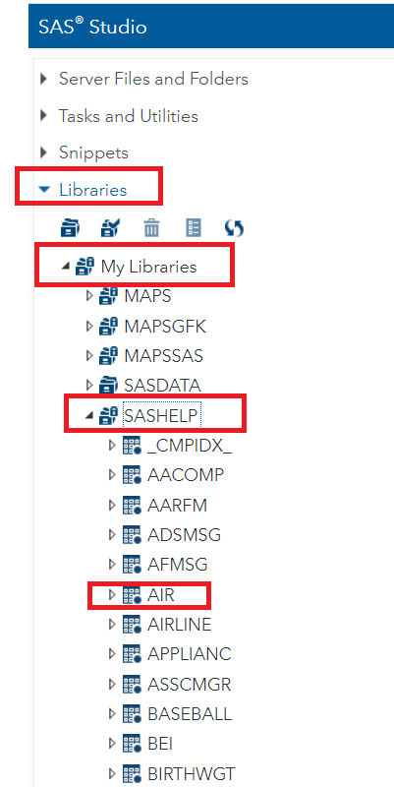
SAS Programming - Basics
1. Data Sets - continued
Two types of data sets
a. Temporary data set - used by the SAS program and then discarded once the session is complete.
Permanent data set - stored permanently under a specific library for future use
Built-in Data sets
These data sets are already available for use in the installed SAS software.
To explore these data sets go to Libraries > My Libraries > SASHELP. On expanding it we observe the list of names of all the built-in Data sets.

Slide 6
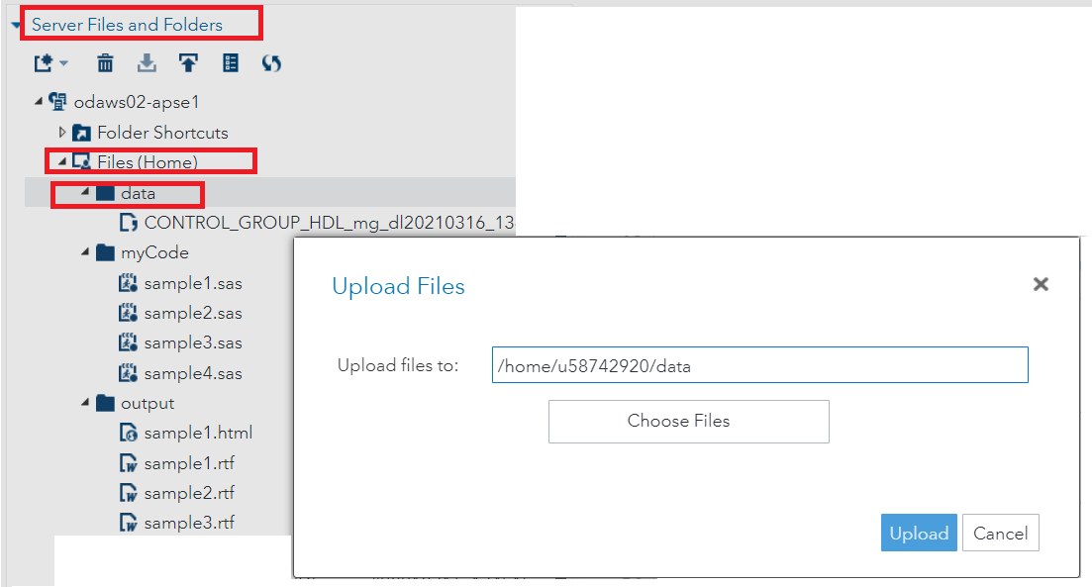
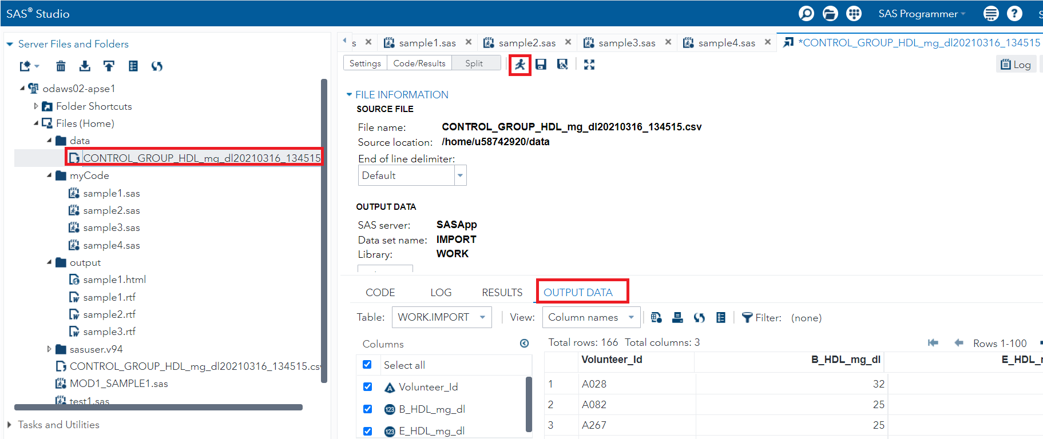
SAS Programming - Basics
1. Data Sets - continued
Importing External Data Sets
We can upload the source data files to SAS folder by using the upload option under the Server Files and Folders.
View the imported data
You can view the imported data first by double-clicking on it and then by runnung the default import code generated by Run option.

Slide 7
SAS Programming - Basics
2. Variables
Variables are containers that hold information and the purpose is to label and store data in memory.
Variables represent the column names of the data sets used for analysis.
It can be used for other purpose such as a loop counter
Three variable types
Numeric Variable
Used in mathematical expressions.
This is the default variable type
Syntax
INPUT NVAR1 NVAR2 NVAR3 NVAR4;
Example
INPUT SALARY BONUS INCREMENT;

Slide 8
SAS Programming - Basics
2. Variables - continued
Three variable types - continued
b. Character variables
They are treated as text or strings.
Character variable is denoted by adding a $ sign with a space at the end of the variable name.
The name cannot contain more than 32 characters.
The default number of bytes for both numeric and character variables is 8. By using the LENGTH statement, you can specify the number of bytes for storing variables.
Syntax
INPUT CVAR1 $ CVAR2 $ CVAR3 $ CVAR4 $;
Example
LENGTH FIRSTNAME $30 LASTNAME $30;
INPUT FIRSTNAME $ LASTNAME $ GENDER $;

Slide 9
SAS Programming - Basics
2. Variables - continued
Three variable types - continued
c. Date variables
They are treated only as dates and they need to be in valid date formats.
Date variable is denoted by adding a date format with a space at the end of the variable name.
Syntax
INPUT DVAR1 DATE11. DVAR2 MMDDYY10. ;
Example
INPUT DOB DATE11. DOJ MMDDYY10.;
Note: Here 10 & 11 after DATE refers to the width of the date.
11 represents both DD-MMM-YY and DD-MMM-YYYY date formats
10 represents DD-MM-YYYY date format

Slide 10
SAS Programming - Basics
2. Variables - continued
The code, sample5.sas shows how the three types of variables are declared and used in a SAS Program

Slide 11
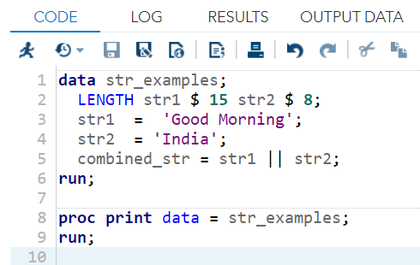
SAS Programming - Basics
3. Strings
Values which are enclosed within a pair of single quotes is called a string.
String variables are declared by adding a space and $ sign at the end of the variable declaration.
The keyword, LENGTH is used for declaring length of the variables.
Example

Slide 12
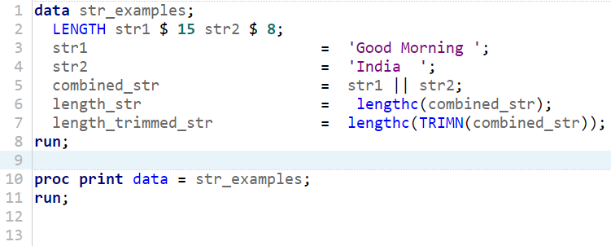
SAS Programming - Basics
3. Strings - continued
String functions
a. SUBSTRN - extracts a substring using the start and end positions.
Syntax
SUBSTRN ('STRINGVAL', P1, P2)
where STRINGVAL is the value of the string variable
P1 is the start position of extraction
P2 is the final position of extraction
b. TRIMN - removes the trailing space from a string
Syntax
TRIMN('STRINGVAL')

Slide 13
SAS Programming - Basics
4. Arrays
Arrays are used to store and retrieve a series of values using an index value. The index represents the location in a reserved memory area.
Syntax
ARRAY ARRAY-NAME (Subscript) ($) VARIABLE-LIST ARRAY-VALUES
In the above syntax -
ARRAY is the KEYWORD to declare an array
ARRAY-NAME is the name of the array which follows the same rule as variable names
($) is an optional parameter to be used only if the array is going to store character values
VARIABLE-LIST is the optional list of variables which are the place holders for array values.
ARRAY-VALUES are the actual values that are stored in the array. They can be read from a file or dataline or declared here.

Slide 14
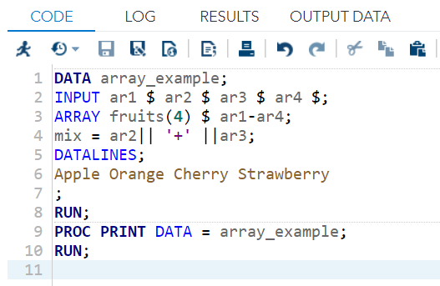
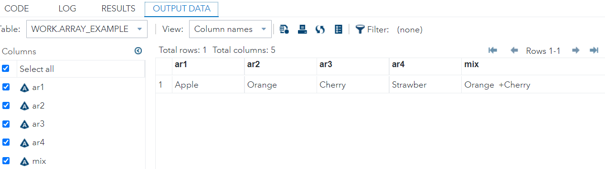
SAS Programming - Basics
4. Arrays continued

Slide 15
SAS Programming - Basics
5. Numeric Formats
SAS can handle different types of numeric data formats.
These formats are used at the end of the variable name to apply a specific numeric format to the data.
Two types of numeric formats:
informat - specification of how SAS should read data
output fotmat- a layout specification of how a variable should be displayed in the output.
There are many informats & output formats and also user-defined informats & output formats (created by PROC FORMAT). For more info, refer to 'help format’.
Syntax for numeric informat
VarName Format-name-w.d
where VarName is the name of the variable, Format-name is the name of the numeric format applied to the variable, w is the max. number of data columns (including the decimal point, the digits after the decimal point) allowed to be stored and d is the number of digits to the right of the decimal point.

Slide 16
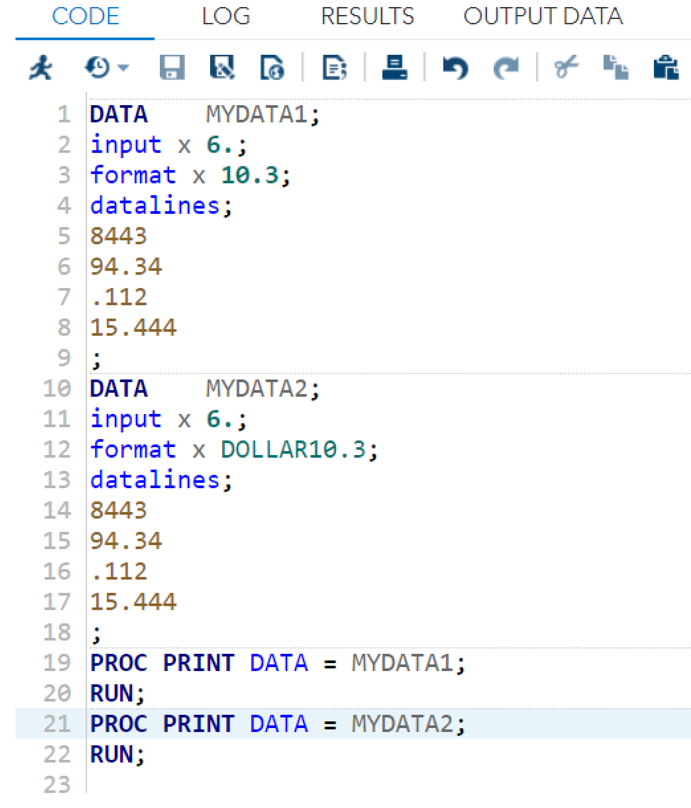
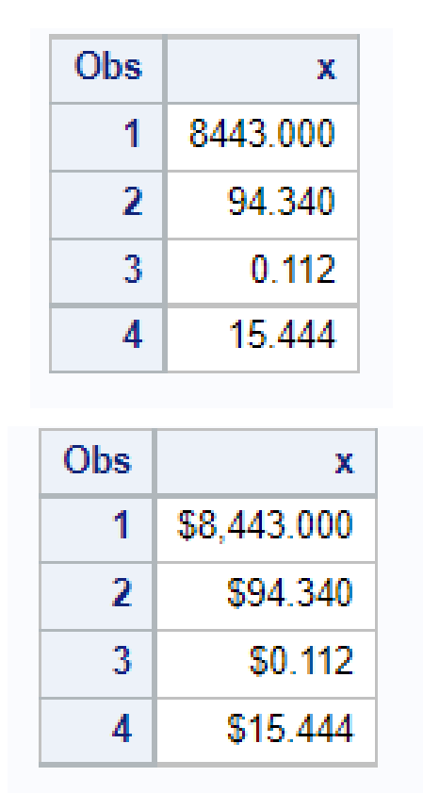
SAS Programming - Basics
5. Numeric Formats continued
Reading numeric formats
Input numeric formats
Format | Use
n. | Max. n number of columns with no decimal point
n.p | Max. n number of columns with p decimal points
DOLLARn.p | Max. n number of columns with p decimal points with comma in thousandth place and a leading dollar sign

Slide 17
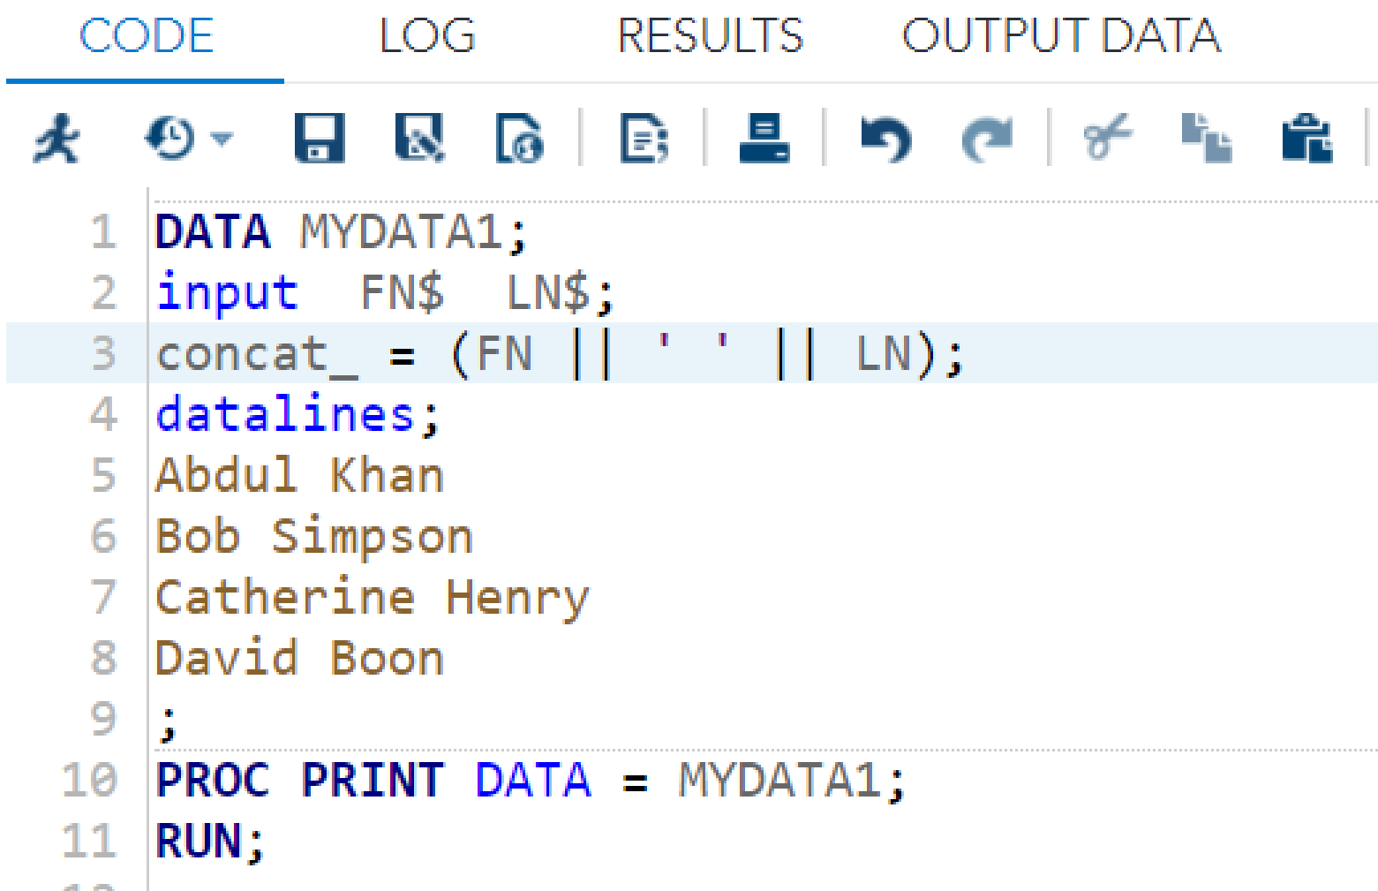
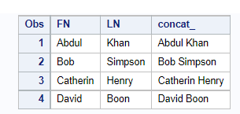
SAS Programming - Basics
6. Operators
An operator in SAS is a symbol which is used in a mathematical, logical or comparison expression.
List of operators in SAS
a. Arithmetic operator such as + (addition) - (subtraction) * (multiplication) / (division) ** (exponentiation)
b. Logical operators such as & (AND) | (OR) ~ (Not)
c. Comparison operators such as = (equal to) ^= (not equal to) < (less than) <= (less than r=or equal to) >(greater than) >= (greater than or equal to) IN (contained in the list)
d. Minimum / Maximum Operators such as MIN MAX
e. Concatenation Operator such as ||

Slide 18
SAS Programming - Basics
6. Operators - continued

