Slide 1
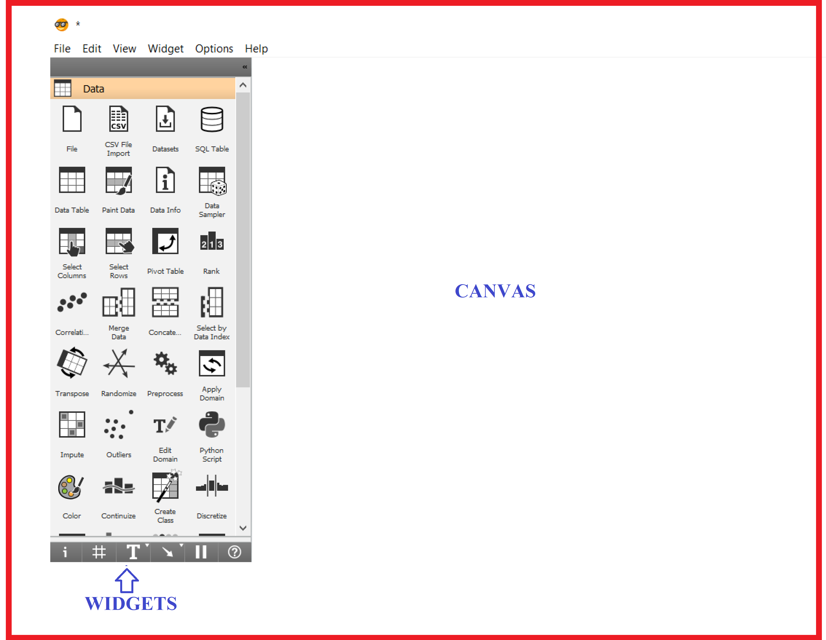
Orange screen shot
Orange consists of a canvas interface onto which the user places widgets and create a data analysis workflow.
Canvas: Graphical front-end for data analysis
Widgets: Components in Orange Canvas, a visual programming environment of Orange.

