Slide 1
LapsPython
Extend LAPS to synthesize Python/R
Christopher Brückner
29.08.2022

Slide 2
Important Links
Git Repository: https://github.com/pvs-hd-tea/LapsPython
Documentation: https://pvs-hd-tea.github.io/LapsPython
Including developer guide, API reference, accounting, metrics, presentations.

Slide 3
Goals & Results

Slide 4
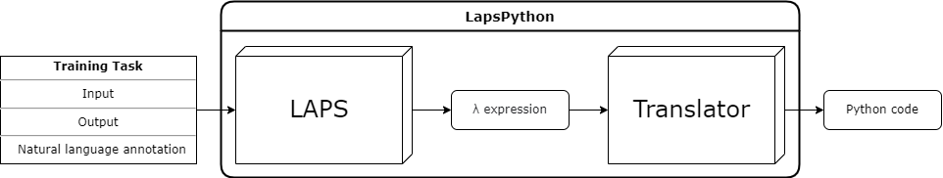
Goals
Create a rule-based translator from λ-calculus to Python or R
Target useful domains, e.g., data processing, string processing
Maybe address different target languages

Slide 5
Goals: What did I achieve?
Translator: Working, but sometimes small bugs in translations
Example: Slide 6
Target Domain: re2
Pre-implemented
Combines string processing (regex) and list processing
Target Languages: Python, R
Python is obligatory for LAPS to work
Extended by manually translating the Python primitives to R

Slide 6
Evaluation Metrics
Small checkpoint: 3 iterations of LAPS
75 synthesized programs in 18 tasks
100% bug-free translated by LapsPython
Large checkpoint: Provided by the authors
1646 synthesized programs in 346 tasks
27 tasks (8%) solved with bug-free translations
Bugs typically easy to detect and fix
Usually calls to invented primitives
Example: Next slide

Slide 7
Example: Flawed Translation
Task: if there is any letter, add v after that
Program: (λ (f8 $0 (λ (_rconcat $0 _v))))
Translation:
Fix: return f8(lambda lx: lx + 'v', arg1)
def f8(arg1, arg2):
rsplit_1 = __regex_split('.', arg2)
map_1 = list(map(arg1, rsplit_1))
return "".join(map_1)
def re2_train_41_if_there_is_any_letter_add_v_after_that(arg1):
rconcat_1 = arg1 + 'v’
return f8(f8_0, arg1, lambda lx: lx + 'v')

Slide 8
Architecture

Slide 9
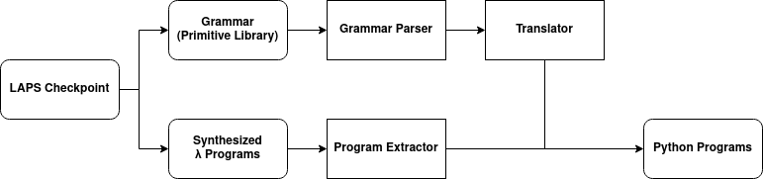
LapsPython Pipeline
GrammarParser: Read Python/R implementations, parse arguments, reformat code
ProgramExtractor: Read tasks descriptions, programs, input/output examples
Translator: Traverse program tree, substitute primitives with Python/R code

Slide 10
Example: Code Reformatting
Primitive implemented by LAPS:
def _rsplit(s1) : return lambda s2: __regex_split(s1, s2)
🡻
Primitive used by LapsPython:
def _rsplit(s1, s2):
return __regex_split(s1, s2)

Slide 11
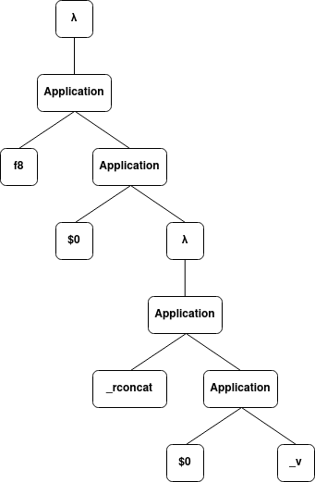
Example: Program Tree
Task: if there is any letter, add v after that
Program: (λ (f8 $0 (λ (_rconcat $0 _v))))
Translation: f8(lambda lx: lx + 'v', arg1)

Slide 12
Code Quality & Statistics

Slide 13
Code Quality
Continuous Integration Pipeline:
Unit Tests (pytest + pytest-cov)
Static Typechecks (mypy)
Linting (Flake8)
Flake8 is used with extensions to
enforce stricter conventions in compliance with modern Python and Clean Code
simplify complex code
prevent bugs and security issues
PEP-8 score according to Flake8: 100%

Slide 14
Code Statistics
Lines of Code
Main Code: 775
Test Code: 430
Ratio: 1.8
Test Coverage
Test Cases: 50
94% coverage total, ranging from 88% to 100% per module
Out of 666 statements, 43 are missed (many unreachable)
Exception handling for fixed bugs
Handling of special cases not present in current dataset

Slide 15
Software Process
Scrum: Sprints were very helpful
Helps with project planning
Regular insights into what is achievable and what isn’t
In general, I learned a lot about working with GitHub
Team Work: Unfortunately zero
Biggest Issue: Original project plan was designed for 2 people
Some interesting ideas had to be scrapped, e.g., more domains
Lack of different perspectives on problems
Huge workload

Slide 16
Special Difficulties
LAPS is really difficult to get running
LapsPython will work anyway by using LAPS checkpoints ☺
It can still be injected into the LAPS code
Different approaches for similar problems required
Python primitives can be read from memory (inspect module)
R primitives need to be manually parsed from the source file
Translation difficult and hard to debug
Program trees are not always simple to traverse
Lots of special cases to handle
LAPS does not give you insights into intermediate results
Translation module was rewritten twice and is still flawed

Slide 17
1-Click-Demo

