Slide 1
BREAST CANCER CLASSIFICATION

Slide 2
TABLE OF CONTENTS
01
INTRODUCTION
02
MOTIVE
03
DATASET DESCRIPTION
METHODOLOGY
(MACHINE LEARNING)
04

Slide 3
TABLE OF CONTENTS
05
METHODOLOGY
(DEEP LEARNING MODELS)
06
RESULT ANALYSIS
07
FUTURE WORK
08
CONCLUSION

Slide 4


BREAST CANCER CLASSIFICATION

Slide 5
BREAST CANCER CLASSIFICATION
Breast cancer is cancer that develops from breast tissue.
Signs of breast cancer may include a lump in the breast, a change in breast shape, dimpling of the skin, milk rejection, fluid coming from the nipple, a newly inverted nipple, or a red or scaly patch of skin.
In those with distant spread of the disease, there may be bone pain, swollen lymph nodes, shortness of breath, or yellow skin.

Slide 6
BREAST CANCER CLASSIFICATION
One of the most prevalent cancers in women worldwide is breast cancer. Effective treatment and better patient outcomes depend on early identification and correct diagnosis of breast cancer.
In order to enable precise and quick diagnosis, machine learning and deep learning has emerged as a viable method for breast cancer classification.
We'll look at how machine learning and deep learning algorithms are used to categorize breast cancer and how this might aid in the early identification and diagnosis of the disease.
We'll also go through a few current studies in this area and their conclusions.

Slide 7


Slide 8
MOTIVE
The goal of utilizing machine learning and deep learning to classify breast cancer is to increase the precision and effectiveness of breast cancer diagnosis.
Breast cancer is a severe condition, and successful treatment and better patient outcomes depend on early identification. The systematic and objective classification of breast cancer by pathologists with the aid of machine learning and deep learning algorithms can result in a more precise prognosis.
The main goal of research in this area is to use machine learning to identify and categorize breast cancer, which has the potential to be more precise and efficient than current diagnostic methods.
Different machine learning techniques, including Logistic Regression, XG-Boost, Random Forest, KNN and Decision Tree, along with Back propagation & multi-layer perceptron and deep learning models include Vgg-net, res-net, Alex-net, google-net and efficient-net are used to categorize whether a breast cancer is benign or malignant.

Slide 9
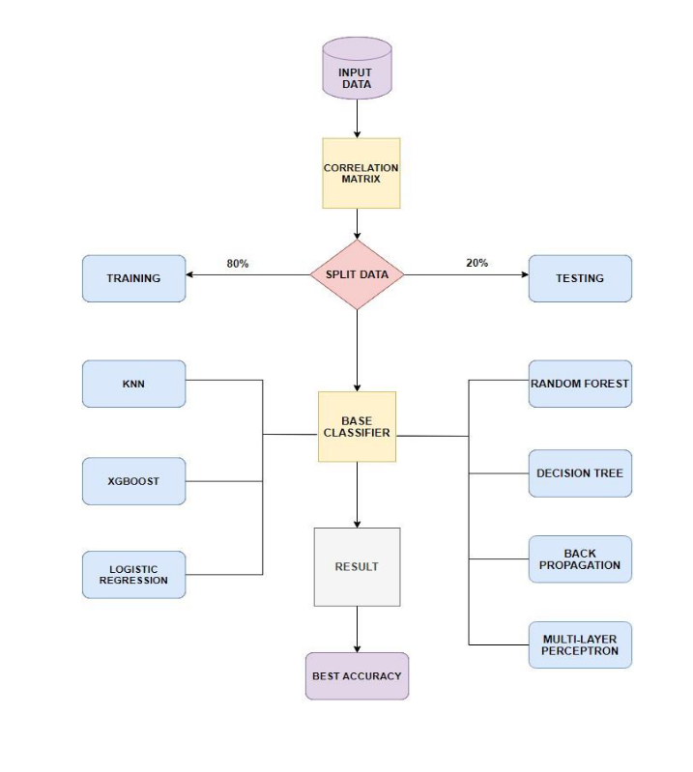
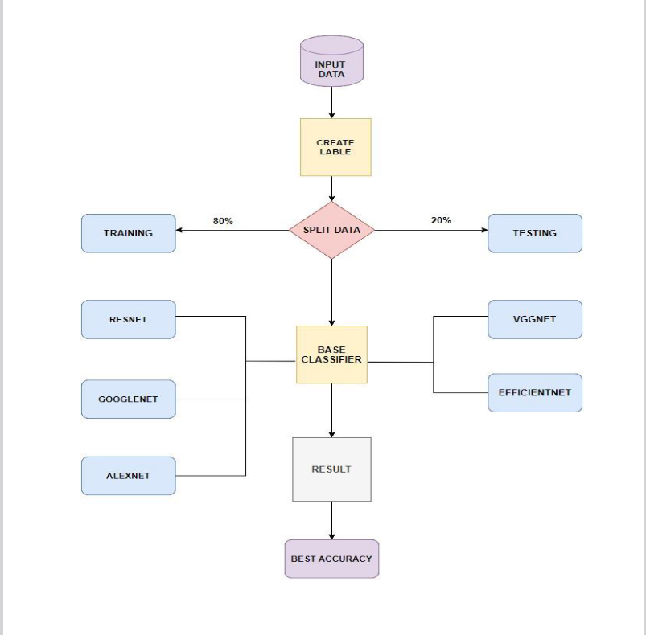
MACHINE LEARNING FLOWCHART
DEEP LEARNING FLOWCHART

Slide 10
DEEP LEARNING FLOWCHART
MACHINE LEARNING FLOWCHART

Slide 11


Slide 12
DATASET DESCRIPTION
In this study, we used breast cancer dataset to create our model. We took this dataset from Kaggle.
For machine learning, initially there were only 5630 rows and 32 columns in the dataset taken. We extended the dataset to 60000 rows and 32 columns by adding the data from multiple resources.
Our dataset is classified into two types, Benign and Malignant (cancer is present).
There are 30081 Benign and 29918 Malignant.
For deep learning, we took a dataset which consists of 1008 images.

Slide 13
The dataset was exposed to 5 classification algorithms, 2 neural networks and 5 deep learning models in order to compare accuracy and find the top performing algorithm.
Accuracy, Precision, Recall, and F-Score/F-Measure are the performance evaluation metrics used to compare ML algorithms.
The confusion matrix was obtained in order to calculate the Accuracy, Precision, Recall, and F-Score of each algorithm's outcome. Various statistical parameters (PRC) were used to compare the efficiency of various approaches, such as precision, recall, f-measure, and precision-recall.
  MODEL TRAINING AND EVALUATION USING ACCURACY SCORE

Slide 14
MACHINE LEARNING ALGORITHMS
DECISION TREE: Decision tree is a supervised Machine Learning Algorithm that is used to tackle most classification and prediction issues. It is in the shape of a tree. Each internal node represents an attribute test, each branch a test outcome, and each leaf node a class label. Accuracy on whole data: 89.844830
LOGISTIC REGRESSION: Logistic regression is a Supervised Machine Learning Algorithm that predicts the likelihood of a link between two variables. The main goal is to determine the model that best fits the connection between independent and dependent variables. Accuracy on whole data: 50.57417623627061
RANDOM FOREST: Random forest is a Supervised Machine Learning Algorithm that can handle Regression and Classification tasks. To make predictions, Random Forest uses features of decision trees. Random Forest makes accurate predictions by using a huge dataset. Accuracy on whole data:90.00150002500041
K-NEAREST NEIGHBOR: KNN is one of the simplest Supervised Machine Learning algorithm mostly used for classification. It classifies a data point based on how its neighbors are classified. KNN stores all available cases and classifies new cases based on a similarity measure. Accuracy on whole data: 64.93941565692761

Slide 15
MACHINE LEARNING ALGORITHMS
XG-BOOST: XGBoost is a decision tree based ensemble Machine Learning algorithm that uses a gradient boosting framework. It can be used to solve regression, classification, ranking and user-defined prediction problems. Accuracy on whole data: 70.46117435290589
BACK PROPAGATION: The goal of the back propagation algorithm is to reduce the error values in randomly assigned weights and biases, resulting in the desired output. The supervised learning method is used to teach the system, in which the system is presented the difference between its output and a known expected output and used to modify its internal state.
MULTI-LAYER PERCEPTRON: Multi-Layer Perceptron is an input layer, a hidden layer, and an output layer make up a straightforward neural network. For accuracy and precisely detecting the layers in the image, several hidden layers are important and reliable. Accuracy on whole data: 57.830963

Slide 16
DEEP LEARNING ALGORITHMS
RES-NET: Res Net is a deep learning architecture designed to address challenges in training deep neural networks. In this project, Res Net is used as a deep learning model for breast cancer classification.
  Accuracy on whole data: 52.867830423940156
ALEX-NET: Alex Net, a deep convolutional neural network, made significant advancements in computer vision tasks, especially image categorization.
  Accuracy on whole data: 49.37655860349127
GOOGLE-NET: The Google Net architecture is renowned for its efficiency in image classification tasks, utilizing deep convolutional neural networks.
  Accuracy on whole data : 6.81787688123887
VGG-NET: VGGNet is a popular convolutional neural network architecture widely used for image classification tasks. It is known for its deep architecture, consisting of stacked convolutional layers that excel at extracting intricate patterns from images.
  Accuracy on whole data: 83.51620947630923
EFFICIENT-NET: This project focuses on creating an image classification model using the EfficientNetB0 architecture, known for its high effectiveness and performance. The EfficientNetB0 model is pre-trained on the ImageNet dataset and serves as the base model.
  Accuracy on whole data: 49.87531172069826

Slide 17

RANDOM FOREST
DECISION
TREE
VGG-NET

Slide 18
CONCLUSION
Finally, machine learning algorithms have demonstrated great assurance in the diagnosis and classification of breast cancer.
Breast cancer has been classified using supervised and unsupervised learning algorithms based on various variables such as genes, imaging data, and radiomic features.
Combining breast cancer characteristics into breast cancer risk assessment algorithms has demonstrated enormous potential for enhancing breast cancer risk assessment. Artificial intelligence has also been utilized in the phenotyping of breast cancer risk using mammography, providing robust and breast density evaluation for risk estimation.
Machine learning and artificial intelligence have the potential to transform breast cancer detection and classification, but more research is needed to fully realize their potential in improving breast cancer diagnosis and therapy.
Our motive is to find which among the machine learning algorithms gives higher accuracy for classification of breast cancer. Based on our research we found that Decision Tree gives higher accuracy for the breast cancer classification.
FUTURE WORK
Future research on the classification of breast cancer using machine learning will look into the usage of algorithms that have the potential to increase classification accuracy.
A tailored model of breast cancer risk classification based on machine learning will also be created in the future.
This model will assist women in identifying breast cancer risk factors and enable early detection.
RESULT ANALYSIS
  M ---> Malignant (represents persons who is having Sevier stage of cancer )
  B ---> Benign (represents persons who are having starting stage)
  On the basis of accuracy, we examined and compared all of the algorithms. We used popular assessing criteria such as Precision, Recall, F-Score/F-Measure. Summarizes the outcomes of all algorithms in terms of accuracy, F-Score/F-Measure, precision,
  and recall.
  We can observe that the Logistic Regression and Back propagation have predicted nearly the same in terms of Accuracy which are 50, XGBoost has given 70%, Decision tree has given 89.8%, Multi-Layer Perceptron and K-Nearest Neighbor has given 57.2 and 64.9 as well as Random forest has given 90.001.
  In terms of accuracy and other evaluation metrics, Random Forest outperformed all other algorithms. So, according to the results obtained, we came to the conclusion that the Random Forest algorithm accurately predicted the best outcome.
  For Deep Learning models Alex Net and Efficient Net has shown the same Accuracy of 49, Res Net has shown 52, Google Net has given the least accuracy of the models which is 46 and VGG has given the highest accuracy of 83%. VGGNet surpassed all other algorithms in terms of accuracy and other evaluation parameters.
  So as per our project and our calculations we got the highest Accuracy Random Forest Algorithm that is 90 compared to all the machine learning algorithms that we have used. While coming to deep learning VGGNet gives the highest accuracy than other deep learning algorithms.

Slide 19
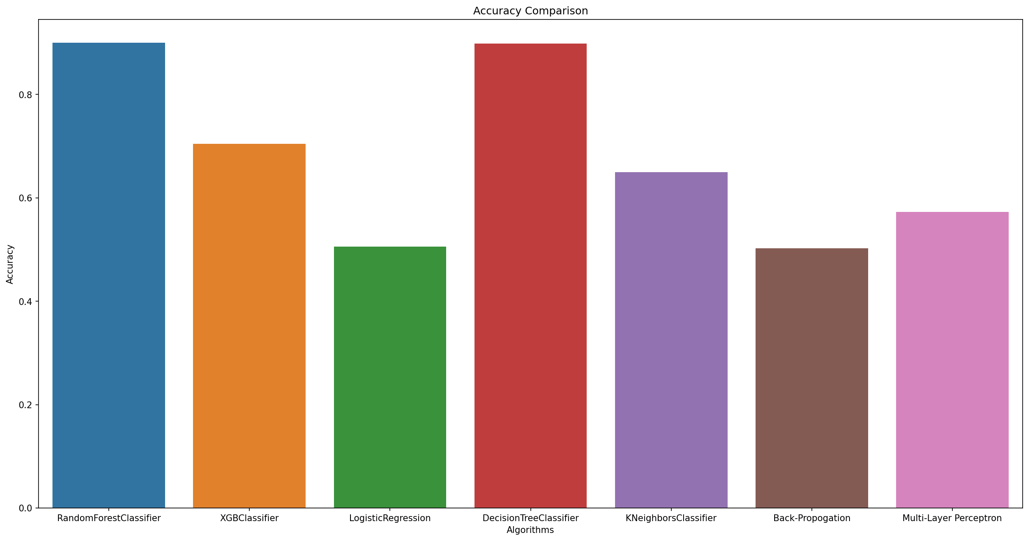
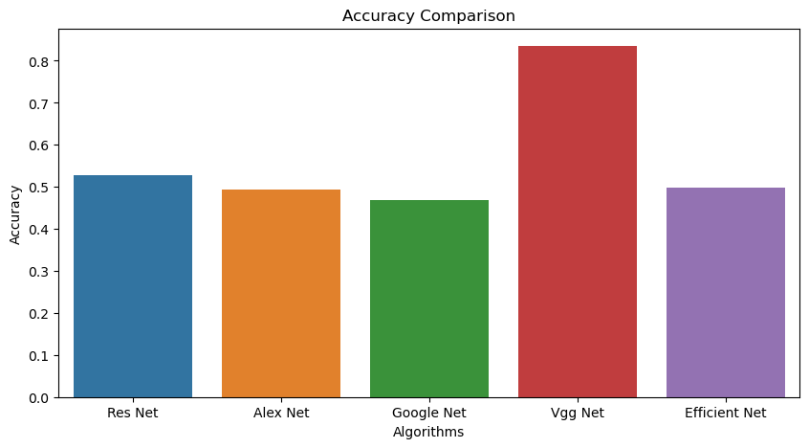
ACCURACY COMPARISON FOR
DEEP LEARNING ALGORITHMS
ACCURACY COMPARISON FOR
MACHINE LEARNING ALGORITHMS

Slide 20
ACCURACY COMPARISON FOR
DEEP LEARNING ALGORITHMS
ACCURACY COMPARISON FOR
MACHINE LEARNING ALGORITHMS

Slide 21
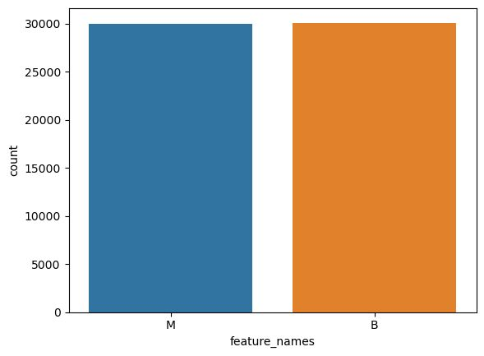
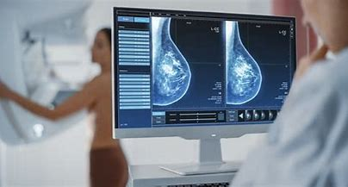
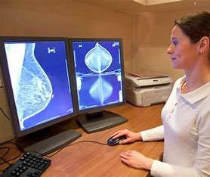
CONCLUSION
Finally, machine learning algorithms have demonstrated great assurance in the diagnosis and classification of breast cancer.
Breast cancer has been classified using supervised and unsupervised learning algorithms based on various variables such as genes, imaging data, and radiomic features.
Combining breast cancer characteristics into breast cancer risk assessment algorithms has demonstrated enormous potential for enhancing breast cancer risk assessment. Artificial intelligence has also been utilized in the phenotyping of breast cancer risk using mammography, providing robust and breast density evaluation for risk estimation.
Machine learning and artificial intelligence have the potential to transform breast cancer detection and classification, but more research is needed to fully realize their potential in improving breast cancer diagnosis and therapy.
Our motive is to find which among the machine learning algorithms gives higher accuracy for classification of breast cancer. Based on our research we found that Decision Tree gives higher accuracy for the breast cancer classification.
FUTURE WORK
Future research on the classification of breast cancer using machine learning will look into the usage of algorithms that have the potential to increase classification accuracy.
A tailored model of breast cancer risk classification based on machine learning will also be created in the future.
This model will assist women in identifying breast cancer risk factors and enable early detection.
RESULT ANALYSIS
  M ---> Malignant (represents persons who is having Sevier stage of cancer )
  B ---> Benign (represents persons who are having starting stage)
  On the basis of accuracy, we examined and compared all of the algorithms. We used
  popular assessing criteria such as Precision, Recall, F-Score/F-Measure. Summarizes
  the outcomes of all algorithms in terms of accuracy, F-Score/F-Measure, precision,
  and recall.
  We can observe that the Logistic Regression and Back propagation have
  predicted nearly the same in terms of Accuracy which are 50, XGBoost has given
  70%, Decision tree has given 89.8%, Multi-Layer Perceptron and K-Nearest Neighbor
  has given 57.2 and 64.9 as well as Random forest has given 90.001.
  In terms of accuracy and other evaluation metrics, Random Forest outperformed all other
  algorithms. So, according to the results obtained, we came to the conclusion that the
  Random Forest algorithm accurately predicted the best outcome.
  For Deep Learning models Alex Net and Efficient Net has shown the same Accuracy of 49, Res
  Net has shown 52, Google Net has given the least accuracy of the models which is 46 and
  VGG has given the highest accuracy of 83%. VGGNet surpassed all other algorithms
  in terms of accuracy and other evaluation parameters.
  So as per our project and our calculations we got the highest Accuracy Random Forest Algorithm that is 90 compared to all the machine learning algorithms that we have used. While coming to
  deep learning VGGNet gives the highest accuracy than other deep learning algorithms.

Slide 22
CONCLUSION
Finally, machine learning and deep learning algorithms have demonstrated great assurance in the diagnosis and classification of breast cancer.
Breast cancer has been classified using supervised and unsupervised learning algorithms based on various variables such as genes, imaging data, and radiomic features.
Combining breast cancer characteristics into breast cancer risk assessment algorithms has demonstrated enormous potential for enhancing breast cancer risk assessment. Artificial intelligence has also been utilized in the phenotyping of breast cancer risk using mammography, providing robust and breast density evaluation for risk estimation.
Machine learning, deep learning and artificial intelligence have the potential to transform breast cancer detection and classification, but more research is needed to fully realize their potential in improving breast cancer diagnosis and therapy.
Our motive is to find which among the machine learning and deep learning algorithms gives higher accuracy for classification of breast cancer. Based on our research we found that Random Forest gives higher accuracy for the breast cancer classification.
FUTURE WORK
Future research on the classification of breast cancer using machine learning will look into the usage of algorithms that have the potential to increase classification accuracy.
A tailored model of breast cancer risk classification based on machine learning will also be created in the future.
This model will assist women in identifying breast cancer risk factors and enable early detection.
RESULT ANALYSIS
  M ---> Malignant (represents persons who is having Sevier stage of cancer )
  B ---> Benign (represents persons who are having starting stage)
  On the basis of accuracy, we examined and compared all of the algorithms. We used
  popular assessing criteria such as Precision, Recall, F-Score/F-Measure. Summarizes
  the outcomes of all algorithms in terms of accuracy, F-Score/F-Measure, precision,
  and recall.
  We can observe that the Logistic Regression and Back propagation have
  predicted nearly the same in terms of Accuracy which are 50, XGBoost has given
  70%, Decision tree has given 89.8%, Multi-Layer Perceptron and K-Nearest Neighbor
  has given 57.2 and 64.9 as well as Random forest has given 90.001.
  In terms of accuracy and other evaluation metrics, Random Forest outperformed all other
  algorithms. So, according to the results obtained, we came to the conclusion that the
  Random Forest algorithm accurately predicted the best outcome.
  For Deep Learning models Alex Net and Efficient Net has shown the same Accuracy of 49, Res
  Net has shown 52, Google Net has given the least accuracy of the models which is 46 and
  VGG has given the highest accuracy of 83%. VGGNet surpassed all other algorithms
  in terms of accuracy and other evaluation parameters.
  So as per our project and our calculations we got the highest Accuracy Random Forest Algorithm that is 90 compared to all the machine learning algorithms that we have used. While coming to
  deep learning VGGNet gives the highest accuracy than other deep learning algorithms.

