Slide 1





Nextech Mind
S2P Robotic
INNOHACK 2.0
Presented By Bot Buddies

Slide 2


innohack 2.0
AI Stock Predictor
Team Name :
Void Main
Venshu Naresh Anandani
Ritesh Sunil Metange
Pratik Prashant Kolhe
Sudarshan Govindrao Naik
Dr. DY Patil Technical Campus
MGMs Jawaharlal Nehru Engineering College
Team Members :
Institute :

Slide 3

WHY THIS PROBLEM MATTERS
To avoid losses from fake tips given via Telegram groups and WhatsApp groups.
Weak financial base of the individual investors
We aim to fill the gap between raw data and responsible investing
To make stock market analysis accessible, trustworthy, and easy to understand for everyone

Slide 4
PROPOSED SOLUTION
We propose a Machine Learning-based stock signal prediction system that:
Analyzes historical stock data using technical indicators (e.g., Moving Averages,).
Trains a classification model (e.g., Random Forest or Logistic Regression) to learn patterns from profitable trades.
Predicts “Buy” or “Don’t Buy” signals, helping users make smarter investment decisions.
Continuously improves by retraining on the latest data to stay adaptive to market trends.
Accessible & fast, empowering both novice and experienced investors with data-driven insights.

Slide 5
TECH STACK
Python^{3.13.2}
Yahoo Finance
Flask
Jupyter
(Main programming language used)
(For collecting data)
(For integrating AI data with frontend)
(For training and testing our model)

Slide 6
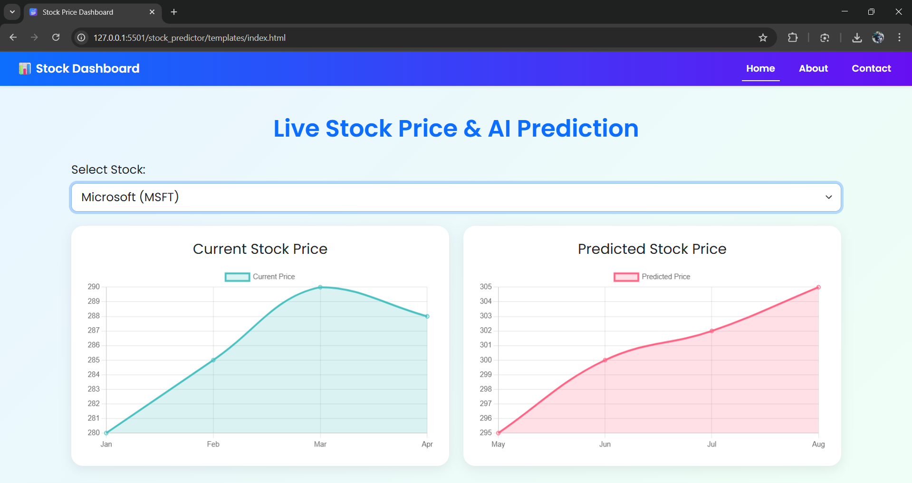
PROTOTYPE / SCREENSHOTS

Slide 7
INNOVATION & IMPACT
INNOVATION
IMPACT
Signal Prediction : Our system predicts buy/hold/sell signals using historical data patterns and machine learning algorithms, moving beyond basic technical analysis.
Democratizing Financial Intelligence : Empowers small-scale investors and beginners to make data-driven decisions, reducing reliance on expensive financial advisors.
Adaptive Learning : The model can be retrained periodically to adapt to new market conditions, ensuring it stays relevant and accurate over time.
Time-Saving : Eliminates hours of manual chart analysis — users can instantly know whether to consider buying a stock or not.

Slide 8
TEAM & ROLES
Individual Roles/ Responsibilities:
Frontend Developer
Ritesh Metange
Flask API Developer
Pratik Kolhe
Model Trainer
Sudarshan Naik
Team Lead
Venshu Anandani

Slide 9
Thank You

