Slide 1
Group 1 presentation

Slide 2
Introduction
Description: this is a system management for drinking shop
User: Shop owner, shop’s staff
Function: Managing products, staff, storage, sales
Team member:
Phạm Vương Triều (leader)
Hoàng Trọng Việt
Huỳnh Đặng Công Khánh

Slide 3
Requirement
Staff can login to system
For each type of staff, display different function:
Cashier: View products, manage orders
Storage Manager: Manage orders and imports
Manager: Manage staff and above function

Slide 4
Technical
Using Winform on Visual Studio
Datatabase: Microsoft SQL Server
Framework: ADO.net entity
Git control: Github
Project link: https://github.com/pvtrieu/DrinkStore

Slide 5
Member & Task
Task | Person in charge | Status
Use-case diagram | Triều | Complete
ERD diagram | Khánh | Complete
UML diagram | Việt | Complete
GUI designed | Triều | Finished 4 main form - 3 more to completed
Database | Khánh | Completed data structure Not input sample data yet
Model Class | Việt | - Done 70%
DataLayer | Khánh | Not started yet
BussinesLayer | Việt | Not started yet
PresentasionLayer | Triều | Not started yet
Testing | Triều | Not started yet

Slide 6
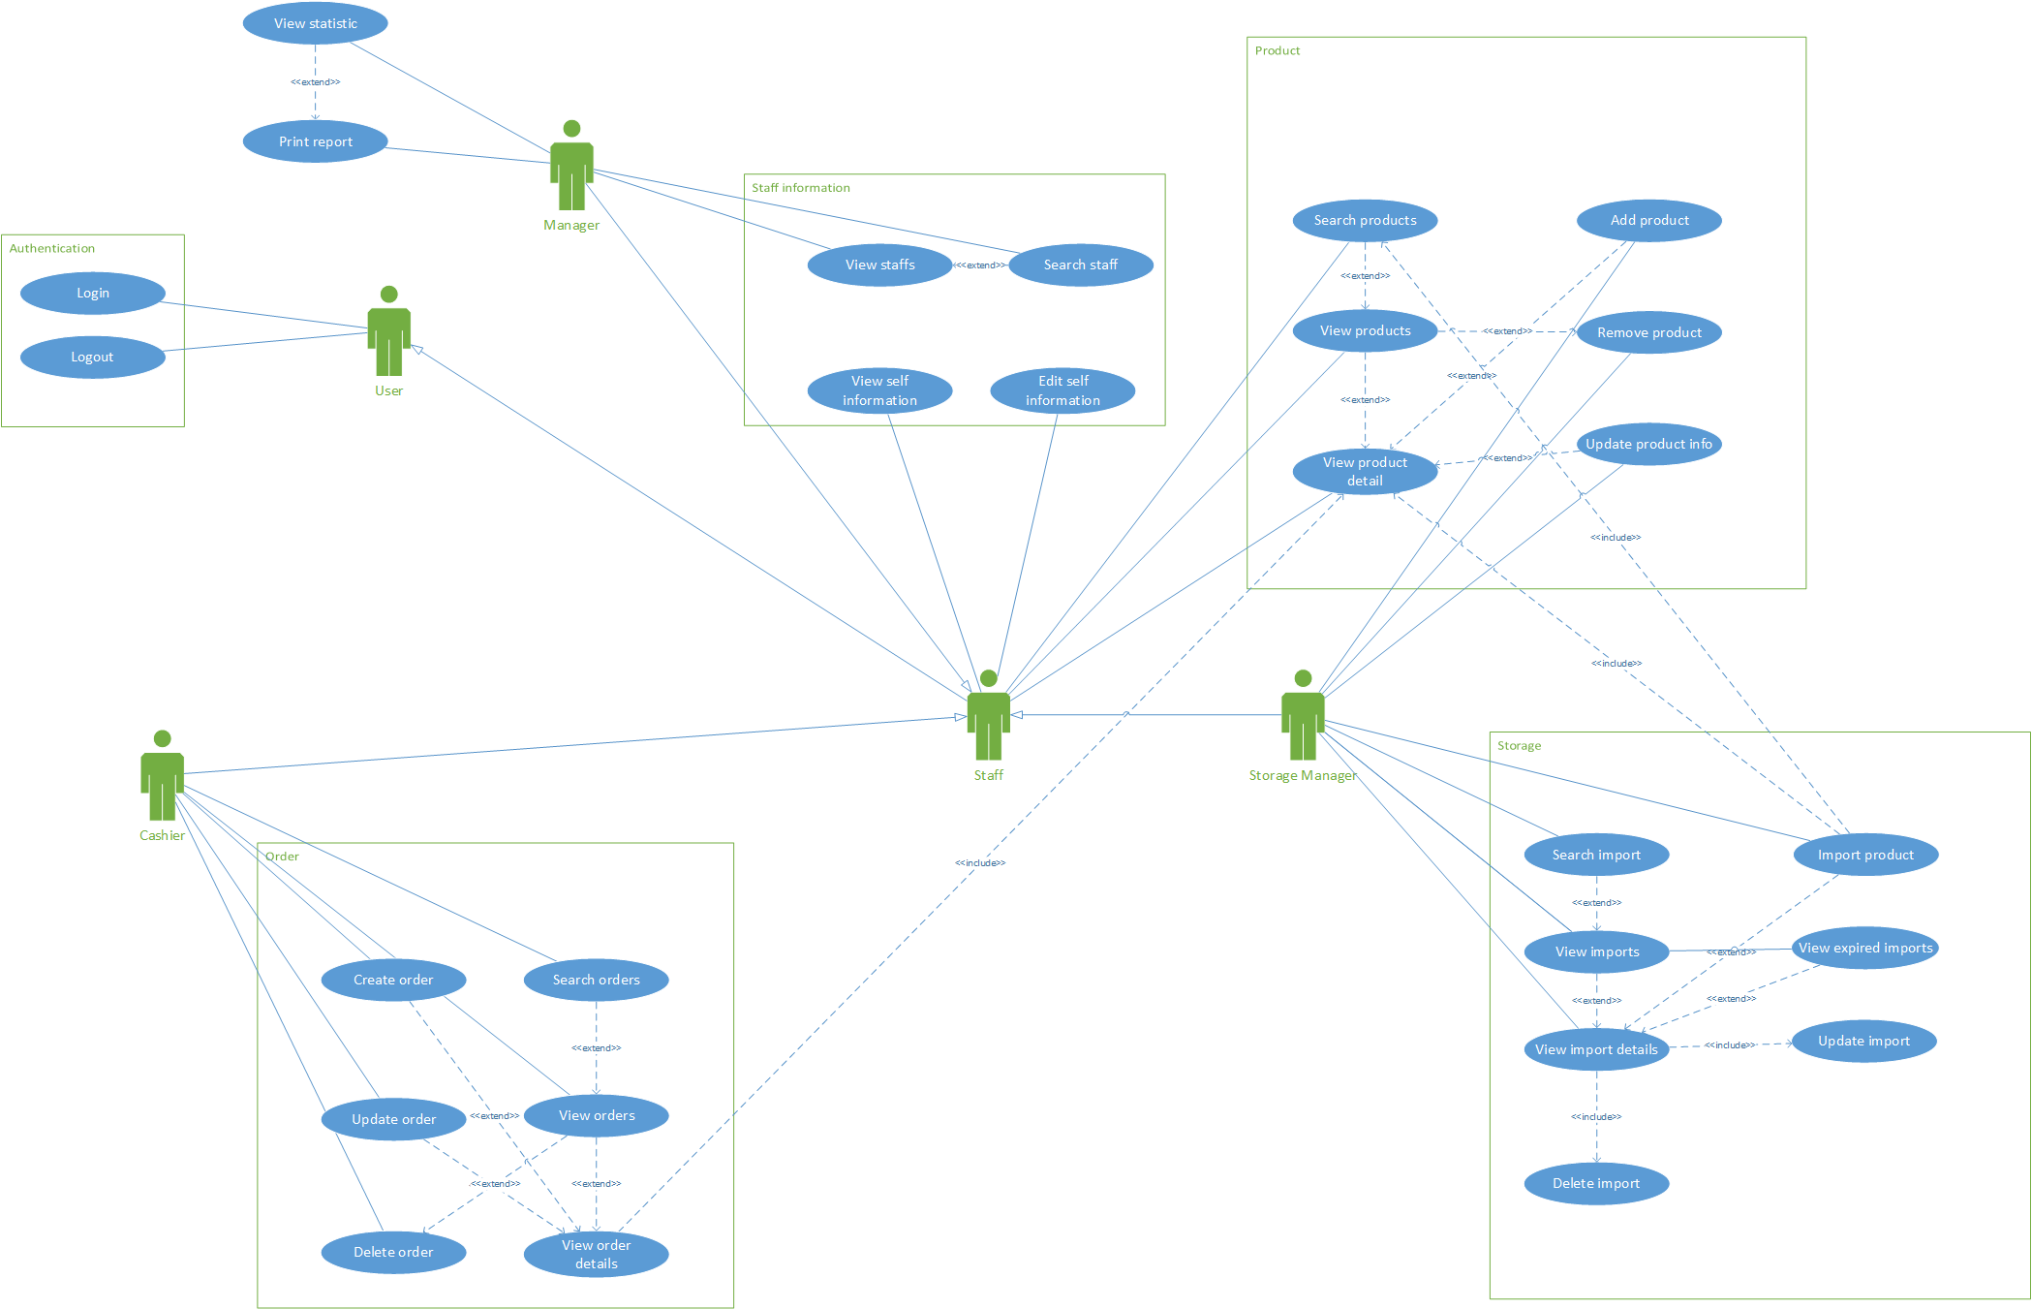
Use-case

Slide 7
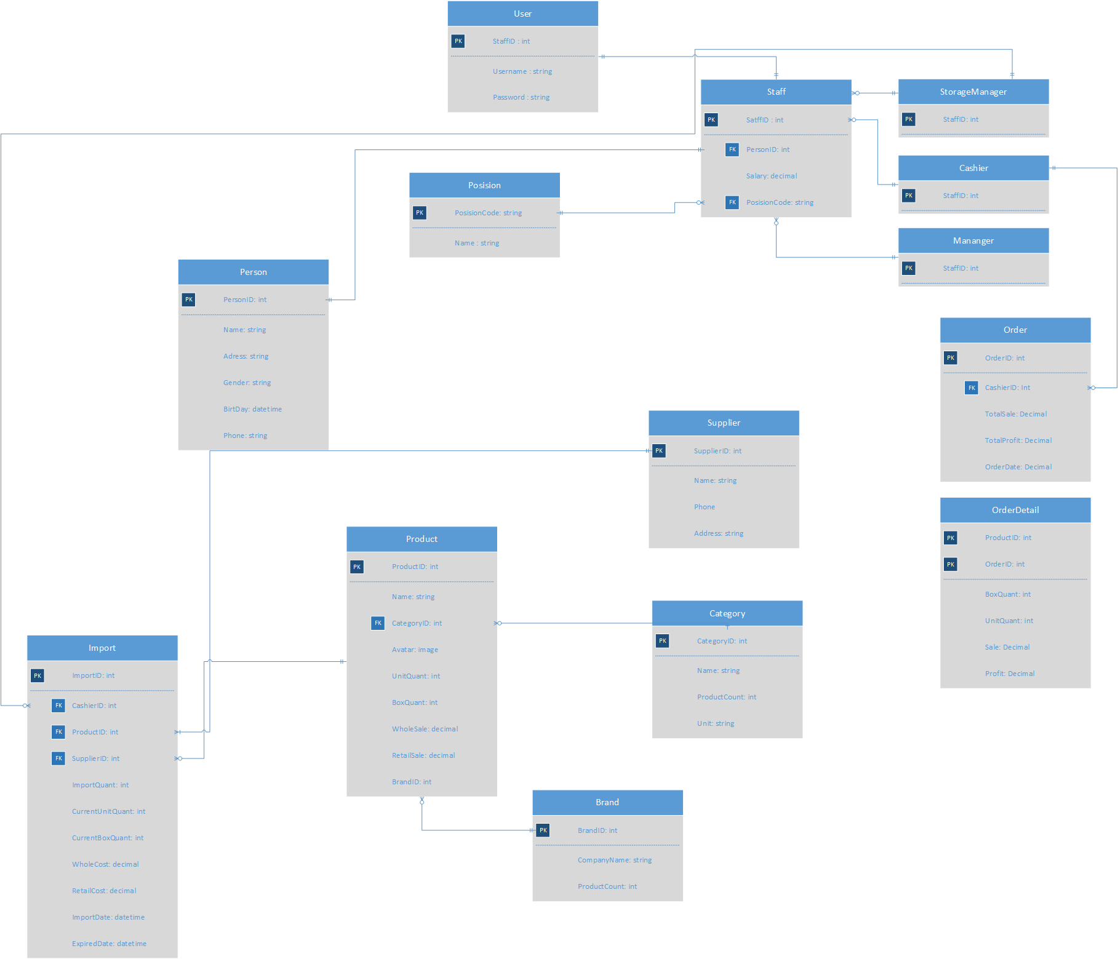
ERD

Slide 8
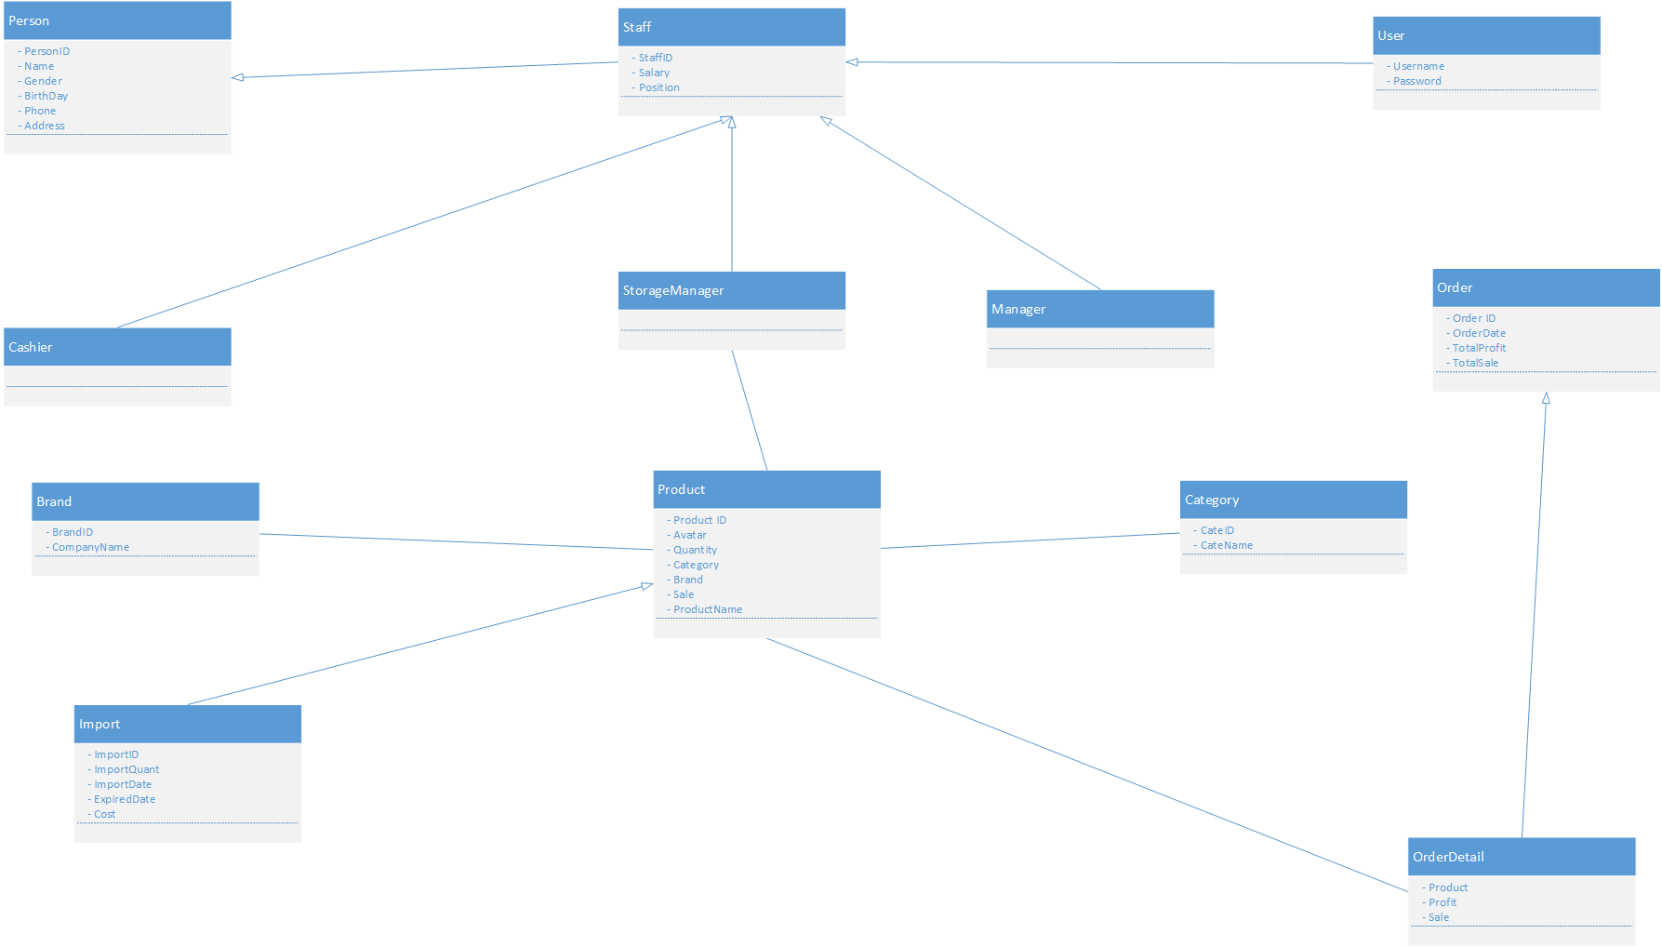
UML

Slide 9
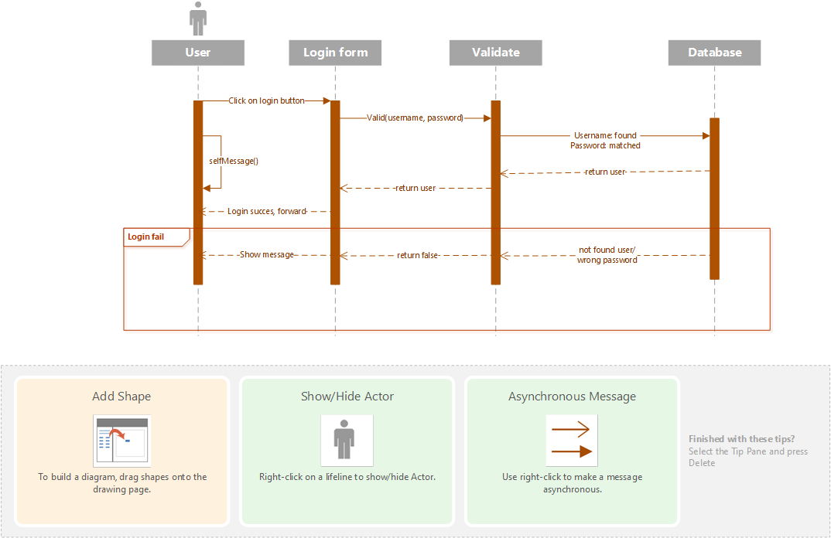
Login Sequence diagram

Slide 10
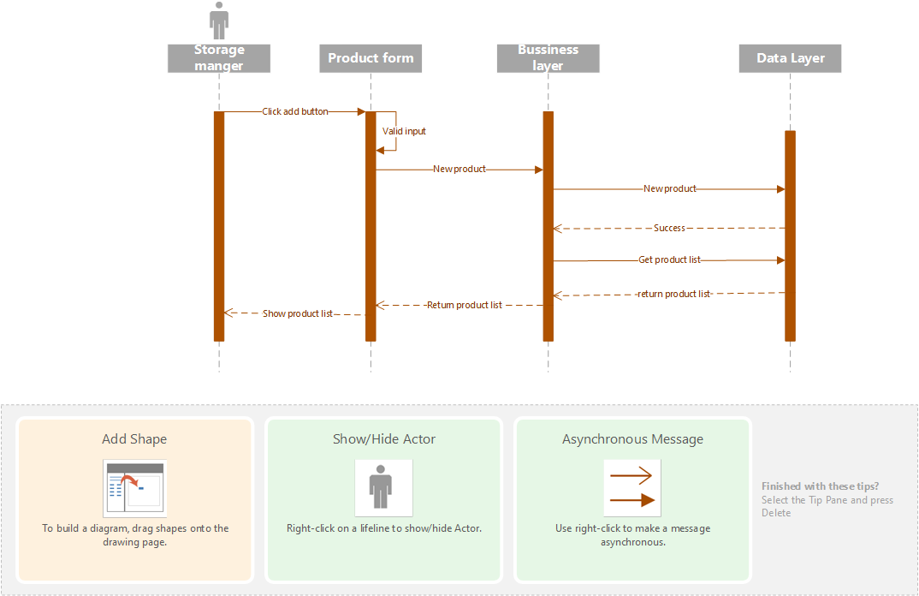
Create product Sequence diagram

Slide 11
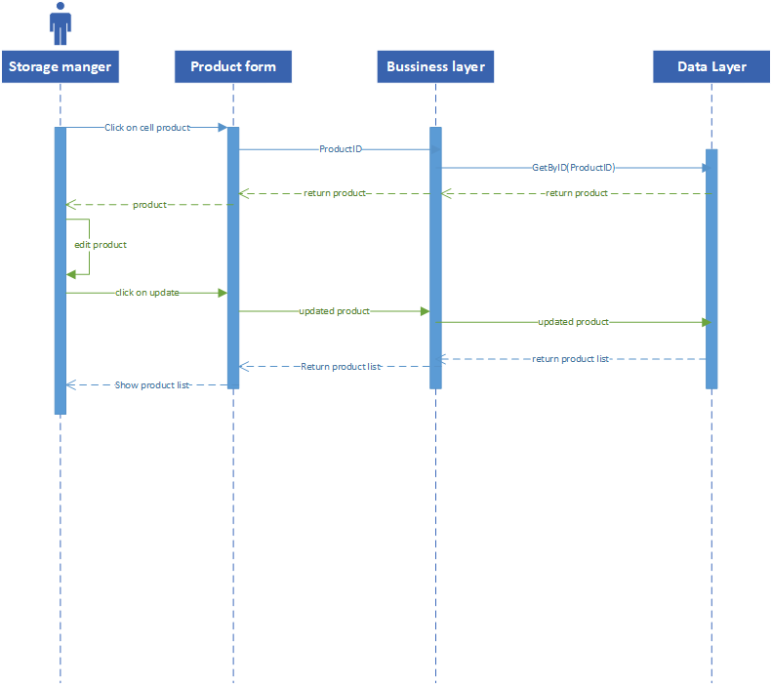
Update product Sequence diagram

Slide 12
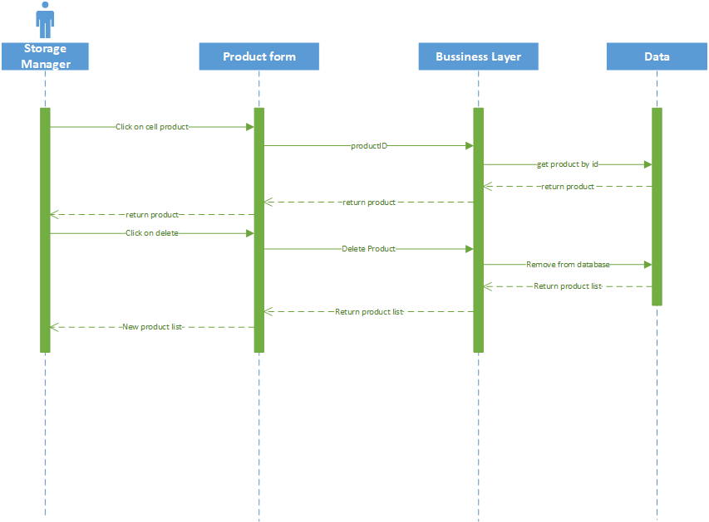
Delete product Sequence diagram

Slide 13
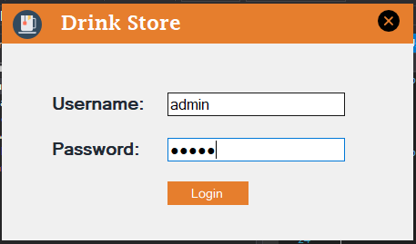
GUI design example

Slide 14
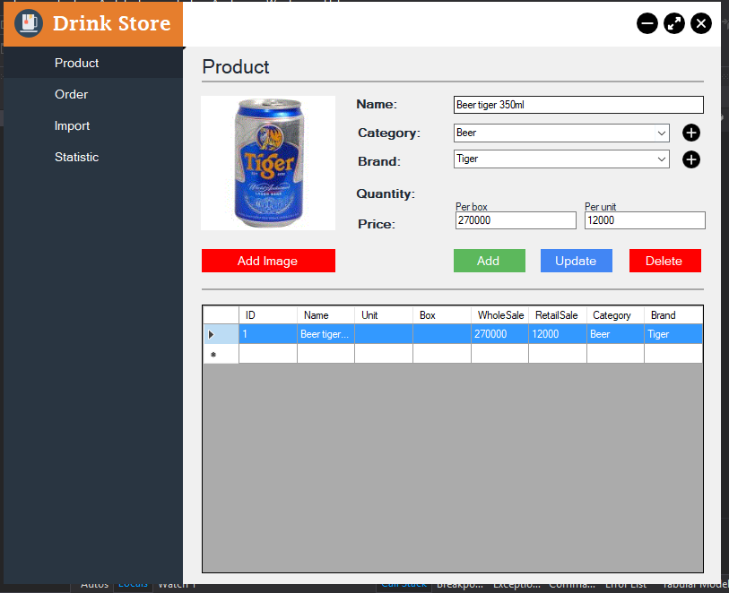
GUI design example

Slide 15
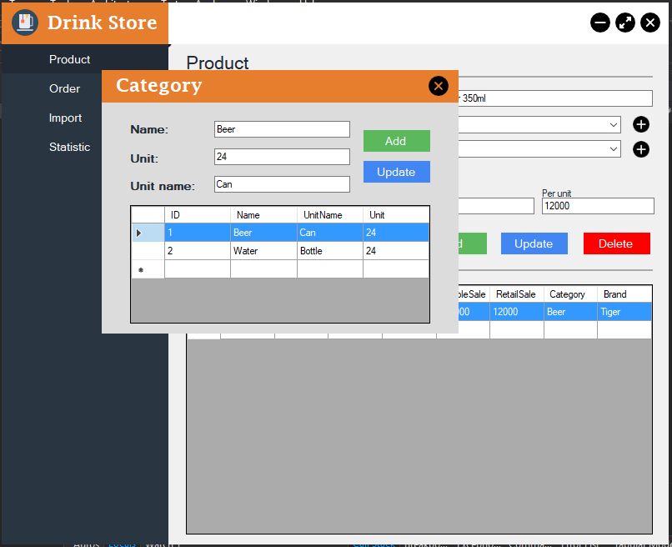
GUI design example

Slide 16
GUI design example

