Slide 1
Group 1 presentation

Slide 2
Introduction
Description: this is a system management for drinking shop
User: Shop owner, shop’s staff
Function: Managing products, staff, storage, sales
Team member:
Phạm Vương Triều (leader)
Hoàng Trọng Việt
Huỳnh Đặng Công Khánh

Slide 3
Requirement
Staff can login to system
For each type of staff, display different function:
Cashier: View products, manage orders
Storage Manager: Manage orders and imports
Manager: Manage staff and above function

Slide 4
Product
View all product
Search product by name, category, brand
Add new product
Update, delete product
Add new category, brand

Slide 5
Import
View all import
Search import by name, product, category, brand supplier
Add new import
Update, delete product
Add new supplier

Slide 6
Order
View all order
Search order by date
Add new order and order details
Update, delete order

Slide 7
Technical
Using Winform on Visual Studio
Datatabase: Microsoft SQL Server
Framework: ADO.net entity
Git control: Github
Project link: https://github.com/pvtrieu/DrinkStore

Slide 8
Member & Task
Task | Person in charge | Status
Use-case diagram | Triều | Complete
ERD diagram | Khánh | Complete
UML diagram | Việt | Complete
GUI designed | Triều | Complete
Database | Khánh | Completed data structure Have some sample data
Model Class | Việt | Complete
Order | Khánh | 50%
Import | Việt | 70%
Product | Triều | 95%
Testing and debug | Triều | Not started yet

Slide 9
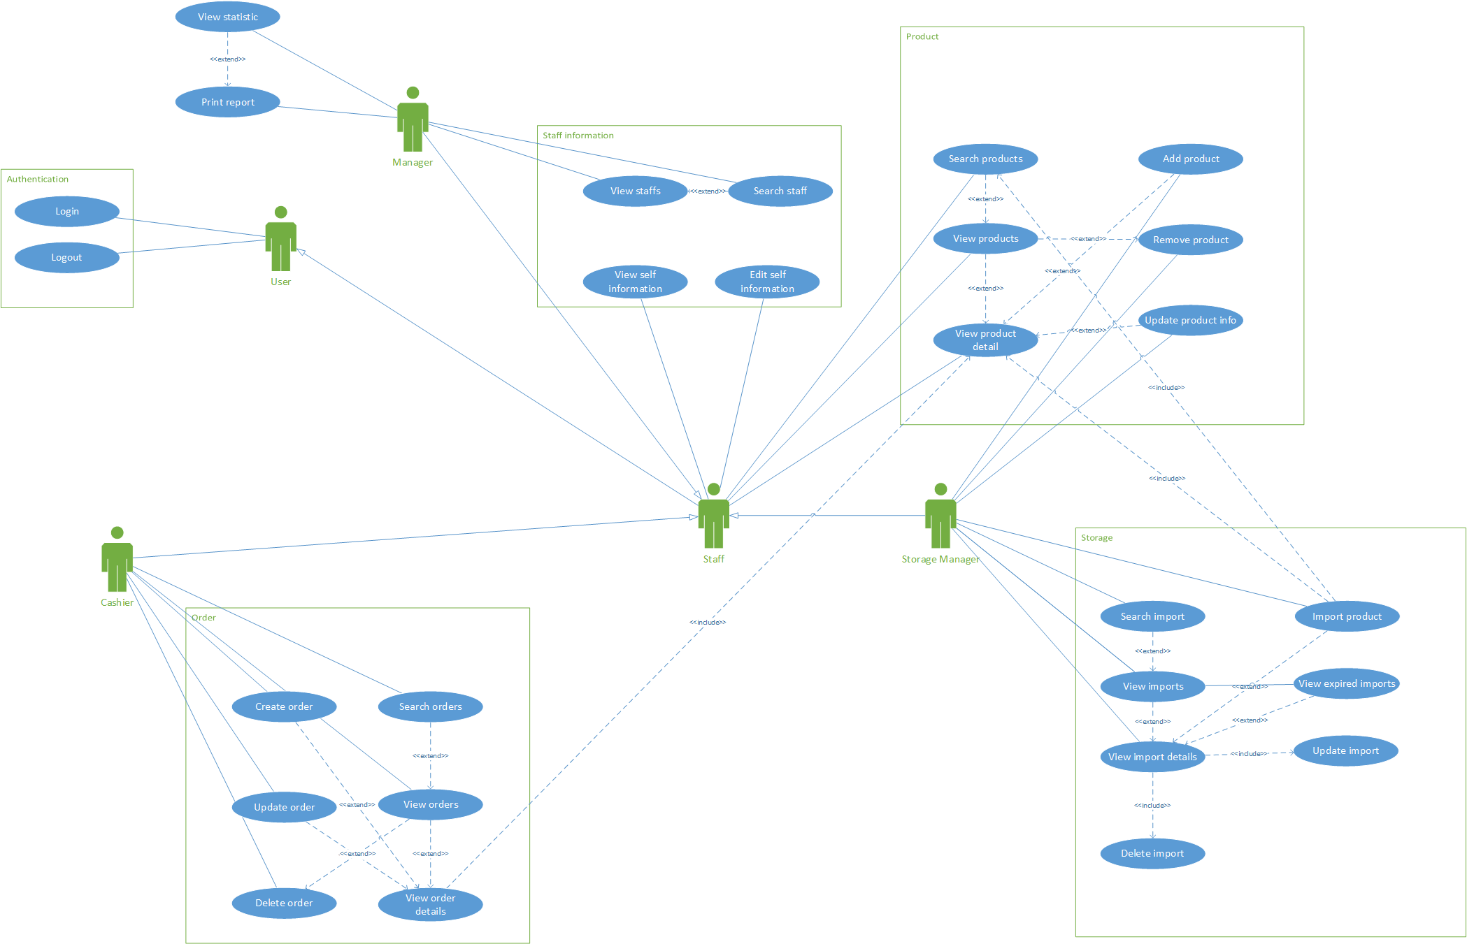
Use-case

Slide 10
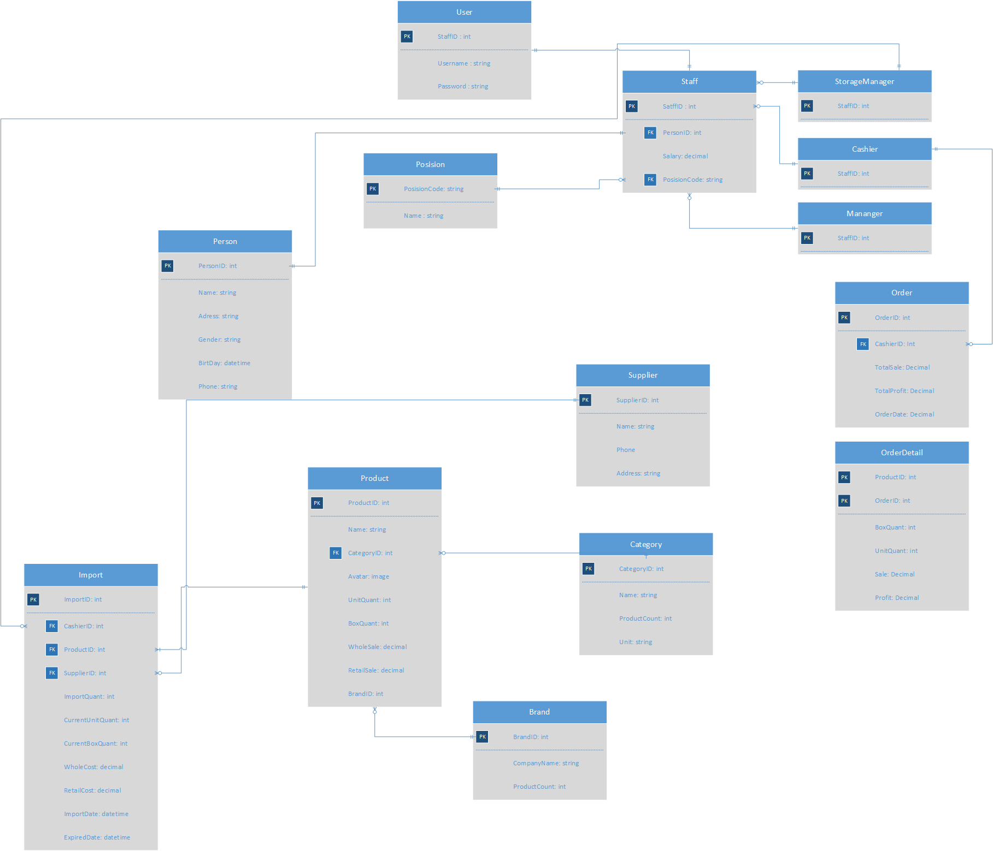
ERD

Slide 11
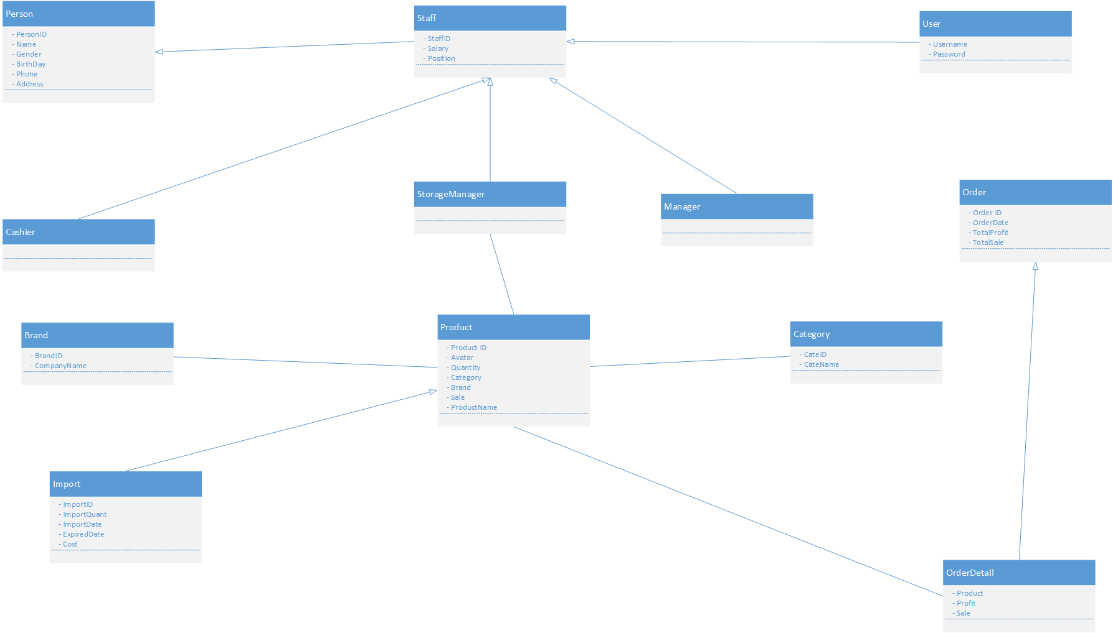
UML

Slide 12
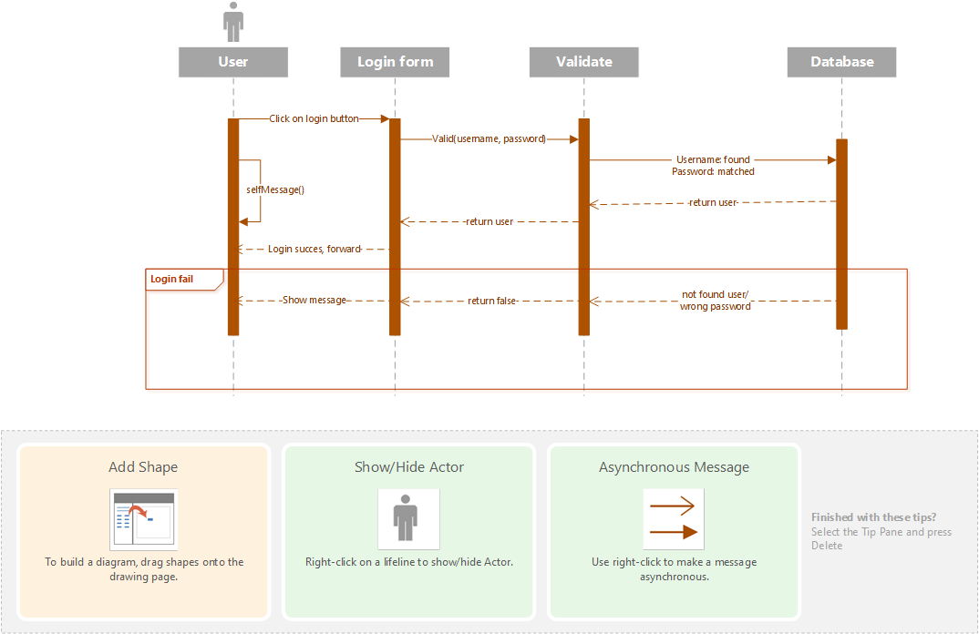
Login Sequence diagram

Slide 13
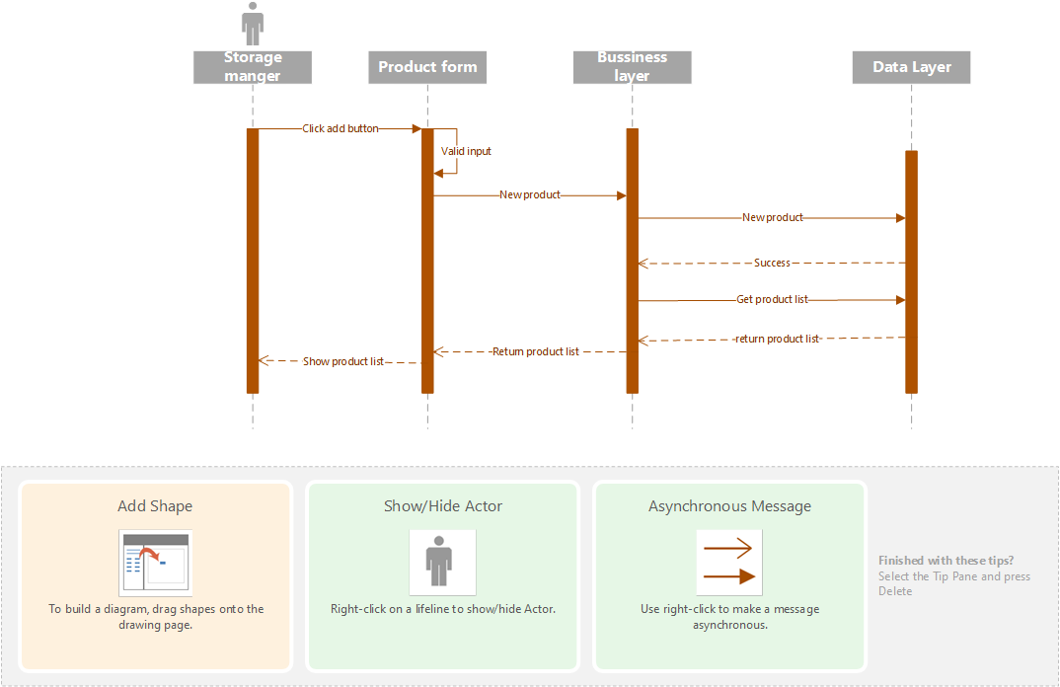
Create product Sequence diagram

Slide 14
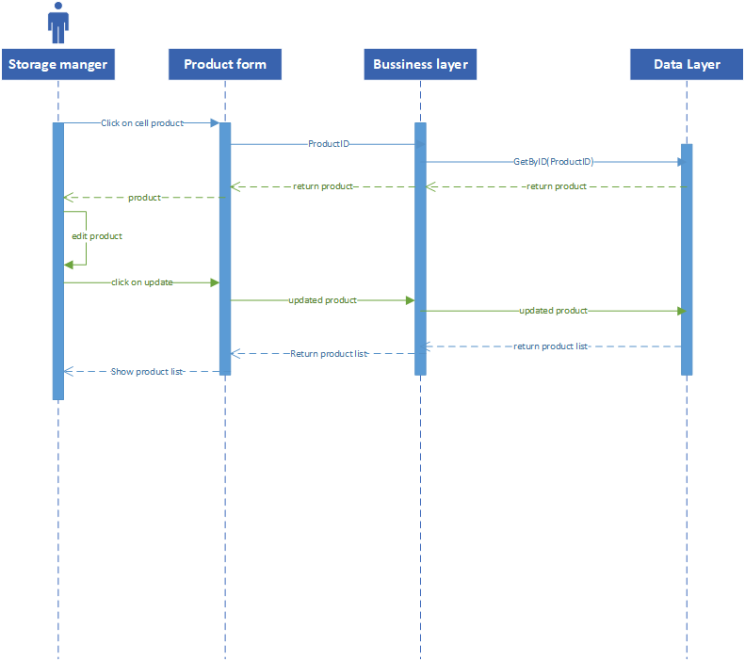
Update product Sequence diagram

Slide 15
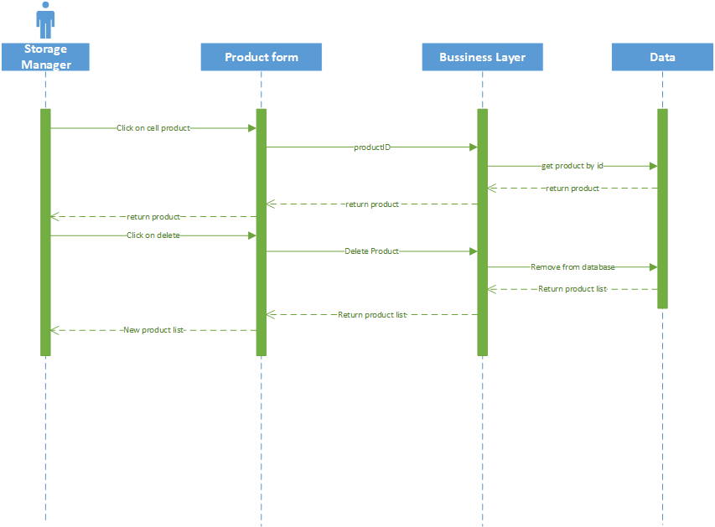
Delete product Sequence diagram

Slide 16
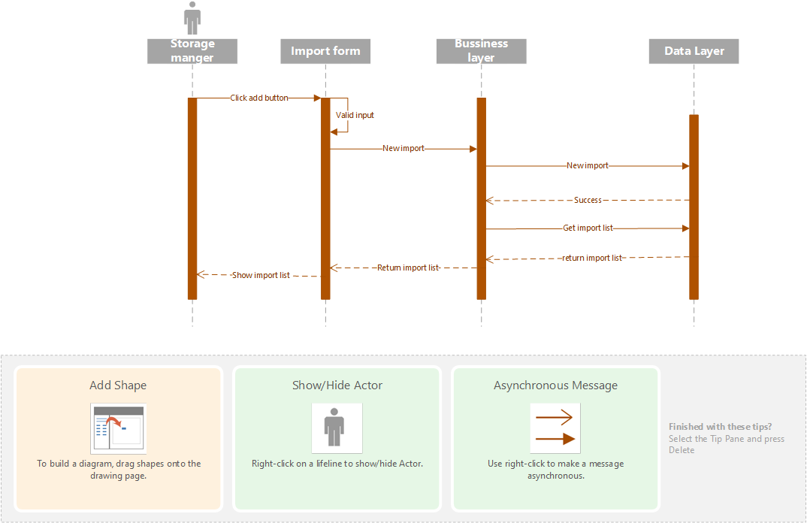
New import sequence diagram

Slide 17


Slide 18
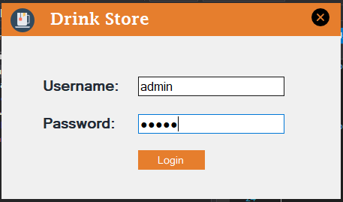
GUI design example

Slide 19
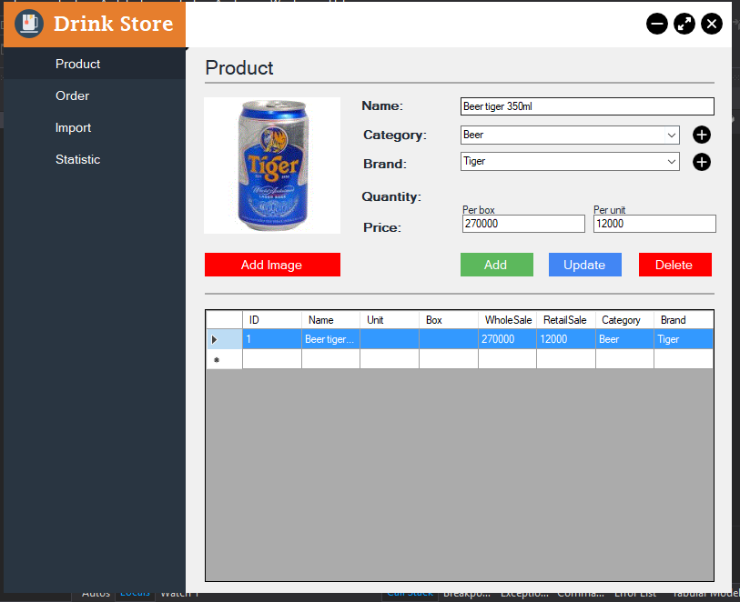
GUI design example

Slide 20
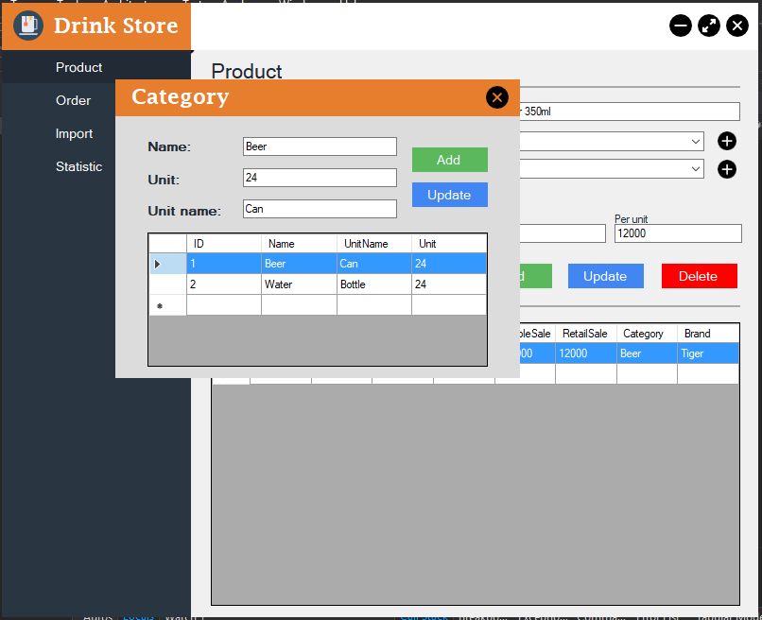
GUI design example

Slide 21
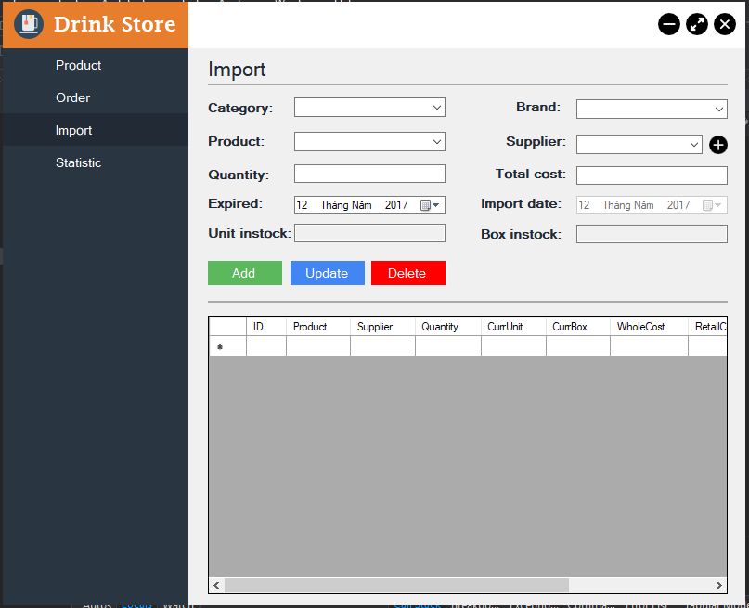
GUI design example

