Slide 1

Version control with Git, Github and Gitlab
Team project workshop
Michal Sojka
ČVUT, CIIRC
8. 3. 2022

Slide 2
Contents
Git
  Basics
  Internals
  Remote repos
  Merge, rebase, conflicts
Forges (Github, Gitlab, Gitea, SourceHut)
Github
  Issues
  Pull Requests
  CI/CD
  External services (codecov, webhooks)
  Github Pages
Presentation available from:
https://github.com/pvty/presentation/

Slide 3
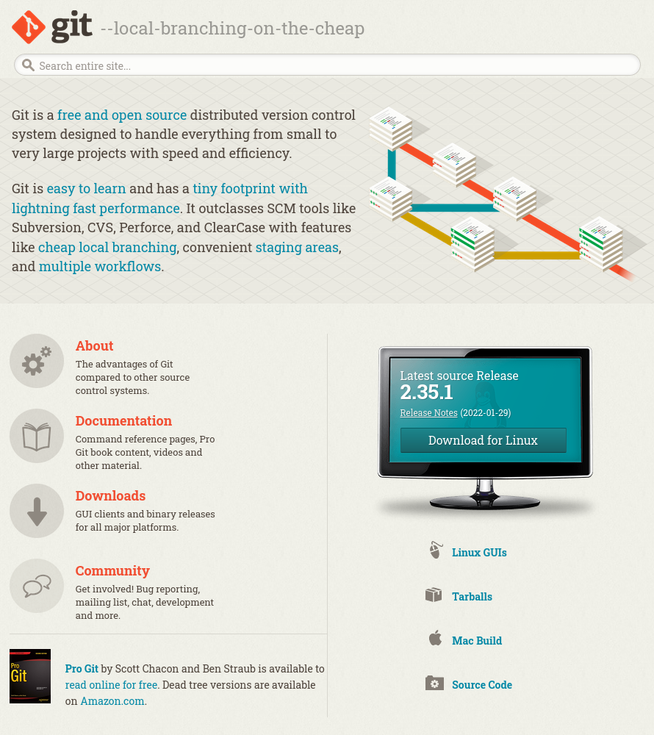
Git – https://git-scm.com/
Version control system
Started by Linux Torvalds for version control of the Linux kernel
Distributed – no need for a central repository (peer-to-peer)
Fast, efficient
Command line tool + many GUIs
  git <subcommand> ...

Slide 4
Git use cases
Source code version management
Documentation (e.g. Markdown)
Wiki
Website
Configuration management
File comparison (advanced diff)
  observing changes in program output
  ...
Storage of virtual machine images...
  extensions like git lfs and git annex

Slide 5
Basics commands (local repo)
Basic commands
  git init – create an empty repository
  git add – add files to index (staging area)
    git add -p
  git commit
  git log
  git diff
    git diff –color-words
  git help, git <command> --help
  git stash
“Built-in” GUI
  git gui – for creating commits
  gitk – history viewer
Branches, tags
  Branch = “pointer” to a commit
    typically the last commit in development history
    creating a commit updates the pointer
  Tag = “fixed pointer” to a commit
    versions, releases
  Merging, rebasing – see later
  git branch
  git checkout/switch
HEAD – points to the currently active commit
  usually same as current branch
  can be detached from a branch (risky)

Slide 6
Working with remote repositories
git clone – create a local copy of a remote repo
git fetch – download updates from remote repo, but don’t modify any local files, commits etc.
git push – push local changes to the remote repo
  diverging branches
  force pushing (--force, --force-with-lease)
git pull – pull remote changes to the local repo
  fetch + merge
git remote – working with multiple remote repos
  upstream (typically read-only)
  personal fork (read-write)
  local CI server
  multiple personal computers
Remote branches
  Each remote has its own branch namespace
  Easy to compare state of repositories
  local branch can be set up to track a remote branch
    git push/pull works automatically
    visible in git branch -vv

Slide 7
Investigating git history
git log ≅ gitk – show history, accepts similar arguments
Specifying revisions and ranges:
  <commit> = hash, branch, tag, ...
  git rev-parse –help
Revisions:
  gitk = gitk HEAD
  gitk HEAD^, gitk HEAD^^ – parent commits
  gitk mybranch~5 – five commits back from mybranch
  gitk main mybranch – show two branches
Ranges
  gitk HEAD~5..HEAD = HEAD~5.. - five last commits
  gitk main..myfeature = gitk myfeature ^main
  Commits in myfeature but not in main.
  Symetrical difference:
  gitk main...myfeature
Filter by file, directory
  gitk ... [--] subdirectory
  Follow file renames:
  gitk --follow dir/file

Slide 8
Git internals
Very efficient storage of history:
  Unpacked Linux 5.16 sources:
    du -sh --exclude=.git: 1.2 GiB
  17 years of Linux development history = 1.06 million commits = 170 commits every day (in average)
    du -sh .git: 2.6 GiB

Slide 9
Git internals – components
Object Database
  collects objects of four types:
    blob,
    tree,
    commit,
    tag
  objects are addressed by SHA1 hash of their content
  individual objects can shown by git cat-file -p <hash-or-similar>
Index (staging area)
  current tree cache
  stores the next revision to be committed

Slide 10
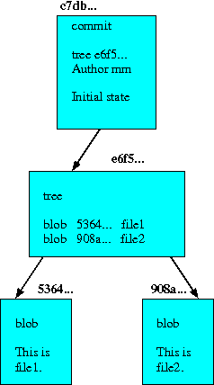
Example: Object Database I.
1. Start with a new repository
2. Create file1 with the content: “This is file1.”
3. Create file2 with the content: “This is file2.”
4. Update the index
5. Make an initial commit

Slide 11
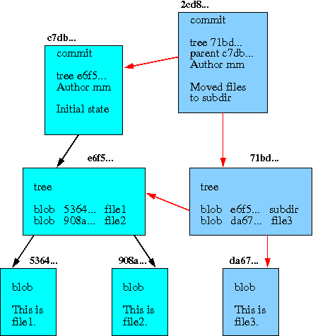
Example: Object Database II.
1. Move file1 and file2 into subdirectory
2. At top level, create file3 with the content: “This is file3.”
3. Update the index
4. Make a commit

Slide 12
Object Database I.
blob object
  represents contents = one version of a file
  if two files in a directory tree (or in multiple different versions of the repository) have the same contents, they will share the same blob object
tree object
  represents one directory
  contains sorted list of text lines with the following information: mode,object type, SHA1, path name
  information about blobs and tree objects lying in the directory
  several tree objects forms hierarchical directory structure

Slide 13
Object Database II.
commit object
  contains by the reference to related tree object, the parent commits, commentary
  sequence of commit objects provides the history
  commit objects tie the directory structures together into a acyclic graph (DAG)
tag object
  assigns symbolic name to particular object reference e.g. commit object associated with a named release
  contains SHA1, object type, symbolic name of referenced object and optionally a signature
Objects are not compressed individually, but together – multiple (similar) versions of the same blob are compressed together ⇒ efficient.

Slide 14
Index
simple binary file, which contains an efficient representation of a virtual directory content
it is implemented by a simple array that associates a set of names, dates, permissions and content (blob) objects together
serves as staging area to prepare commits
helps with merge conflict resolution
improves performance (speed of operations)

Slide 15
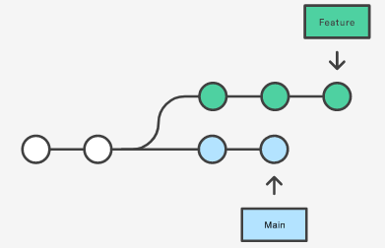
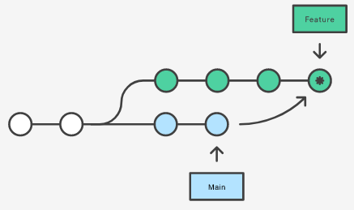
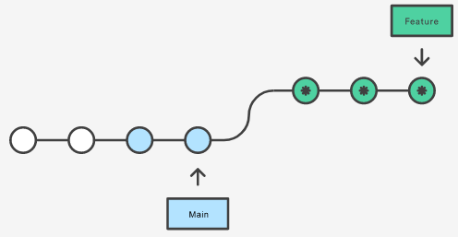
Merging, rebasing, conflicts
git checkout feature
git merge main
  Creates a commit with two parents and merged content
git rebase main
  Moves all commits from feature on top of main
  Don’t use on public branches!!!
git rebase -i
  interactive rebase = editing history (commits, commit messages, ...)
Source: Atlassian

Slide 16
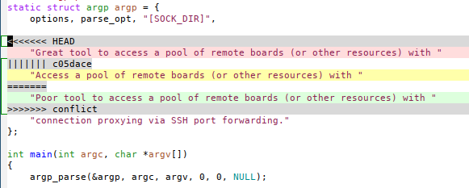
Handling of merge/rebase conflicts
Why conflicts emerge? Two people edit the same piece of code.
Must be resolved manually
Tools can help (e.g. gitk –merge, git mergetool)
git merge branch
Auto-merging src/boardproxy.cpp
CONFLICT (content): Merge conflict in src/boardproxy.cpp
Recorded preimage for 'src/boardproxy.cpp'
Automatic merge failed; fix conflicts and then commit the result.
After merge conflict:
  git merge --abort
  Fix conflict and then:
  git merge - -continue
After rebase conflict:
  git rebase --abort
  git rebase --skip
  Fix conflict and then:
  git rebase --continue

Slide 17



Git forges
Github.com
  proprietary (Microsoft)
  most popular
  single point of failure for open source movement
  Used mostly in the following slides
Gitlab
  open source
  gitlab.com, gitlab.fel.cvut.cz
  feature-wise comparable to github
Gitea
  open source (https://gitea.io/)
  very good for self-hosting (easy to install)
  codeberg.org
sourcehut
  open source
  hacker friendly
  http://sr.ht

Slide 18
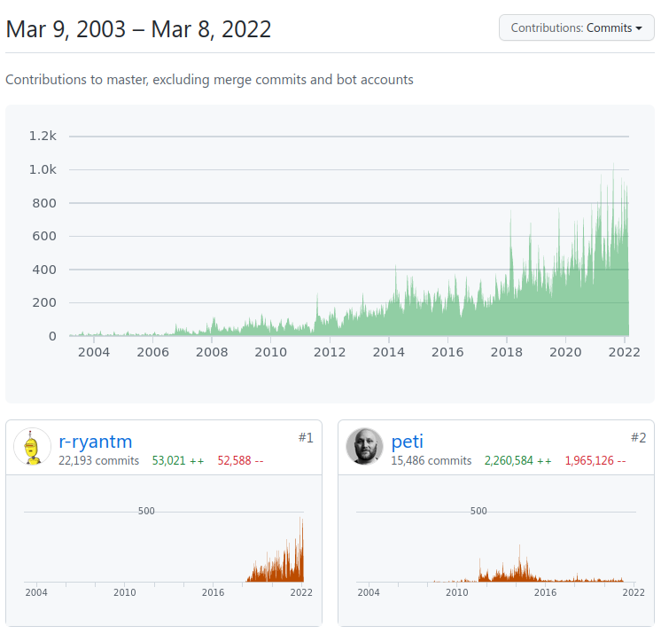
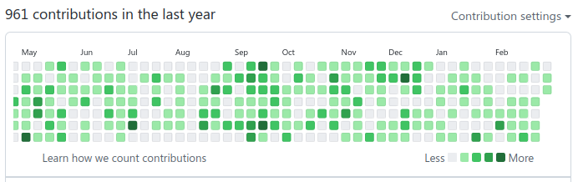
Typical forge features
Organizations/Teams/Repos
Issues/Tickets
Pull requests (Merge requests)
Continuous integration (CI/CD)
Integration with 3rd party tools (webhooks, ...)
Websites (pages), Wiki
Release management
Project management
Development statistics

Slide 19
Repositories
Creating a new repository (few clicks)
  Specify the license for public repos
  (otherwise, nobody can use your project legally)
Forking existing repositories
  Mostly for proposing changes to the original (upstream) repo
Types of repositories on Github
Personal repos: username/reponame
  simple permission management (write or nothing)
Organizations: orgname/reponame
  Team member management
  Role management
  (admin, maintain, write, triage, read)

Slide 20
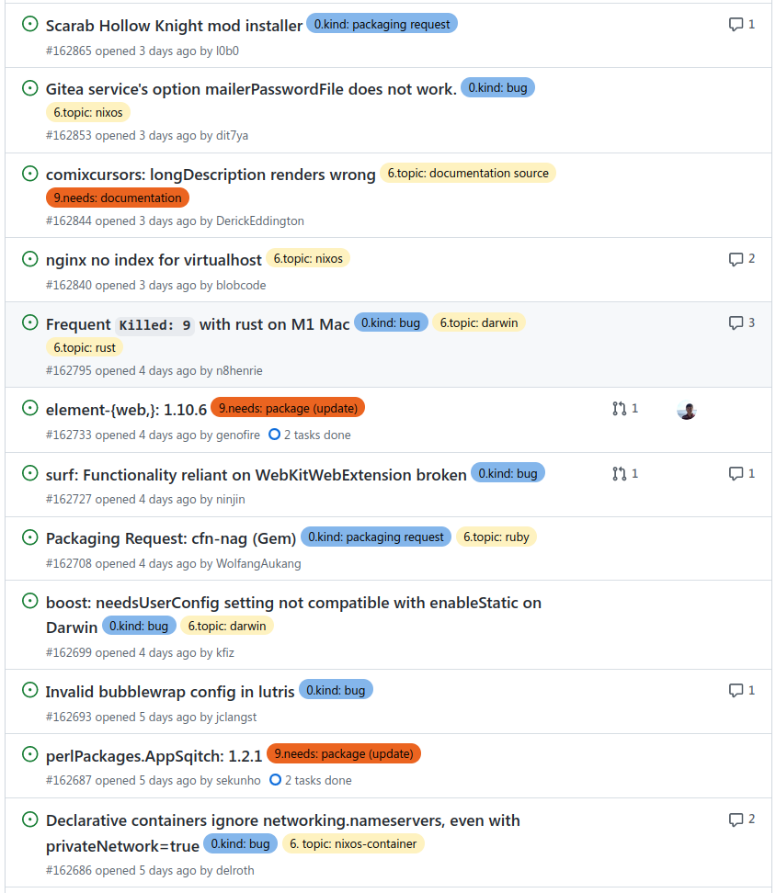
Issues
Communication between users
Templates (documentation)
.github/ISSUE_TEMPLATES/...
Labels (bug, question, ...)
References (documentation)
  to other issues: #NN
  to issues in other projects: owner/repo#NN
Automatic closing of issues with keywords in commits/PRs (documentation):
Closes #13, Fixes #34, ...

Slide 21
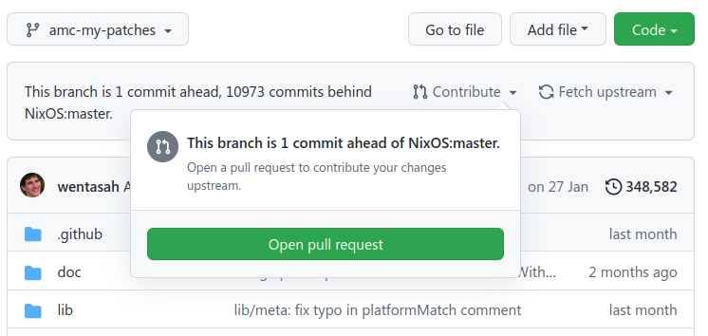
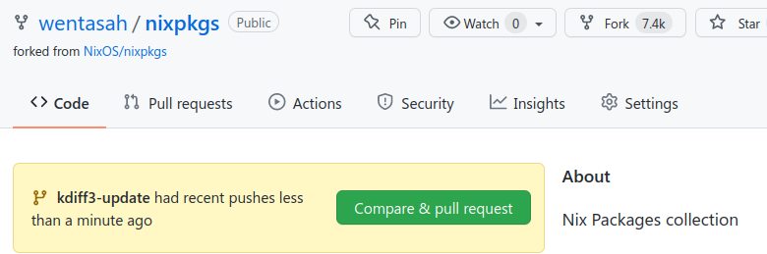
Pull requests (PR, Github), Merge requests (MR, Gitlab)
For proposing changes and discussing about them
Opened via “contribute” link or offered after push:
source branch, destination branch
  same repo
  from fork to upstream repo
Protected branches
  restriction of direct pushes to the branch
  configurable rules:
    Require PR before merging
    Required number of approvals
    CI status

Slide 22
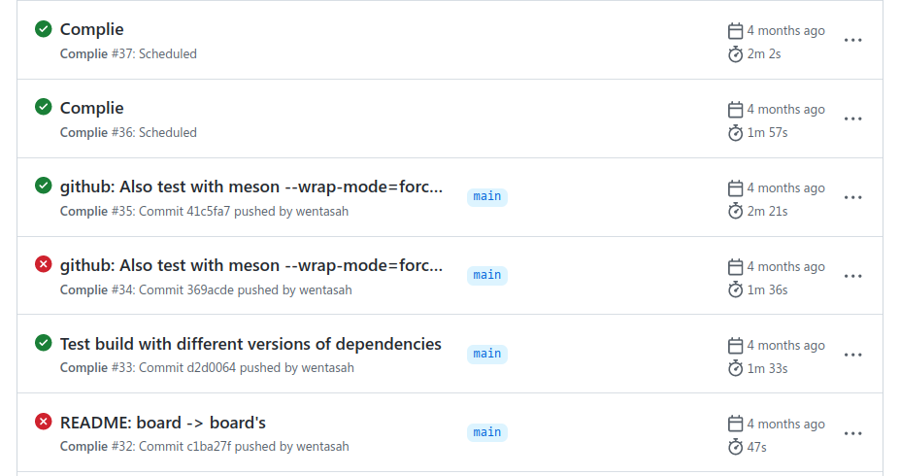
Continuous integration/deployment
Run test suite, checks, ... on every push, PR, time, ...
Github Actions (quickstart docs)
  Configured with a YAML file (doc) in .github/workflows directory in the repo.
    When to run, what to run
    Test matrix (test your code with multiple versions of a dependency)
  Github Actions run in the cloud (2 CPUs, 7 GB RAM) or on self-hosted runners (doc)
  You can execute plain (Linux) commands (run keyword) or whole actions (uses keyword)
Secret management
problem-matchers
Example with a simple (1D) matrix and 3rd-party actions:
https://github.com/wentasah/meson-mode/blob/master/.github/workflows/run-tests.yml
Example with combination of 3rd-party actions and “run” commands:
https://github.com/wentasah/boardproxy/blob/main/.github/workflows/test.yml

Slide 23
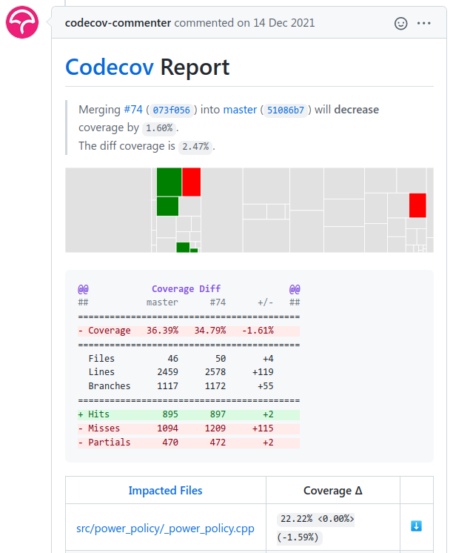
Integration of 3rd-party services
Example: https://codecov.io
Generate test coverage report as a part of your CI
Upload the report to codecov.io:
Example workflow
steps:
- ...
- name: Generate coverage report
run: ninja -C build coverage-xml
- name: Upload coverage to Codecov
uses: codecov/codecov-action@v2
with:
directory: ./build/meson-logs
fail_ci_if_error: true
verbose: true

Slide 24
Gitlab webhook examples
Run a script on every push:https://gitlab.fel.cvut.cz/sojkam1/brute-ae-sync/-/blob/master/gitlab-webhook-receiver.py
Manage issues for osy.pages.fel.cvut.cz
(uses Gitlab HTTP API):
def handle_open_issue(env, event):
gl = gitlab.Gitlab('https://gitlab.fel.cvut.cz', env['GITLAB_API_TOKEN'])
p = gl.projects.get(event['project']['id'])
student = event['user']['username']
teacher = teachers[cviceni[student]]
users = p.users.list(search=teacher)
for u in users: # Find exact username
if u.username == teacher:
user = u
issue = p.issues.get(event['object_attributes']['iid'])
if re.search('přednáška.*slide', event['object_attributes']['title'],
re.IGNORECASE) is not None:
# Přednáška
issue.labels.append('Přednášky')
else:
# Cvičení - přiřaď cvičícího
if not event['object_attributes']['assignee_ids']:
issue.assignee_ids = [user.id]
issue.save()
if event['object_attributes']['confidential']:
issue.notes.create({'body': textwrap.dedent("""
Je opravdu nutné utajovat toto issue? Sdělujete nám
zde svá hesla, čísla platebních karet apod.? Pokud ne,
změňte prosím toto issue na veřejné, aby odpovědi
učitelů byly dostupné i ostatním.
""")})
return True
#!/usr/bin/env python3
import gitlab
cviceni = { ... }
teachers = { .... }
def application(env, start_response):
def handle_event(env, event):
if \
not "HTTP_X_GITLAB_TOKEN" in env \
or env['HTTP_X_GITLAB_TOKEN'] != \
HTTP_X_GITLAB_TOKEN:
return False
if event['object_kind'] == 'issue' and \
event['object_attributes']['action'] == 'open':
return handle_open_issue(env, event)
return True

Slide 25
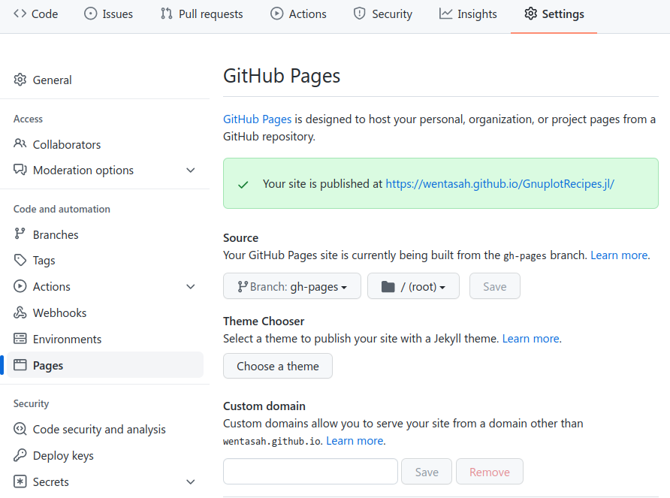
Github/Gitlab pages
Maintain a website in a git repo
  Documentation to a project
  Plain web sites, ...
Content in Markdown (or similar) formats
Every push triggeres CI/CD and updates the web site
Github – Jekyll static site generator
Other SSG: Hugo
Gitlab example: http://osy.pages.fel.cvut.cz/
  CI config with Hugo

