Slide 1
Assessment
Questions to attempt
1 || 2 && 3

Slide 2
Requirements
Document your code properly
Send your ID.zip file with code files in it to
narasimedu@gmail.com

Slide 3
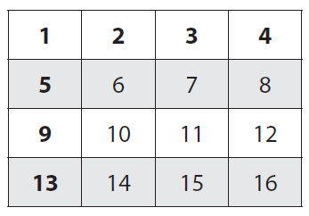
Binary Search in a 2-Dimensional array
Input:
a[n, n], a two dimensional array containing n rows and n columns, where n is a power of 2.
‘item’, which is to be searched in the above array.
Output:
The algorithm prints “Found”, when the element (item) is found in the array otherwise it prints “Not Found”.
Condition:
The given array is sorted such that an element in a particular column in ith row is less than the element in that column in the jth row, where j > i. In addition, an element in the ith column of a particular row is less than the item in the jth column of the same row if j > i.
1<=n,m<=100

Slide 4
Kth Smallest
Write an efficient program to find the k^{th} smallest element in a given list of elements.
0<=n<1000
0<=k<n/2

Slide 5
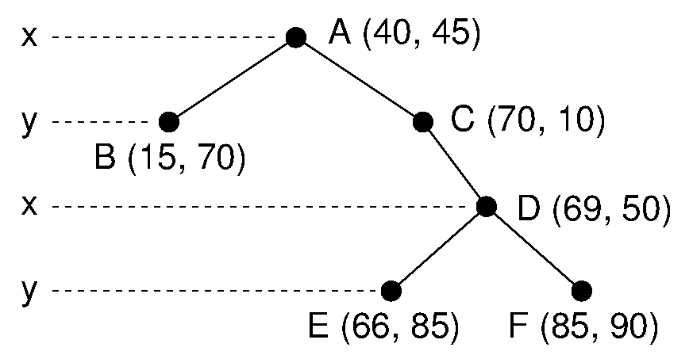
2-D Tree
The 2d tree is a modification to the BST that allows for efficient processing of multi-dimensional search keys. The 2d tree differs from the BST in that each level of the 2d tree makes branching decisions based on a particular search key associated with that level, called the discriminator. We define the discriminator at level i to be (i mod 2) for 2 dimensions.
The x-coordinate field arbitrarily designated key 0, and the y-coordinate field designated key 1. At each level, the discriminator alternates between x and y. Thus, a node N at level 0 (the root) would have in its left subtree only nodes whose x values are less than Nx. The right subtree would contain nodes whose x values are greater than Nx. A node M at level 1 would have in its left subtree only nodes whose y values are less than My. There is no restriction on the relative values of Mx and the x values of M ‘s descendants, because branching decisions made at M are based solely on the y coordinate
Write a program to insert an elements into the 2d-tree and print elements in inorder traversal
0 <= n < 50
0 <= x,y <=10⁵

