Slide 1
Charity Data Analysis
Vu Viet Hoang Pham - 2022

Slide 2
The problem of donor churn
Total number: 24,589 churns
Duration for the churns: 31 years, from 1989 to 2020
Average number per year: About 793 churns
Total amount lost per year: About $190,366
  Suppose that the amount for each donation per month is $20
  Total amount lost per year due to the churns = average number of churns per year * 12 months * $20 per month = 793 * 12 * 20 = $190,366

Slide 3
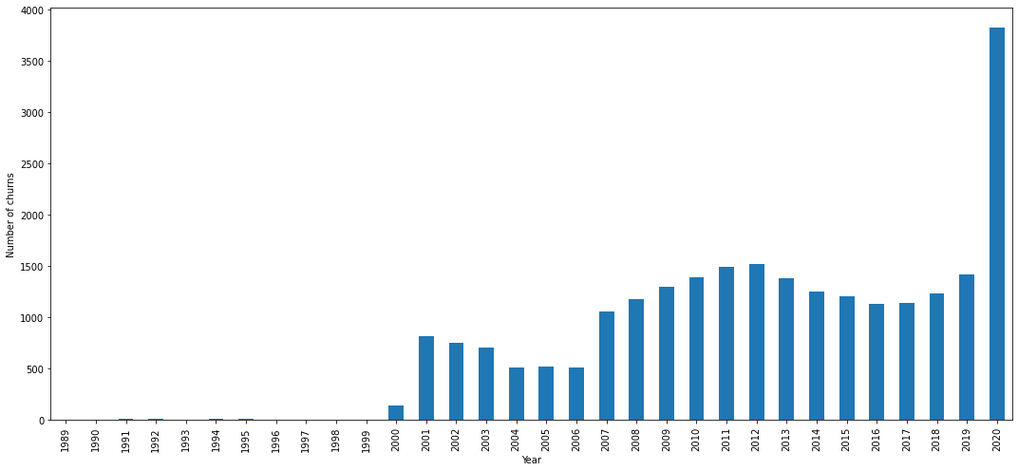
The progress of churns over time
Churns are worse over time
Significant increase since 2001
Number of churns was sharply increased from about 1,500 in 2019 to nearly 4,000 in 2020

Slide 4
Downgrade and churns
Number of churns after a downgrade: 296 churns
Although it is a small number, we may need to follow up the cases of Downgrade to avoid unnecessary churns

Slide 5
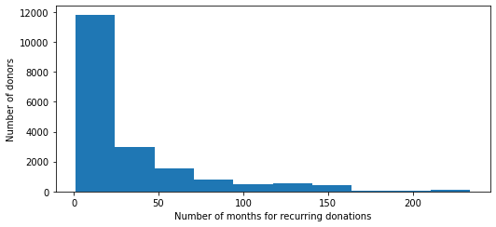
The duration for recurring donations
Average number of months for recurring donations: 32.2 months
Thus, we may need to follow up with donors who have their donations over continuous 30 months

Slide 6
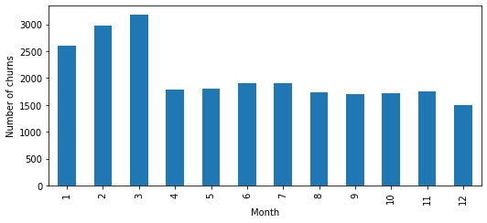
The churns over months
Churns in January, February, and March are significantly more than those in other months
Thus, we may also need to focus on these months

Slide 7
Summary
The problem of donor churns is big, and it is increasingly worser over time
To solve the problem, we may need (i.e., based on the data I have)
  Follow up the cases of Downgrade to avoid unnecessary churns
  Follow up with donors who have their donations over continuous 30 months
  Focus on January, February, and March
If I have more data about donors, I can
  Use machine learning methods to identify what variables which have effects on the churns
  Build networks (e.g. donor networks based on social networks) to identify critical donors, which might not only help to reduce churns, but also help to increase the number of new donors

