Slide 1
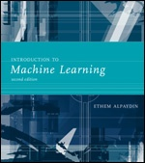
INTRODUCTION TO Machine Learning 2nd Edition
Lecture Slides for
ETHEM ALPAYDIN
© The MIT Press, 2010
alpaydin@boun.edu.tr
http://www.cmpe.boun.edu.tr/~ethem/i2ml2e

Slide 2
CHAPTER 1: Introduction

Slide 3
Why “Learn” ?
Machine learning is programming computers to optimize a performance criterion using example data or past experience.
There is no need to “learn” to calculate payroll
Learning is used when:
Human expertise does not exist (navigating on Mars),
Humans are unable to explain their expertise (speech recognition)
Solution changes in time (routing on a computer network)
Solution needs to be adapted to particular cases (user biometrics)

Slide 4
What We Talk About When We Talk About“Learning”
Learning general models from a data of particular examples
Data is cheap and abundant (data warehouses, data marts); knowledge is expensive and scarce.
Example in retail: Customer transactions to consumer behavior:
People who bought “Blink” also bought “Outliers” (www.amazon.com)
Build a model that is a good and useful approximation to the data.

Slide 5
Data Mining
Retail: Market basket analysis, Customer relationship management (CRM)
Finance: Credit scoring, fraud detection
Manufacturing: Control, robotics, troubleshooting
Medicine: Medical diagnosis
Telecommunications: Spam filters, intrusion detection
Bioinformatics: Motifs, alignment
Web mining: Search engines
...

Slide 6
What is Machine Learning?
Optimize a performance criterion using example data or past experience.
Role of Statistics: Inference from a sample
Role of Computer science: Efficient algorithms to
Solve the optimization problem
Representing and evaluating the model for inference

Slide 7
Applications
Association
Supervised Learning
Classification
Regression
Unsupervised Learning
Reinforcement Learning

Slide 8
Learning Associations
Basket analysis:
P (Y | X ) probability that somebody who buys X also buys Y where X and Y are products/services.
Example: P ( chips | beer ) = 0.7

Slide 9
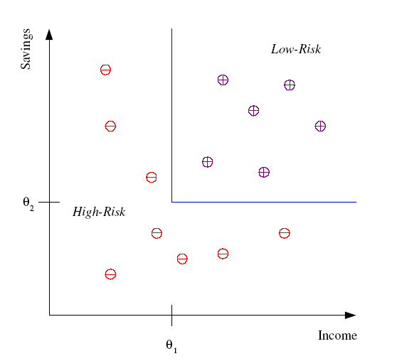
Classification
Example: Credit scoring
Differentiating between low-risk and high-risk customers from their income and savings
Discriminant: IF income > θ₁ AND savings > θ₂
THEN low-risk ELSE high-risk

Slide 10
Classification: Applications
Aka Pattern recognition
Face recognition: Pose, lighting, occlusion (glasses, beard), make-up, hair style
Character recognition: Different handwriting styles.
Speech recognition: Temporal dependency.
Medical diagnosis: From symptoms to illnesses
Biometrics: Recognition/authentication using physical and/or behavioral characteristics: Face, iris, signature, etc
...

Slide 11








Face Recognition
Training examples of a person
Test images
ORL dataset,
AT&T Laboratories, Cambridge UK

Slide 12
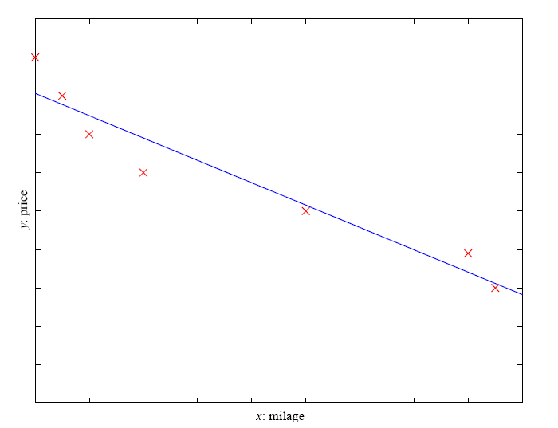
Regression
Example: Price of a used car
x : car attributes
y : price
y = g (x | θ )
g ( ) model,
θ parameters
y = wx+w₀

Slide 13
Regression Applications
Navigating a car: Angle of the steering
Kinematics of a robot arm
(x,y)
α₁= g₁(x,y)
α₂= g₂(x,y)
α₂
α₁
Response surface design

Slide 14
Supervised Learning: Uses
Prediction of future cases: Use the rule to predict the output for future inputs
Knowledge extraction: The rule is easy to understand
Compression: The rule is simpler than the data it explains
Outlier detection: Exceptions that are not covered by the rule, e.g., fraud

Slide 15
Unsupervised Learning
Learning “what normally happens”
No output
Clustering: Grouping similar instances
Example applications
Customer segmentation in CRM
Image compression: Color quantization
Bioinformatics: Learning motifs

Slide 16
Reinforcement Learning
Learning a policy: A sequence of outputs
No supervised output but delayed reward
Credit assignment problem
Game playing
Robot in a maze
Multiple agents, partial observability, ...

Slide 17
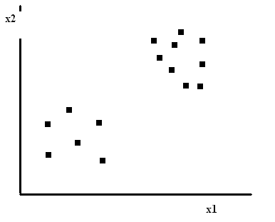
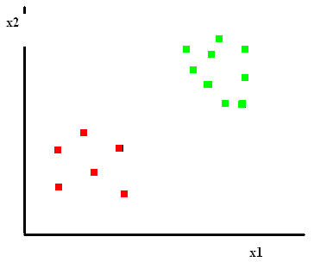
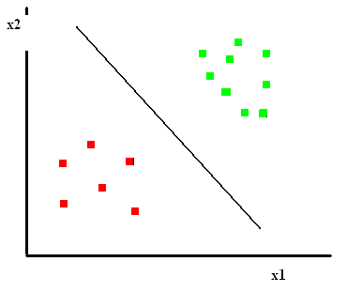
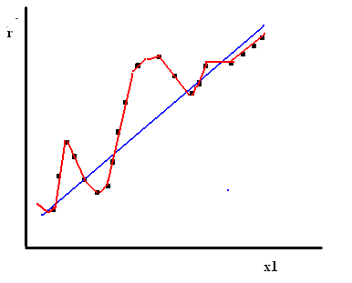
ML Aplications
Unsupervised
Supervised
Classification
Regression

Slide 18
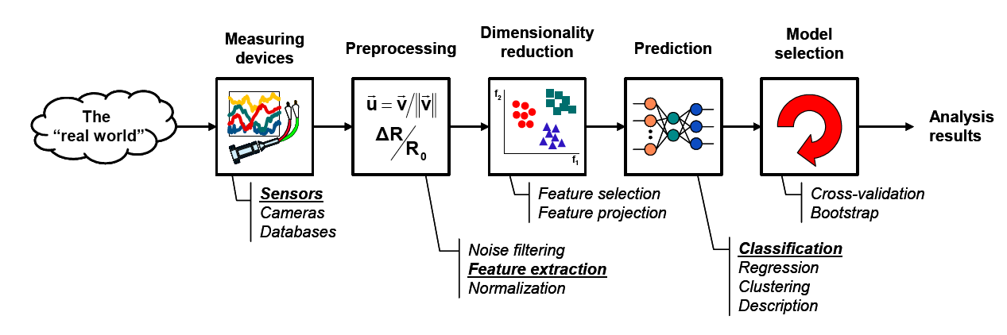
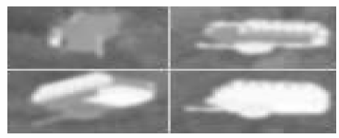
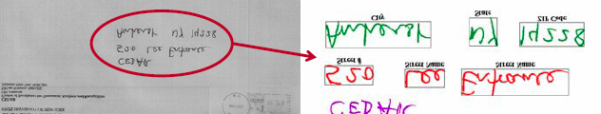
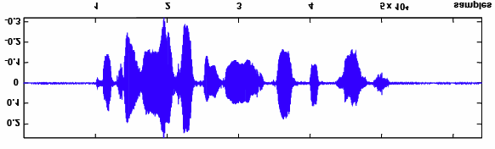
Components of a PR System
A basic pattern classification system contains
A sensor, preprocessing and feature extraction mechanism (manual or automated)
Dimensionality reduction step
A classification (regression, clustering, description) algorithm
Model selection mechanism (Cross validation or bootstrap)
A set of examples (training set) already classified or described

Slide 19
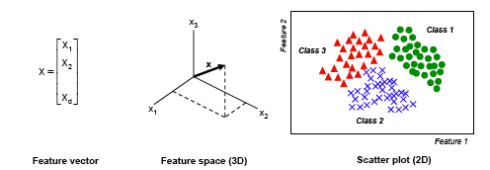
Features and patterns (1)
Feature is any distinctive aspect, quality or characteristic
Features may be symbolic (i.e., color) or numeric (i.e., height)
The combination of d features is represented as a d-dimensional column vector called a feature vector
The d-dimensional space defined by the feature vector is called the feature space
Objects are represented as points in feature space. This representation is called a scatter plot
Pattern is a composite of traits or features characteristic of an individual
In classification tasks, a pattern is a pair of variables {x,r} where
x is a collection of observations or features (feature vector)
r is the concept behind the observation (label) (sometimes we will use t instead of r)

Slide 20
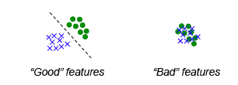
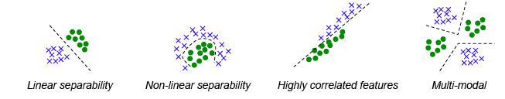
Features and patterns (2)
What makes a “good” feature vector?
The quality of a feature vector is related to its ability to discriminate examples from different classes
Examples from the same class should have similar feature values
Examples from different classes have different feature values

Slide 21
PR design cycle
Data collection
Probably the most time-intensive component of a PR project
How many examples are enough?
Feature choice
Critical to the success of the PR problem
“Garbage in, garbage out”
Requires basic prior knowledge
Model choice
Statistical, neural and structural approaches
Parameter settings
Training
Given a feature set and a “blank” model, adapt the model to explain the data
Supervised, unsupervised and reinforcement learning
Evaluation
How well does the trained model do?
Overfitting vs. generalization

Slide 22
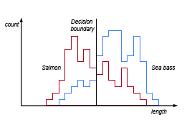
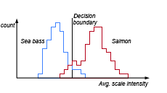
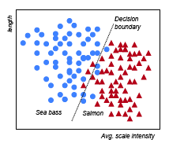
Feature Selection
(Salmon vs Sea Bass Recognition Problem)
Length
Avg. scale intensity
Length and Avg. scale intensity

Slide 23
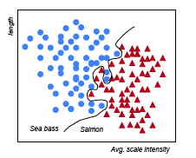
Model Selection
(Salmon vs Sea Bass Recognition Problem)
Linear Discriminant Function
Performance: 95.7%
Nonlinear (Neural Network) Function
Performance: 99.9%
Which model should we use?
Training vs. Test performance.

Slide 24
Resources: Datasets
UCI Repository: http://www.ics.uci.edu/~mlearn/MLRepository.html
UCI KDD Archive: http://kdd.ics.uci.edu/summary.data.application.html
Statlib: http://lib.stat.cmu.edu/
Delve: http://www.cs.utoronto.ca/~delve/

Slide 25
Resources: Journals
Journal of Machine Learning Research
Machine Learning
Neural Computation
Neural Networks
IEEE Transactions on Neural Networks
IEEE Transactions on Pattern Analysis and Machine Intelligence
Annals of Statistics
Journal of the American Statistical Association
...

Slide 26
Resources: Conferences
International Conference on Machine Learning (ICML)
European Conference on Machine Learning (ECML)
Neural Information Processing Systems (NIPS)
Uncertainty in Artificial Intelligence (UAI)
Computational Learning Theory (COLT)
International Conference on Artificial Neural Networks (ICANN)
International Conference on AI & Statistics (AISTATS)
International Conference on Pattern Recognition (ICPR)
...

Slide 27
Resources: Video Lectures
Lectures:
Yaser S. Abu-Mostafa:
http://work.caltech.edu/telecourse.html
Andrew Ng:http://www.academicearth.org/courses/machine-learning
http://see.stanford.edu/see/lecturelist.aspx?coll=348ca38a-3a6d-4052-937d-cb017338d7b1
Tom Mitchell:http://www.cs.cmu.edu/~tom/10701_sp11/lectures.shtml
Anil Jain:
http://ocw.korea.edu/ocw/college-of-engineering/introduction-to-pattern-recognition
….
Latest topics:
http://videolectures.net/Top/Computer_Science/Machine_Learning/

