Slide 1

INTRODUCTION TO Machine Learning 2nd Edition
Lecture Slides for
ETHEM ALPAYDIN
© The MIT Press, 2010
alpaydin@boun.edu.tr
http://www.cmpe.boun.edu.tr/~ethem/i2ml2e

Slide 2
CHAPTER 11: Multilayer Perceptrons

Slide 3
Neural Networks
Networks of processing units (neurons) with connections (synapses) between them
Large number of neurons: 10¹⁰
Large connectitivity: 10⁵
Parallel processing
Distributed computation/memory
Robust to noise, failures

Slide 4
Understanding the Brain
Levels of analysis (Marr, 1982)
Computational theory
Representation and algorithm
Hardware implementation
Reverse engineering: From hardware to theory
Parallel processing: SIMD vs MIMD
Neural net: SIMD with modifiable local memory
Learning: Update by training/experience

Slide 5
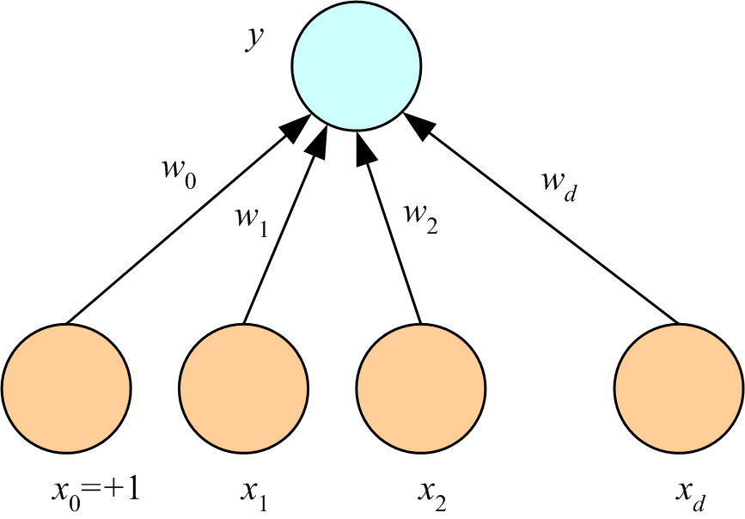
Perceptron
(Rosenblatt, 1962)

Slide 6
What a Perceptron Does
Regression: y=wx+w₀
Classification: y=1(wx+w₀>0)
y
y
s
y
w₀
w
w₀
w
x
w₀
x
x
x₀=+1

Slide 7
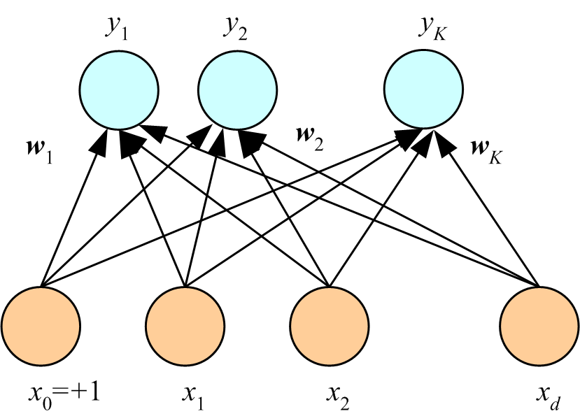
K Outputs
Regression:
Classification:

Slide 8
Training
Online (instances seen one by one) vs batch (whole sample) learning:
No need to store the whole sample
Problem may change in time
Wear and degradation in system components
Stochastic gradient-descent: Update after a single pattern
Generic update rule (LMS rule):

Slide 9
Training a Perceptron: Regression
Regression (Linear output):

Slide 10
Classification
Single sigmoid output
K>2 softmax outputs

Slide 11
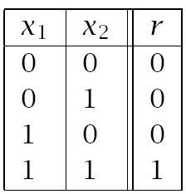
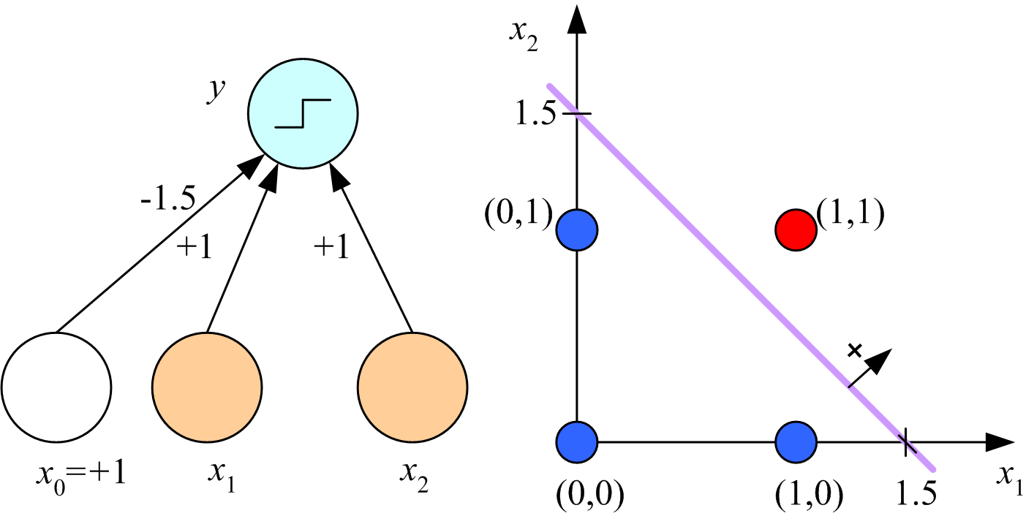
Learning Boolean AND

Slide 12
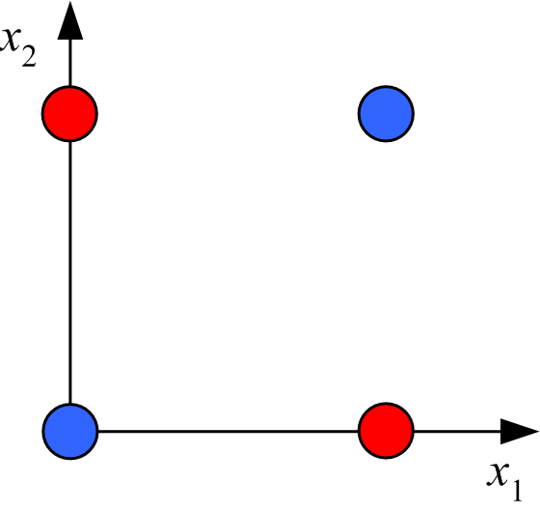
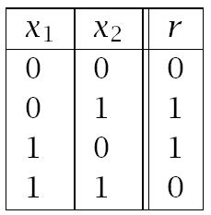
XOR
No w₀, w₁, w₂ satisfy:
(Minsky and Papert, 1969)

Slide 13
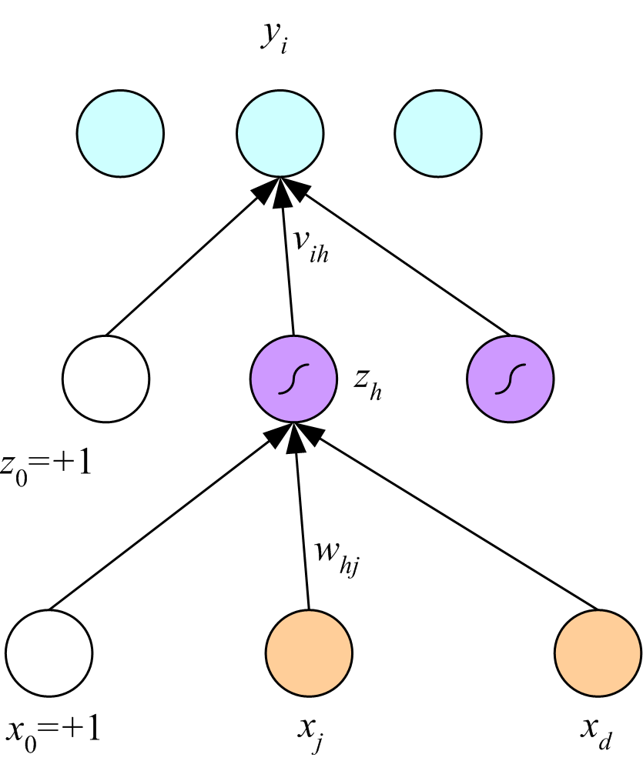
Multilayer Perceptrons
(Rumelhart et al., 1986)

Slide 14
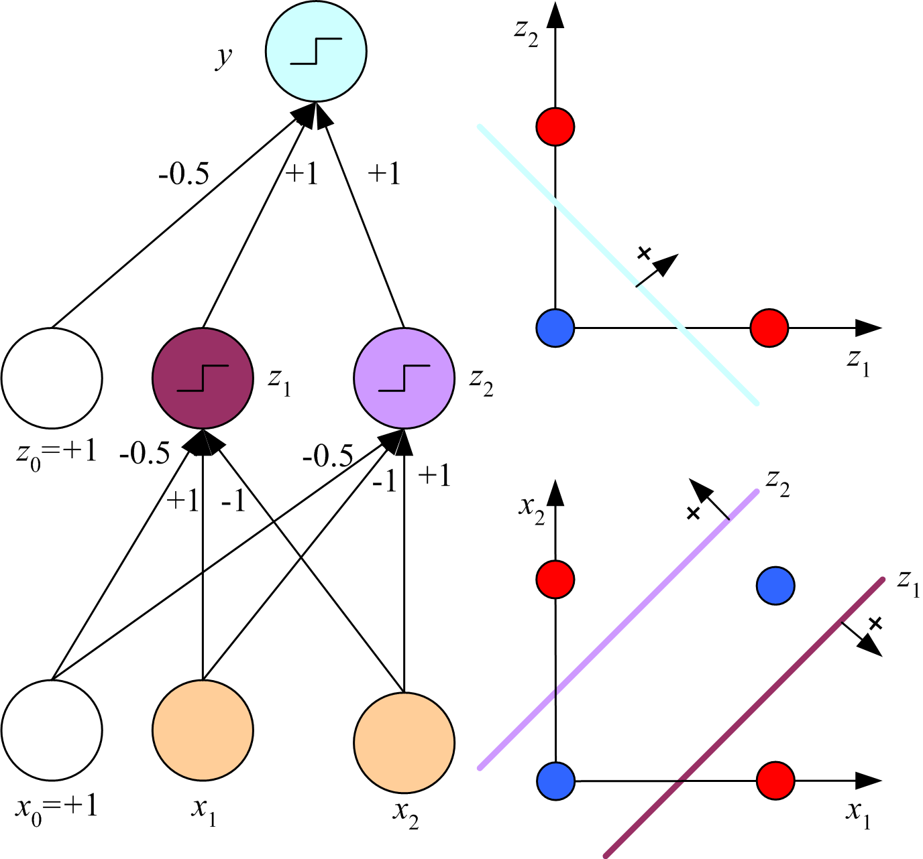
x₁ XOR x₂ = (x₁ AND ~x₂) OR (~x₁ AND x₂)

Slide 15
Backpropagation

Slide 16
Regression
Backward
Forward
x

Slide 17
Regression with Multiple Outputs
y_{i}
v_{ih}
z_{h}
w_{hj}
x_{j}

Slide 18
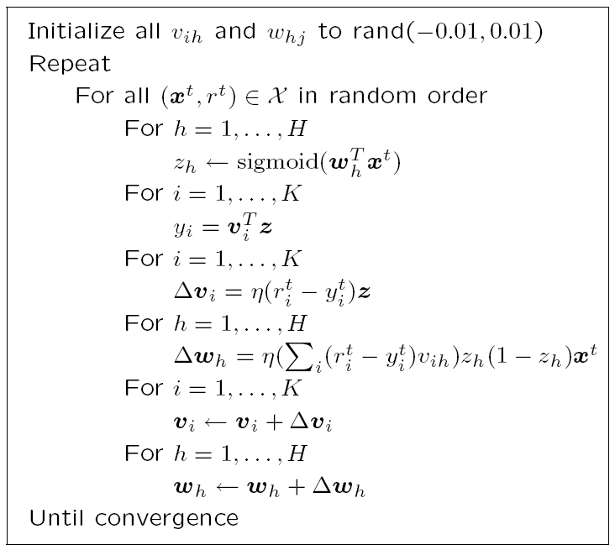

Slide 19
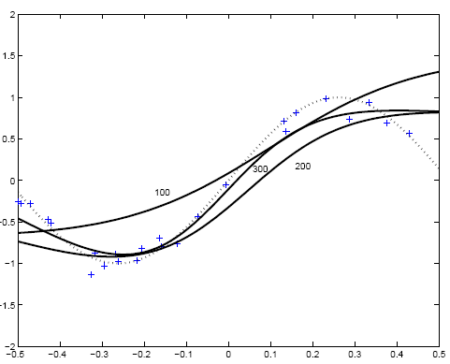
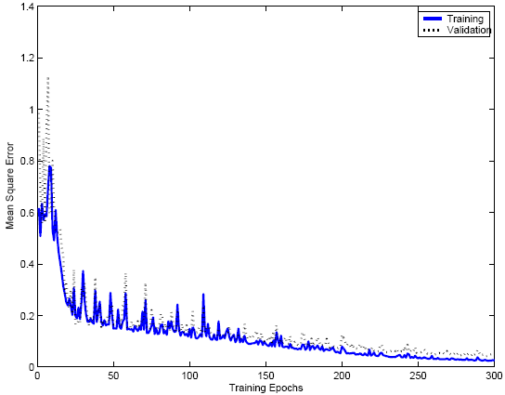

Slide 20
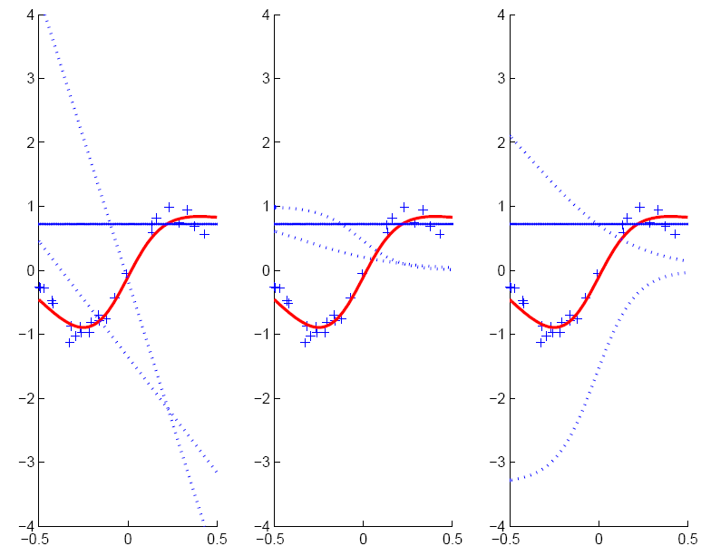
w_{h}x+w₀
v_{h}z_{h}
z_{h}

Slide 21
Two-Class Discrimination
One sigmoid output y^{t} for P(C₁|x^{t}) and P(C₂|x^{t}) ≡ 1-y^{t}

Slide 22
K>2 Classes

Slide 23
Multiple Hidden Layers
MLP with one hidden layer is a universal approximator (Hornik et al., 1989), but using multiple layers may lead to simpler networks

Slide 24
Improving Convergence
Momentum
Adaptive learning rate

Slide 25
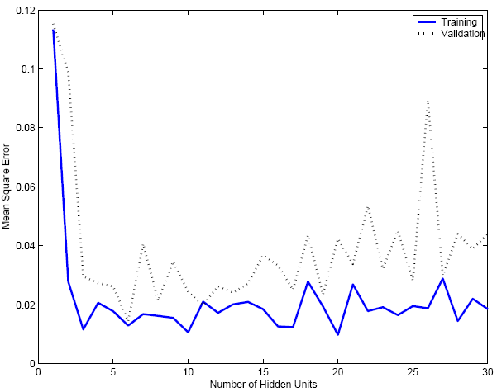
Overfitting/Overtraining
Number of weights: H (d+1)+(H+1)K

Slide 26
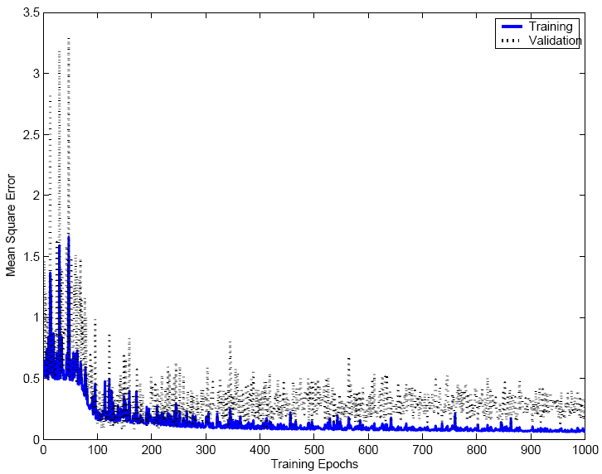

Slide 27
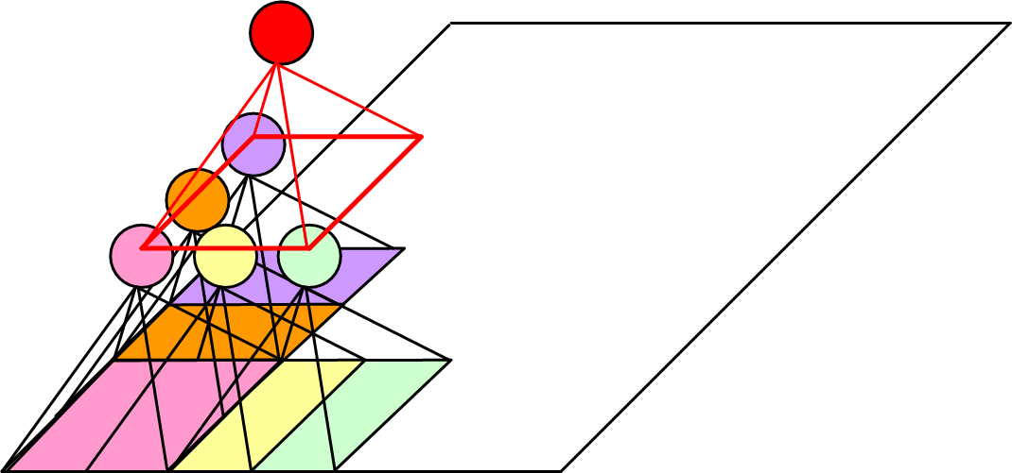
Structured MLP
(Le Cun et al, 1989)

Slide 28
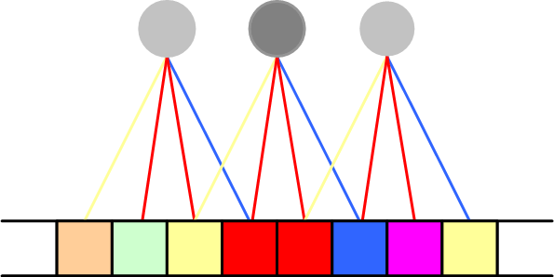
Weight Sharing

Slide 29

Hints
(Abu-Mostafa, 1995)
Invariance to translation, rotation, size
Virtual examples
Augmented error: E’=E+λ_{h}E_{h}
If x’ and x are the “same”: E_{h}=[g(x|θ)- g(x’|θ)]²
Approximation hint:

Slide 30
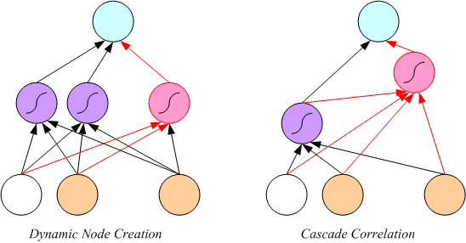
Tuning the Network Size
Destructive
Weight decay:
Constructive
Growing networks
(Ash, 1989)
(Fahlman and Lebiere, 1989)

Slide 31
Bayesian Learning
Consider weights w_{i} as random vars, prior p(w_{i})
Weight decay, ridge regression, regularization
cost=data-misfit + λ complexity
More about Bayesian methods in chapter 14

Slide 32
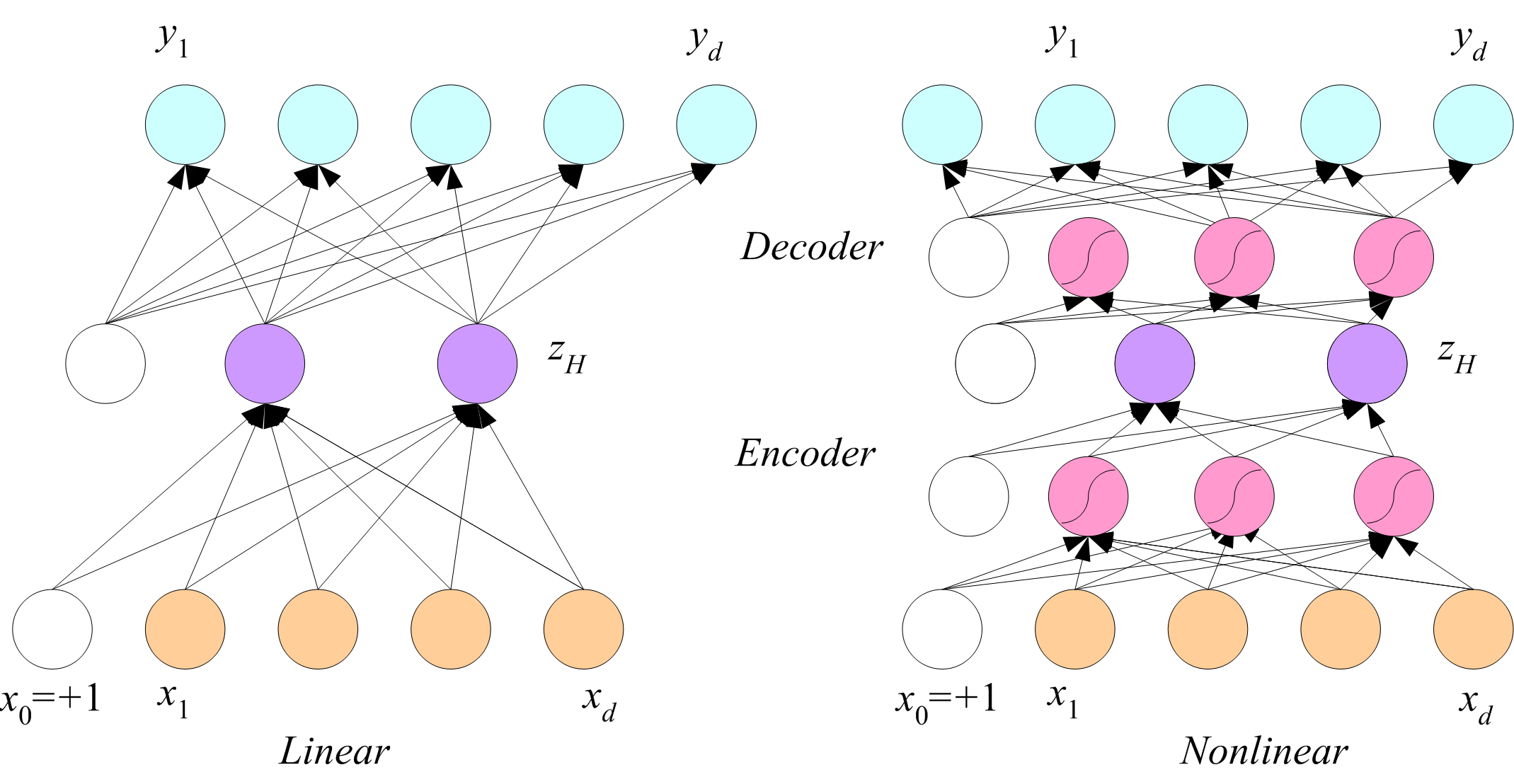
Dimensionality Reduction

Slide 33
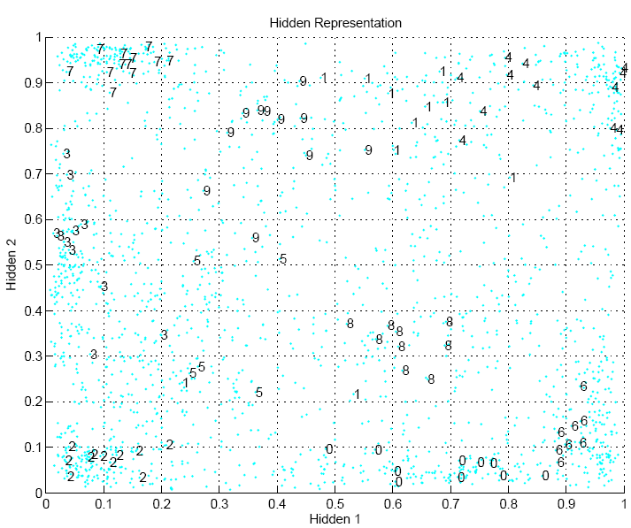

Slide 34
Learning Time
Applications:
Sequence recognition: Speech recognition
Sequence reproduction: Time-series prediction
Sequence association
Network architectures
Time-delay networks (Waibel et al., 1989)
Recurrent networks (Rumelhart et al., 1986)

Slide 35
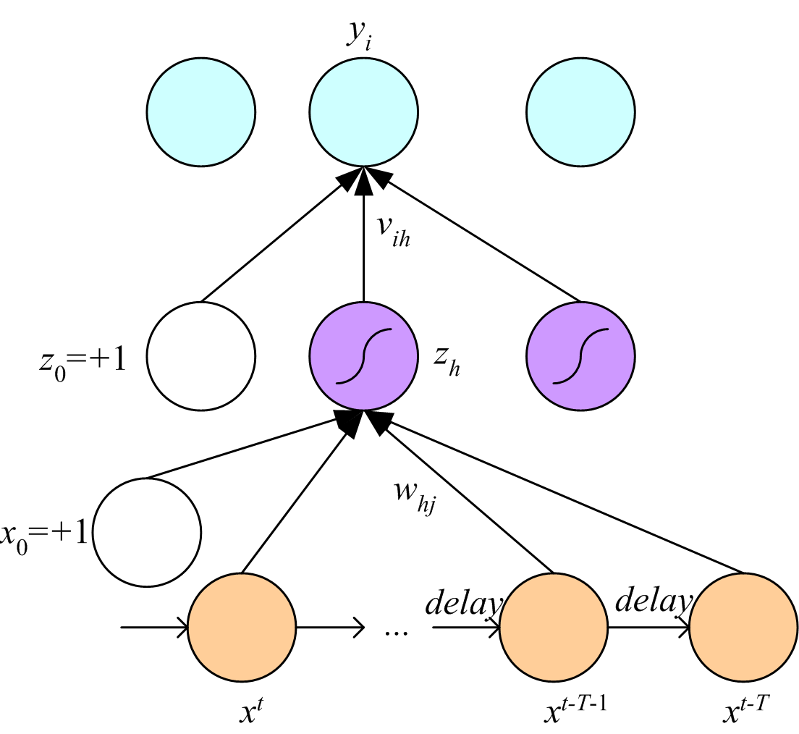
Time-Delay Neural Networks

Slide 36
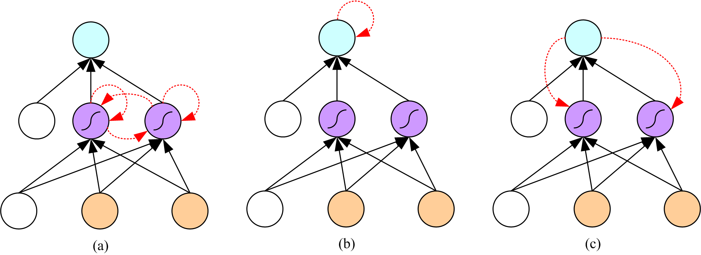
Recurrent Networks

Slide 37
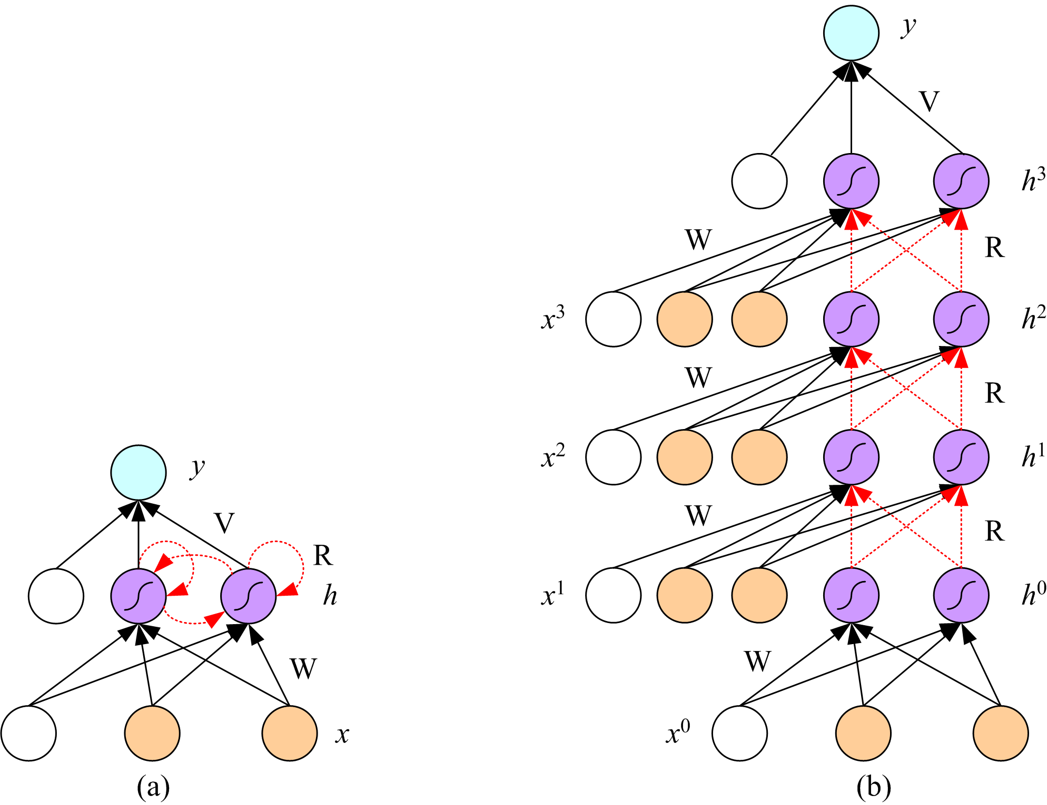
Unfolding in Time

