Slide 1

INTRODUCTION TO Machine Learning 2nd Edition
Lecture Slides for
ETHEM ALPAYDIN
© The MIT Press, 2010
alpaydin@boun.edu.tr
http://www.cmpe.boun.edu.tr/~ethem/i2ml2e

Slide 2
CHAPTER 12: Local Models

Slide 3
Introduction
Divide the input space into local regions and learn simple (constant/linear) models in each patch
Unsupervised: Competitive, online clustering
Supervised: Radial-basis functions, mixture of experts

Slide 4
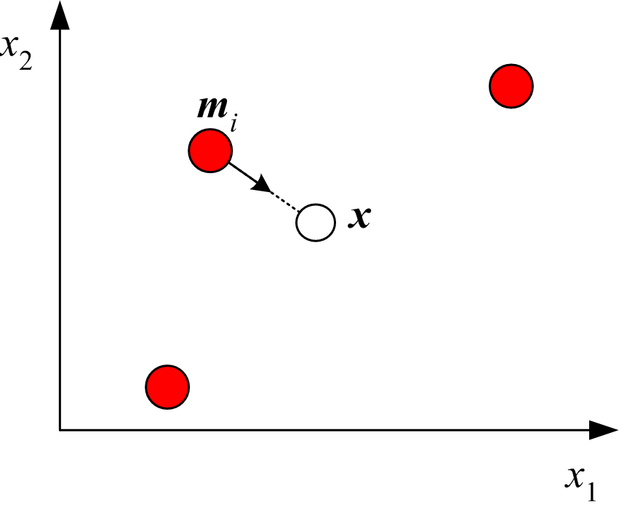
Competitive Learning

Slide 5
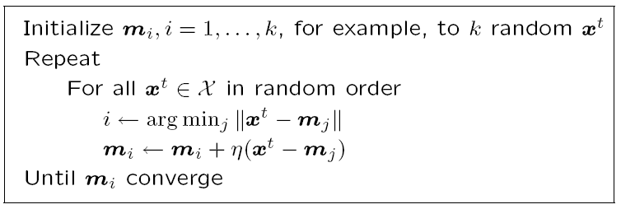
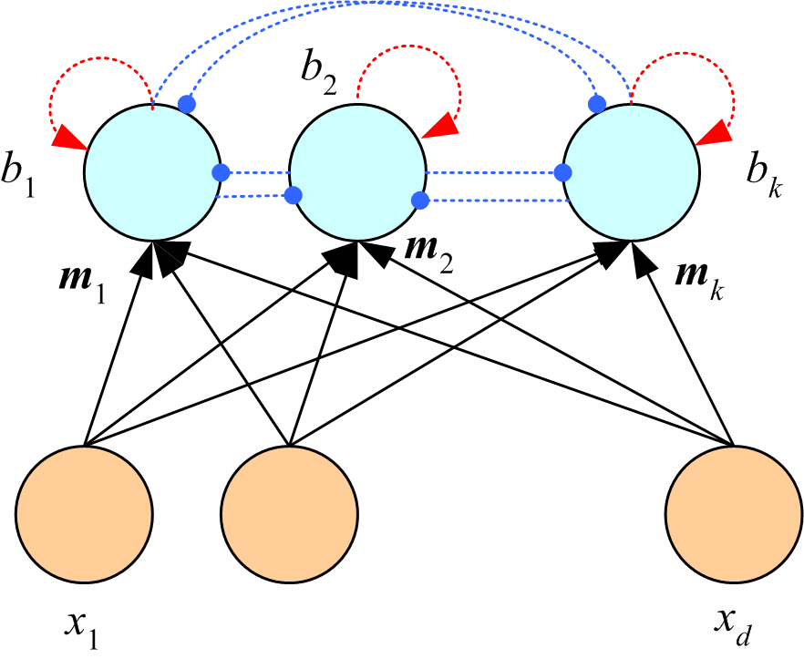
Winner-take-all
network

Slide 6
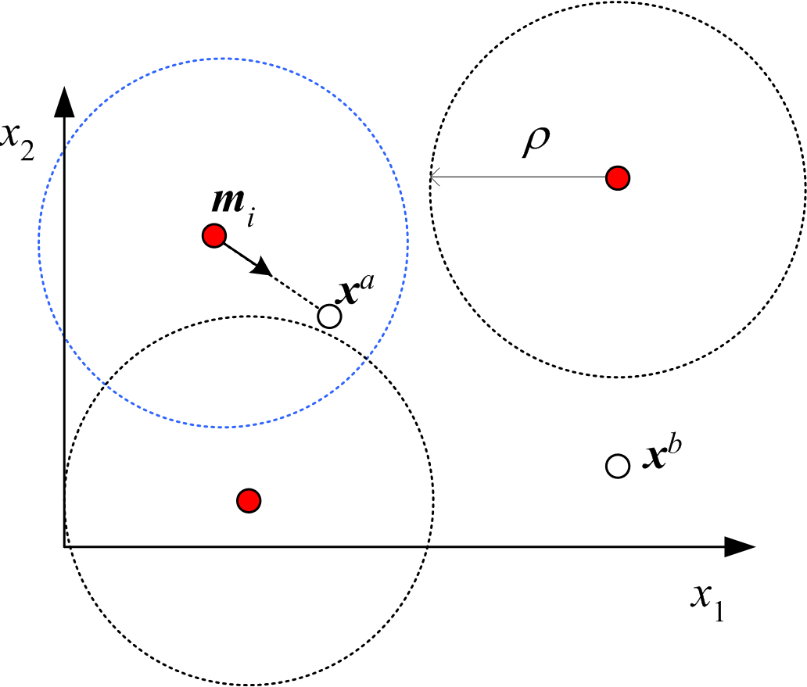
Adaptive Resonance Theory
Incremental; add a new cluster if not covered; defined by vigilance, ρ
(Carpenter and Grossberg, 1988)

Slide 7
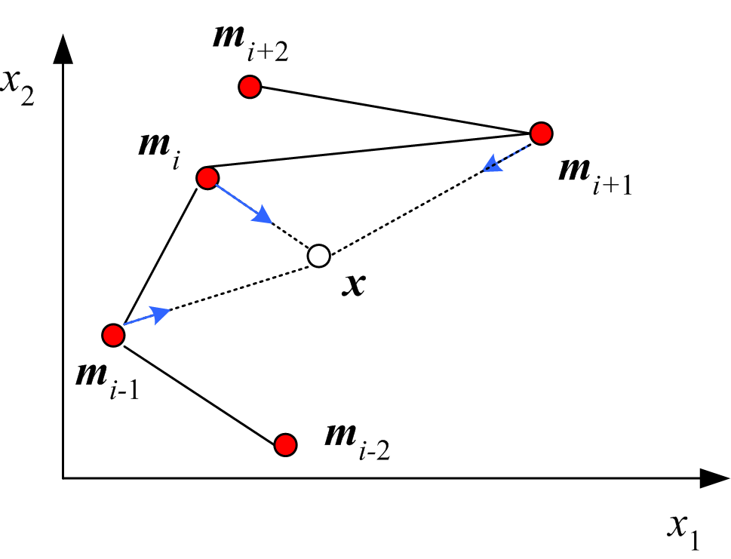
Self-Organizing Maps
Units have a neighborhood defined; m_{i} is “between” m_{i-1} and m_{i+1}, and are all updated together
One-dim map:
(Kohonen, 1990)

Slide 8
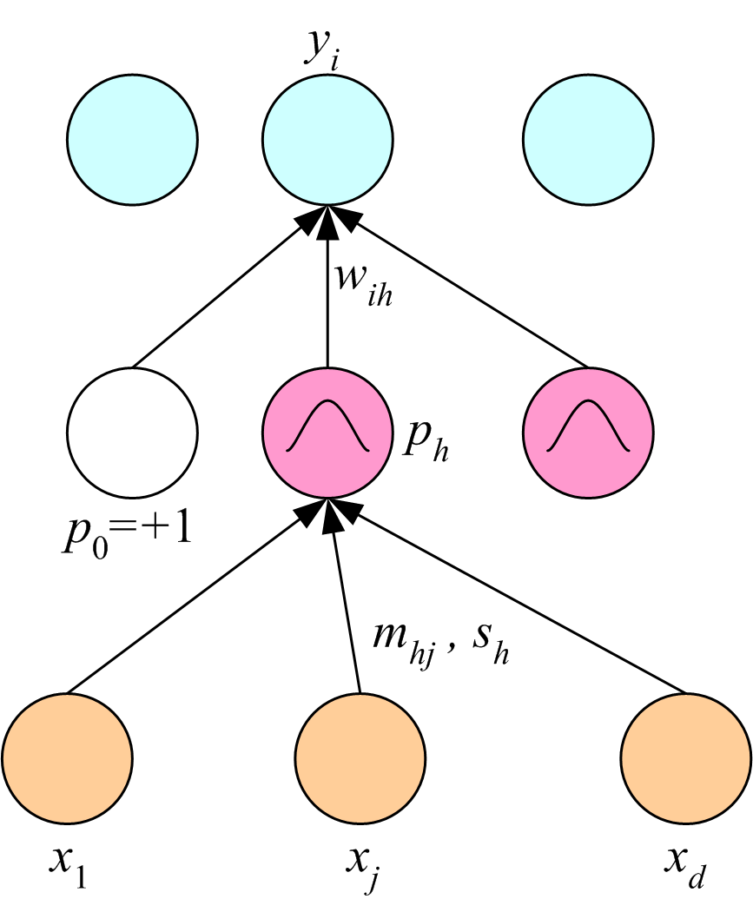
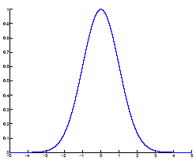
Radial-Basis Functions
Locally-tuned units:

Slide 9
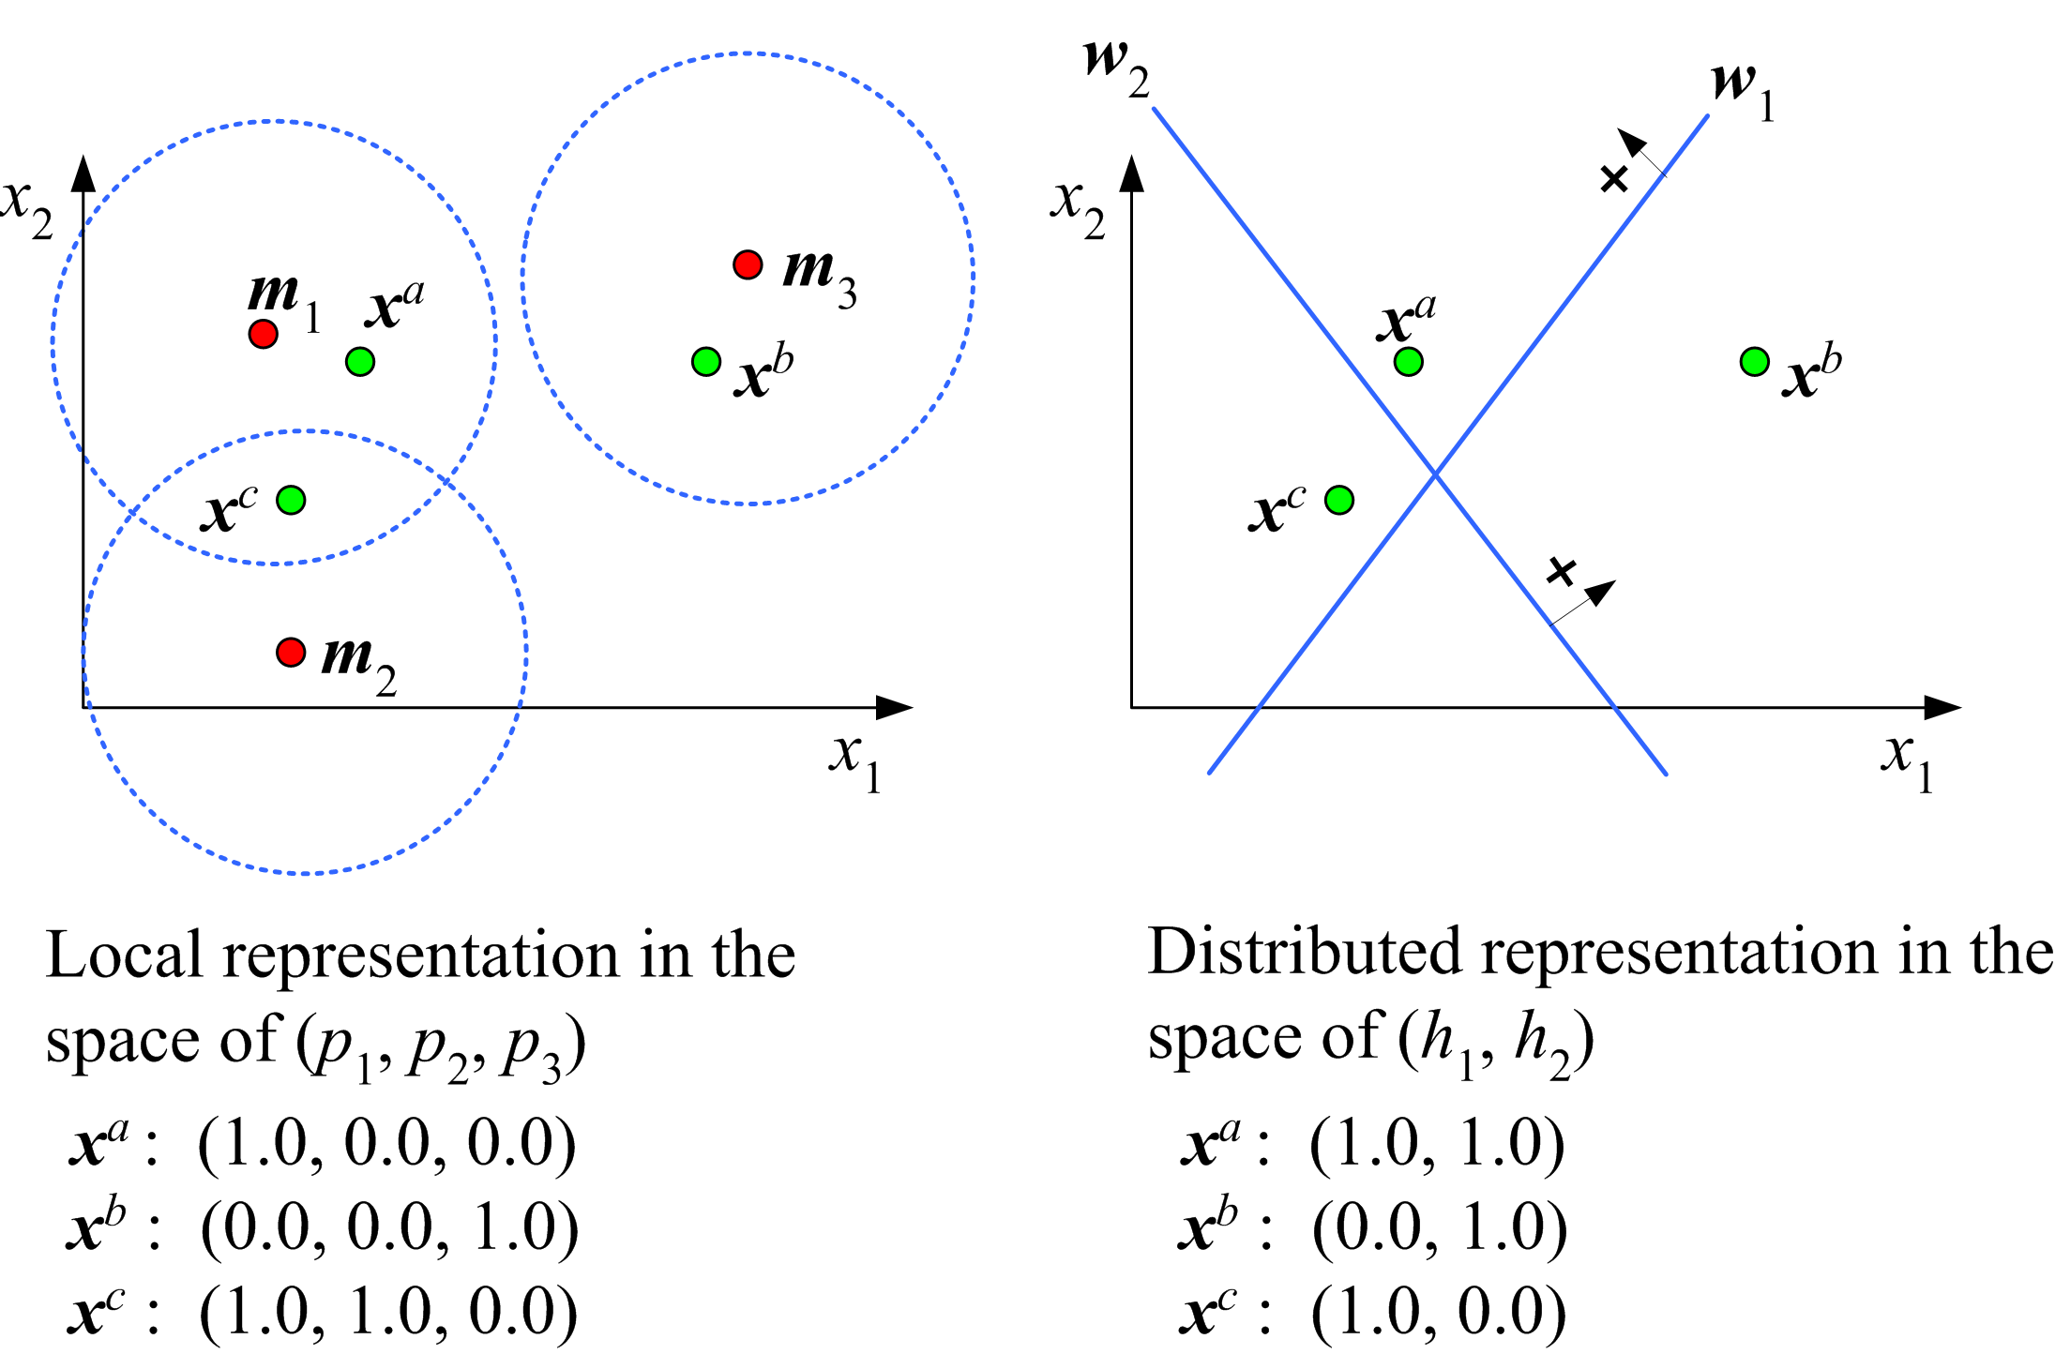
Local vs Distributed Representation

Slide 10
Training RBF
Hybrid learning:
First layer centers and spreads:
Unsupervised k-means
Second layer weights: Supervised gradient-descent
Fully supervised
(Broomhead and Lowe, 1988; Moody and Darken, 1989)

Slide 11
Regression

Slide 12
Classification

Slide 13
Rules and Exceptions
Default
rule
Exceptions

Slide 14
Rule-Based Knowledge
Incorporation of prior knowledge (before training)
Rule extraction (after training) (Tresp et al., 1997)
Fuzzy membership functions and fuzzy rules

Slide 15
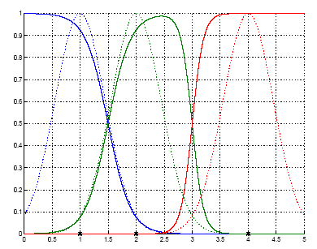
Normalized Basis Functions

Slide 16
Competitive Basis Functions
Mixture model:

Slide 17
Regression

Slide 18
Classification

Slide 19
EM for RBF (Supervised EM)
E-step:
M-step:

Slide 20
Learning Vector Quantization
H units per class prelabeled (Kohonen, 1990)
Given x, m_{i} is the closest:
x
m_{i}
m_{j}

Slide 21
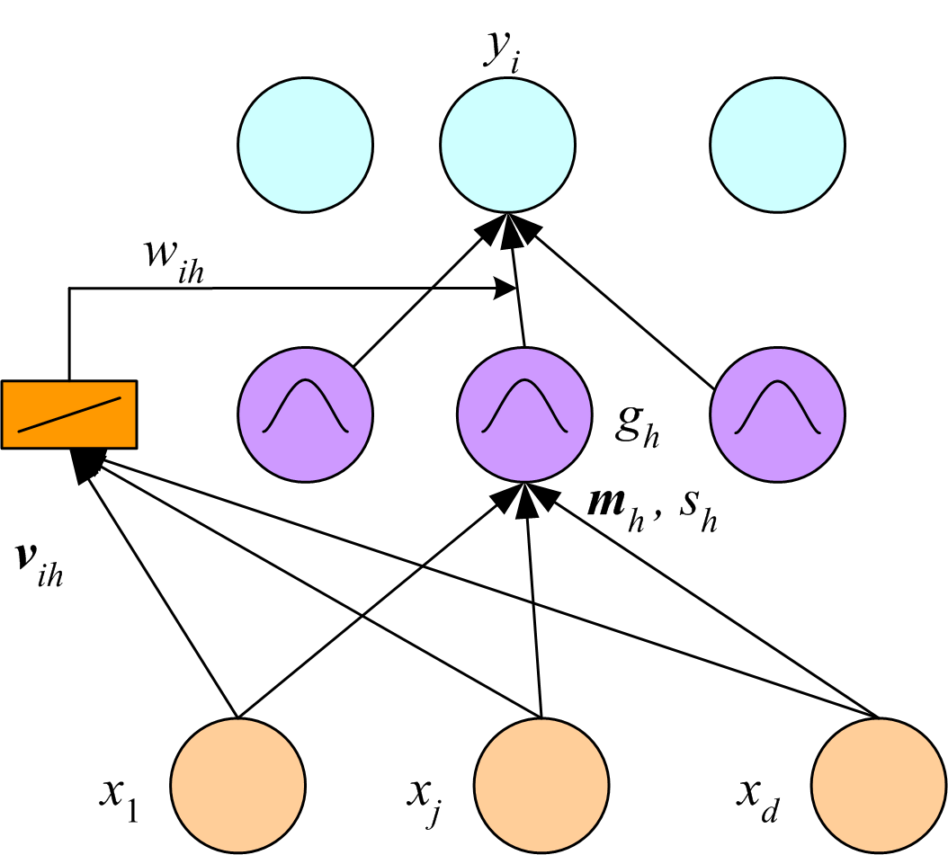
Mixture of Experts
In RBF, each local fit is a constant, w_{ih}, second layer weight
In MoE, each local fit is a linear function of x, a local expert:
(Jacobs et al., 1991)

Slide 22
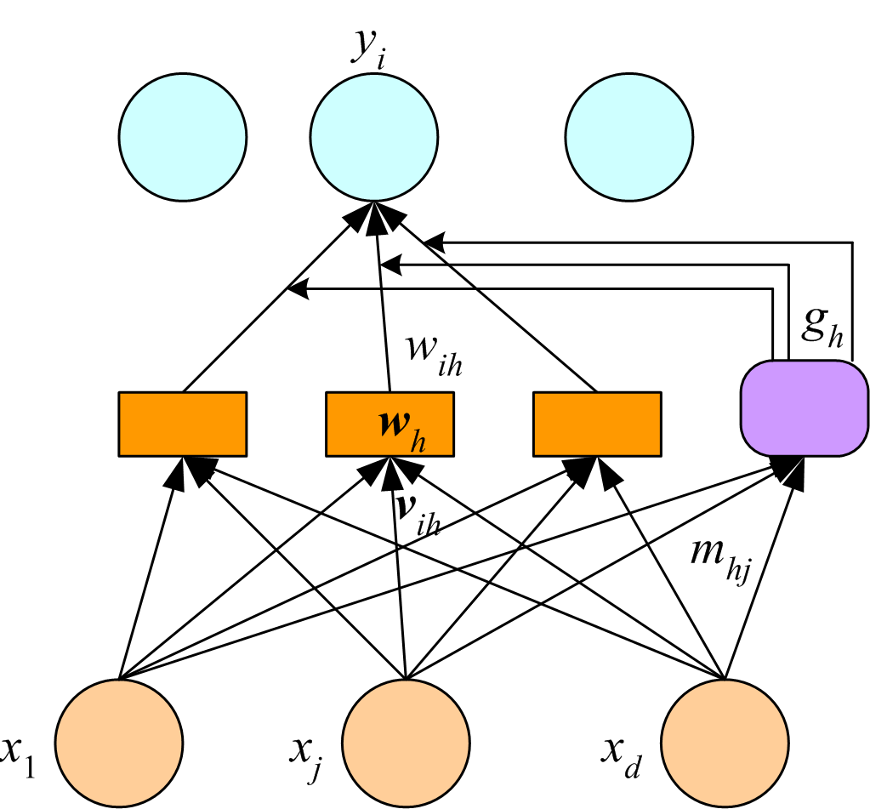
MoE as Models Combined
Radial gating:
Softmax gating:

Slide 23
Cooperative MoE
Regression

Slide 24
Competitive MoE: Regression

Slide 25
Competitive MoE: Classification

Slide 26
Hierarchical Mixture of Experts
Tree of MoE where each MoE is an expert in a higher-level MoE
Soft decision tree: Takes a weighted (gating) average of all leaves (experts), as opposed to using a single path and a single leaf
Can be trained using EM (Jordan and Jacobs, 1994)

