Slide 1
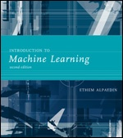
INTRODUCTION TO Machine Learning 2nd Edition
Lecture Slides for
ETHEM ALPAYDIN
© The MIT Press, 2010
alpaydin@boun.edu.tr
http://www.cmpe.boun.edu.tr/~ethem/i2ml2e

Slide 2
CHAPTER 14: Bayesian Estimation

Slide 3
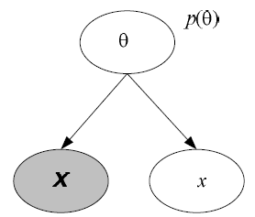
Rationale
Bayes’ Rule:
Generative model:

Slide 4
Estimating the Parameters of a Distribution: Discrete case
x^{t}_{i}=1 if in instance t is in state i, probability of state i is q_{i}
Dirichlet prior, α_{i} are hyperparameters
Sample likelihood
Posterior
Dirichlet is a conjugate prior
With K=2, Dirichlet reduced to Beta

Slide 5
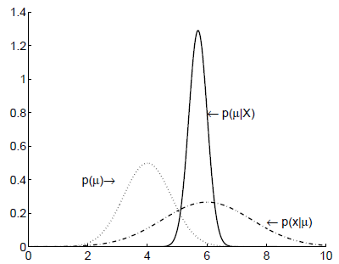
Estimating the Parameters of a Distribution: Continuous case
p(x^{t})~N(μ,σ²)
Gaussian prior for μ, p(μ)~ N(μ₀, σ₀²)
Posterior is also Gaussian p(μ|X)~ N(μ_{N}, σ_{N}²) where

Slide 6
Estimating the Parameters of a Function: Regression
r=w^{T}x+ ε where p(ε)~N(0,1/β), and p(r^{t}|x^{t},w, β) ~ N(w^{T}x^{t}, 1/β)
Log likelihood
ML solution
Gaussian conjugate prior: p(w)~N(0,1/α)
Posterior: p(w|X)~N(μ_{N},Σ_{N}) where
6

Slide 7
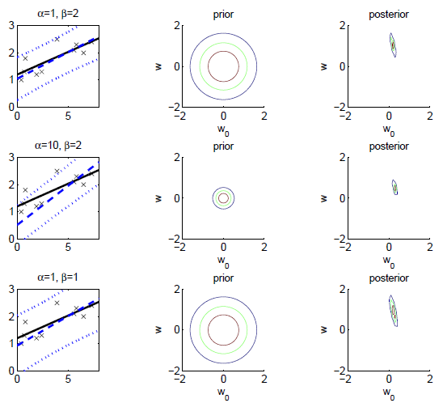

Slide 8
Basis/Kernel Functions
For new x’, the estimate r’ is calculated as
Linear kernel
For any other φ(x), we can write K(x’,x)=φ(x’)^{T}φ(x)
Dual representation
8
8

Slide 9
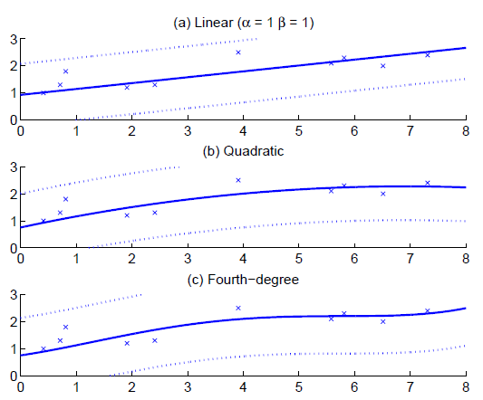
Kernel Functions

Slide 10
Gaussian Processes
Assume Gaussian prior p(w)~N(0,1/α)
y=Xw, where E[y]=0 and Cov(y)=K with K_{ij}= (x^{i})^{T}x^{i}
K is the covariance function, here linear
With basis function φ(x), K_{ij}= (φ(x^{i}))^{T}φ(x^{i})
r~N_{N}(0,C_{N}) where C_{N}= (1/β)I+K
With new x’ added as x_{N+1}, r_{N+1}~N_{N+1}(0,C_{N+1})
where k = [K(x’,x^{t})_{t}]^{T} and c=K(x’,x’)+1/β.
p(r’|x’,X,r)~N(k^{T}C_{N-1}r,c-k^{T}C_{N-1}k)
10
10
10

Slide 11
