Slide 1

INTRODUCTION TO Machine Learning 2nd Edition
Lecture Slides for
ETHEM ALPAYDIN
© The MIT Press, 2010
alpaydin@boun.edu.tr
http://www.cmpe.boun.edu.tr/~ethem/i2ml2e

Slide 2
CHAPTER 16: Graphical Models

Slide 3
Graphical Models
Aka Bayesian networks, probabilistic networks
Nodes are hypotheses (random vars) and the probabilities corresponds to our belief in the truth of the hypothesis
Arcs are direct influences between hypotheses
The structure is represented as a directed acyclic graph (DAG)
The parameters are the conditional probabilities in the arcs (Pearl, 1988, 2000; Jensen, 1996; Lauritzen, 1996)

Slide 4
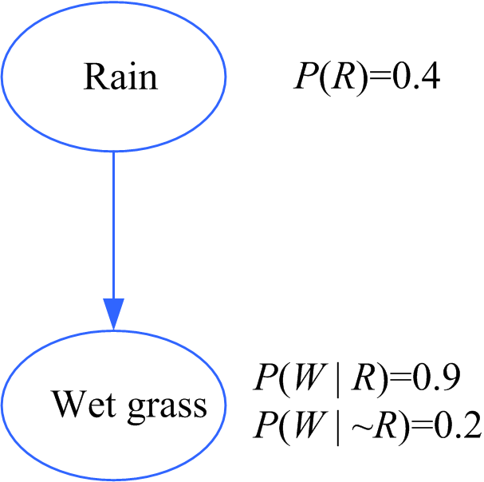
Causes and Bayes’ Rule
Diagnostic inference:
Knowing that the grass is wet,
what is the probability that rain is
the cause?
diagnostic
causal

Slide 5
Conditional Independence
X and Y are independent if
P(X,Y)=P(X)P(Y)
X and Y are conditionally independent given Z if
P(X,Y|Z)=P(X|Z)P(Y|Z)
or
P(X|Y,Z)=P(X|Z)
Three canonical cases: Head-to-tail, Tail-to-tail, head-to-head

Slide 6
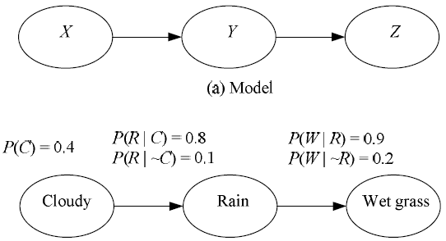
Case 1: Head-to-Head
P(X,Y,Z)=P(X)P(Y|X)P(Z|Y)
P(W|C)=P(W|R)P(R|C)+P(W|~R)P(~R|C)

Slide 7
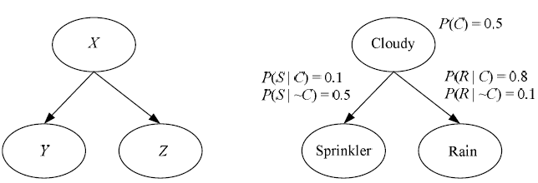
Case 2: Tail-to-Tail
P(X,Y,Z)=P(X)P(Y|X)P(Z|X)

Slide 8
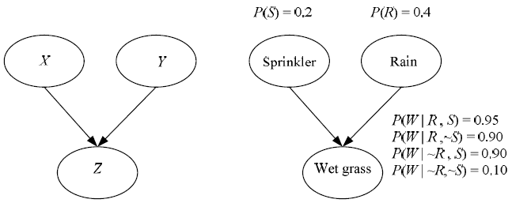
Case 3: Head-to-Head
P(X,Y,Z)=P(X)P(Y)P(Z|X,Y)

Slide 9
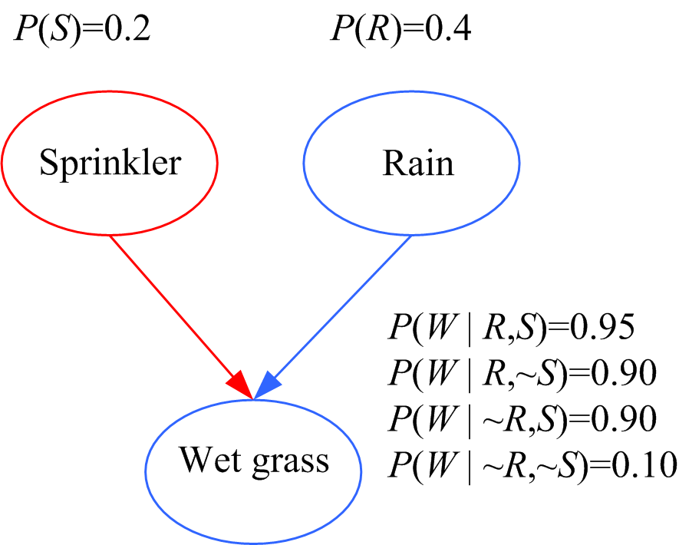
Causal vs Diagnostic Inference
Causal inference: If the
sprinkler is on, what is the
probability that the grass is wet?
P(W|S) = P(W|R,S) P(R|S) +
P(W|~R,S) P(~R|S)
= P(W|R,S) P(R) +
P(W|~R,S) P(~R)
= 0.95 0.4 + 0.9 0.6 = 0.92
Diagnostic inference: If the grass is wet, what is the probability
that the sprinkler is on? P(S|W) = 0.35 > 0.2 P(S)
P(S|R,W) = 0.21 Explaining away: Knowing that it has rained
decreases the probability that the sprinkler is on.

Slide 10
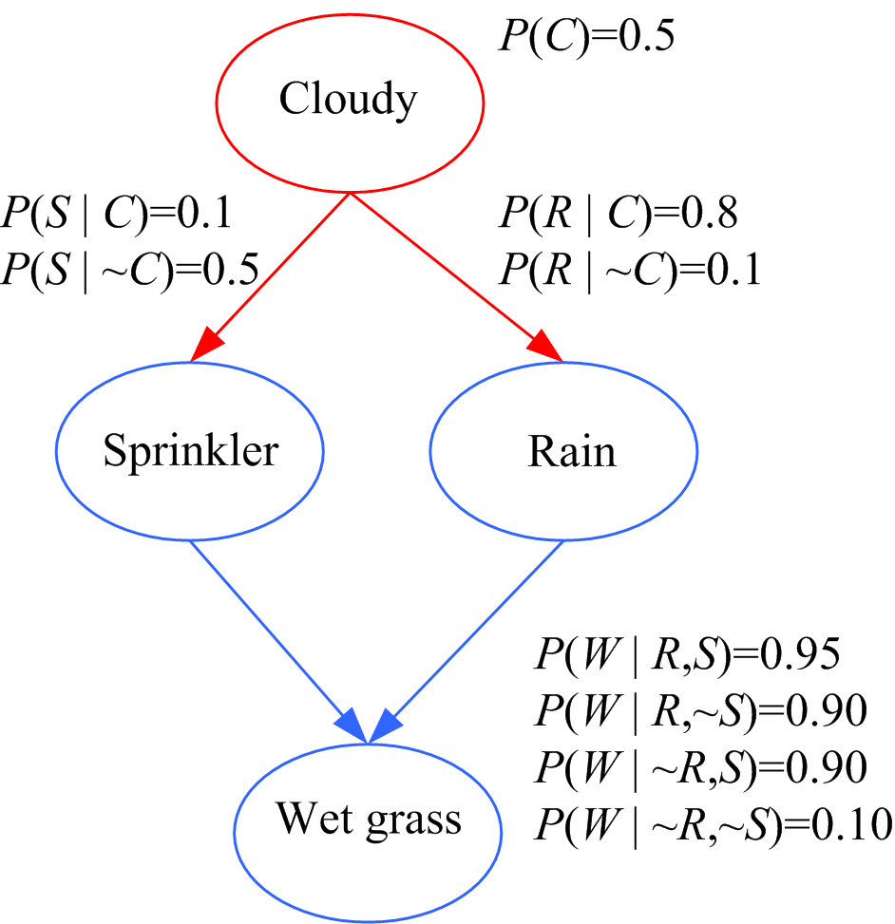
Causes
Causal inference:
P(W|C) = P(W|R,S) P(R,S|C) +
P(W|~R,S) P(~R,S|C) +
P(W|R,~S) P(R,~S|C) +
P(W|~R,~S) P(~R,~S|C)
and use the fact that
P(R,S|C) = P(R|C) P(S|C)
Diagnostic: P(C|W ) = ?

Slide 11
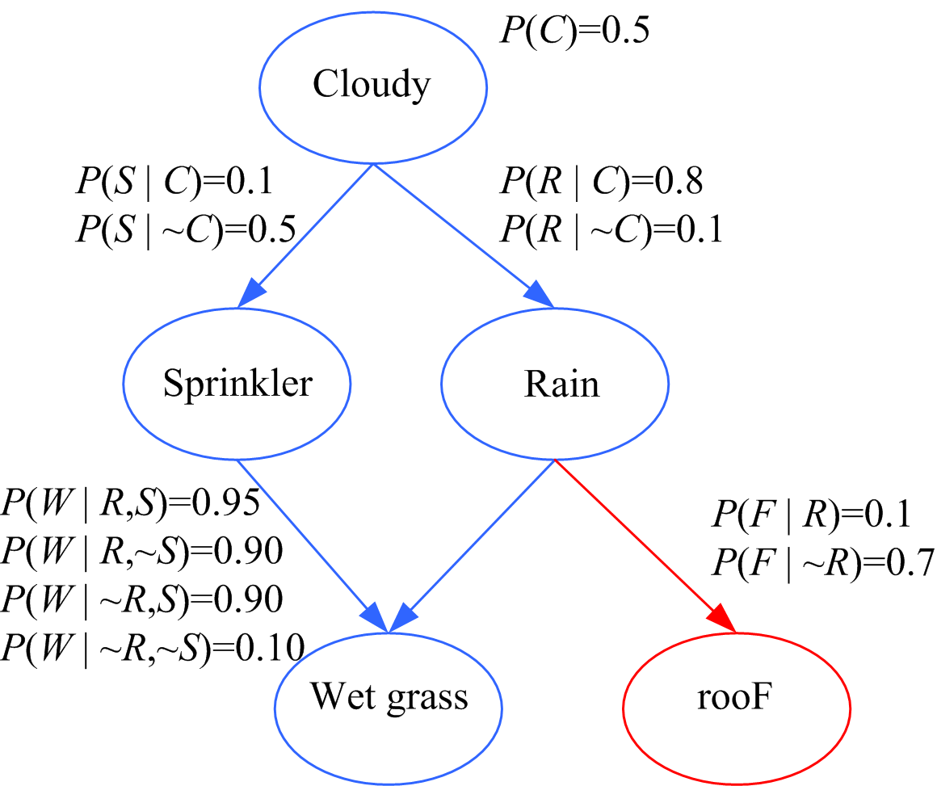
Exploiting the Local Structure
P (F | C) = ?

Slide 12
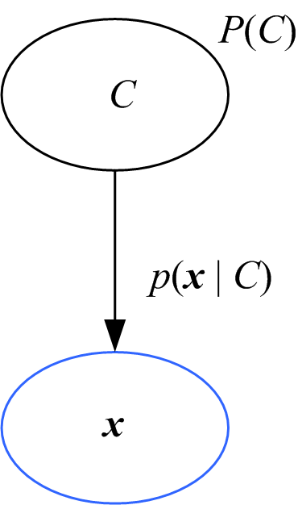
Classification
Bayes’ rule inverts the arc:
diagnostic
P (C | x )

Slide 13
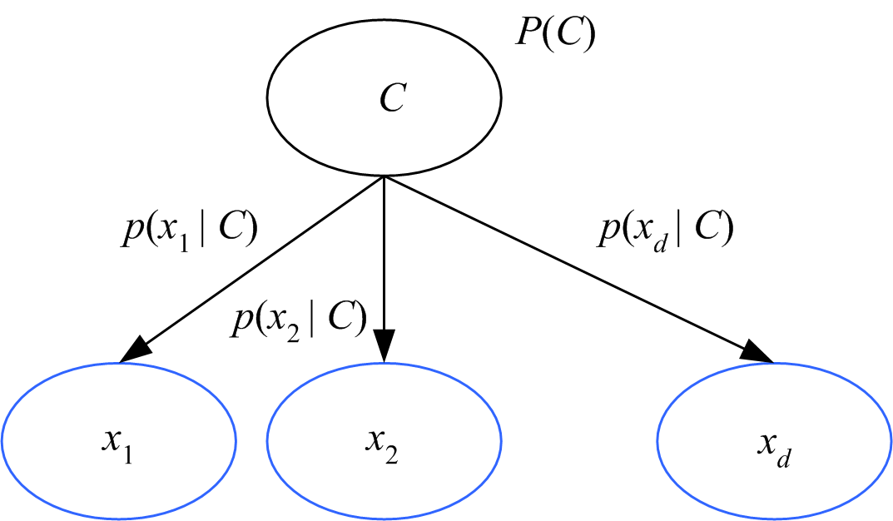
Naive Bayes’ Classifier
Given C, x_{j} are independent:
p(x|C) = p(x₁|C) p(x₂|C) ... p(x_{d}|C)

Slide 14
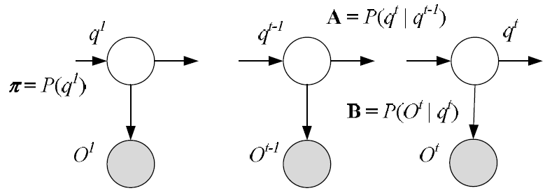
Hidden Markov Model as a Graphical Model

Slide 15
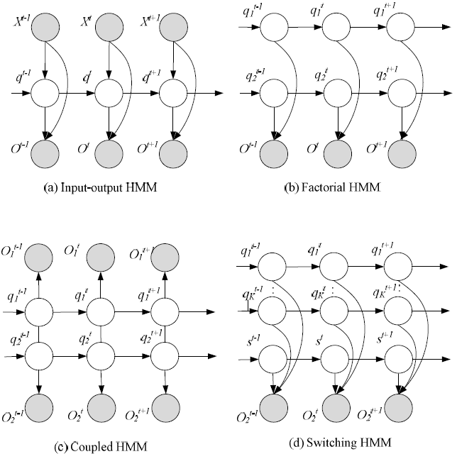

Slide 16
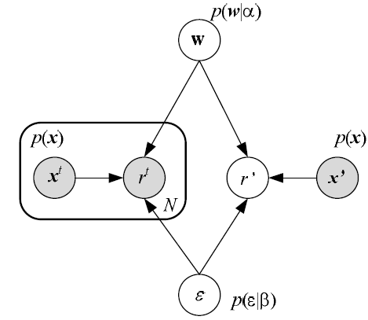
Linear Regression

Slide 17
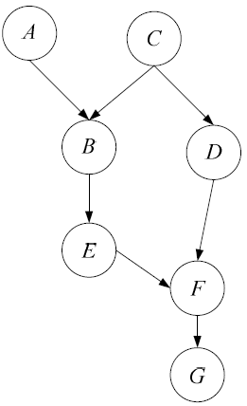
d-Separation
A path from node A to node B is blocked if
The directions of edges on the path meet head-to-tail (case 1) or tail-to-tail (case 2) and the node is in C, or
The directions of edges meet head-to-head (case 3) and neither that node nor any of its descendants is in C.
If all paths are blocked, A and B are d-separated (conditionally independent) given C.
BCDF is blocked given C.
BEFG is blocked by F.
BEFD is blocked unless F (or G) is
given.

Slide 18
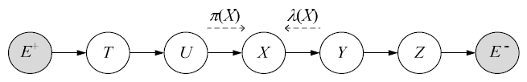
Belief Propagation (Pearl, 1988)
Chain:

Slide 19
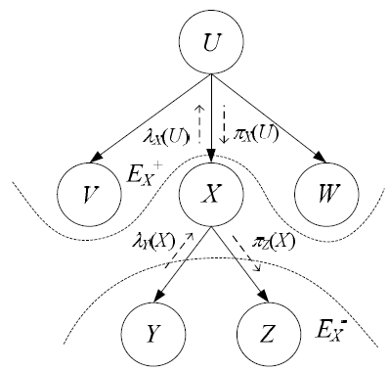
Trees

Slide 20
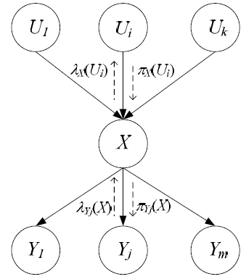
Polytrees
How can we model P(X|U₁,U₂,...,U_{k}) cheaply?

Slide 21
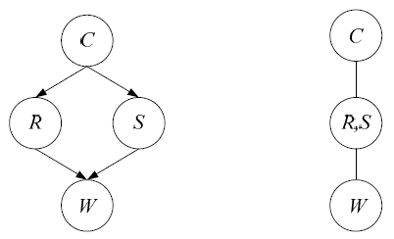
Junction Trees
If X does not separate E⁺ and E⁻, we convert it into a junction tree and then apply the polytree algorithm
Tree of moralized,
clique nodes

Slide 22
Undirected Graphs: Markov Random Fields
In a Markov random field, dependencies are symmetric, for example, pixels in an image
In an undirected graph, A and B are independent if removing C makes them unconnected.
Potential function ψ_{c}(X_{c}) shows how favorable is the particular configuration X over the clique C
The joint is defined in terms of the clique potentials

Slide 23
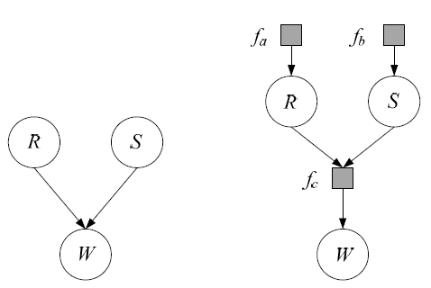
Factor Graphs
Define new factor nodes and write the joint in terms of them

Slide 24
Learning a Graphical Model
Learning the conditional probabilities, either as tables (for discrete case with small number of parents), or as parametric functions
Learning the structure of the graph: Doing a state-space search over a score function that uses both goodness of fit to data and some measure of complexity

Slide 25
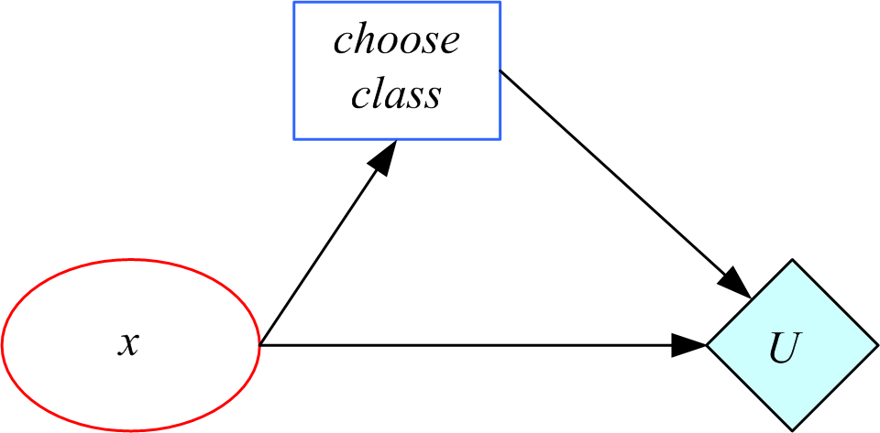
Influence Diagrams
decision node
chance node
utility node

