Slide 1
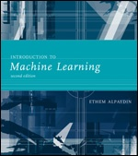
INTRODUCTION TO Machine Learning 2nd Edition
Lecture Slides for
ETHEM ALPAYDIN
© The MIT Press, 2010
alpaydin@boun.edu.tr
http://www.cmpe.boun.edu.tr/~ethem/i2ml2e

Slide 2
CHAPTER 17: Combining Multiple Learners

Slide 3
Rationale
No Free Lunch Theorem: There is no algorithm that is always the most accurate
Generate a group of base-learners which when combined has higher accuracy
Different learners use different
Algorithms
Hyperparameters
Representations /Modalities/Views
Training sets
Subproblems
Diversity vs accuracy

Slide 4
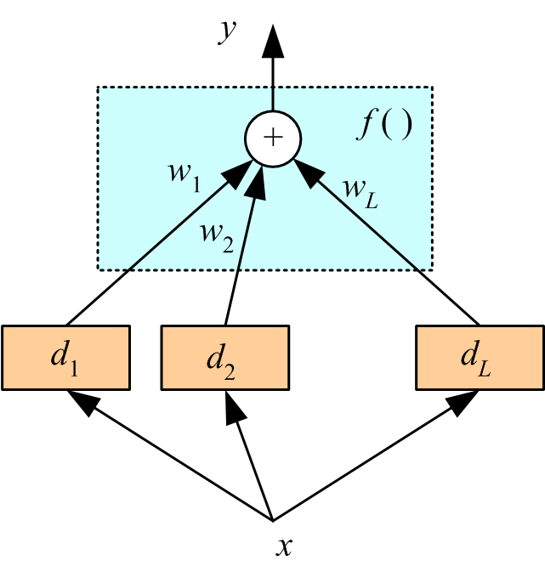
Voting
Linear combination
Classification

Slide 5
Bayesian perspective:
If d_{j} are iid
Bias does not change, variance decreases by L
If dependent, error increase with positive correlation

Slide 6
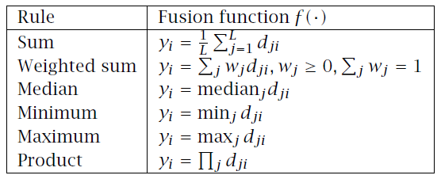
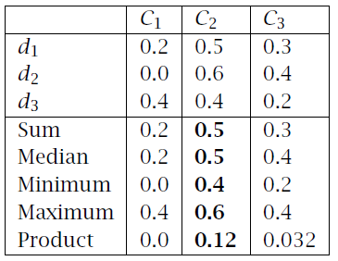
Fixed Combination Rules

Slide 7
Error-Correcting Output Codes
K classes; L problems (Dietterich and Bakiri, 1995)
Code matrix W codes classes in terms of learners
One per class
L=K
Pairwise
L=K(K-1)/2

Slide 8
Full code L=2^{(K-1)}-1
With reasonable L, find W such that the Hamming distance btw rows and columns are maximized.
Voting scheme
Subproblems may be more difficult than one-per-K

Slide 9
Bagging
Use bootstrapping to generate L training sets and train one base-learner with each (Breiman, 1996)
Use voting (Average or median with regression)
Unstable algorithms profit from bagging

Slide 10
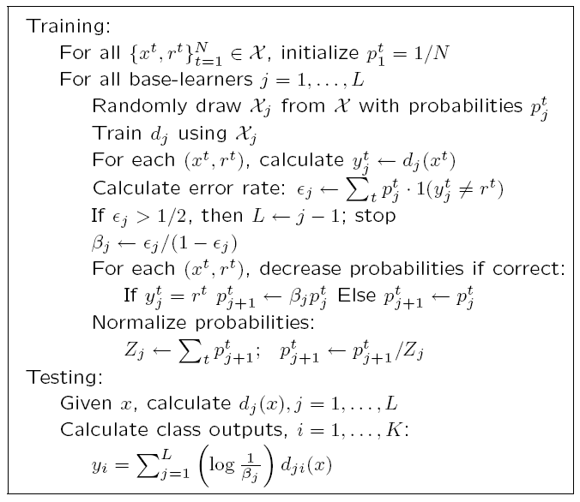
AdaBoost
Generate a sequence of base-learners each focusing on previous one’s errors
(Freund and Schapire, 1996)

Slide 11
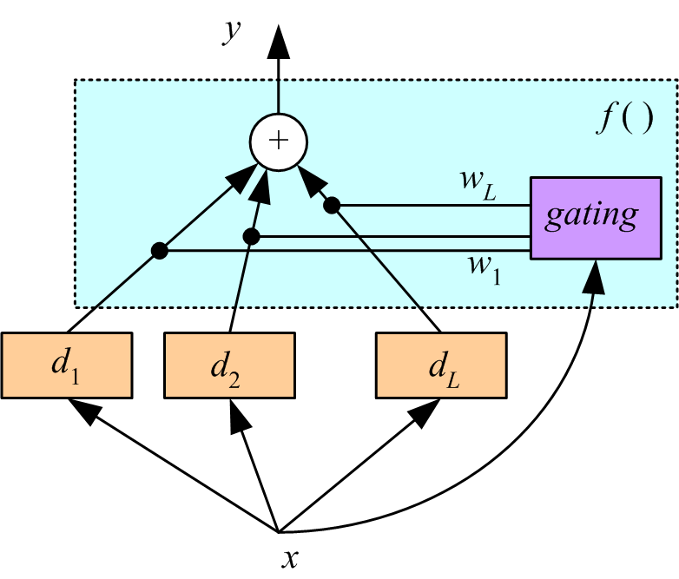
Mixture of Experts
Voting where weights are input-dependent (gating)
(Jacobs et al., 1991)
Experts or gating
can be nonlinear

Slide 12
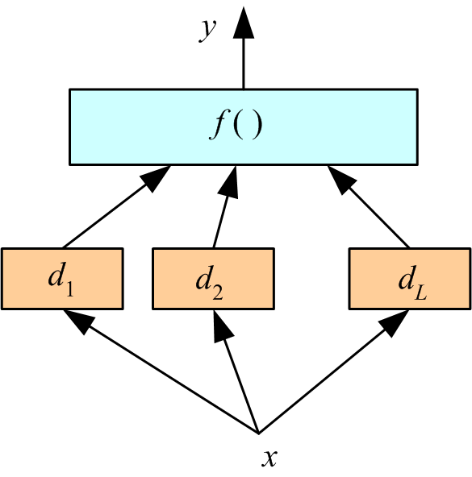
Stacking
Combiner f () is another learner (Wolpert, 1992)

Slide 13
Fine-Tuning an Ensemble
Given an ensemble of dependent classifiers, do not use it as is, try to get independence
Subset selection: Forward (growing)/Backward (pruning) approaches to improve accuracy/diversity/independence
Train metaclassifiers: From the output of correlated classifiers, extract new combinations that are uncorrelated. Using PCA, we get “eigenlearners.”
Similar to feature selection vs feature extraction

Slide 14
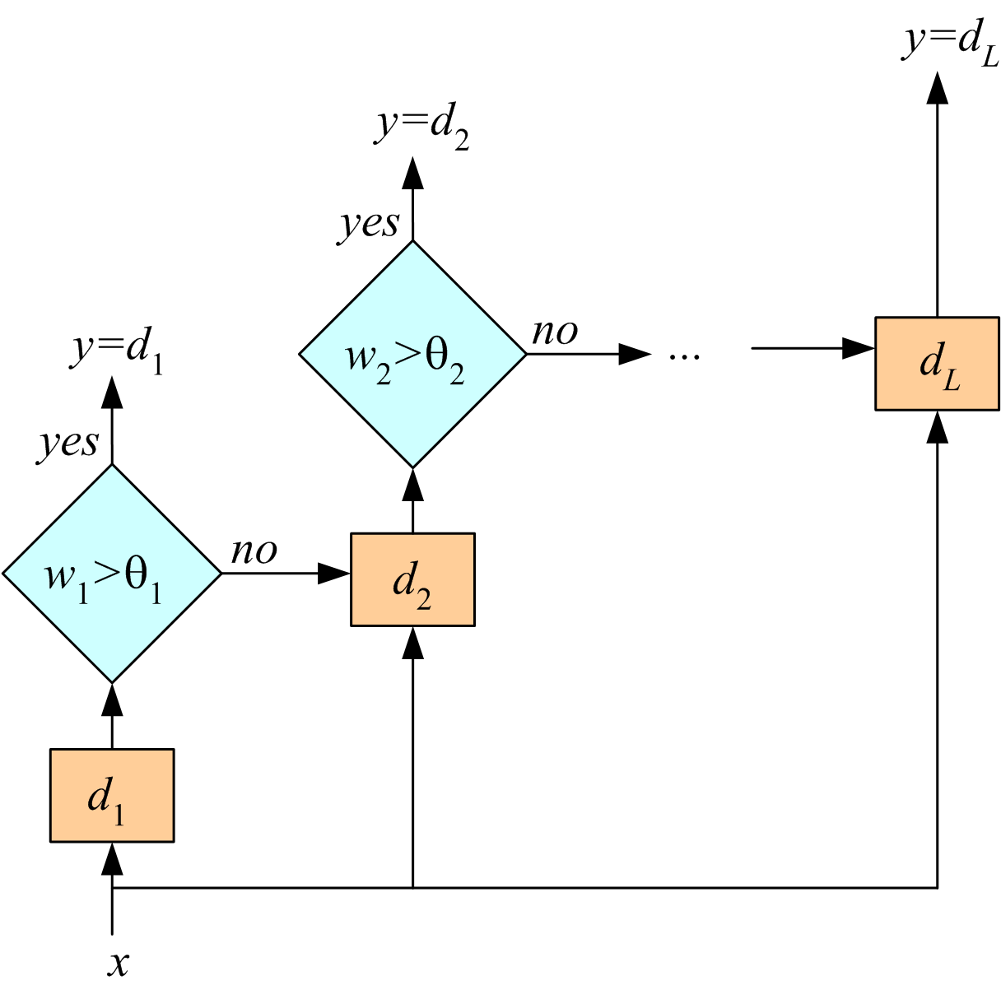
Cascading
Use d_{j} only if preceding ones are not confident
Cascade learners in order of complexity

Slide 15
Combining Multiple Sources
Early integration: Concat all features and train a single learner
Late integration: With each feature set, train one learner, then either use a fixed rule or stacking to combine decisions
Intermediate integration: With each feature set, calculate a kernel, then use a single SVM with multiple kernels
Combining features vs decisions vs kernels

