Slide 1
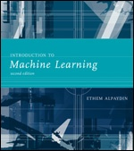
INTRODUCTION TO Machine Learning 2nd Edition
Lecture Slides for
ETHEM ALPAYDIN
© The MIT Press, 2010
alpaydin@boun.edu.tr
http://www.cmpe.boun.edu.tr/~ethem/i2ml2e
Edited by Zehra Çataltepe, ITU BLG527E Machine Learning
Sep 25, 2013

Slide 2
CHAPTER 19: Design and Analysis of Machine Learning Experiments

Slide 3
Introduction
Questions:
Assessment of the expected error of a learning algorithm:
Is the error rate of 1-NN less than 2%?
Comparing the expected errors of two algorithms:
Is k-NN more accurate than MLP ?
Should k be 1 or 3 in kNN?
Training/validation/test sets
Resampling methods: K-fold cross-validation
Notes:
Can not use training set alone: more complex algorithm will always have less error
Can not use a single validation set: by chance the performance on validation set might be good. Need to understand the errorbars on the validation error because of randomness due to dataset partitioning or algorithm specifics (such as this or that local minimum in a MLP)

Slide 4
Important Notes
Using our experiments we only show that a particular algorithm is better than others for this specific dataset. No algorithm can be the best on all possible datasets (see NFL (No Free Lunch) Theorems, Wolpert 1995)
Once you decide on learning algorithm, parameter setting using the training-validation partitioned data, use ALL (training+validation) data to train your final model.
Use a separate test set (not used for validation) to report the expected test error, not the validation error. (In papers, people do report validation error though.)

Slide 5
Algorithm Preference
Criteria (Application-dependent):
Misclassification error, or risk (loss functions)
Training time/space complexity
Testing time/space complexity
Interpretability
Easy programmability
Cost-sensitive learning (Elkan 2001)
Elkan, C. (2001, August). The foundations of cost-sensitive learning. In International joint conference on artificial intelligence (Vol. 17, No. 1, pp. 973-978). LAWRENCE ERLBAUM ASSOCIATES LTD.
determine the classifier decision when each class may have a different cost. Resampling/reweighting of instances is proposed to achieve the optimal decision boundaries based on a specific cost matrix.

Slide 6
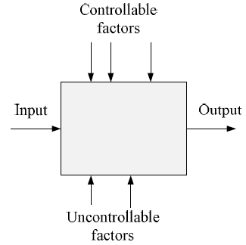
Factors and Response
Learning algorithm
Hyperparameters of the algorithm
(i.e. no of hidden layers/unit in a MLP)
Dataset used
Input representation
used to generate the response variable
- classification error
- expected risk
- precision, recall
- auc
Data noise
Particular resampled training set
Randomness in optimization process

Slide 7
Factors and Response: Example
Controllable Factors:
PCA to reduce dimension to d
Knn classifier with k
Response:
Classification error on validation set
Find the setting of k and d for the best response

Slide 8
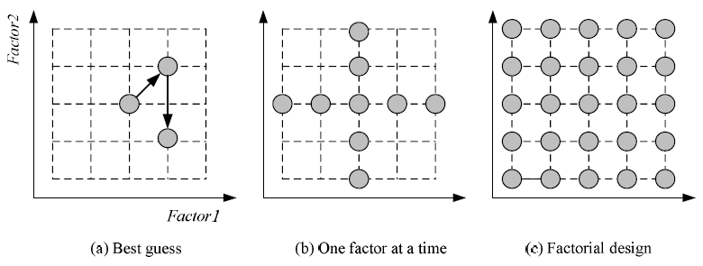
Strategies of Experimentation
Grid search
Best approach
F Factors with L levels each:
Cost: O(L^{F}) (☹ !!!)
F Factors with L levels each:
Cost: O(LF)
Response surface design for approximating and maximizing
the response function in terms of the controllable factors

Slide 9
Experimental Design
Randomization
independent order of experiments)
Replication
For the same configuration, run the experiment a number of times → see Cross Validation
Blocking
Reduce variability due to nuisance factors
Pairing, paired testing: compare algorithms trained on the same resampled training subsets

Slide 10
Guidelines for ML experiments
Aim of the study
Selection of the response variable
Choice of factors and levels
Choice of experimental design
Performing the experiment
Statistical Analysis of the Data
Is Algorithm A more accurate than Algorithm B on this dataset?
Conclusions and Recommendations

Slide 11
Experimental Design: Replication

Slide 12
Resampling and K-Fold Cross-Validation
The need for multiple training/validation sets
{X_{i},V_{i}}_{i}: Training/validation sets of fold i
K-fold cross-validation: Divide X into k, X_{i},i=1,...,K
T_{i} share K-2 parts
Report the validation error on each Vi,
Report the average and std of the validation error
See also the hypothesis testing part below.

Slide 13
5×2 Cross-Validation
5 times 2 fold cross-validation (Dietterich, 1998)
Notes:
Diettrich: You could do more than 5 folds, but errors become more dependent and do not add new information

Slide 14
Leave-One-Out Cross Validation
Leave-One-Out : Sometimes also called LOO
Use especially if there are not many data samples and hence can not afford to leave out a lot of examples for validation.
Do N (no of data samples) folds.
At fold i (i=1..N), use the ith sample for validation and all the remaining samples for training.

Slide 15
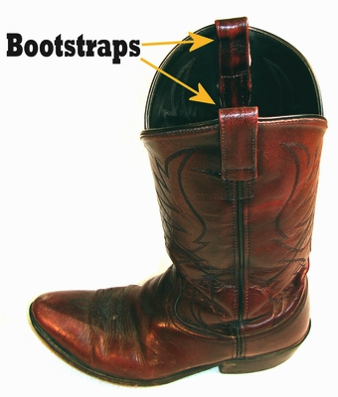

Bootstrapping
Images: rudebaguette.com, lanternlegal.com
Draw instances from a dataset with replacement
Prob that we do not pick an instance after N draws
that is, only 36.8% is new!

Slide 16
Response Variable: Measuring Classifier Performance

Slide 17
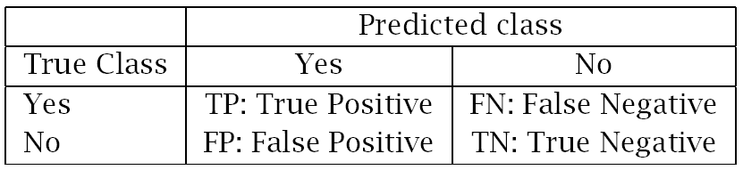
Measuring Error
Error rate = # of errors / # of instances = (FN+FP) / N
Recall = # of found positives / # of positives
= TP / (TP+FN) = sensitivity = hit rate
Precision = # of found positives / # of found
= TP / (TP+FP)
Specificity = TN / (TN+FP)
False alarm rate = FP / (FP+TN) = 1 - Specificity

Slide 18
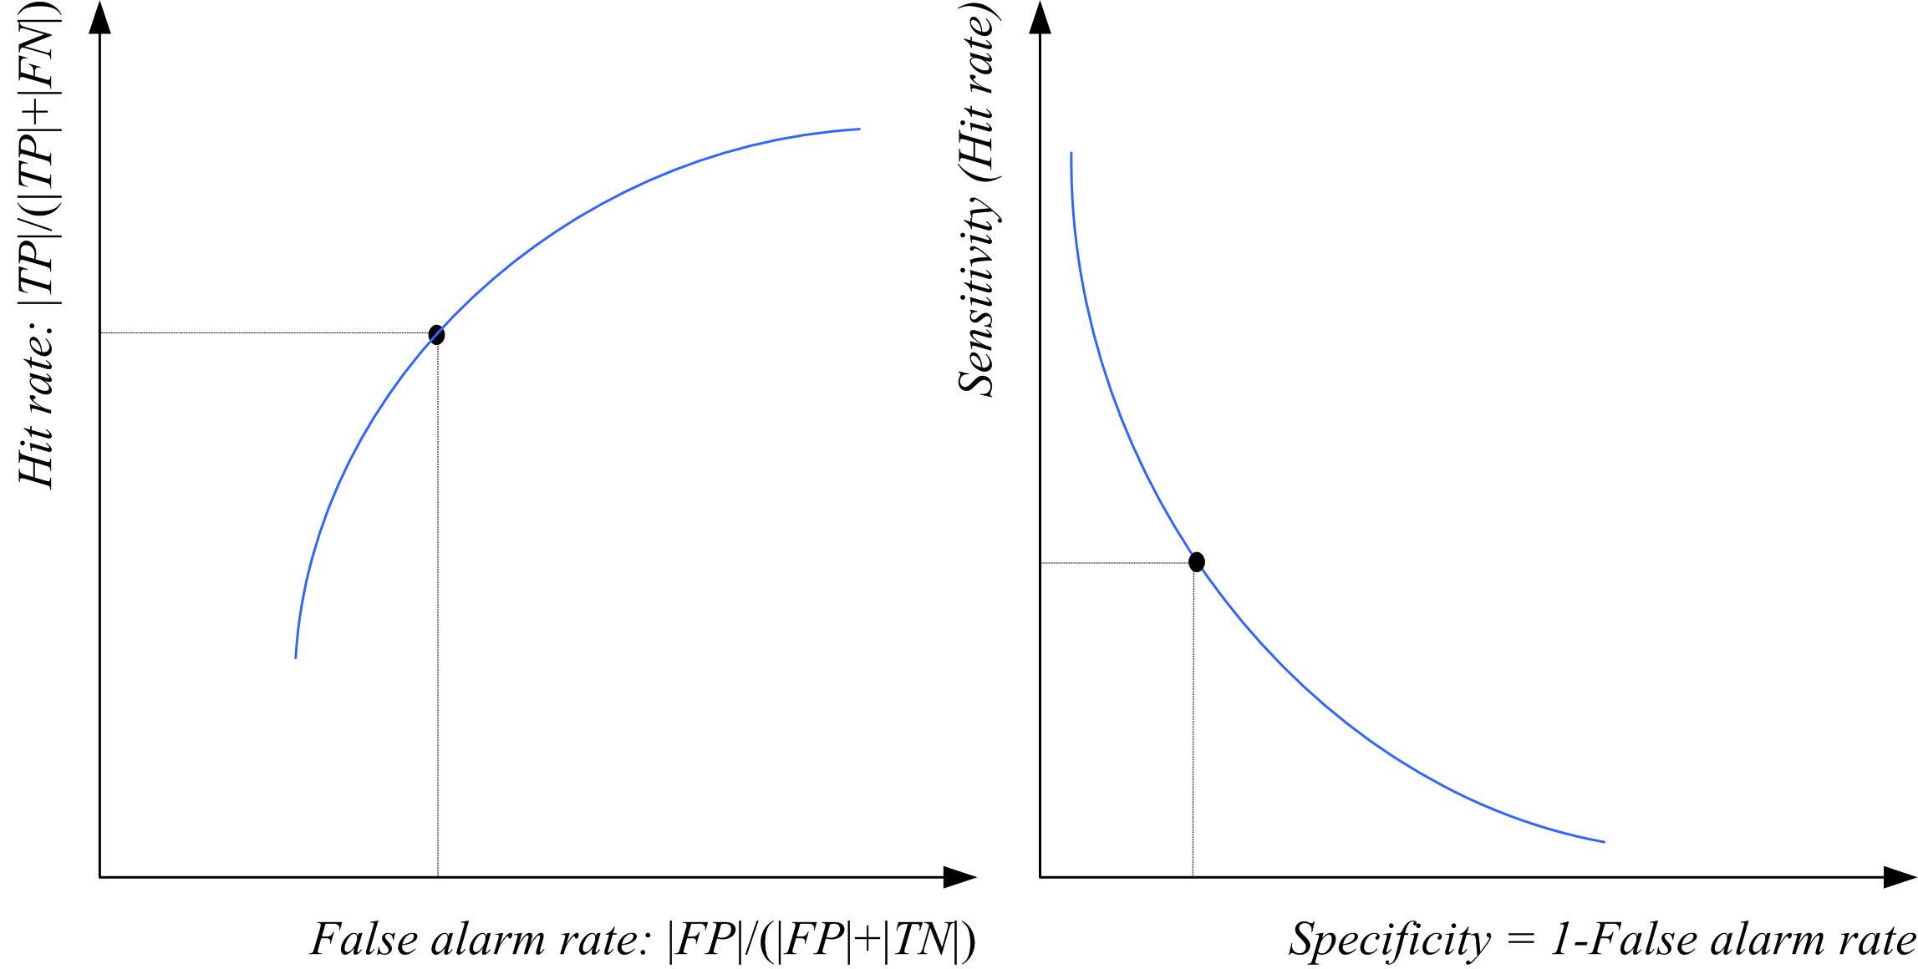
ROC Curve

Slide 19
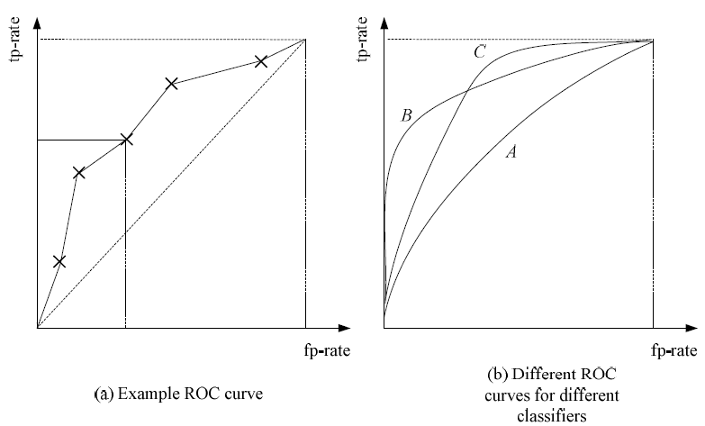

Slide 20
AUC: Area Under the ROC Curve
Used to compare classifiers based on all possible operating points (i.e. thresholds decided for positive or negative class).
Computed by taking the area under the ROC curve.
Maximum possible is 1.
The higher the AUC the better the classifier.

Slide 21
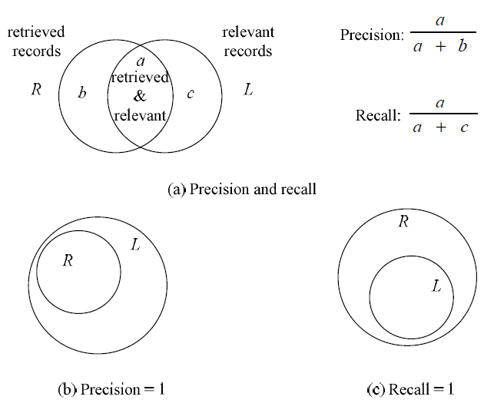
Precision and Recall

Slide 22
Assessing a Classification Algorithm’s Performance
For classification error (same methodolgy can be applied to regression also, if the appropriate parametric form for sampling distribution can be obtained)
Same Data Set (Assume distribution on computed errors)
Single Algorithm
Single Train-Validation Set
Binomial Test
Approximate Normal Test (need large N)
K Train Validation Sets
t test
Two Learning Algorithms
McNemar’s Test
K-Fold Cross-Validated Paired t Test
5x2 cv Paired t test
5x2 cv Paired F test
Multiple Algorithms
Analysis of Variance (ANOVA)
Multiple Datasets (Can not assume the same distribution, non parametric)
Two Algorithms
Sign Test
Wilcoxon Signed Rank Test
Multiple Algorithms
Kruskal-Wallis (nonparametric version of ANOVA)
Tukey’s Test (pairwise comparison of ranks)

Slide 23
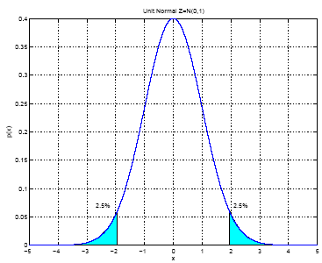
Interval Estimation (Review)
X = { x^{t} }_{t} where x^{t} ~ N ( μ, σ²)
m ~ N ( μ, σ²/N)
Unit normal
100(1- α) percent
(two sided) confidence
İnterval for μ

Slide 24
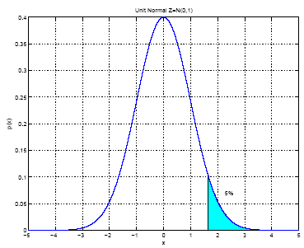
100(1- α) percent
(one sided) confidence interval
When σ² is not known:

Slide 25
Hypothesis Testing
Reject a null hypothesis if not supported by the sample with enough confidence
X = { x^{t} }_{t} where x^{t} ~ N ( μ, σ²)
H₀: μ = μ₀ vs. H₁: μ ≠ μ₀
Accept H₀ with level of significance α if μ₀ is in the
100(1- α) confidence interval
Two-sided test

Slide 26
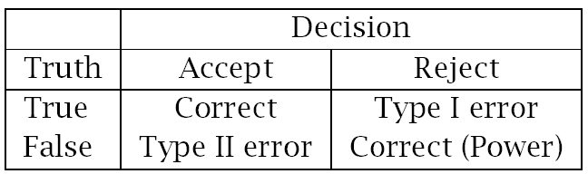
One-sided test: H₀: μ ≤ μ₀ vs. H₁: μ > μ₀
Accept if
Variance unknown: Use t, instead of z
Accept H₀: μ = μ₀ if

Slide 27
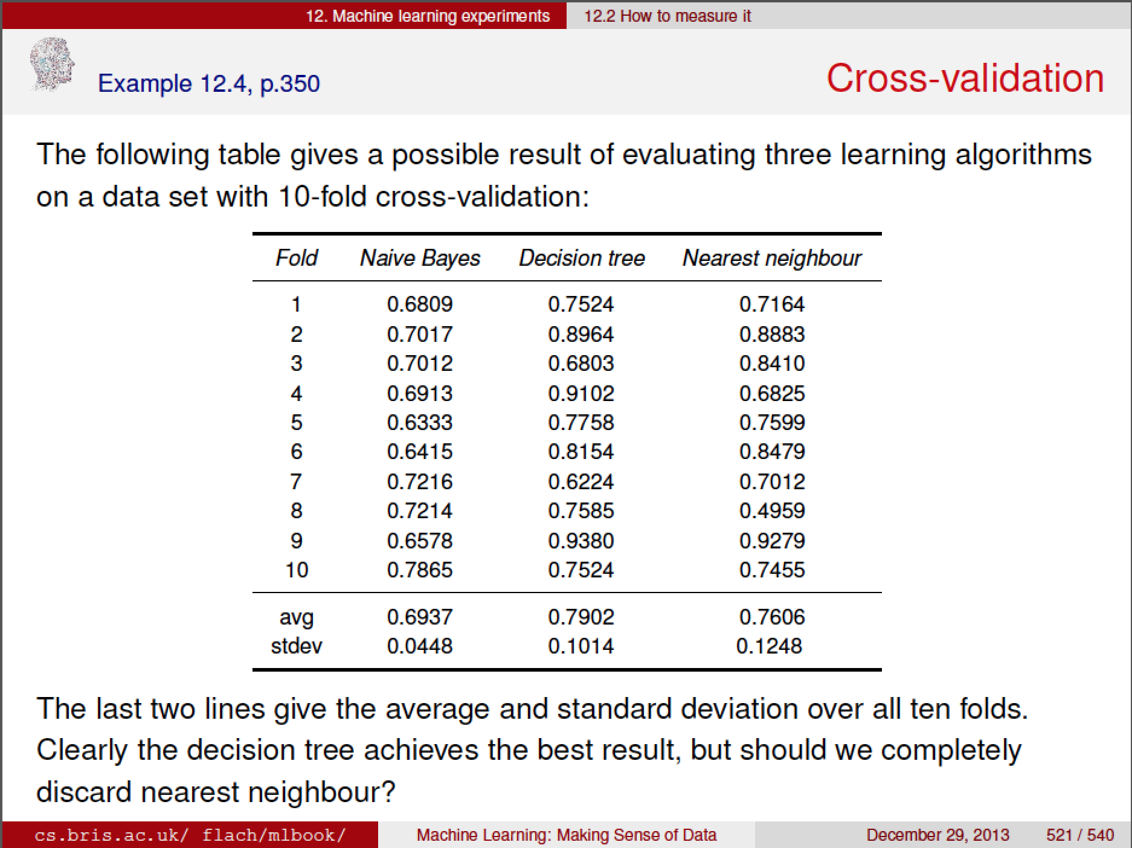

Slide 28
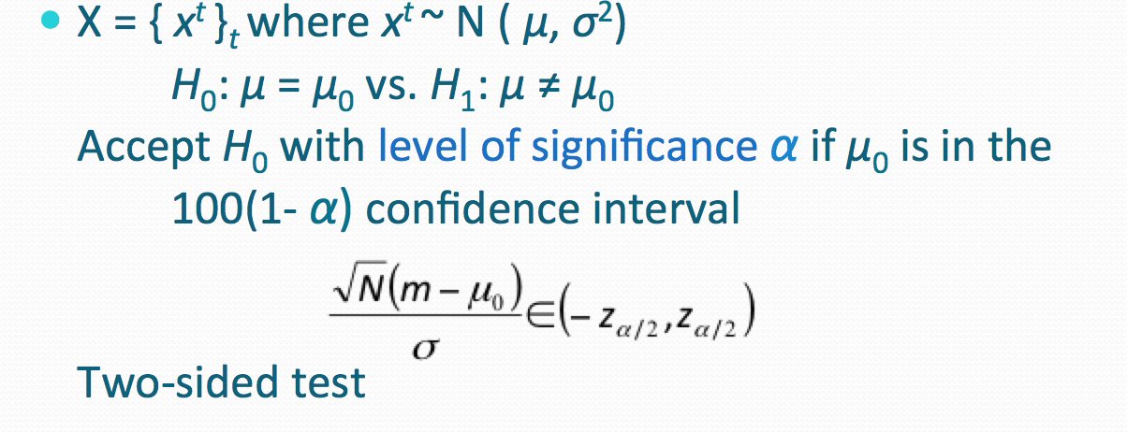
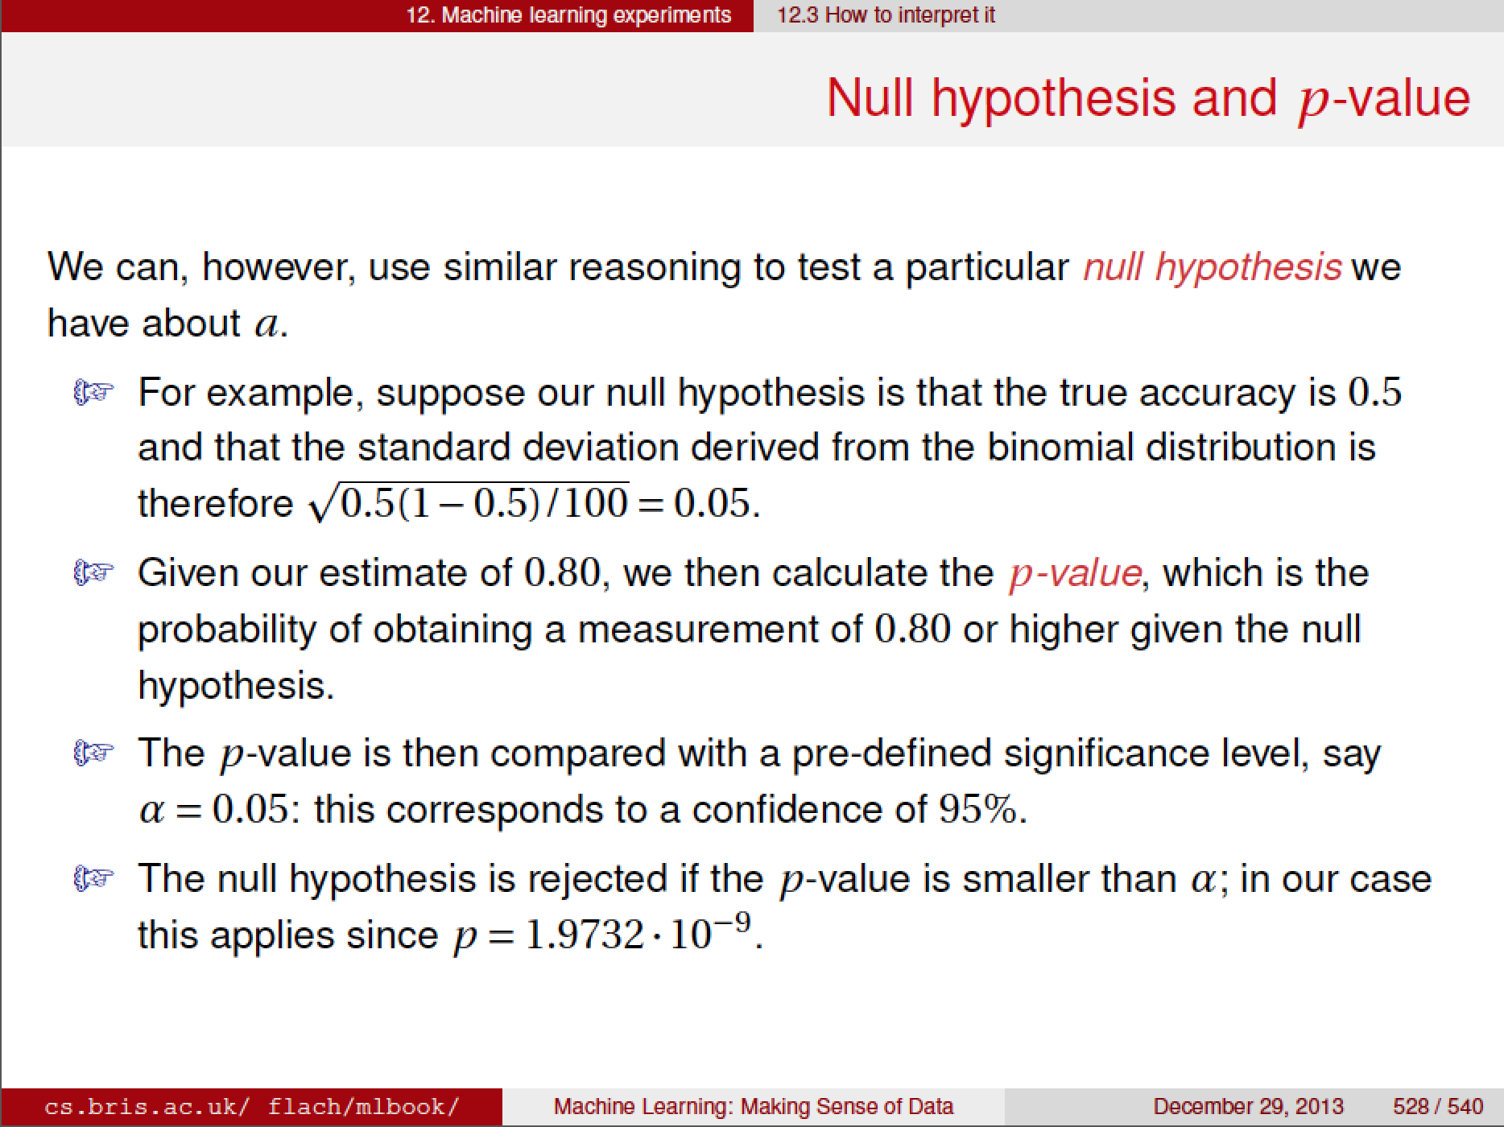

Slide 29
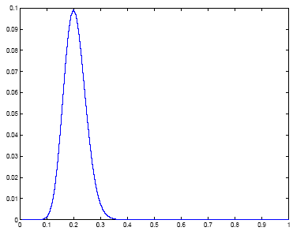
Assessing Error: H₀: p ≤ p₀ vs. H₁: p > p₀
Single training/validation set: Binomial Test
If error prob is p₀, prob that there are e errors or less in N validation trials is
Accept if this prob is less than 1- α
N=100, e=20
1- α

Slide 30
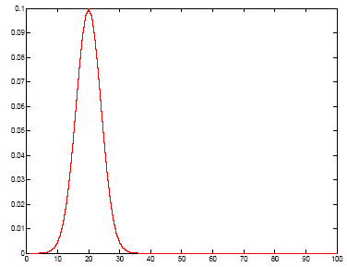
Normal Approximation to the Binomial
Number of errors X is approx N with mean Np₀ and var Np₀(1-p₀)
Accept if this prob for X = e is
less than z_{1-α}
1- α

Slide 31
t Test
Multiple training/validation sets
x^{t}_{i} = 1 if instance t misclassified on fold i
Error rate of fold i:
With m and s² average and var of p_{i} , we accept p₀ or less error if
is less than t_{α,K-1}

Slide 32
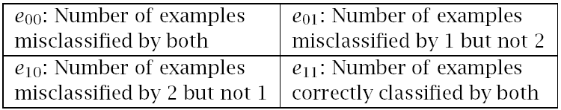
Comparing Classifiers: H₀: μ₀ = μ₁ vs. H₁: μ₀ ≠ μ₁
Single training/validation set: McNemar’s Test
Under H₀, we expect e₀₁= e₁₀=(e₀₁+ e₁₀)/2
Because we are summing squares of normals
Includes Edward’s
Correction for continuity
Accept if < X²_{α,1}

Slide 33
K-Fold CV Paired t Test
Use K-fold cv to get K training/validation folds
p_{i}¹, p_{i}²: Errors of classifiers 1 and 2 on fold i
p_{i} = p_{i}¹ – p_{i}² : Paired difference on fold i
The null hypothesis is whether p_{i} has mean 0

Slide 34
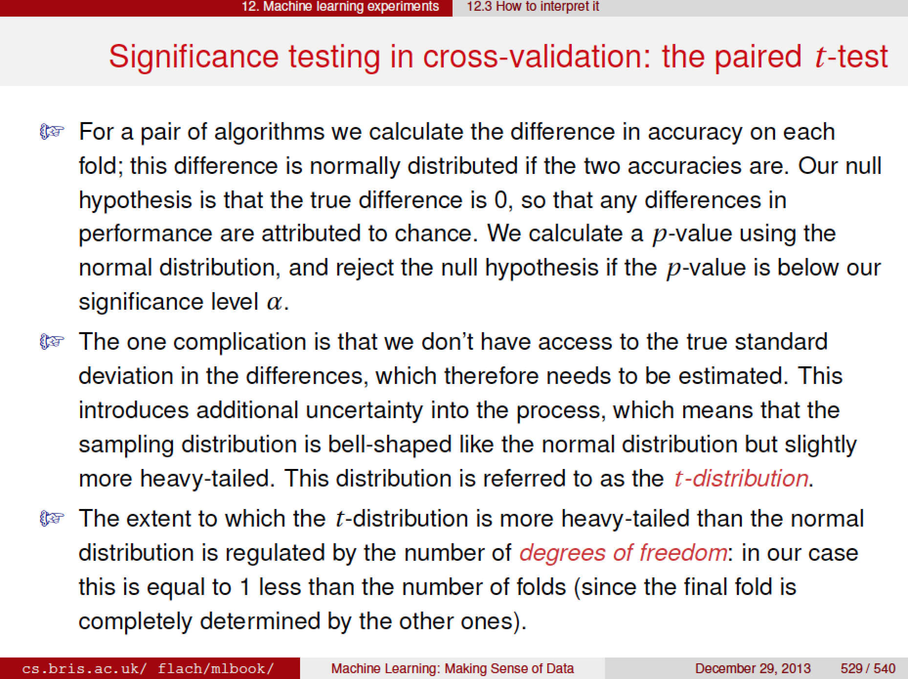

Slide 35
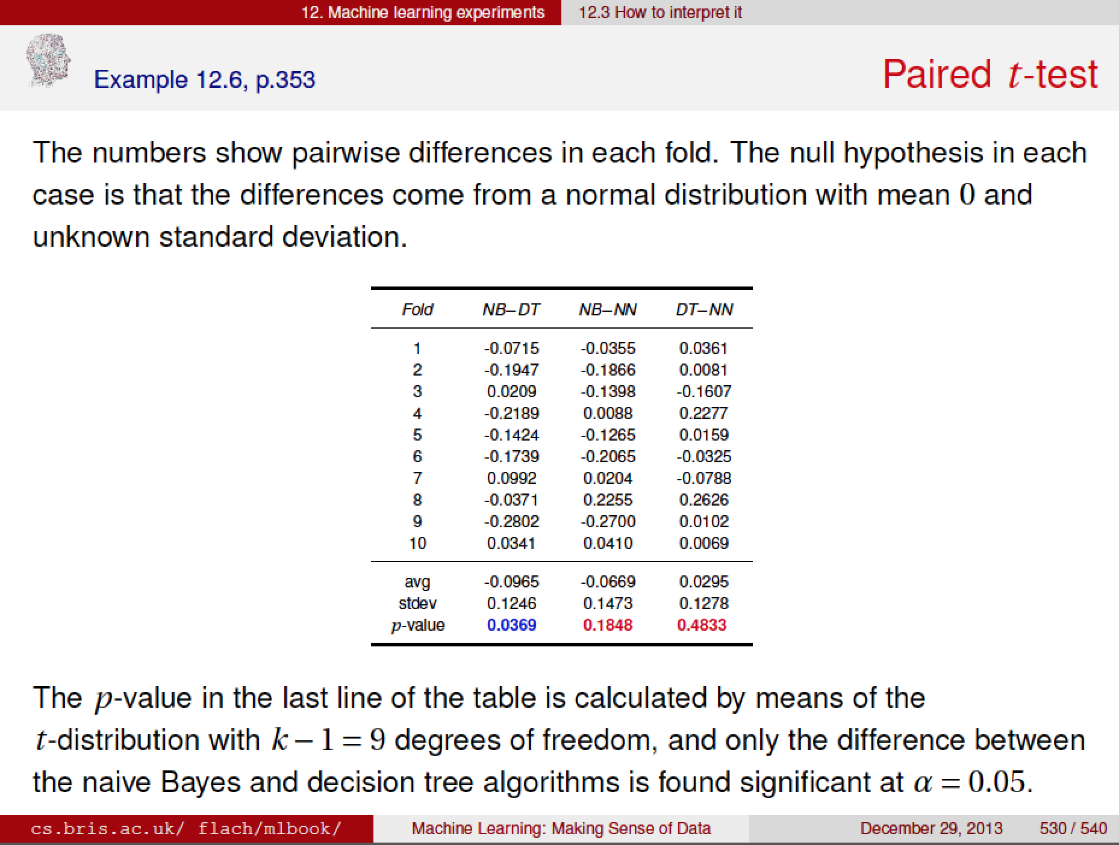

Slide 36
5×2 cv Paired t Test
Use 5×2 cv to get 2 folds of 5 tra/val replications (Dietterich, 1998)
p_{i}^{(j)} : difference btw errors of 1 and 2 on fold j=1, 2 of replication i=1,...,5
Could use here any other p_{i}^{(j)}
Two-sided test: Accept H₀: μ₀ = μ₁ if in (-t_{α/2,5},t_{α/2,5})
One-sided test: Accept H₀: μ₀ ≤ μ₁ if < t_{α,5}

Slide 37
5×2 cv Paired F Test
Compare all values of p_{i}^{(j)}
Because we are taking ratios of two X² r.v.s
Two-sided test: Accept H₀: μ₀ = μ₁ if < F_{α,10,5}

Slide 38
Comparing L>2 Algorithms: Analysis of Variance (Anova)
Errors of L algorithms on K folds
We construct two estimators to σ² .
One is valid if H₀ is true, the other is always valid.
We reject H₀ if the two estimators disagree.

Slide 40
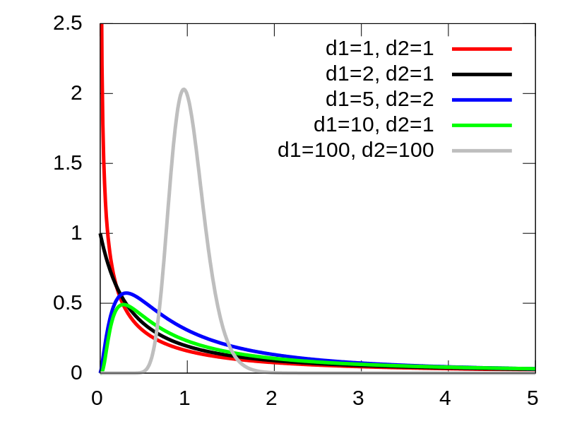

Slide 41
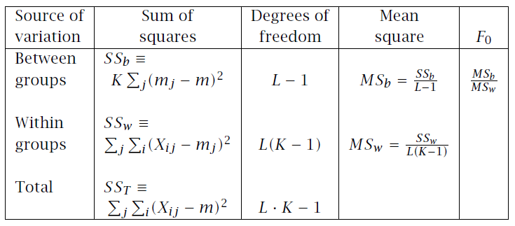
ANOVA table
If ANOVA rejects, we do pairwise posthoc tests
Where mi~N(μi,σ_{w}²=MS_{w}/K)

Slide 42
Comparison over Multiple Datasets
Comparing two algorithms:
Sign test: Count how many times A beats B over N datasets, and check if this could have been by chance if A and B did have the same error rate
Comparing multiple algorithms
Kruskal-Wallis test: Calculate the average rank of all algorithms on N datasets, and check if these could have been by chance if they all had equal error
If KW rejects, we do pairwise posthoc tests to find which ones have significant rank difference

Slide 43
See the Tutorial by Padraic Cunningham at
http://www.ecmlpkdd2009.net/wp-content/uploads/2009/08/evaluation-in-machine-learning.pdf
Peter Flach Machine Learning slides, Ch 12.:
https://docs.google.com/file/d/0B8ya4ynGkqSxdXRoVmJFNmJEQTQ/edit

