Slide 1
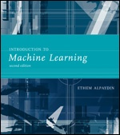
INTRODUCTION TO Machine Learning
Lecture Slides for
ETHEM ALPAYDIN
© The MIT Press, 2010
alpaydin@boun.edu.tr
http://www.cmpe.boun.edu.tr/~ethem/i2ml2e

Slide 2
CHAPTER 2: Supervised Learning

Slide 3
Learning a Class from Examples
Class C of a “family car”
Prediction: Is car x a family car?
Knowledge extraction: What do people expect from a family car?
Output:
Positive (+) and negative (–) examples
Input representation:
x₁: price, x₂ : engine power

Slide 4
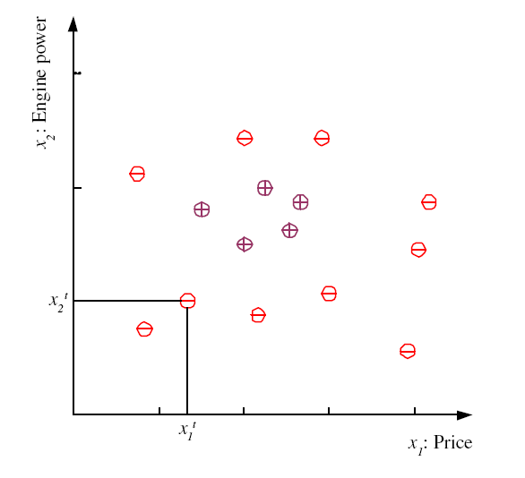
Training set X

Slide 5
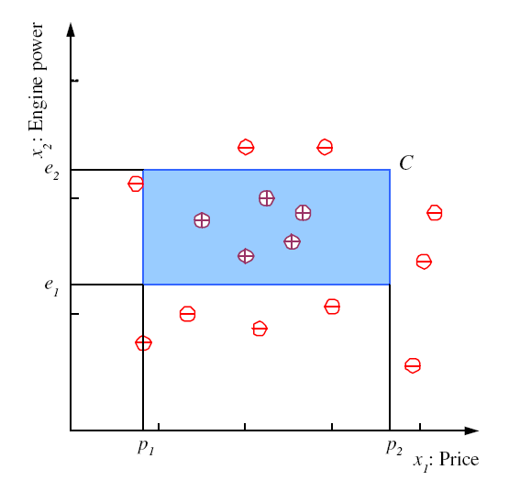
Class C

Slide 6
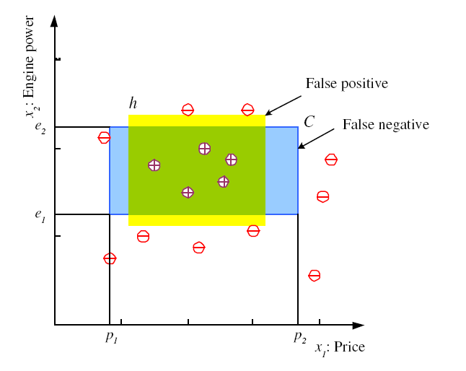
Hypothesis class H
h: a hypothesis from H
X : training set
Error of h on X

Slide 7
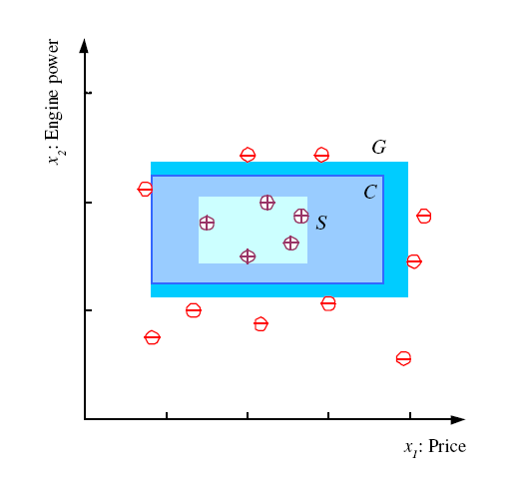
S, G, and the Version Space
most specific hypothesis, S
most general hypothesis, G
h ∈ H, between S and G is
Consistent (error free)
and make up the
version space
(Mitchell, 1997)

Slide 8
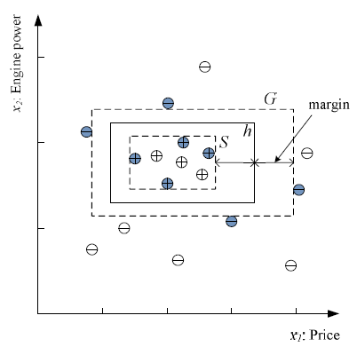
Margin
Choose h with largest margin

Slide 9
VC Dimension and PAC Learning
Tools to analyze expected (test/generalization) error of hypothesis classes (i.e. classifiers)
VC (Vapnik Chervonenkis) Dimension:
Given a hypothesis class (rectangles, circles, lines, neural networks) how many instances can it classify without any error.
Does not consider the input distribution
PAC (Probably Approximately Correct) Learning
How many instances are needed to achieve a certain error with a certain probability?

Slide 10
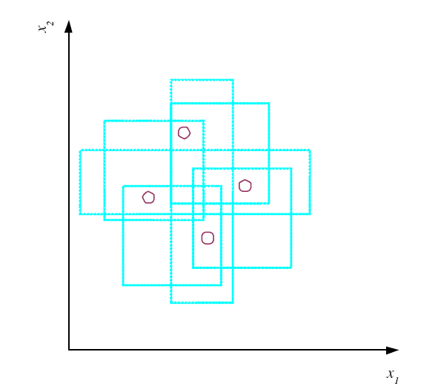
VC Dimension
N points can be labeled in 2^{N} ways as +/–
H shatters N if
there exists h ∈ H consistent
for any of these:
VC(H ) = N
N=3 for this table
 | R1 | R2 | R3 | R4 | R5 | R6 | R7 | R8
x1 | 0 | 0 | 0 | 1 | 0 | 1 | 1 | 1
x2 | 0 | 0 | 1 | 0 | 1 | 0 | 1 | 1
x3 | 0 | 1 | 0 | 0 | 1 | 1 | 0 | 1
An axis-aligned rectangle shatters 4 points only !
Choose points in such a way that they can be shattered.
e.g. Do not put all of them at the same spot.

Slide 11
VC Dimension Examples
We use g to denote hypothesis (like h)
Question: Can the following g (line passing through origin) shatter the following points?
g(x,θ) = sign(x. θ)=sign(x₁θ₁+x₂θ₂)
Answer: No problem. There are four training sets to consider +
θ=(0,1)
θ =(-2,3)
θ =(2,-3)
θ =(0,-1)
by Andrew Moore

Slide 12
VC dim of line machine
Given machine g, the VC-dimension v is
The maximum number of points that can be arranged so that g shatter them.
Example: For 2-d inputs, what’s VC-dim of g(x,θ,b) = sign(θ.x+b)?
Well, can g shatter these three points?
Yes, of course.
All -ve or all +ve is trivial
One +ve can be picked off by a line
One -ve can be picked off too.
by Andrew Moore

Slide 13
VC dim of line machine
Given machine g, the VC-dimension v is
The maximum number of points that can be arranged so that g shatter them.
Example: For 2-d inputs, what’s VC-dim of g(x,θ,b) = sign(θ.x+b)?
Well, can we find four points that g can shatter?
by Andrew Moore

Slide 14
VC dim of line machine
Given machine g, the VC-dimension v is
The maximum number of points that can be arranged so that g shatter them.
Example: For 2-d inputs, what’s VC-dim of g(x,θ,b) = sign(θ.x+b)?
Well, can g shatter these four points?
Can always draw six lines between pairs of four points.
by Andrew Moore

Slide 15
VC dim of line machine
Given machine g, the VC-dimension v is
The maximum number of points that can be arranged so that g shatter them.
Example: For 2-d inputs, what’s VC-dim of g(x,θ,b) = sign(θ.x+b)?
Well, can g shatter these four points?
Can always draw six lines between pairs of four points.
Two of those lines will cross.
by Andrew Moore

Slide 16
VC dim of line machine
Given machine g, the VC-dimension v is
The maximum number of points that can be arranged so that g shatter them.
Example: For 2-d inputs, what’s VC-dim of g(x, θ,b) = sign(θ.x+b)?
Well, can we find four points that g can shatter?
Can always draw six lines between pairs of four points.
Two of those lines will cross.
If we put points linked by the crossing lines in the same class they can’t be linearly separated
So a line can shatter 3 points but not 4
So VC-dim of Line Machine is 3
If inputs are m dimensional, v=m+1(see A. Moore notes).
by Andrew Moore

Slide 17
Why VC Dimension
Given some machine g, let v be its VC dimension.
v is a measure of g’s power (v does not depend on the choice of training set)
Vapnik showed that with probability 1-η
This bound is usually too big, so it may not be useful.
by Andrew Moore

Slide 18
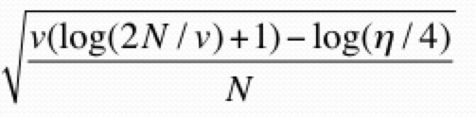
i | f_{i} | TRAINERR | VC-Conf | Probable upper bound on TESTERR | Choice
1 | f₁
2 | f₂
3 | f₃ |  |  |  | 
4 | f₄
5 | f₅
6 | f₆

Slide 19
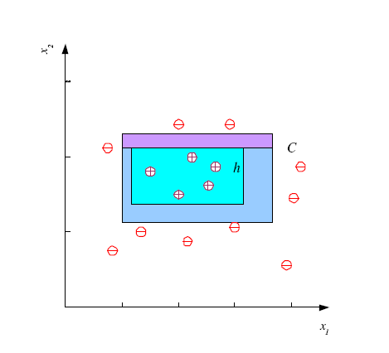
Probably Approximately Correct (PAC) Learning
How many training examples N should we have, such that with probability at least 1 ‒ δ, h has error at most ε ?
(Blumer et al., 1989)
Each strip is at most ε/4
Pr that we miss a strip 1‒ ε/4
Pr that N instances miss a strip (1 ‒ ε/4)^{N}
Pr that N instances miss 4 strips 4(1 ‒ ε/4)^{N}
4(1 ‒ ε/4)^{N} ≤ δ and (1 ‒ x)≤exp( ‒ x)
4exp(‒ εN/4) ≤ δ and N ≥ (4/ε)log(4/δ)

Slide 20
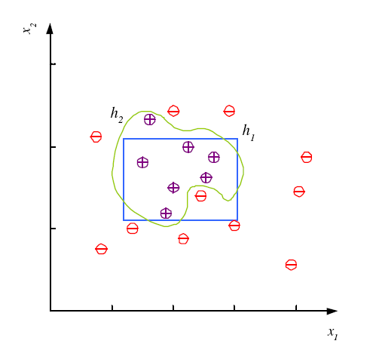
Noise and Model Complexity
Use the simpler one because
Simpler to use
(lower computational
complexity)
Easier to train (lower
space complexity)
Easier to explain
(more interpretable)
Generalizes better (lower
variance - Occam’s razor)

Slide 21
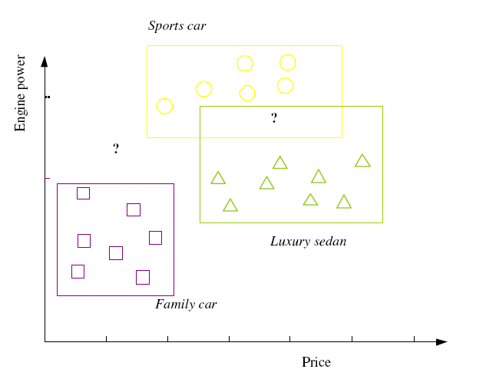

Multiple Classes, C_{i} i=1,...,K
Train hypotheses
h_{i}(x), i =1,...,K:

Slide 22
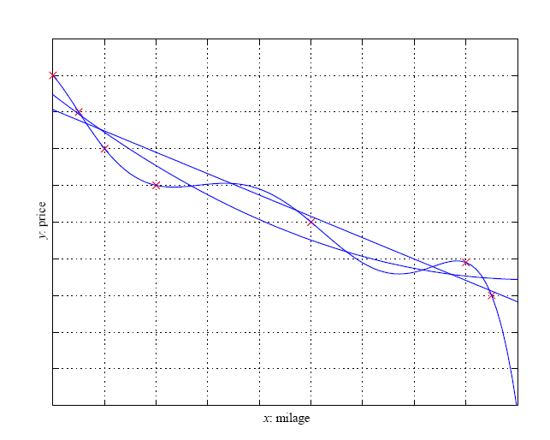
Regression

Slide 23
Model Selection & Generalization
Learning is an ill-posed problem, i.e. data is not sufficient to find a unique solution
The need for inductive bias, assumptions about H
Generalization: How well a model performs on new data
Overfitting: H more complex than C or f
Underfitting: H less complex than C or f

Slide 24
Model Selection & Generalization
Learning is an ill-posed problem, i.e. data is not sufficient to find a unique solution
The need for inductive bias, assumptions about H
Generalization: How well a model performs on new data
Overfitting: H more complex than C or f
Underfitting: H less complex than C or f
Data not sufficient to find a unique solution
Set of assumptions we make to make learning possible.

Slide 25
Triple Trade-Off
There is a trade-off between three factors (Dietterich, 2003):
Complexity of H, c (H),
Training set size, N,
Generalization error, E, on new data
As N, E↓
As c (H), first E↓ and then E

Slide 26
Cross-Validation
To estimate generalization error, we need data unseen during training. We split the data as
Training set (50%)
Validation set (25%)
Test (publication) set (25%)
Resampling (e.g. bootstrapping) when there is few data

Slide 27
Cross Validation
i | f_{i} | TRAINERR | 10-FOLD-CV-ERR | Choice
1 | f₁
2 | f₂
3 | f₃ |  |  | 
4 | f₄
5 | f₅
6 | f₆
h more complex

Slide 28
Dimensions of a Supervised Learner
Model:
Loss function:
Optimization procedure:

