Slide 1
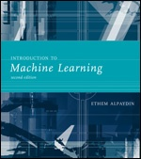
INTRODUCTION TO Machine Learning 2nd Edition
Lecture Slides for
ETHEM ALPAYDIN
© The MIT Press, 2010
alpaydin@boun.edu.tr
http://www.cmpe.boun.edu.tr/~ethem/i2ml2e

Slide 2
CHAPTER 3: Bayesian Decision Theory

Slide 3
Probability and Inference
Result of tossing a coin is ∈ {Heads,Tails}
Random var X ∈{1,0}
Bernoulli: P {X=1} = p_{o}^{X} (1 ‒ p_{o})^{(1 ‒ X)}
Sample: X = {x^{t} }^{N}_{t =1}
Estimation: p_{o} = # {Heads}/#{Tosses} = ∑_{t} x^{t} / N
Prediction of next toss:
Heads if p_{o} > ½, Tails otherwise

Slide 4
Game
You record the following tosses:
{H, T, T, T, H, T, T, T, T, H, H, T, H, T, T, H, H, T, T, H?}
You win if you get the next toss right.
What do you guess?
You win 10TL and lose 5TL if you guess the next toss right.
How do you compute your earnings?
What do you guess?
Based on maximizing your earnings?
Notes:
How do you compute your earnings?

Slide 5
Classification
Credit scoring: Inputs are income and savings.
Output is low-risk vs high-risk
Input: x = [x₁,x₂]^{T} ,Output: C {0,1}
Prediction:

Slide 6
Bayes’ Rule
prior
likelihood
posterior
evidence

Slide 7
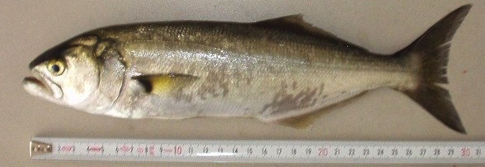
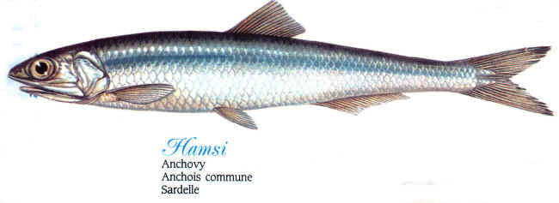
Game
P(x|hamsi)
 | short | tall
white | 0.6 | 0.1
gray | 0.2 | 0.1
P(x|lufer)
 | short | tall
white | 0.05 | 0.2
gray | 0.05 | 0.7
You caught a tall and white fish.
Is it hamsi or lufer?

Slide 8
Bayes’ Rule: K>2 Classes

Slide 9
Losses and Risks
Actions: α_{i}
Loss of α_{i} when the state is C_{k} : λ_{ik}
e.g. cancer prediction
 | Predicted 0 | Predicted 1
Actual 0 | 0 | 1
Actual1 | 1 | 0
 | Predicted 0 | Predicted 1
Actual 0 | 0 | 1
Actual1 | 100 | 0

Slide 10
Losses and Risks
Actions: α_{i}
Loss of α_{i} when the state is C_{k} : λ_{ik}
Expected risk (Duda and Hart, 1973)

Slide 11
Losses and Risks: 0/1 Loss
For minimum risk, choose the most probable class

Slide 12
Losses and Risks: Reject

Slide 13
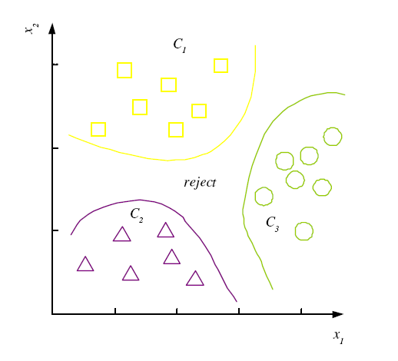
Discriminant Functions
K decision regions R₁,...,R_{K}

Slide 14
K=2 Classes
Dichotomizer (K=2) vs Polychotomizer (K>2)
g(x) = g₁(x) – g₂(x)
Log odds:

Slide 15
Utility Theory
Prob of state k given exidence x: P (S_{k}|x)
Utility of α_{i} when state is k: U_{ik}
Expected utility:
This is equivalent to minimizing the risk
Based on the specific problem, other functions might be optimized (e.g. Minimize worst possible loss, maximize money earned...)

Slide 16
Association Rules
Association rule: X → Y
People who buy/click/visit/enjoy X are also likely to buy/click/visit/enjoy Y.
A rule implies association, not necessarily causation.

Slide 17
Association measures
Support (X → Y):
Confidence (X → Y):
Lift (X → Y):

Slide 18
Apriori algorithm (Agrawal et al., 1996)
For (X,Y,Z), a 3-item set, to be frequent (have enough support), (X,Y), (X,Z), and (Y,Z) should be frequent.
If (X,Y) is not frequent, none of its supersets can be frequent.
Once we find the frequent k-item sets, we convert them to rules: X, Y → Z, ...
and X → Y, Z, ...
See also the FP-Growth Algorithm:
Jiawei Han, Jian Pei, and Yiwen Yin. Mining frequent patterns without candidate generation. In SIGMOD, 2000

