Slide 1
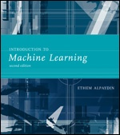
INTRODUCTION TO Machine Learning 2nd Edition
Lecture Slides for
ETHEM ALPAYDIN
© The MIT Press, 2010
alpaydin@boun.edu.tr
http://www.cmpe.boun.edu.tr/~ethem/i2ml2e

Slide 2
CHAPTER 7: Clustering

Slide 3
Semiparametric Density Estimation
Parametric: Assume a single model for p (x | C_{i}) (Chapters 4 and 5)
Semiparametric: p (x | C_{i}) is a mixture of densities
Multiple possible explanations/prototypes:
Different handwriting styles, accents in speech
Nonparametric: No model; data speaks for itself (Chapter 8)

Slide 4
Mixture Densities
where G_{i} the components/groups/clusters,
P ( G_{i} ) mixture proportions (priors),
p ( x | G_{i}) component densities
Gaussian mixture where p(x|G_{i}) ~ N ( μ_{i} , ∑_{i} ) parameters Φ = {P ( G_{i} ), μ_{i} , ∑_{i} }^{k}_{i=1}
unlabeled sample X={x^{t}}_{t} (unsupervised learning)

Slide 5
Classes vs. Clusters
Supervised: X = { x^{t} ,r^{t} }_{t}
Classes C_{i} i=1,...,K
where p ( x | C_{i}) ~ N ( μ_{i} , ∑_{i} )
Φ = {P (C_{i} ), μ_{i} , ∑_{i} }^{K}_{i=1}
Unsupervised : X = { x^{t} }_{t}
Clusters G_{i} i=1,...,k
where p ( x | G_{i}) ~ N ( μ_{i} , ∑_{i} )
Φ = {P ( G_{i} ), μ_{i} , ∑_{i} }^{k}_{i=1}
Labels, r ^{t}_{i} ?

Slide 6
k-Means Clustering
Find k reference vectors (prototypes/codebook vectors/codewords) which best represent data
Reference vectors, m_{j}, j =1,...,k
Use nearest (most similar) reference:
Reconstruction error

Slide 7
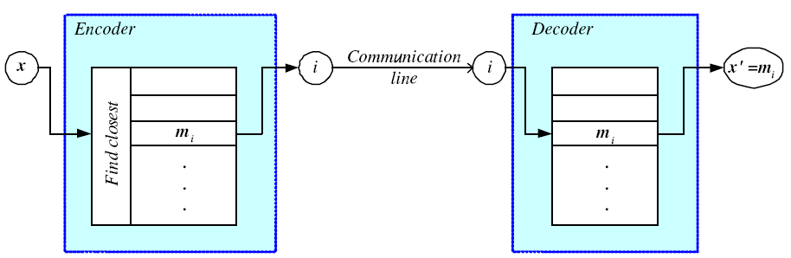
Encoding/Decoding

Slide 8
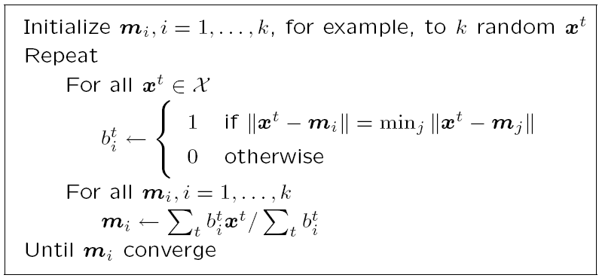
k-means Clustering

Slide 9
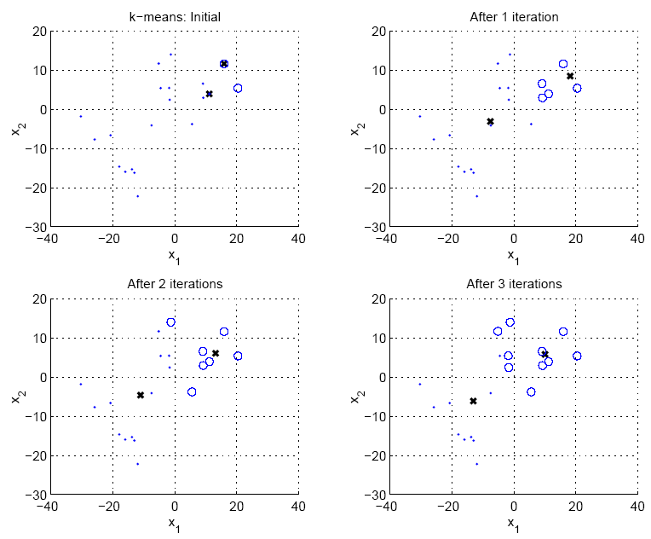

Slide 10
Expectation-Maximization (EM)
Log likelihood with a mixture model
Assume hidden variables z, which when known, make optimization much simpler
Complete likelihood, L_{c}(Φ |X,Z), in terms of x and z
Incomplete likelihood, L(Φ |X), in terms of x

Slide 11
E- and M-steps
Iterate the two steps
E-step: Estimate z given X and current Φ
M-step: Find new Φ’ given z, X, and old Φ.
An increase in Q increases incomplete likelihood

Slide 12
EM in Gaussian Mixtures
z^{t}_{i} = 1 if x^{t} belongs to G_{i}, 0 otherwise (labels r ^{t}_{i} of supervised learning); assume p(x|G_{i})~N(μ_{i},∑_{i})
E-step:
M-step:
Use estimated labels in place of unknown labels

Slide 13
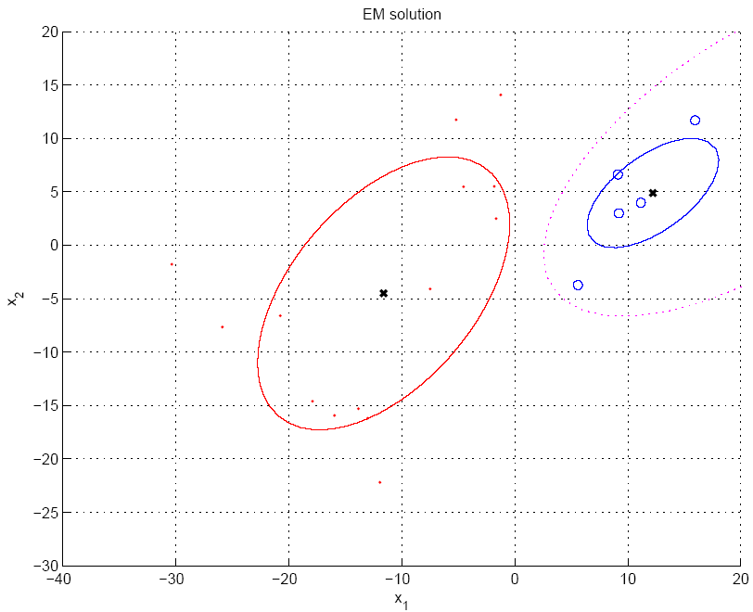
P(G₁|x)=h₁=0.5

Slide 14
Mixtures of Latent Variable Models
Regularize clusters
Assume shared/diagonal covariance matrices
Use PCA/FA to decrease dimensionality: Mixtures of PCA/FA
Can use EM to learn V_{i} (Ghahramani and Hinton, 1997; Tipping and Bishop, 1999)

Slide 15
After Clustering
Dimensionality reduction methods find correlations between features and group features
Clustering methods find similarities between instances and group instances
Allows knowledge extraction through
number of clusters,
prior probabilities,
cluster parameters, i.e., center, range of features.
Example: CRM, customer segmentation

Slide 16
Clustering as Preprocessing
Estimated group labels h_{j} (soft) or b_{j} (hard) may be seen as the dimensions of a new k dimensional space, where we can then learn our discriminant or regressor.
Local representation (only one b_{j} is 1, all others are 0; only few h_{j} are nonzero) vs
Distributed representation (After PCA; all z_{j} are nonzero)

Slide 17
Mixture of Mixtures
In classification, the input comes from a mixture of classes (supervised).
If each class is also a mixture, e.g., of Gaussians, (unsupervised), we have a mixture of mixtures:

Slide 18
Hierarchical Clustering
Cluster based on similarities/distances
Distance measure between instances x^{r} and x^{s}
Minkowski (L_{p}) (Euclidean for p = 2)
City-block distance

Slide 19
Agglomerative Clustering
Start with N groups each with one instance and merge two closest groups at each iteration
Distance between two groups G_{i} and G_{j}:
Single-link:
Complete-link:
Average-link, centroid

Slide 20
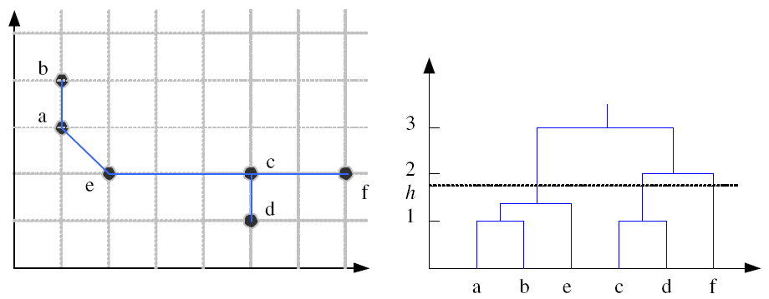
Example: Single-Link Clustering
Dendrogram

Slide 21
Choosing k
Defined by the application, e.g., image quantization
Plot data (after PCA) and check for clusters
Incremental (leader-cluster) algorithm: Add one at a time until “elbow” (reconstruction error/log likelihood/intergroup distances)
Manually check for meaning

