Slide 1
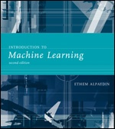
INTRODUCTION TO Machine Learning 2nd Edition
Lecture Slides for
ETHEM ALPAYDIN
© The MIT Press, 2010
alpaydin@boun.edu.tr
http://www.cmpe.boun.edu.tr/~ethem/i2ml2e

Slide 2
CHAPTER 8: Nonparametric Methods

Slide 3
Nonparametric Estimation
Parametric (single global model), semiparametric (small number of local models)
Parametric: model parameters contain summary of the information in the dataset
Nonparametric: Similar inputs have similar outputs
Functions (pdf, discriminant, regression) change smoothly
Keep the training data;“let the data speak for itself”
Given x, find a small number of closest training instances and interpolate from these
Aka lazy/memory-based/case-based/instance-based learning

Slide 4
Density Estimation
Given the training set X={x^{t}}_{t} drawn iid from p(x)
Divide data into bins of size h
Histogram:
Naive estimator:
or

Slide 5
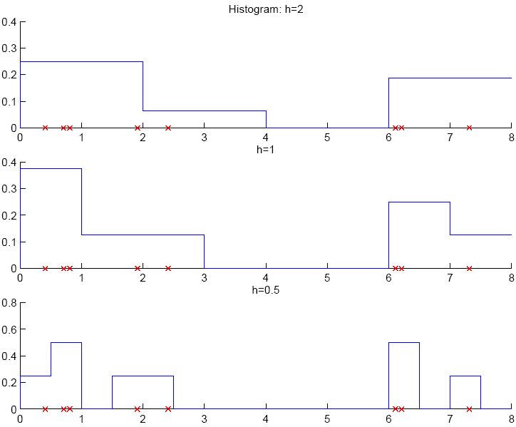

Slide 6
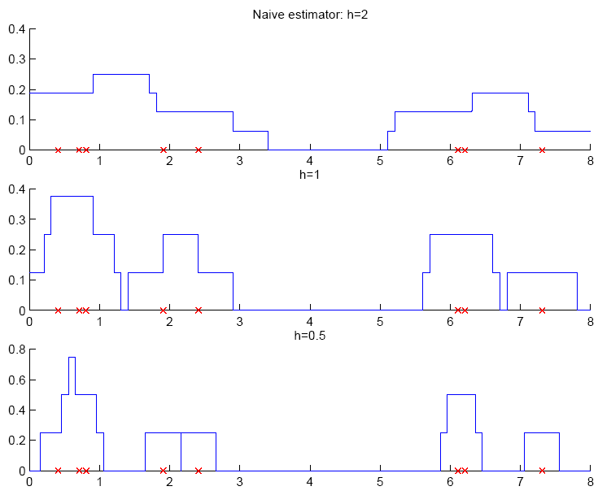

Slide 7
Why not histograms
very simple but:
The final shape of the density estimate depends on the starting position of the bins
For multivariate data, the final shape of the density is also affected by the orientation of the bins
The discontinuities of the estimate are not due to the underlying density, they are only an artifact of the chosen bin locations
These discontinuities make it very difficult, without experience, to grasp the structure of the data
A much more serious problem is the curse of dimensionality, since the number of bins grows exponentially with the number of dimensions
In high dimensions we would require a very large number of examples or else most of the bins would be empty

Slide 8
Kernel Estimator
Kernel function, e.g., Gaussian kernel:
Kernel estimator (Parzen windows)

Slide 9
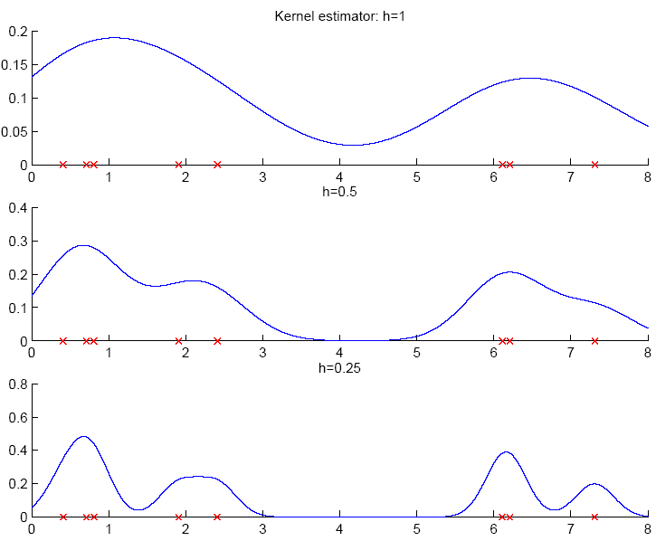

Slide 10
Nonparametric Density Estimation General Formulation (1)
The probability that a vector x, drawn from a distribution p(x), will fall in a given region ℜ of the sample space is
Suppose now that N vectors {x(1, x(2, …, x(N)} are drawn from the distribution. The probability that k of these N vectors fall in ℜ is given by the binomial distribution
It can be shown (from the properties of the binomial p.m.f.) that the mean and variance of the ratio k/N are
and

Slide 11
Nonparametric Density Estimation General Formulation(2)
Therefore, as N→∞, the distribution becomes sharper (the variance gets smaller) so we can expect that a good estimate of the probability P can be obtained from the mean fraction of the points that fall within ℜ
On the other hand, if we assume that ℜ is so small that p(x) does not vary appreciably within it, then
where V is the volume enclosed by region ℜ

Slide 12
Nonparametric Density Estimation General Formulation(3)
Merging with the previous result we obtain
This estimate becomes more accurate as we increase the number of sample points N and shrink the volume V
In practice the value of N (the total number of examples) is fixed
In order to improve the accuracy of the estimate p(x) we could let V approach zero but then the region ℜ would then become so small that it would enclose no examples
This means that, in practice, we will have to find a compromise value for the volume V
Large enough to include enough examples within ℜ
Small enough to support the assumption that p(x) is constant within ℜ

Slide 13
Nonparametric Density Estimation General Formulation(4)
When applying this result to practical density estimation problems, two basic approaches can be adopted
We can choose a fixed value of the volume V and determine k from the data. This leads to methods commonly referred to as Kernel Density Estimation (KDE)
We can choose a fixed value of k and determine the corresponding volume V from the data. This gives rise to the k Nearest Neighbor (kNN) approach
It can be shown that both kNN and KDE converge to the true probability density as N→∞, provided that V shrinks with N, and k grows with N appropriately.

Slide 14
k-Nearest Neighbor Estimator
Instead of fixing bin width h and counting the number of instances, fix the instances (neighbors) k and check bin width
d_{k}(x), distance to kth closest instance to x

Slide 15
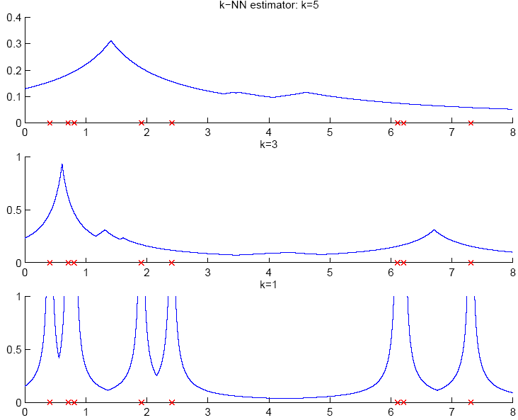

Slide 16
Multivariate Data
Kernel density estimator
Multivariate Gaussian kernel
spheric
ellipsoid

Slide 17
Nonparametric Classification
Estimate p(x|C_{i}) and use Bayes’ rule
Kernel estimator
k-NN estimator

Slide 18
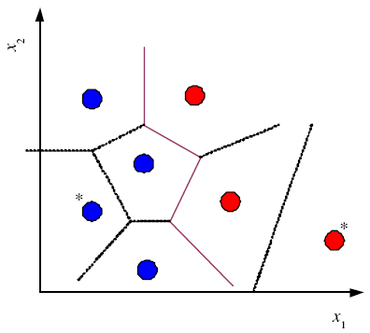
Condensed Nearest Neighbor
Time/space complexity of k-NN is O (N)
Find a subset Z of X that is small and is accurate in classifying X (Hart, 1968)
Voronoi Tessalation

Slide 19
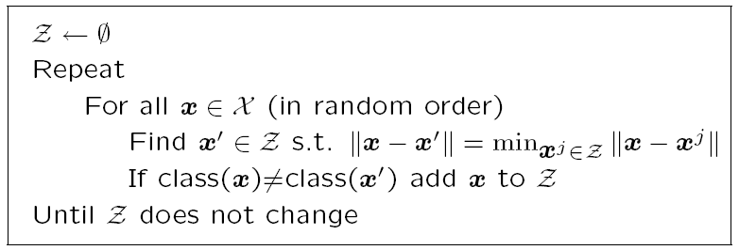
Condensed Nearest Neighbor
Incremental algorithm: Add instance if needed

Slide 20
Nonparametric Regression
Aka smoothing models
Regressogram

Slide 21
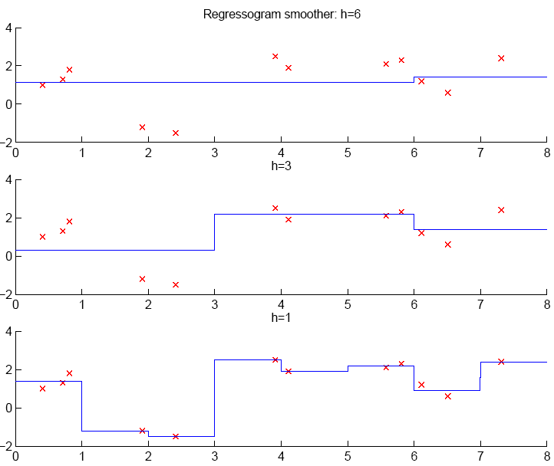

Slide 22
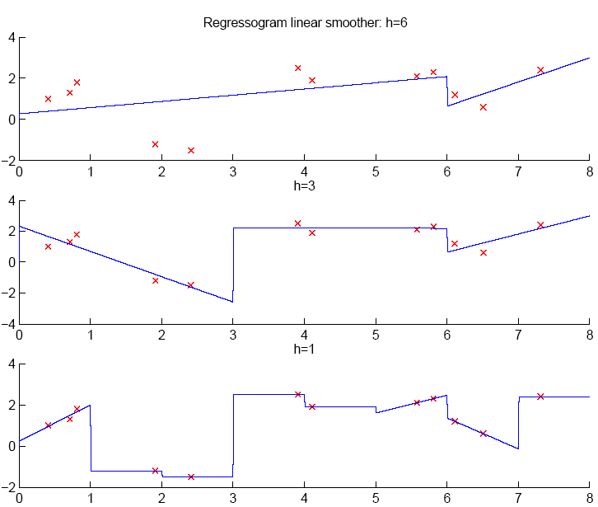

Slide 23
Running Mean/Kernel Smoother
Running mean smoother
Running line smoother
Kernel smoother
where K( ) is Gaussian
Additive models (Hastie and Tibshirani, 1990)

Slide 24
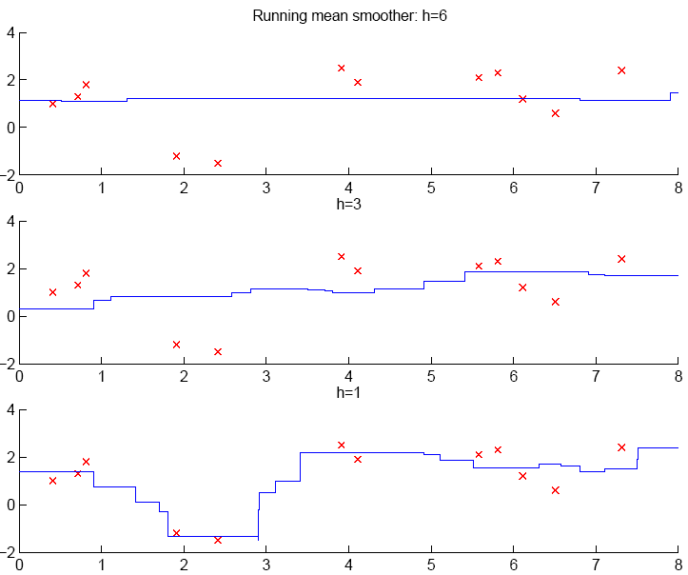

Slide 25
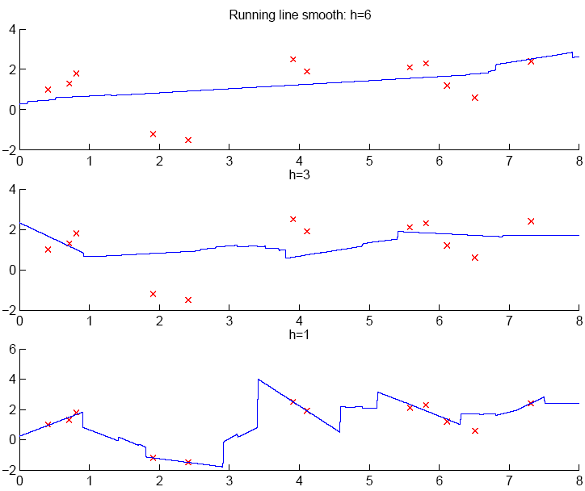

Slide 26
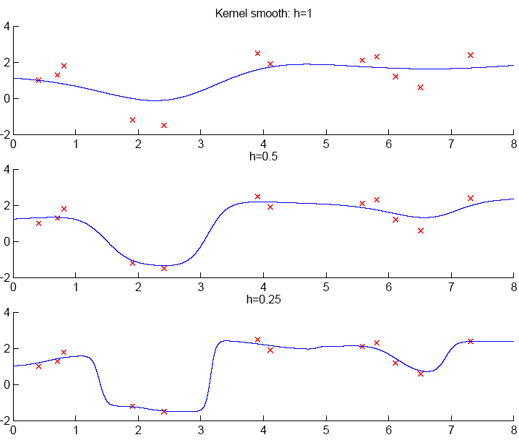

Slide 27
How to Choose k or h?
When k or h is small, single instances matter; bias is small, variance is large (undersmoothing): High complexity
As k or h increases, we average over more instances and variance decreases but bias increases (oversmoothing): Low complexity
Cross-validation is used to finetune k or h.

Slide 28
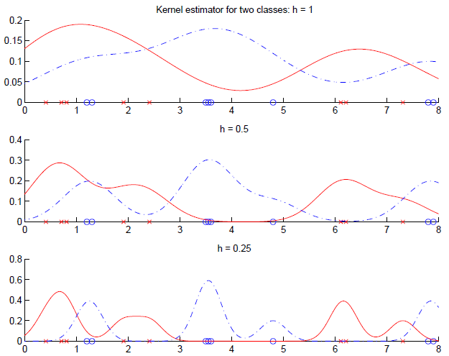

Slide 29
Nonparametric Methods for Classification/Regression?
Mostly used models:
Classification : knn
Regression: Parzen windows

