Slide 1
Proving NP-hardness when carbon dioxide becomes dry ice
Jiaheng Wang
University of Helsinki

Slide 2
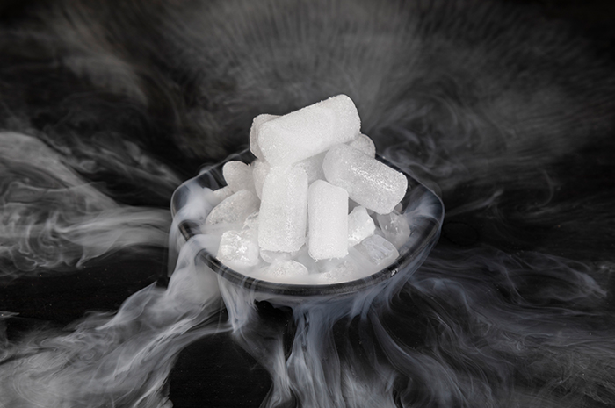

Slide 3
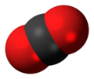
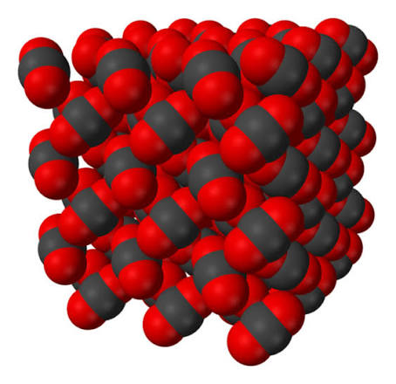

Slide 11
Independent set
occupied
unoccupied

Slide 12
Independent set
occupied
–
+
–
+
–
+
–
unoccupied

Slide 13


Independent set
#
Hard-core gas model
–
+
$$Δ$$
$$λ$$
–
+
–
maximum degree
“fugacity”
+
–

Slide 14
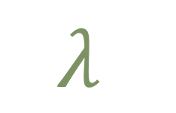

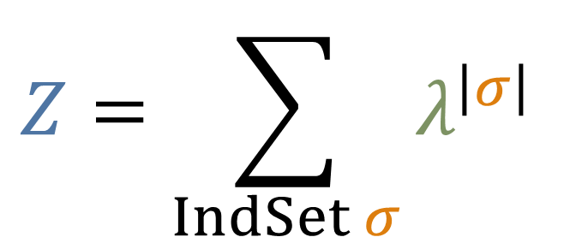

$$Δ$$
$$λ$$
Independent set
#
maximum degree
“fugacity”
Hard-core gas model
Input:
a graph with max degree $≤Δ$
Output:
the partition function
$$Z=\sum_{IndSet σ}{λ^{\left|σ\right|}}$$

Slide 15

$$Δ$$
$$λ$$
Independent set
#
maximum degree
“fugacity”
Hard-core gas model
Input:
–
a graph with max degree $≤Δ$
+
Output:
–
+
the partition function
–
$$Z=\sum_{IndSet σ}{λ^{\left|σ\right|}}$$
+
–
$$λ^{3}$$

Slide 16
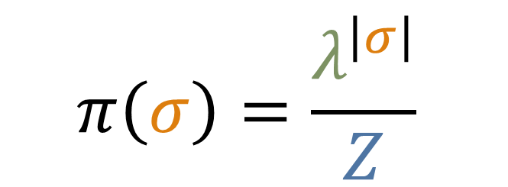

–
configuration
+
–
+
weight
–
+
$$π\left(σ\right)=\frac{λ^{\left|σ\right|}}{Z}$$
–
the partition function
$$Z=\sum_{IndSet σ}{λ^{\left|σ\right|}}$$
partition function

Slide 17
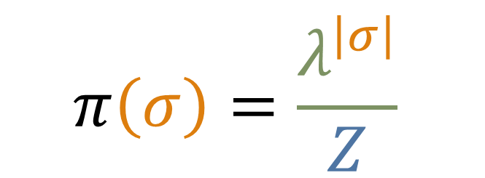

$$Δ$$
$$λ$$
Independent set
#
maximum degree
“fugacity”
Hard-core gas model
Input:
–
a graph with max degree $≤Δ$
+
Output:
–
+
sample the Gibbs distribution
–
$$π\left(σ\right)=\frac{λ^{\left|σ\right|}}{Z}$$
+
–
$$λ^{3}/Z$$

Slide 18
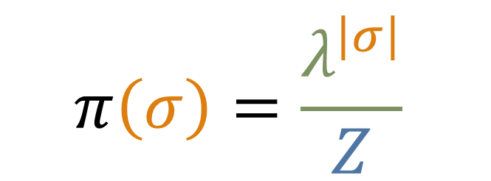
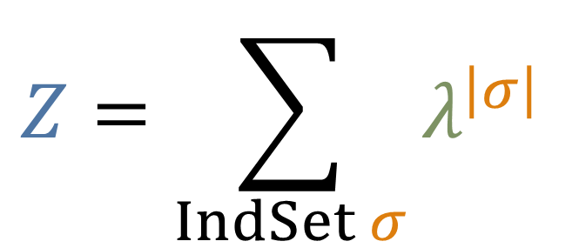
Hard-core gas model
$$Z=\sum_{IndSet σ}{λ^{\left|σ\right|}}$$
$$π\left(σ\right)=\frac{λ^{\left|σ\right|}}{Z}$$
Approximate counting
Uniform
sampling

Slide 19
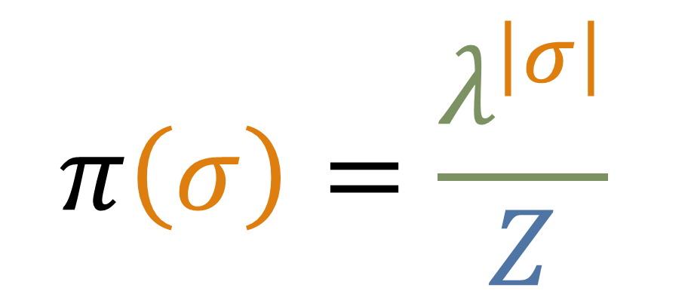
Hard-core gas model
$$π\left(σ\right)=\frac{λ^{\left|σ\right|}}{Z}$$

Slide 20


Hard-core gas model
$$π\left(σ\right)=\frac{λ^{\left|σ\right|}}{Z}$$
$$μ_{r}$$

Slide 21

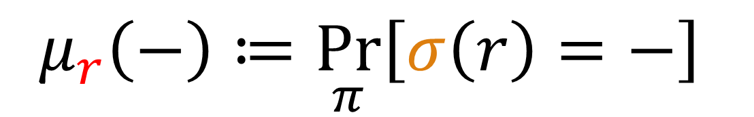

Hard-core gas model
$$π\left(σ\right)=\frac{λ^{\left|σ\right|}}{Z}$$
$$μ_{r}\left(+\right)≔\underset{π}{Pr}\left[σ\left(r\right)=+\right]$$
$$μ_{r}$$
$$μ_{r}\left(−\right)≔\underset{π}{Pr}\left[σ\left(r\right)=−\right]$$

Slide 22
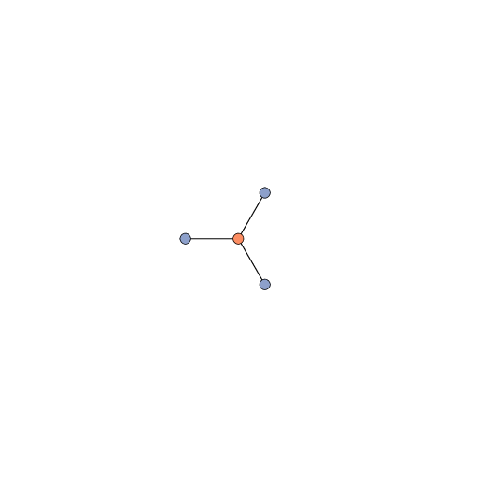
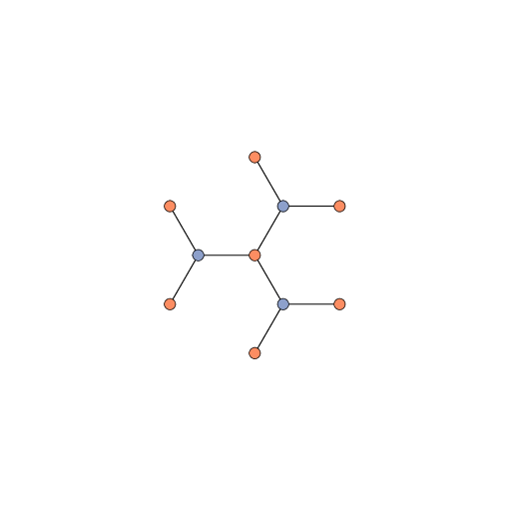
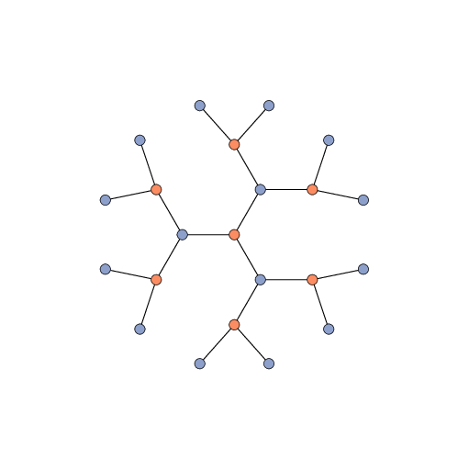
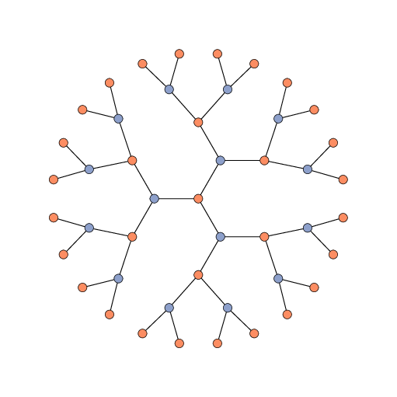
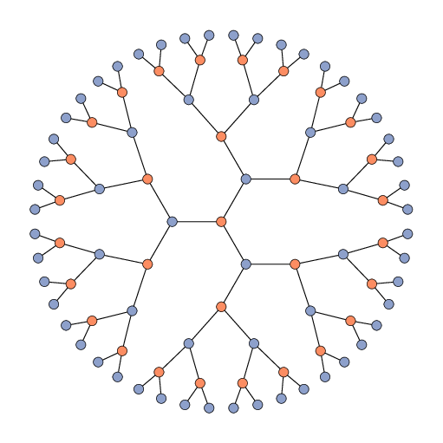
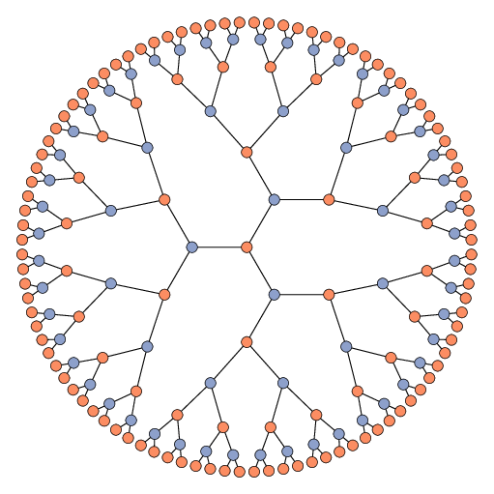











Bethe lattice
$$μ_{r}$$
$$\left(−,ℓ\right)$$
$$\left(−,ℓ\right)$$
$$1$$
$$2$$
$$3$$
$$4$$
$$5$$
$$…$$
$$r$$
first $ℓ$ levels

Slide 23
Bethe lattice
$$μ_{r}$$
$$\left(−,ℓ\right)$$
Does this converge?
$$r$$

Slide 24








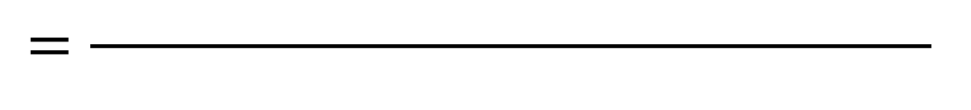


$$T$$
$$r$$
$$μ_{r}$$
$$\left(−,ℓ\right)$$
$$v_{Δ−1}$$
$$v_{1}$$
$$T_{1}$$
$$T_{Δ−1}$$
$$Z_{T}[σ\left(r\right)=−]$$
$$=\frac{ }{ }$$
$$Z_{T}$$

Slide 25



$$T$$
$$r$$
$$μ_{r}$$
$$\left(−,ℓ\right)$$
$$v_{Δ−1}$$
$$v_{1}$$
$$T_{1}$$
$$T_{Δ−1}$$
$$Z_{T}[σ\left(r\right)=−]$$
$$=\frac{ }{ }$$
$$Z_{T}[σ\left(r\right)=−]$$
$$+$$
$$Z_{T}[σ\left(r\right)=+]$$

Slide 26
$$T$$
$$μ_{r}$$
$$\left(−,ℓ\right)$$
$$v_{Δ−1}$$
$$v_{1}$$
$$T_{1}$$
$$T_{Δ−1}$$
$$Z_{T}[σ\left(r\right)=−]$$
$$=\frac{ }{ }$$
$$Z_{T}[σ\left(r\right)=−]$$
$$+$$
$$Z_{T}[σ\left(r\right)=+]$$

Slide 27


$$T$$
$$μ_{r}$$
$$\left(−,ℓ\right)$$
$$v_{Δ−1}$$
$$v_{1}$$
$$T_{1}$$
$$T_{Δ−1}$$
$$Z_{T_{1}}Z_{T_{2}}…Z_{T_{Δ−1}}$$
$$=\frac{ }{ }$$
$$Z_{T_{1}}Z_{T_{2}}…Z_{T_{Δ−1}}$$
$$+$$
$$Z_{T}[σ\left(r\right)=+]$$

Slide 28
$$T$$
$$r$$
$$μ_{r}$$
$$\left(−,ℓ\right)$$
$$v_{Δ−1}$$
$$v_{1}$$
$$T_{1}$$
$$T_{Δ−1}$$
$$Z_{T_{1}}Z_{T_{2}}…Z_{T_{Δ−1}}$$
$$=\frac{ }{ }$$
$$Z_{T_{1}}Z_{T_{2}}…Z_{T_{Δ−1}}$$
$$+$$
$$Z_{T}[σ\left(r\right)=+]$$

Slide 29

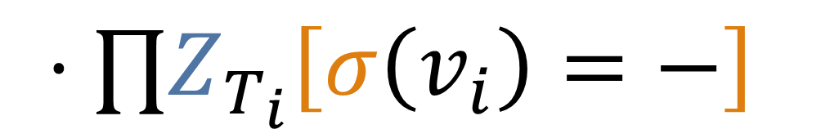
$$T$$
$$μ_{r}$$
$$\left(−,ℓ\right)$$
$$v_{Δ−1}$$
$$v_{1}$$
–
–
–
–
$$T_{1}$$
$$T_{Δ−1}$$
$$Z_{T_{1}}Z_{T_{2}}…Z_{T_{Δ−1}}$$
$$=\frac{ }{ }$$
$$Z_{T_{1}}Z_{T_{2}}…Z_{T_{Δ−1}}$$
$$⋅∏Z_{T_{i}}\left[σ\left(v_{i}\right)=−\right]$$
$$+$$
$$λ$$

Slide 30



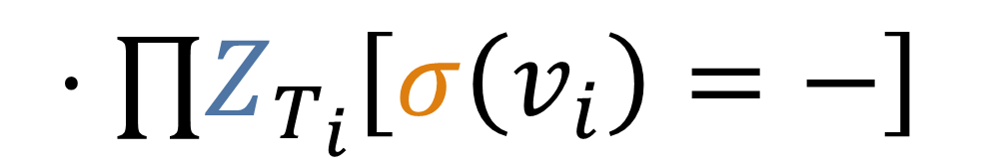
$$T$$
$$μ_{r}$$
$$\left(−,ℓ\right)$$
$$v_{Δ−1}$$
$$v_{1}$$
–
–
–
–
$$T_{1}$$
$$T_{Δ−1}$$
$$Z_{T_{1}}Z_{T_{2}}…Z_{T_{Δ−1}}$$
$$=\frac{ }{ }$$
$$Z_{T_{1}}Z_{T_{2}}…Z_{T_{Δ−1}}$$
$$⋅∏Z_{T_{i}}\left[σ\left(v_{i}\right)=−\right]$$
$$+$$
$$λ$$

Slide 31
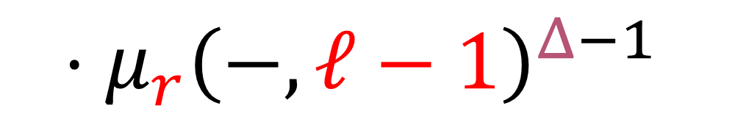




$$T$$
$$μ_{r}$$
$$\left(−,ℓ\right)$$
$$v_{Δ−1}$$
$$v_{1}$$
–
–
–
–
$$T_{1}$$
$$T_{Δ−1}$$
$$1$$
$$=\frac{ }{ }$$
$$+$$
$$⋅μ_{r}{\left(−,ℓ−1\right)}^{Δ−1}$$
$$1$$
$$λ$$

Slide 32


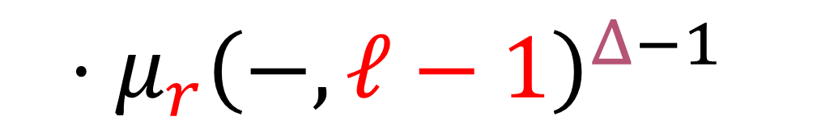
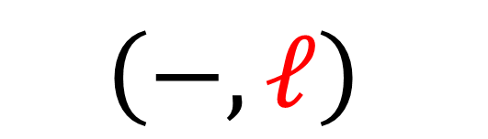

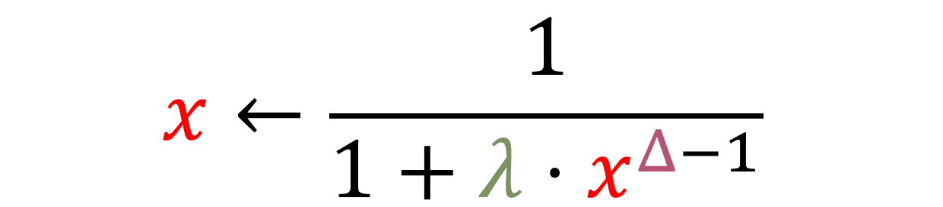

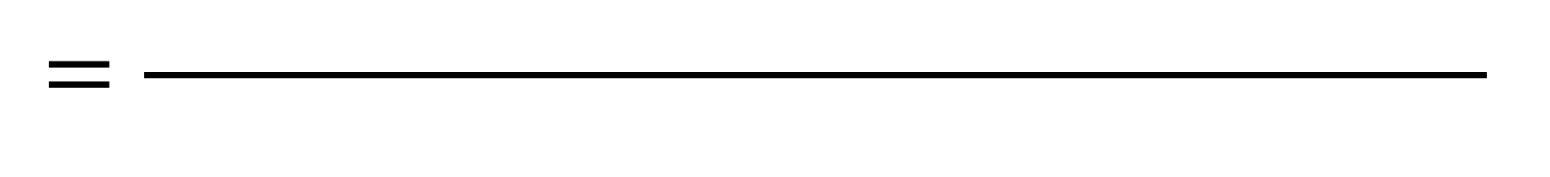

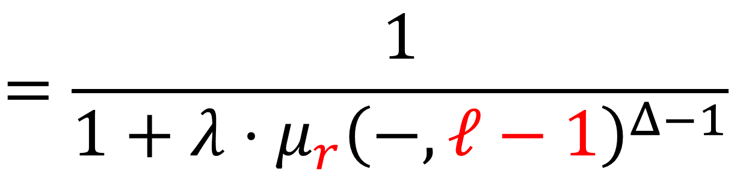
$$1$$
$$μ_{r}$$
$$\left(−,ℓ\right)$$
$$=\frac{ }{ }$$
$$1$$
$$+$$
$$λ$$
$$⋅μ_{r}{\left(−,ℓ−1\right)}^{Δ−1}$$
$$x←\frac{1}{1+λ⋅x^{Δ−1}}$$
Tree recursion
$$=\frac{1}{1+λ⋅μ_{r}{\left(−,ℓ−1\right)}^{Δ−1}}$$

Slide 33


$$x←\frac{1}{1+λ⋅x^{Δ−1}}$$
$$x$$

Slide 34
$$x←\frac{1}{1+λ⋅x^{Δ−1}}$$
$$x$$

Slide 35
$$x←\frac{1}{1+λ⋅x^{Δ−1}}$$
$$x$$

Slide 36

$$x←\frac{1}{1+λ⋅x^{Δ−1}}$$
$$x$$
$$f\left(x\right)$$

Slide 37
$$x←\frac{1}{1+λ⋅x^{Δ−1}}$$
$$x$$
$$f\left(x\right)$$

Slide 38
$$x←\frac{1}{1+λ⋅x^{Δ−1}}$$
$$x$$
$$f\left(x\right)$$

Slide 39

$$x←\frac{1}{1+λ⋅x^{Δ−1}}$$
$$x$$
$$f\left(x\right)$$
$$f\left(f\left(x\right)\right)$$

Slide 40
$$x←\frac{1}{1+λ⋅x^{Δ−1}}$$

Slide 41
$$x←\frac{1}{1+λ⋅x^{Δ−1}}$$

Slide 42



$$Δ$$
$$λ$$
maximum degree
“fugacity”
$$x←\frac{1}{1+λ⋅x^{Δ−1}}$$

Slide 43
$$Δ$$
$$λ$$
maximum degree
“fugacity”
$$x←\frac{1}{1+λ⋅x^{Δ−1}}$$

Slide 44
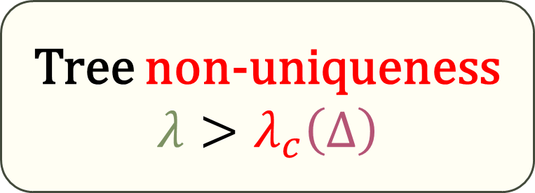
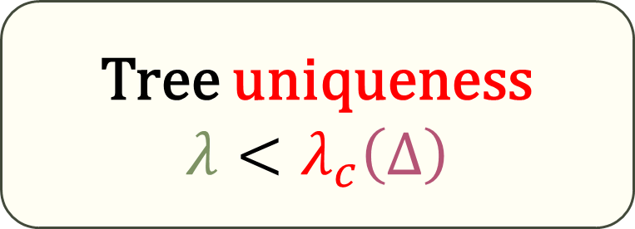



$$Δ$$
$$λ$$
$$x←\frac{1}{1+λ⋅x^{Δ−1}}$$
maximum degree
“fugacity”
Tree uniqueness
$$λ<λ_{c}\left(Δ\right)$$
Tree non-uniqueness
$$λ>λ_{c}\left(Δ\right)$$

Slide 45


$$Δ$$
$$λ$$
$$x←\frac{1}{1+λ⋅x^{Δ−1}}$$
maximum degree
“fugacity”
Tree uniqueness
$$λ<λ_{c}\left(Δ\right)$$
Tree non-uniqueness
$$λ>λ_{c}\left(Δ\right)$$

Slide 46


Tree uniqueness
$$λ<λ_{c}\left(Δ\right)$$
Tree non-uniqueness
$$λ>λ_{c}\left(Δ\right)$$
Ⅰ.
Convergence

Slide 47


Bethe lattice
$$μ_{r}$$
$$\left(−,ℓ\right)$$
$$r$$

Slide 48

Bethe lattice
$$μ_{r}$$
$$\left(−,2\right)$$
$$r$$

Slide 49










Bethe lattice
$$−$$
$$−$$
$$−$$
$$μ_{r}$$
$$\left(−,2\right)$$
$$−$$
$$−$$
$$r$$
$$−$$
$$−$$
$$−$$
$$−$$
$$−$$
$$−$$
$$−$$

Slide 50


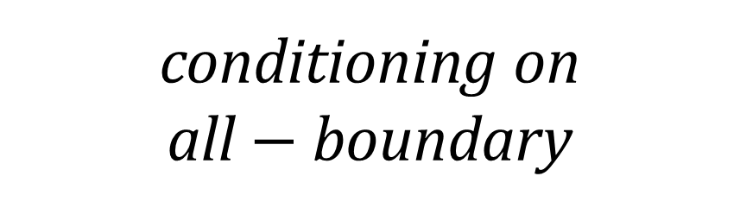



Bethe lattice
$$μ_{r}$$
$$\left(−,2\right)$$
$$−$$
$$−$$
$$−$$
$$−$$
$$=$$
$$−$$
$$μ_{r}$$
$$\left(−,3\right)$$
$$r$$
$$−$$
$$−$$
$$−$$
conditioning on all $−$ boundary
$$−$$
$$−$$
$$−$$
$$−$$

Slide 51
Bethe lattice
$$μ_{r}$$
$$\left(−,2\right)$$
$$−$$
$$−$$
$$−$$
$$−$$
$$=$$
$$−$$
$$μ_{r}$$
$$\left(−,3\right)$$
–
$$r$$
$$−$$
$$−$$
$$−$$
$$−$$
$$−$$
$$−$$
$$−$$

Slide 52





















Bethe lattice
$$μ_{r}$$
$$\left(−,2\right)$$
$$+$$
$$+$$
$$+$$
$$+$$
$$+$$
$$−$$
$$+$$
$$−$$
$$+$$
$$−$$
$$+$$
$$−$$
$$=$$
$$+$$
$$−$$
$$+$$
$$μ_{r}$$
$$\left(−,3\right)$$
–
$$+$$
$$r$$
$$−$$
$$+$$
$$+$$
$$−$$
$$−$$
$$+$$
$$+$$
$$+$$
$$+$$
$$−$$
$$+$$
$$−$$
$$−$$
$$−$$
$$+$$
$$+$$
$$+$$
$$+$$
$$+$$
$$+$$

Slide 53







Bethe lattice
$$μ_{r}$$
$$\left(−,2\right)$$
$$+$$
$$+$$
$$+$$
$$+$$
$$+$$
$$−$$
$$+$$
$$−$$
$$+$$
$$−$$
$$+$$
$$=$$
$$−$$
$$μ_{r}$$
$$\left(−,3\right)$$
–
$$+$$
$$−$$
$$+$$
$$+$$
$$r$$
$$−$$
$$+$$
$$+$$
$$−$$
$$−$$
$$=$$
$$μ_{r}$$
$$\left(−,4\right)$$
$$+$$
+
$$+$$
$$−$$
$$+$$
$$+$$
$$−$$
$$+$$
$$−$$
$$−$$
$$+$$
$$+$$
$$+$$
$$+$$
$$+$$
$$+$$

Slide 54
Bethe lattice
$$μ_{r}$$
$$\left(−,2\right)$$
$$+$$
$$+$$
$$+$$
$$+$$
$$+$$
$$+$$
$$+$$
$$+$$
$$=$$
$$μ_{r}$$
$$\left(−,3\right)$$
–
$$+$$
$$+$$
$$+$$
$$r$$
$$+$$
$$+$$
$$=$$
$$μ_{r}$$
$$\left(−,4\right)$$
$$+$$
+
$$+$$
$$+$$
$$+$$
$$+$$
$$+$$
$$+$$
$$+$$
$$+$$
$$+$$
$$+$$

Slide 55








Bethe lattice
$$μ_{r}$$
$$\left(−,2\right)$$
$$=$$
$$μ_{r}$$
$$\left(−,3\right)$$
$$+$$
$$+$$
$$+$$
–
$$+$$
$$+$$
$$+$$
$$=$$
$$+$$
$$μ_{r}$$
$$\left(−,4\right)$$
$$+$$
+
$$+$$
$$+$$
$$+$$
$$r$$
$$+$$
$$+$$
$$+$$
$$+$$
$$+$$
$$+$$
$$+$$
$$+$$
$$+$$
$$+$$
$$+$$
$$+$$
$$+$$

Slide 56





Bethe lattice
$$μ_{r}$$
$$\left(−,2\right)$$
$$=$$
$$μ_{r}$$
$$\left(−,3\right)$$
$$+$$
$$+$$
$$+$$
–
$$+$$
$$+$$
$$+$$
$$=$$
$$+$$
$$μ_{r}$$
$$\left(−,4\right)$$
$$+$$
+
$$+$$
$$+$$
$$+$$
$$r$$
$$+$$
$$+$$
$$μ_{r}$$
$$\left(−,3\right)$$
$$+$$
$$+$$
$$+$$
$$+$$
$$+$$
$$=$$
$$μ_{r}$$
$$\left(−,4\right)$$
–
$$+$$
$$+$$
$$+$$
$$+$$
$$+$$
$$+$$

Slide 57
Bethe lattice
$$μ_{r}$$
$$\left(−,2\right)$$
$$+$$
$$+$$
$$+$$
$$+$$
$$+$$
$$+$$
$$=$$
$$+$$
$$μ_{r}$$
$$\left(−,4\right)$$
$$+$$
+
$$+$$
$$+$$
$$+$$
$$r$$
$$+$$
$$+$$
$$μ_{r}$$
$$\left(−,3\right)$$
$$+$$
$$+$$
$$+$$
$$+$$
$$+$$
$$=$$
$$μ_{r}$$
$$\left(−,4\right)$$
–
$$+$$
$$+$$
$$+$$
$$+$$
$$+$$
$$+$$

Slide 58






















Bethe lattice
$$μ_{r}$$
$$\left(−,2\right)$$
$$=$$
$$μ_{r}$$
$$\left(−,4\right)$$
+
$$μ_{r}$$
$$\left(−,3\right)$$
$$=$$
$$μ_{r}$$
$$\left(−,4\right)$$
–
$$+$$
$$+$$
$$+$$
$$+$$
$$+$$
$$+$$
$$+$$
$$+$$
$$+$$
$$+$$
$$+$$
$$r$$
$$+$$
$$+$$
$$+$$
$$+$$
$$+$$
$$+$$
$$+$$
$$+$$
$$+$$
$$+$$
$$+$$
$$+$$
$$+$$

Slide 59








Bethe lattice
$$μ_{r}$$
$$\left(−,2\right)$$
$$μ_{r}$$
$$μ_{r}$$
$$\left(−,4\right)$$
$$\left(−,4\right)$$
–
+
$$μ_{r}$$
$$\left(−,3\right)$$

Slide 60




Bethe lattice
Tree uniqueness
$$λ<λ_{c}\left(Δ\right)$$
$$μ_{r}$$
$$\left(−,2\right)$$
$$μ_{r}$$
$$μ_{r}$$
$$\left(−,ℓ\right)$$
$$\left(−,ℓ\right)$$
–
+
$$μ_{r}$$
$$\left(−,3\right)$$
Tree non-uniqueness
$$λ>λ_{c}\left(Δ\right)$$

Slide 61


Bethe lattice
Tree uniqueness
$$λ<λ_{c}\left(Δ\right)$$
$$μ_{r}$$
$$\left(−,2\right)$$
$$μ_{r}$$
$$μ_{r}$$
$$\left(−,ℓ\right)$$
$$\left(−,ℓ\right)$$
–
+
$$μ_{r}$$
$$\left(−,3\right)$$
Tree non-uniqueness
$$λ>λ_{c}\left(Δ\right)$$
$$μ_{r}$$

Slide 62




Tree uniqueness
$$λ<λ_{c}\left(Δ\right)$$
Bethe lattice
Ⅱ.
2nd-order fixpoints
$$μ_{r}^{even}$$
$$μ_{r}^{odd}$$
$$μ_{r}$$
$$\left(−,2\right)$$
$$μ_{r}$$
$$μ_{r}$$
$$\left(−,ℓ\right)$$
$$\left(−,ℓ\right)$$
–
+
$$μ_{r}$$
$$\left(−,3\right)$$
Tree non-uniqueness
$$λ>λ_{c}\left(Δ\right)$$

Slide 63






$$λ<λ_{c}$$
coordinate sum: odd / even
$$λ>λ_{c}$$

Slide 64



$$λ<λ_{c}$$
coordinate sum: odd / even
$$λ>λ_{c}$$

Slide 65


$$λ<λ_{c}$$
Uniqueness
=
Correlation decay
$$λ>λ_{c}$$
coordinate sum: odd / even

Slide 66
$$λ<λ_{c}$$
$$λ>λ_{c}$$
coordinate sum: odd / even

Slide 67

$$λ<λ_{c}$$
coordinate sum: odd / even
$$λ>λ_{c}$$

Slide 68



$$λ>λ_{c}$$
$$λ<λ_{c}$$
coordinate sum: odd / even

Slide 69


$$λ>λ_{c}$$
Non-uniqueness
=
Long-range correlation
$$λ<λ_{c}$$
coordinate sum: odd / even

Slide 70
$$λ>λ_{c}$$
$$λ<λ_{c}$$
coordinate sum: odd / even

Slide 71
Ⅲ.
Correlation decay
$$λ<λ_{c}$$
coordinate sum: odd / even
$$λ>λ_{c}$$

Slide 72
Physical phase transition
Computational phase transition
$$λ<λ_{c}$$
coordinate sum: odd / even
$$λ>λ_{c}$$

Slide 73





Computational phase transition
$$Z=\sum_{IndSet σ}{λ^{\left|σ\right|}}$$
Ⅲ.
Correlation decay
Can be approximated efficiently
$NP$-hard to approximate
$λ_{c}$ for tree-uniqueness
$$λ<λ_{c}$$
$$λ>λ_{c}$$

Slide 74



Tree uniqueness
$$λ<λ_{c}\left(Δ\right)$$
Tree non-uniqueness
$$λ>λ_{c}\left(Δ\right)$$
Bethe lattice
$$μ_{r}$$
$$\left(−,2\right)$$
$$μ_{r}^{even}$$
$$μ_{r}^{odd}$$
$$μ_{r}$$
$$\left(−,ℓ\right)$$
$$μ_{r}$$
$$\left(−,ℓ\right)$$
+
–
$$μ_{r}$$
$$\left(−,3\right)$$
Finite graph that looks like a tree and has the even-odd structure?

Slide 75

Tree uniqueness
$$λ<λ_{c}\left(Δ\right)$$
Tree non-uniqueness
$$λ>λ_{c}\left(Δ\right)$$
Finite graph that looks like a tree and has the even-odd structure?
Bethe lattice
$$μ_{r}$$
$$\left(−,2\right)$$
$$μ_{r}$$
$$\left(−,3\right)$$
Random regular bipartite graph

Slide 76


Finite graph that looks like a tree and has the even-odd structure?
Tree uniqueness
$$λ<λ_{c}\left(Δ\right)$$
Tree non-uniqueness
$$λ>λ_{c}\left(Δ\right)$$
Random regular bipartite graph

Slide 77

Finite graph that looks like a tree and has the even-odd structure?
Tree non-uniqueness
$$λ>λ_{c}\left(Δ\right)$$
Tree uniqueness
$$λ<λ_{c}\left(Δ\right)$$
Random regular bipartite graph

Slide 78

Finite graph that looks like a tree and has the even-odd structure?
Tree non-uniqueness
$$λ>λ_{c}\left(Δ\right)$$
Tree uniqueness
$$λ<λ_{c}\left(Δ\right)$$
$$\operatorname{Pr}{[ ]}$$
Random regular bipartite graph

Slide 79


Finite graph that looks like a tree and has the even-odd structure?
Tree non-uniqueness
$$λ>λ_{c}\left(Δ\right)$$
Tree uniqueness
$$λ<λ_{c}\left(Δ\right)$$
$$μ_{up}$$
$$\operatorname{Pr}{[ ]}$$
$$μ_{down}$$
Random regular bipartite graph

Slide 80


Finite graph that looks like a tree and has the even-odd structure?
Tree non-uniqueness
$$λ>λ_{c}\left(Δ\right)$$
Tree uniqueness
$$λ<λ_{c}\left(Δ\right)$$
$$μ_{up}$$
=
$$μ_{down}$$
Random regular bipartite graph

Slide 81
Finite graph that looks like a tree and has the even-odd structure?
Tree uniqueness
$$λ<λ_{c}\left(Δ\right)$$
Tree non-uniqueness
$$λ>λ_{c}\left(Δ\right)$$
$$μ_{up}$$
=
$$μ_{down}$$
Random regular bipartite graph

Slide 82
Finite graph that looks like a tree and has the even-odd structure?
Tree uniqueness
$$λ<λ_{c}\left(Δ\right)$$
Tree non-uniqueness
$$λ>λ_{c}\left(Δ\right)$$
$$μ_{up}$$
$$μ_{up}$$
$$μ_{down}$$
=
$$μ_{down}$$
Random regular bipartite graph

Slide 83



Finite graph that looks like a tree and has the even-odd structure?
Tree uniqueness
$$λ<λ_{c}\left(Δ\right)$$
Tree non-uniqueness
$$λ>λ_{c}\left(Δ\right)$$
$$μ_{up}$$
=
$$μ_{down}$$
$$μ_{up}$$
$$≠$$
$$μ_{down}$$
Random regular bipartite graph

Slide 84







Finite graph that looks like a tree and has the even-odd structure?
Tree uniqueness
$$λ<λ_{c}\left(Δ\right)$$
Tree non-uniqueness
$$λ>λ_{c}\left(Δ\right)$$
$$μ_{up}$$
=
$$μ_{down}$$
$$μ_{up}$$
$$≠$$
$$μ_{down}$$
Random regular bipartite graph

Slide 85


Finite graph that looks like a tree and has the even-odd structure?
Tree uniqueness
$$λ<λ_{c}\left(Δ\right)$$
Tree non-uniqueness
$$λ>λ_{c}\left(Δ\right)$$
$$μ_{up}$$
$$≠$$
$$μ_{down}$$
$$<$$
Random regular bipartite graph

Slide 86






Finite graph that looks like a tree and has the even-odd structure?
Tree uniqueness
$$λ<λ_{c}\left(Δ\right)$$
Tree non-uniqueness
$$λ>λ_{c}\left(Δ\right)$$
$$μ_{up}$$
$$<$$
$$μ_{down}$$
$$μ_{up}$$
$$>$$
$$μ_{down}$$
Random regular bipartite graph

Slide 87



Finite graph that looks like a tree and has the even-odd structure?
Tree uniqueness
$$λ<λ_{c}\left(Δ\right)$$
Tree non-uniqueness
$$λ>λ_{c}\left(Δ\right)$$
$$μ_{up}$$
$$<$$
$$μ_{down}$$
$$μ_{up}$$
$$>$$
$$μ_{down}$$
Random regular bipartite graph

Slide 88
Finite graph that looks like a tree and has the even-odd structure?
Tree uniqueness
$$λ<λ_{c}\left(Δ\right)$$
Tree non-uniqueness
$$λ>λ_{c}\left(Δ\right)$$
DOWN
UP
$$μ_{up}$$
$$<$$
$$μ_{down}$$
$$μ_{up}$$
$$>$$
$$μ_{down}$$
Random regular bipartite graph

Slide 89







Finite graph that looks like a tree and has the even-odd structure?
$$μ_{up}$$
$$<$$
$$μ_{down}$$
$$μ_{up}$$
$$>$$
$$μ_{down}$$
Tree non-uniqueness
$$λ>λ_{c}\left(Δ\right)$$
Tree uniqueness
$$λ<λ_{c}\left(Δ\right)$$
DOWN
UP
Random regular bipartite graph

Slide 90
Finite graph that looks like a tree and has the even-odd structure?
$$μ_{up}$$
$$<$$
$$μ_{down}$$
$$μ_{up}$$
$$>$$
$$μ_{down}$$
Tree non-uniqueness
$$λ>λ_{c}\left(Δ\right)$$
Tree uniqueness
$$λ<λ_{c}\left(Δ\right)$$
DOWN
UP
Random regular bipartite graph

Slide 91
Finite graph that looks like a tree and has the even-odd structure?
$$μ_{up}$$
$$<$$
$$μ_{down}$$
$$μ_{up}$$
$$>$$
$$μ_{down}$$
Tree non-uniqueness
$$λ>λ_{c}\left(Δ\right)$$
Tree uniqueness
$$λ<λ_{c}\left(Δ\right)$$
DOWN
UP
Random regular bipartite graph

Slide 92
Finite graph that looks like a tree and has the even-odd structure?
$$μ_{up}$$
$$<$$
$$μ_{down}$$
$$μ_{up}$$
$$>$$
$$μ_{down}$$
Tree non-uniqueness
$$λ>λ_{c}\left(Δ\right)$$
Tree uniqueness
$$λ<λ_{c}\left(Δ\right)$$
DOWN
UP
Random regular bipartite graph

Slide 93
Finite graph that looks like a tree and has the even-odd structure?
$$μ_{up}$$
$$<$$
$$μ_{down}$$
$$μ_{up}$$
$$>$$
$$μ_{down}$$
Tree non-uniqueness
$$λ>λ_{c}\left(Δ\right)$$
Tree uniqueness
$$λ<λ_{c}\left(Δ\right)$$
DOWN
UP
Random regular bipartite graph

Slide 94



Finite graph that looks like a tree and has the even-odd structure?
Tree non-uniqueness
$$λ>λ_{c}\left(Δ\right)$$
$$μ_{up}$$
$$<$$
$$μ_{down}$$
$$μ_{up}$$
$$>$$
$$μ_{down}$$
Tree uniqueness
$$λ<λ_{c}\left(Δ\right)$$
DOWN
UP
$$\operatorname{Pr}\left[compatible | disagree\right]$$
$$={\left(1−μ_{up}μ_{down}\right)}^{2}$$
Random regular bipartite graph

Slide 95
Finite graph that looks like a tree and has the even-odd structure?
Tree non-uniqueness
$$λ>λ_{c}\left(Δ\right)$$
$$μ_{up}$$
$$<$$
$$μ_{down}$$
$$μ_{up}$$
$$>$$
$$μ_{down}$$
Tree uniqueness
$$λ<λ_{c}\left(Δ\right)$$
DOWN
UP
DOWN
$$\operatorname{Pr}\left[compatible | disagree\right]$$
$$={\left(1−μ_{up}μ_{down}\right)}^{2}$$
Random regular bipartite graph

Slide 96


Finite graph that looks like a tree and has the even-odd structure?
Tree non-uniqueness
$$λ>λ_{c}\left(Δ\right)$$
$$μ_{up}$$
$$<$$
$$μ_{down}$$
$$μ_{up}$$
$$>$$
$$μ_{down}$$
Tree uniqueness
$$λ<λ_{c}\left(Δ\right)$$
DOWN
DOWN
UP
$$\operatorname{Pr}\left[compatible | disagree\right]$$
$$={\left(1−μ_{up}μ_{down}\right)}^{2}$$
$$\operatorname{Pr}\left[compatible | agree\right]$$
$$={\left(1−μ_{up}\right)}^{2}{\left(1−μ_{down}\right)}^{2}$$
Random regular bipartite graph

Slide 97

Finite graph that looks like a tree and has the even-odd structure?
Tree non-uniqueness
$$λ>λ_{c}\left(Δ\right)$$
$$μ_{up}$$
$$<$$
$$μ_{down}$$
$$μ_{up}$$
$$>$$
$$μ_{down}$$
Tree uniqueness
$$λ<λ_{c}\left(Δ\right)$$
DOWN
UP
DOWN
$$\operatorname{Pr}\left[compatible | disagree\right]$$
$$={\left(1−μ_{up}μ_{down}\right)}^{2}$$
$$\operatorname{Pr}\left[compatible | agree\right]$$
$$<$$
$$={\left(1−μ_{up}\right)}^{2}{\left(1−μ_{down}\right)}^{2}$$
Random regular bipartite graph

Slide 98
Finite graph that looks like a tree and has the even-odd structure?
Tree non-uniqueness
$$λ>λ_{c}\left(Δ\right)$$
$$μ_{up}$$
$$<$$
$$μ_{down}$$
$$μ_{up}$$
$$>$$
$$μ_{down}$$
DOWN
UP
Tree uniqueness
$$λ<λ_{c}\left(Δ\right)$$
DOWN
$$\operatorname{Pr}\left[compatible | disagree\right]$$
$$={\left(1−μ_{up}μ_{down}\right)}^{2}$$
$$\operatorname{Pr}\left[compatible | agree\right]$$
$$<$$
$$={\left(1−μ_{up}\right)}^{2}{\left(1−μ_{down}\right)}^{2}$$
Remind you anything?

Slide 99
Finite graph that looks like a tree and has the even-odd structure?
Tree non-uniqueness
$$λ>λ_{c}\left(Δ\right)$$
$$μ_{up}$$
$$<$$
$$μ_{down}$$
$$μ_{up}$$
$$>$$
$$μ_{down}$$
DOWN
UP
Tree uniqueness
$$λ<λ_{c}\left(Δ\right)$$
DOWN
MAXCUT
$$\operatorname{Pr}\left[compatible | disagree\right]$$
$$={\left(1−μ_{up}μ_{down}\right)}^{2}$$
$$\operatorname{Pr}\left[compatible | agree\right]$$
$$<$$
Remind you anything?
$$={\left(1−μ_{up}\right)}^{2}{\left(1−μ_{down}\right)}^{2}$$

Slide 100


Finite graph that looks like a tree and has the even-odd structure?
$$μ_{up}$$
$$<$$
$$μ_{down}$$
$$μ_{up}$$
$$>$$
$$μ_{down}$$
DOWN
If you can draw independent sets in
UP
Tree uniqueness
$$λ<λ_{c}\left(Δ\right)$$
Tree non-uniqueness
$$λ>λ_{c}\left(Δ\right)$$
DOWN
then with high probability you “solve”
$$\operatorname{Pr}\left[compatible | disagree\right]$$
$$={\left(1−μ_{up}μ_{down}\right)}^{2}$$
MAXCUT
$$\operatorname{Pr}\left[compatible | agree\right]$$
$$<$$
$$={\left(1−μ_{up}\right)}^{2}{\left(1−μ_{down}\right)}^{2}$$
Remind you anything?

Slide 101




uniqueness
non-uniqueness
$$λ$$
$$0$$
$$λ_{c}$$
correlation decay
$$λ_{c}\left(Δ\right)=\frac{{\left(Δ−1\right)}^{Δ−1}}{{\left(Δ−2\right)}^{Δ}}∼\frac{e}{Δ}$$
phase gadget
efficient sampling
reducing from MAXCUT

Slide 102



uniqueness
non-uniqueness
$$λ$$
$$0$$
$$λ_{c}$$
$$λ=1$$
$$Δ≤5$$
$$Δ≥6$$

Slide 103

Computational phase transition
Independent sets
graph colouring
graph cuts
$k$-CNF

Slide 104
Computational phase transition
Independent sets
graph colouring
hardcore model
Potts model
graph cuts
$k$-CNF
Ising model

Slide 105
Physicist-complexist dictionary
partition function
object count
Gibbs measure
random object
ground state
extremal object
free energy
asymptotics
Hamiltonian
(log of) weight

Slide 106
Physicist-complexist dictionary
partition function
object count
Gibbs measure
random object
ground state
extremal object
free energy
asymptotics
Hamiltonian
(log of) weight
Tackar!! / Kiitos!!

Slide 107
Reference list is too long to fit here
A. Sly, Computational Transition at the Uniqueness Threshold, FOCS 2010 [Best paper]

