Slide 1
Approximating total variation distance between product distributions
Weiming Feng¹, Heng Guo², Mark Jerrum³, Jiaheng Wang⁴
¹Hong Kong University
²University of Edinburgh
³Queen Mary, University of London
⁴University of Helsinki

Slide 2

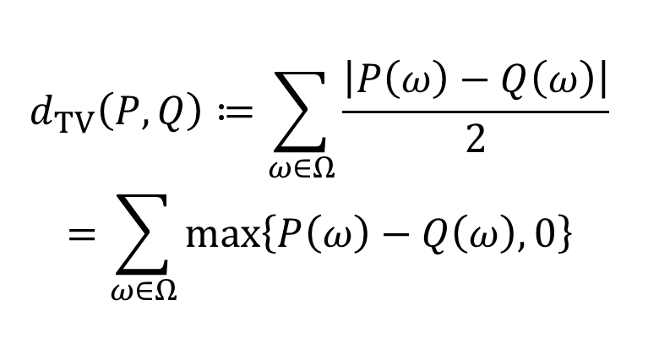


Total variation distance
$$P\left(ω\right)$$
$$Q\left(ω\right)$$
$$d_{TV}\left(P,Q\right)≔\sum_{ω∈Ω}{\frac{\left|P\left(ω\right)−Q\left(ω\right)\right|}{2}}$$
$$=\sum_{ω∈Ω}{\max\left\{P\left(ω\right)−Q\left(ω\right),0\right\}}$$
$$ω$$

Slide 3



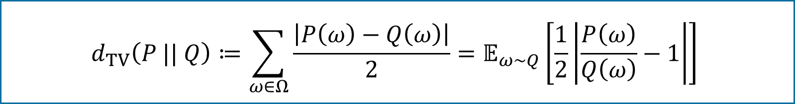
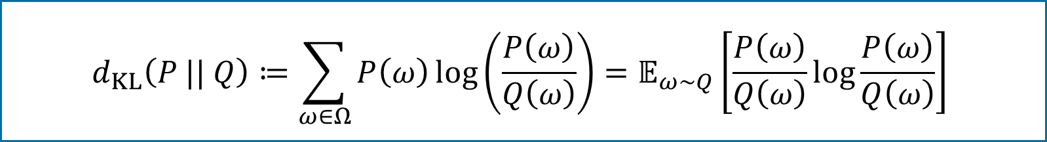
$f$-divergences
TV distance
$$d_{TV}\left(P || Q\right)≔\sum_{ω∈Ω}{\frac{\left|P\left(ω\right)−Q\left(ω\right)\right|}{2}}=𝔼_{ω∼Q}\left[\frac{1}{2}\left|\frac{P\left(ω\right)}{Q\left(ω\right)}−1\right|\right]$$
Kullback–Leibler divergence
$$d_{KL}\left(P || Q\right)≔\sum_{ω∈Ω}{P\left(ω\right)\log\left(\frac{P\left(ω\right)}{Q\left(ω\right)}\right)}=𝔼_{ω∼Q}\left[\frac{P\left(ω\right)}{Q\left(ω\right)}\log{\frac{P\left(ω\right)}{Q\left(ω\right)}}\right]$$
$f$-divergence
$$d_{f}\left(P || Q\right)≔\sum_{ω∈Ω}{Q\left(ω\right)f\left(\frac{P\left(ω\right)}{Q\left(ω\right)}\right)}=𝔼_{ω∼Q}\left[f\left(\frac{P\left(ω\right)}{Q\left(ω\right)}\right)\right]$$

Slide 4
A simple distribution…
independent
$$P=P_{1}⊗P_{2}⊗…⊗P_{n}$$
$$P\left(x_{1}x_{2}…x_{n}\right)=P_{1}\left(x_{1}\right)P_{2}\left(x_{2}\right)…P_{n}\left(x_{n}\right)$$

Slide 5
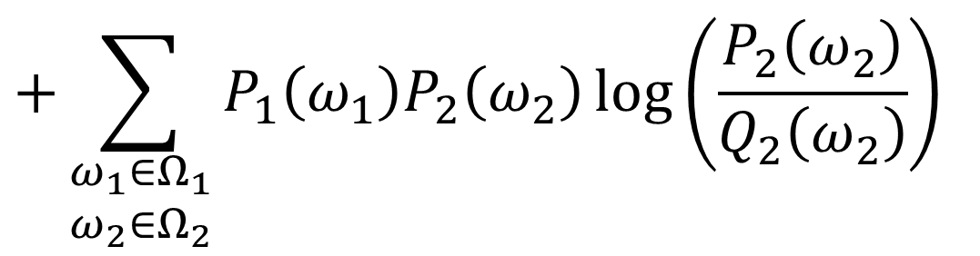
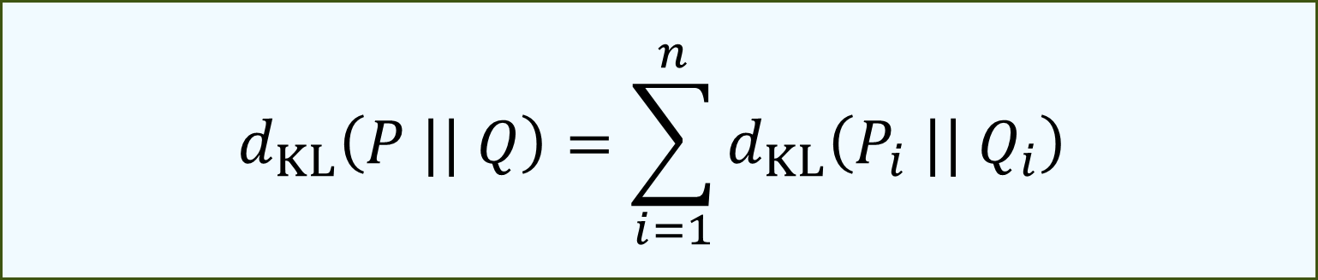

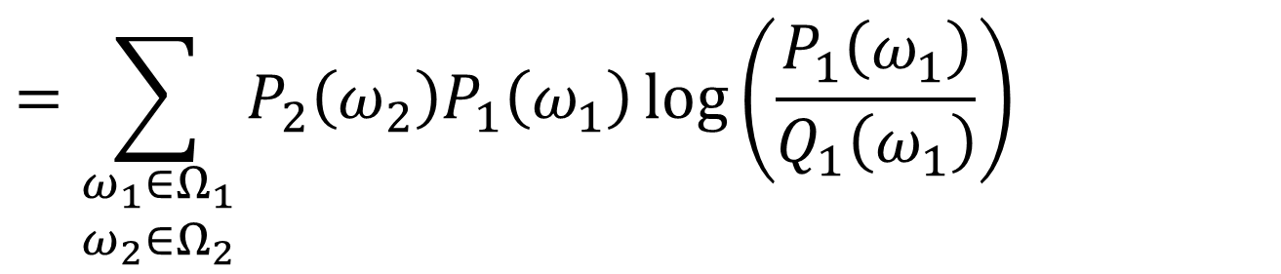
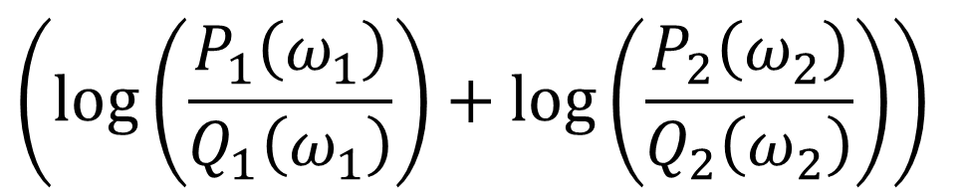
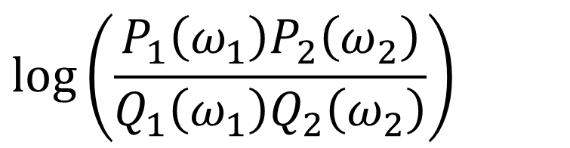

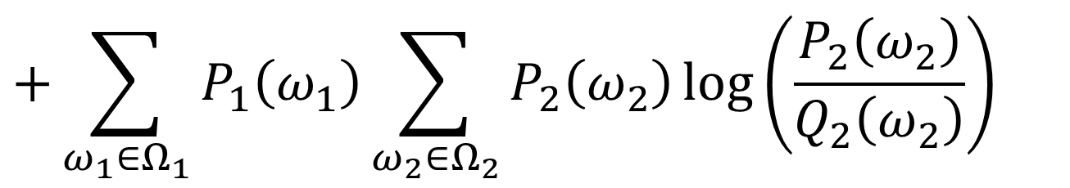

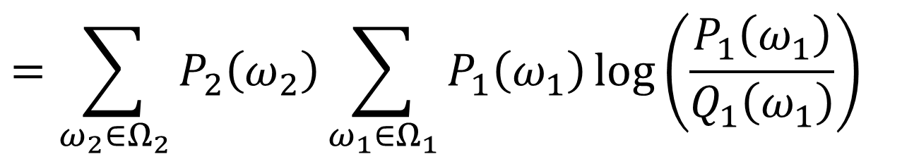
Tensorisation of KL-divergence
Kullback–Leibler divergence
$$d_{KL}\left(P || Q\right)≔\sum_{ω∈Ω}{P\left(ω\right)\log\left(\frac{P\left(ω\right)}{Q\left(ω\right)}\right)}=𝔼_{ω∼Q}\left[\frac{P\left(ω\right)}{Q\left(ω\right)}\log{\frac{P\left(ω\right)}{Q\left(ω\right)}}\right]$$
$$d_{KL}\left(P_{1}⊗P_{2} || Q_{1}⊗Q_{2}\right)$$
$$=d_{KL}\left(P_{1} || Q_{1}\right)+d_{KL}\left(P_{2} || Q_{2}\right)$$
$$=\sum_{\begin{aligned}ω_{1}∈Ω_{1} \\ ω_{2}∈Ω_{2}\end{aligned}}{P_{2}\left(ω_{2}\right)P_{1}\left(ω_{1}\right)\log\left(\frac{P_{1}\left(ω_{1}\right)}{Q_{1}\left(ω_{1}\right)}\right)}$$
$$=\sum_{ω_{2}∈Ω_{2}}{P_{2}\left(ω_{2}\right)}\sum_{ω_{1}∈Ω_{1}}{P_{1}\left(ω_{1}\right)\log\left(\frac{P_{1}\left(ω_{1}\right)}{Q_{1}\left(ω_{1}\right)}\right)}$$
$$=\sum_{\begin{aligned}ω_{1}∈Ω_{1} \\ ω_{2}∈Ω_{2}\end{aligned}}{P_{1}\left(ω_{1}\right)P_{2}\left(ω_{2}\right)}$$
$$\left(\log\left(\frac{P_{1}\left(ω_{1}\right)}{Q_{1}\left(ω_{1}\right)}\right)+\log\left(\frac{P_{2}\left(ω_{2}\right)}{Q_{2}\left(ω_{2}\right)}\right)\right)$$
$$\log\left(\frac{P_{1}\left(ω_{1}\right)P_{2}\left(ω_{2}\right)}{Q_{1}\left(ω_{1}\right)Q_{2}\left(ω_{2}\right)}\right)$$
$$d_{KL}\left(P || Q\right)=\sum_{i=1}^{n}{d_{KL}\left(P_{i} || Q_{i}\right)}$$
$$+\sum_{\begin{aligned}ω_{1}∈Ω_{1} \\ ω_{2}∈Ω_{2}\end{aligned}}{P_{1}\left(ω_{1}\right)P_{2}\left(ω_{2}\right)\log\left(\frac{P_{2}\left(ω_{2}\right)}{Q_{2}\left(ω_{2}\right)}\right)}$$
$$+\sum_{ω_{1}∈Ω_{1}}{P_{1}\left(ω_{1}\right)}\sum_{ω_{2}∈Ω_{2}}{P_{2}\left(ω_{2}\right)\log\left(\frac{P_{2}\left(ω_{2}\right)}{Q_{2}\left(ω_{2}\right)}\right)}$$

Slide 6


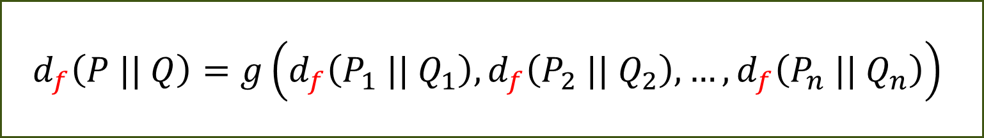


Tensorisation of $f$-divergences
$f$-divergence
$$d_{f}\left(P || Q\right)≔\sum_{ω∈Ω}{Q\left(ω\right)f\left(\frac{P\left(ω\right)}{Q\left(ω\right)}\right)}=𝔼_{ω∼Q}\left[f\left(\frac{P\left(ω\right)}{Q\left(ω\right)}\right)\right]$$
Total variation distance $d_{TV}$: $f\left(x\right)=\left|x−1\right|/2$
KL divergence $d_{KL}$: $f\left(x\right)=x\log{x}$
$χ^{2}$ divergence $d_{χ^{2}}$: $f\left(x\right)={\left(x−1\right)}^{2}$
Hellinger² distance $d_{H^{2}}$: $f\left(x\right)={\left(1−\sqrt{x}\right)}^{2}$
$$d_{f}\left(P || Q\right)=g\left(d_{f}\left(P_{1} || Q_{1}\right),d_{f}\left(P_{2} || Q_{2}\right),…,d_{f}\left(P_{n} || Q_{n}\right)\right)$$
?
Tensorisable
Tensorisable
Tensorisable

Slide 7
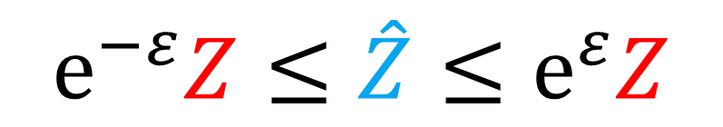
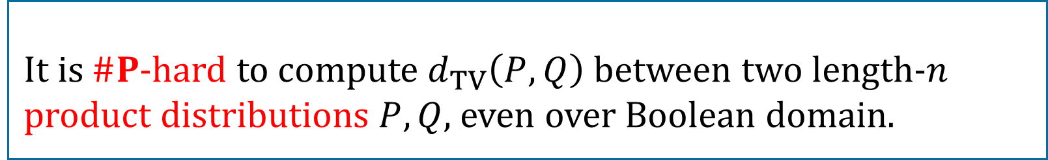
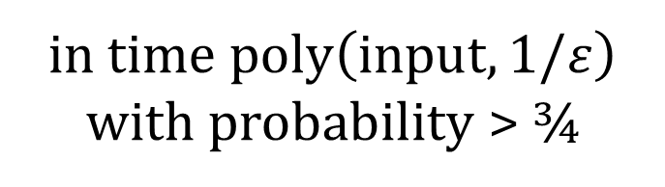
TV distance cannot be tensorised!
Theorem
It is $\#P$-hard to compute $d_{TV}\left(P,Q\right)$ between two length-$n$ product distributions $P,Q$, even over Boolean domain.
[Bhattacharyya-Gayen-Meel-Myrisiotis-Pavan-Vinodchandran’22]
Fully
polynomial-time randomised approximation scheme
(FPRAS)
Can we efficiently approximate it?
actual count
$$e^{−ε}Z≤\hat{Z}≤e^{ε}Z$$
output
in time $poly\left(input,1/ε\right)$ with probability > ¾

Slide 8
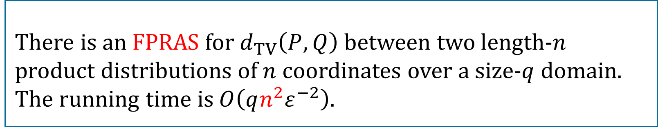
Our result
Theorem
There is an FPRAS for $d_{TV}\left(P,Q\right)$ between two length-$n$ product distributions of $n$ coordinates over a size-$q$ domain. The running time is $O\left(qn^{2}ε^{−2}\right)$.
[This paper]
actual count
$$e^{−ε}Z≤\hat{Z}≤e^{ε}Z$$
output

Slide 9
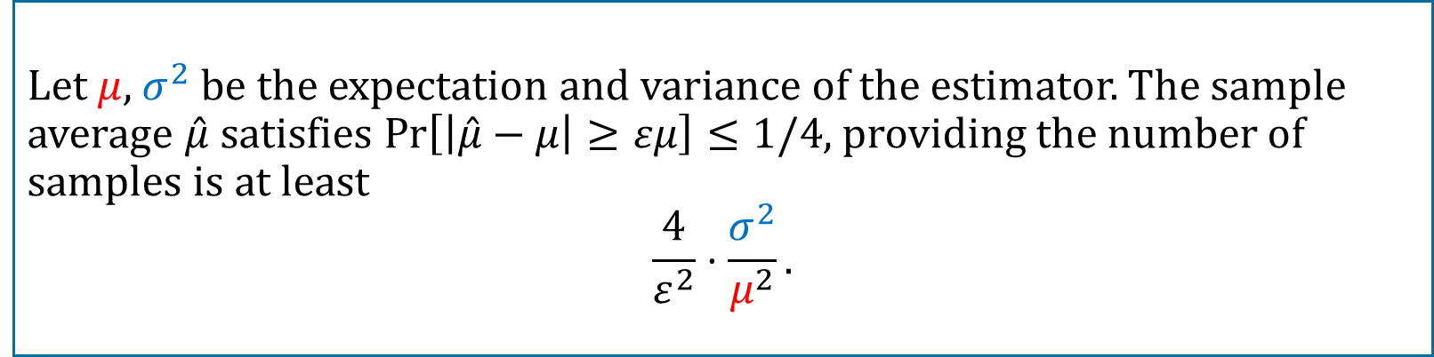
The first attempt
Let’s do Monte Carlo!
But it can be exponentially small…
TV distance
$$d_{TV}\left(P || Q\right)≔\sum_{ω∈Ω}{\frac{\left|P\left(ω\right)−Q\left(ω\right)\right|}{2}}=𝔼_{ω∼Q}\left[\frac{1}{2}\left|\frac{P\left(ω\right)}{Q\left(ω\right)}−1\right|\right]$$
Unbiased estimator theorem
Let $μ$, $σ^{2}$ be the expectation and variance of the estimator. The sample average $\hat{μ}$ satisfies $\operatorname{Pr}\left[\left|\hat{μ}−μ\right|≥εμ\right]≤1/4$, providing the number of samples is at least
$$\frac{4}{ε^{2}}⋅\frac{σ^{2}}{μ^{2}}.$$

Slide 10








Coupling
(joint distribution with correct marginals)
$$P_{1}:P_{1}\left(0\right)=0.5, P_{1}\left(1\right)=0.5$$
$$P_{2}:P_{2}\left(0\right)=0.5, P_{2}\left(1\right)=0.5$$
$$Q_{1}:Q_{1}\left(0\right)=0.6, Q_{1}\left(1\right)=0.4$$
$$Q_{2}:Q_{2}\left(0\right)=0.7, Q_{2}\left(1\right)=0.3$$
$$P$$
$$P$$
 | 0 | 1
0 |  |  | 0.6
1 |  |  | 0.4
 | 0.5 | 0.5
 | 0 | 1
0 |  |  | 0.7
1 |  |  | 0.3
 | 0.5 | 0.5
$$Q$$
$$Q$$
0.5
0.1
0.5
0.2
0.4
0.3

Slide 11








Coupling
(joint distribution with correct marginals)
$$P$$
 | 00 | 01 | 10 | 11
00 | .25 | .05 | .04 | .08 | .42
01 |  | .12 | .01 | .05 | .18
10 |  | .01 | .20 | .07 | .28
11 |  | .07 |  | .05 | .12
 | .25 | .25 | .25 | .25
 | 00 | 01 | 10 | 11
00 | .25 | .05 | .04 | .08 | .42
01 |  | .12 | .01 | .05 | .18
10 |  | .01 | .20 | .07 | .28
11 |  | .07 |  | .05 | .12
 | .25 | .25 | .25 | .25
$$P_{1}:P_{1}\left(0\right)=0.5, P_{1}\left(1\right)=0.5$$
 | 00 | 01 | 10 | 11
00 |  |  |  |  | .42
01 |  |  |  |  | .18
10 |  |  |  |  | .28
11 |  |  |  |  | .12
 | .25 | .25 | .25 | .25
$$Q$$
$$P_{2}:P_{2}\left(0\right)=0.5, P_{2}\left(1\right)=0.5$$
$$Q_{1}:Q_{1}\left(0\right)=0.6, Q_{1}\left(1\right)=0.4$$
$$Q_{2}:Q_{2}\left(0\right)=0.7, Q_{2}\left(1\right)=0.3$$
$$P=P_{1}⊗P_{2},Q=Q_{1}⊗Q_{2}$$
Discrepancy of a coupling:
$$\underset{\left(X,Y\right)∼Coupling}{Pr}\left[X≠Y\right]$$
$$=0.38$$

Slide 12
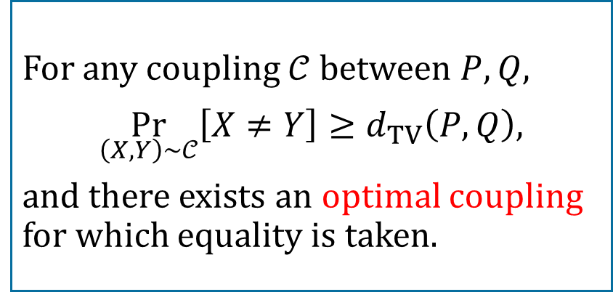


Coupling
(joint distribution with correct marginals)
Discrepancy of a coupling:
$$P$$
 | 00 | 01 | 10 | 11
00 | .25 | .04 |  | .13 | .42
01 |  | .18 |  |  | .18
10 |  | .03 | .25 |  | .28
11 |  |  |  | .12 | .12
 | .25 | .25 | .25 | .25
 | 00 | 01 | 10 | 11
00 | .25 | .06 |  | .11 | .42
01 |  | .18 |  |  | .18
10 |  | .01 | .25 | .02 | .28
11 |  |  |  | .12 | .12
 | .25 | .25 | .25 | .25
 | 00 | 01 | 10 | 11
00 | .25 | .06 |  | .11 | .42
01 |  | .18 |  |  | .18
10 |  | .01 | .25 | .02 | .28
11 |  |  |  | .12 | .12
 | .25 | .25 | .25 | .25
 | 00 | 01 | 10 | 11
00 |  |  |  |  | .42
01 |  |  |  |  | .18
10 |  |  |  |  | .28
11 |  |  |  |  | .12
 | .25 | .25 | .25 | .25
$$\underset{\left(X,Y\right)∼Coupling}{Pr}\left[X≠Y\right]$$
$$Q$$
$$=0.20$$
How far can we go?
Coupling Lemma
For any coupling $𝒞$ between $P,Q$,
$$\underset{\left(X,Y\right)∼𝒞}{Pr}\left[X≠Y\right]≥d_{TV}\left(P,Q\right),$$
and there exists an optimal coupling for which equality is taken.

Slide 13
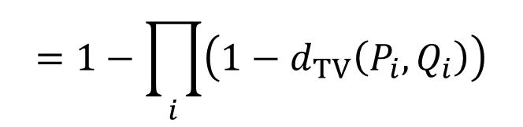

Coupling
Greedy coupling
(joint distribution with correct marginals)
$$P$$
 | 00 | 01 | 10 | 11
00 |  |  |  |  | .42
01 |  |  |  |  | .18
10 |  |  |  |  | .28
11 |  |  |  |  | .12
 | .25 | .25 | .25 | .25
 | 0? | 1?
0? |  |  | 0.6
1? |  |  | 0.4
 | 0.5 | 0.5
 | ?0 | ?1 | ?0 | ?1
?0 |  |  |  |  | 0.7
?1 |  |  |  |  | 0.3
?0 |  |  |  |  | 0.7
?1 |  |  |  |  | 0.3
 | 0.5 | 0.5 | 0.5 | 0.5
 | 0? | 1?
0? | 0.5 | 0.1 | 0.6
1? |  | 0.4 | 0.4
 | 0.5 | 0.5
 | 00 | 01 | 10 | 11
00 |  |  |  |  | .42
01 |  |  |  |  | .18
10 |  |  |  |  | .28
11 |  |  |  |  | .12
 | .25 | .25 | .25 | .25
 | ?0 | ?1 | ?0 | ?1
?0 | 0.5 | 0.2 | 0.5 | 0.2 | 0.7
?1 |  | 0.3 |  | 0.3 | 0.3
?0 | 0.5 | 0.2 | 0.5 | 0.2 | 0.7
?1 |  | 0.3 |  | 0.3 | 0.3
 | 0.5 | 0.5 | 0.5 | 0.5
 | 0.5 | 0.1
 |  | 0.4
 | 0.5 | 0.2 | 0.5 | 0.2
 |  | 0.3 |  | 0.3
 | 0.5 | 0.2 | 0.5 | 0.2
 |  | 0.3 |  | 0.3
$$P_{1}:P_{1}\left(0\right)=0.5, P_{1}\left(1\right)=0.5$$
 | 00 | 01 | 10 | 11
00 | .25 | .10 | .05 | .02 | .42
01 |  | .15 |  | .03 | .18
10 |  |  | .20 | .08 | .28
11 |  |  |  | .12 | .12
 | .25 | .25 | .25 | .25
$$Q$$
$$P_{2}:P_{2}\left(0\right)=0.5, P_{2}\left(1\right)=0.5$$
$$Q_{1}:Q_{1}\left(0\right)=0.6, Q_{1}\left(1\right)=0.4$$
$$Q_{2}:Q_{2}\left(0\right)=0.7, Q_{2}\left(1\right)=0.3$$
$$P=P_{1}⊗P_{2},Q=Q_{1}⊗Q_{2}$$
Discrepancy of a coupling:
$$\underset{\left(X,Y\right)∼Coupling}{Pr}\left[X≠Y\right]$$
$$=0.28$$
$$=1−\prod_{i}{\left(1−d_{TV}\left(P_{i},Q_{i}\right)\right)}$$

Slide 14
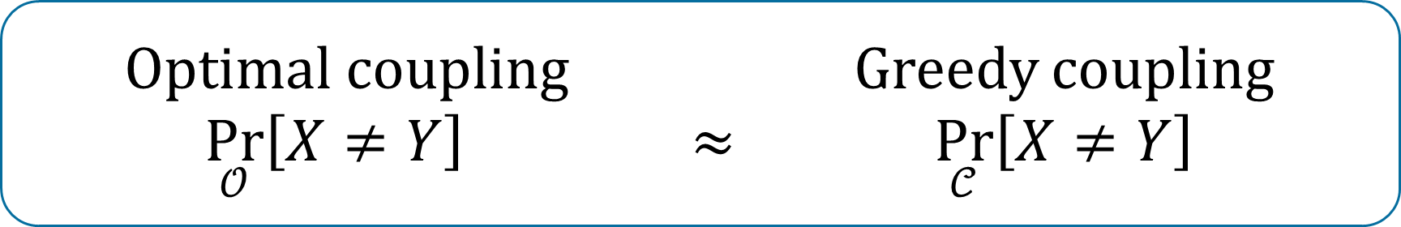

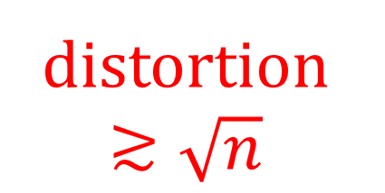
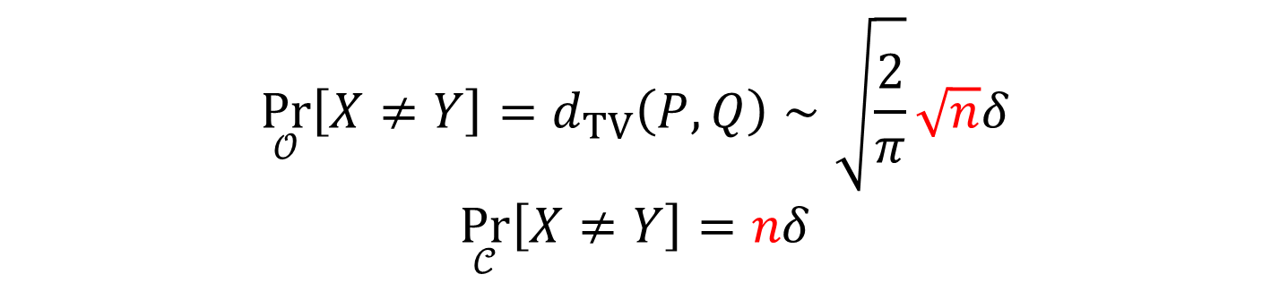
Optimal coupling $≠$ greedy coupling
Optimal coupling Greedy coupling
$\underset{𝒪}{Pr}\left[X≠Y\right]$ $≈$ $\underset{𝒞}{Pr}\left[X≠Y\right]$
?
Consider $P_{i}\left(1\right)=0.5$, $Q_{i}\left(1\right)=0.5+δ$. Then
distortion
$≳\sqrt{n}$
$$\underset{𝒪}{Pr}\left[X≠Y\right]=d_{TV}\left(P,Q\right)∼\sqrt{\frac{2}{π}}\sqrt{n}δ$$
$$\underset{𝒞}{Pr}\left[X≠Y\right]=nδ$$

Slide 15
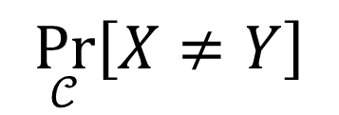

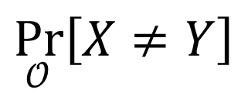



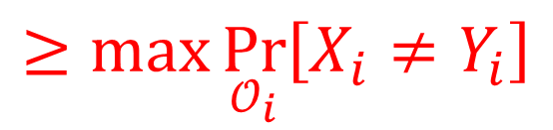


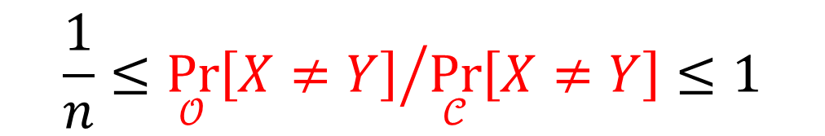

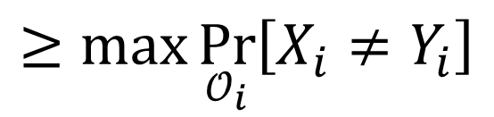


Optimal coupling $≈$ greedy coupling
“ ”
Projection of coupling is a coupling
Coupling lemma
$$\underset{𝒪}{Pr}\left[X≠Y\right]$$
$$≥\max{\underset{𝒪_{i}}{Pr}\left[X_{i}≠Y_{i}\right]}$$
$$≥\max{d_{TV}\left(P_{i},Q_{i}\right)}$$
$$≥\max{\underset{𝒪_{i}}{Pr}\left[X_{i}≠Y_{i}\right]}$$
$$≥\max{d_{TV}\left(P_{i},Q_{i}\right)}$$
(not necessarily optimal)
$$≤\sum_{i=1}^{n}{\underset{𝒞_{i}}{Pr}\left[X_{i}≠Y_{i}\right]}$$
$$≤\sum_{i=1}^{n}{\underset{𝒞_{i}}{Pr}\left[X_{i}≠Y_{i}\right]}$$
$$=\sum_{i=1}^{n}{d_{TV}\left(P_{i},Q_{i}\right)}$$
$$=\sum_{i=1}^{n}{d_{TV}\left(P_{i},Q_{i}\right)}$$
$$≤n\max{d_{TV}\left(P_{i},Q_{i}\right)}$$
$$\underset{𝒞}{Pr}\left[X≠Y\right]$$
$$≤n\max{d_{TV}\left(P_{i},Q_{i}\right)}$$
$$\frac{1}{n}≤{\underset{𝒪}{Pr}\left[X≠Y\right]}/{\underset{𝒞}{Pr}\left[X≠Y\right]}≤1$$
Union bound
Optimal coupling
We estimate this!

Slide 16
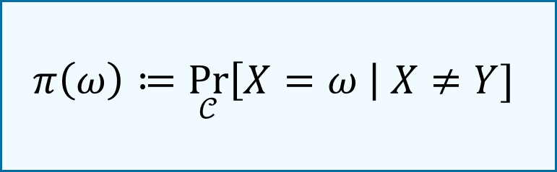
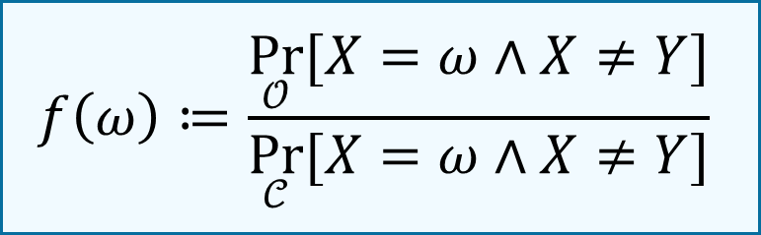
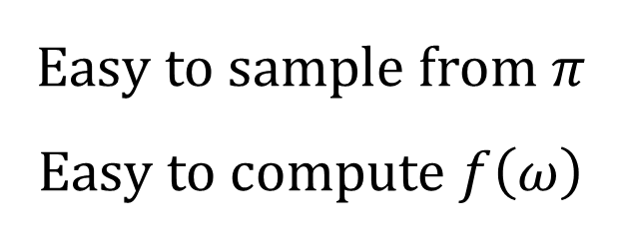
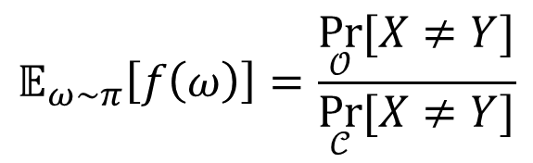
The estimator
$$f\left(ω\right)≔\frac{\underset{𝒪}{Pr}{[X=ω∧X≠Y]}}{\underset{𝒞}{Pr}{[X=ω∧X≠Y]}}$$
$$π\left(ω\right)≔\underset{𝒞}{Pr}\left[X=ω \right| X≠Y]$$
Correctness
# samples
Implementation
Easy to sample from $π$
Easy to compute $f\left(ω\right)$
$$𝔼_{ω∼π}\left[f\left(ω\right)\right]=\frac{\underset{𝒪}{Pr}{[X≠Y]}}{\underset{𝒞}{Pr}{[X≠Y]}}$$
Low variance

Slide 17


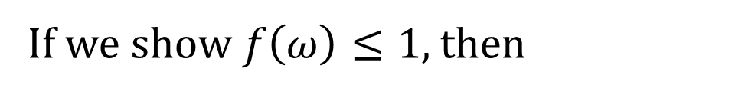

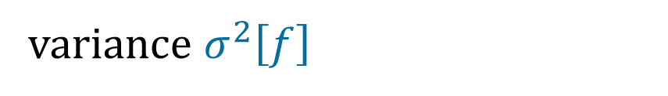
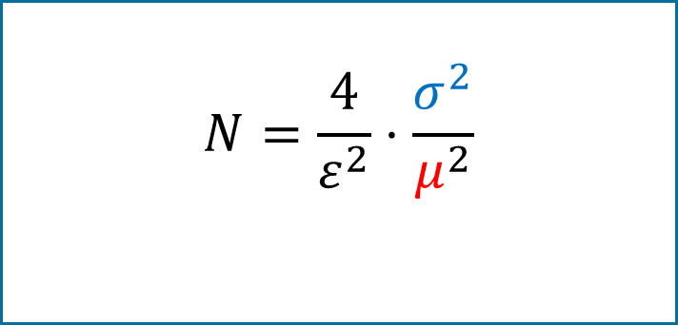


Low variance
$$f\left(ω\right)≔\frac{\underset{𝒪}{Pr}{[X=ω∧X≠Y]}}{\underset{𝒞}{Pr}{[X=ω∧X≠Y]}}$$
$$π\left(ω\right)≔\underset{𝒞}{Pr}\left[X=ω \right| X≠Y]$$
$$1/n≤𝔼\left[f\right]≤1$$
Unbiased estimator
If we show $f\left(ω\right)≤1$, then
$$N=\frac{4}{ε^{2}}⋅\frac{σ^{2}}{μ^{2}}$$
variance $σ^{2}\left[f\right]$
$$=𝔼\left[f^{2}\right]−𝔼^{2}\left[f\right]$$
$$≤𝔼\left[f^{2}\right]$$
$$≤𝔼\left[f\right]$$
$$=O\left(1/𝔼\left[f\right]\right)=O\left(n\right)$$

Slide 18
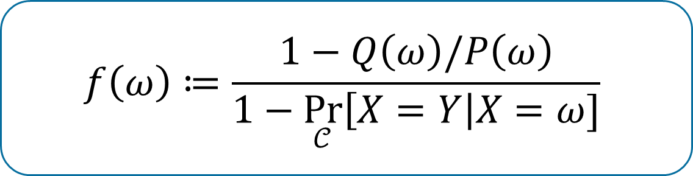
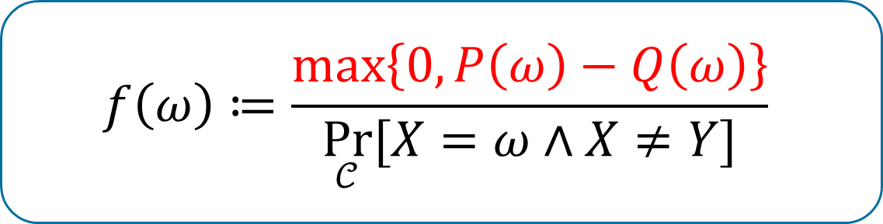
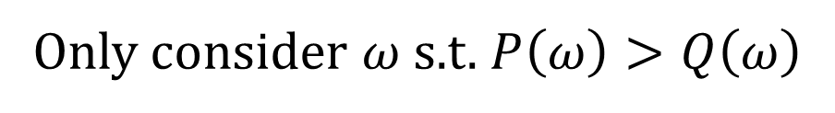
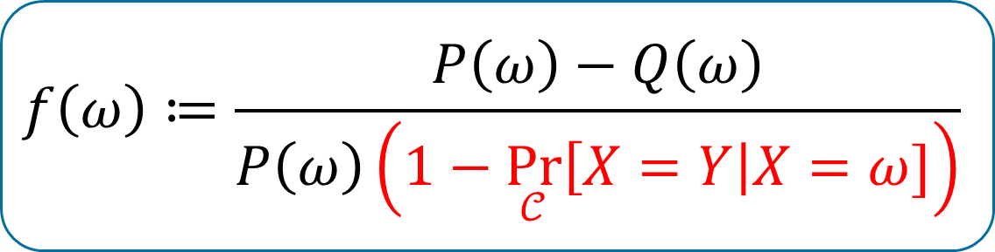
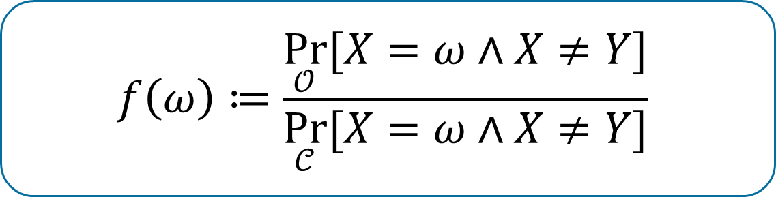
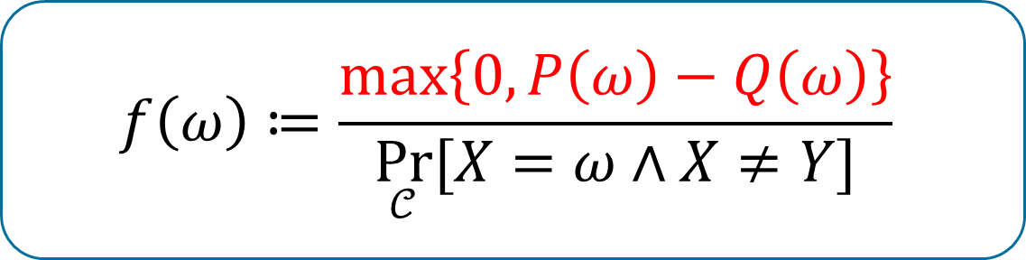
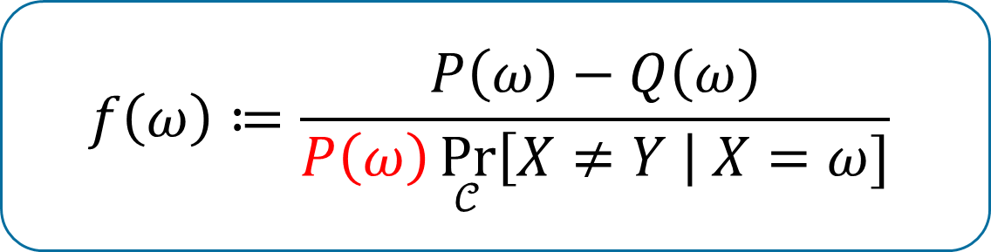
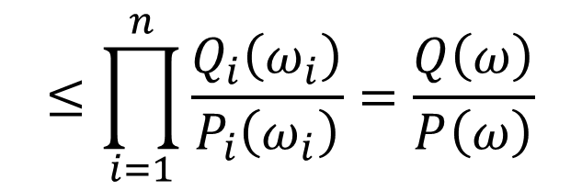
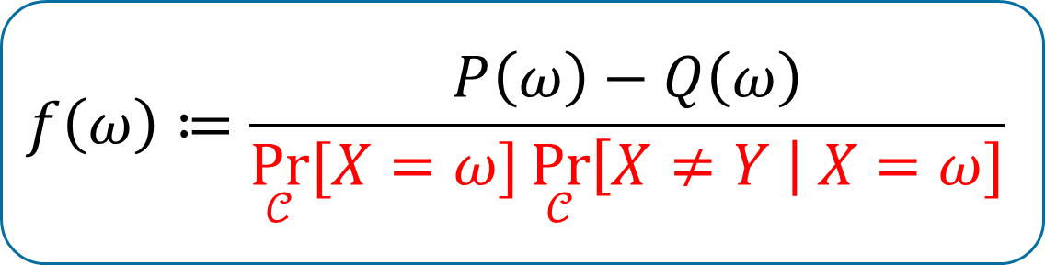
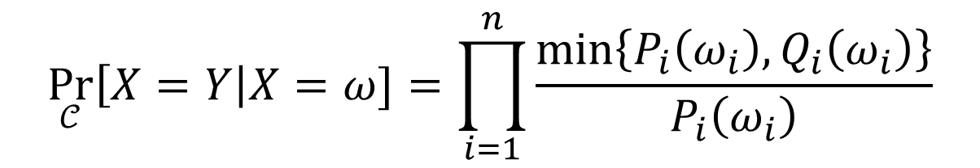
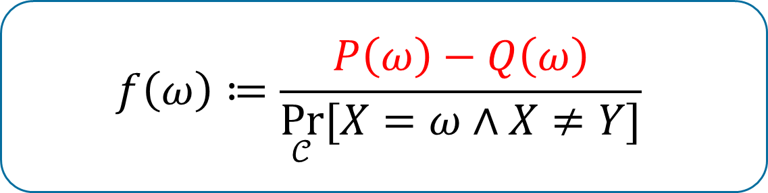

Low variance (boring page…)
$$P$$
 | 00 | 01 | 10 | 11
00 | .25 | .06 |  | .11 | .42
01 |  | .18 |  |  | .18
10 |  | .01 | .25 | .02 | .28
11 |  |  |  | .12 | .12
 | .25 | .25 | .25 | .25
$$Q$$
$$f\left(ω\right)≔\frac{1−Q\left(ω\right)/P\left(ω\right)}{1−\underset{𝒞}{Pr}\left[X=Y\right|X=ω]}$$
$$f\left(ω\right)≔\frac{1−Q\left(ω\right)/P\left(ω\right)}{1−\underset{𝒞}{Pr}\left[X=Y\right|X=ω]}$$
$$f\left(ω\right)≔\frac{\underset{𝒪}{Pr}{[X=ω∧X≠Y]}}{\underset{𝒞}{Pr}{[X=ω∧X≠Y]}}$$
$$f\left(ω\right)≔\frac{\max\left\{0,P\left(ω\right)−Q\left(ω\right)\right\}}{\underset{𝒞}{Pr}{[X=ω∧X≠Y]}}$$
$$f\left(ω\right)≔\frac{P\left(ω\right)−Q\left(ω\right)}{P\left(ω\right)\left(1−\underset{𝒞}{Pr}\left[X=Y\right|X=ω]\right)}$$
$$f\left(ω\right)≔\frac{P\left(ω\right)−Q\left(ω\right)}{P\left(ω\right)\underset{𝒞}{Pr}\left[X≠Y \right| X=ω]}$$
$$f\left(ω\right)≔\frac{P\left(ω\right)−Q\left(ω\right)}{\underset{𝒞}{Pr}{[X=ω]}\underset{𝒞}{Pr}\left[X≠Y \right| X=ω]}$$
$$f\left(ω\right)≔\frac{\max\left\{0,P\left(ω\right)−Q\left(ω\right)\right\}}{\underset{𝒞}{Pr}{[X=ω∧X≠Y]}}$$
$$f\left(ω\right)≔\frac{P\left(ω\right)−Q\left(ω\right)}{\underset{𝒞}{Pr}{[X=ω∧X≠Y]}}$$
Only consider $ω$ s.t. $P\left(ω\right)>Q\left(ω\right)$
$$\underset{𝒞}{Pr}\left[X=Y\right|X=ω]=\prod_{i=1}^{n}{\frac{\min\left\{P_{i}\left(ω_{i}\right),Q_{i}\left(ω_{i}\right)\right\}}{P_{i}\left(ω_{i}\right)}}$$
$$≤\prod_{i=1}^{n}{\frac{Q_{i}\left(ω_{i}\right)}{P_{i}\left(ω_{i}\right)}}=\frac{Q\left(ω\right)}{P\left(ω\right)}$$

Slide 19


More progress upon this work…
An open access journal in theoretical computer science
Deterministic algorithm
[Feng-Liu-Liu’23]
Improved running time
$O\left(n^{1.5}\right)$, by bounding distortion
[Kontorovich’25]
Similarity ($1−d_{TV}$)
[Bhattacharyya-Gayen-Meel-Myrisiotis-Pavan-Vinodchandran’25]
More interesting distributions
Gaussian
[Bhattacharyya-Feng-Srivastava’25]
Spin system
[Feng-Liu-Yang’25]
“Completeness” for “VNP” with ReLU gates?
Tackar!
arXiv: 2208.00740v1, 5 pages

