Slide 1
Beyond bilinear complexity: what works and what breaks with many modes?
Many authors
CCC 2026

Slide 2
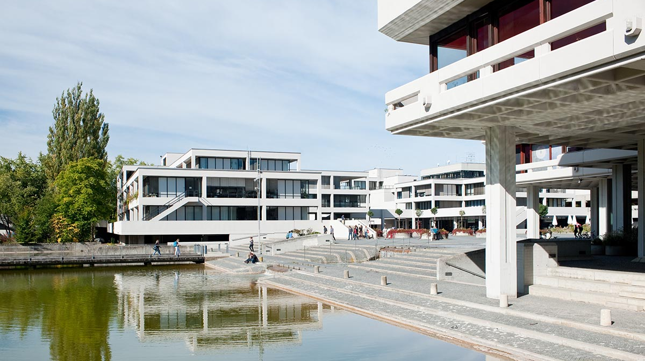
Cornelius Brand
University of Regensburg
Radu Curticapean
University of Regensburg
IT University of Copenhagen
Baitian Li
Columbia University
Petteri Kaski
Aalto University
Ian Orzel
University of Copenhagen
Tim Seppelt
IT University of Copenhagen
Jiaheng Wang
University of Helsinki

Slide 3
4
1
3
0
0
0
8
2
6

Slide 4
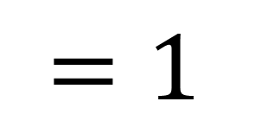
4
1
3
0
0
0
rank
$$=1$$
8
2
6

Slide 5
4
1
3
1
4
1
3
0
0
0
0
rank
$$=1$$
2
8
2
6

Slide 6
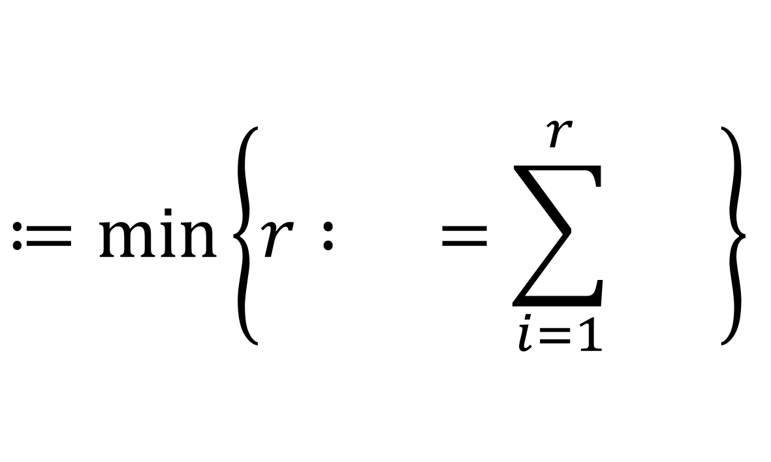



4
1
3
1
4
1
3
rank-1 matrices
0
0
0
0
$$≔\min\left\{r : =\sum_{i=1}^{r}{ }\right\}$$
2
8
2
6
rank
$$\left(M\right)$$
$$M$$
$$M_{i}$$

Slide 7
4
1
3
0
0
0
8
2
6
8
2
6
0
0
0
-4
-1
-3
16
4
12
0
0
0
-8
-2
-6

Slide 8
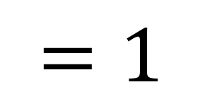
4
1
3
1
4
1
3
1
0
0
0
0
8
2
6
2
8
2
6
2
rank
$$=1$$
0
0
0
-4
-1
-3
16
4
12
-1
0
0
0
-8
-2
-6

Slide 9
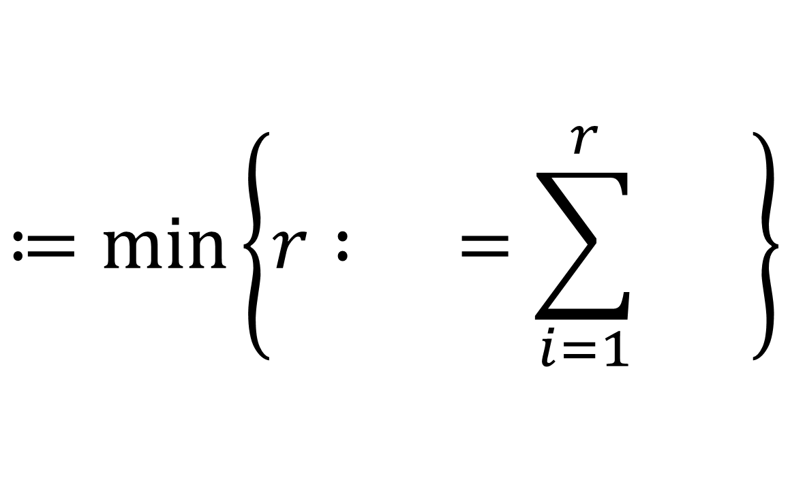



4
1
3
1
4
1
3
1
0
0
0
0
8
2
6
rank-1 tensors
2
8
2
6
2
0
0
0
-4
-1
-3
$$≔\min\left\{r : =\sum_{i=1}^{r}{ }\right\}$$
16
4
12
-1
0
0
0
-8
-2
-6
rank
$$\left(T\right)$$
$$T$$
$$T_{i}$$

Slide 10

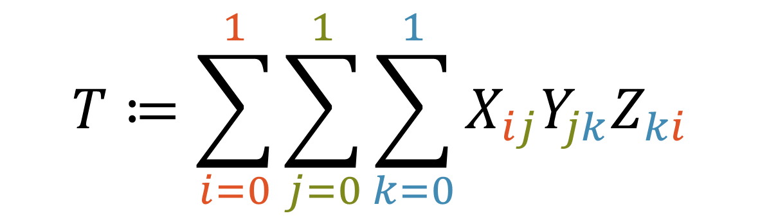


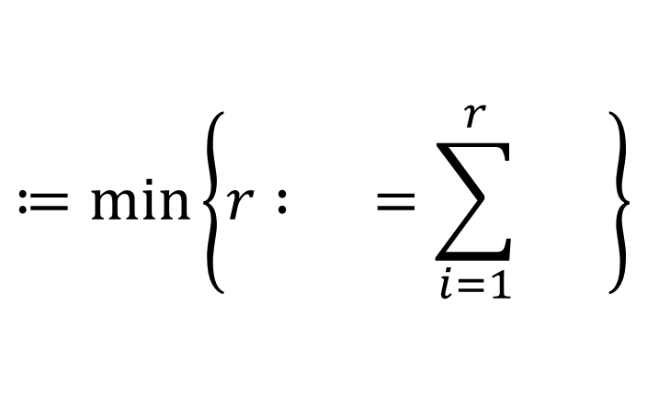
rank-1 tensors
$$≔\min\left\{r : =\sum_{i=1}^{r}{ }\right\}$$
rank
$$\left(T\right)$$
$$T$$
$$T_{i}$$
$$T≔\sum_{i=0}^{1}{\sum_{j=0}^{1}{\sum_{k=0}^{1}{X_{ij}Y_{jk}Z_{ki}}}}$$

Slide 11



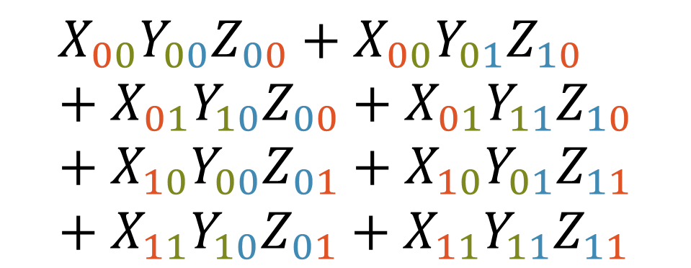



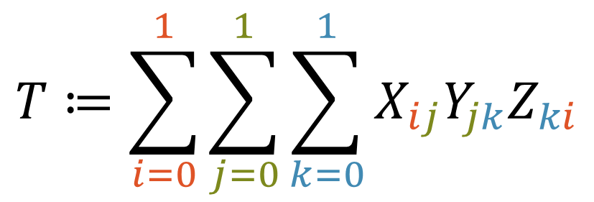











$$X_{00}$$
$$X_{01}$$
$$X_{10}$$
$$X_{11}$$
rank-1 tensors
$$≔\min\left\{r : =\sum_{i=1}^{r}{ }\right\}$$
$$Y_{00}$$
1
1
rank
$$\left(T\right)$$
$$T$$
$$T_{i}$$
$$Y_{01}$$
1
1
$$Z_{00}$$
$$Z_{01}$$
$$Z_{10}$$
$$Z_{11}$$
$$Y_{10}$$
1
1
$$Y_{11}$$
1
1
$$T≔\sum_{i=0}^{1}{\sum_{j=0}^{1}{\sum_{k=0}^{1}{X_{ij}Y_{jk}Z_{ki}}}}$$
$$=$$
$$X_{00}Y_{00}Z_{00}+X_{00}Y_{01}Z_{10}+X_{01}Y_{10}Z_{00}+X_{01}Y_{11}Z_{10}+X_{10}Y_{00}Z_{01}+X_{10}Y_{01}Z_{11}+X_{11}Y_{10}Z_{01}+X_{11}Y_{11}Z_{11}$$

Slide 12
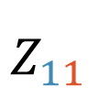

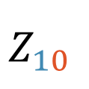

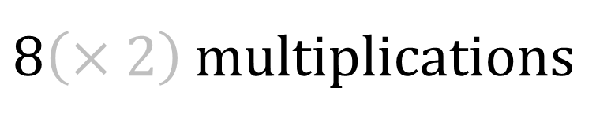

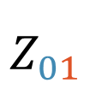

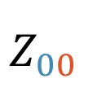




$$X_{00}$$
$$X_{01}$$
$$X_{10}$$
$$X_{11}$$
$$Y_{00}$$
1
$$T≔\sum_{i=0}^{1}{\sum_{j=0}^{1}{\sum_{k=0}^{1}{X_{ij}Y_{jk}Z_{ki}}}}$$
$$Y_{01}$$
$$Z_{00}$$
1
$$Y_{10}$$
1
$$=$$
$$Y_{11}$$
$$Z_{01}$$
$$X_{00}Y_{00}Z_{00}+X_{00}Y_{01}Z_{10}+X_{01}Y_{10}Z_{00}+X_{01}Y_{11}Z_{10}+X_{10}Y_{00}Z_{01}+X_{10}Y_{01}Z_{11}+X_{11}Y_{10}Z_{01}+X_{11}Y_{11}Z_{11}$$
1
1
$$Z_{10}$$
1
1
$$Z_{11}$$
$8\left(×2\right)$ multiplications
1

Slide 13
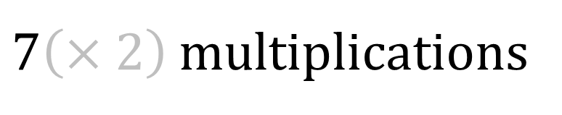
$$X_{00}$$
$$X_{01}$$
$$X_{10}$$
$$X_{11}$$
$$Y_{00}$$
1
1
$$Y_{01}$$
1
1
$$Z_{00}$$
$$Z_{01}$$
$$Z_{10}$$
$$Z_{11}$$
$$Y_{10}$$
1
1
$$Y_{11}$$
1
1
$$T≔\sum_{i=0}^{1}{\sum_{j=0}^{1}{\sum_{k=0}^{1}{X_{ij}Y_{jk}Z_{ki}}}}$$
$$=$$
$$\left(X_{00}+X_{11}\right)\left(Y_{00}+Y_{11}\right)\left(Z_{00}+Z_{11}\right)$$
$$+\left(X_{10}+X_{11}\right)Y_{00}\left(Z_{10}−Z_{11}\right)$$
$$+X_{00}\left(Y_{01}−Y_{11}\right)\left(Z_{01}+Z_{11}\right)$$
$$−X_{11}\left(Y_{00}−Y_{10}\right)\left(Z_{00}+Z_{10}\right)$$
$$−\left(X_{00}+X_{01}\right)Y_{11}\left(Z_{00}−Z_{01}\right)$$
$$−\left(X_{00}−X_{10}\right)\left(Y_{00}+Y_{01}\right)Z_{11}$$
$$+\left(X_{01}−X_{11}\right)\left(Y_{10}+Y_{11}\right)Z_{00}$$
$7\left(×2\right)$ multiplications

Slide 14
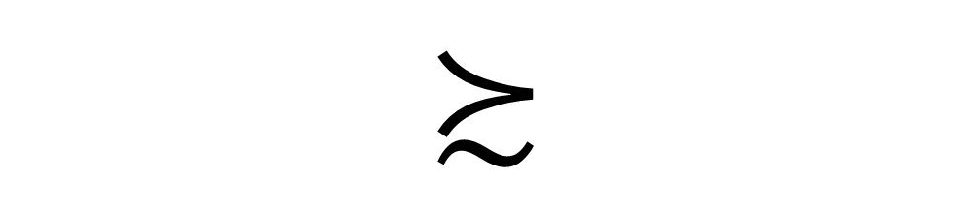

rank
complexity
$$R\left(T\right)≈C\left(T\right)$$
$$≿$$

Slide 15
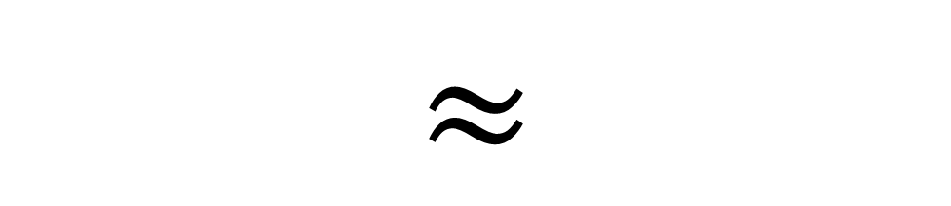
rank
complexity
$$R\left(T\right)≈C\left(T\right)$$
$$≈$$
3-tensor

Slide 16
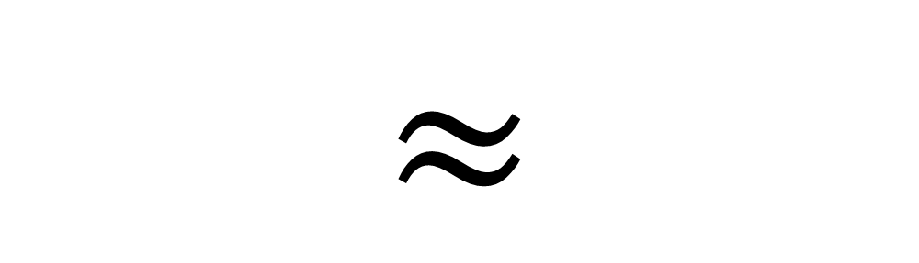

„Vermeidung von Divisionen“
Strassen, 1973
$$R\left(T\right)≈C\left(T\right)$$
$$≈$$
“ ”
3-tensor

Slide 17
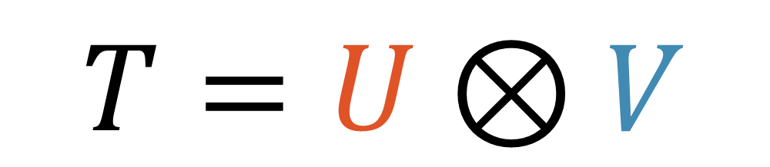


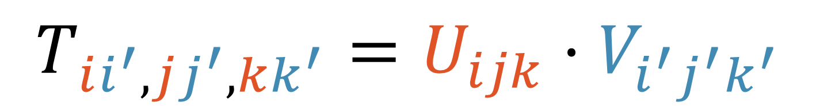
Kronecker product
$$T=U⊗V$$
$$U$$
$$V$$
$$T_{ii^{′},jj^{′},kk^{′}}=U_{ijk}⋅V_{i^{′}j^{′}k^{′}}$$
Notes:
Motivation is to build large, structural tensors

Slide 18

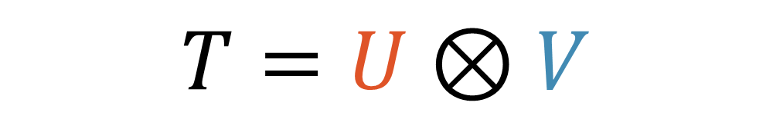

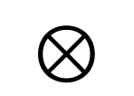
$$T=U⊗V$$
$$⊗$$
$$U$$
$$V$$

Slide 19
$$T=U⊗V$$
$$⊗$$
$$U$$
$$V$$

Slide 20
$$T=U⊗V$$
$$⊗$$
$$U$$
$$V$$

Slide 21
$$T=U⊗V$$
$$⊗$$
$$U$$
$$V$$

Slide 22
Kronecker product
$$T=U⊗V$$
$$U$$
$$V$$
$$T_{ii^{′},jj^{′},kk^{′}}=U_{ijk}⋅V_{i^{′}j^{′}k^{′}}$$
matrix
multiplication
tensor
hypergraph
clique
tensor
maybe…
more?
🤔

Slide 23








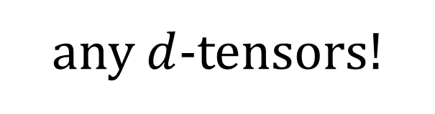



$$T=U⊗V$$
any $d$-tensors!
$$T=U⊗V$$
$$U$$
$$V$$
$$R$$
$$\left(T\right)$$
$$≤$$
$$R$$
$$\left(U\right)$$
$$R$$
$$\left(V\right)$$
can be strict

Slide 24
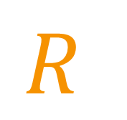
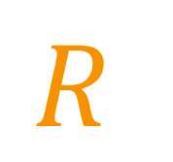



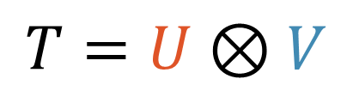




rank
complexity
$$R\left(T\right)≈C\left(T\right)$$
-tensor
$$3$$
$$R$$
$$\left(T\right)$$
$$≤$$
$$R$$
$$\left(U\right)$$
$$R$$
$$\left(V\right)$$
$$T=U⊗V$$

Slide 25




rank
complexity
$$R\left(T\right)≈C\left(T\right)$$
-tensor
$$3$$
$$C$$
$$\left(T\right)$$
$$≲$$
$$C$$
$$\left(U\right)$$
$$C$$
$$\left(V\right)$$
$$T=U⊗V$$

Slide 26

rank
complexity
?
$$R\left(T\right)≈C\left(T\right)$$
-tensor
$$d$$
$$C$$
$$\left(T\right)$$
$$≲$$
$$C$$
$$\left(U\right)$$
$$C$$
$$\left(V\right)$$
?
$$T=U⊗V$$

Slide 27

rank
complexity
$$R\left(T\right)≈C\left(T\right)$$
／
-tensor
$$4$$
$$C$$
$$\left(T\right)$$
$$≲$$
$$C$$
$$\left(U\right)$$
$$C$$
$$\left(V\right)$$
?
$$T=U⊗V$$

Slide 28

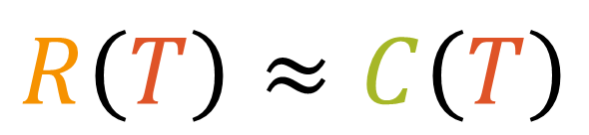
$$R\left(T\right)≈C\left(T\right)$$
Product of Inner Products
／
-tensor
$$4$$

Slide 29
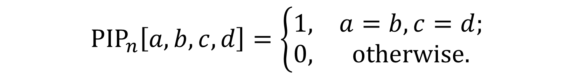
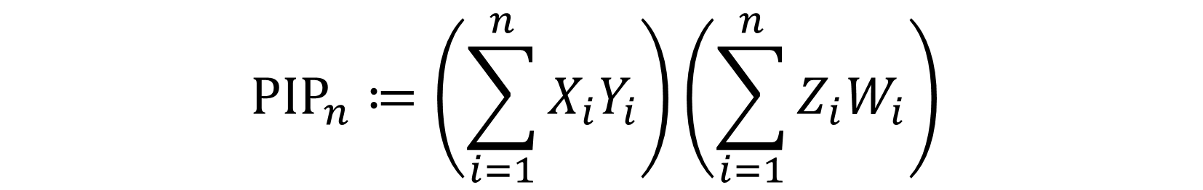
$$R\left(T\right)≈C\left(T\right)$$
Product of Inner Products
／
-tensor
$$4$$
$${PIP}_{n}≔\left(\sum_{i=1}^{n}{X_{i}Y_{i}}\right)\left(\sum_{i=1}^{n}{Z_{i}W_{i}}\right)$$
$${PIP}_{n}\left[a,b,c,d\right]=\left\{\begin{matrix}1, & a=b,c=d; \\ 0, & otherwise.\end{matrix}\right.$$

Slide 30
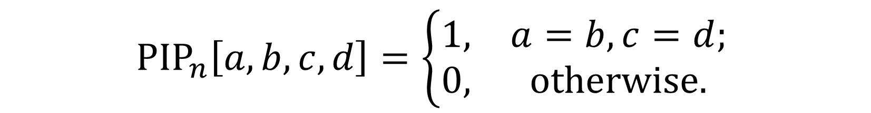

$$R\left(T\right)≈C\left(T\right)$$
Product of Inner Products
／
-tensor
$$4$$
$${PIP}_{n}≔\left(\sum_{i=1}^{n}{X_{i}Y_{i}}\right)\left(\sum_{i=1}^{n}{Z_{i}W_{i}}\right)$$
$${PIP}_{n}\left[a,b,c,d\right]=\left\{\begin{matrix}1, & a=b,c=d; \\ 0, & otherwise.\end{matrix}\right.$$
$$C\left(T\right)≤4n$$

Slide 31





$$R\left(T\right)≈C\left(T\right)$$
／
$${PIP}_{n}\left[a,b,c,d\right]=\left\{\begin{matrix}1, & a=b,c=d; \\ 0, & otherwise.\end{matrix}\right.$$
-tensor
$$4$$
$$R\left(T\right)=n^{2}$$
$$C\left(T\right)≤4n$$
$$\left[x,y\right]=\left\{\begin{matrix}1, & x=y; \\ 0, & otherwise.\end{matrix}\right.$$
$$I_{n^{2}}$$

Slide 32
rank
complexity
$$R\left(T\right)≈C\left(T\right)$$
／
-tensor
$$4$$
?
$$C$$
$$\left(T\right)$$
$$≲$$
$$C$$
$$\left(U\right)$$
$$C$$
$$\left(V\right)$$
$$T=U⊗V$$

Slide 33








?
$$T=U⊗V$$
$$C$$
$$\left(T\right)$$
$$≲$$
$$C$$
$$\left(U\right)$$
$$C$$
$$\left(V\right)$$

Slide 34

$$T=U⊗V$$
$$C$$
$$\left(T\right)$$
$$≫$$
$$C$$
$$\left(U\right)$$
$$C$$
$$\left(V\right)$$

Slide 35

$$T=U⊗V$$
$$C$$
$$\left(T\right)$$
$$≲$$
$$C$$
$$\left(U\right)$$
$$C$$
$$\left(V\right)$$

Slide 36








$$T=U⊗V$$
$$C$$
$$\left(T\right)$$
$$≲$$
$$C$$
$$\left(U\right)$$
$$C$$
$$\left(V\right)$$
3-tensor

Slide 37

$$T=U⊗V$$
$$C$$
$$\left(T\right)$$
$$≲$$
$$C$$
$$\left(U\right)$$
$$C$$
$$\left(V\right)$$
3-tensor
4-tensor
$$ω=2$$

Slide 38



$$T=U⊗V$$
$$C$$
$$\left(T\right)$$
$$≲$$
$$C$$
$$\left(U\right)$$
$$C$$
$$\left(V\right)$$
3-tensor
8-tensor
$$ω=2$$
4-tensor
Hyperclique conjecture
is false
$¬$HC
$$O\left(n^{3.99}\right)?$$

Slide 39




$$T=U⊗V$$
$$C$$
$$\left(T\right)$$
$$≲$$
$$C$$
$$\left(U\right)$$
$$C$$
$$\left(V\right)$$
3-tensor
25-tensor
$$ω=2$$
4-tensor
Vol. 2, 4.6.4, “Exercise” 11
Is there any way to evaluate the permanent of a general $n×n$ matrix using fewer than $2^{n}$ arithmetic operations?
$n×n$ permanent in time $O\left({1.7412}^{n}\right)$
$¬$HC
8-tensor
FastPerm

Slide 40


$$T=U⊗V$$
$$C$$
$$\left(T\right)$$
$$≲$$
$$C$$
$$\left(U\right)$$
$$C$$
$$\left(V\right)$$
3-tensor
$d$-tensor
$$ω=2$$
4-tensor
$$VP=VNP$$
$¬$HC
8-tensor
FastPerm
25-tensor

Slide 41


$$T=U⊗V$$
$$C$$
$$\left(T\right)$$
$$≲$$
$$C$$
$$\left(U\right)$$
$$C$$
$$\left(V\right)$$
3-tensor
$$ω=2$$
4-tensor
$¬$HC
8-tensor
FastPerm
25-tensor
$$VP=VNP$$
$d$-tensor

Slide 42



any $d$-tensors!
$$T=U⊗V$$
$$U$$
$$V$$
$$R$$
$$\left(T\right)$$
$$≤$$
$$R$$
$$\left(U\right)$$
$$R$$
$$\left(V\right)$$
can be strict

Slide 43


any $d$-tensors!
$$T=U⊗V$$
$$U$$
$$U$$
$$R$$
$$\left(T\right)$$
$$≤$$
$$R$$
$$\left(U\right)$$
$$R$$
$$\left(U\right)$$
can be strict

Slide 44




any $d$-tensors!
$$T=U⊗V$$
$$U$$
$$U$$
$$⊗$$
$$U$$
$$R$$
$$\left(T\right)$$
$$≤$$
$$R$$
$$\left(U\right)$$
$$R$$
$$\left(U\right)$$
$$R$$
$$\left(U\right)$$
can be strict

Slide 45




any $d$-tensors!
$$T=U⊗V$$
$$U$$
$$U$$
$$⊗$$
$$U$$
$$⊗$$
$$U$$
$$R$$
$$\left(T\right)$$
$$≤$$
$$R$$
$$\left(U\right)$$
$$R$$
$$\left(U\right)$$
$$R$$
$$\left(U\right)$$
$$R$$
$$\left(U\right)$$
can be strict

Slide 46





any $d$-tensors!
$$U^{⊗k}$$
$$T=U⊗V$$
$$U$$
$$U$$
$$⊗$$
$$U$$
$$⊗$$
$$U$$
$$R$$
$$\left(U^{⊗k}\right)$$
$$≤$$
$$R$$
$$\left(U\right)$$
$$R$$
$$\left(U\right)$$
$$R$$
$$\left(U\right)$$
$$R$$
$$\left(U\right)$$
can be strict

Slide 47


any $d$-tensors!
$$U^{⊗k}$$
$$T=U⊗V$$
$$U$$
$$U$$
$$⊗$$
$$U$$
$$⊗$$
$$U$$
$$\sqrt[k]{ }$$
$$\sqrt[k]{ }$$
$$R$$
$$\left(U^{⊗k}\right)$$
$$≤$$
$$R$$
$$\left(U\right)$$
$$R$$
$$\left(U\right)$$
$$R$$
$$\left(U\right)$$
$$R$$
$$\left(U\right)$$
can be strict

Slide 48
any $d$-tensors!
$$U^{⊗k}$$
$$T=U⊗V$$
$$U$$
$$U$$
$$⊗$$
$$U$$
$$⊗$$
$$U$$
$$\sqrt[k]{ }$$
$$R$$
$$\left(U^{⊗k}\right)$$
$$≤$$
$$R$$
$$\left(U\right)$$
can be strict

Slide 49









$$\sqrt[k]{ }$$
$$\overset{̰}{R}$$
$$\left(U^{⊗k}\right)$$
$$\left(U\right)$$
$$R$$
$$≤$$
$$R$$
$$←$$
$$\left(U\right)$$

Slide 50


Asymptotic rank
$$\sqrt[k]{ }$$
$$\overset{̰}{R}$$
$$\left(U^{⊗k}\right)$$
$$\left(U\right)$$
$$R$$
$$≤$$
$$R$$
$$←$$
$$\left(U\right)$$
$$\overset{̰}{R}\left({MM}_{2}\right)=2^{ω}$$
$$R\left({MM}_{2}\right)=7$$

Slide 51





















$$\overset{̰}{R}$$
$$\left(T\right)$$
$$≤$$
$$\overset{̰}{R}$$
$$\left(U\right)$$
$$\overset{̰}{R}$$
$$\left(V\right)$$
?
$$\overset{̰}{C}$$
$$\left(T\right)$$
$$≲$$
$$\overset{̰}{C}$$
$$\left(U\right)$$
$$\overset{̰}{C}$$
$$\left(V\right)$$
$$\overset{̰}{C}$$
$$\left(T\right)$$
$$≤$$
$$\overset{̰}{R}$$
$$\left(U\right)$$
$$\overset{̰}{C}$$
$$\left(V\right)$$
$$T=U⊗V$$
Notes:
“main results” in the upcoming few slides

Slide 52


















Strassen’s Theorem
$$\overset{̰}{R}\left(T\right)≤$$
$$n^{2ω/3}$$
$n×n×n$ tensor
?
$$\overset{̰}{C}$$
$$\left(T\right)$$
$$≲$$
$$\overset{̰}{C}$$
$$\left(U\right)$$
$$\overset{̰}{C}$$
$$\left(V\right)$$
$$\overset{̰}{C}$$
$$\left(T\right)$$
$$≤$$
$$\overset{̰}{R}$$
$$\left(U\right)$$
$$\overset{̰}{C}$$
$$\left(V\right)$$
$$T=U⊗V$$

Slide 53


Generalised
Strassen’s Theorem
$$\overset{̰}{R}\left(T\right)≤$$
$$n^{(d−1)ω/3}$$
$d$-tensor

Slide 54

Generalised
Strassen’s Theorem
$$\overset{̰}{R}\left(T\right)≤$$
$$n^{0.7905(d−1)}$$
$d$-tensor

Slide 55

Better
Generalised
Strassen’s Theorem
$$\overset{̰}{R}\left(T\right)≤$$
$$n^{0.7724(d−1)}$$
$d$-tensor

Slide 56










$$\overset{̰}{R}\left(T\right)≤$$
$$n^{0.7724(d−1)}$$
$$\overset{̰}{C}\left(T\right)≤$$
$$n^{0.5d+1−1.5/d}$$
$$\overset{̰}{C}\left(T\right)≤$$
$$n^{2.2928}$$
$$,d=4$$
$$\overset{̰}{C}\left(T\right)≤$$
$$n^{2.8738}$$
$$,d=5$$

Slide 57
Graph tensors
Notes:
“technical part of the talk”

Slide 58



Graph tensors
$$X$$
$$Y$$
$$Z$$

Slide 59



Graph tensors
$$X$$
$$1$$
$$1$$
$$Y$$
$$Z$$
$$1$$

Slide 60

Graph tensors
$$X$$
$$1$$
$$1$$
$$X_{11}Y_{11}Z_{11}$$
$$Y$$
$$Z$$
$$1$$

Slide 61


Graph tensors
$$X$$
$$1$$
$$X_{11}Y_{11}Z_{11}$$
$$1$$
$$Y$$
$$Z$$
$$2$$

Slide 62


Graph tensors
$$X$$
$$1$$
$$X_{11}Y_{11}Z_{11}$$
$$1$$
$$+$$
$$X_{11}Y_{12}Z_{21}$$
$$Y$$
$$Z$$
$$2$$

Slide 63




Graph tensors
$$X_{11}Y_{11}Z_{11}$$
$$X$$
$$1$$
$$+$$
$$X_{11}Y_{12}Z_{21}$$
$$1$$
$$Y$$
$$Z$$
$$3$$

Slide 64

Graph tensors
$$X_{11}Y_{11}Z_{11}$$
$$X$$
$$1$$
$$+$$
$$X_{11}Y_{12}Z_{21}$$
$$1$$
$$+$$
$$X_{11}Y_{13}Z_{31}$$
$$Y$$
$$Z$$
$$3$$

Slide 65


Graph tensors
$$X$$
$$T_{△,n}≔\sum_{i=1}^{n}{\sum_{j=1}^{n}{\sum_{k=1}^{n}{X_{ij}Y_{jk}Z_{ki}}}}$$
$$Y$$
$${MM}_{n}$$
$$Z$$

Slide 66




Graph tensors
$$Y$$
$$X$$
$$W$$
$$Z$$

Slide 67


Graph tensors
$$Y$$
$$T_{M_{2},n}≔\sum_{i=1}^{n}{\sum_{j=1}^{n}{X_{i}Y_{i}Z_{j}W_{j}}}$$
$$X$$
$$W$$
$${PIP}_{n}$$
$$Z$$

Slide 68

Graph tensors
each vertex is a mode
$$T_{G,n}≔\sum_{σ : E→\left[n\right]}{\prod_{v∈V}{X_{σ | I\left(v\right)}^{\left(v\right)}}}$$
indexing by edges

Slide 69

holant = holographic + Valiant
Holant problem
Signature / local function
$$T_{G,d}≔\sum_{σ : E→\left[d\right]}{\prod_{v∈V}{X_{σ | I\left(v\right)}^{\left(v\right)}}}$$
domain

Slide 70
Graph tensors
each vertex is a mode
$$T_{G,n}≔\sum_{σ : E→\left[n\right]}{\prod_{v∈V}{X_{σ | I\left(v\right)}^{\left(v\right)}}}$$
indexing by edges

Slide 71




$$Y$$
$$Y$$
$$Y$$
$$Y$$
$$X$$
$$X$$
$$X$$
$$X$$
$$+$$
$$→$$
$$W$$
$$W$$
$$W$$
$$W$$
$$Z$$
$$Z$$
$$Z$$
$$Z$$

Slide 72

$$Y$$
$$Y$$
$$Y$$
$$Y$$
$$X$$
$$X$$
$$X$$
$$X$$
$$+$$
$$→$$
$$W$$
$$W$$
$$W$$
$$W$$
$$Z$$
$$Z$$
$$Z$$
$$Z$$

Slide 73
$$Y$$
$$Y$$
$$Y$$
$$Y$$
$$X$$
$$X$$
$$X$$
$$X$$
$$+$$
$$→$$
$$W$$
$$W$$
$$W$$
$$W$$
$$Z$$
$$Z$$
$$Z$$
$$Z$$

Slide 74
$$Y$$
$$Y$$
$$Y$$
$$Y$$
$$X$$
$$X$$
$$X$$
$$X$$
$$+$$
$$→$$
$$W$$
$$W$$
$$W$$
$$W$$
$$Z$$
$$Z$$
$$Z$$
$$Z$$

Slide 75





$$Y$$
$$Y$$
$$Y$$
$$Y$$
$$X$$
$$X$$
$$X$$
$$X$$
$$+$$
$$→$$
$$W$$
$$W$$
$$W$$
$$W$$
$$Z$$
$$Z$$
$$Z$$
$$Z$$
$$T_{M_{2},n}$$
$$⊗$$
$$T_{M_{2},n}$$
$$=$$
$$T_{C_{4},n}$$

Slide 76


$$Y$$
$$Y$$
$$Y$$
$$Y$$
$$X$$
$$X$$
$$X$$
$$X$$
$$+$$
$$→$$
$$W$$
$$W$$
$$W$$
$$W$$
$$Z$$
$$Z$$
$$Z$$
$$Z$$
$${PIP}_{n}$$
$$⊗$$
$${PIP}_{n}$$
$$=$$
$$T_{C_{4},n}$$

Slide 77





$$Y$$
$$Y$$
$$Y$$
$$Y$$
$$X$$
$$X$$
$$X$$
$$X$$
$$+$$
$$→$$
$$W$$
$$W$$
$$W$$
$$W$$
$$Z$$
$$Z$$
$$Z$$
$$Z$$
$$\overset{̰}{C}\left( \right)$$
$${PIP}_{n}$$
$$×$$
$$\overset{̰}{C}\left( \right)$$
$${PIP}_{n}$$
$$≥$$
$$\overset{̰}{C}\left( \right)$$
$$T_{C_{4},n}$$

Slide 78


$$Y$$
$$Y$$
$$Y$$
$$Y$$
$$X$$
$$X$$
$$X$$
$$X$$
$$+$$
$$→$$
$$W$$
$$W$$
$$W$$
$$W$$
$$Z$$
$$Z$$
$$Z$$
$$Z$$
$$n$$
$$×$$
$$n$$
$$≥$$
$$\overset{̰}{C}\left( \right)$$
$$T_{C_{4},n}$$

Slide 79










$$Y$$
$$Y$$
$$Y$$
$$Y$$
$$Y$$
$$X$$
$$X$$
$$X$$
$$X$$
$$X$$
$$+$$
$$→$$
$$W$$
$$W$$
$$W$$
$$W$$
$$W$$
$$Z$$
$$Z$$
$$Z$$
$$Z$$
$$Z$$
$$n$$
$$×$$
$$n$$
$$≥$$
$$\overset{̰}{C}\left( \right)$$
$$T_{C_{4},n}$$

Slide 80

$$Y$$
$$Y$$
$$Y$$
$$Y$$
$$Y$$
$$X$$
$$X$$
$$X$$
$$X$$
$$X$$
$$+$$
$$→$$
$$W$$
$$W$$
$$W$$
$$W$$
$$W$$
$$Z$$
$$Z$$
$$Z$$
$$Z$$
$$Z$$
$$n$$
$$×$$
$$n$$
$$≥$$
$$\overset{̰}{C}\left( \right)$$
$$T_{C_{4},n}$$

Slide 81


$$Y$$
$$Y$$
$$Y$$
$$Y$$
$$Y$$
$$X$$
$$X$$
$$X$$
$$X$$
$$X$$
$$+$$
$$→$$
$$⟼$$
$$W$$
$$W$$
$$W$$
$$W$$
$$W$$
$$Z$$
$$Z$$
$$Z$$
$$Z$$
$$Z$$
$$W_{kℓ}=𝕀\left[k=ℓ\right]$$
$$n$$
$$×$$
$$n$$
$$≥$$
$$\overset{̰}{C}\left( \right)$$
$$T_{C_{4},n}$$

Slide 82
$$Y$$
$$Y$$
$$Y$$
$$Y$$
$$Y$$
$$X$$
$$X$$
$$X$$
$$X$$
$$X$$
$$+$$
$$→$$
$$⟼$$
$$W$$
$$W$$
$$W$$
$$W$$
$$Z$$
$$Z$$
$$Z$$
$$Z$$
$$Z$$
$$n$$
$$×$$
$$n$$
$$≥$$
$$\overset{̰}{C}\left( \right)$$
$$T_{C_{4},n}$$

Slide 83



$$Y$$
$$Y$$
$$Y$$
$$Y$$
$$Y$$
$$X$$
$$X$$
$$X$$
$$X$$
$$X$$
$$+$$
$$→$$
$$⟼$$
$$W$$
$$W$$
$$W$$
$$W$$
$$Z$$
$$Z$$
$$Z$$
$$Z$$
$$Z$$
$$n$$
$$×$$
$$n$$
$$≥$$
$$\overset{̰}{C}\left( \right)$$
$≥$
$$\overset{̰}{C}\left( \right)$$
$$T_{C_{4},n}$$
$${MM}_{n}$$

Slide 84




$$Y$$
$$Y$$
$$Y$$
$$Y$$
$$Y$$
$$X$$
$$X$$
$$X$$
$$X$$
$$X$$
$$ω=2$$
4-tensor
$$+$$
$$→$$
$$⟼$$
$$W$$
$$W$$
$$W$$
$$W$$
$$Z$$
$$Z$$
$$Z$$
$$Z$$
$$Z$$
$$n$$
$$×$$
$$n$$
$$≥$$
$$\overset{̰}{C}\left( \right)$$
$≥$
$$\overset{̰}{R}\left( \right)$$
$$=$$
$$n^{ω}$$
$$T_{C_{4},n}$$
$${MM}_{n}$$

Slide 85









$$Y$$
$$Y$$
$$Y$$
$$Y$$
$$X$$
$$X$$
$$X$$
$$X$$
$$ω=2$$
4-tensor
$$+$$
$$→$$
$$W$$
$$W$$
$$W$$
$$W$$
$$Z$$
$$Z$$
$$Z$$
$$Z$$
$$n$$
$$×$$
$$n$$
$$≥$$
$$\overset{̰}{C}\left( \right)$$
$$T_{C_{4},n}$$
$≥$
$$n^{ω}$$

Slide 86




$$Y$$
$$Y$$
$$Y$$
$$Y$$
$$X$$
$$X$$
$$X$$
$$X$$
$$ω=2$$
4-tensor
$$+$$
$$→$$
$¬$HC
8-tensor
$$W$$
$$W$$
$$W$$
$$W$$
$$Z$$
$$Z$$
$$Z$$
$$Z$$
FastPerm
25-tensor
$$n$$
$$×$$
$$n$$
$$≥$$
$$\overset{̰}{C}\left( \right)$$
$$VP=VNP$$
$d$-tensor
$$T_{C_{4},n}$$
$≥$

Slide 87








$$→$$
$$ω=2$$
4-tensor
$¬$HC
8-tensor
FastPerm
25-tensor
$$n$$
$$VP=VNP$$
$d$-tensor
$$×$$
$$n$$
$$×$$
$$n$$
$$×$$
$$n$$
$$≥$$
$$\overset{̰}{C}\left( \right)$$
$$T_{⊞,n}$$
$≥$

Slide 88
$$→$$
$$ω=2$$
4-tensor
$¬$HC
8-tensor
FastPerm
25-tensor
$$n$$
$$VP=VNP$$
$d$-tensor
$$×$$
$$n$$
$$×$$
$$n$$
$$×$$
$$n$$
$$≥$$
$$\overset{̰}{C}\left( \right)$$
$$T_{⊞,n}$$
$≥$

Slide 89
$$→$$
$$ω=2$$
4-tensor
$¬$HC
8-tensor
FastPerm
25-tensor
$$n$$
$$VP=VNP$$
$d$-tensor
$$×$$
$$n$$
$$×$$
$$n$$
$$×$$
$$n$$
$$≥$$
$$\overset{̰}{C}\left( \right)$$
$$T_{⊞,n}$$
$≥$

Slide 90















$$→$$
$$ω=2$$
4-tensor
$¬$HC
8-tensor
FastPerm
25-tensor
$$n$$
$$VP=VNP$$
$d$-tensor
$$×$$
$$n$$
$$×$$
$$n$$
$$×$$
$$n$$
$$≥$$
$$\overset{̰}{C}\left( \right)$$
$$T_{⊞,n}$$
$≥$

Slide 91
















circuit submult.??
“mixed” submult.
?
$$\overset{̰}{C}\left(U⊗V\right)≤\overset{̰}{C}\left(U\right)\overset{̰}{C}\left(V\right)$$
$$\overset{̰}{C}\left(U⊗V\right)≤\overset{̰}{R}\left(U\right)\overset{̰}{C}\left(V\right)$$
$$\overset{̰}{R}\left(T\right)≤n^{0.7724\left(d−1\right)}$$
$$\overset{̰}{C}\left(T\right)≤n^{0.5(d+2−3/d)}$$
$$Y$$
$$Y$$
$$Y$$
$$Y$$
$$X$$
$$X$$
$$X$$
$$+$$
$$X$$
$$→$$
$$W$$
$$W$$
$$W$$
$$W$$
$$Z$$
$$Z$$
$$Z$$
$$Z$$
$$T_{M_{2},n}$$
$$⊗$$
$$T_{M_{2},n}$$
$$=$$
$$T_{C_{4},n}$$
Notes:
“summary”

Slide 92




Future directions
$$\overset{̰}{C}\left(T\right)$$
$$\overset{̰}{R}\left(T\right)$$
$$≿$$
$$/$$

Slide 93

Future directions
$$\overset{̰}{C}\left(T\right)$$
$$?$$
$$≿$$

Slide 94

See you again at ESA’26 @ Italy
Future directions
Super-linear circuit lower bound via many-mode tensors?
$$\overset{̰}{C}\left(T\right)$$
$${\overset{̰}{R}}_{1,1}\left(T\right)$$
$$≿$$
“two-slice” rank
Hope of proving algebraic hyperclique conjecture?!
…and super-linear algebraic circuit lower bound?!

Slide 95





$$T=U⊗V$$
Future directions
Super-linear circuit lower bound via many-mode tensors?
Unconditional proof of non-submultiplicativity of circuit complexity?
$$\overset{̰}{C}\left(U\right)$$
$$\overset{̰}{C}\left(V\right)$$
$$/$$
$$≿$$
$$\overset{̰}{C}\left(T\right)$$
…unconditionally, based on known unconditional circuit lower bounds?

Slide 96
Future directions
Super-linear circuit lower bound via many-mode tensors?
Unconditional proof of non-submultiplicativity of circuit complexity?
$$Y$$
$$Y$$
$$Y$$
$$Y$$
$$X$$
$$X$$
$$X$$
$$+$$
$$X$$
$$→$$
$$W$$
$$W$$
$$W$$
$$W$$
$$Z$$
$$Z$$
$$Z$$
$$Z$$
$$T_{M_{2},n}$$
$$⊗$$
$$T_{M_{2},n}$$
$$=$$
$$T_{C_{4},n}$$

Slide 97
Future directions
Super-linear circuit lower bound via many-mode tensors?
Unconditional proof of non-submultiplicativity of circuit complexity?
$$Y$$
$$Y$$
$$Y$$
$$Y$$
$$X$$
$$X$$
$$X$$
$$+$$
$$X$$
$$→$$
$$W$$
$$W$$
$$W$$
$$W$$
$$Z$$
$$Z$$
$$Z$$
$$Z$$
$$T_{M_{2},n}$$
$$⊗$$
$$T_{M_{2},n}$$
$$=$$
$$T_{C_{4},n}$$

Slide 98

Future directions
Super-linear circuit lower bound via many-mode tensors?
Unconditional proof of non-submultiplicativity of circuit complexity?
More applications of graph tensors?
No $\tilde{O}\left(n^{c}\right)$ algorithm for counting planar perfect matchings for any $c<ω/2$
$$Y$$
$$Y$$
$$Y$$
$$Y$$
$$X$$
$$X$$
$$X$$
$$+$$
$$X$$
$$→$$
$$W$$
$$W$$
$$W$$
$$W$$
$$Z$$
$$Z$$
$$Z$$
$$Z$$
$$T_{M_{2},n}$$
$$⊗$$
$$T_{M_{2},n}$$
$$=$$
$$T_{C_{4},n}$$

Slide 99
Thank you!
This project is funded by the European Union (ERC, CountHom, 101077083). Views and opinions expressed are however those of the authors of the research article only and do not necessarily reflect those of the European Union or the European Research Council Executive Agency.

Slide 100








$$X_{00}$$
$$X_{01}$$
$$X_{10}$$
$$X_{11}$$
$$Y_{00}$$
1
1
$$Y_{01}$$
$$Z_{00}$$
$$T≔\sum_{i=0}^{1}{\sum_{j=0}^{1}{\sum_{k=0}^{1}{X_{ij}Y_{jk}Z_{ki}}}}$$
$$Y_{10}$$
1
$$Z_{01}$$
1
1
$$Z_{10}$$
$$Y_{11}$$
1
$$Z_{11}$$
$$=$$
1
$$X_{00}Y_{00}Z_{00}+X_{00}Y_{01}Z_{10}+X_{01}Y_{10}Z_{00}+X_{01}Y_{11}Z_{10}+X_{10}Y_{00}Z_{01}+X_{10}Y_{01}Z_{11}+X_{11}Y_{10}Z_{01}+X_{11}Y_{11}Z_{11}$$
1
$8\left(×2\right)$ multiplications

Slide 101
1
1
1
1
1
1
1
1

