Slide 1



A simple polynomial-time approximation algorithm for the total variation distance between two product distributions
Weiming Feng¹, Heng Guo¹, Mark Jerrum², Jiaheng Wang¹
¹University of Edinburgh
²Queen Mary, University of London
Oxford A&C Seminars

Slide 2
A simple polynomial-time approximation algorithm for the total variation distance between two product distributions
Weiming Feng¹, Heng Guo¹, Mark Jerrum², Jiaheng Wang¹
¹University of Edinburgh
²Queen Mary, University of London
SOSA 2023

Slide 3

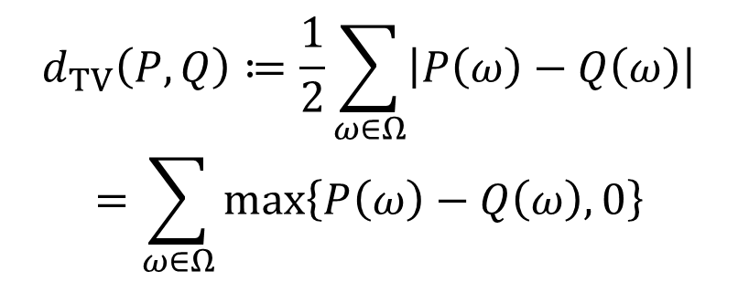

Total variation distance (aka. statistical distance)
$$P\left(ω\right)$$
$$d_{TV}\left(P,Q\right)≔\frac{1}{2}\sum_{ω∈Ω}{\left|P\left(ω\right)−Q\left(ω\right)\right|}$$
$$=\sum_{ω∈Ω}{\max\left\{P\left(ω\right)−Q\left(ω\right),0\right\}}$$
$$Q\left(ω\right)$$

Slide 4
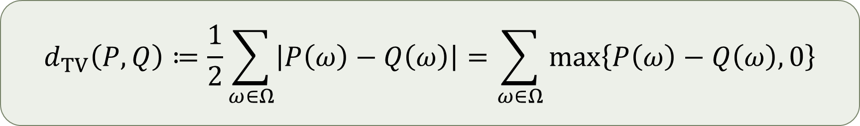
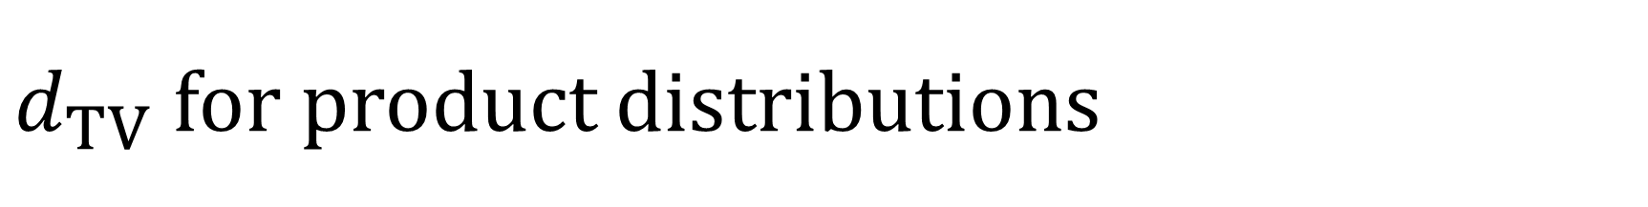
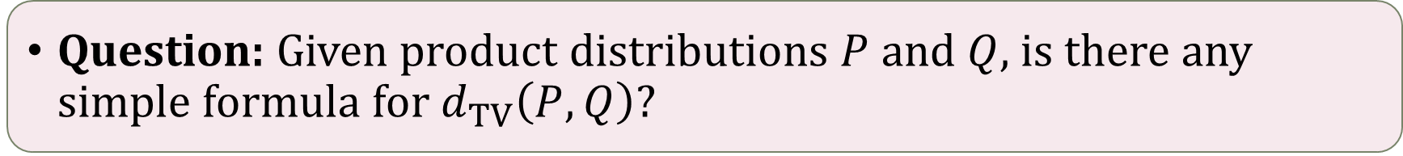
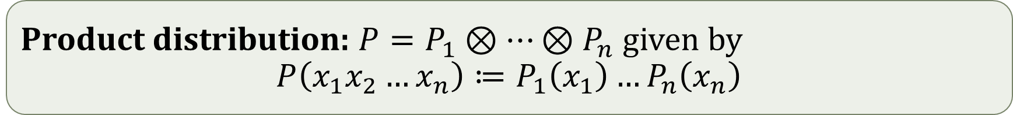
$d_{TV}$for product distributions
$$d_{TV}\left(P,Q\right)≔\frac{1}{2}\sum_{ω∈Ω}{\left|P\left(ω\right)−Q\left(ω\right)\right|}=\sum_{ω∈Ω}{\max\left\{P\left(ω\right)−Q\left(ω\right),0\right\}}$$
Product distribution: $P=P_{1}⊗…⊗P_{n}$ given by
$$P\left(x_{1}x_{2}…x_{n}\right)≔P_{1}\left(x_{1}\right)…P_{n}\left(x_{n}\right)$$
Question: Given product distributions $P$ and $Q$, is there any simple formula for $d_{TV}\left(P,Q\right)$?

Slide 5
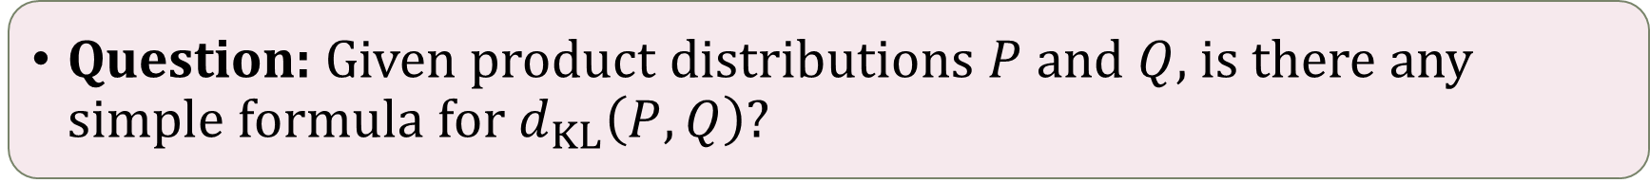
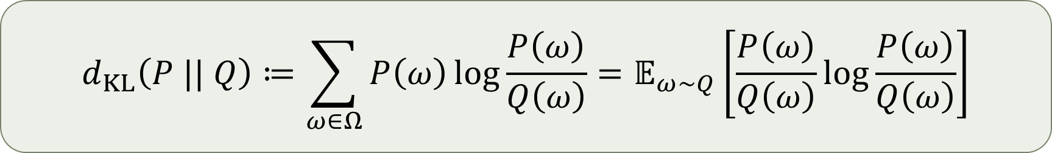
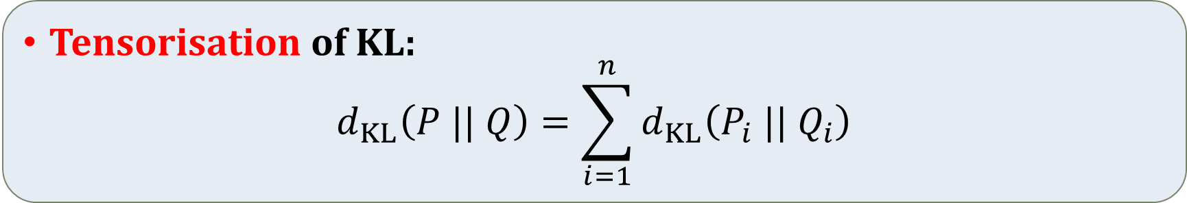
Kullback-Leibler divergence (aka. relative entropy)
$$d_{KL}\left(P || Q\right)≔\sum_{ω∈Ω}{P\left(ω\right)\log{\frac{P\left(ω\right)}{Q\left(ω\right)}}}=𝔼_{ω∼Q}\left[\frac{P\left(ω\right)}{Q\left(ω\right)}\log{\frac{P\left(ω\right)}{Q\left(ω\right)}}\right]$$
Question: Given product distributions $P$ and $Q$, is there any simple formula for $d_{KL}\left(P,Q\right)$?
Tensorisation of KL:
$$d_{KL}\left(P || Q\right)=\sum_{i=1}^{n}{d_{KL}\left(P_{i} || Q_{i}\right)}$$

Slide 6

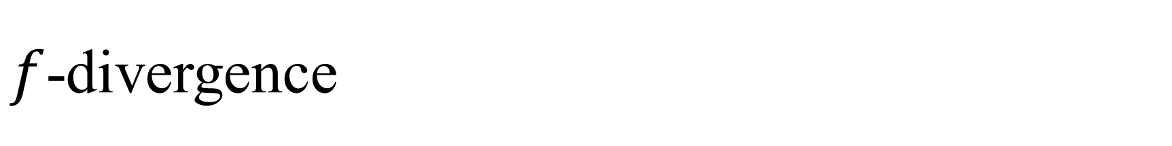
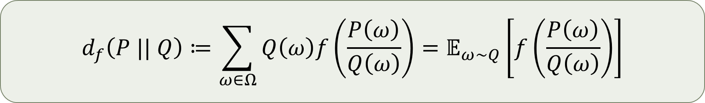
$f$-divergence
$$d_{f}\left(P || Q\right)≔\sum_{ω∈Ω}{Q\left(ω\right)f\left(\frac{P\left(ω\right)}{Q\left(ω\right)}\right)}=𝔼_{ω∼Q}\left[f\left(\frac{P\left(ω\right)}{Q\left(ω\right)}\right)\right]$$
Total variation distance $d_{TV}$: $f\left(x\right)=\left|x−1\right|/2$
KL divergence $d_{KL}$: $f\left(x\right)=x\log{x}$
$χ^{2}$ divergence $d_{χ^{2}}$: $f\left(x\right)={\left(x−1\right)}^{2}$
Hellinger² distance $d_{H^{2}}$: $f\left(x\right)={\left(1−\sqrt{x}\right)}^{2}$
?
Tensorisable
Tensorisable
Tensorisable

Slide 7

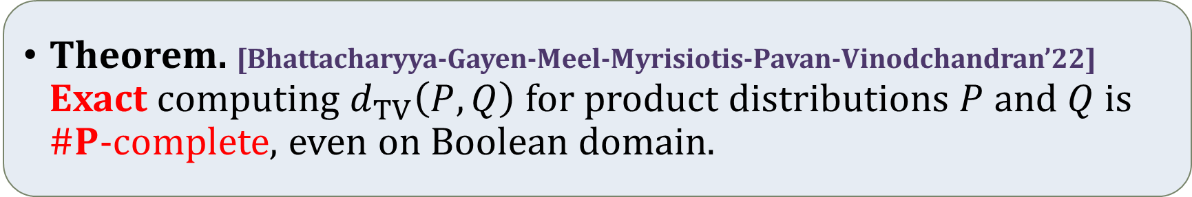

Lack of tensorisation is essential
Theorem. [Bhattacharyya-Gayen-Meel-Myrisiotis-Pavan-Vinodchandran’22] Exact computing $d_{TV}\left(P,Q\right)$ for product distributions $P$ and $Q$ is $\#P$-complete, even on Boolean domain.
A possible reduction chain:
#PerfectMatching
#SubsetProduct
TVProdDist
$$≤_{T}$$
$$≤_{T}$$

Slide 8
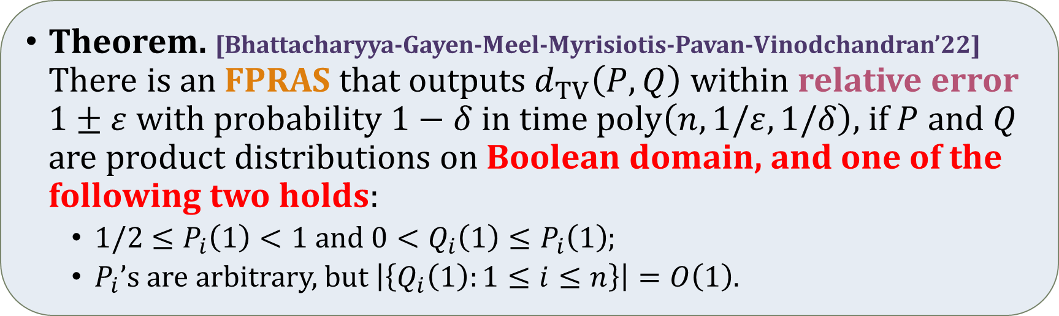

Approximation algorithms?
Is it possible to approximate it in polynomial time? Fully Polynomial Randomised Approximation Scheme (FPRAS)
Relative (multiplicative) error: $\left(1−ε\right)Z≤\hat{Z}≤\left(1+ε\right)Z$
Running time: $poly\left(input_size\right)poly\left(1/ε\right)$
Theorem. [Bhattacharyya-Gayen-Meel-Myrisiotis-Pavan-Vinodchandran’22] There is an FPRAS that outputs $d_{TV}\left(P,Q\right)$ within relative error $1±ε$ with probability $1−δ$ in time $poly\left(n,1/ε,1/δ\right)$, if $P$ and $Q$ are product distributions on Boolean domain, and one of the following two holds:
$1/2≤P_{i}\left(1\right)<1$ and $0<Q_{i}\left(1\right)≤P_{i}\left(1\right)$;
$P_{i}$’s are arbitrary, but $\left|\left\{Q_{i}\left(1\right):1≤i≤n\right\}\right|=O\left(1\right)$.

Slide 9
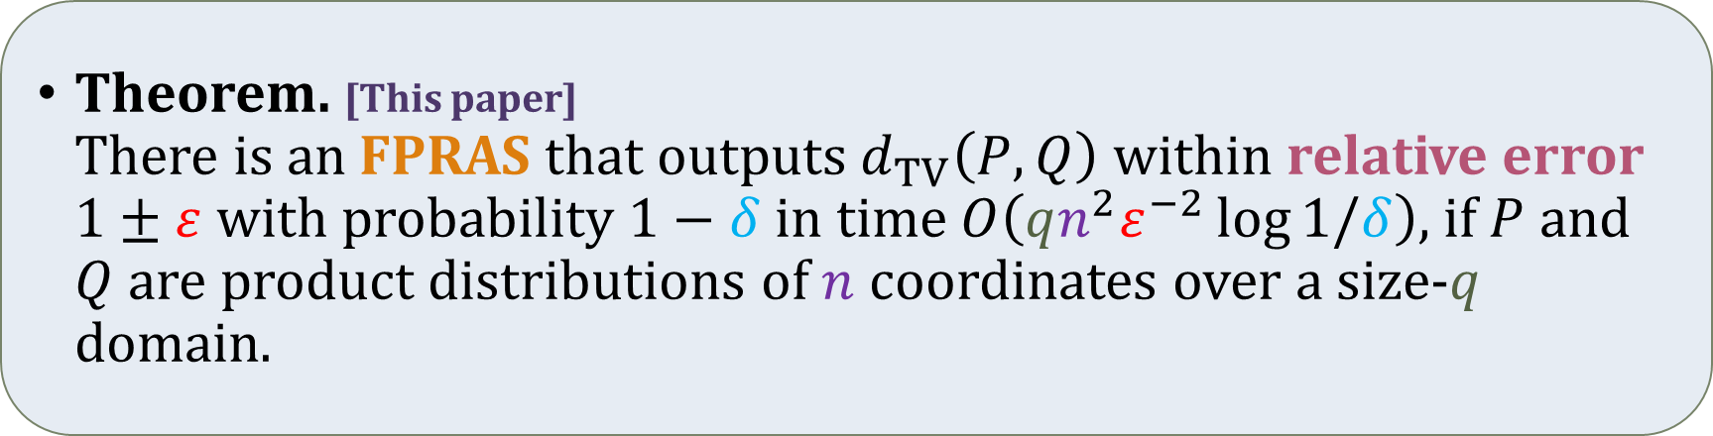
Our result
Theorem. [This paper] There is an FPRAS that outputs $d_{TV}\left(P,Q\right)$ within relative error $1±ε$ with probability $1−δ$ in time $O\left(qn^{2}ε^{−2}\log{1/δ}\right)$, if $P$ and $Q$ are product distributions of $n$ coordinates over a size-$q$ domain.
There is no further restriction.
Also polynomial under bit complexity.

Slide 10
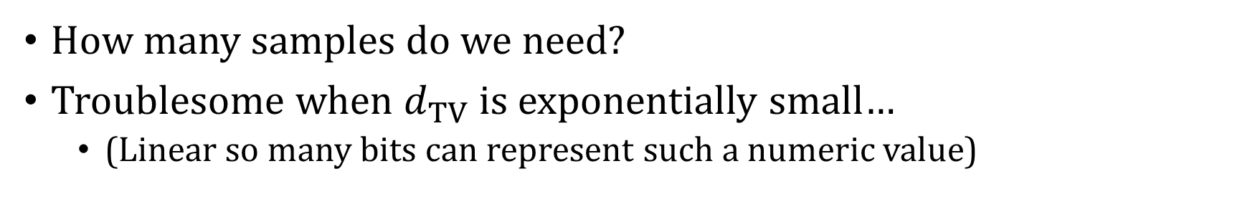
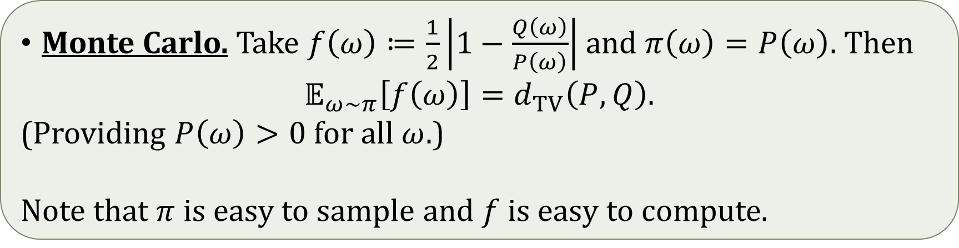
One attempt…
Monte Carlo. Take $f\left(ω\right)≔\frac{1}{2}\left|1−\frac{Q\left(ω\right)}{P\left(ω\right)}\right|$ and $π\left(ω\right)=P\left(ω\right)$. Then
$$𝔼_{ω∼π}\left[f\left(ω\right)\right]=d_{TV}\left(P,Q\right).$$
(Providing $P\left(ω\right)>0$ for all $ω$.)
Note that $π$ is easy to sample and $f$ is easy to compute.
How many samples do we need?
Troublesome when $d_{TV}$ is exponentially small…
(Linear so many bits can represent such a numeric value)

Slide 11
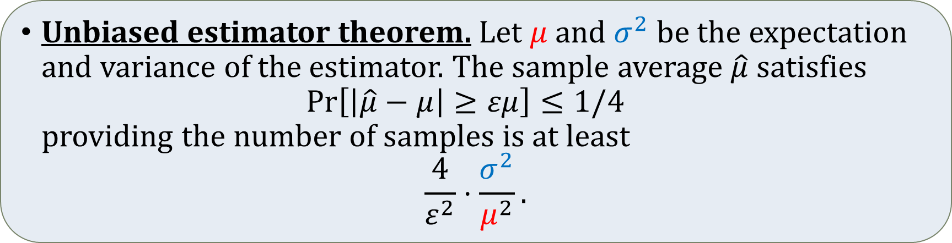
A good estimator?
Unbiased estimator theorem. Let $μ$ and $σ^{2}$ be the expectation and variance of the estimator. The sample average $\hat{μ}$ satisfies $\operatorname{Pr}\left[\left|\hat{μ}−μ\right|≥εμ\right]≤1/4$ providing the number of samples is at least
$$\frac{4}{ε^{2}}⋅\frac{σ^{2}}{μ^{2}}.$$
A good estimator should:
have comparably low variance and high expectation; and
cost little time to generate a sample.

Slide 12
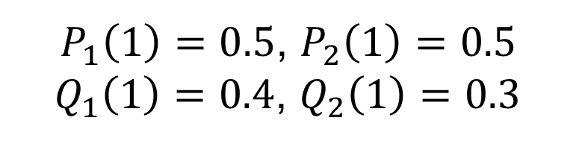
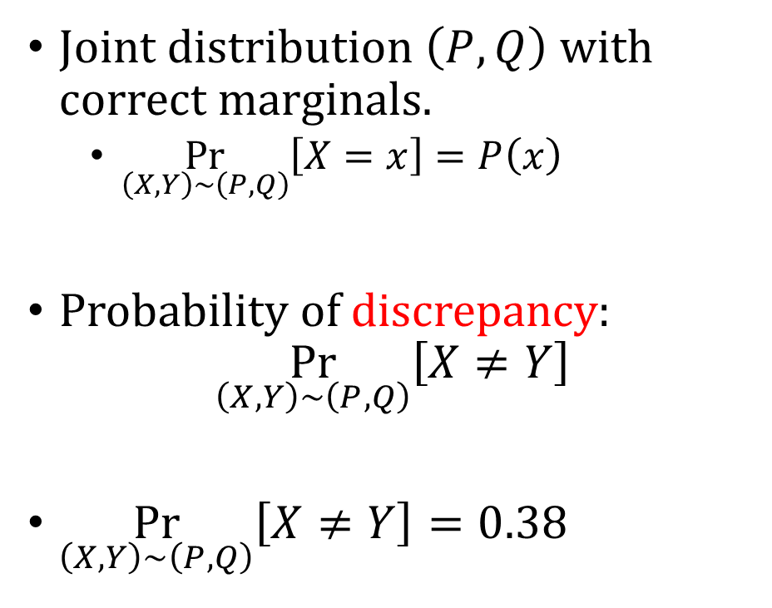
Coupling
$P_{1}\left(1\right)=0.5$, $P_{2}\left(1\right)=0.5$
$Q_{1}\left(1\right)=0.4$, $Q_{2}\left(1\right)=0.3$
 | .25
 |  | .12
 |  |  | .20
 |  |  |  | .05
 |  | .05 | .04 | .08
 | .00 |  | .01 | .05
 | .00 | .01 |  | .07
 | .00 | .07 | .00
 |  | .05 | .04 | .08
 | .00 |  | .01 | .05
 | .00 | .01 |  | .07
 | .00 | .07 | .00
Joint distribution $\left(P,Q\right)$ with correct marginals.
$\underset{\left(X,Y\right)∼\left(P,Q\right)}{Pr}\left[X=x\right]=P\left(x\right)$
Probability of discrepancy: $\underset{\left(X,Y\right)∼\left(P,Q\right)}{Pr}\left[X≠Y\right]$
$\underset{\left(X,Y\right)∼\left(P,Q\right)}{Pr}\left[X≠Y\right]=0.38$
_{Q} ^{P} | 00 | 01 | 10 | 11
00 |  |  |  |  | .42
01 |  |  |  |  | .18
10 |  |  |  |  | .28
11 |  |  |  |  | .12
 | .25 | .25 | .25 | .25

Slide 13

Coupling
$P_{1}\left(1\right)=0.5$, $P_{2}\left(1\right)=0.5$
$Q_{1}\left(1\right)=0.4$, $Q_{2}\left(1\right)=0.3$
_{Q} ^{P} | 00 | 01 | 10 | 11
00 | .25 | .06 | .00 | .11 | .42
01 | .00 | .18 | .00 | .00 | .18
10 | .00 | .01 | .25 | .02 | .28
11 | .00 | .00 | .00 | .12 | .12
 | .25 | .25 | .25 | .25
 | .25 | .06 | .00 | .11
 | .00 | .18 | .00 | .00
 | .00 | .01 | .25 | .02
 | .00 | .00 | .00 | .12
 | .25 | .04 | .00 | .13
 | .00 | .18 | .00 | .00
 | .00 | .03 | .25 | .00
 | .00 | .00 | .00 | .12
How far can we go with? $\underset{\left(X,Y\right)∼\left(P,Q\right)}{Pr}\left[X≠Y\right]$
$\underset{\left(X,Y\right)∼\left(P,Q\right)}{Pr}\left[X≠Y\right]=0.20$
_{Q} ^{P} | 00 | 01 | 10 | 11
00 |  |  |  |  | .42
01 |  |  |  |  | .18
10 |  |  |  |  | .28
11 |  |  |  |  | .12
 | .25 | .25 | .25 | .25

Slide 14

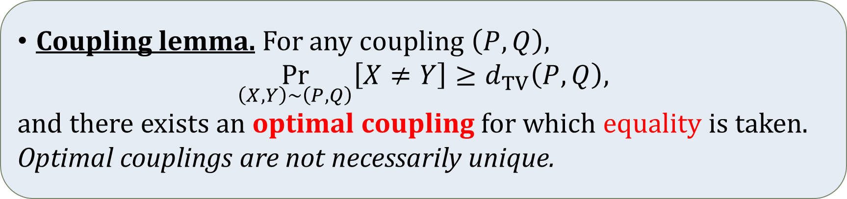
Optimal coupling
$P_{1}\left(1\right)=0.5$, $P_{2}\left(1\right)=0.5$
$Q_{1}\left(1\right)=0.4$, $Q_{2}\left(1\right)=0.3$
How far can we go with? $\underset{\left(X,Y\right)∼\left(P,Q\right)}{Pr}\left[X≠Y\right]$
_{Q} ^{P} | 00 | 01 | 10 | 11
00 | .25 | .06 | .00 | .11 | .42
01 | .00 | .18 | .00 | .00 | .18
10 | .00 | .01 | .25 | .02 | .28
11 | .00 | .00 | .00 | .12 | .12
 | .25 | .25 | .25 | .25
Coupling lemma. For any coupling $\left(P,Q\right)$,
$$\underset{\left(X,Y\right)∼\left(P,Q\right)}{Pr}\left[X≠Y\right]≥d_{TV}\left(P,Q\right),$$ and there exists an optimal coupling for which equality is taken. Optimal couplings are not necessarily unique.
Apparently, the optimal coupling is hard to compute.

Slide 15


Greedy coupling
$P_{1}\left(1\right)=0.5$, $P_{2}\left(1\right)=0.5$
$Q_{1}\left(1\right)=0.4$, $Q_{2}\left(1\right)=0.3$
_{Q} ^{P} | 00 | 01 | 10 | 11
00 |  |  |  |  | .42
01 |  |  |  |  | .18
10 |  |  |  |  | .28
11 |  |  |  |  | .12
 | .25 | .25 | .25 | .25
Couple bit-by-bit independently for product distributions?
Optimal coupling for each bit
 |  | .10
$$\operatorname{Pr}\left[X=01,Y=00\right] \\ =\operatorname{Pr}\left[X=0\#,Y=0\#\right] \\ ×\operatorname{Pr}\left[X=\#1,Y=\#0\right]$$
$$\operatorname{Pr}\left[X=01,Y=00\right] \\ =0.5 \\ ×0.2$$

Slide 16
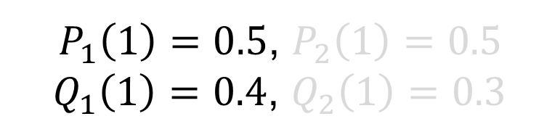
Greedy coupling
$P_{1}\left(1\right)=0.5$, $P_{2}\left(1\right)=0.5$
$Q_{1}\left(1\right)=0.4$, $Q_{2}\left(1\right)=0.3$
Couple bit-by-bit independently for product distributions?
Optimal coupling for each bit
_{Q} ^{P} | 00 | 01 | 10 | 11
00 | .50 |  | .10 |  | .42
01 |  |  |  |  | .18
10 | .00 |  | .40 |  | .28
11 |  |  |  |  | .12
 | .25 | .25 | .25 | .25

Slide 17
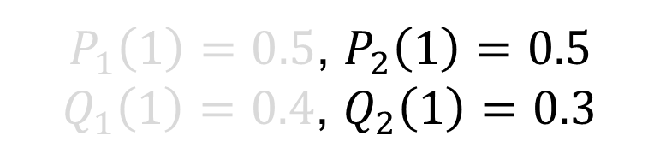
Greedy coupling
$P_{1}\left(1\right)=0.5$, $P_{2}\left(1\right)=0.5$
$Q_{1}\left(1\right)=0.4$, $Q_{2}\left(1\right)=0.3$
_{Q} ^{P} | 00 | 01 | 10 | 11
00 | .50 | .20 | .50 | .20 | .42
01 | .00 | .30 | .00 | .30 | .18
10 | .50 | .20 | .50 | .20 | .28
11 | .00 | .30 | .00 | .30 | .12
 | .25 | .25 | .25 | .25
Couple bit-by-bit independently for product distributions?
Optimal coupling for each bit
 | .50 |  | .10
 | .00 |  | .40

Slide 18


Greedy coupling
$P_{1}\left(1\right)=0.5$, $P_{2}\left(1\right)=0.5$
$Q_{1}\left(1\right)=0.4$, $Q_{2}\left(1\right)=0.3$
Couple bit-by-bit independently for product distributions?
Optimal coupling for each bit
$\underset{\left(X,Y\right)∼𝒞}{Pr}\left[X≠Y\right]=0.28$
_{Q} ^{P} | 00 | 01 | 10 | 11
00 | .25 | .10 | .05 | .02 | .42
01 | .00 | .15 | .00 | .03 | .18
10 | .00 | .00 | .20 | .08 | .28
11 | .00 | .00 | .00 | .12 | .12
 | .25 | .25 | .25 | .25
$$\underset{\left(X,Y\right)∼𝒞}{Pr}\left[X≠Y\right]=1−\prod_{i}{\underset{\left(X_{i},Y_{i}\right)∼𝒪}{Pr}\left[X_{i}=Y_{i}\right]}$$
$$=1−\prod_{i}{\left(1−d_{TV}\left(P_{i},Q_{i}\right)\right)}$$

Slide 19
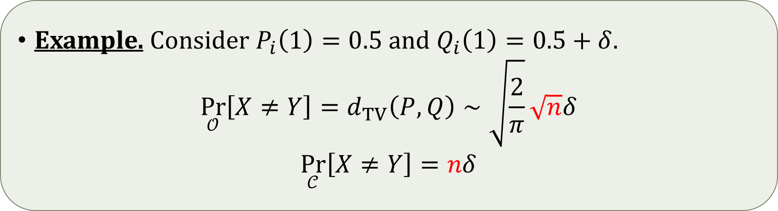
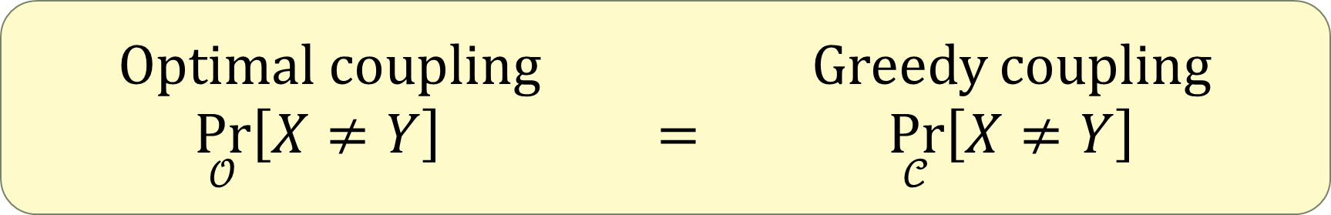


Temptation
Not even a constant approximate!
Optimal coupling Greedy coupling
$\underset{𝒪}{Pr}\left[X≠Y\right]$ $=$ $\underset{𝒞}{Pr}\left[X≠Y\right]$
Optimal coupling Greedy coupling
$\underset{𝒪}{Pr}\left[X≠Y\right]$ $≠$ $\underset{𝒞}{Pr}\left[X≠Y\right]$
Optimal coupling Greedy coupling
$\underset{𝒪}{Pr}\left[X≠Y\right]$ $≈$ $\underset{𝒞}{Pr}\left[X≠Y\right]$
?
?
?
Example. Consider $P_{i}\left(1\right)=0.5$ and $Q_{i}\left(1\right)=0.5+δ$.
$$\underset{𝒪}{Pr}\left[X≠Y\right]=d_{TV}\left(P,Q\right)∼\sqrt{\frac{2}{π}}\sqrt{n}δ$$
$$\underset{𝒞}{Pr}\left[X≠Y\right]=nδ$$

Slide 20


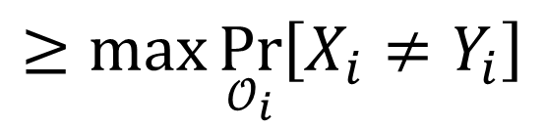
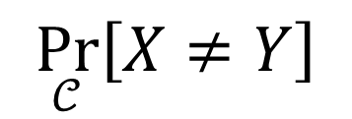

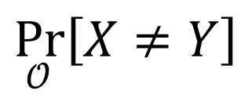


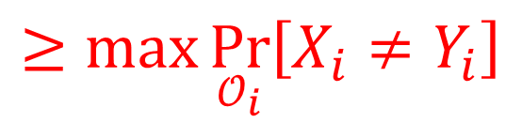



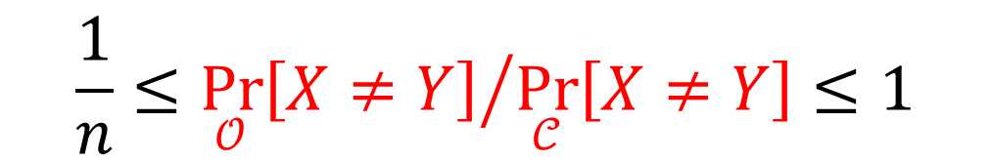
Greedy coupling is not that bad
Projection of coupling is a coupling
Coupling lemma
$$\underset{𝒪}{Pr}\left[X≠Y\right]$$
$$≥\max{\underset{𝒪_{i}}{Pr}\left[X_{i}≠Y_{i}\right]}$$
$$≥\max{d_{TV}\left(P_{i},Q_{i}\right)}$$
$$≥\max{\underset{𝒪_{i}}{Pr}\left[X_{i}≠Y_{i}\right]}$$
$$≥\max{d_{TV}\left(P_{i},Q_{i}\right)}$$
(not necessarily optimal)
$$≤\sum_{i=1}^{n}{\underset{𝒞_{i}}{Pr}\left[X_{i}≠Y_{i}\right]}$$
$$≤\sum_{i=1}^{n}{\underset{𝒞_{i}}{Pr}\left[X_{i}≠Y_{i}\right]}$$
$$=\sum_{i=1}^{n}{d_{TV}\left(P_{i},Q_{i}\right)}$$
$$=\sum_{i=1}^{n}{d_{TV}\left(P_{i},Q_{i}\right)}$$
$$≤n\max{d_{TV}\left(P_{i},Q_{i}\right)}$$
$$\underset{𝒞}{Pr}\left[X≠Y\right]$$
$$≤n\max{d_{TV}\left(P_{i},Q_{i}\right)}$$
$$\frac{1}{n}≤{\underset{𝒪}{Pr}\left[X≠Y\right]}/{\underset{𝒞}{Pr}\left[X≠Y\right]}≤1$$
Union bound
Optimal coupling
We estimate this!

Slide 21
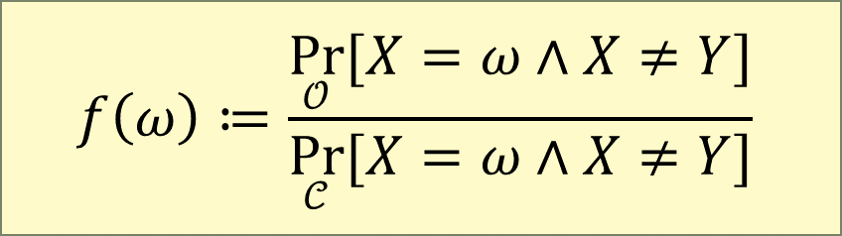

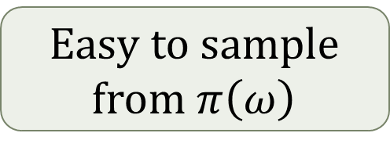
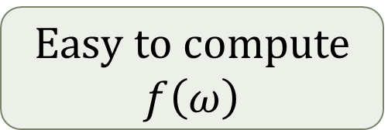
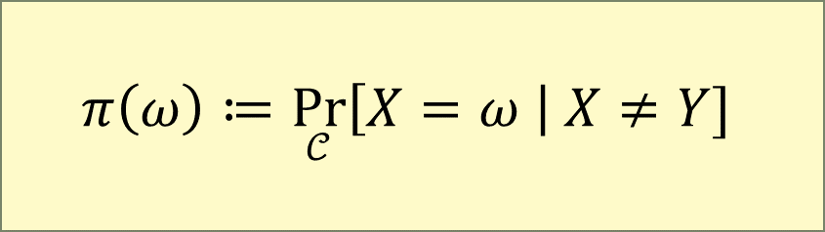
Another estimator
We choose:
A simple calculation gives $𝔼_{ω∼π}\left[f\left(ω\right)\right]={\underset{𝒪}{Pr}\left[X≠Y\right]}/{\underset{𝒞}{Pr}\left[X≠Y\right]}$
Goals:
$$f\left(ω\right)≔\frac{\underset{𝒪}{Pr}{[X=ω∧X≠Y]}}{\underset{𝒞}{Pr}{[X=ω∧X≠Y]}}$$
$$π\left(ω\right)≔\underset{𝒞}{Pr}\left[X=ω \right| X≠Y]$$
High expectation
Low variance
Easy to compute $f\left(ω\right)$
Easy to sample from $π\left(ω\right)$

Slide 22
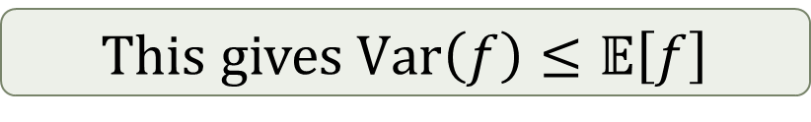

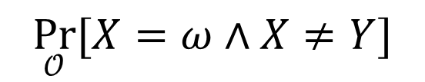
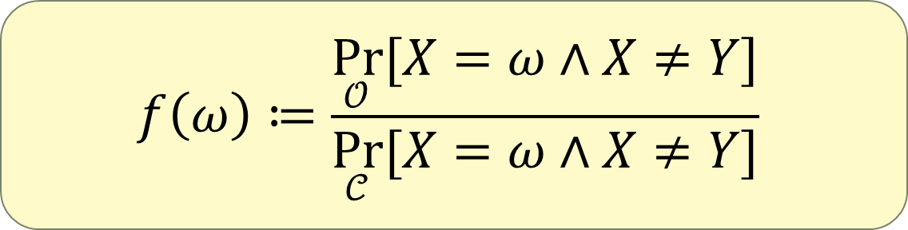
High expectation / low variance
_{Q} ^{P} | 00 | 01 | 10 | 11
00 | .25 | .06 | .00 | .11 | .42
01 | .00 | .18 | .00 | .00 | .18
10 | .00 | .01 | .25 | .02 | .28
11 | .00 | .00 | .00 | .12 | .12
 | .25 | .25 | .25 | .25
Recall we have $𝔼\left[f\right]≥1/n$
Suffices to show $0≤f\left(ω\right)≤1$
This gives $Var\left(f\right)≤𝔼\left[f\right]$
$$f\left(ω\right)≔\frac{\underset{𝒪}{Pr}{[X=ω∧X≠Y]}}{\underset{𝒞}{Pr}{[X=ω∧X≠Y]}}$$
$$\underset{𝒪}{Pr}{[X=ω∧X≠Y]}$$
$$=\underset{𝒪}{Pr}{[X=ω]}−\underset{𝒪}{Pr}\left[X=Y=ω\right]=\max\left\{0,P\left(ω\right)−Q\left(ω\right)\right\}$$

Slide 23
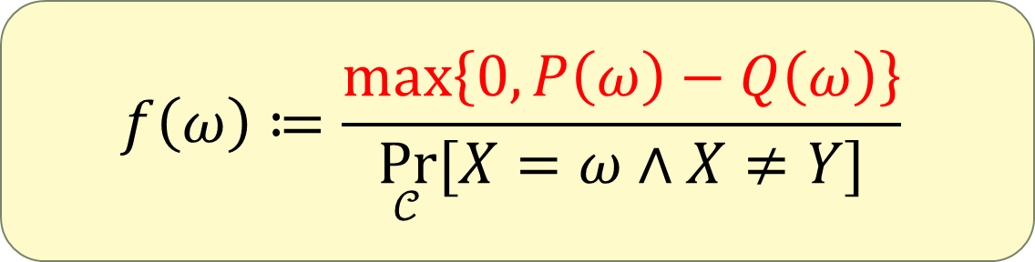

High expectation / low variance
Recall we have $𝔼\left[f\right]≥1/n$
Suffices to show $0≤f\left(ω\right)≤1$
$$f\left(ω\right)≔\frac{\max\left\{0,P\left(ω\right)−Q\left(ω\right)\right\}}{\underset{𝒞}{Pr}{[X=ω∧X≠Y]}}$$
Only consider $ω$ s.t. $P\left(ω\right)>Q\left(ω\right)$

Slide 24








High expectation / low variance
Recall we have $𝔼\left[f\right]≥1/n$
Suffices to show $0≤f\left(ω\right)≤1$
$$f\left(ω\right)≔\frac{1−Q\left(ω\right)/P\left(ω\right)}{1−\underset{𝒞}{Pr}\left[X=Y\right|X=ω]}$$
$$f\left(ω\right)≔\frac{1−Q\left(ω\right)/P\left(ω\right)}{1−\underset{𝒞}{Pr}\left[X=Y\right|X=ω]}$$
$$f\left(ω\right)≔\frac{P\left(ω\right)−Q\left(ω\right)}{P\left(ω\right)\left(1−\underset{𝒞}{Pr}\left[X=Y\right|X=ω]\right)}$$
$$f\left(ω\right)≔\frac{P\left(ω\right)−Q\left(ω\right)}{P\left(ω\right)\underset{𝒞}{Pr}\left[X≠Y \right| X=ω]}$$
$$f\left(ω\right)≔\frac{P\left(ω\right)−Q\left(ω\right)}{\underset{𝒞}{Pr}{[X=ω]}\underset{𝒞}{Pr}\left[X≠Y \right| X=ω]}$$
$$f\left(ω\right)≔\frac{P\left(ω\right)−Q\left(ω\right)}{\underset{𝒞}{Pr}{[X=ω∧X≠Y]}}$$
$$\underset{𝒞}{Pr}\left[X=Y\right|X=ω]=\prod_{i=1}^{n}{\frac{\min\left\{P_{i}\left(ω_{i}\right),Q_{i}\left(ω_{i}\right)\right\}}{P_{i}\left(ω_{i}\right)}}$$
$$≤\prod_{i=1}^{n}{\frac{Q_{i}\left(ω_{i}\right)}{P_{i}\left(ω_{i}\right)}}=\frac{Q\left(ω\right)}{P\left(ω\right)}$$

Slide 25


Time efficiency
Last slide gives an explicit formula:
$π\left(ω\right)$ is also easy to sample from
Sample bit by bit (see next slide if we have time…)
$$f\left(ω\right)≔\max\left\{0,\frac{1−\prod_{i=1}^{n}{\frac{Q_{i}\left(ω_{i}\right)}{P_{i}\left(ω_{i}\right)}}}{1−\prod_{i=1}^{n}{\frac{\min\left\{P_{i}\left(ω_{i}\right),Q_{i}\left(ω_{i}\right)\right\}}{P_{i}\left(ω_{i}\right)}}}\right\}$$

Slide 26







In case we have time…
$$π\left(ω\right)≔\underset{𝒞}{Pr}\left[X=ω \right| X≠Y]$$
(Rather straightforward) strategy: sample bit by bit
$$\underset{X∼π}{Pr}\left[X_{k}=ω_{k} | X_{1,…,k−1}=ω_{1,…,k−1}\right]=\frac{\underset{X∼π}{Pr}\left[X_{1,…,k}=ω_{1,…,k}\right]}{\underset{X∼π}{Pr}\left[X_{1,…,k−1}=ω_{1,…,k−1}\right]}$$
$$\underset{X∼π}{Pr}\left[X_{1,…,k}=ω_{1,…,k}\right]$$
$$=\underset{(X,Y)∼𝒞}{Pr}\left[X_{1,…,k}=ω_{1,…,k} | X≠Y\right]$$
$$=\left(1−\underset{(X,Y)∼𝒞}{Pr}\left[X=Y \right| X_{1,…,k}=ω_{1,…,k}]\right)⋅\frac{\underset{\left(X,Y\right)∼𝒞}{Pr}\left[X_{1,…,k}=ω_{1,…,k}\right]}{\underset{\left(X,Y\right)∼𝒞}{Pr}\left[X≠Y\right]}$$
$$=\left(1−\underset{(X,Y)∼𝒞}{Pr}\left[X=Y \right| X_{1,…,k}=ω_{1,…,k}]\right)⋅\frac{\underset{\left(X,Y\right)∼𝒞}{Pr}\left[X_{1,…,k}=ω_{1,…,k}\right]}{\underset{\left(X,Y\right)∼𝒞}{Pr}\left[X≠Y\right]}$$
$$=\left(1−\underset{(X,Y)∼𝒞}{Pr}\left[X=Y \right| X_{1,…,k}=ω_{1,…,k}]\right)⋅\frac{\prod_{i=1}^{k}{P_{i}\left(ω_{i}\right)}}{\underset{\left(X,Y\right)∼𝒞}{Pr}\left[X≠Y\right]}$$
$$\underset{(X,Y)∼𝒞}{Pr}\left[X=Y \right| X_{1,…,k}=ω_{1,…,k}]=\prod_{i=1}^{k}{\frac{\min\left\{P_{i}\left(ω_{i}\right),Q_{i}\left(ω_{i}\right)\right\}}{P_{i}\left(ω_{i}\right)}}\prod_{i=k+1}^{n}{\left(1−d_{TV}\left(P_{i},Q_{i}\right)\right)}$$

Slide 27

Future directions
An FPTAS to be made public ... but not via derandomising the algorithm here!
[Feng, Liu, Liu’23]
Deterministic approximation scheme (FPTAS)?
Restricted version: connect to counting knapsack solutions
The latter problem admits deterministic algorithms
Other interesting distributions?
Complexity dichotomy for computing $f$-divergences (for product distributions)?
Potential applications of our algorithm?

Slide 28
Thank you!
arXiv: 2208.00740v3
(5 pages)
(7 pages)

