Slide 1
Partition rank and algebraic circuit lower bounds
Cornelius Brand U.Regensburg
Petteri Kaski Aalto U.
Jiaheng Wang U.Helsinki

Slide 2
CCC 2026 Recap…
4
1
3
0
0
0
8
2
6

Slide 3
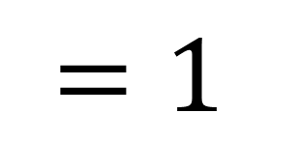
4
1
3
0
0
0
rank
$$=1$$
8
2
6

Slide 4
4
1
3
1
4
1
3
0
0
0
0
rank
$$=1$$
2
8
2
6

Slide 5
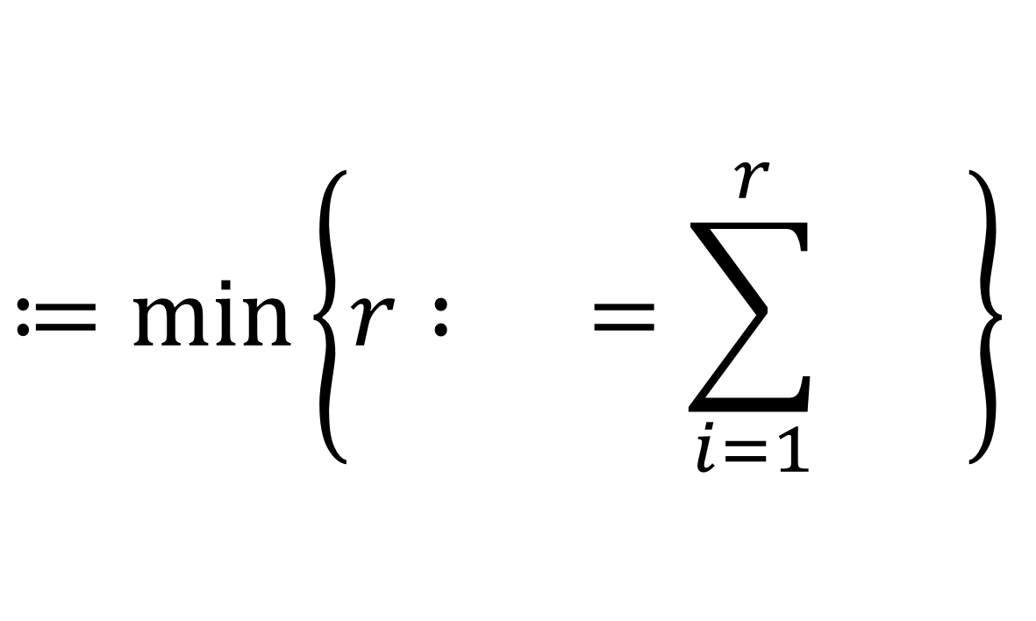



4
1
3
1
4
1
3
rank-1 matrices
0
0
0
0
$$≔\min\left\{r : =\sum_{i=1}^{r}{ }\right\}$$
2
8
2
6
rank
$$\left(M\right)$$
$$M$$
$$M_{i}$$

Slide 6
4
1
3
0
0
0
8
2
6
8
2
6
0
0
0
-4
-1
-3
16
4
12
0
0
0
-8
-2
-6

Slide 7
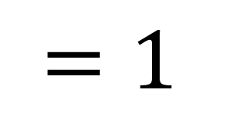
4
1
3
1
4
1
3
1
0
0
0
0
8
2
6
2
8
2
6
2
rank
$$=1$$
0
0
0
-4
-1
-3
16
4
12
-1
0
0
0
-8
-2
-6

Slide 8
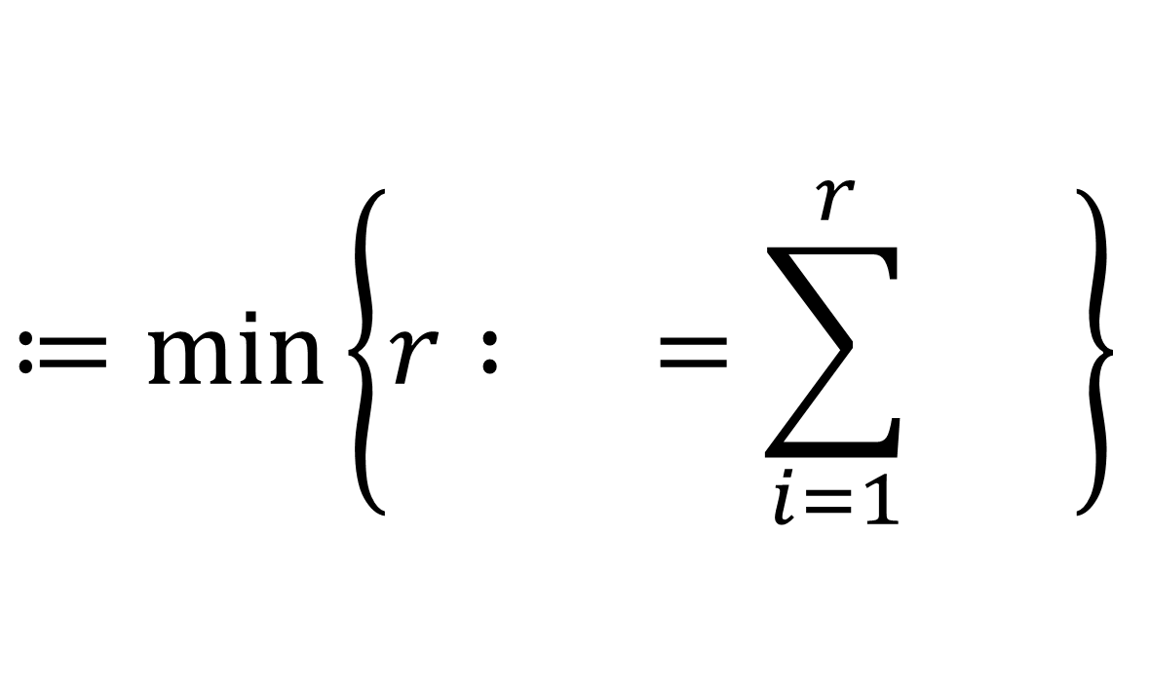



4
1
3
1
4
1
3
1
0
0
0
0
8
2
6
rank-1 tensors
2
8
2
6
2
0
0
0
-4
-1
-3
$$≔\min\left\{r : =\sum_{i=1}^{r}{ }\right\}$$
16
4
12
-1
0
0
0
-8
-2
-6
rank
$$\left(T\right)$$
$$T$$
$$T_{i}$$

Slide 9
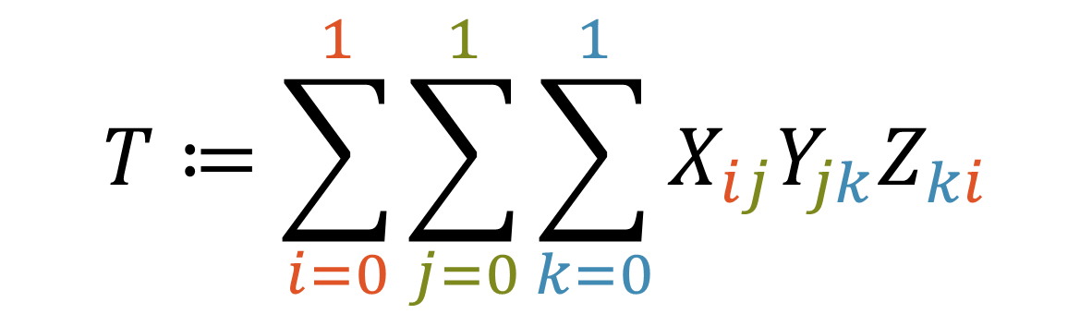
$$T≔\sum_{i=0}^{1}{\sum_{j=0}^{1}{\sum_{k=0}^{1}{X_{ij}Y_{jk}Z_{ki}}}}$$

Slide 10


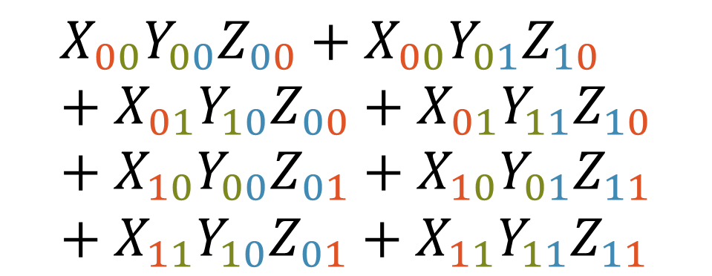


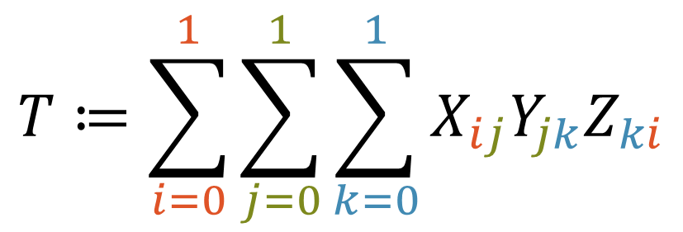









$$X_{00}$$
$$X_{01}$$
$$X_{10}$$
$$X_{11}$$
$$Y_{00}$$
1
1
$$Y_{01}$$
1
1
$$Z_{00}$$
$$Z_{01}$$
$$Z_{10}$$
$$Z_{11}$$
$$Y_{10}$$
1
1
$$Y_{11}$$
1
1
$$T≔\sum_{i=0}^{1}{\sum_{j=0}^{1}{\sum_{k=0}^{1}{X_{ij}Y_{jk}Z_{ki}}}}$$
$$=$$
$$X_{00}Y_{00}Z_{00}+X_{00}Y_{01}Z_{10}+X_{01}Y_{10}Z_{00}+X_{01}Y_{11}Z_{10}+X_{10}Y_{00}Z_{01}+X_{10}Y_{01}Z_{11}+X_{11}Y_{10}Z_{01}+X_{11}Y_{11}Z_{11}$$

Slide 11
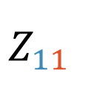

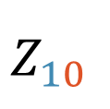

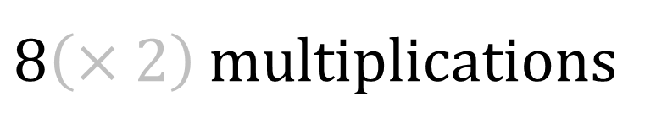

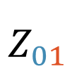

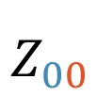




$$X_{00}$$
$$X_{01}$$
$$X_{10}$$
$$X_{11}$$
$$Y_{00}$$
1
$$T≔\sum_{i=0}^{1}{\sum_{j=0}^{1}{\sum_{k=0}^{1}{X_{ij}Y_{jk}Z_{ki}}}}$$
$$Y_{01}$$
$$Z_{00}$$
1
$$Y_{10}$$
1
$$=$$
$$Y_{11}$$
$$Z_{01}$$
$$X_{00}Y_{00}Z_{00}+X_{00}Y_{01}Z_{10}+X_{01}Y_{10}Z_{00}+X_{01}Y_{11}Z_{10}+X_{10}Y_{00}Z_{01}+X_{10}Y_{01}Z_{11}+X_{11}Y_{10}Z_{01}+X_{11}Y_{11}Z_{11}$$
1
1
$$Z_{10}$$
1
1
$$Z_{11}$$
$8\left(×2\right)$ multiplications
1

Slide 12
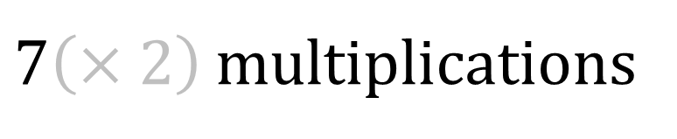
$$X_{00}$$
$$X_{01}$$
$$X_{10}$$
$$X_{11}$$
$$Y_{00}$$
1
1
$$Y_{01}$$
1
1
$$Z_{00}$$
$$Z_{01}$$
$$Z_{10}$$
$$Z_{11}$$
$$Y_{10}$$
1
1
$$Y_{11}$$
1
1
$$T≔\sum_{i=0}^{1}{\sum_{j=0}^{1}{\sum_{k=0}^{1}{X_{ij}Y_{jk}Z_{ki}}}}$$
$$=$$
$$\left(X_{00}+X_{11}\right)\left(Y_{00}+Y_{11}\right)\left(Z_{00}+Z_{11}\right)$$
$$+\left(X_{10}+X_{11}\right)Y_{00}\left(Z_{10}−Z_{11}\right)$$
$$+X_{00}\left(Y_{01}−Y_{11}\right)\left(Z_{01}+Z_{11}\right)$$
$$−X_{11}\left(Y_{00}−Y_{10}\right)\left(Z_{00}+Z_{10}\right)$$
$$−\left(X_{00}+X_{01}\right)Y_{11}\left(Z_{00}−Z_{01}\right)$$
$$−\left(X_{00}−X_{10}\right)\left(Y_{00}+Y_{01}\right)Z_{11}$$
$$+\left(X_{01}−X_{11}\right)\left(Y_{10}+Y_{11}\right)Z_{00}$$
$7\left(×2\right)$ multiplications

Slide 13


rank
complexity
$$R\left(T\right)≈C\left(T\right)$$
$$≿$$

Slide 14


rank
complexity
$$R\left(T\right)≈C\left(T\right)$$
$$≈$$
-tensor
$$3$$

Slide 15



„Vermeidung von Divisionen“
Strassen, 1973
$$R\left(T\right)≈C\left(T\right)$$
$$≈$$
“ ”
-tensor
$$3$$

Slide 16



?
$$R\left(T\right)≈C\left(T\right)$$
$$≈$$
“ ”
-tensor
$$d$$

Slide 17

/
$$R\left(T\right)≈C\left(T\right)$$
$$≈$$
“ ”
-tensor
$$4$$

Slide 18

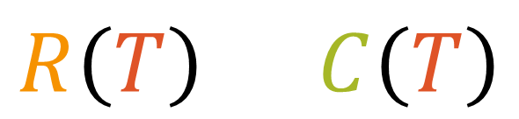

/
$$≈$$
$$R\left(T\right)≈C\left(T\right)$$
Product of Inner Products
-tensor
$$4$$

Slide 19


/
$$≈$$
$$R\left(T\right)≈C\left(T\right)$$
Product of Inner Products
-tensor
$$4$$
$${PIP}_{n}≔\left(\sum_{i=1}^{n}{X_{i}Y_{i}}\right)\left(\sum_{i=1}^{n}{Z_{i}W_{i}}\right)$$
$${PIP}_{n}\left[a,b,c,d\right]=\left\{\begin{matrix}1, & a=b,c=d; \\ 0, & otherwise.\end{matrix}\right.$$

Slide 20

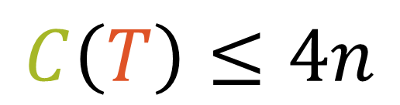
/
$$≈$$
$$R\left(T\right)≈C\left(T\right)$$
Product of Inner Products
-tensor
$$4$$
$${PIP}_{n}≔\left(\sum_{i=1}^{n}{X_{i}Y_{i}}\right)\left(\sum_{i=1}^{n}{Z_{i}W_{i}}\right)$$
$${PIP}_{n}\left[a,b,c,d\right]=\left\{\begin{matrix}1, & a=b,c=d; \\ 0, & otherwise.\end{matrix}\right.$$
$$C\left(T\right)≤4n$$

Slide 21

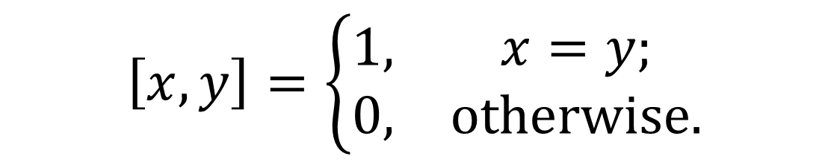



/
$$≈$$
$$R\left(T\right)≈C\left(T\right)$$
$${PIP}_{n}\left[a,b,c,d\right]=\left\{\begin{matrix}1, & a=b,c=d; \\ 0, & otherwise.\end{matrix}\right.$$
-tensor
$$4$$
$$R\left(T\right)=n^{2}$$
$$C\left(T\right)≤4n$$
$$\left[x,y\right]=\left\{\begin{matrix}1, & x=y; \\ 0, & otherwise.\end{matrix}\right.$$
$$I_{n^{2}}$$

Slide 22
/
$$R\left(T\right)≈C\left(T\right)$$
$$≈$$
“ ”
-tensor
$$4$$

Slide 23

/
$$R\left(T\right)≈C\left(T\right)$$
$$≲$$
“ ”
-tensor
$$4$$

Slide 24
/
$$R\left(T\right)≈C\left(T\right)$$
$$≲$$
“ ”
-tensor
$$4$$

Slide 25


$$R\left(T\right)≈C\left(T\right)$$
$$T$$
$$≲$$
“ ”
-tensor
$$4$$

Slide 26
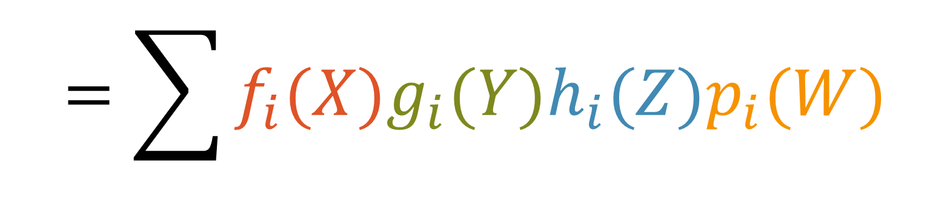


$$=\sum{f_{i}(X)g_{i}(Y)h_{i}(Z)p_{i}(W)}$$
$$+\sum{f_{i}(X)g_{i}(Y)h_{i}(Z)p_{i}(W)}$$
$$+\sum{f_{i}(X)g_{i}(Y)h_{i}(Z)p_{i}(W)}$$
$$+\sum{f_{i}(X)g_{i}(Y)h_{i}(Z)p_{i}(W)}$$
$$T$$

Slide 27
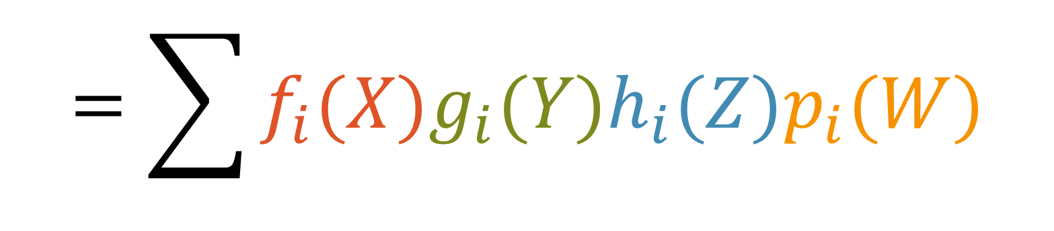

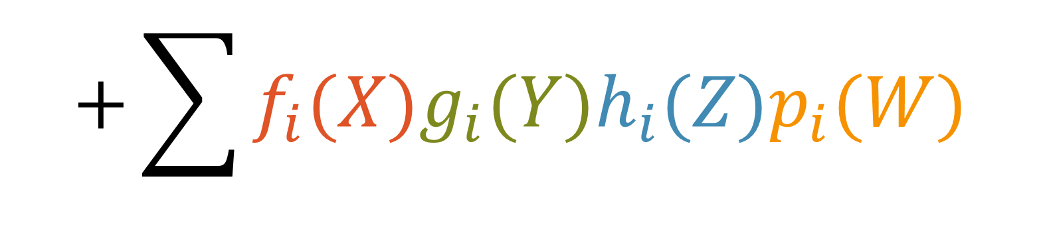


$$=\sum{f_{i}(X)g_{i}(Y)h_{i}(Z)p_{i}(W)}$$
$$T$$
$$+\sum{f_{i}(X)g_{i}(Y)h_{i}(Z)p_{i}(W)}$$
$$+\sum{f_{i}(X)g_{i}(Y)h_{i}(Z)p_{i}(W)}$$
$$+\sum{f_{i}(X)g_{i}(Y)h_{i}(Z)p_{i}(W)}$$

Slide 28



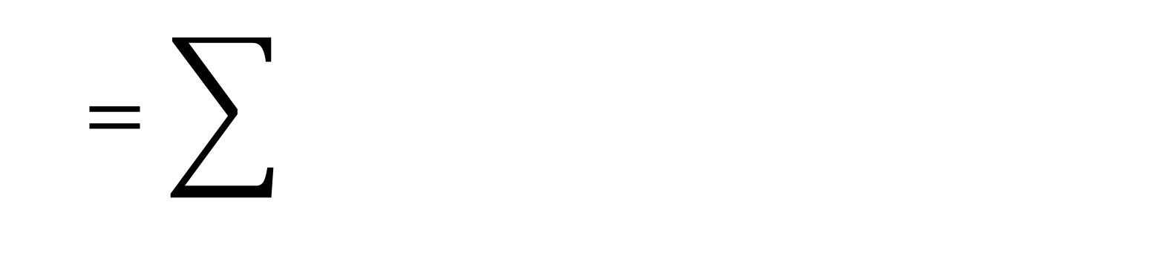






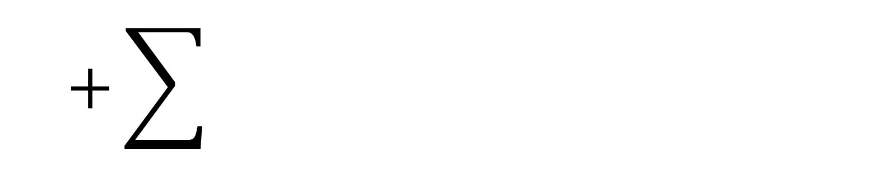

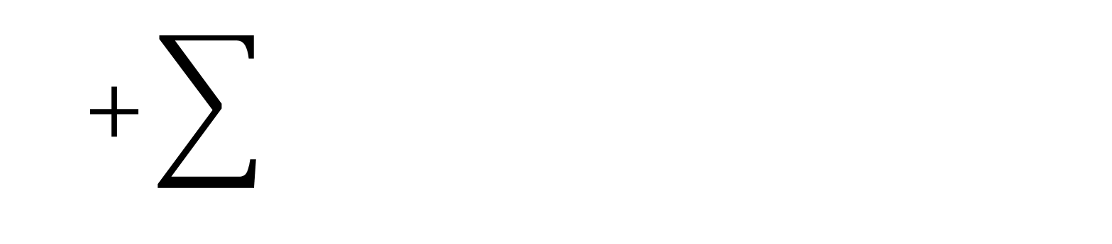



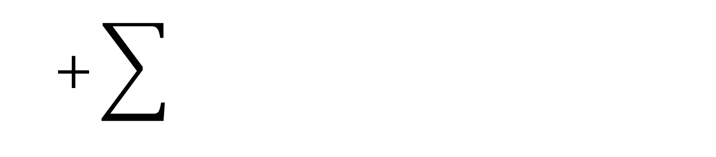



$$=\sum{f_{i}(X)g_{i}(Y)h_{i}(Z)t_{i}(W)}$$
$$T$$
$$f_{i}(X)$$
$$g_{i}(Y)$$
$$p_{i}(W)$$
$$h_{i}(Z)$$
$$+\sum{f_{i}(X)g_{i}(Y)h_{i}(Z)t_{i}(W)}$$
$$f_{i}(X)$$
$$g_{i}(Y)$$
$$p_{i}(W)$$
$$h_{i}(Z)$$
$$+\sum{f_{i}(X)g_{i}(Y)h_{i}(Z)t_{i}(W)}$$
$$f_{i}(X)$$
$$g_{i}(Y)$$
$$p_{i}(W)$$
$$h_{i}(Z)$$
$$+\sum{f_{i}(X)g_{i}(Y)h_{i}(Z)t_{i}(W)}$$
$$f_{i}(X)$$
$$g_{i}(Y)$$
$$p_{i}(W)$$
$$h_{i}(Z)$$

Slide 29













$$=\sum{f_{i}(X)g_{i}(Y)h_{i}(Z)t_{i}(W)}$$
$$T$$
$$f_{i}(X)$$
$$g_{i}(Y)$$
$$p_{i}(W)$$
$$h_{i}(Z)$$
$$+\sum{f_{i}(X)g_{i}(Y)h_{i}(Z)t_{i}(W)}$$
$$g_{i}(Y)$$
$$h_{i}(Z)$$
$$p_{i}(W)$$
$$f_{i}(X)$$
$$+\sum{f_{i}(X)g_{i}(Y)h_{i}(Z)t_{i}(W)}$$
$$h_{i}(Z)$$
$$p_{i}(W)$$
$$f_{i}(X)$$
$$g_{i}(Y)$$
$$+\sum{f_{i}(X)g_{i}(Y)h_{i}(Z)t_{i}(W)}$$
$$p_{i}(W)$$
$$f_{i}(X)$$
$$g_{i}(Y)$$
$$h_{i}(Z)$$

Slide 30








$$=\sum{f_{i}(X)g_{i}(Y)h_{i}(Z)t_{i}(W)}$$
$$T$$
$$f_{i}(X)$$
$$g_{i}(Y)$$
$$p_{i}(W)$$
$$h_{i}(Z)$$
$$+\sum{f_{i}(X)g_{i}(Y)h_{i}(Z)t_{i}(W)}$$
$$g_{i}(Y)$$
$$p_{i}(W)$$
$$f_{i}(X)$$
$$h_{i}(Z)$$
$$+\sum{f_{i}(X)g_{i}(Y)h_{i}(Z)t_{i}(W)}$$
$$p_{i}(W)$$
$$g_{i}(Y)$$
$$h_{i}(Z)$$
$$f_{i}(X)$$
$$+\sum{f_{i}(X)g_{i}(Y)h_{i}(Z)t_{i}(W)}$$
$$p_{i}(W)$$
$$f_{i}(X)$$
$$g_{i}(Y)$$
$$h_{i}(Z)$$

Slide 31





$$=\sum{f_{i}(X)g_{i}(Y)h_{i}(Z)t_{i}(W)}$$
$$T$$
$$f_{i}(X)$$
$$F_{i}(Y,Z,W)$$
$$+\sum{f_{i}(X)g_{i}(Y)h_{i}(Z)t_{i}(W)}$$
$$g_{i}(Y)$$
$$G_{i}(X,Z,W)$$
Slice rank
$$+\sum{f_{i}(X)g_{i}(Y)h_{i}(Z)t_{i}(W)}$$
$$R_{1}\left(T\right)$$
$$h_{i}(Z)$$
$$H_{i}(X,Y,W)$$
$$+\sum{f_{i}(X)g_{i}(Y)h_{i}(Z)t_{i}(W)}$$
$$p_{i}(W)$$
$$P_{i}(X,Y,Z)$$

Slide 32


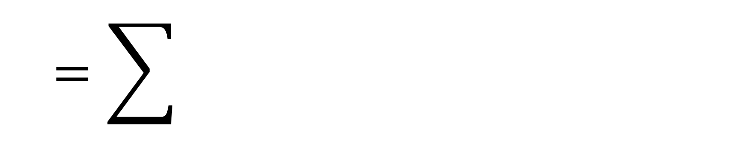



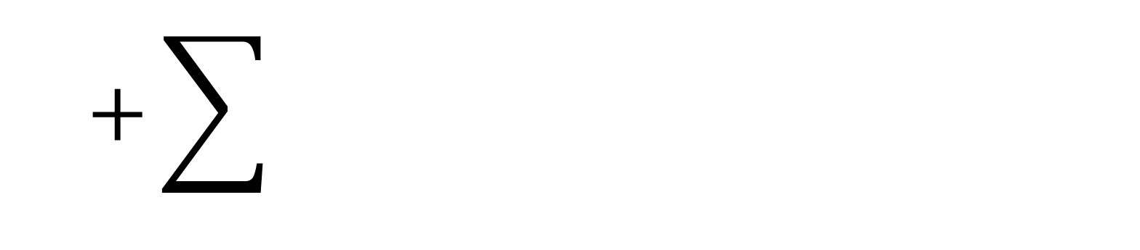

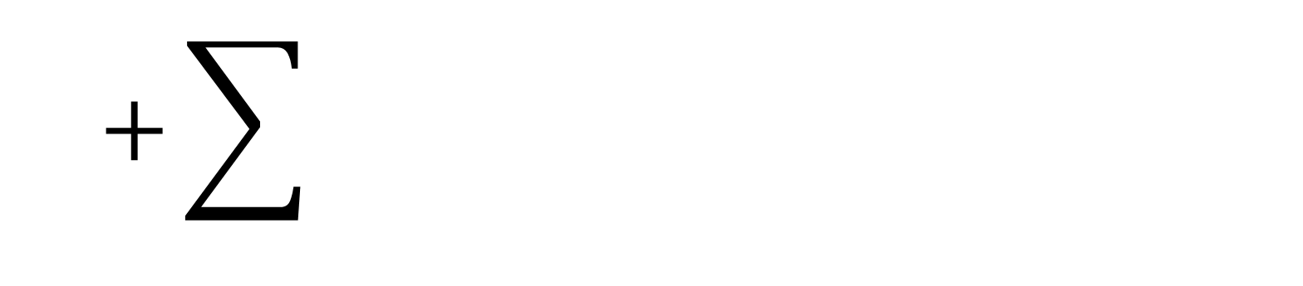


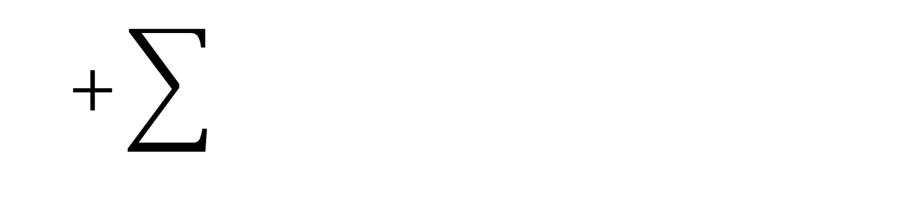


$$=\sum{f_{i}(X)g_{i}(Y)h_{i}(Z)t_{i}(W)}$$
$$T$$
$$f_{i}(X)$$
$$F_{i}(Y,Z,W)$$
$$+\sum{f_{i}(X)g_{i}(Y)h_{i}(Z)t_{i}(W)}$$
$$g_{i}(Y)$$
$$G_{i}(X,Z,W)$$
Slice rank
$$+\sum{f_{i}(X)g_{i}(Y)h_{i}(Z)t_{i}(W)}$$
$$R_{1}\left(T\right)$$
$$h_{i}(Z)$$
$$H_{i}(X,Y,W)$$
$$+\sum{f_{i}(X)g_{i}(Y)h_{i}(Z)t_{i}(W)}$$
$$p_{i}(W)$$
$$P_{i}(X,Y,Z)$$

Slide 33


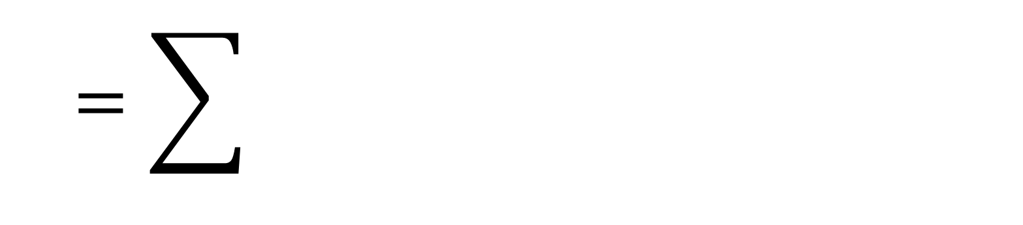



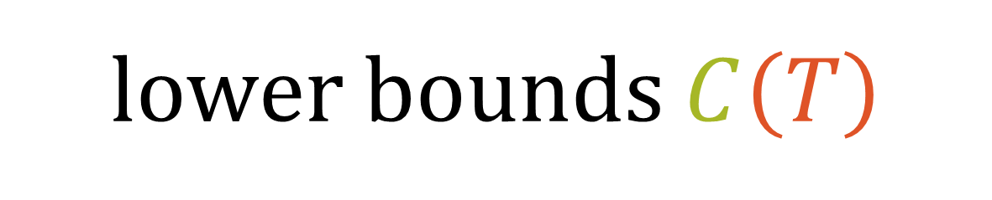
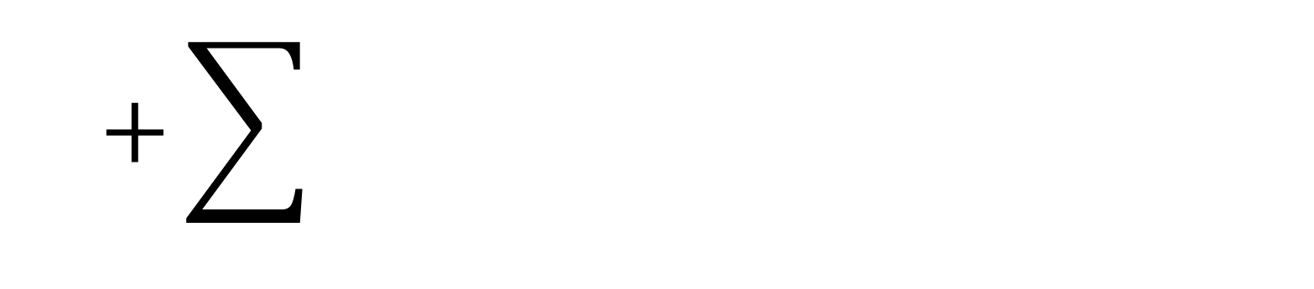

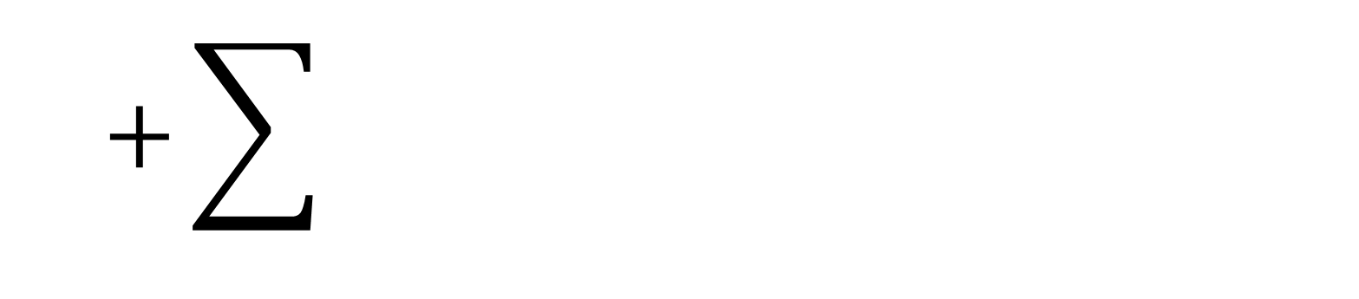


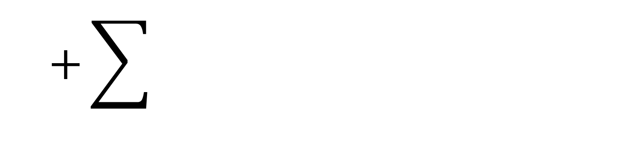


$$=\sum{f_{i}(X)g_{i}(Y)h_{i}(Z)t_{i}(W)}$$
$$T$$
$$f_{i}(X)$$
$$F_{i}(Y,Z,W)$$
lower bounds $C\left(T\right)$
$$+\sum{f_{i}(X)g_{i}(Y)h_{i}(Z)t_{i}(W)}$$
$$g_{i}(Y)$$
$$G_{i}(X,Z,W)$$
Slice rank
explicit combinatorial interpretation
$$+\sum{f_{i}(X)g_{i}(Y)h_{i}(Z)t_{i}(W)}$$
$$R_{1}\left(T\right)$$
$$h_{i}(Z)$$
$$H_{i}(X,Y,W)$$
$$+\sum{f_{i}(X)g_{i}(Y)h_{i}(Z)t_{i}(W)}$$
$$p_{i}(W)$$
$$P_{i}(X,Y,Z)$$

Slide 34
$$=\sum{f_{i}(X)g_{i}(Y)h_{i}(Z)t_{i}(W)}$$
$$T$$
$$f_{i}(X)$$
$$F_{i}(Y,Z,W)$$
$$+\sum{f_{i}(X)g_{i}(Y)h_{i}(Z)t_{i}(W)}$$
$$g_{i}(Y)$$
$$G_{i}(X,Z,W)$$
Slice rank
$$+\sum{f_{i}(X)g_{i}(Y)h_{i}(Z)t_{i}(W)}$$
$$R_{1}\left(T\right)$$
$$h_{i}(Z)$$
$$H_{i}(X,Y,W)$$
$$+\sum{f_{i}(X)g_{i}(Y)h_{i}(Z)t_{i}(W)}$$
$$p_{i}(W)$$
$$P_{i}(X,Y,Z)$$

Slide 35


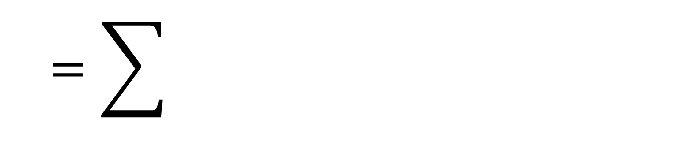




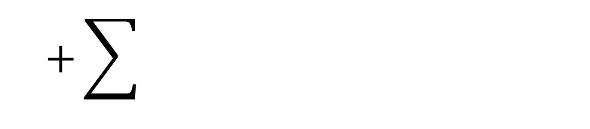

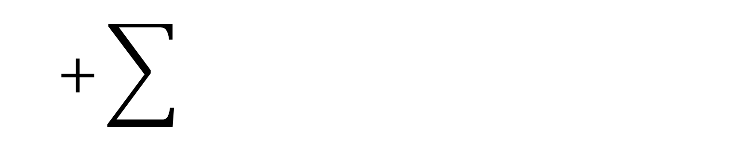


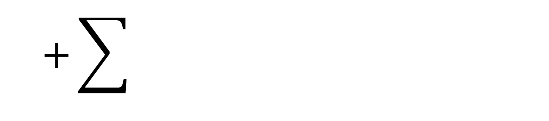


$$=\sum{f_{i}(X)g_{i}(Y)h_{i}(Z)t_{i}(W)}$$
Slice rank
$$T$$
$$f_{i}(X)$$
$$F_{i}(Y,Z,W)$$
$$R_{1}\left(T\right)$$
$$+\sum{f_{i}(X)g_{i}(Y)h_{i}(Z)t_{i}(W)}$$
$$g_{i}(Y)$$
$$G_{i}(X,Z,W)$$
$$+\sum{f_{i}(X)g_{i}(Y)h_{i}(Z)t_{i}(W)}$$
$$R_{1}\left(T\right)≤R\left(T\right)$$
$$h_{i}(Z)$$
$$H_{i}(X,Y,W)$$
$$+\sum{f_{i}(X)g_{i}(Y)h_{i}(Z)t_{i}(W)}$$
$$p_{i}(W)$$
$$P_{i}(X,Y,Z)$$

Slide 36





$$=\sum{f_{i}(X)g_{i}(Y)h_{i}(Z)t_{i}(W)}$$
Slice rank
$$T$$
$$f_{i}(X)$$
$$F_{i}(Y,Z,W)$$
$$X$$
$$R_{1}\left(T\right)$$
$$+\sum{f_{i}(X)g_{i}(Y)h_{i}(Z)t_{i}(W)}$$
$$Y$$
$$g_{i}(Y)$$
$$G_{i}(X,Z,W)$$
$$+\sum{f_{i}(X)g_{i}(Y)h_{i}(Z)t_{i}(W)}$$
$$R_{1}\left(T\right)≤R\left(T\right)$$
$$h_{i}(Z)$$
$$H_{i}(X,Y,W)$$
$$Z$$
$$+\sum{f_{i}(X)g_{i}(Y)h_{i}(Z)t_{i}(W)}$$
$$R_{1}\left(T\right)≤n$$
$$p_{i}(W)$$
$$P_{i}(X,Y,Z)$$
$$W$$

Slide 37
















$$=\sum{f_{i}(X)g_{i}(Y)h_{i}(Z)t_{i}(W)}$$
$$T$$
$$f_{i}(X)$$
$$F_{i}(Y,Z,W)$$
$$+\sum{f_{i}(X)g_{i}(Y)h_{i}(Z)t_{i}(W)}$$
Slice rank
$$g_{i}(Y)$$
$$G_{i}(X,Z,W)$$
$$R_{1}\left(T\right)$$
$$Y$$
$$X$$
$$Z$$
$$W$$
$$+\sum{f_{i}(X)g_{i}(Y)h_{i}(Z)t_{i}(W)}$$
$$h_{i}(Z)$$
$$H_{i}(X,Y,W)$$
$$+\sum{f_{i}(X)g_{i}(Y)h_{i}(Z)t_{i}(W)}$$
$$R_{1}\left(T\right)≤R\left(T\right)$$
$$p_{i}(W)$$
$$P_{i}(X,Y,Z)$$
$$R_{1}\left(T\right)≤n$$

Slide 38
$$Y$$
$$X$$
$$Z$$
$$W$$

Slide 39





$$Z$$
$$Y$$
$$X$$
$$\underset{xy}{F}\left(X,Y\right)\underset{w}{F}\left(W\right)\underset{z}{F}\left(Z\right)$$
$$W$$

Slide 40


$$= \left\{\begin{aligned}XY;Z;W \\ XZW;Y \\ X;Y;Z;W \\ …\end{aligned}\right\}$$
$$𝒫$$

Slide 41

$$= \left\{\begin{aligned}XY;Z;W \\ XZW;Y \\ X;Y;Z;W \\ …\end{aligned}\right\}$$
$$𝒫$$

Slide 42



$$= \left\{\begin{aligned}XY;Z;W \\ XZW;Y \\ X;Y;Z;W \\ …\end{aligned}\right\}$$
$$𝒫$$
-rank
$$R_{𝒫}\left(T\right)$$

Slide 43




$$= \left\{\begin{aligned}XY;Z;W \\ XZW;Y \\ X;Y;Z;W \\ …\end{aligned}\right\}$$
$$𝒫$$
-rank
$$R_{𝒫}\left(T\right)$$
$$𝒫=\left\{X;Y;Z;W\right\}$$
$$𝒫=\left\{\begin{aligned}X;YZW \\ Y;XZW \\ Z;XYW \\ W;XYZ\end{aligned}\right\}$$
rank
$$𝒫=\left\{XYZW\right\}$$
trivial rank
slice rank
$$𝒫=\left\{\begin{aligned}X;Y;ZW \\ X;Z;YW \\ X;W;YZ \\ Y;Z;XW \\ Y;W;XZ \\ Z;W;XY\end{aligned}\right\}$$
two-slice rank

Slide 44




$$𝒫$$
-rank
$$R_{𝒫}\left(T\right)$$
$$𝒫=\left\{\begin{aligned}X;Y;ZW \\ X;Z;YW \\ X;W;YZ \\ Y;Z;XW \\ Y;W;XZ \\ Z;W;XY\end{aligned}\right\}$$
$$𝒫=\left\{X;Y;Z;W\right\}$$
$$𝒫=\left\{\begin{aligned}X;YZW \\ Y;XZW \\ Z;XYW \\ W;XYZ\end{aligned}\right\}$$
rank
$$𝒫=\left\{XYZW\right\}$$
trivial rank
two-slice rank
slice rank

Slide 45







$$𝒫$$
-rank
$$R_{𝒫}\left(T\right)$$
two-slice rank
$$R_{1,1}\left(T\right)$$
$${PIP}_{n}≔$$
$$𝒫=\left\{\begin{aligned}X;Y;ZW \\ X;Z;YW \\ X;W;YZ \\ Y;Z;XW \\ Y;W;XZ \\ Z;W;XY\end{aligned}\right\}$$
$$\left(\sum_{j=1}^{n}{Z_{j}W_{j}}\right)$$
$$\left(\sum_{i=1}^{n}{X_{i}Y_{i}}\right)$$

Slide 46

$$𝒫$$
-rank
$$R_{𝒫}\left(T\right)$$
two-slice rank
$$R_{1,1}\left(T\right)$$
$${PIP}_{n}≔$$
$$𝒫=\left\{\begin{aligned}X;Y;ZW \\ X;Z;YW \\ X;W;YZ \\ Y;Z;XW \\ Y;W;XZ \\ Z;W;XY\end{aligned}\right\}$$
$$\left(\sum_{j=1}^{n}{Z_{j}W_{j}}\right)$$
$$\sum_{i=1}^{n}{X_{i}Y_{i}}$$

Slide 47


$$𝒫$$
-rank
$$R_{𝒫}\left(T\right)$$
two-slice rank
$$R_{1,1}\left(T\right)$$
$${PIP}_{n}≔$$
$$𝒫=\left\{\begin{aligned}X;Y;ZW \\ X;Z;YW \\ X;W;YZ \\ Y;Z;XW \\ Y;W;XZ \\ Z;W;XY\end{aligned}\right\}$$
$$\sum_{i=1}^{n}{X_{i}Y_{i}}$$
$$F\left(Z,W\right)$$
$$R_{1,1}\left({PIP}_{n}\right)=n$$

Slide 48

$$𝒫$$
-rank
$$R_{𝒫}\left(T\right)$$
two-slice rank
$$R_{1,1}\left(T\right)$$
$$R_{1,1}\left(T\right)≲C\left(T\right)$$

Slide 49







$$𝒫$$
two-slice rank
$$R_{1,1}\left(T\right)$$
-rank
$$R_{𝒫}\left(T\right)$$
$$R_{1,1}\left(T\right)≲C\left(T\right)$$
$$R_{1,1}$$
$$R_{1,1}\left(T\right)=Θ\left(n^{2}\right)$$
two-slice
1+1+2
for random $T∈𝔽_{2}^{n×n×n×n}$

Slide 50





$$𝒫$$
two-slice rank
$$R_{1,1}\left(T\right)$$
-rank
$$R_{𝒫}\left(T\right)$$
$$R_{1,1}\left(T\right)≲C\left(T\right)$$
$$R_{1,1}$$
two-slice
1+1+2
$$R_{1,1}\left(T\right)=Θ\left(n^{2}\right)$$
for random $T∈𝔽_{2}^{n×n×n×n}$
$$R_{1}$$
$$R_{2}$$
$$C$$
$$R$$
slice
1+3
thick
2+2
rank
1+1+1+1

Slide 51



$$𝒫$$
-rank
$$R_{𝒫}\left(T\right)$$
$$R_{1}$$
slice
1+3
$$R_{1,1}$$
$$R$$
two-slice
1+1+2
rank
1+1+1+1
$$R_{2}$$
thick
2+2
$$C$$

Slide 52



$$𝒫$$
-rank
$$R_{𝒫}\left(T\right)$$
$$R_{1}$$
$$≲$$
slice
1+3
$$R_{1,1}$$
$$≲$$
$$R$$
two-slice
1+1+2
rank
1+1+1+1
$$R_{2}$$
$$≲$$
thick
2+2
$$C$$

Slide 53



$$𝒫$$
-rank
$$R_{𝒫}\left(T\right)$$
$$R_{1}$$
$$≲$$
slice
1+3
$$≲$$
$$C$$
$$R_{1,1}$$
$$≲$$
$$R$$
two-slice
1+1+2
rank
1+1+1+1
$$R_{2}$$
$$≲$$
thick
2+2

Slide 54


$$𝒫$$
-rank
$$R_{𝒫}\left(T\right)$$
$$R_{1}$$
$$≲$$
$$n≲$$
slice
1+3
$$≲$$
$$C$$
$$R_{1,1}$$
$$≲$$
$$R$$
two-slice
1+1+2
rank
1+1+1+1
$$R_{2}$$
$$≲$$
thick
2+2

Slide 55
$$𝒫$$
-rank
$$R_{𝒫}\left(T\right)$$
$$R_{1}$$
$$≲$$
$$n≲$$
slice
1+3
$$≲$$
$$C$$
$$R_{1,1}$$
$$≲$$
$$R$$
two-slice
1+1+2
rank
1+1+1+1
$$R_{2}$$
$$≲$$
thick
2+2

Slide 56

$$R_{1}$$
explicit combinatorial interpretation
slice
1+3

Slide 57

two-slice rank
$$R_{1,1}\left(T\right)$$
$$R_{1,1}\left(T\right)≲C\left(T\right)$$
How can we lower bound it?

Slide 58


two-slice rank
$$R_{1,1}\left(T\right)$$
$$R_{1,1}\left(T\right)≲C\left(T\right)$$
$n^{1.01}$ circuit lower bound?

Slide 59

two-slice rank
$$R_{1,1}\left(T\right)$$
$$R_{1,1}\left(T\right)≲C\left(T\right)$$
$n^{1.01}$ circuit lower bound?
Explicit construction
(random 0-1 tensor has $R_{1,1}=Θ\left(n^{2}\right)$)

Slide 60

two-slice rank
$$R_{1,1}\left(T\right)$$
$$R_{1,1}\left(T\right)≲C\left(T\right)$$
Hyperclique
conjecture
$$O\left(n^{3.99}\right)?$$

Slide 61


two-slice rank
$$R_{1,1}\left(T\right)$$
$$R_{1,1}\left(T\right)≲C\left(T\right)$$
$$\sum_{i,j,k,ℓ∈\left[n\right]}{X_{ijk}Y_{ijℓ}Z_{ikℓ}W_{jkℓ}}$$
Hyperclique
conjecture
$$O\left(n^{3.99}\right)?$$

Slide 62
$$𝒫$$
-rank
$$R_{𝒫}\left(T\right)$$
$$R_{1}$$
$$≲$$
$$n≲$$
slice
1+3
$$≲$$
$$C$$
$$R_{1,1}$$
$$≲$$
$$R$$
two-slice
1+1+2
rank
1+1+1+1
$$R_{2}$$
$$≲$$
thick
2+2
Thank you!

