Slide 1

Towards derandomising Markov chain Monte Carlo
Weiming Feng¹, Heng Guo¹, Chunyang Wang², Jiaheng Wang¹, Yitong Yin²
¹University of Edinburgh ²Nanjing University
on 28/07/2023 at

Slide 2
Approximate counting
1 Approximate counting
2 Deterministic approximate counting
3 Applications

Slide 3
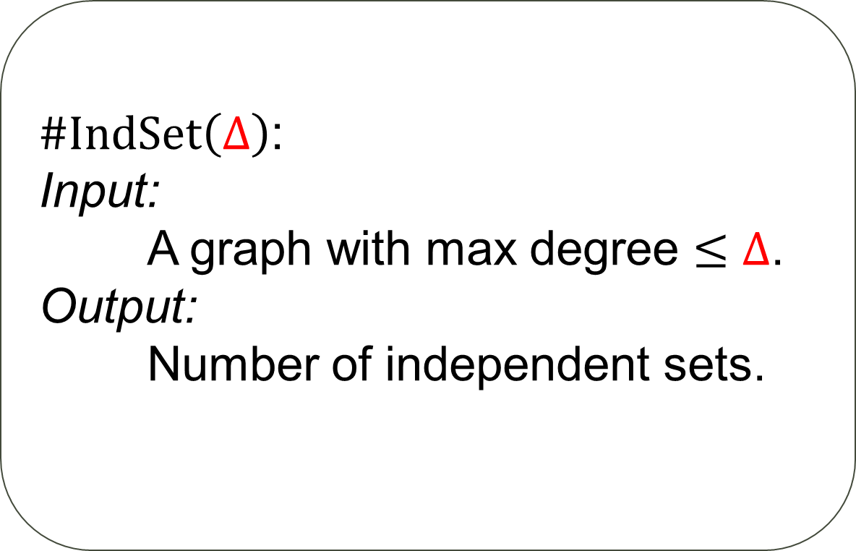
Counting independent sets
Problem
$\#IndSet\left(Δ\right)$:
Input:
A graph with max degree $≤Δ$.
Output:
Number of independent sets.

Slide 4

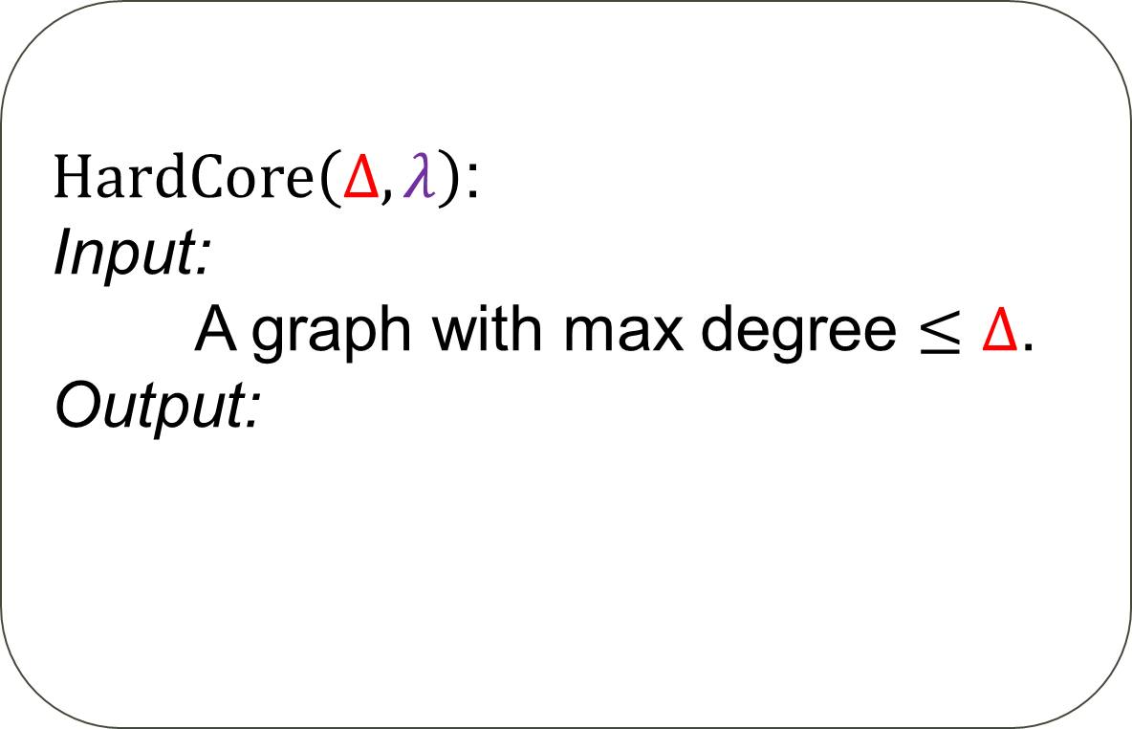

Hard-core model
Problem
configuration
$HardCore\left(Δ,λ\right)$:
Input:
A graph with max degree $≤Δ$.
Output:
$$Z=\sum_{IndSet I}{λ^{\left|I\right|}}$$
weight
$$λ^{3}$$
partition function

Slide 5
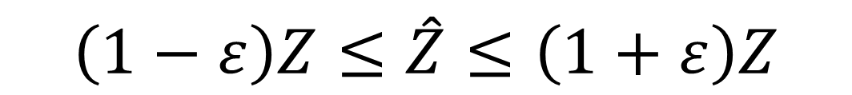
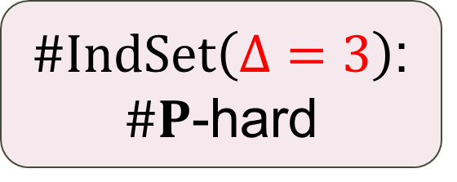
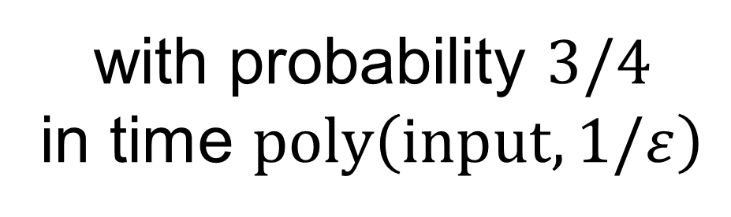
Approximate counting
$\#IndSet\left(Δ=3\right)$: $\#P$-hard
Fully polynomial-time randomised approximation scheme (FPRAS)
$$\left(1−ε\right)Z≤\hat{Z}≤\left(1+ε\right)Z$$
with probability $3/4$
in time $poly\left(input,1/ε\right)$

Slide 6
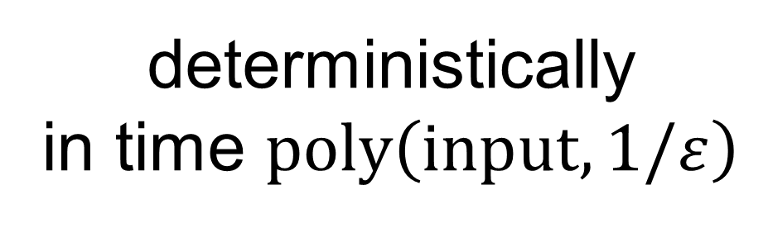
Approximate counting
$\#IndSet\left(Δ=3\right)$: $\#P$-hard
Fully polynomial-time randomised approximation scheme (FPTAS)
$$\left(1−ε\right)Z≤\hat{Z}≤\left(1+ε\right)Z$$
deterministically
in time $poly\left(input,1/ε\right)$

Slide 7
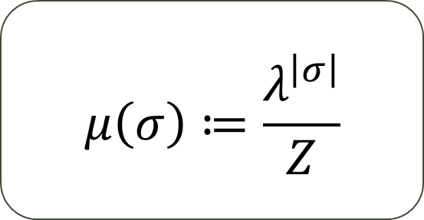
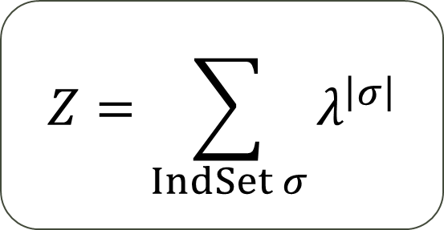
Counting to sampling
$$Z=\sum_{IndSet σ}{λ^{\left|σ\right|}}$$
$$μ\left(σ\right)≔\frac{λ^{\left|σ\right|}}{Z}$$

Slide 8
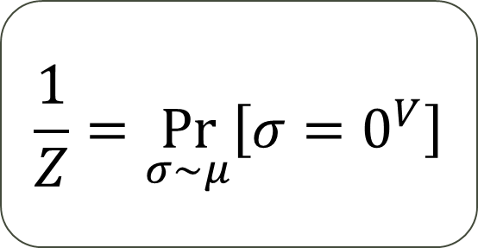
Counting to sampling
$$Z=\sum_{IndSet σ}{λ^{\left|σ\right|}}$$
$$μ\left(σ\right)≔\frac{λ^{\left|σ\right|}}{Z}$$
$$\frac{1}{Z}=\underset{σ∼μ}{Pr}\left[σ=0^{V}\right]$$

Slide 9
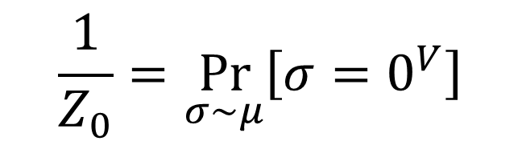

Counting to sampling
2
$G_{0}$
1
5
4
3
7
6
$$\frac{1}{Z_{0}}=\underset{σ∼μ}{Pr}\left[σ=0^{V}\right]$$

Slide 10

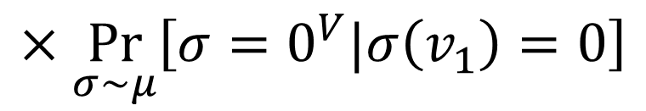
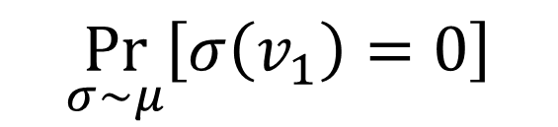
Counting to sampling
2
$G_{0}$
1
5
4
3
7
6
$$\frac{1}{Z_{0}}=\underset{σ∼μ}{Pr}\left[σ=0^{V}\right]$$
$$=$$
$$×\underset{σ∼μ}{Pr}\left[σ=0^{V}|σ\left(v_{1}\right)=0\right]$$
$$\underset{σ∼μ}{Pr}\left[σ\left(v_{1}\right)=0\right]$$

Slide 11
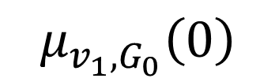
Counting to sampling
2
$G_{0}$
1
5
4
3
7
6
$$\frac{1}{Z_{0}}=\underset{σ∼μ}{Pr}\left[σ=0^{V}\right]$$
$$=$$
$$μ_{v_{1},G_{0}}\left(0\right)$$
$$×\underset{σ∼μ}{Pr}\left[σ=0^{V}|σ\left(v_{1}\right)=0\right]$$
$$\underset{σ∼μ}{Pr}\left[σ\left(v_{1}\right)=0\right]$$

Slide 12
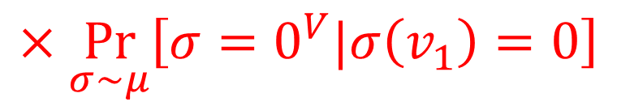
Counting to sampling
2
$G_{0}$
1
5
4
3
7
6
$$\frac{1}{Z_{0}}=\underset{σ∼μ}{Pr}\left[σ=0^{V}\right]$$
$$=$$
$$μ_{v_{1},G_{0}}\left(0\right)$$
$$×\underset{σ∼μ}{Pr}\left[σ=0^{V}|σ\left(v_{1}\right)=0\right]$$

Slide 13



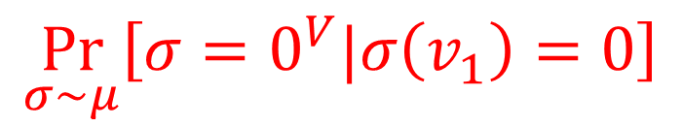

Counting to sampling
$G_{0}$
$G_{1}$
2
2
$G_{0}$
1
1
5
5
4
4
3
3
7
7
6
6
$$\frac{1}{Z_{0}}=\underset{σ∼μ}{Pr}\left[σ=0^{V}\right]$$
$$\frac{1}{Z_{1}}$$
$$=$$
$$×$$
$$μ_{v_{1},G_{0}}\left(0\right)$$
$$\underset{σ∼μ}{Pr}\left[σ=0^{V}|σ\left(v_{1}\right)=0\right]$$

Slide 14

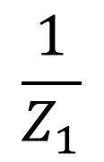
Counting to sampling
2
$G_{0}$
2
$G_{1}$
1
5
5
4
4
3
3
7
7
6
6
$$\frac{1}{Z_{0}}=\underset{σ∼μ}{Pr}\left[σ=0^{V}\right]$$
$$\frac{1}{Z_{1}}$$
$$=$$
$$×$$
$$μ_{v_{1},G_{0}}\left(0\right)$$

Slide 15



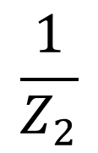
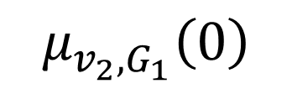
Counting to sampling
2
$G_{1}$
2
$G_{2}$
5
5
4
4
3
3
7
7
6
6
$$\frac{1}{Z_{0}}=\underset{σ∼μ}{Pr}\left[σ=0^{V}\right]$$
$$\frac{1}{Z_{1}}$$
$$\frac{1}{Z_{2}}$$
$$=$$
$$×$$
$$μ_{v_{1},G_{0}}\left(0\right)$$
$$μ_{v_{2},G_{1}}\left(0\right)$$
$$×$$

Slide 16
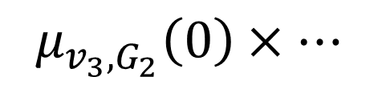
Counting to sampling
2
$G_{1}$
$G_{2}$
5
5
4
4
3
3
7
7
Self-reduction:
Suffices to estimate the marginals
6
6
$$\frac{1}{Z_{0}}=\underset{σ∼μ}{Pr}\left[σ=0^{V}\right]$$
$$=$$
$$×$$
$$μ_{v_{3},G_{2}}\left(0\right)×…$$
$$μ_{v_{1},G_{0}}\left(0\right)$$
$$μ_{v_{2},G_{1}}\left(0\right)$$
$$×$$
Markov chain Monte Carlo

Slide 17


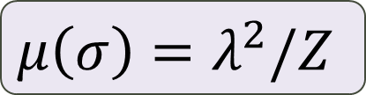

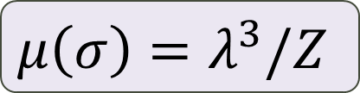

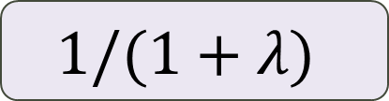
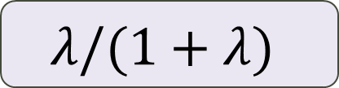
Glauber dynamics
$$0$$
$$\frac{1}{1+λ}$$
$$1$$
$$λ/(1+λ)$$
$$μ\left(σ\right)=λ^{3}/Z$$
$$1/(1+λ)$$
$$μ\left(σ\right)=λ^{2}/Z$$

Slide 18
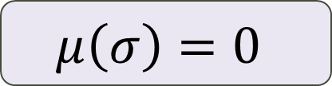
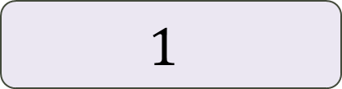
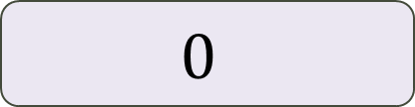
Glauber dynamics
$$0$$
$$1$$
$$0$$
$$μ\left(σ\right)=0$$
$$1$$
$$μ\left(σ\right)=λ^{2}/Z$$

Slide 19
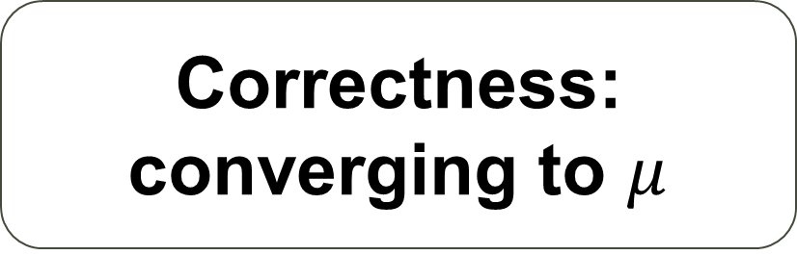
After a long run…
Correctness:
converging to $μ$
Efficiency 1:
rapid mixing
Glauber
Hard nut
Efficiency 2:
easy implementation
Only look at neighbours

Slide 20
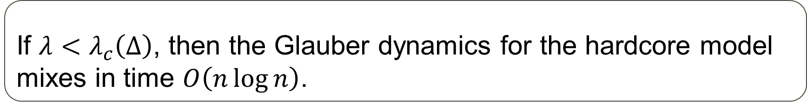
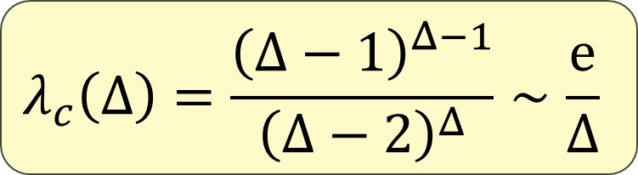
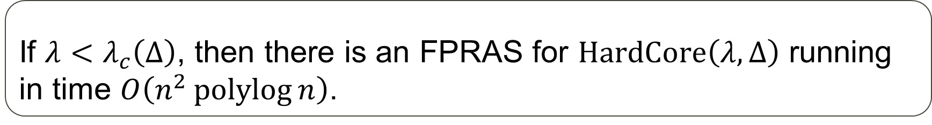
Approximate counting: hard-core
Theorem [Anari-Liu-Oveis Gharan’20, Chen-Liu-Vigoda’21]
If $λ<λ_{c}\left(Δ\right)$, then the Glauber dynamics for the hardcore model mixes in time $O\left(n\log{n}\right)$.
$$λ_{c}\left(Δ\right)=\frac{{\left(Δ−1\right)}^{Δ−1}}{{\left(Δ−2\right)}^{Δ}}∼\frac{e}{Δ}$$
Corollary [Štefankovič-Vempala-Vigoda’09, Kolmogorov’18]
If $λ<λ_{c}\left(Δ\right)$, then there is an FPRAS for $HardCore\left(λ,Δ\right)$ running in time $O\left(n^{2}\operatorname{polylog}{n}\right)$.
Adaptive simulated annealing
Theorem [Sly’10, Sly-Sun’14, Galanis-Štefankovič-Vigoda’16]
It is $NP$-hard to approximate $HardCore\left(λ,Δ\right)$ when $λ>λ_{c}\left(Δ\right)$.

Slide 21
Deterministic approximate counting
1 Approximate counting
2 Deterministic approximate counting
3 Applications

Slide 22
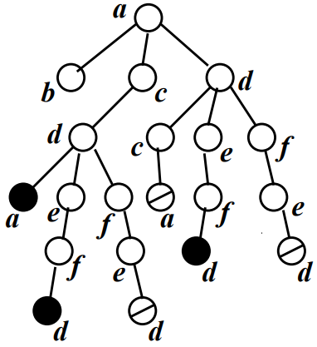
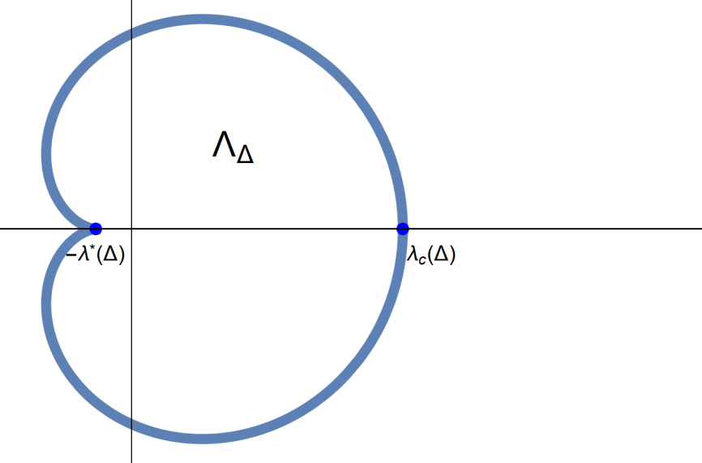
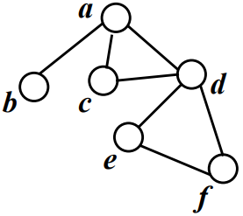
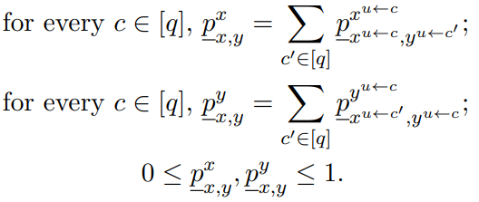
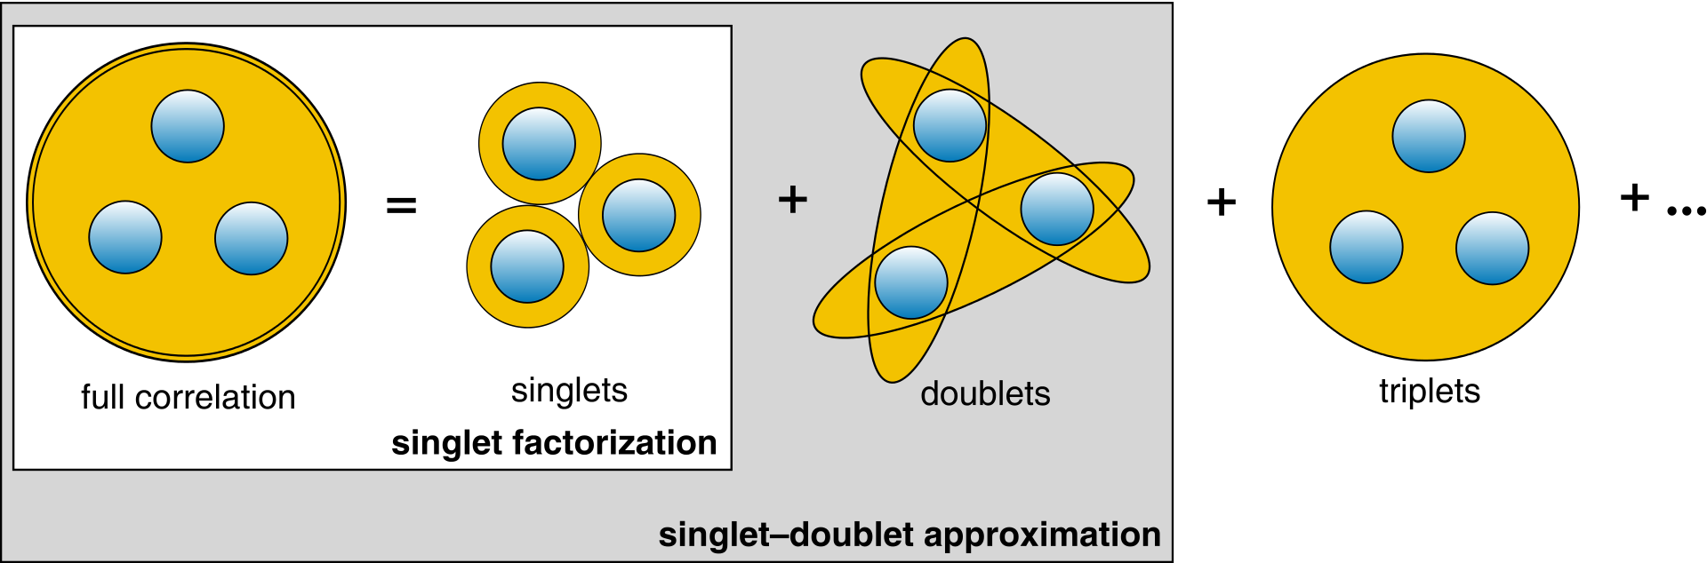
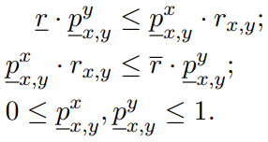

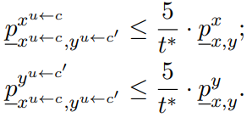
Deterministic counting
Zero-freeness
[Barvinok’16, Patel-Regts’17]
FPTAS from MCMC?
Correlation decay [Weitz’06]
Linear programming [Moitra’19, Guo-Liao-Lu-Zhang’20, Jain-Pham-Vuong’21a]
Cluster expansion [Helmuth-Perkins-Regts’20, Jenssen-Keevash-Perkins’20]

Slide 23
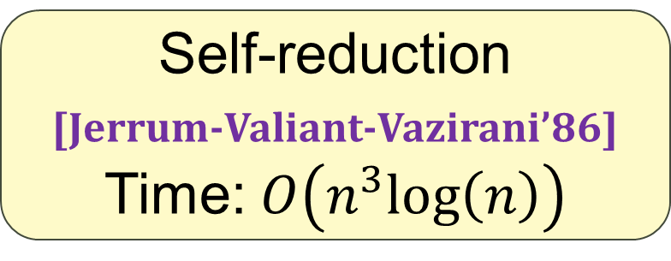
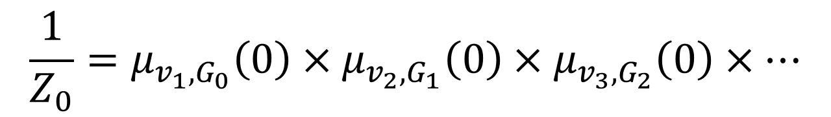
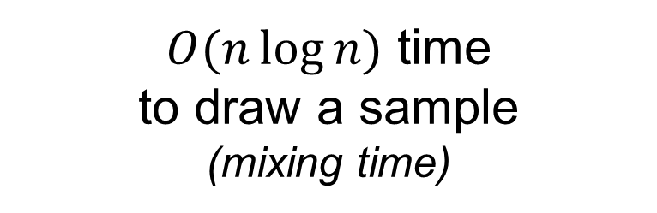
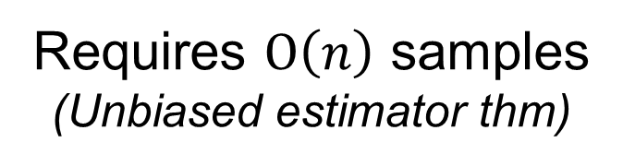
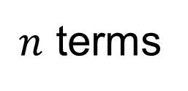
Counting to sampling: revisited
$O(n\log{n})$ time
to draw a sample
(mixing time)
Requires $O\left(n\right)$ samples
(Unbiased estimator thm)
$$\frac{1}{Z_{0}}=μ_{v_{1},G_{0}}\left(0\right)×μ_{v_{2},G_{1}}\left(0\right)×μ_{v_{3},G_{2}}\left(0\right)×…$$
$n$ terms
Self-reduction
[Jerrum-Valiant-Vazirani’86]
Time: $O\left(n^{3}log\left(n\right)\right)$

Slide 24
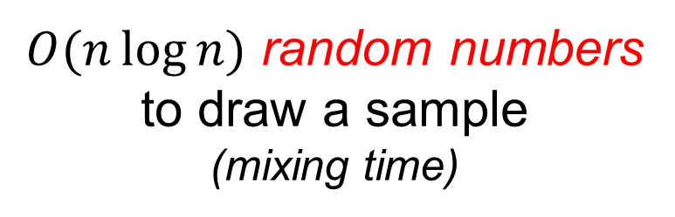
Counting to sampling: revisited
Trivial derandomisation:
enumerate them!
$O(n\log{n})$ random numbers
to draw a sample
(mixing time)
Requires $O\left(n\right)$ samples
(Unbiased estimator thm)
$$\frac{1}{Z_{0}}=μ_{v_{1},G_{0}}\left(0\right)×μ_{v_{2},G_{1}}\left(0\right)×μ_{v_{3},G_{2}}\left(0\right)×…$$
$n$ terms
Self-reduction
[Jerrum-Valiant-Vazirani’86]
Time: $O\left(n^{3}log\left(n\right)\right)$

Slide 25
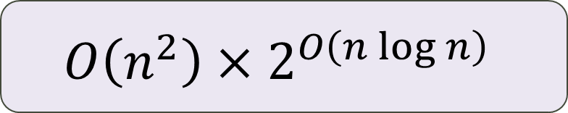
Counting to sampling: revisited
$O(n\log{n})$ random numbers
to draw a sample
(mixing time)
Requires $O\left(n\right)$ samples
(Unbiased estimator thm)
$$\frac{1}{Z_{0}}=μ_{v_{1},G_{0}}\left(0\right)×μ_{v_{2},G_{1}}\left(0\right)×μ_{v_{3},G_{2}}\left(0\right)×…$$
$n$ terms
$$O\left(n^{2}\right)×2^{O\left(n\log{n}\right)}$$
Do we really need so many random numbers?

Slide 26
Anand-Jerrum lazy sampler

Slide 27





Anand-Jerrum lazy sampler
?
?
$$0$$
$$\frac{1}{1+λ}$$
$$1$$
?
$$0$$
$$1$$

Slide 28



Anand-Jerrum lazy sampler
?
$$0$$
$$\frac{1}{1+λ}$$
$$1$$
?
Zone of indecision
$$0$$
$$\frac{1}{1+λ}$$
$$1$$
?
$$0$$
$$1$$

Slide 29
Anand-Jerrum lazy sampler
?
Zone of indecision
$$0$$
$$\frac{1}{1+λ}$$
$$1$$

Slide 30
Anand-Jerrum lazy sampler
Recursion (DFS)
?
?
Zone of indecision
?
$$0$$
$$\frac{1}{1+λ}$$
$$1$$
?

Slide 31





Anand-Jerrum lazy sampler
Conditioned on neighbours
$$0$$
$$\frac{1}{1+λ}$$
$$1$$
?
Zone of indecision
“Lower bound”
distribution
$$0$$
$$\frac{1}{1+λ}$$
$$1$$
“Padding”
distribution
Condition on falling into ZoI
$$0$$
$$1$$

Slide 32



Anand-Jerrum lazy sampler
Theorem (simplified) [Anand-Jerrum’22]
Assuming some condition (SSM) $⇒$
Generating a sample of a vertex “exactly” subject to its marginal distribution, in $O\left(1\right)$ time.
Lemma (simplified) [This work]
Assuming some slightly stronger condition $⇒$
Terminating in $O\left(\log{1/ε_{0}}\right)$ with probability $1−ε_{0}$
Trivial derandomisation:
enumerate them!
$⇒$ Hence $O\left(\log{n}\right)$ random numbers are used if $ε_{0}$ is set $O\left(1/n\right)$.

Slide 33
Systematic scan GD

Slide 34





Systematic scan GD
Timer $T=2$
Timer $T=0$
Timer $T=1$
2
1
Update $v_{i}$ with
$$i≡T (mod n)$$
5
4
3
7
6

Slide 35


Coupling Towards The Past
State of MC?
7
7
7
7
6
6
6
6
5
5
5
5
4
4
4
3
3
3
2
2
2
1
1
1
Already “converges”
at $T=−∞$
Desired distribution
at any $T$
-16 | -15 | -14 | -13 | -12 | -11 | -10 | -9 | -8 | -7 | -6 | -5 | -4 | -3 | -2 | -1 | 0

Slide 36




Coupling Towards The Past
$$0$$
$$\frac{1}{1+λ}$$
$$1$$
?
$$∼μ_{v_{7} }$$
7
6
5
4
3
2
1
-16 | -15 | -14 | -13 | -12 | -11 | -10 | -9 | -8 | -7 | -6 | -5 | -4 | -3 | -2 | -1 | 0

Slide 37
Coupling Towards The Past
$$0$$
$$\frac{1}{1+λ}$$
$$1$$
?
7
6
5
4
3
2
1
-16 | -15 | -14 | -13 | -12 | -11 | -10 | -9 | -8 | -7 | -6 | -5 | -4 | -3 | -2 | -1 | 0

Slide 38
Coupling Towards The Past
$$0$$
$$\frac{1}{1+λ}$$
$$1$$
7
?
6
?
5
4
3
2
1
-16 | -15 | -14 | -13 | -12 | -11 | -10 | -9 | -8 | -7 | -6 | -5 | -4 | -3 | -2 | -1 | 0

Slide 39
Coupling Towards The Past
might be different
7
?
6
5
4
3
2
1
-16 | -15 | -14 | -13 | -12 | -11 | -10 | -9 | -8 | -7 | -6 | -5 | -4 | -3 | -2 | -1 | 0

Slide 40
Coupling Towards The Past
7
?
6
5
4
3
$$0$$
$$1$$
2
1
-16 | -15 | -14 | -13 | -12 | -11 | -10 | -9 | -8 | -7 | -6 | -5 | -4 | -3 | -2 | -1 | 0

Slide 41
Coupling Towards The Past
“Predestined” past
7
?
6
5
4
3
2
1
-16 | -15 | -14 | -13 | -12 | -11 | -10 | -9 | -8 | -7 | -6 | -5 | -4 | -3 | -2 | -1 | 0

Slide 42

Coupling Towards The Past
“Predestined” past
7
6
5
4
3
2
$$r_{i}∼μ_{LB}$$
$$r_{i}∈supp\left(μ_{LB}\right)=\left\{0,ZoI\right\}$$
1
$$r_{−16}$$ | $$r_{−15}$$ | $$r_{−14}$$ | $$r_{−13}$$ | $$r_{−12}$$ | $$r_{−11}$$ | $$r_{−10}$$ | $$r_{−9}$$ | $$r_{−8}$$ | $$r_{−7}$$ | $$r_{−6}$$ | $$r_{−5}$$ | $$r_{−4}$$ | $$r_{−3}$$ | $$r_{−2}$$ | $$r_{−1}$$ | $$r_{−0}$$

Slide 43


Coupling Towards The Past
“Predestined” past
7
6
5
4
Time $−T$
3
2
Trivial derandomisation:
enumerate them!
w.p. $\exp\left(−O\left(T\right)\right)$
$$r_{i}∼μ_{LB}$$
$$r_{i}∈supp\left(μ_{LB}\right)=\left\{0,ZoI\right\}$$
1
$$r_{−16}$$ | $$r_{−15}$$ | $$r_{−14}$$ | $$r_{−13}$$ | $$r_{−12}$$ | $$r_{−11}$$ | $$r_{−10}$$ | $$r_{−9}$$ | $$0$$ | $$0$$ | $$r_{−6}$$ | $$r_{−5}$$ | $$r_{−4}$$ | $$0$$ | $$ZoI$$ | $$ZoI$$ | $$ZoI$$

Slide 44
Applications
1 Approximate counting
2 Deterministic approximate counting
3 Applications

Slide 45
Hypergraph independent sets

Slide 46

Hypergraph independent sets
Problem. $\#HyperIndSet\left(k,Δ\right)$:
Input:
A $k$-uniform hypergraph with
max degree $≤Δ$.
Output:
Number of (weak) ind sets.

Slide 47




Hypergraph independent sets
Zone of indecision
$$0$$
$$1/2$$
$$1$$
Must be OUT
Theorem
There is an FPTAS for $\#HyperIndSet\left(k,Δ\right)$ when
$$Δ≤\frac{0.214}{k^{2}}⋅2^{k/2}.$$

Slide 48


Hypergraph independent sets
[This work] Deterministic counting when $Δ≤c⋅2^{k/2}/k^{2}$.
[Bezáková-Galanis-Goldberg-Guo-Štefankovič’19]
$NP$-hard when $Δ≥5⋅2^{k/2}$.
[Hermon-Sly-Zhang’19] Randomised counting: $Δ≤c⋅2^{k/2}$.
[Qiu-Wang-Zhang’22] Perfect sampling: $Δ≤c⋅2^{k/2}/k$.
[He-Wang-Yin’23] Deterministic counting: $Δ≲2^{k/5}$.

Slide 49

Hypergraph colourings
Problem. $\#HyperCol\left(k,Δ,q\right)$:
Input:
A $k$-uniform hypergraph with
max degree $≤Δ$.
Output:
Number of $q$-colourings.

Slide 50

Zone of indecision?
$$μ_{LB}\left( \right)=0$$
?
AJ: look at a larger neighbourhood
Here: bucketing + local lemma

Slide 51





















The local lemma
$$\operatorname{Pr}\left[B_{i}\right]=p$$
$$\operatorname{Pr}\left[B_{i}\right]=p$$
$$\operatorname{Pr}\left[B_{i}\right]=p$$
$$B_{1}$$
$$B_{1}$$
$$B_{1}$$
$$B_{2}$$
$$B_{5}$$
$$B_{2}$$
$$B_{5}$$
$$B_{2}$$
$$B_{5}$$
$$B_{3}$$
$$B_{4}$$
$$B_{3}$$
$$B_{4}$$
$$B_{3}$$
$$B_{4}$$
$$\operatorname{Pr}\left[No bad event\right]>0$$
$$\operatorname{Pr}\left[No bad event\right]=0$$
$$\operatorname{Pr}\left[No bad event\right] ? 0$$

Slide 52


The local lemma
Symmetric Lovász Local Lemma [Erdős-Lovász’75]
Assume $\operatorname{Pr}\left[B_{i}\right]=p$ and each event $B_{i}$ depends on at most other $d$ events. If
$$ep\left(d+1\right)≤1,$$
then $\operatorname{Pr}\left[no B_{i} happens\right]>0$.
Corollary
$\#HyperCol\left(k,Δ,q\right)\left(H\right)≥1$ whenever
$$Δ≤q^{k−1}/(ek)$$

Slide 53
Projection (bucketing)
No hard constraints
State space is connected
Go back
by brute force

Slide 54

Local uniformity
Evenly devide $q$ colours into $s$ buckets. ($s=q^{2/3}$ in our application)
Lemma (local uniformity)
If ${\left\lfloor q/s\right\rfloor }^{k}≥4eqskΔ$, then
$$\frac{1}{s}\left(1−\frac{1}{4s}\right)≤ ≤\frac{1}{s}\left(1+\frac{1}{s}\right).$$
Marginal of
any bucket
on any vertex under any pinning

Slide 55




Hypergraph colourings
Theorem
There is an FPTAS for $\#HyperCol\left(q,k,Δ\right)$ when $k≥20$,
$$Δ≤{\left(\frac{q}{64}\right)}^{k/3−5/3}.$$
Zone of
indecision
$$0$$
$$1−1/4s$$
$$1$$

Slide 56



Hypergraph colourings
[This work] Deterministic counting when $Δ≲q^{k/3}$.
[Galanis-Guo-W.’22]
$NP$-hard to approximate count when $Δ≥5⋅q^{k/2}$ for even $q≥4$.
[Galanis-Guo-W.’22]
$NP$-hard to decide when $Δ≥2kq^{k}\ln{q}+2q$ for $\left(q,k\right)≠\left(2,2\right)$
[Jain-Pham-Vuong’21b] Randomised counting: $Δ≲q^{k/3}$.
[He-Sun-Wu’21] Perfect sampling: $Δ≲q^{k/3}$.
[He-Wang-Yin’23] Deterministic counting: $Δ≲q^{k/5}$.

Slide 57
Future directions?
Counting in LLL
[He-Wang-Yin’22, He-Wu-Yang’23]
Derandomising MCMC
[This work]
Power of “Laziness”
Lazy marginal sampler [Anand-Jerrum’22,23]
Sub-quadratic counting
[Anand-Feng-Freifeld-Guo-W.’23]
… and more?

Slide 58

Future directions?
Concrete problems:
Hypergraph colouring when $Δ≲q^{k/2}$?
Derandomise Glauber dynamics for matchings?
Avoid marginal lower bounds?
FPTAS running time: ${\left(n/ε\right)}^{poly\left(k,Δ,\log{q}\right)}$ (under LLL settings).
$poly\left(k,Δ,\log{q}\right){\left(n/ε\right)}^{c}$ for some absolute $c>0$?

Slide 59
Thank you!
arXiv: 2211.03487v2
(to appear at FOCS’23)

