Slide 1
Approximate counting for spin systems in sub-quadratic time
Konrad Anand¹ Weiming Feng² Graham Freifeld²
Heng Guo² Jiaheng Wang²
¹Queen Mary, University of London ²University of Edinburgh
on xx/xx/xxxx at

Slide 2
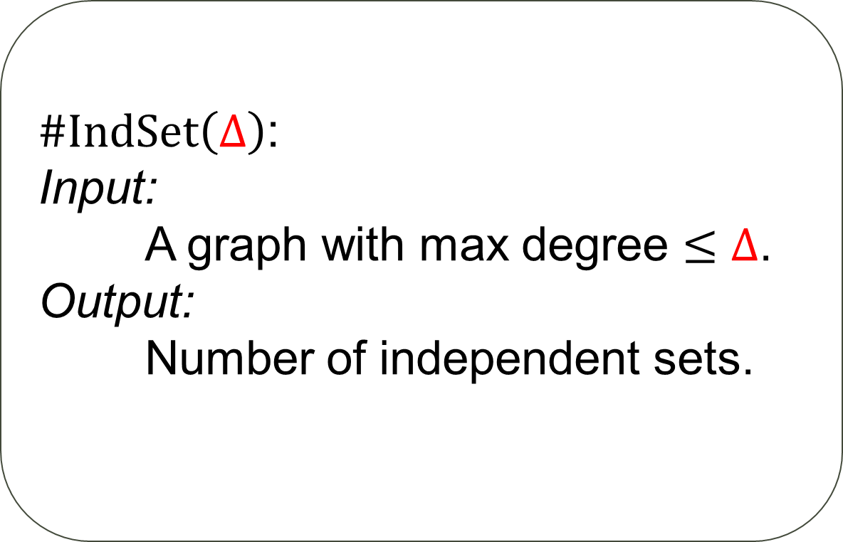
Counting independent sets
Problem
$\#IndSet\left(Δ\right)$:
Input:
A graph with max degree $≤Δ$.
Output:
Number of independent sets.

Slide 3
Hard-core model
Problem
configuration
$HardCore\left(Δ,λ\right)$:
Input:
A graph with max degree $≤Δ$.
Output:
$$Z=\sum_{IndSet I}{λ^{\left|I\right|}}$$
weight
$$λ^{3}$$
partition function

Slide 4
Approximate counting
$\#IndSet\left(Δ=3\right)$: $\#P$-hard
Fully polynomial-time randomised approximation scheme (FPRAS)
$$\left(1−ε\right)Z≤\hat{Z}≤\left(1+ε\right)Z$$
with probability $3/4$
in time $poly\left(input,1/ε\right)$

Slide 5
Counting to sampling
$$Z=\sum_{IndSet σ}{λ^{\left|σ\right|}}$$
$$μ\left(σ\right)≔\frac{λ^{\left|σ\right|}}{Z}$$

Slide 6
Counting to sampling
$$Z=\sum_{IndSet σ}{λ^{\left|σ\right|}}$$
$$μ\left(σ\right)≔\frac{λ^{\left|σ\right|}}{Z}$$
$$\frac{1}{Z}=\underset{σ∼μ}{Pr}\left[σ=0^{V}\right]$$

Slide 7
Counting to sampling
2
$G_{0}$
1
5
4
3
7
6
$$\frac{1}{Z_{0}}=\underset{σ∼μ}{Pr}\left[σ=0^{V}\right]$$

Slide 8
Counting to sampling
2
$G_{0}$
1
5
4
3
7
6
$$\frac{1}{Z_{0}}=\underset{σ∼μ}{Pr}\left[σ=0^{V}\right]$$
$$=$$
$$×\underset{σ∼μ}{Pr}\left[σ=0^{V}|σ\left(v_{1}\right)=0\right]$$
$$\underset{σ∼μ}{Pr}\left[σ\left(v_{1}\right)=0\right]$$

Slide 9
Counting to sampling
2
$G_{0}$
1
5
4
3
7
6
$$\frac{1}{Z_{0}}=\underset{σ∼μ}{Pr}\left[σ=0^{V}\right]$$
$$=$$
$$μ_{v_{1},G_{0}}\left(0\right)$$
$$×\underset{σ∼μ}{Pr}\left[σ=0^{V}|σ\left(v_{1}\right)=0\right]$$
$$\underset{σ∼μ}{Pr}\left[σ\left(v_{1}\right)=0\right]$$

Slide 10
Counting to sampling
2
$G_{0}$
1
5
4
3
7
6
$$\frac{1}{Z_{0}}=\underset{σ∼μ}{Pr}\left[σ=0^{V}\right]$$
$$=$$
$$μ_{v_{1},G_{0}}\left(0\right)$$
$$×\underset{σ∼μ}{Pr}\left[σ=0^{V}|σ\left(v_{1}\right)=0\right]$$

Slide 11
Counting to sampling
$G_{0}$
$G_{1}$
2
2
$G_{0}$
1
1
5
5
4
4
3
3
7
7
6
6
$$\frac{1}{Z_{0}}=\underset{σ∼μ}{Pr}\left[σ=0^{V}\right]$$
$$\frac{1}{Z_{1}}$$
$$=$$
$$×$$
$$μ_{v_{1},G_{0}}\left(0\right)$$
$$\underset{σ∼μ}{Pr}\left[σ=0^{V}|σ\left(v_{1}\right)=0\right]$$

Slide 12
Counting to sampling
2
$G_{0}$
2
$G_{1}$
1
5
5
4
4
3
3
7
7
6
6
$$\frac{1}{Z_{0}}=\underset{σ∼μ}{Pr}\left[σ=0^{V}\right]$$
$$\frac{1}{Z_{1}}$$
$$=$$
$$×$$
$$μ_{v_{1},G_{0}}\left(0\right)$$

Slide 13
Counting to sampling
2
$G_{1}$
2
$G_{2}$
5
5
4
4
3
3
7
7
6
6
$$\frac{1}{Z_{0}}=\underset{σ∼μ}{Pr}\left[σ=0^{V}\right]$$
$$\frac{1}{Z_{1}}$$
$$\frac{1}{Z_{2}}$$
$$=$$
$$×$$
$$μ_{v_{1},G_{0}}\left(0\right)$$
$$μ_{v_{2},G_{1}}\left(0\right)$$
$$×$$

Slide 14
Counting to sampling
2
$G_{1}$
$G_{2}$
5
5
4
4
3
3
7
7
Self-reduction:
Suffices to estimate the marginals
6
6
$$\frac{1}{Z_{0}}=\underset{σ∼μ}{Pr}\left[σ=0^{V}\right]$$
$$=$$
$$×$$
$$μ_{v_{3},G_{2}}\left(0\right)×…$$
$$μ_{v_{1},G_{0}}\left(0\right)$$
$$μ_{v_{2},G_{1}}\left(0\right)$$
$$×$$

Slide 15
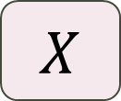
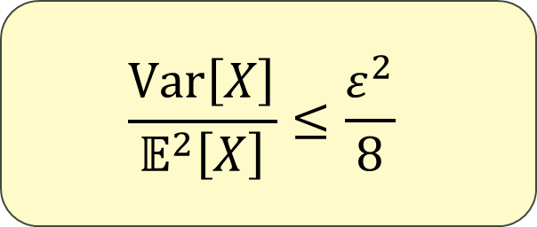
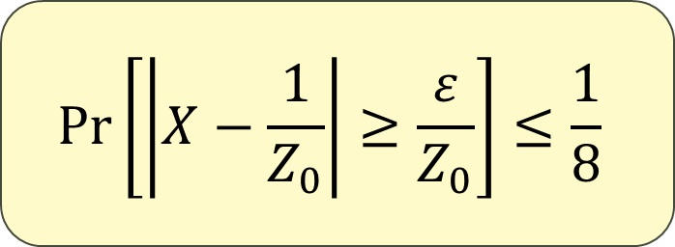
Counting to sampling
time
to draw a sample
???
Requires samples
???
estimate
$$\frac{1}{Z_{0}}=μ_{v_{1},G_{0}}\left(0\right)×μ_{v_{2},G_{1}}\left(0\right)×μ_{v_{3},G_{2}}\left(0\right)×…$$
$$X$$
Goal:
$n$ terms
$$\operatorname{Pr}\left[\left|X−\frac{1}{Z_{0}}\right|≥\frac{ε}{Z_{0}}\right]≤\frac{1}{8}$$
$$\frac{Var\left[X\right]}{𝔼^{2}\left[X\right]}≤\frac{ε^{2}}{8}$$
Chebyshev’s

Slide 16
Counting to sampling
estimate
$$\frac{1}{Z_{0}}=μ_{v_{1},G_{0}}\left(0\right)×μ_{v_{2},G_{1}}\left(0\right)×μ_{v_{3},G_{2}}\left(0\right)×…$$
$$X$$
$n$ terms
$$\frac{Var\left[X\right]}{𝔼^{2}\left[X\right]}≤\frac{ε^{2}}{8}$$

Slide 17
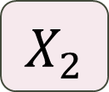
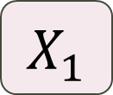

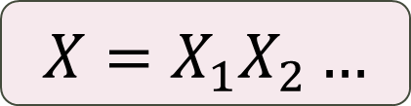
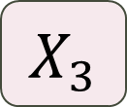
Counting to sampling
$$X_{1}$$
$$X_{2}$$
$$X_{3}$$
$$X=X_{1}X_{2}…$$
estimate
$$\frac{1}{Z_{0}}=μ_{v_{1},G_{0}}\left(0\right)×μ_{v_{2},G_{1}}\left(0\right)×μ_{v_{3},G_{2}}\left(0\right)×…$$
$$X$$
$n$ terms
$$\frac{Var\left[X\right]}{𝔼^{2}\left[X\right]}≤\frac{ε^{2}}{8}$$

Slide 18
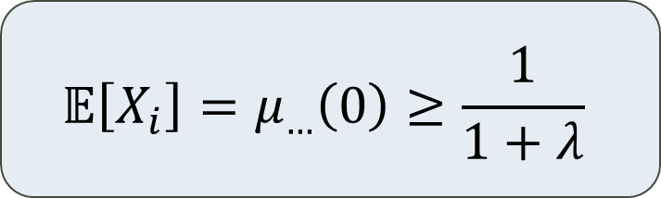
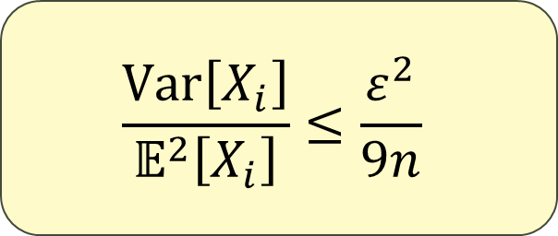
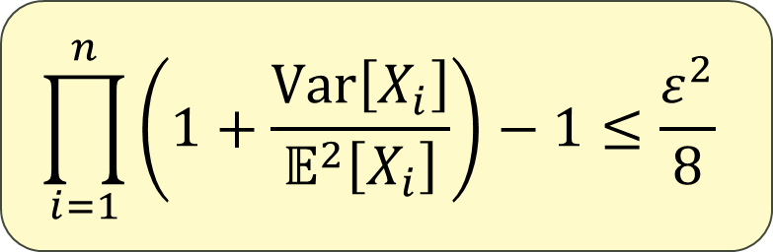
Counting to sampling
$$X_{1}$$
$$X_{2}$$
$$X_{3}$$
$$X=X_{1}X_{2}…$$
estimate
$$\frac{1}{Z_{0}}=μ_{v_{1},G_{0}}\left(0\right)×μ_{v_{2},G_{1}}\left(0\right)×μ_{v_{3},G_{2}}\left(0\right)×…$$
$$X$$
$$𝔼\left[X_{i}\right]=μ_{…}\left(0\right)≥\frac{1}{1+λ}$$
$n$ terms
$$\prod_{i=1}^{n}{\left(1+\frac{Var\left[X_{i}\right]}{𝔼^{2}\left[X_{i}\right]}\right)}−1≤\frac{ε^{2}}{8}$$
$$\frac{Var\left[X_{i}\right]}{𝔼^{2}\left[X_{i}\right]}≤\frac{ε^{2}}{9n}$$

Slide 19
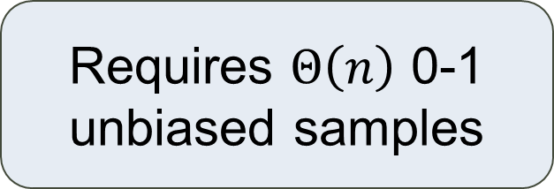
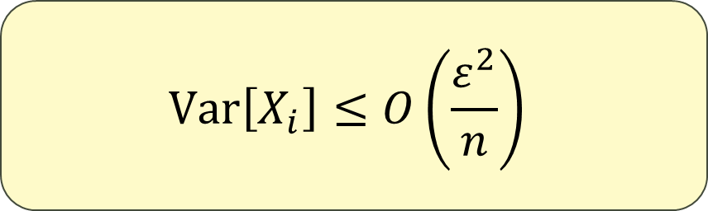
Counting to sampling
$$X_{1}$$
$$X_{2}$$
$$X_{3}$$
$$X=X_{1}X_{2}…$$
estimate
$$\frac{1}{Z_{0}}=μ_{v_{1},G_{0}}\left(0\right)×μ_{v_{2},G_{1}}\left(0\right)×μ_{v_{3},G_{2}}\left(0\right)×…$$
$$X$$
$n$ terms
Goal:
Requires $Θ\left(n\right)$ 0-1 unbiased samples
$$Var\left[X_{i}\right]≤O\left(\frac{ε^{2}}{n}\right)$$

Slide 20
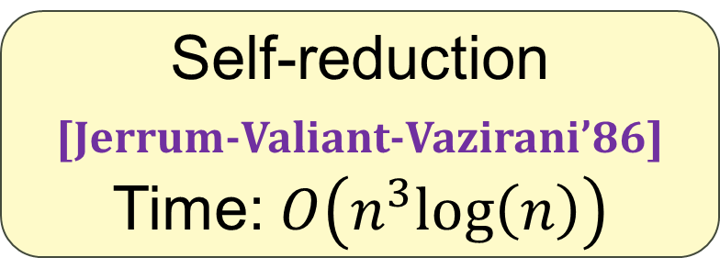

Counting to sampling
$O(n\log{n})$ time
to draw a sample
(mixing time)
Requires $O\left(n\right)$ samples
$$\frac{1}{Z_{0}}=μ_{v_{1},G_{0}}\left(0\right)×μ_{v_{2},G_{1}}\left(0\right)×μ_{v_{3},G_{2}}\left(0\right)×…$$
$n$ terms
Self-reduction
[Jerrum-Valiant-Vazirani’86]
Time: $O\left(n^{3}log\left(n\right)\right)$

Slide 21
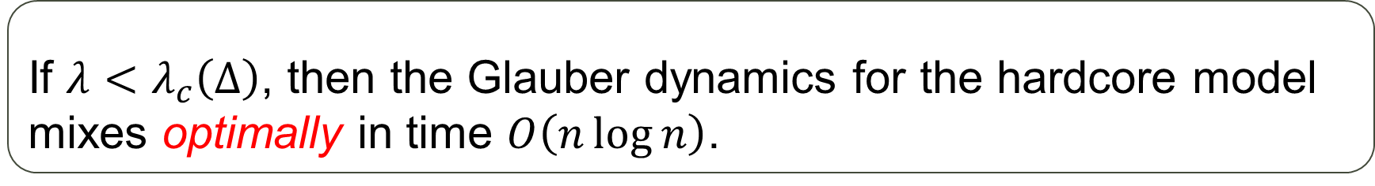
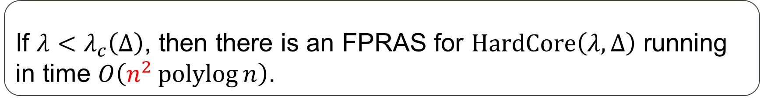
Approximate counting: hard-core
Theorem [Anari-Liu-Oveis Gharan’20, Chen-Liu-Vigoda’21]
If $λ<λ_{c}\left(Δ\right)$, then the Glauber dynamics for the hardcore model mixes optimally in time $O\left(n\log{n}\right)$.
$$λ_{c}\left(Δ\right)=\frac{{\left(Δ−1\right)}^{Δ−1}}{{\left(Δ−2\right)}^{Δ}}∼\frac{e}{Δ}$$
Theorem [Štefankovič-Vempala-Vigoda’09, Kolmogorov’18]
If $λ<λ_{c}\left(Δ\right)$, then there is an FPRAS for $HardCore\left(λ,Δ\right)$ running in time $O\left(n^{2}\operatorname{polylog}{n}\right)$.
Adaptive simulated annealing
Theorem [Sly’10, Sly-Sun’14, Galanis-Štefankovič-Vigoda’16]
It is $NP$-hard to approximate $HardCore\left(λ,Δ\right)$ when $λ>λ_{c}\left(Δ\right)$.

Slide 22


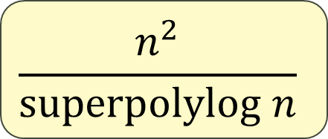

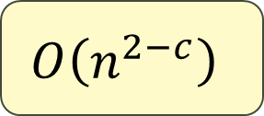
Our contributions
Previous best:
$$λ=o\left(Δ^{−2}\right)$$
1. Hard-core model
For all $Δ$-degree graphs:
(Strongly) sub-quadratic counting when $λ=o\left(Δ^{−1.5}\right)$
$$O\left(n^{2−c}\right)$$
2. Spin systems
For planar graph families with quadratic growth:
(Strongly) sub-quadratic counting when SSM is exhibited
For graph families with polynomial growth:
(Weakly) sub-quadratic counting when SSM is exhibited
$$\frac{n^{2}}{superpolylog n}$$
$$\frac{n^{2}}{ω\left(1\right)}$$

Slide 23


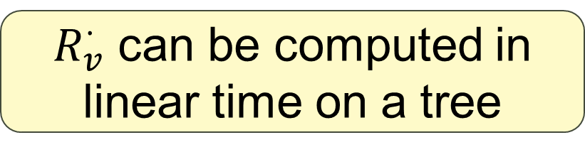
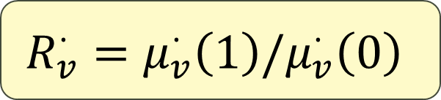
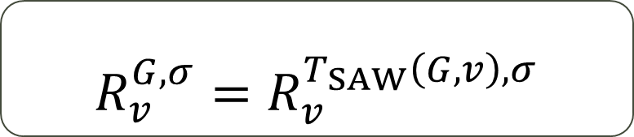
Weitz’s algorithm
$$v$$
$$v$$
Self-avoid walking (SAW) tree
Theorem [Weitz’06]
$$R_{v}^{G,σ}=R_{v}^{T_{SAW}\left(G,v\right),σ}$$
$R_{v}^{⋅}$ can be computed in linear time on a tree
$$R_{v}^{⋅}=μ_{v}^{⋅}\left(1\right)/μ_{v}^{⋅}\left(0\right)$$

Slide 24

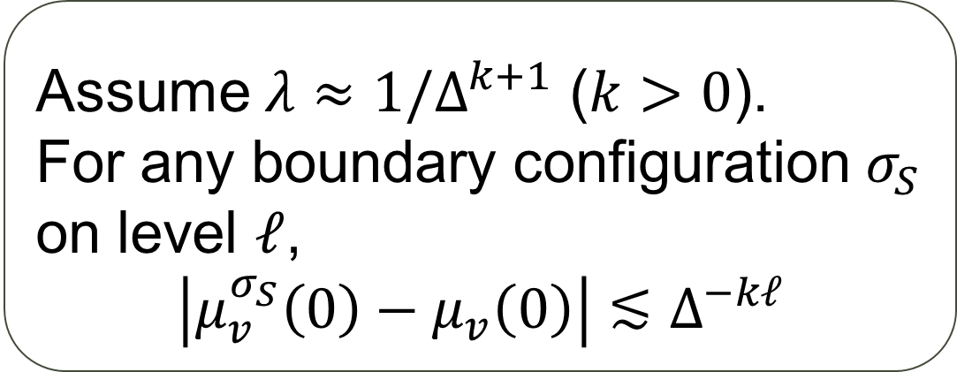
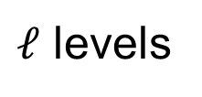
Weitz’s algorithm
$$v$$
Proposition
$ℓ$ levels
Assume $λ≈1/Δ^{k+1}$ ($k>0$).
For any boundary configuration $σ_{S}$ on level $ℓ$,
$$\left|μ_{v}^{σ_{S}}\left(0\right)−μ_{v}\left(0\right)\right|≲Δ^{−kℓ}$$
$$S$$

Slide 25

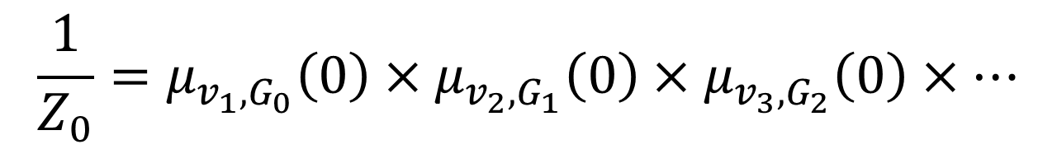
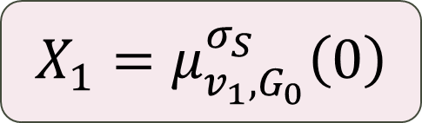
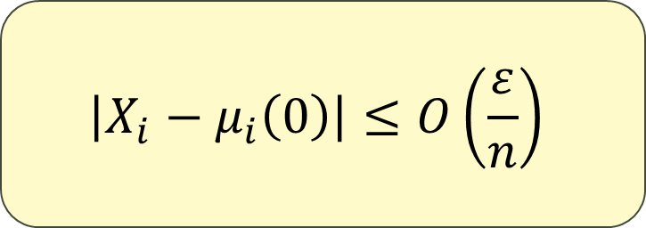
Using Weitz’s for reduction
Biased but deterministic
Goal:
$$\left|X_{i}−μ_{i}\left(0\right)\right|≤O\left(\frac{ε}{n}\right)$$
$$X_{1}=μ_{v_{1},G_{0}}^{σ_{S}}\left(0\right)$$
$$\frac{1}{Z_{0}}=μ_{v_{1},G_{0}}\left(0\right)×μ_{v_{2},G_{1}}\left(0\right)×μ_{v_{3},G_{2}}\left(0\right)×…$$
$n$ terms

Slide 26
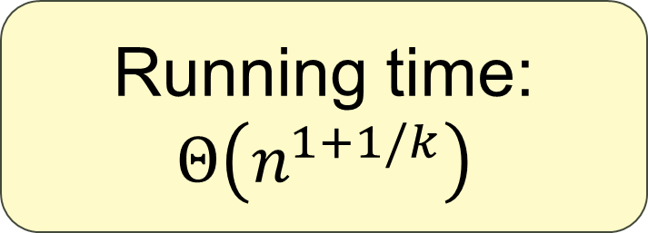
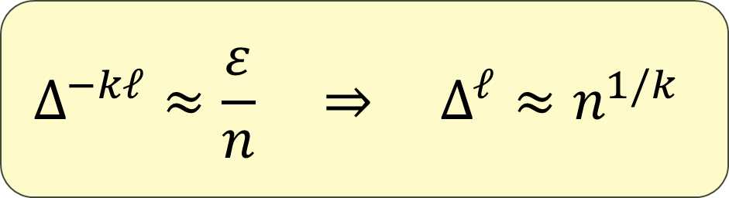
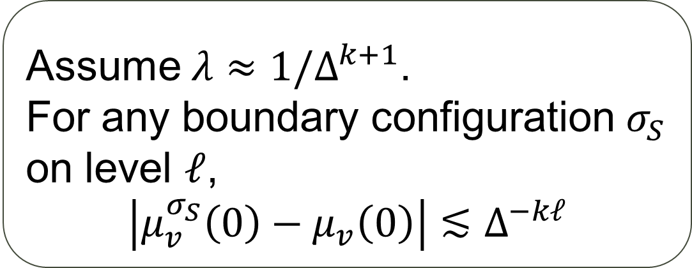
Weitz’s algorithm
$$v$$
Proposition
$ℓ$ levels
Assume $λ≈1/Δ^{k+1}$.
For any boundary configuration $σ_{S}$ on level $ℓ$,
$$\left|μ_{v}^{σ_{S}}\left(0\right)−μ_{v}\left(0\right)\right|≲Δ^{−kℓ}$$
$$S$$
$$Δ^{−kℓ}≈\frac{ε}{n} ⇒ Δ^{ℓ}≈n^{1/k}$$
Running time: $Θ\left(n^{1+1/k}\right)$

Slide 27
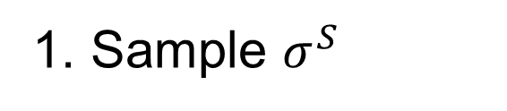
Speeding up Weitz’s
$$v$$
$ℓ$ levels
Correctly distributed boundary configuration
$$S$$
Marginal estimator
1. Sample $σ^{S}$

Slide 28
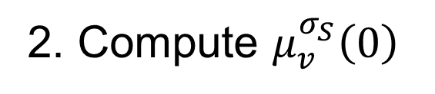
Speeding up Weitz’s
$$v$$
$ℓ$ levels
Correctly distributed boundary configuration
$$S$$
Marginal estimator
1. Sample $σ^{S}$
Suppose we can do this for now
2. Compute $μ_{v}^{σ_{S}}\left(0\right)$
unbiased

Slide 29
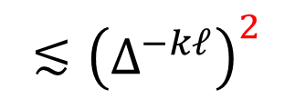
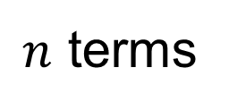

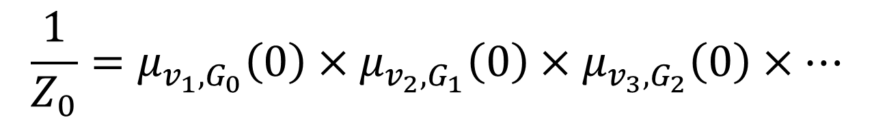
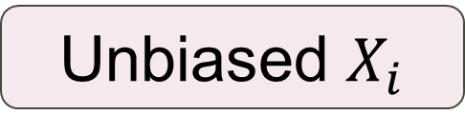
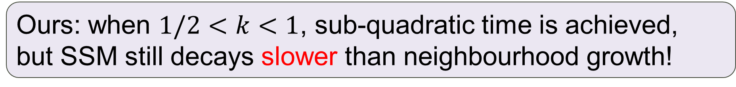
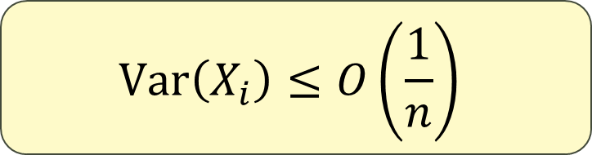
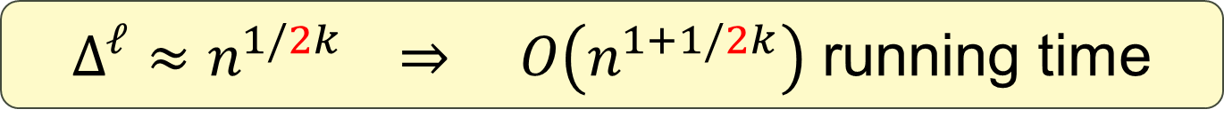
New estimator (ideally)
Unbiased $X_{i}$
Goal:
Remark
$$Var\left(X_{i}\right)≤O\left(\frac{1}{n}\right)$$
Proposition
Weitz’s gets sub-quadratic when correlation decays faster than neighbourhood growth
Assume $λ≈1/Δ^{k+1}$.
For any boundary configuration $σ_{S}$ on level $ℓ$,
$$\left|μ_{v}^{σ_{S}}\left(0\right)−μ_{v}\left(0\right)\right|≲Δ^{−kℓ}$$
$$\frac{1}{Z_{0}}=μ_{v_{1},G_{0}}\left(0\right)×μ_{v_{2},G_{1}}\left(0\right)×μ_{v_{3},G_{2}}\left(0\right)×…$$
Ours: when $1/2<k<1$, sub-quadratic time is achieved,
but SSM still decays slower than neighbourhood growth!
$n$ terms
$$Var\left(X_{i}\right)={Var}_{σ_{S}}\left(μ_{v}^{σ_{S}}\left(0\right)\right)=𝔼_{σ_{s}}\left[{\left|μ_{v}^{σ_{S}}\left(0\right)−μ_{v}\left(0\right)\right|}^{2}\right]$$
$$≲{\left(Δ^{−kℓ}\right)}^{2}$$
$Δ^{ℓ}≈n^{1/2k} ⇒ O\left(n^{1+1/2k}\right)$ running time

Slide 30
Speeding up Weitz’s
$$v$$
$ℓ$ levels
Correctly distributed boundary configuration
$$S$$
Marginal estimator
How can we do this?
1. Sample $σ^{S}$
2. Compute $μ_{v}^{σ_{S}}\left(0\right)$
unbiased

Slide 31
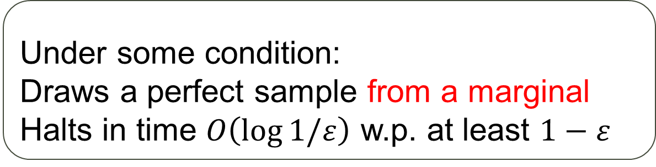

Tool: Anand-Jerrum [Anand-Jerrum’22,23]
$$w$$
Lazy marginal sampler
Proposition
Under some condition:
Draws a perfect sample from a marginal
Halts in time $O\left(\log{1/ε}\right)$ w.p. at least $1−ε$

Slide 32
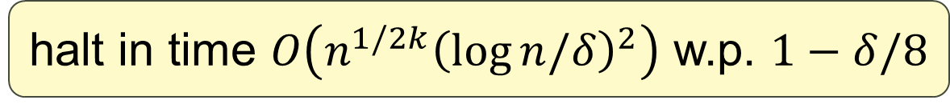


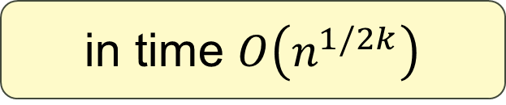
New estimator
$$v$$
$ℓ$ levels
Correctly distributed boundary configuration
$$S$$
Marginal estimator
expand $T_{SAW}$ on the fly
1. Sample $σ^{S}$
halt in time $O\left(n^{1/2k}{\left(\log{n/δ}\right)}^{2}\right)$ w.p. $1−δ/8$
2. Compute $μ_{v}^{σ_{S}}\left(0\right)$
in time $O\left(n^{1/2k}\right)$
$$Δ^{ℓ}≈n^{1/2k}$$

Slide 33
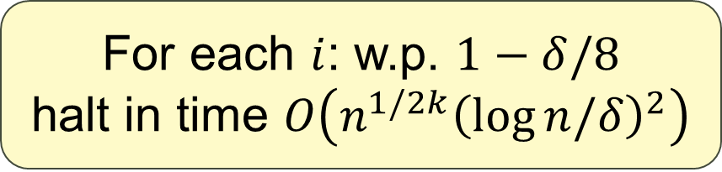
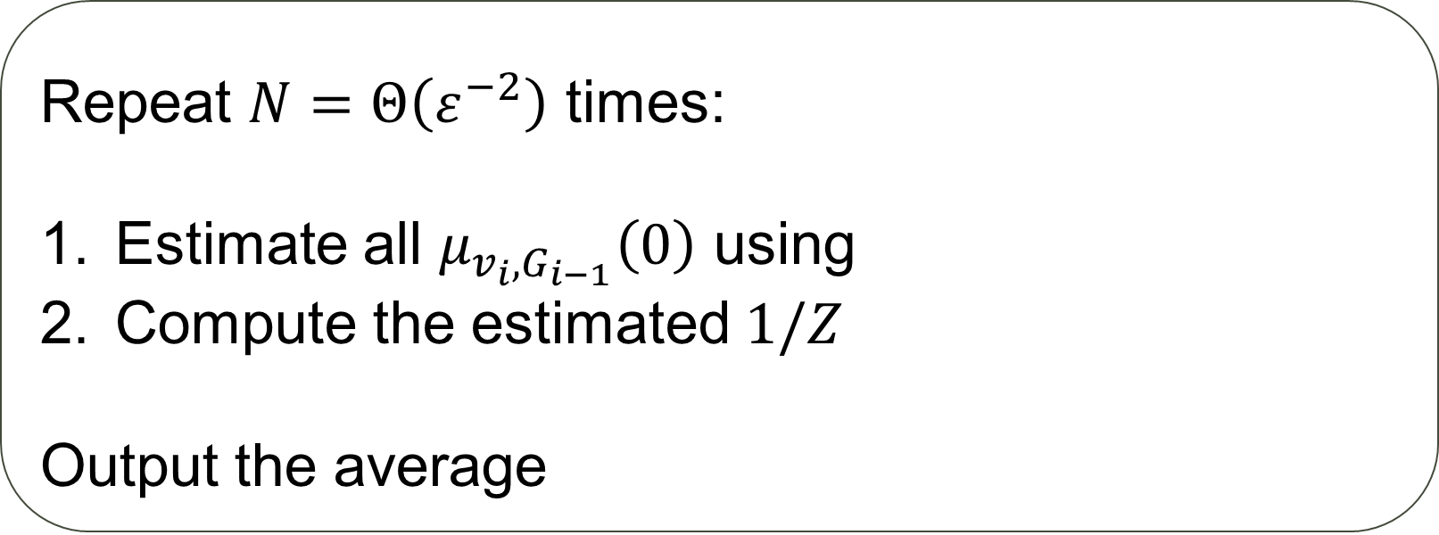
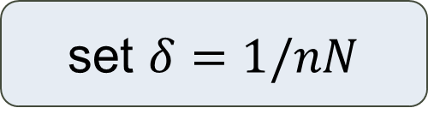
Full algorithm
Algorithm
set $δ=1/nN$
Repeat $N=Θ\left(ε^{−2}\right)$ times:
Estimate all $μ_{v_{i},G_{i−1}}\left(0\right)$ using
Compute the estimated $1/Z$
Output the average
For each $i$: w.p. $1−δ/8$
halt in time $O\left(n^{1/2k}{\left(\log{n/δ}\right)}^{2}\right)$
marginal estimator

Slide 34




New marginal estimator
To estimate $μ_{v}\left(c\right)$:
$$v$$
1
Choose a proper boundary $S$
2
Sample $σ^{S}∼$ correct distribution

Slide 35
New marginal estimator
To estimate $μ_{v}\left(c\right)$:
$$v$$
1
Choose a proper boundary $S$
2
Sample $σ^{S}∼$ correct distribution

Slide 36

New marginal estimator
To estimate $μ_{v}\left(c\right)$:
$$v$$
1
Choose a proper boundary $S$
2
variance emerges
Sample $σ^{S}∼$ correct distribution
3
exact computation
Compute $μ_{v}^{σ_{S}}\left(c\right)$ as an estimator

Slide 37
Beyond hard-core?
To estimate $μ_{v}\left(c\right)$:
1
Choose a proper boundary $S$
2
Sample $σ^{S}∼$ correct distribution
3
exact computation
Compute $μ_{v}^{σ_{S}}\left(c\right)$ as an estimator

Slide 38

General $q$-spin system

Slide 39


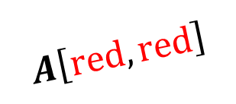

General $q$-spin system
Interaction matrix $A$: $q×q$ matrix
$$A\left[red,red\right]$$
External field $b$: $q$-dim vector
$$b\left[blue\right]$$
Weight of a configuration:
multiplying everything together

Slide 40
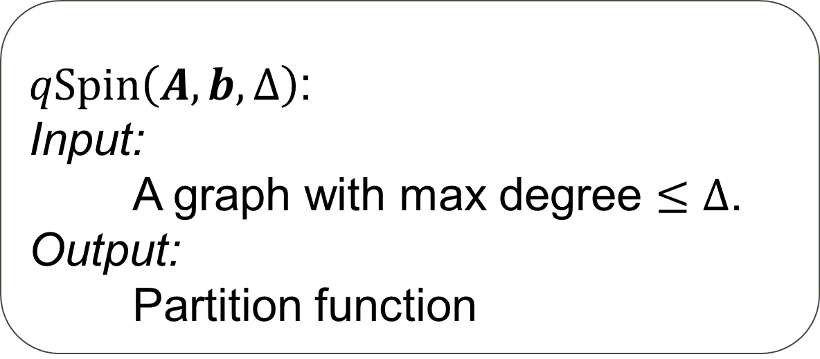
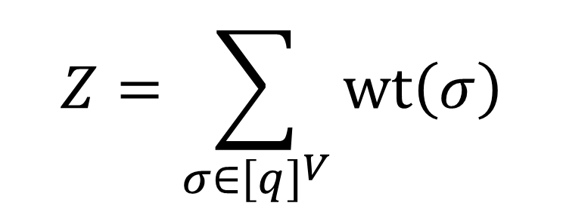
General $q$-spin system
$$Z=\sum_{σ∈{\left[q\right]}^{V}}{wt\left(σ\right)}$$
Problem
$qSpin\left(A,b,Δ\right)$:
Input:
A graph with max degree $≤Δ$.
Output:
Partition function

Slide 41



Beyond hard-core?
To estimate $μ_{v}\left(c\right)$:
Hard-core
1
$ℓ$-boundary on $T_{SAW}$
Choose a proper boundary $S$
2
$Δ^{ℓ}$ vertices
Sample $σ^{S}∼$ correct distribution
3
exact computation
$O\left(Δ^{ℓ}\right)$ exact computing
Compute $μ_{v}^{σ_{S}}\left(c\right)$ as an estimator

Slide 42



Beyond hard-core?
To estimate $μ_{v}\left(c\right)$:
General
1
$ℓ$-boundary on original
Choose a proper boundary $S$
2
$Δ^{ℓ}$ vertices
Sample $σ^{S}∼$ correct distribution
3
exact computation
$O\left(q^{Δ^{ℓ}}\right)$ exact computing
Compute $μ_{v}^{σ_{S}}\left(c\right)$ as an estimator

Slide 43


Beyond hard-core?
“amenable” graph?
To estimate $μ_{v}\left(c\right)$:
General
1
$ℓ$-boundary on original
Choose a proper boundary $S$
2
$O\left(ℓ^{d}\right)$ vertices
Sample $σ^{S}∼$ correct distribution
3
exact computation
$q^{O\left(ℓ^{d}\right)}$ exact computing
Compute $μ_{v}^{σ_{S}}\left(c\right)$ as an estimator

Slide 44












Attempt #1
Choose an $ℓ$-boundary $S$
Polynomial growth:
$O\left(ℓ^{d}\right)$ ball size
One sample of $σ^{S}$:
$${Var}_{σ_{S}}\left(μ_{v}^{σ_{S}}\left(c\right)\right)≤Cr^{−2ℓ}$$
SSM: For any boundary configuration $σ_{S}$ on level $ℓ$,
$$\left|μ_{v}^{σ_{S}}\left(c\right)−μ_{v}\left(c\right)\right|≲r^{−ℓ}$$
Need $nCr^{−2ℓ}$ samples
Total running time:
$$n$$
$$×$$
$$nCr^{−2ℓ}$$
$$q^{{C^{′}ℓ}^{d}}$$
Goal:
$$×$$
$$Var\left(X_{i}\right)≤O\left(1/n\right)$$
$$≈n^{2}r^{−2ℓ}q^{{C^{′}ℓ}^{d}}$$

Slide 45

Attempt #1
Choose an $ℓ$-boundary $S$
Polynomial growth:
$O\left(ℓ^{d}\right)$ ball size
One sample of $σ^{S}$:
$${Var}_{σ_{S}}\left(μ_{v}^{σ_{S}}\left(c\right)\right)≤Cr^{−2ℓ}$$
SSM: For any boundary configuration $σ_{S}$ on level $ℓ$,
$$\left|μ_{v}^{σ_{S}}\left(c\right)−μ_{v}\left(c\right)\right|≲r^{−ℓ}$$
Need $nCr^{−2ℓ}$ samples
#samples $≥$
#possible boundary configurations
Total running time:
$$n$$
$$×$$
$$nCr^{−2ℓ}$$
$$q^{{C^{′}ℓ}^{d}}$$
Goal:
$$×$$
$$Var\left(X_{i}\right)≤O\left(1/n\right)$$
$$≈n^{2}r^{−2ℓ}q^{{C^{′}ℓ}^{d}}$$

Slide 46










Attempt #2
Can we speed up computation?
For all $S$, compute $μ_{v}^{σ_{S}}\left(c\right)$
Takes $q^{{C^{′}ℓ}^{d}}×q^{{C^{′}ℓ}^{d}}$ in total
Polynomial growth:
$O\left(ℓ^{d}\right)$ ball size
Need $nCr^{−2ℓ}$ samples
We can look up in the table
SSM: For any boundary configuration $σ_{S}$ on level $ℓ$,
$$\left|μ_{v}^{σ_{S}}\left(c\right)−μ_{v}\left(c\right)\right|≲r^{−ℓ}$$
Total running time:
$$q^{{2C^{′}ℓ}^{d}}$$
$$n$$
$$+$$
$$×( )$$
$$nCr^{−2ℓ}$$
Goal:
$$nCr^{−2ℓ}ℓ^{d}$$
$$=O\left(\frac{n^{2}}{2^{c{\left(\log{n}\right)}^{1/d}}}\right)$$
$$Var\left(X_{i}\right)≤O\left(1/n\right)$$
$$ℓ←\frac{0.99{\left(\log{n}\right)}^{1/d}}{2C^{′}\log{q}}$$

Slide 47

Attempt #3
[Eppstein’00]
planar graphs
linear local tree-width
[Yin-Zhang’13]
Estimating $μ_{v}^{σ_{S}}\left(c\right)$ costs $2^{O\left(ℓ\right)}poly\left(ℓ\right)$

Slide 48





Attempt #3
For all $S$, compute $μ_{v}^{σ_{S}}\left(c\right)$
Takes $q^{{C^{′}ℓ}^{d}}×2^{O\left(ℓ\right)}poly\left(ℓ\right)$ in total
Polynomial growth:
$O\left(ℓ^{d}\right)$ ball size
Need $nCr^{−2ℓ}$ samples
We can look up in the table
Planar graph
SSM: For any boundary configuration $σ_{S}$ on level $ℓ$,
$$\left|μ_{v}^{σ_{S}}\left(c\right)−μ_{v}\left(c\right)\right|≲r^{−ℓ}$$
Total running time:
$$n$$
$$nCr^{−2ℓ}$$
$$q^{{C^{′}ℓ}^{d}}2^{O\left(ℓ\right)}poly\left(ℓ\right)$$
$$+$$
$$×( )$$
$$ℓ=Ω\left(\log{n}\right)$$

Slide 49




Attempt #3
#boundarys
For all $S$, compute $μ_{v}^{σ_{S}}\left(c\right)$
Takes $q^{{C^{′}ℓ}^{d}}×2^{O\left(ℓ\right)}poly\left(ℓ\right)$ in total
Polynomial growth:
$O\left(ℓ^{d}\right)$ ball size
Need $nCr^{−2ℓ}$ samples
We can look up in the table
Planar graph
SSM: For any boundary configuration $σ_{S}$ on level $ℓ$,
$$\left|μ_{v}^{σ_{S}}\left(c\right)−μ_{v}\left(c\right)\right|≲r^{−ℓ}$$
Total running time:
$$n$$
$$nCr^{−2ℓ}$$
$$q^{O\left(ℓ\right)}2^{O\left(ℓ\right)}poly\left(ℓ\right)$$
$$+$$
$$×( )$$
$$d=1$$
$$=O\left(n^{2−c_{0}}\right)$$
$$ℓ←Θ\left(\log{n}\right)$$

Slide 50




Attempt #3
#boundarys
For all $S$, compute $μ_{v}^{σ_{S}}\left(c\right)$
Takes $q^{C^{′}ℓ}×2^{O\left(ℓ\right)}poly\left(ℓ\right)$ in total
Quadratic growth:
$O\left(ℓ\right)$-size boundary exists
Need $nCr^{−2ℓ}$ samples
We can look up in the table
Planar graph
SSM: For any boundary configuration $σ_{S}$ on level $ℓ$,
$$\left|μ_{v}^{σ_{S}}\left(c\right)−μ_{v}\left(c\right)\right|≲r^{−ℓ}$$
Total running time:
$$n$$
$$nCr^{−2ℓ}$$
$$q^{O\left(ℓ\right)}2^{O\left(ℓ\right)}poly\left(ℓ\right)$$
$$+$$
$$×( )$$
$$=O\left(n^{2−c_{0}}\right)$$
$$ℓ←Θ\left(\log{n}\right)$$

Slide 51




Detour: linear-size boundary
$ℤ^{2}$ grid graph has size-$Θ\left(ℓ\right)$ distance-$ℓ$ boundaries
$ℤ^{2}$ subgraph has size-$Θ\left(ℓ\right)$ distance-$ℓ$ boundaries?
Average argument:
$O\left(ℓ\right)$-size boundary exists
$$v$$

Slide 52
Quadratic-growth planar graphs

Slide 53

Quadratic-growth planar graphs
Theorem (Koebe-Andreev-Thurston)
Any planar graph admits a circle packing.
$$radius ratio ≔\min{radius} / \max{radius}$$
Observation
$∃$ constant radius ratio circle packing
$⇒$ quadratic growth

Slide 54





Tiling lattices
Tiling of , ratio $=1$
Nonexample
Tiling of , ratio $=0.268$
Bethe lattice
(Infinite regular tree)

Slide 55








Lazy-marginal-sampler party-goers
[Anand-Jerrum’22,23]
Non-atomic LLL
[He-Wang-Yin’22]
Random $k$-SAT
[He-Wu-Yang’23]
Derandomising MCMC
[Feng-Guo-Wang-W.-Yin’23]
Sub-quadratic counting
[This work]
… and more?

Slide 56

More concrete problems
Strongly sub-quadratic counting on $ℤ^{d}$ for $d≥3$?
Sub-quadratic counting without SSM (e.g., on hypergraphs)?
Fine-grained inter-reduction between different parameter regimes? $Θ(n^{c})$ algorithm for $λ=Δ^{−k}$ on hard-core model $⟹$ $Θ(n^{c^{′}})$ algorithm for $λ=Δ^{−k^{′}}$ where $c=c(c^{′},k,k^{′})$?

Slide 57
Thank you!
arXiv: 2306.14867

