Slide 1
ECE 382 Lesson 14
Lesson Outline
Polling
Multiplexing
Intro to Logic Analyzer
Debouncing
Software Delay Routines
Admin
Extra Credit badlec5.asm due today

Slide 2
Practice from last time
Modify this program so the two LEDs always have the opposite value
bis.b #BIT0|BIT6, &P1DIR ; output pin direction
bic.b #BIT3, &P1DIR ; input pin direction
bis.b #BIT3, &P1REN ; enable pin 3’s resistor
bis.b #BIT3, &P1OUT ; make it a pull-up? (trick)
check_btn: bit.b #BIT3, &P1IN
jz set_lights
bic.b #BIT0|BIT6, &P1OUT
jmp check_btn
set_lights: bis.b #BIT0|BIT6, &P1OUT
jmp check_btn

Slide 3
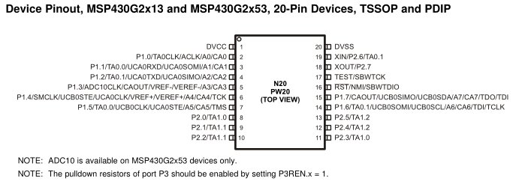
Multiplexing
Only 20 Pins !!! But want access to many more signals
Therefore, each pin shares several signals → multiplexing
Use PxSEL1 and PxSEL2 to select signal for each pin
The details are in the MSP430G2x53 2x13 Mixed Signal MCU Datasheet.
Reference:
Page 43 of Device Specific (BB pp 124)
And/Or Page 333 of Family User Guide (BB pp 41)

Slide 4
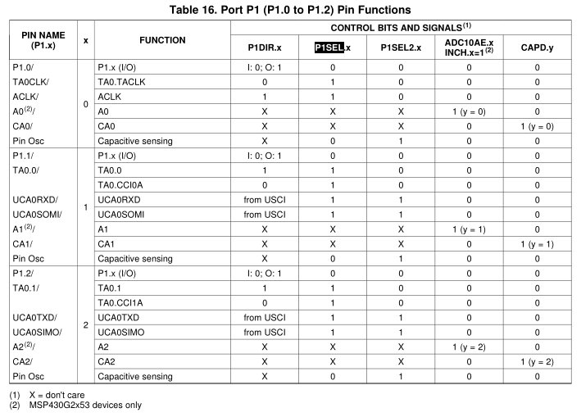
Pitfall !!!
Let's say I wanted to make the UCA0SOMI function available on P1.1:
; 'from USCI' means this bit is set automatically by the USCI when enabled
bis.b #BIT1, P1SEL
bis.b #BIT1, P1SEL2
Reference: Page 43 of Device Specific

Slide 5
Pitfall !!!
Anything wrong with this?
mov.b #0xff, P1DIR
What do these commands do?
mov.b #0b00001111, &P1DIR
bis.b #0b00001111, &P1OUT
mov.b #0xff, &P1OUT
mov.b &P1IN, r5

Slide 6
Interfacing Peripherals to the MCU
What is Polling?
What are Interrupts?
bic.b #BIT3, &P1DIR
bis.b #BIT3, &P1REN
bis.b #BIT3, &P1OUT
poll_button: bit.b #BIT3, &P1IN
jnz poll_button
; Do useful stuff after button press
forever jmp forever

Slide 7
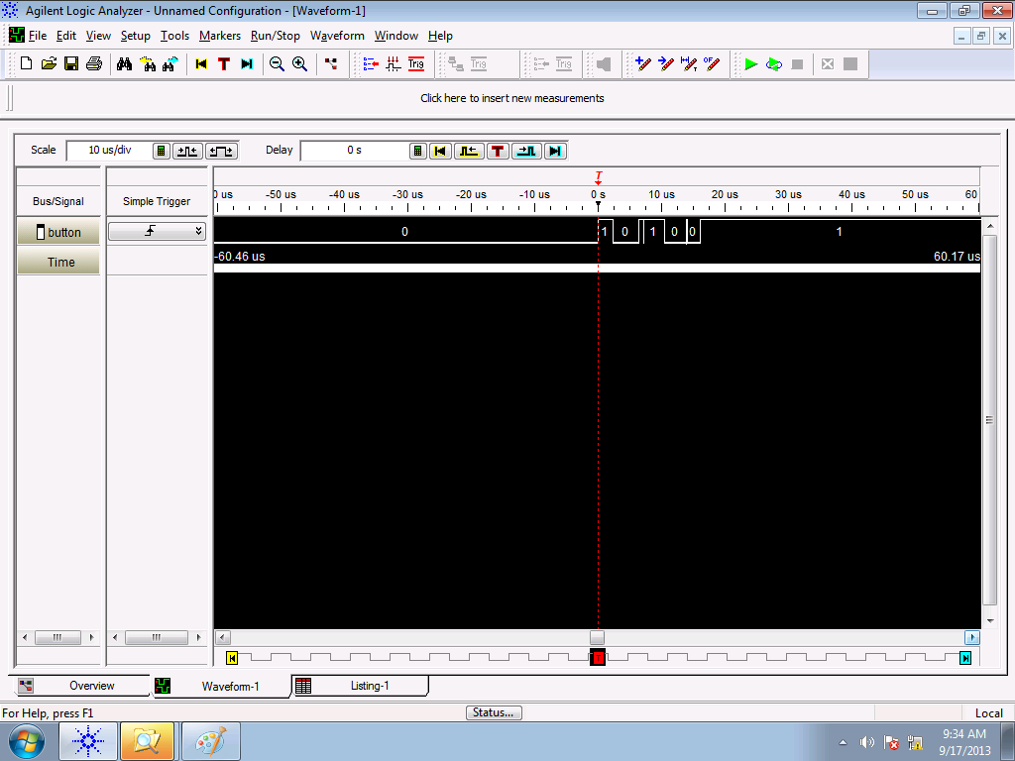
Logic Analyzer
What is the difference between an O’Scope and a Logic Analyzer?
Debouncing?

Slide 8
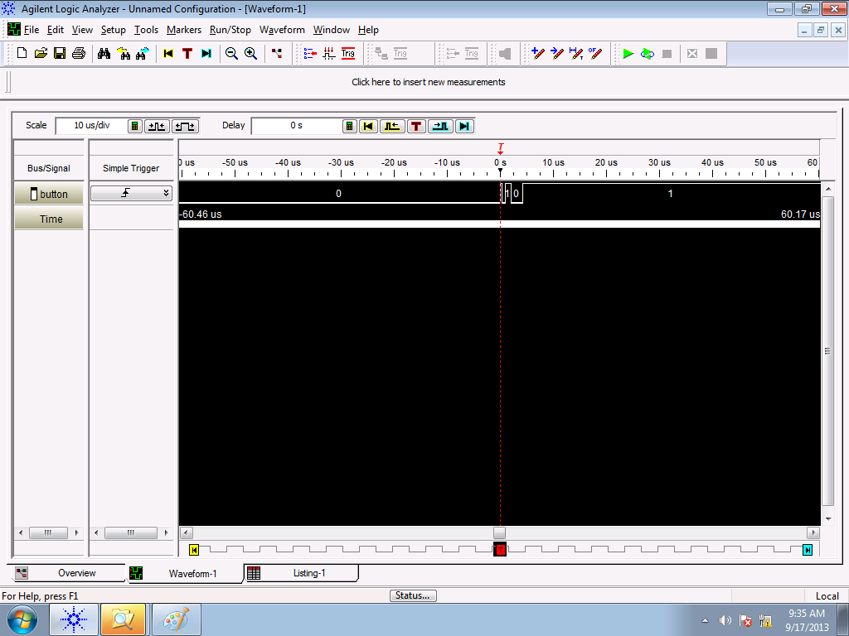
Logic Analyzer
Debouncing: random bounces each time…

Slide 9
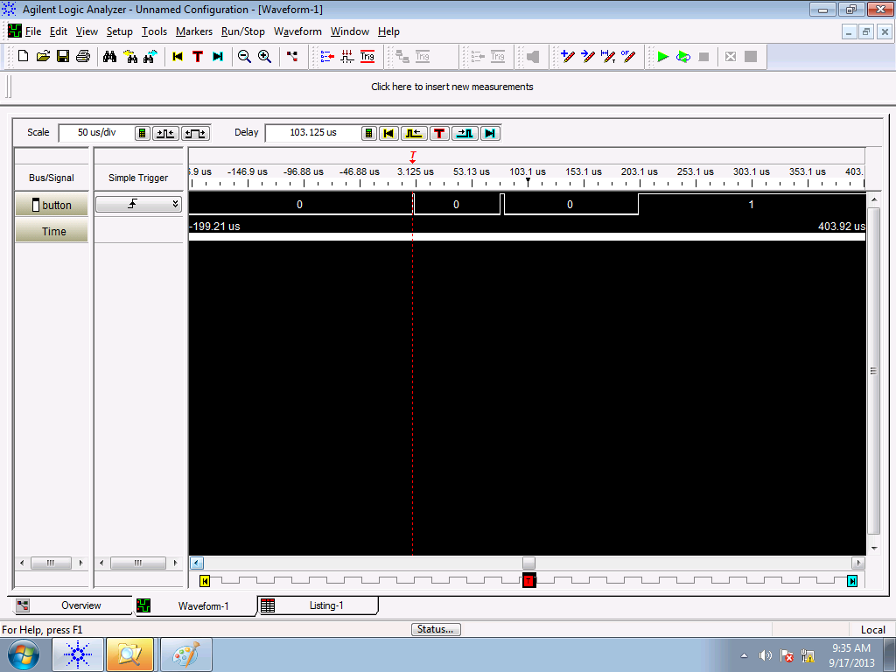

Slide 10
Is bouncing a problem?
bis.b #BIT3, &P1OUT
bis.b #BIT3, &P1REN
bic.b #BIT3, &P1DIR
clr r4
check_btn: bit.b #BIT3, &P1IN
jz btn_pushed
jmp check_btn
btn_pushed: inc r4
wait: bit.b #BIT3, &P1IN
jz wait
inc r4
jmp check_btn

Slide 11
Debouncing Strategies
How can we fix this?

Slide 12
Debouncing Strategies
How can we fix this?
There is hardware debouncing
And there is software debouncing:
Delay until bouncing has stopped
with a Software Delay Routine
or
with a Hardware Counter
Then resume
What are some potential problems with this?

Slide 13
Debouncing Strategies
How can we fix this?
There is hardware debouncing
And there is software debouncing:
Delay until bouncing has stopped
with a Software Delay Routine
or
with a Hardware Counter
Then resume
What are some potential problems with this?
You could delay for too short a period and still be impacted by bouncing.
You could delay for too long a period and miss good button pushes

Slide 14
Example Software Delay Routine
How long is this software delay?
call #software_delay
software_delay:
push r5
mov.w #0xaaaa, r5
delay: dec r5
jnz delay
pop r5
ret
MSP430 Family Users Guide Section 3.4.4, p 60 for cycles per instruction (Blue Book pp 18)
For emulated instructions, use the table on the back of your blue book as a guide. See Sections 3.4.5 – 3.4.6 of the Family users guide for more information.

Slide 15
Emulated Instructions
Emulated Instruction | Assembly Instruction | Notes
NOP | MOV r3, r3 | Any register from r3 to r15 would do the same thing.
POP dst | MOV @SP+, dst
BR dst | MOV dst, PC | BR dst
RET | MOV @SP+, PC | RET
CLRC | BIC #1, SR
SETC | BIS #1, SR
CLRZ | BIC #2, SR
SETZ | BIS #2, SR
CLRN | BIC #4, SR
SETN | BIS #4, SR
DINT | BIC #8, SR
EINT | BIS #8, SR

Slide 16
More Emulated Instructions
Emulated Instruction | Assembly Instruction
RLA(.B) | ADD(.B) dst, dst
RLC(.B) | ADDC(.B) dst, dst
INV(.B) dst | XOR(.B) #-1, dst
CLR(.B) dst | MOV(.B) #0, dst
TST(.B) dst | CMP(.B) #0, dst
DEC(.B) dst | SUB(.B) #1, dst
DECD(.B) dst | SUB(.B) #2, dst
INC(.B) dst | ADD(.B) #1, dst
INCD(.B) dst | ADD(.B) #2, dst
ADC(.B) dst | ADDC(.B) #0, dst
DADC(.B) dst | DADD(.B) #0, dst
SBC(.B) dst | SUBC(.B) #0, dst
:

Slide 17
Example Software Delay Routine
How long is this software delay?
call #software_delay ; 5 cycles
software_delay:
push r5 ; 3 cycles
mov.w #0xaaaa, r5 ; 2 cycles
delay: dec r5 ; 2 cycles?
; no 1 cycle !!!
jnz delay ; 2 cycles
pop r5 ; 2 cycles
ret ; 2 cycles?
; no 3 cycles !!!
5 + 3 + 2 + (0xaaaa * (1 + 2)) + 2 + 3 = 131085 total clock cycles
Only variable is r5… if I change r5 by “one”, how many cycles is this?
(ie., precision of delay?)
So, How long in time is this?

Slide 18
MSP430’s Digitally Controlled Oscillator
MSP430’s Clock = Digitally Controlled Oscillator (DCO)
Advantage: It is tunable. Can run at many different frequencies
Disadvantage: It is an RC oscillator, so can be inaccurate
Default: 1 MHz, with significant variance (0.8MHz - 1.5MHz)
Fix: At the factory, each chip is calibrating with a more accurate quartz crystal resonator. TI stores the proper calibrated values for DCOCTL and BCSCTL1 for 1MHz, 8MHz, 12MHz, and 16MHz in protected memory.
We can measure clock speed (SMCLK) on P1.4

Slide 19
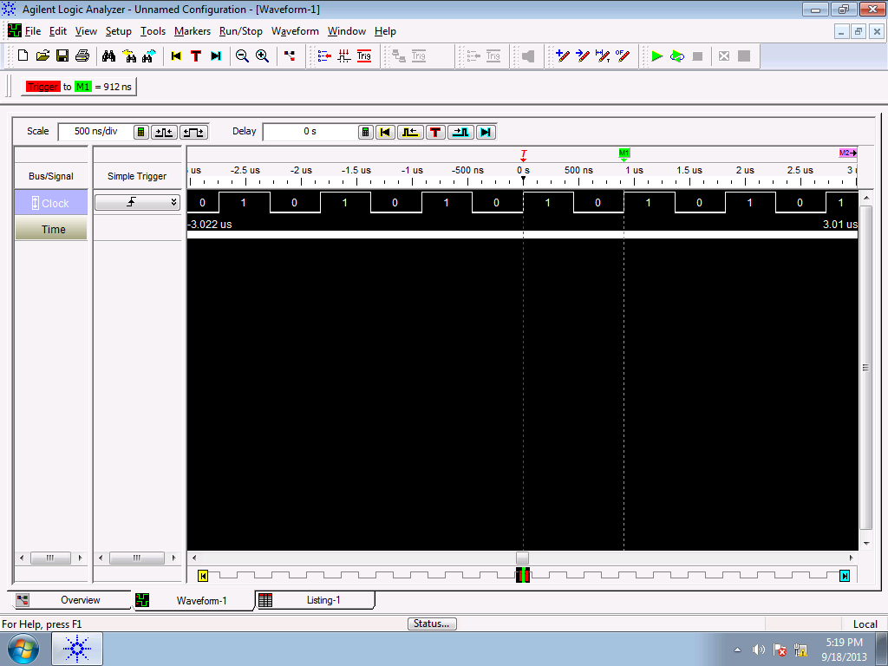
SMCLK
bis.b #BIT4, &P1DIR
bis.b #BIT4, &P1SEL
forever jmp forever
If Clock period is 912ns, how long is
131085 clock cycles?
BB Pg. 126

Slide 20
Measure Software Delay Routine
bis.b #BIT0, &P1DIR
blinkLED: bic.b #BIT0, &P1OUT
call #software_delay
bis.b #BIT0, &P1OUT
call #software_delay
jmp blinkLED
software_delay:
push r5
mov.w #0xaaaa, r5
delay: dec r5
jnz delay
pop r5
ret

Slide 21
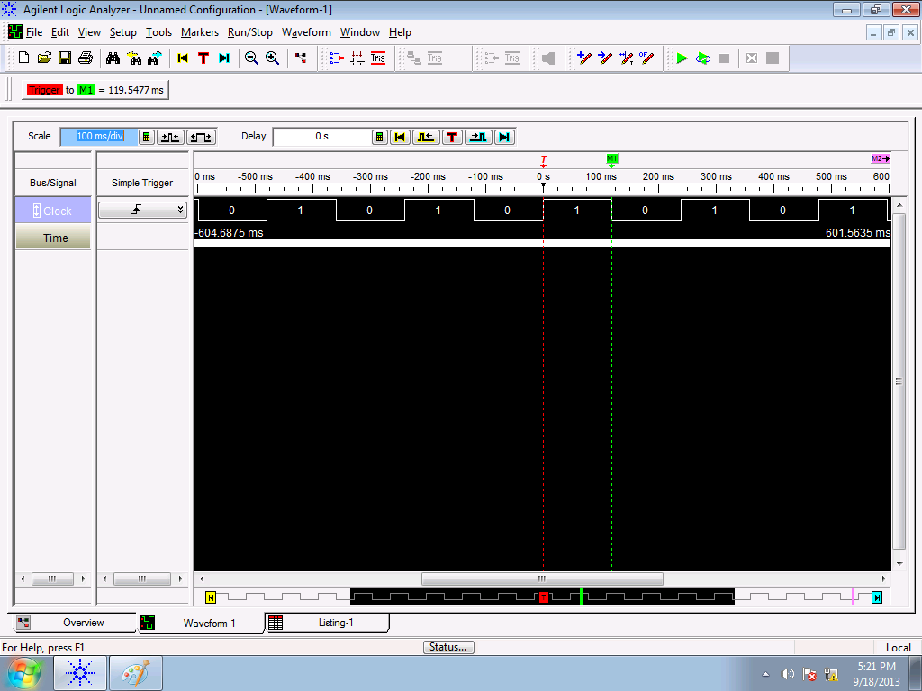
Measure SW delay routine
bis.b #BIT4, &P1DIR
bis.b #BIT4, &P1SEL
forever jmp forever
If Clock period is 912ns, how long is
131085 clock cycles?

Slide 22
Debounced code with SW delay
; Setup P1.3 for button input
bis.b #BIT3, &P1OUT
bis.b #BIT3, &P1REN
bic.b #BIT3, &P1DIR
clr R4 ; BtnCounter
; Increment Btn Counter on Btn press
; A delay is used immediately after the press and release
check_btn: bit.b #BIT3, &P1IN
jnz check_btn
inc R4
call #software_delay
jmp btn_pushed
btn_pushed: bit.b #BIT3, &P1IN
jz btn_pushed
; Btn released
call #software_delay
jmp check_btn

Slide 23
Debounced code with SW delay
; -------------------------------------------
; Software delay
; Purpose: Delays code based on value of R5
; R5 is currently hard coded as 0xAAAA
; -------------------------------------------
software_delay:
push r5
mov.w #0xaaaa, r5
delay: dec r5
jnz delay
pop r5
ret
; End Software delay ---------------------------

