Slide 1
ECE 382 Lesson 15
Lesson Outline
S/W Delays Wrap up
Serial Comm Fundamentals
Serial Peripheral Interface (SPI)
SPI on the MSP430
Lab 3 Introduction
BB-8 in action, Cracking open BB-8
STM32F3
Admin
Lab 3 prelab? (a bit different this time…must be typed, pushed, and printed)

Slide 2
Lab#2 feedback
What is wrong with this subroutine?
Other Issues: pass-by-reference and pass-by-value; using labels to refer to location of the encrypted and decrypted messsages and the key; committing early and often.
Subroutine Header: Which is the best?
Choice A
; Inputs:
; Outputs:
Choice B
; Inputs: r10, r11, r6, r8
; Outputs: r8
decryptMessage:
tst r5
jz forever
mov.b @r7+, r10
call #decryptCharacter
mov.b r10, 0(r9)
inc.w r9
dec.b r5
jmp decryptMessage
ret
Choice C
;Inputs:
r10 length of message
r11 length of key
r6 address location of encrypted message
r8 address location for decrypted message
;Outputs:
RAM [@r8 to @(r8+r11)] decrypted results

Slide 3
Serial Communication
Lab#3: Using Serial port to control LCD Display
Parallel versus Serial?
Serial Advantages?
Serial Disadvantages?

Slide 4
Serial Communication
Lab#3: Using Serial port to control LCD Display
Parallel versus Serial?
Serial Advantages?
Simple interface – less hardware, less pins, less cost
Faster clock speed per wire (no “cross-talk”)
Longer Distance (no “cross-talk”)
Serial Disadvantages?
Slower
Overhead
On-chip hardware to encode/decode serial signal

Slide 5
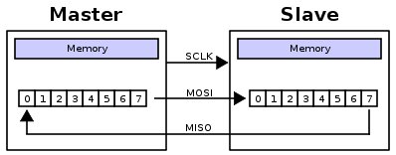
Serial Peripheral Interface (SPI)
Simple: with each clock cycle, a single bit is transferred from the MSB of one shift register to the other
Is this a half-duplex or full-duplex protocol?
Synchronous or Asynchronous protocol?
How many clocks cycles to transfer a byte?
Signals
MOSI: Master Out Slave In
MISO: Master In Slave Out
SCLK: Clock
SS: Slave Select
TI renamed these:
MOSI = SIMO
MISO = SOMI

Slide 6
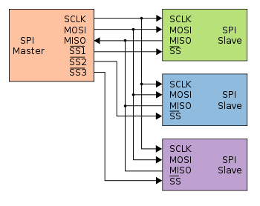

Serial Peripheral Interface (SPI)
Slave Select signal allows the master to potentially use the same interface to potentially interact with multiple slaves. It's usually active low

Slide 7
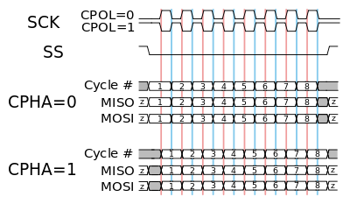
Serial Peripheral Interface (SPI)
Page 35 of LCD Driver
Can we just tie SS low?
Configurable Elements:
Clock frequency
Clock polarity
Clock phase
On the MSP430:
MSB first or LSB first
you'll pretty much always want MSB first, which isn't the default
8-bits or 7-bits per transmission
7-bits is justified toward the LSB
3-pin or 4-pin modes
Control Register: Page 445 of the Family User Guide (Blue book pp 73)
SPI: Page 436 of the Family User Guide (Blue book pp 69)

Slide 8
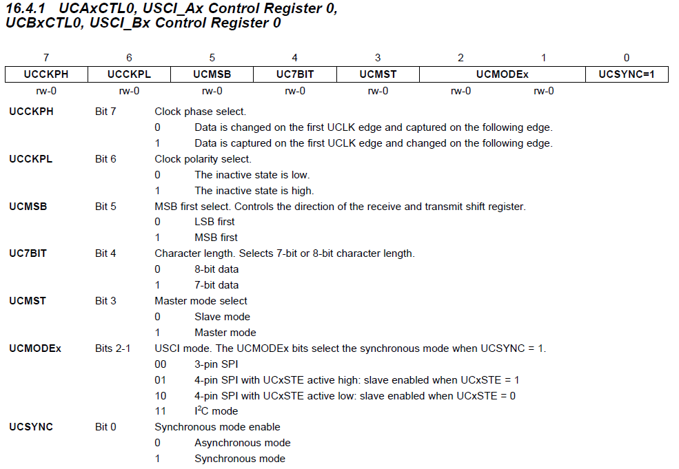
UCA/B Control Register 0
Control Register: Page 445 of the Family User Guide (Blue book pp 73)

Slide 9
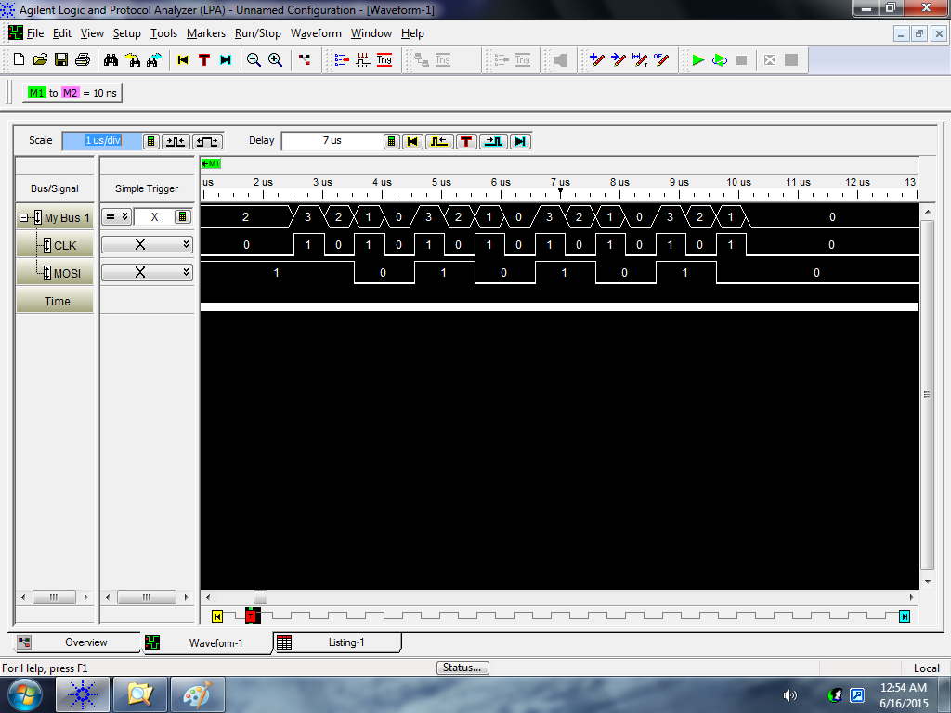
Phase = 0 and Polarity = 0
Change
Capture
Input = 0xAA
bis.b #UCMSB|UCMST|UCSYNC, &UCA0CTL0 ; UCCKPH = 0, UCCKPL = 0

Slide 10
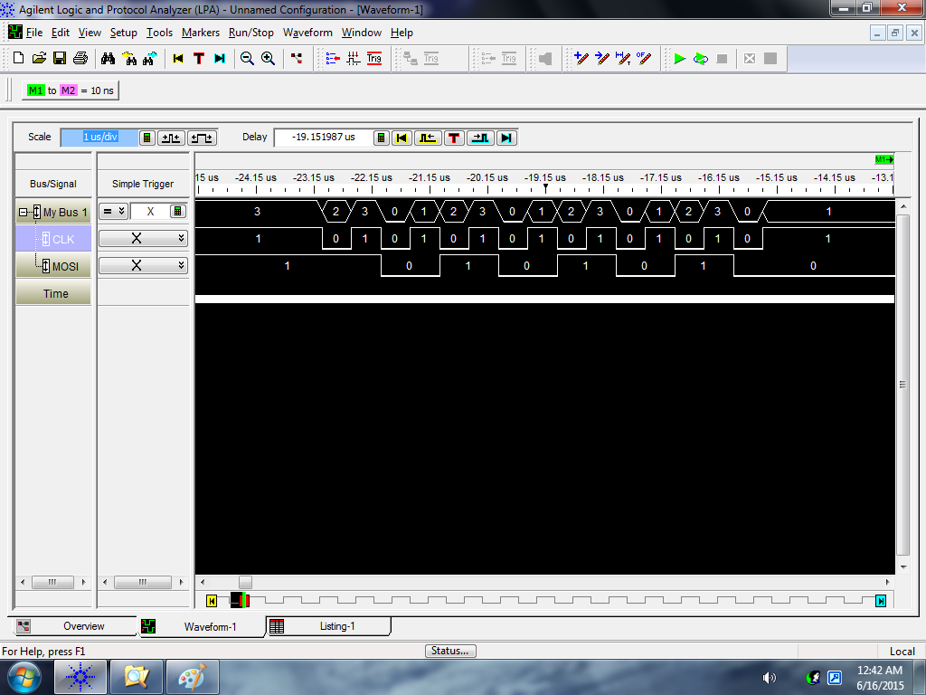
Phase = 0 and Polarity = 1
Change
Capture
Input = 0xAA
bis.b #UCCKPL|UCMSB|UCMST|UCSYNC, &UCA0CTL0 ; UCCKPH = 0, UCCKPL = 1

Slide 11

Phase = 1 and Polarity = 0
Change
Capture
Input = 0xAA
bis.b #UCCKPH|UCMSB|UCMST|UCSYNC, &UCA0CTL0 ; UCCKPH = 1, UCCKPL = 0

Slide 12
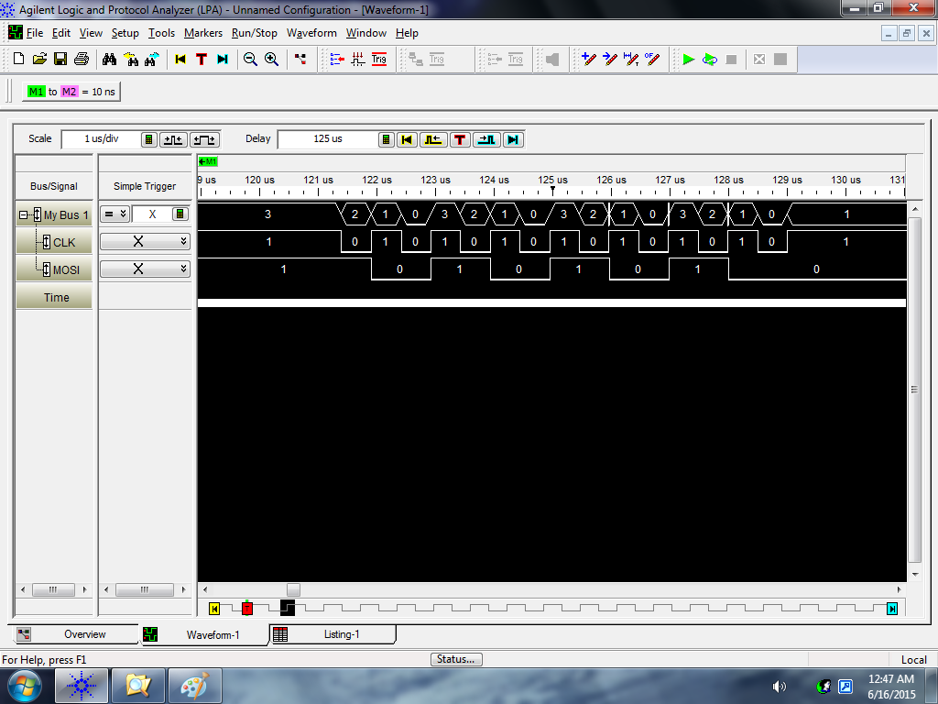
Phase = 1 and Polarity = 1
Change
Capture
Input = 0xAA
bis.b #UCCKPH|UCCKPL|UCMSB|UCMST|UCSYNC, &UCA0CTL0 ; UCCKPH = 1, UCCKPL = 1

Slide 13
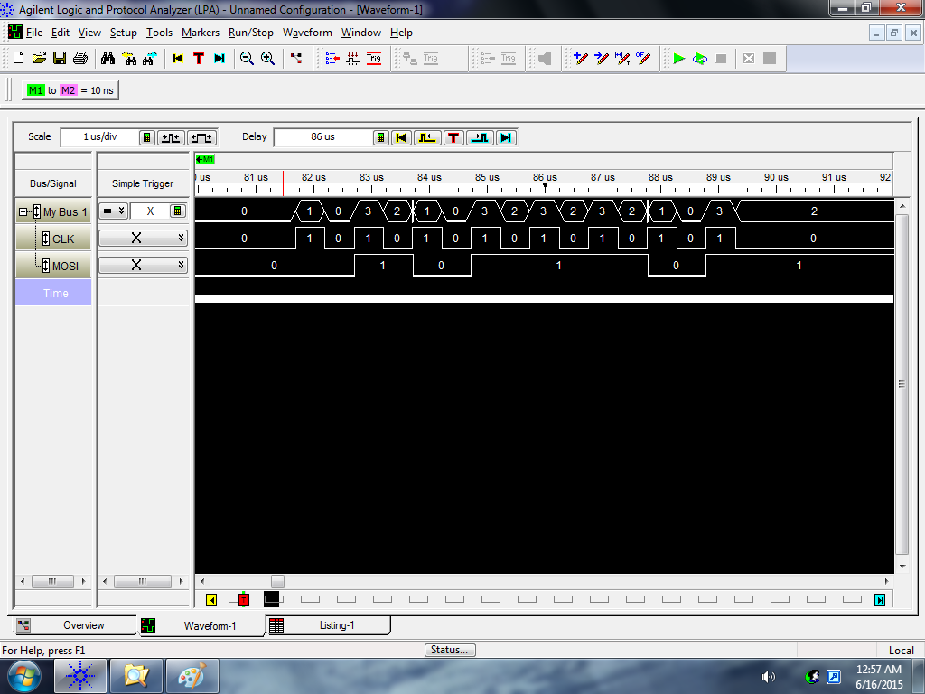
Phase = 0 and Polarity = 0
Change
Capture
Input = 0x5D
bis.b #UCMSB|UCMST|UCSYNC, &UCA0CTL0 ; UCCKPH = 0, UCCKPL = 0

Slide 14
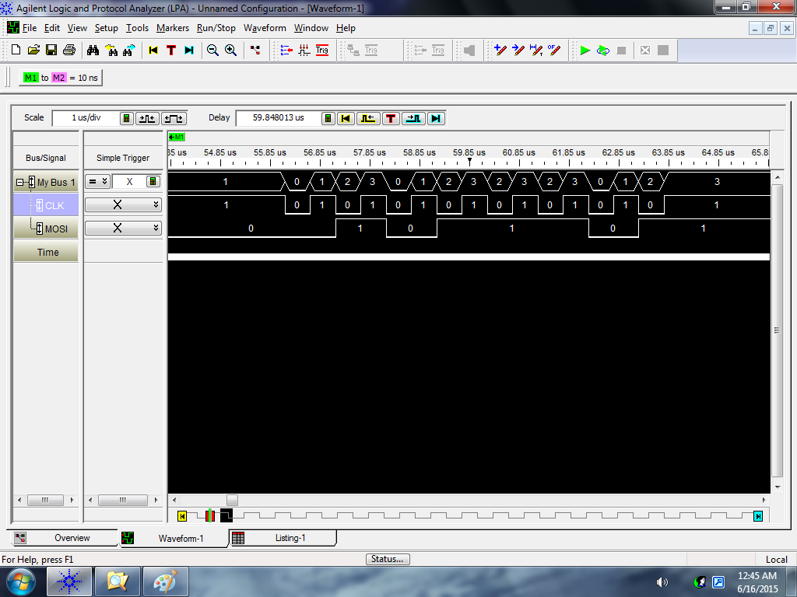
Phase = 0 and Polarity = 1
Change
Capture
Input = 0x5D
bis.b #UCCKPL|UCMSB|UCMST|UCSYNC, &UCA0CTL0 ; UCCKPH = 0, UCCKPL = 1

Slide 15
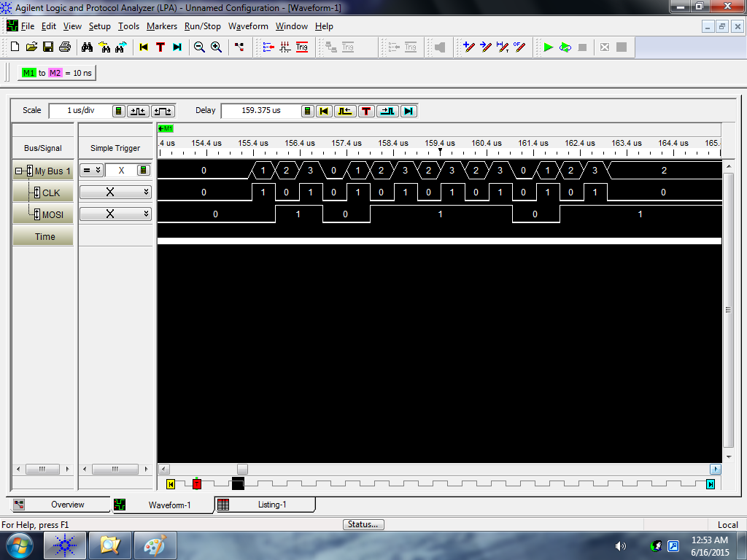
Phase = 1 and Polarity = 0
Change
Capture
Input = 0x5D
bis.b #UCCKPH|UCMSB|UCMST|UCSYNC, &UCA0CTL0 ; UCCKPH = 1, UCCKPL = 0

Slide 16

Phase = 1 and Polarity = 1
Change
Capture
Input = 0x5D
bis.b #UCCKPH|UCCKPL|UCMSB|UCMST|UCSYNC, &UCA0CTL0 ; UCCKPH = 1, UCCKPL = 1

Slide 17
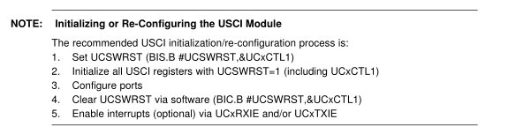
Universal Serial Communication Interface (USCI)
On the MSP430:
Two Universal Serial Communication Interfaces (USCI), A and B
Can do multiple protocols (one is SPI), defined by configuration registers
UCA0 and UCB0
datasheet - control registers (pp 435-448)
Page 436 or 452 of the Family User Guide (Blue book pp 69 or 76)

Slide 18
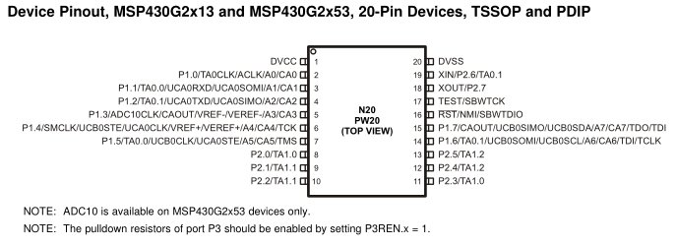
Universal Serial Communication Interface (USCI)
i.e (SW reset)
Step 1
Setting the UCSWRST bit in the CTL1 register [16.4.2] resets the subsystem into a known state until it is cleared. All the registers will hold their default values.
Step 2
Set the appropriate bits in the control registers to configure our signal the way we want.
Remember, you've got to set UCSYNC for the system to function!
CTL0 [bit 7 phase; bit 6 polarity; bit 3 master/slave; bit 0 UCSYNC = 1 ] [16.4.1]
CTL1 [bit 7&6 clock; bit 0 UCSWRST][16.4.2]
UCBRx [clock speed] [16.4.3 & 16.4.4]
STAT [16.4.5]
Step 3
All the ports on our MSP430 are multiplexed! We need to set the PxSEL and PxSEL2
Step 4
Clear the UCSWRST bit in the CTL1 register - releases the system to operate.
pp 437 for Block Diagram

Slide 19
Example SPI Setup for Lab 3
1) bis.b #UCSWRST, &UCB0CTL1
2) mov #UCCKPH|UCMSB|UCMST|UCSYNC, &UCB0CTL0
bis #UCSSEL_2, &UCB0CTL1
bis #BIT0, &UCB0BR0
clr &UCB0BR1
3) bis #LCD_SCLK_PIN|LCD_MOSI_PIN|LCD_MISO_PIN, &P1SEL
bis #LCD_SCLK_PIN|LCD_MOSI_PIN|LCD_MISO_PIN, &P1SEL2
4) bic.b #UCSWRST, &UCB0CTL1

Slide 20
Universal Serial Communication Interface (USCI)
Step 5
Use the subsystem!
To send a byte, just write to the TXBUF register. [16.4.6]
To read a received byte, read from the RXBUF register. [16.4.7]
How do you know “you’ve got mail” or last transmission is done?
You've got to monitor the flags in the IFG2 register [16.4.9] to know when it's safe the send
TXIFG
Set when TXBUF is ready for a byte
Cleared on write
Just because the TXBUF is ready for another byte doesn't mean that the transmission is complete! It's double-buffered!
RXIFG
Set when RXBUF has received a complete character
Cleared on read
This is what you should monitor to determine a transmission has completed!

Slide 21
Example (loopback)
bis.b #UCSWRST, &UCA0CTL1
bis.b #UCCKPL|UCMSB|UCMST|UCSYNC, &UCA0CTL0 ; don't forget UCSYNC!
bis.b #UCSSEL1, &UCA0CTL1 ; select a clock to use!
bis.b #UCLISTEN, &UCA0STAT ; enables internal loopback
bis.b #BIT4, &P1SEL ; make UCA0CLK available on P1.4
bis.b #BIT4, &P1SEL2
bis.b #BIT2, &P1SEL ; make UCA0SSIMO available on P1.2
bis.b #BIT2, &P1SEL2
bis.b #BIT1, &P1SEL ; make UCA0SSOMI available on P1.1
bis.b #BIT1, &P1SEL2
bic.b #UCSWRST, &UCA0CTL1 ; enable subsystem
send mov.b #0xBB, &UCA0TXBUF ; place a byte in the TX buffer
wait bit.b #UCA0RXIFG, &IFG2 ; wait for receive flag to be set (operation complete)
jz wait
mov.b &UCA0RXBUF, r4 ; read RX buffer to clear flag
jmp send ; send another byte

Slide 22
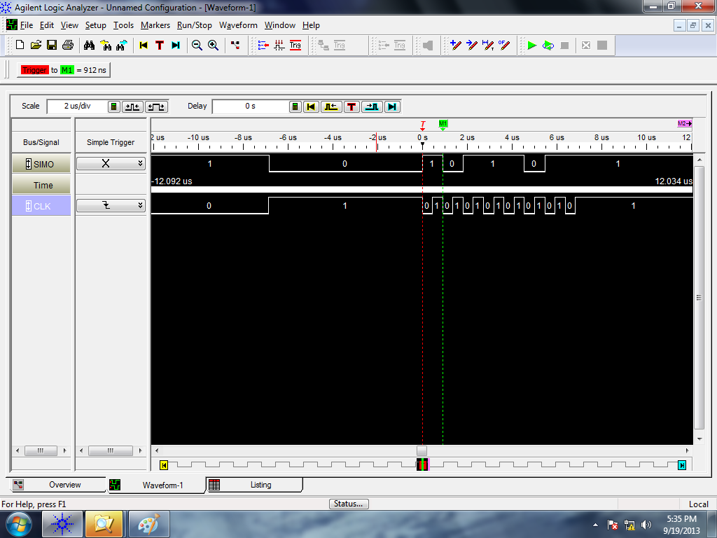
Logic Analyzer
Sending 0xBB once (0x1011 1011) [MSB first!]
Note how the clock default state is high and data is read on the second clock edge - consistent with our settings.

Slide 23
Lab3
http://ece.ninja/382/labs/lab3/index.html

