Slide 1
ECE 382 Lesson 32
Lesson Outline
GR 2 Hot Wash
Lab 6 Introduction
Pulse Width Modulation
Capture / Compare
Example
Lab 6 Tips
Admin
Lab#6 “prelab” due BOC lesson 33
Note ***Includes Schematic and Flowgraph!

Slide 2
Lab#6: Robot Motion
Prelab:
Answers to questions
Hardware Schematic
Software Design (flowchart and/or pseudo-code)
Basic Functionality:
Move the Robot Forward, Reverse, Left, Right (small and large turn) (no USB cord)
Remote Functionality:
Move the Robot Forward, Reverse, Left, Right using the IR remote control

Slide 3
Using DC Motors
How do DC motors work? How do you make them go faster?

Slide 4
Using DC Motors
How do DC motors work? How do you make them go faster?
Provide analog DC voltage… The higher the voltage, the faster it spins
[ motor demo ]

Slide 5
Using DC Motors
How do DC motors work? How do you make them go faster?
Provide analog DC voltage… The higher the voltage, the faster it spins
[ motor demo ]
How to we control a DC motor with the MSP430 ?
Can we use the ADC converter?

Slide 6
Using DC Motors
How do DC motors work? How do you make them go faster?
Provide analog DC voltage… The higher the voltage, the faster it spins
[ motor demo ]
How to we control a DC motor with the MSP430 ?
Can we use the ADC converter?
Two issues interfacing MSP430 with a DC motor?

Slide 7
Using DC Motors
How do DC motors work? How do you make them go faster?
Provide analog DC voltage… The higher the voltage, the faster it spins
[ motor demo ]
How to we control a DC motor with the MSP430 ?
Can we use the ADC converter?
Two issues interfacing MSP430 with a DC motor?
MSP430 only produces two voltages (Vcc and Gnd)
Solution?.

Slide 8
Using DC Motors
How do DC motors work? How do you make them go faster?
Provide analog DC voltage… The higher the voltage, the faster it spins
[ motor demo ]
How to we control a DC motor with the MSP430 ?
Can we use the ADC converter?
Two issues interfacing MSP430 with a DC motor?
MSP430 only produces two voltages (Vcc and Gnd)
Solution? PWM- pulse width modulation (remember this?)
[PWM demos]

Slide 9
PWM Setup Tasks
Set I/O direction for output
MUX PWM
Set period
Set on time
Enable PWM mode on timer
Config / Start timer

Slide 10
Using DC Motors
How do DC motors work? How do you make them go faster?
Provide analog DC voltage… The higher the voltage, the faster it spins
[ motor demo ]
How to we control a DC motor with the MSP430 ?
Can we use the ADC converter?
Two issues interfacing MSP430 with a DC motor?
MSP430 only produces two voltages (Vcc and Gnd)
Solution? PWM- pulse width modulation (remember this?)
MSP430 does not source enough current to power the motors (blow the chip)

Slide 11
Using DC Motors
How do DC motors work? How do you make them go faster?
Provide analog DC voltage… The higher the voltage, the faster it spins
[ motor demo ]
How to we control a DC motor with the MSP430 ?
Can we use the ADC converter?
Two issues interfacing MSP430 with a DC motor?
MSP430 only produces two voltages (Vcc and Gnd)
Solution? PWM- pulse width modulation (remember this?)
MSP430 does not source enough current to power the motors (blow the chip)
Solution?

Slide 12
Using DC Motors
How do DC motors work? How do you make them go faster?
Provide analog DC voltage… The higher the voltage, the faster it spins
[ motor demo ]
How to we control a DC motor with the MSP430 ?
Can we use the ADC converter?
Two issues interfacing MSP430 with a DC motor?
MSP430 only produces two voltages (Vcc and Gnd)
Solution? PWM- pulse width modulation (remember this?)
MSP430 does not source enough current to power the motors (blow the chip)
Solution? Motor driver chip (SN754410)
MSP430 Timer system helps
Input Capture: Monitor a pin for a specified signal (rising edge, falling edge, either edge) and record when it occurs. → Ultrasonic sensor
Output Compare: Generate a specified signal with precise timing. (can make a PWM signal) → drive motors, servos
Do Not Exceed the 1A current rating (i.e. ~60% Duty Cycle)

Slide 13
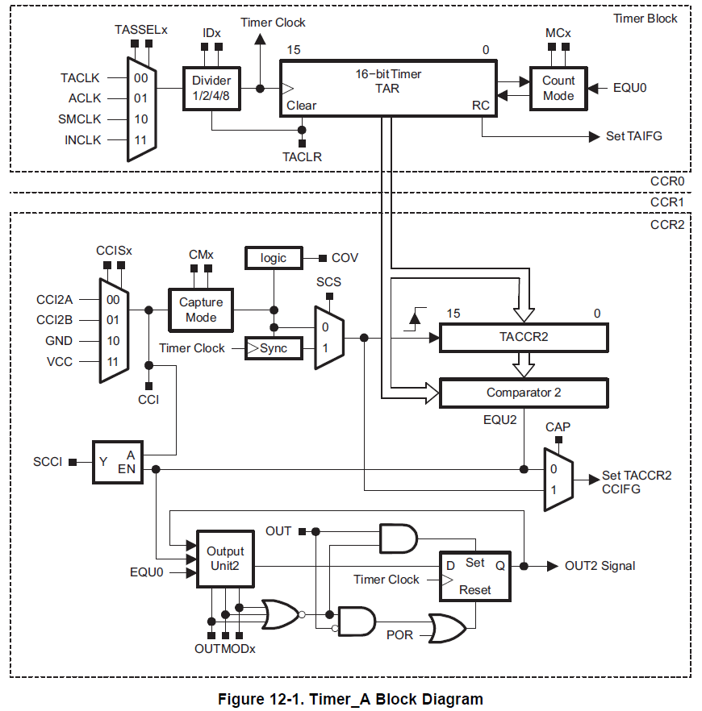
Timer Block Diagram
1
2
3
0
clks
cnts
Capture / Compare
4
5
Family User Guide pp 357
Blue Book pp 46

Slide 14
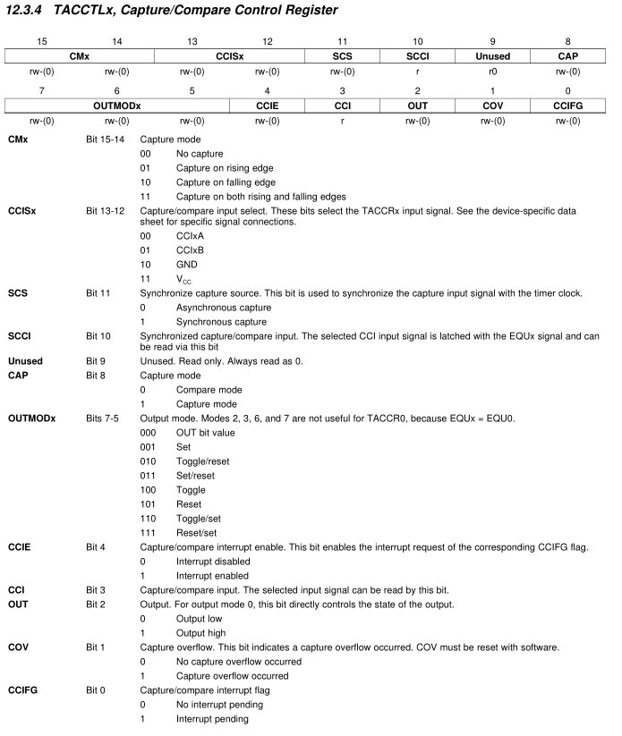
Backup Slides
Family User Guide pp 372
Blue Book pp 53

Slide 15
Timer Block Diagram
CAP
Family User Guide pp 357
Blue Book pp 46

Slide 16
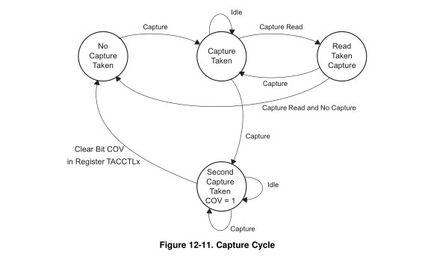
Input Capture
Capture mode is selected when the CAP bit in TACCTL is set to 1. It's used to record time events. It can be used for:
Event detection
Event counting
Pulse-width measurement ***
Frequency measurement
Each TACCRx has two possible capture pins - CCIxA and CCIxB. The one being monitored is selectable by software.
If a capture occurs: - The TAR value is copied into the TACCRx register - The interrupt flag CCIFG is set
Family User Guide pp 363
Blue Book pp 49

Slide 17
Backup Slides
Family User Guide pp 372
Blue Book pp 53

Slide 18
Timer Block Diagram
CCISx
CMx
SCS
CCIFG
Family User Guide pp 357
Blue Book pp 46

Slide 19
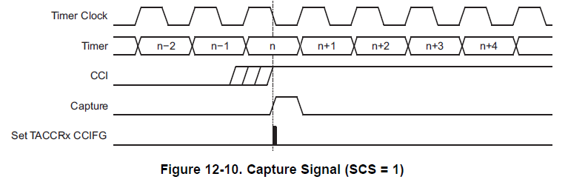
Input Capture
The input signal level can be read at any time via the CCI bit. MSP430x2xx family devices may have different signals connected to CCIxA and CCIxB. See the device-specific data sheet for the connections of these signals.
Family User Guide pp 362
Blue Book pp 48

Slide 20
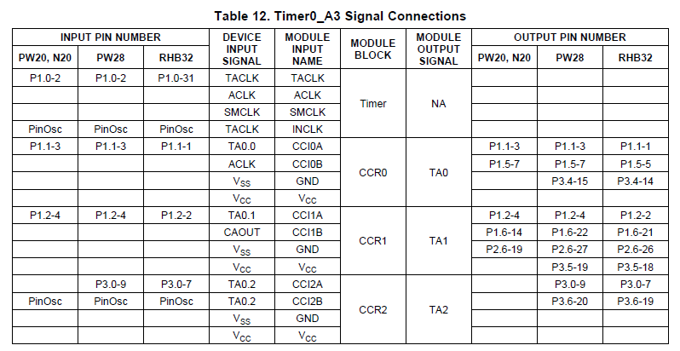
Input Capture
The input signal level can be read at any time via the CCI bit. MSP430x2xx family devices may have different signals connected to CCIxA and CCIxB. See the device-specific data sheet for the connections of these signals.
Device Specific pp 16
Blue Book pp 112

Slide 21
Backup Slides
Family User Guide pp 372
Blue Book pp 53

Slide 22
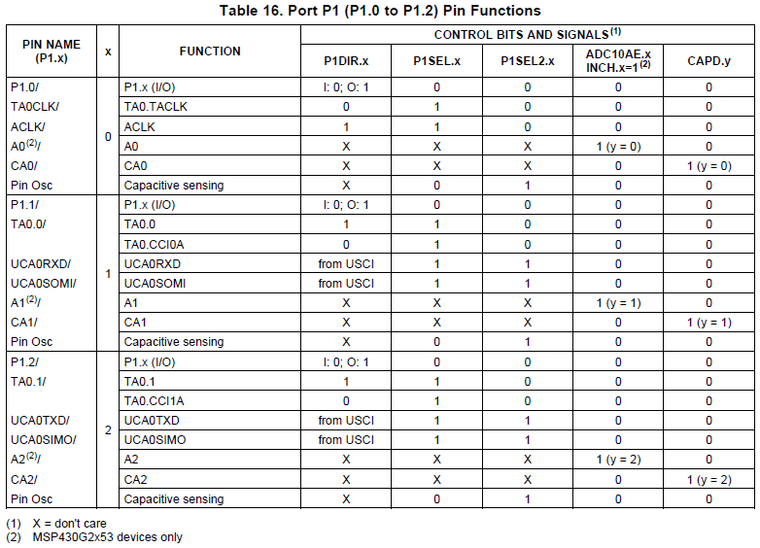
Input Capture
Device Specific pp 43
Blue Book pp 124

Slide 23
PWM Setup Tasks
Set I/O direction for output
MUX PWM
Set period
Set on time
Enable PWM mode on timer
Config / Start timer

Slide 24
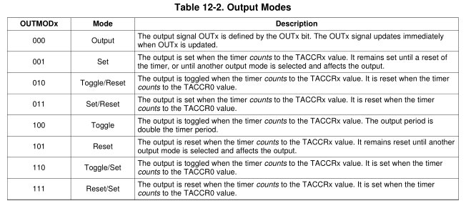
Output Compare
Compare mode is selected when the CAP bit in TACCTL is set to 0
Same Timer Modes: MCx
Count up to TACCRO. Now adding two new registers: TA0CCR1 and TA0CCR2
Mcx | Mode | Description
00 | Stop | The timer is halted. MC_0
01 | Up | The timer repeatedly counts from zero to the value of TACCR0. MC_1
10 | Continuous | The timer repeatedly counts from zero to 0FFFFh. MC_2
11 | Up/down | The timer repeatedly counts from zero up to the value of TACCR0 and back down to zero. MC_3

Slide 25
Timer Block Diagram
CCR0-2
Family User Guide pp 357
Blue Book pp 46

Slide 26
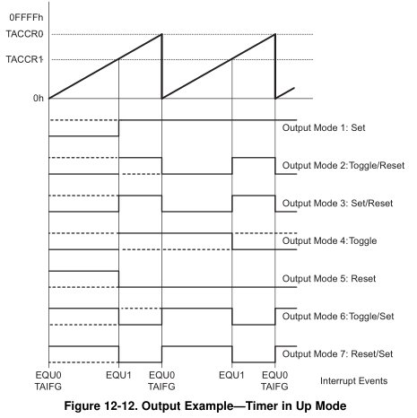
Output Compare
You will likely use mode 3 & 7 for PWM

Slide 27
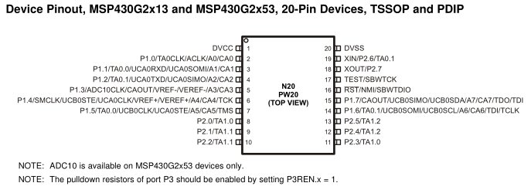
Ports?
Pin 3 TA0.0 P1.1
Pin 4 TA0.1 P1.2
Pin 8 TA1.0 P2.0
Pin 9 TA1.1 P2.1

Slide 28
PWM Setup Tasks
Set I/O direction for output
MUX PWM
Set period
Set on time
Enable PWM mode on timer
Config / Start timer
PxDIR
PxSEL, PxSEL2
TAxCCRx
TAxCCTLx
TAxCTL

Slide 29
Example
#include <msp430.h>
int main(void)
{
WDTCTL = WDTPW|WDTHOLD; // stop the watchdog timer
P1DIR |= BIT2; // TA0CCR1 on P1.2
P1SEL |= BIT2; // TA0CCR1 on P1.2
TA0CTL &= ~MC1|MC0; // stop timer A0
TA0CTL |= TACLR; // clear timer A0
TA0CTL |= TASSEL1; // configure for SMCLK
TA0CCR0 = 100; // set signal period to 100 clock cycles (~100 microseconds)
TA0CCR1 = 25; // set duty cycle to 25/100 (25%)
TA0CCTL1 |= OUTMOD_7; // set TACCTL1 to Reset / Set mode
TA0CTL |= MC0; // count up
while (1) {
__delay_cycles(1000000);
TA0CCR1 = 50; // set duty cycle to 50/100 (50%)
__delay_cycles(1000000);
TA0CCR1 = 75; // set duty cycle to 75/100 (75%)
__delay_cycles(1000000);
TA0CCR1 = 100; // set duty cycle to 100/100 (100%)
__delay_cycles(1000000);
TA0CCR1 = 25; // set duty cycle to 25/100 (25%)
}
return 0;
}

Slide 30
Example with Interrupt
#include <msp430.h>
void main(void)
{
WDTCTL = WDTPW|WDTHOLD;// stop the watchdog timer
P2DIR |= BIT1; // TA1CCR1 on P2.1
P2SEL |= BIT1; // TA1CCR1 on P2.1
P2OUT &= ~BIT1;
TA1CTL |= TASSEL_2|MC_1|ID_0; // configure for SMCLK
P1DIR |= BIT0; //use LED to indicate duty cycle has toggled
P1REN |= BIT3;
P1OUT |= BIT3;
TA1CCR0 = 1000; // set signal period to 1000 clock cycles (~1 millisecond)
TA1CCR1 = 250; // set duty cycle to 250/1000 (25%)
TA1CCTL0 |= CCIE; // enable CC interrupts
TA1CCTL1 |= OUTMOD_7|CCIE; // set TACCTL1 to Set / Reset mode//enable CC interrupts
TA1CCTL1 &= ~CCIFG; //clear capture compare interrupt flag
_enable_interrupt();
while (1) {
while (P1IN & BIT3); //every time the button is pushed, toggle the duty cycle
__delay_cycles(1000000);
TA1CCR1 = 1000; // set duty cycle to 1000/1000 (100%)
while (P1IN & BIT3);
__delay_cycles(1000000);
TA1CCR1 = 750; // set duty cycle to 750/1000 (75%)
while (P1IN & BIT3);
__delay_cycles(1000000);
TA1CCR1 = 500; // set duty cycle to 500/1000 (50%)
while (P1IN & BIT3);
__delay_cycles(1000000);
TA1CCR1 = 250; // set duty cycle to 250/1000 (25%)
while (P1IN & BIT3);
__delay_cycles(1000000);
TA1CCR1 = 100; // set duty cycle to 100/1000 (10%)
while (P1IN & BIT3);
__delay_cycles(1000000);
TA1CCR1 = 20; // set duty cycle to 20/1000 (2%)
}
}
#pragma vector = TIMER1_A0_VECTOR // This is from the MSP430G2553.h file
__interrupt void captureCompareInt (void) {
P1OUT |= BIT0; //Turn on LED
// Disable Timer A Interrupt
TA1CCTL1 &= ~CCIFG; //clear capture compare interrupt flag
// TACTL &= ~TAIFG;
}
#pragma vector = TIMER1_A1_VECTOR // This is from the MSP430G2553.h file
__interrupt void captureCompareInt2 (void) {
P1OUT &= ~BIT0; //Turn off LED
// Disable Timer A Interrupt
TA1CCTL1 &= ~CCIFG; //clear capture compare interrupt flag
// TACTL &= ~TAIFG;
}

Slide 31
Lab Tips
Drives like a tank? How do you turn?
Motor Driver Chip
You cannot hook your MSP430 directly up to the motors - it can't supply enough current! We need to use a motor driver chip instead. It can only supply 1A per circuit! Do not exceed that! Check out the datasheet for wiring details.
http://ece.ninja/382/datasheets/SN754410.pdf
Motor Stall Current
This is the max current draw your motor might have - usually happens when it runs up against the wall or something. This better not exceed the 1A your motor driver chip can supply or you'll burn it!
[Show technique to measure stall current]
On my robot, the stall current does not go below one amp until my motor is being driven at 8V or less - roughly 60% duty cycle. Exceed this at your own risk!

Slide 32
Lab Tips
Robot Guidance and Troubleshooting
http://ece.ninja/382/datasheets/robot_guide.html
MSP430 In-Circuit
Supplying Power
We have 3.3V regulators! Use them! If you try to give 5V to your MSP430, you will fry it! Check out the datasheet for wiring details.
http://ece.ninja/382/datasheets/LD1117V33.pdf
Wiring it up
http://ece.ninja/382/datasheets/robot.html
Programming
See the tutorial on the website! You can just jump the VCC / TEST / RESET signal over to the chip on the breadboard.
http://ece.ninja/382/datasheets/in_circuit_programming.html
http://ece.ninja/382/datasheets/standalone.html
Chip Reset Due to Current Fluctuation
If the motors draw a large amount of current (due to stall), there is a good chance it will interfere with the current provided to your MSP430. To combat this, you can put a large capacitor across the 5V rail (between power and ground). This will supplement the lost current and prevent your chip from being reset.

Slide 33
Lab Details
http://ece.ninja/382/labs/lab6/index.html

Slide 34
Backup slides

Slide 35
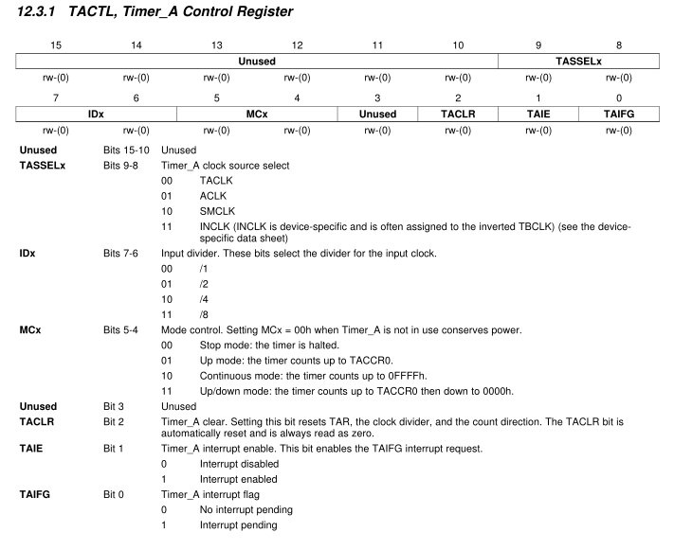
Timer (p 355 User’s Guide)

Slide 36
Multiplexing
Only 20 Pins !!! But want access to many more signals
Therefore, each pin shares several signals → multiplexing
Use PxSEL1 and PxSEL2 to select signal for each pin
The details are in the MSP430G2x53 2x13 Mixed Signal MCU Datasheet.

Slide 37
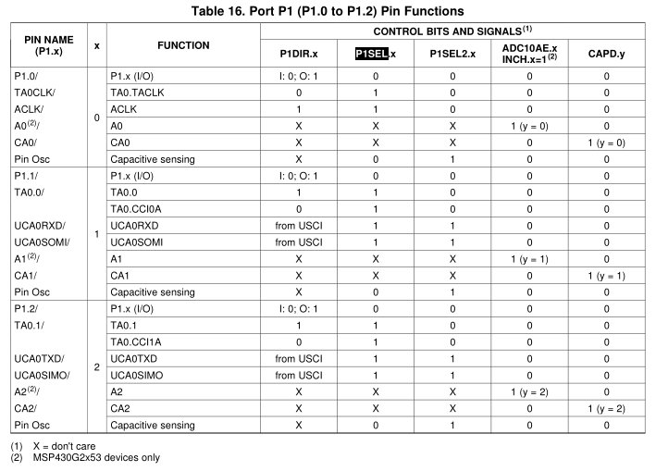
Pitfall !!!

Slide 38
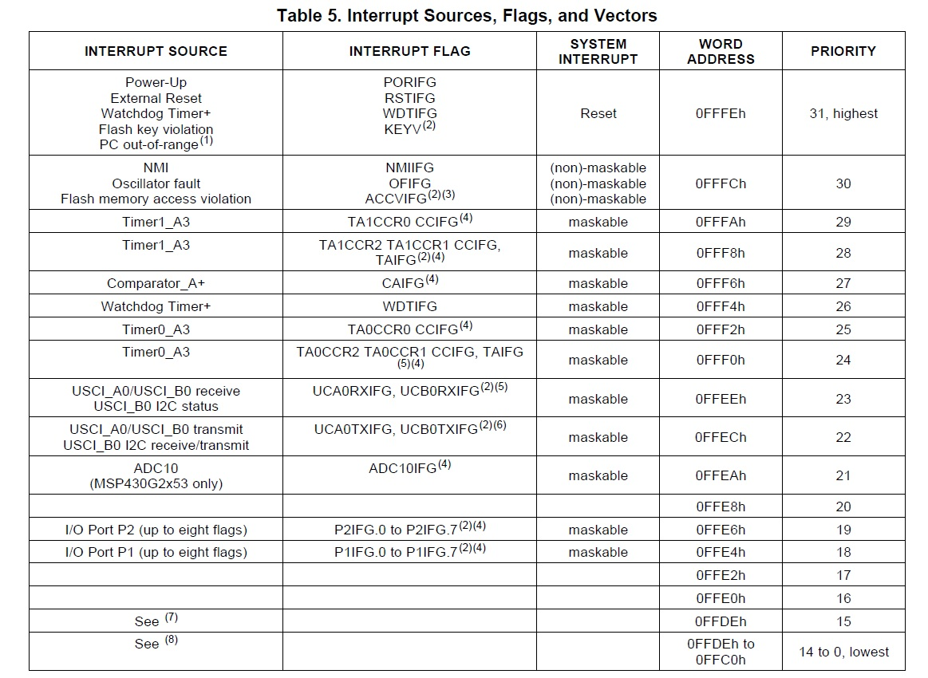

Slide 39
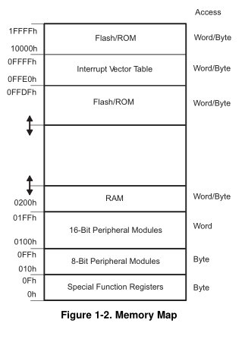
Interrupt Vector Table

