Slide 1

Exploring Ames Housing Data
Modeling to predict housing price

Slide 2
The Process: Trying to predict Sale Price
Define our Data
Data Cleaning
Exploratory Visuals
Pre-Processing the Data
Modeling the Data
Additional Visualization
Recommendations

Slide 3
Defining the Data: What data do we have?
The data has 82 columns
From:
23 nominal variables
Ames, Iowa - Assessor’s Office
23 ordinal variables
Individual Residential Properties
14 discrete variables
Homes Sold from: 2006 - 2010
20 continuous variables
2930 individual observations

Slide 4
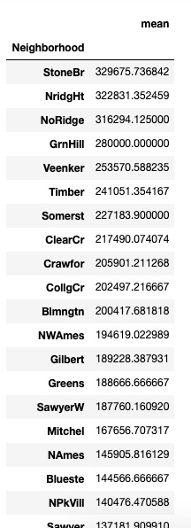
Data Cleaning
Filled Empty Discrete & Continuous with the mean
Left the Ordinal Variables as and dropped NaN
Transformed nominal variables
Sorted them with respect to the mean Sale Price of each level
Assigned each level a value associated scaled to the sale price of that particular level
Dropped remaining NaNs

Slide 5
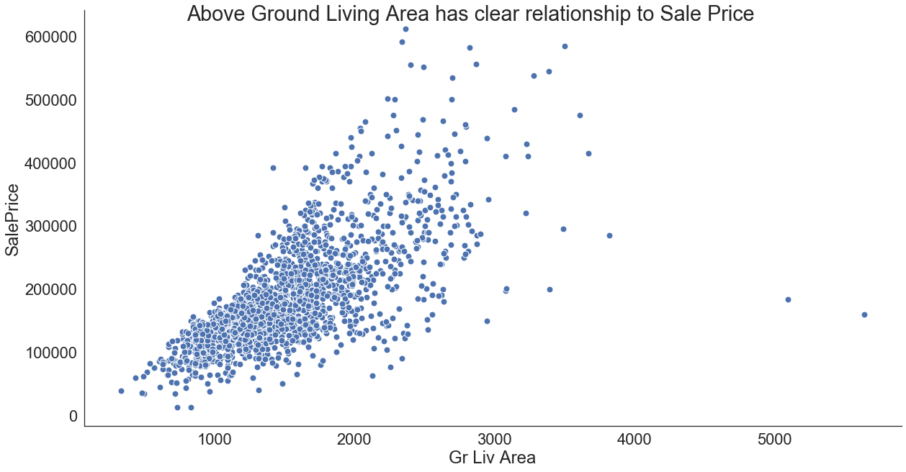
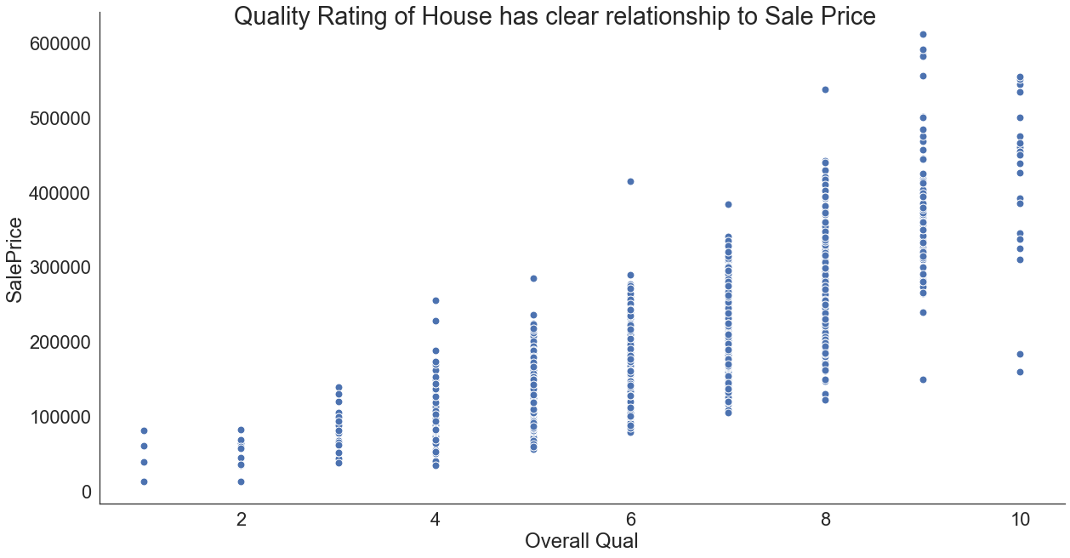
Exploring the Data: What relationships are there?
Two of the most influential variables were the Above Ground Living Area and the Quality rating of the house. You can see from the scatter plot that as Area and rating increase so too does the price.
Other variables that showed this relationship were: 1st Floor Square footage, Garage Area

Slide 6
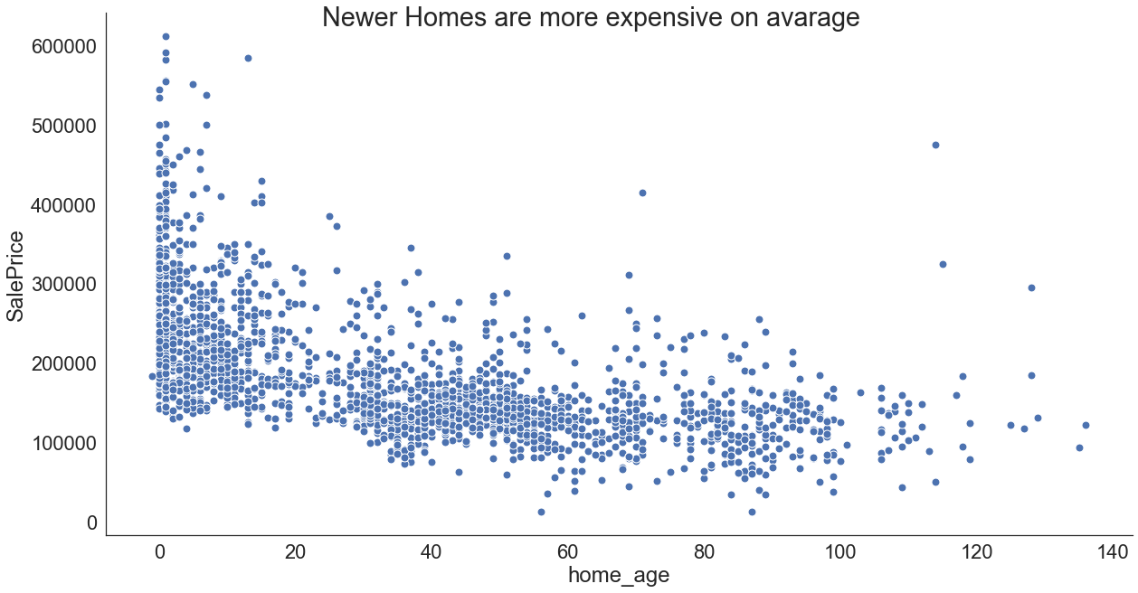
Exploring the Data: What relationships are there?
Feature Engineering
Home Age = Year Sold = Year Built
Home age is an engineered variable that was created by taking the Year Sold variable and subtracting the Year built variable.
The home age shows that newer homes are much more expensive on average than older homes

Slide 7
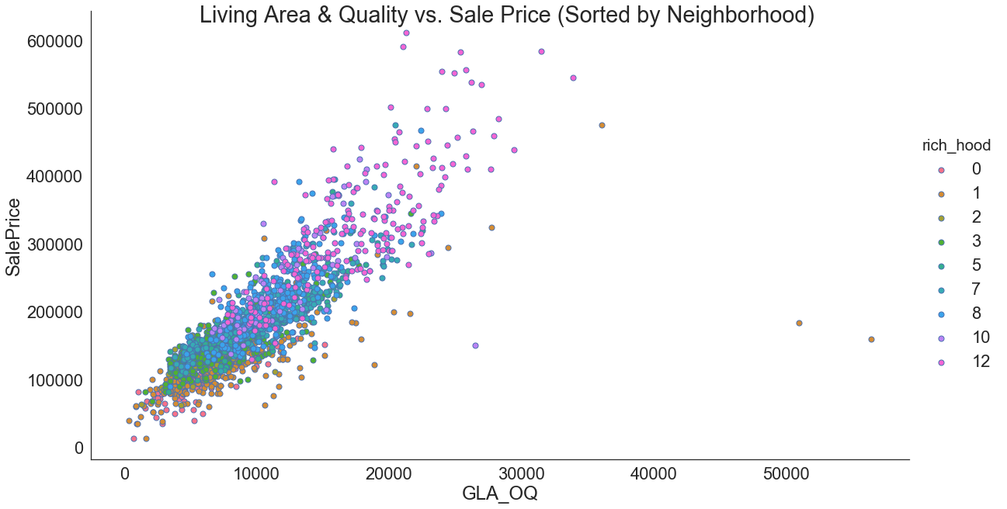
Exploring the Data: Relationships cont.
Feature Engineering
Above Ground Living Area * Overall Quality | The data is then displayed by neighborhood
You can see that product of Living Area and Quality is even more linear and that there is a clear relationship between neighborhood and sale price.

Slide 8
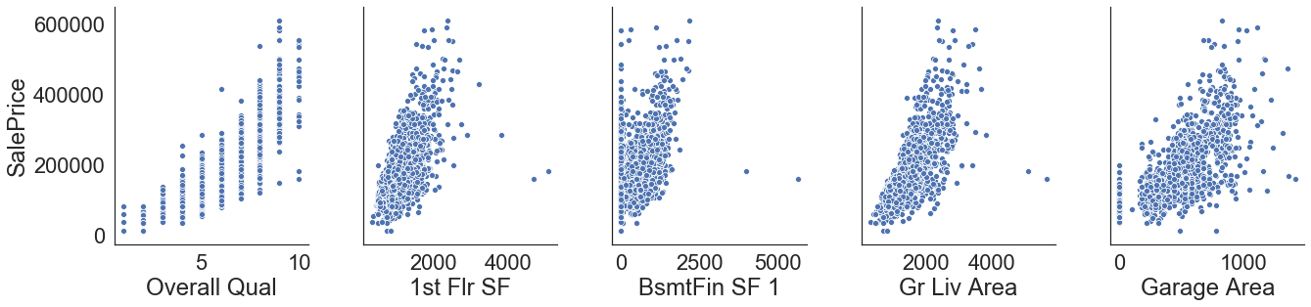
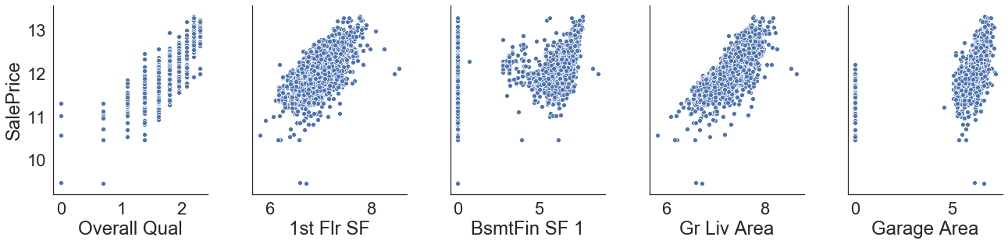
Exploring the Data: Log X & Log y
The graph above variables vs. sale price; the graphs below show the log of each variable vs. the log of sale price

Slide 9
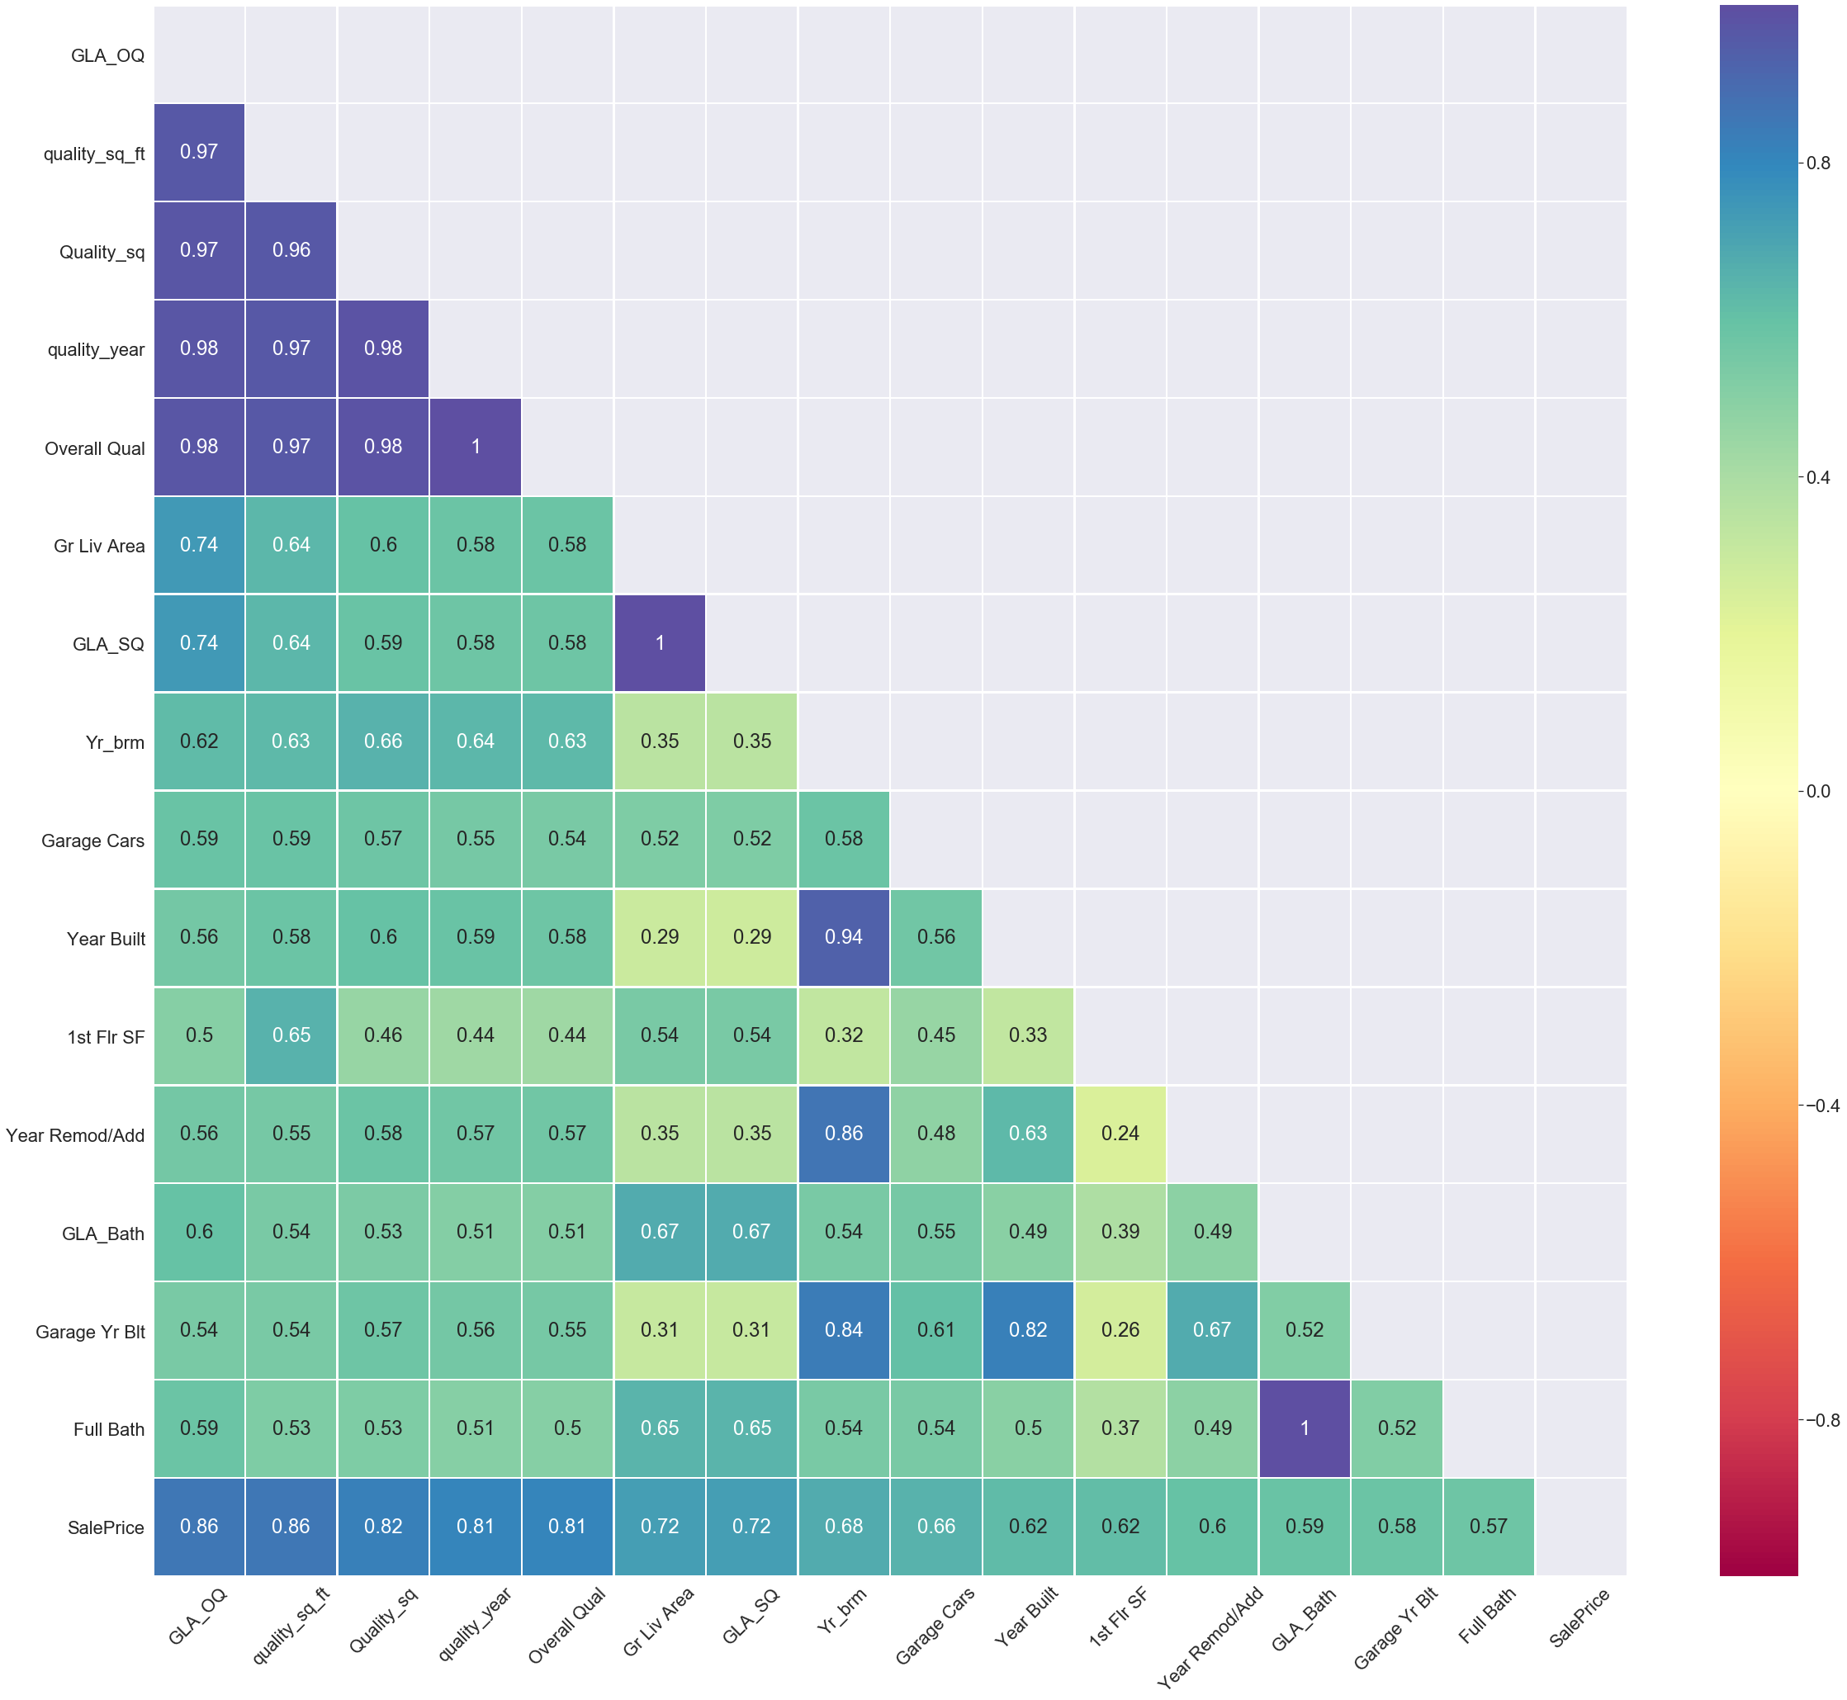
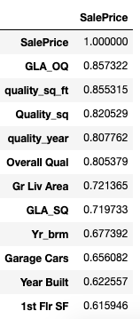
Choosing our variables: Correlations

Slide 10
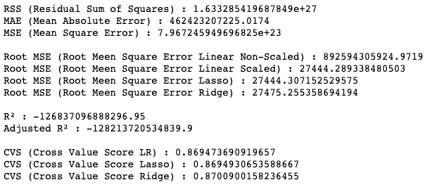
Pre Processing & Modeling the Data
Baseline Est. = $181,469.70
Scaled the Data using a Standard Scalar Model
Took the log of our y-variable (Sale Price)
Fit a linear regression
Performed Cross Validation
Examined the residuals
Fit a LASSO & Ridge Regression models
Tested out tuning parameters - changed alpha, polynomial features
Looked into additional feature creation

Slide 11
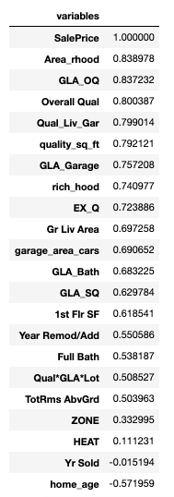
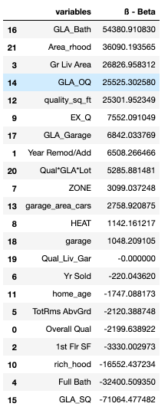
Production Model
Examine the ß-values for each feature
Do any stick out?
If some ß_{x} are zero should we get rid of them?
What if the R² value is still high?
Ex: Above Ground Area * Qual * Garage is a powerful variable, model worse without it. But ß_{QLG} = ~0.0
It was imperative to be rigorous in the analysis.

Slide 12
Recommendations: What now?
Where does value come from:
Interpreting the model:
Above Ground Living Area
Fairly representative model
Overall Quality
Age of home? Pos or Neg?
Neighborhood:
Stone Brook
Northridge
Northridge Heights
Represents: 2006-2010 but after?
Want more recent data
Adding to or Remodeling
Age of the home

Slide 13
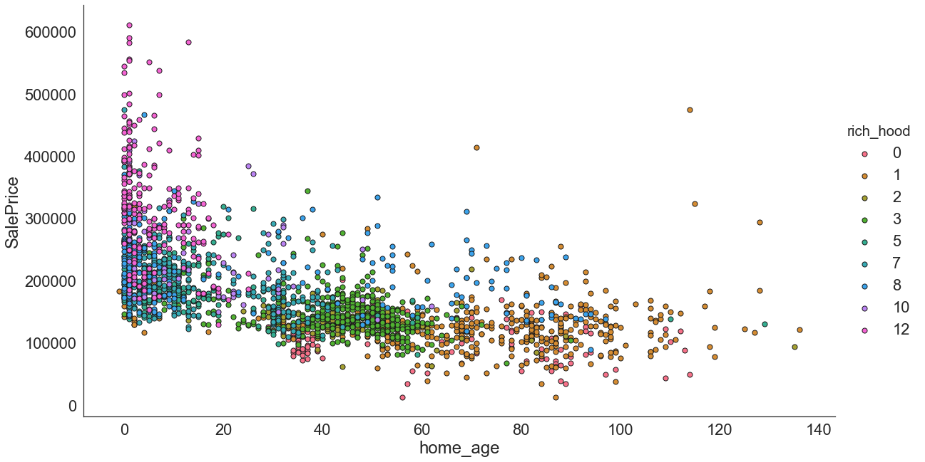
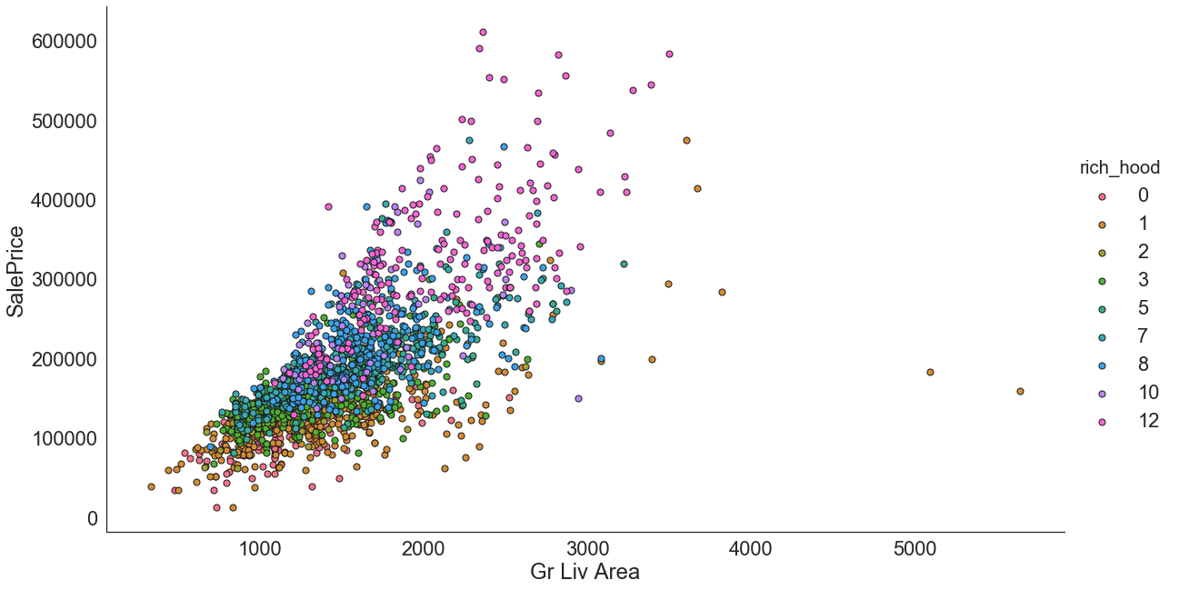
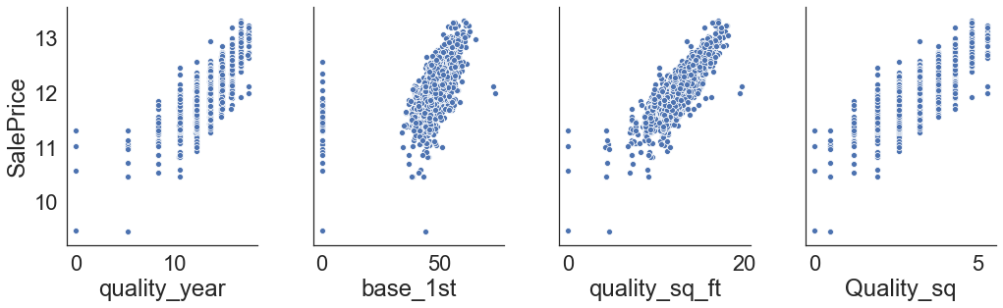
Appendix:

Slide 14
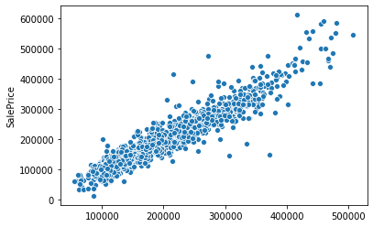
Appendix:

