Slide 1
GUI of Media Manipulation
Aaron Haycraft and Peter Walker

Slide 2
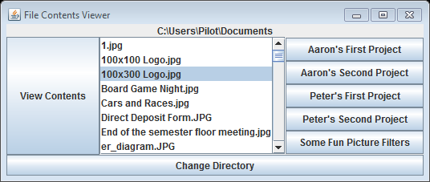
Objective
Combine previous projects into one GUI
GUI is easy to use and understand

Slide 3
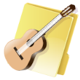


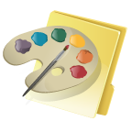
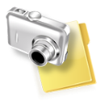
Approach

Slide 4
Results
Peter
Imported and modified previous projects to work within the GUI
Created look and feel of GUI
Implemented multiple picture filters
Aaron
Imported and modified previous projects to work within the GUI
Provided text for GUI
Implemented multiple picture filters

Slide 5
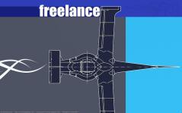
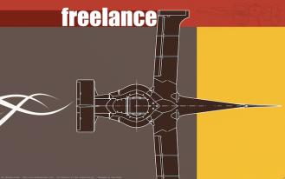
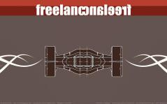
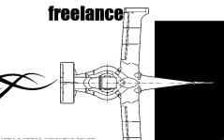
Demo
http://youtu.be/Q-JD0xu_slc
Swap red/blue
Mirror image
Black/white
contrast

Slide 6
Next Steps
Step 1: Continue to refine code
Step 2: Add more filters?
Step 3: Profit

Slide 7
Knowledge gained
Peter
Ability to program efficiently in Python
Advantages of version control with Git
Team management
Aaron
Ability to program efficiently in Python
How to work with different file formats
Patience

