Slide 1



KE_Dashboard
View in Power BI
Last data refresh:
14-6-2023 15:29:16 UTC
Downloaded at:
14-6-2023 15:35:29 UTC

Slide 2
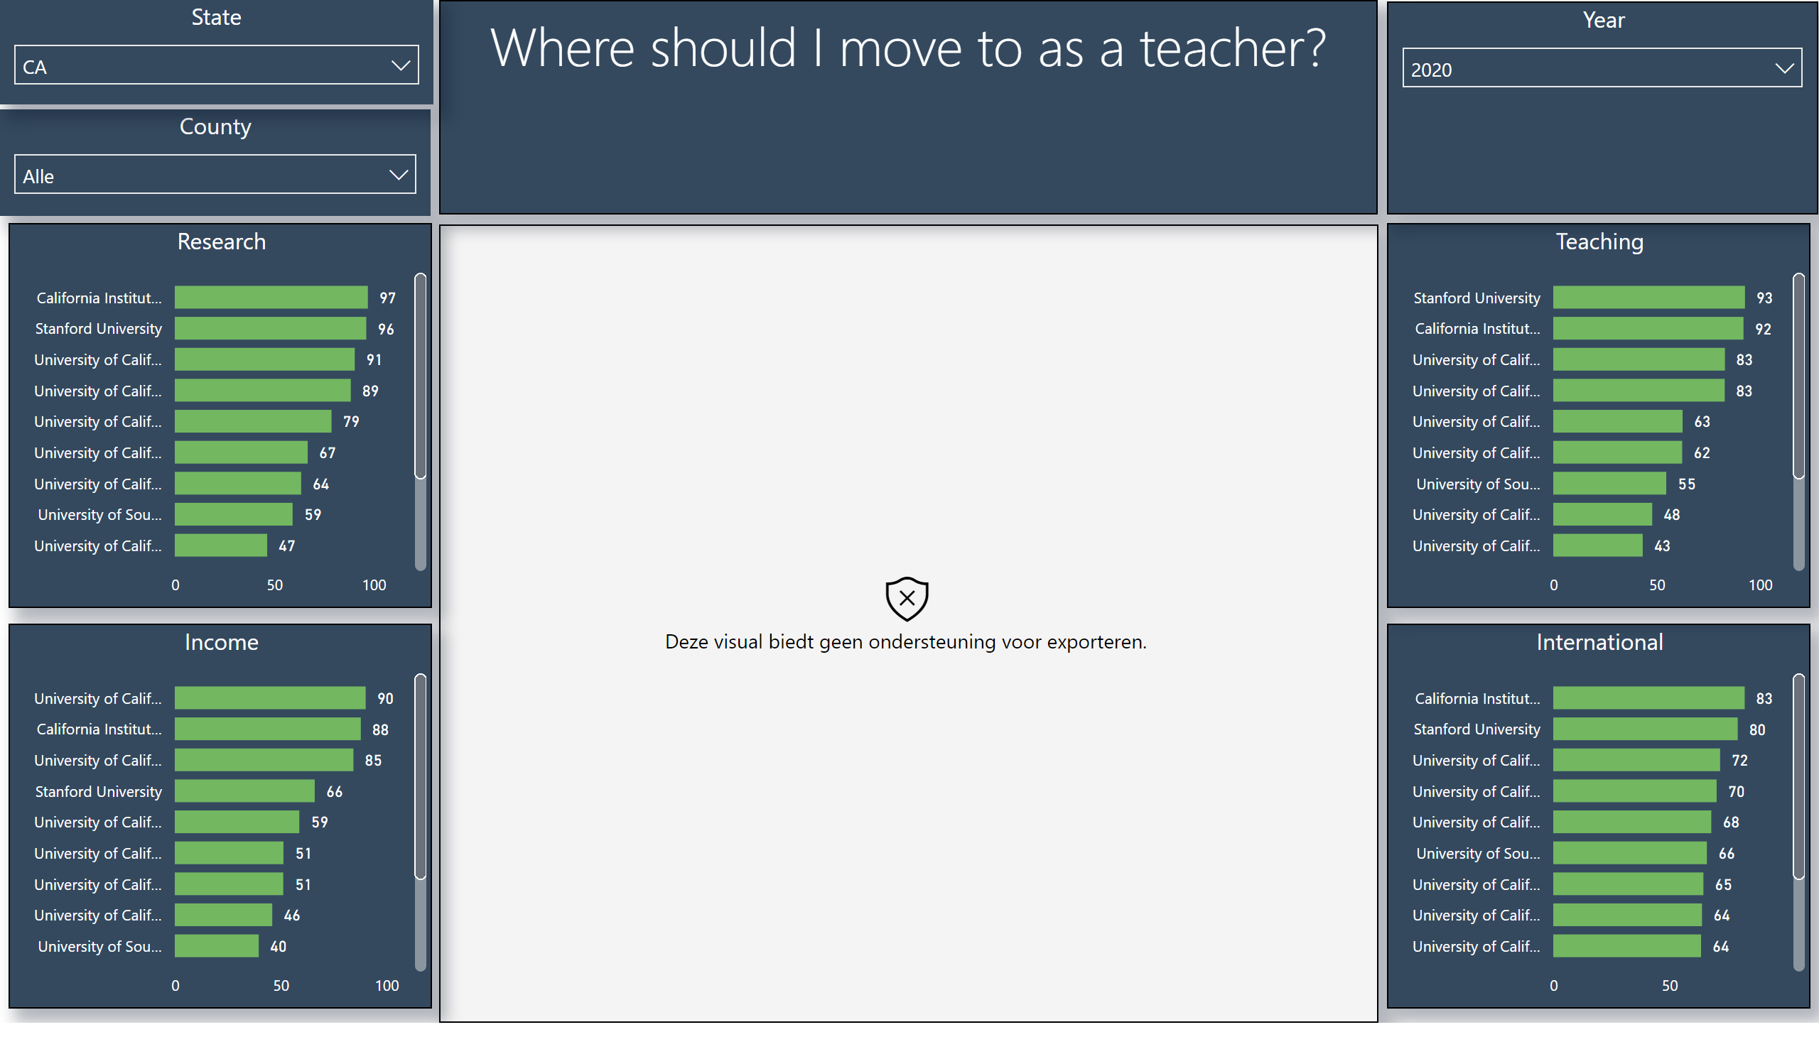
1. Uni
Notes:
esriVisual
No alt text provided
slicer
No alt text provided
County
No alt text provided
Research
No alt text provided
Where should I move to as a teacher?
No alt text provided
Income
No alt text provided
International
No alt text provided
Teaching
No alt text provided
Year
No alt text provided
slicer
No alt text provided
slicer
No alt text provided
State
No alt text provided

Slide 3
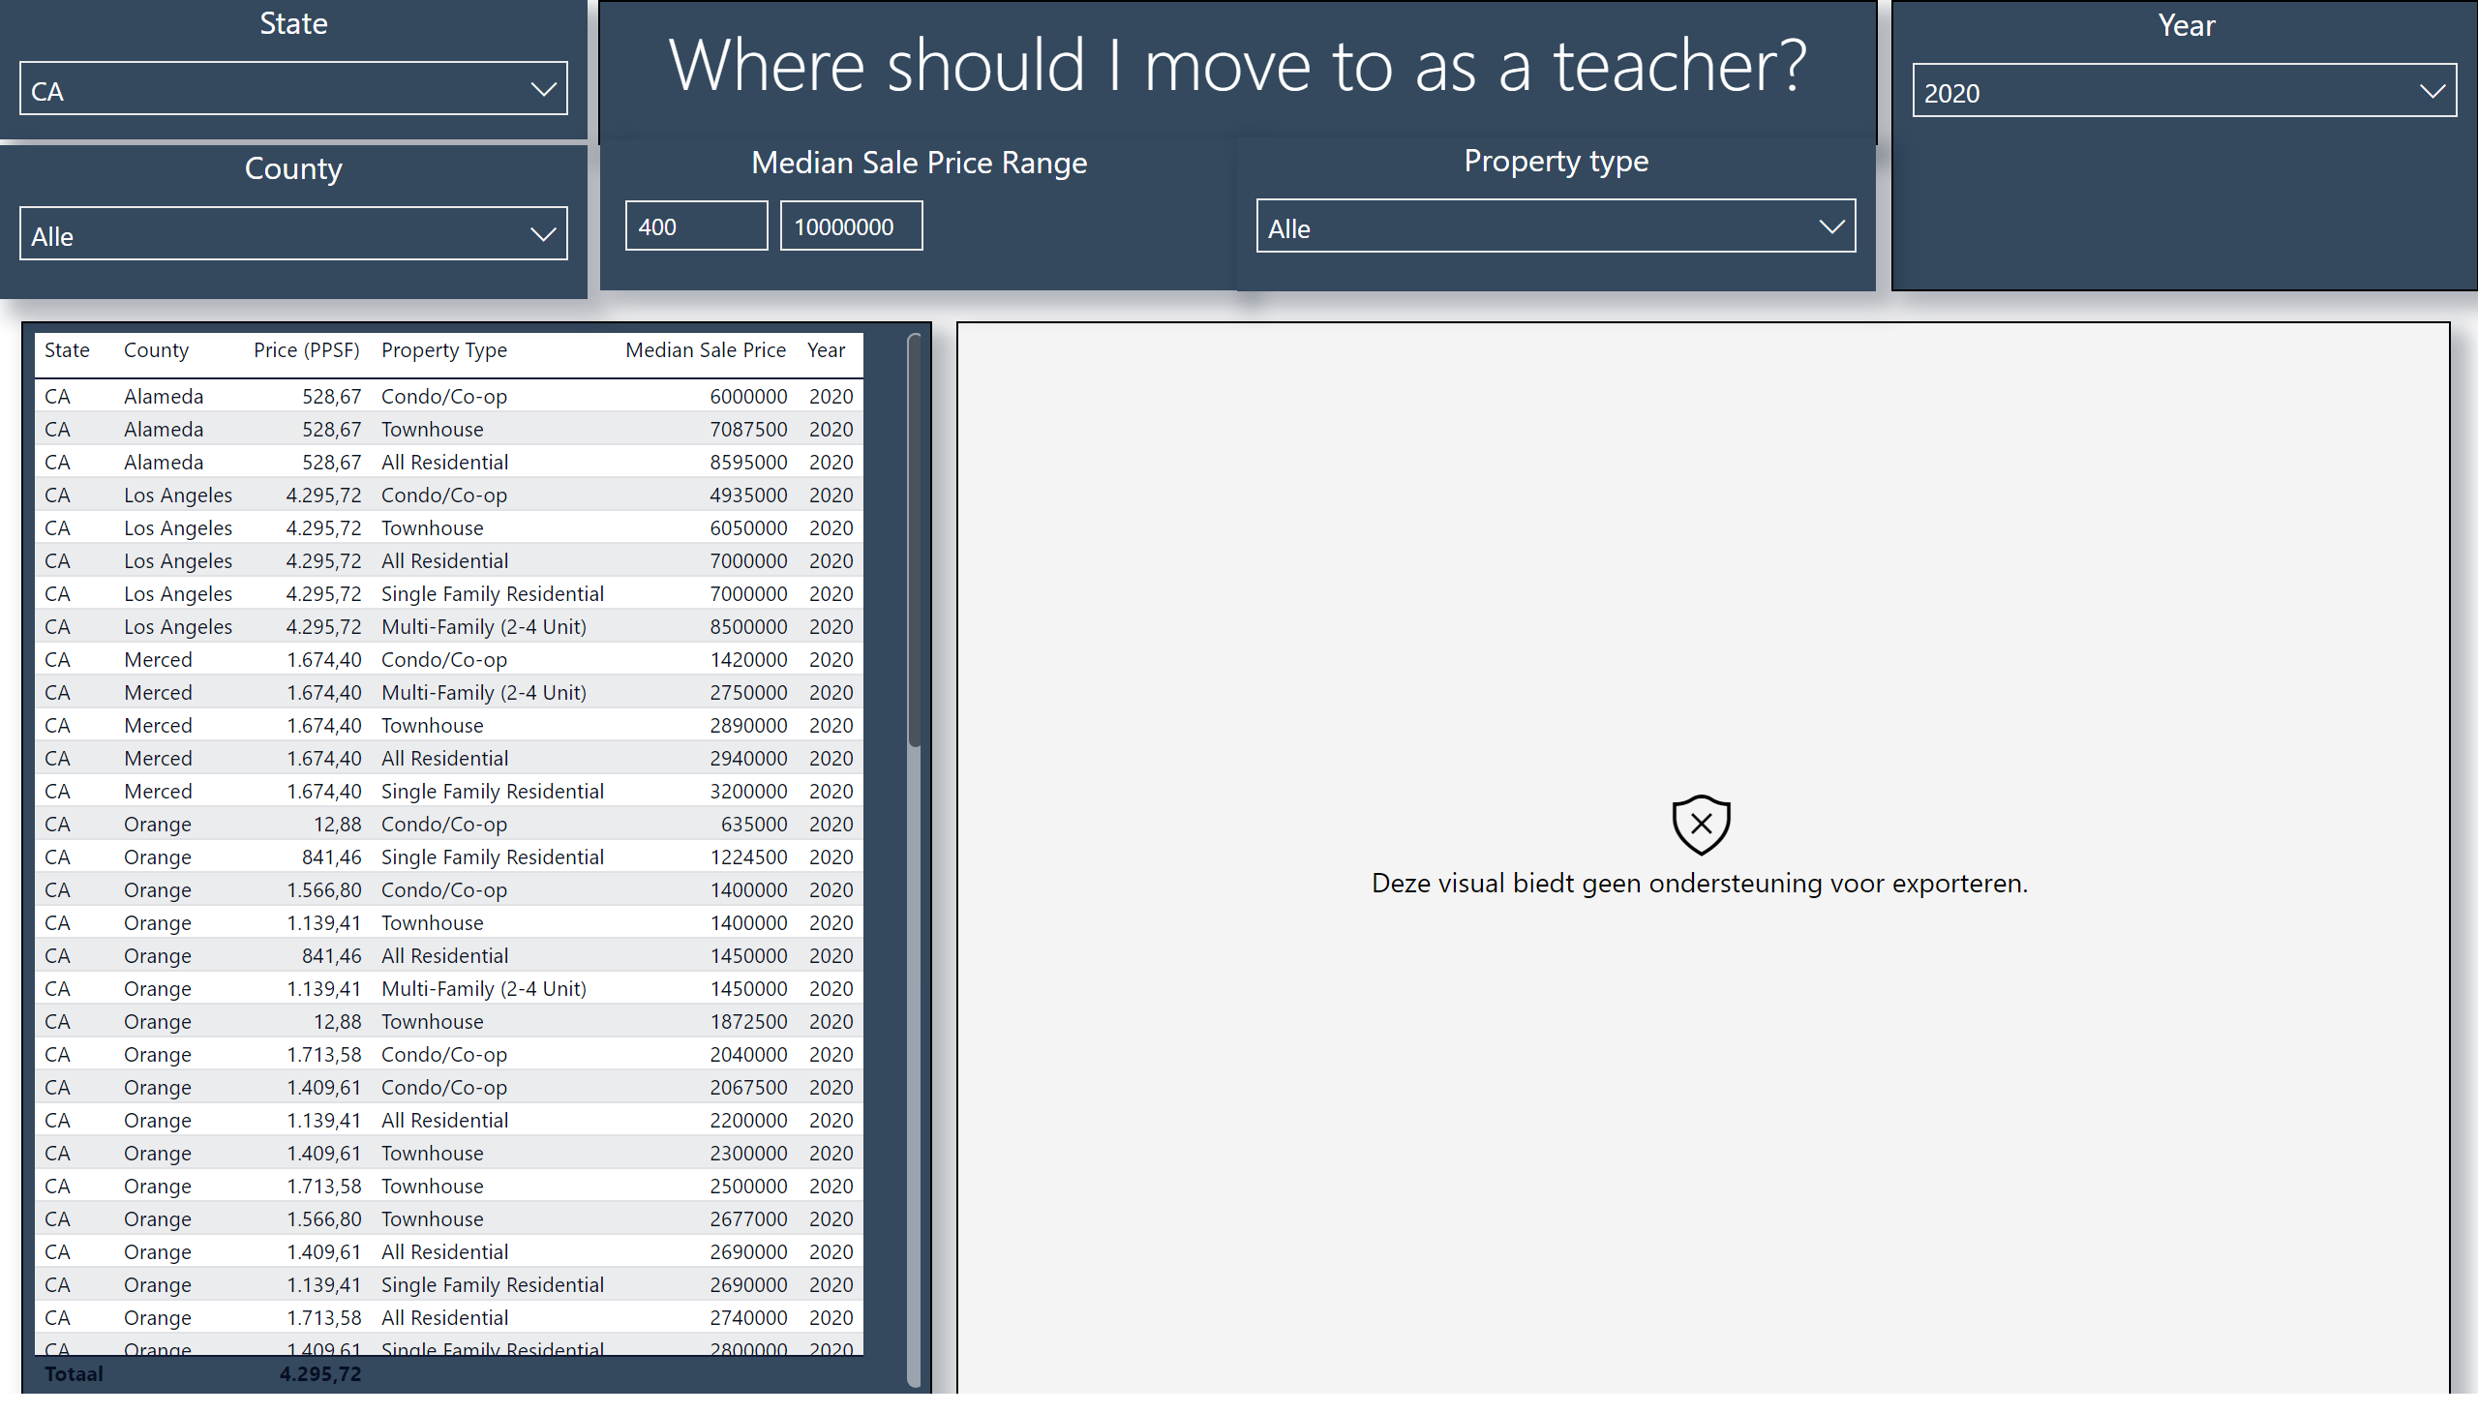
2. Housing
Notes:
State
No alt text provided
Where should I move to as a teacher?
No alt text provided
tableEx
No alt text provided
County
No alt text provided
Year
No alt text provided
esriVisual
No alt text provided
Median Sale Price Range
No alt text provided
Property type
No alt text provided

Slide 4
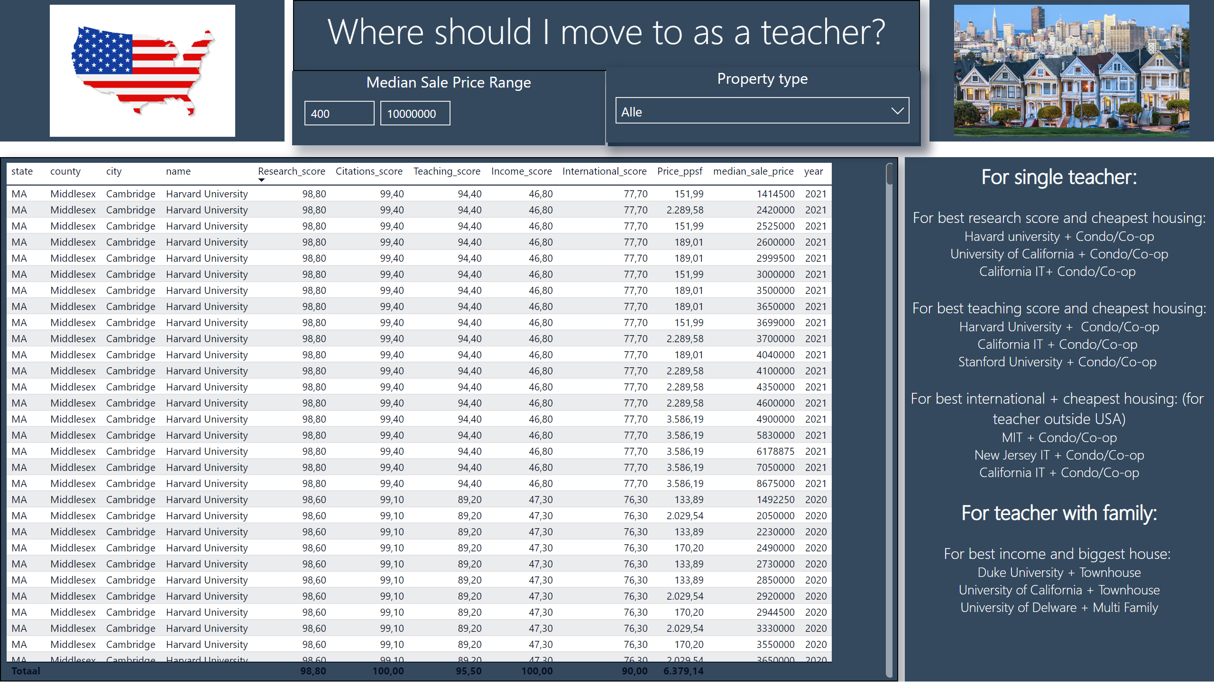
3. Suggestions
Notes:
slicer
No alt text provided
Where should I move to as a teacher?
No alt text provided
tableEx
No alt text provided
slicer
No alt text provided
slicer
No alt text provided
Property type
No alt text provided
textbox
No alt text provided
image
No alt text provided
image
No alt text provided
Median Sale Price Range
No alt text provided
Property type
No alt text provided

