Slide 1
RTL Entropy
$30 5Mb/s entropy source

Slide 2
Software Defined Radio
Electronics:
Antenna ->
Lots of complex thingies ->
Output
Antenna ->
Quadrature Sampling Detector ->
ADC ->
Software ->
Output

Slide 3
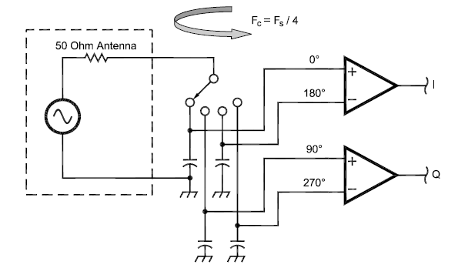
Quadrature Sampling Detector
I and Q give all you need to know about the complex phase space.

Slide 4
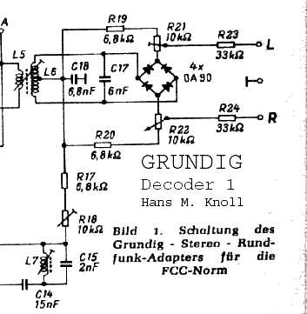
Maths = Electronics

Slide 5
= Code
for (var i = 0; i < length; i++) {
var pilot = _pilotFilter->Process(baseBand[i]);
_pll->Process(pilot);
_channelBPtr[i] = baseBand[i] * Trig.Sin((float) (_pll->AdjustedPhase * 2.0));
}
for (var i = 0; i < audioLength; i++)
{
var a = _channelAPtr[i];
var b = 2f * _channelBPtr[i];
interleavedStereo[i * 2] = (a + b) * AudioGain;
interleavedStereo[i * 2 + 1] = (a - b) * AudioGain;
}

Slide 6
RTL-SDR
Cheap USB DVB-T/DAB+/FM
DAB+ and FM done in software
Antti Polassari discovered this.
Osmocom-SDR wrote the rtl-sdr C libraries.
Others wrote GnuRadio blocks, other apps
GQRX Demo.

Slide 7
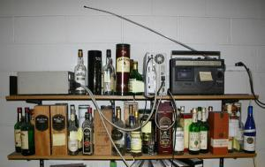
Hrm, I remember something...
random.org uses many radios connected to sound cards.

Slide 8
Informational Entropy
Lots of maths see https://en.wikipedia.org/wiki/Informational_entropy
Boils down to: a data sequence has high entropy when you can’t beat 50/50 odds on predicting the next bit given all previous bits.

Slide 9
Entropy Sources
Classical
  Atmospheric Radio
  Amplifier Noise
  Coupled Oscillators
  Reversed Bias Diodes
Quantum
  Quantum Vacuum Noise (On campus, 2Gb/s)
  Schottky Noise (photodiode excitation)
  degenerate optical parametric oscillator

Slide 10
RTL-Entropy
Reads 6 LSB of 8 bit I/Q samples
Does Von Neumann debiasing
Sends to FIPS 140-2 test library
XOR with previous buffer if passed
Output!
Works well, at about 5Mb/s
Daemon mode included for interaction with rngd to add entropy to the kernel

Slide 11
Cryptography Concerns
Atmospheric Radio inherently insecure!
  Wideband FM doesn’t have much effect
  we still get entropy from the amplifier noise and ADC aliasing.
Short the antenna with a 50Ω load
put in shielded box
Amplifier Noise is harder to mess with

Slide 12
More Debiasing Needed?
This is where I start getting hazy
Kaminsky Debiasing, Does it help?
SHA512(discarded bits from Von Neumann step)
Encrypt entropy with hash
I think…
Is XORing on old entropy good/bad?
Just following what some dude on the internet said!

Slide 13
Thanks!
https://github.com/pwarren/rtl-entropy
Credits:
http://www.random.org/history/
http://www.flex-radio.com/Products.aspx?topic=faq

