Slide 1
TECHNICAL DEEP-DIVE
Detecting Anomalies in Network Traffic
An end-to-end machine-learning pipeline for network intrusion detection on the UNSW-NB15 benchmark
Binary anomaly detection • 5 models compared • Explainability & fairness audit
Notes:
Technical deck for peers. Walks through the full ML lifecycle: framing, data, preprocessing, modelling, and the ethical-AI audit on UNSW-NB15.

Slide 2
PROBLEM FRAMING
From security pain to a defined ML task
No team can manually inspect millions of daily connections. We frame intrusion detection as a supervised task that flags suspicious connections for analyst triage.
175K
training records
TASK TYPE
Binary classification framed as anomaly detection
82K
Normal vs Attack, extendable to 9 attack families (multi-class).
held-out test records
PRIMARY METRICS — WHY RECALL LEADS
Recall (attack)
A missed attack is the costly error
PR-AUC
Minority-aware, threshold-independent
42
predictive features
F1-score
Balances recall vs false alarms
Accuracy
Reported only — misleading here
Metric choice follows established practice for imbalanced data — Saito & Rehmsmeier (2015); Davis & Goadrich (2006).
Notes:
The framing decision: recall-first because false negatives (missed attacks) are far more costly than false positives. Accuracy is demoted.

Slide 3
DATA
UNSW-NB15 — realistic, labelled traffic
Generated by the Australian Centre for Cyber Security using real attack tooling. Dual-labelled (binary + 9 families), with flow, timing, content and connection-history features.
Attack families (training set)
No missing values
No duplicates
service '-' placeholder (54%)
Heavy right-skew outliers
Data quality is high; the two flags on the right are handled in preprocessing.
Notes:
Severe multi-class imbalance — Generic 40k vs Worms 130 — shapes the fairness audit later. Binary balance is ~68% attack / 32% normal.

Slide 4
PREPROCESSING
A leakage-safe feature pipeline
Every encoder and scaler is fit on the training split only, then applied to test — preventing information leakage and mirroring deployment against unseen traffic.
01
02
03
04
Clean
Engineer
Encode
Scale
Drop id; recode service '-'; keep outliers, log-compress them
7 domain features: bytes/packet, byte ratios, TTL difference
One-hot service & state; frequency-encode proto (131 values)
RobustScaler (median/IQR) — resistant to heavy tails
Result:
69 model-ready features. Two engineered features — TTL difference and source/destination byte ratio — rank in the top five by importance, confirming the domain reasoning added real signal.
Leakage-safe, fit-on-train-only preprocessing per scikit-learn (2024) and Kaufman et al. (2012).
Notes:
The pipeline is reusable (src/preprocessing.py) and is what the deployment step will load. Per-split fitting is the key discipline.

Slide 5
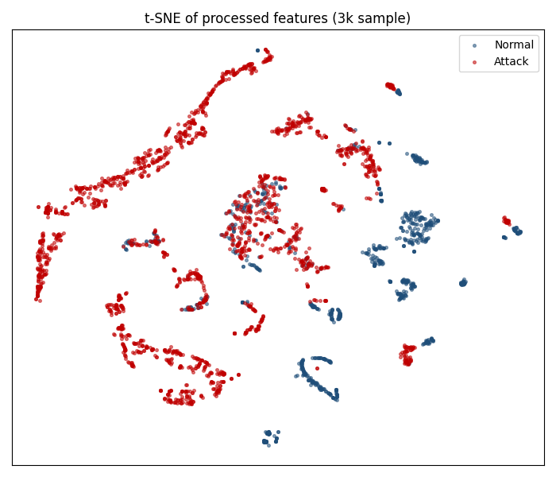
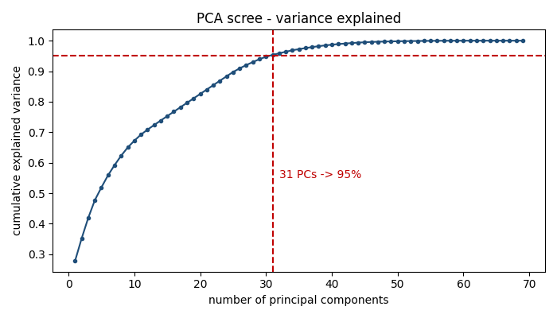
EXPLORATORY ANALYSIS
Structure, feature selection & dimensionality reduction
PCA — 31 of 69 components capture 95% of variance
Feature selection — 69 → 21 features (Random Forest importance + correlation filter).
From EDA — skew log-compressed (45→1); attack rate varies sharply by service & state.
t-SNE — normal vs attack are largely separable (3,000-row sample)
Notes:
Covers the rest of Step 3: t-SNE + PCA (dimensionality reduction) and the embedded+filter feature selection down to 21 features.

Slide 6
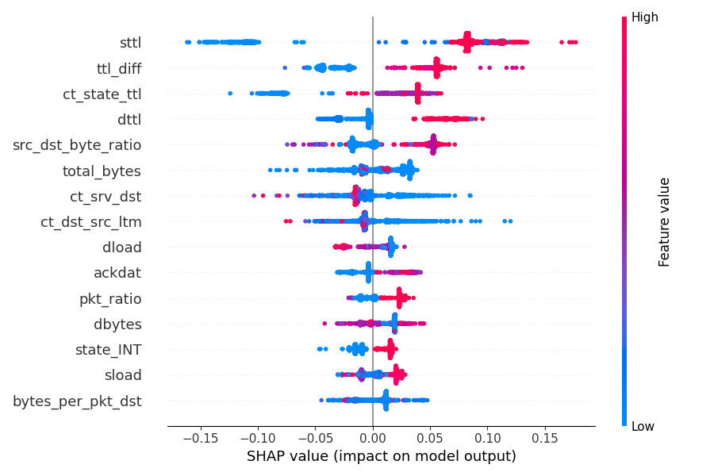
EXPLAINABILITY
SHAP and LIME agree on what drives detection
TTL features dominate
Random Forest importances, global SHAP, and a local LIME explanation independently rank time-to-live features first — consistent with intrusion-detection theory, where spoofed and crafted packets show abnormal TTLs.
sttl
source TTL
ttl_diff
engineered feature
ct_state_ttl
state × TTL counter
src_dst_byte_ratio
engineered feature
SHAP summary — impact on attack prediction
Three independent methods (SHAP, LIME, tree importance) converging = confidence the model learns real structure, not artefacts.
Notes:
SHAP (global) and LIME (local) agree; two engineered features are in the top four — evidence the feature engineering paid off.

Slide 7
MODELLING
Seven models, compared on the held-out test set
SELECTED
Random Forest
0.974
Recall (best)
0.989
PR-AUC (best)
0.919
F1-score
The neural net matched but didn't beat the ensembles — the usual tabular-data result. SVM maximises recall; RF wins recall + PR-AUC.
*Isolation Forest is unsupervised (trained on normal traffic only); lower scores are expected. A K-Means study confirmed attack structure is only weakly visible without labels.
Notes:
RF and XGBoost are near-identical and both excellent. RF selected for best recall + PR-AUC and robustness.

Slide 8
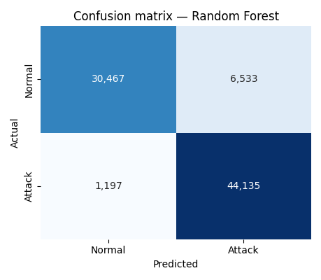
SELECTED MODEL
Random Forest — error profile suits triage
97.4%
Recall on the attack class
of all attacks are caught
1,197
False negatives
missed attacks out of 45,332 — the costly error, kept low
6,533
False positives
normal flagged as attack — the cheaper, tolerable error
Confusion matrix — held-out test set
Notes:
For a security triage tool this is the right error profile: catch almost all attacks, tolerate some false alarms.

Slide 9
LIMITATIONS
Where it could go wrong
We stress-tested our own model. Six limitations — each measured, not assumed:
Fairness blind spot
Adversarial evasion
Fuzzers detected at 0.82 vs ~1.0 for other families — disparate-impact ratio of 0.82.
Under small feature perturbation, F1 falls 0.92 → 0.80. Clean accuracy ≠ robustness.
Concept drift
Mild overfitting
Attack patterns evolve; the benchmark's own train/test split already shifts (PSI flags counters).
Train F1 0.98 vs test F1 0.92 — a 0.06 gap, held in check by depth limits and class weighting.
Benchmark realism
Rare-class fragility
UNSW-NB15 is attack-heavy and lab-generated; live traffic is mostly benign and messier.
With only 130 Worms samples, fine-grained attack typing is unreliable — binary is the safe target.
Robustness & drift framing per NIST AI 100-2 (2023), Goodfellow et al. (2015), Madry et al. (2018), Gama et al. (2014).
Notes:
The honest limitations slide. Red = higher priority (fairness gap, adversarial evasion); amber = monitored. Sets up the mitigations slide.

Slide 10
MITIGATIONS
What we fixed — and what we recommend next
APPLIED IN THIS BUILD
RECOMMENDED FOR PRODUCTION
✓
Threshold tuning
→
Adversarial hardening
Lifts Fuzzers recall 0.82 → 0.94 for a small, deliberate F1 trade-off.
Adversarial training and ensembles to resist evasion.
✓
Drift quantified (PSI)
→
Explanation-drift alerts
Shift is mild and isolated to connection-counter features.
Shifting SHAP patterns as an early adversarial signal.
✓
Leakage controlled
→
Cost-sensitive thresholds
All encoders and scalers fit on the training split only.
Tuned per traffic profile to balance misses vs alarms.
✓
SMOTE — honest miss
→
Scheduled retraining
Tested to boost rare classes; it did not help, and is reported as-is.
Refresh the model as attack behaviour evolves.
Notes:
Two columns: what we actually did (incl. the honest SMOTE failure) vs the production defences we recommend. Threshold tuning is the headline win.

Slide 11
SCOPE & FUTURE WORK
What we left out — and what comes next
OUT OF SCOPE — THIS BUILD
OPEN RESEARCH QUESTIONS
Production multi-class typing
→
Temporal / sequence models
×
rare families too sparse to classify reliably
do LSTMs or Transformers catch multi-stage attacks?
→
Cross-dataset generalisation
×
Real-time, line-rate inference
does it transfer to live traffic and other benchmarks?
a distinct systems-engineering effort
→
Robustness to real adversaries
Cloud MLOps platform
hold up under constrained, problem-space evasion?
×
a later, separate deployment decision
→
Cost-sensitive thresholds
tie the operating point to real breach and analyst costs
×
Certified adversarial defences
→
Faithful explanations
specialised and compute-intensive; deferred
can explanation drift flag evasion reliably?
Notes:
Pairs deliberate exclusions (left) with the open research agenda from the report's synthesis chapter (right) — framing future work for a next paper or PhD.

Slide 12
PRODUCTION & MLOPS
Built to keep learning
A continuous improvement loop
Adapts to new threats
Monitor
Scheduled and drift-triggered retraining keep the model current as attacks evolve.
1
traffic volume, performance & drift (PSI)
Detect
Watches itself
2
PSI and explanation-drift monitoring flag when the world changes — or when evasion begins.
distribution shift or evasion signals
Retrain
Stays robust
3
on fresh, recently-labelled traffic
Adversarial hardening and ensembles blunt evasion attempts before they land.
Revalidate
Reproducible & reversible
4
then redeploy — with rollback ready
Versioned models and a shared pipeline enable safe rollback and audit at any time.
↺ repeats as the threat landscape changes
The threat landscape never stops evolving — a static model quietly decays. This one is built to adapt.
MLOps practices per Sculley et al. (2015).
Notes:
Forward-looking close: MLOps loop + robustness pillars. Message: relevance requires continual learning against an evolving threat landscape.

