Slide 1
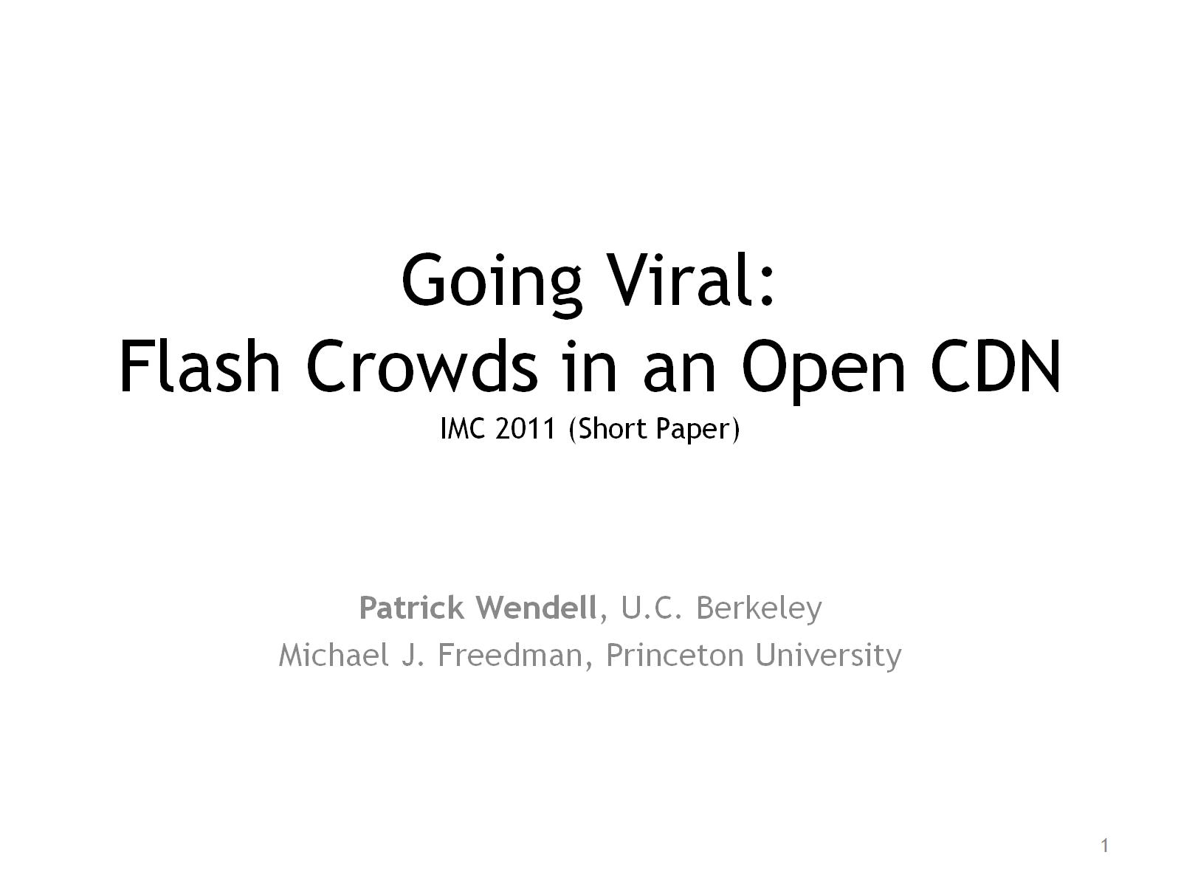
Going Viral: Flash Crowds in an Open CDN

Slide 2
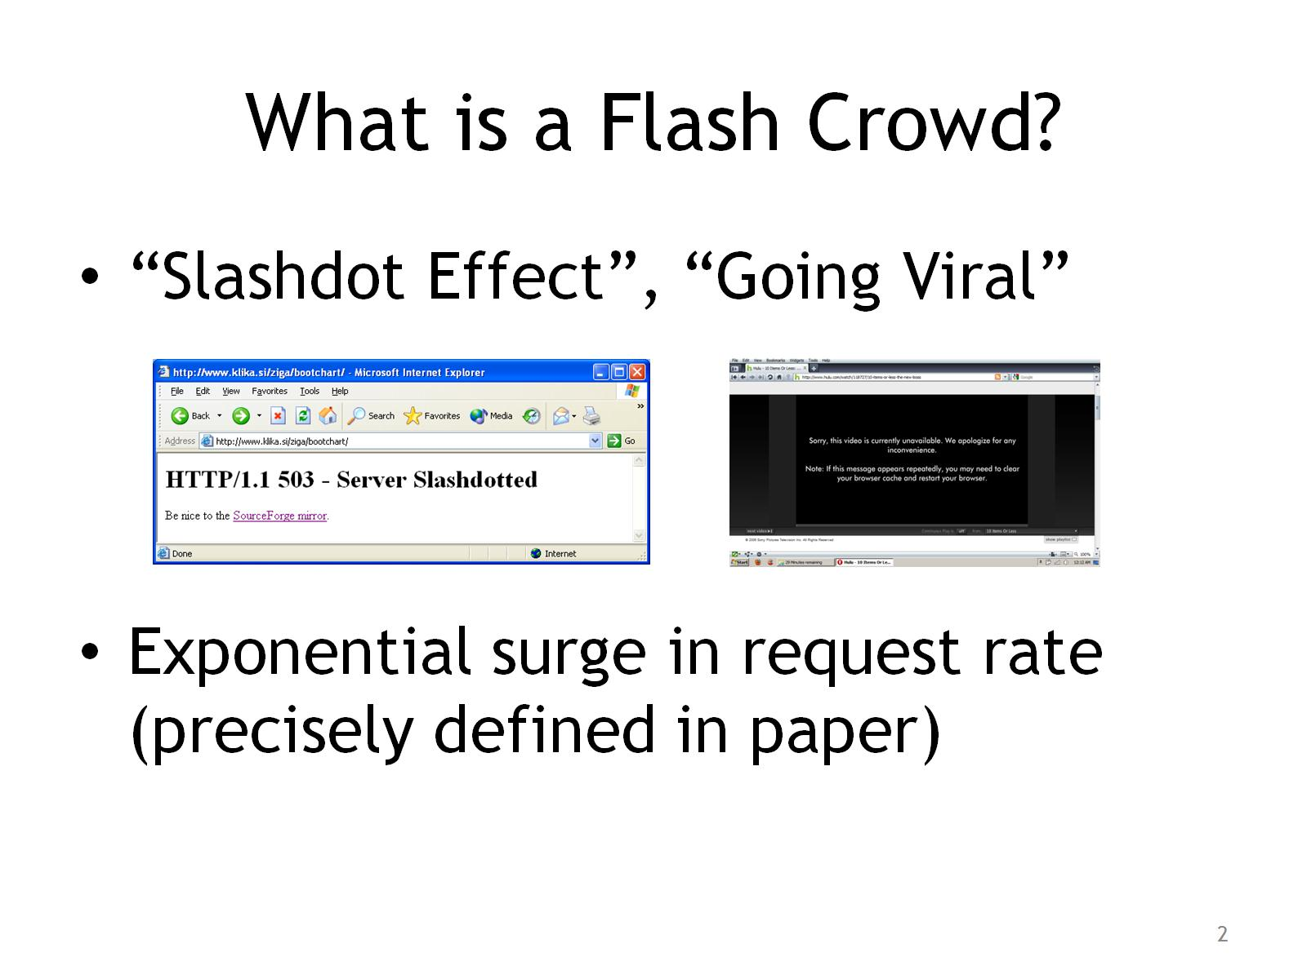
What is a Flash Crowd?

Slide 3
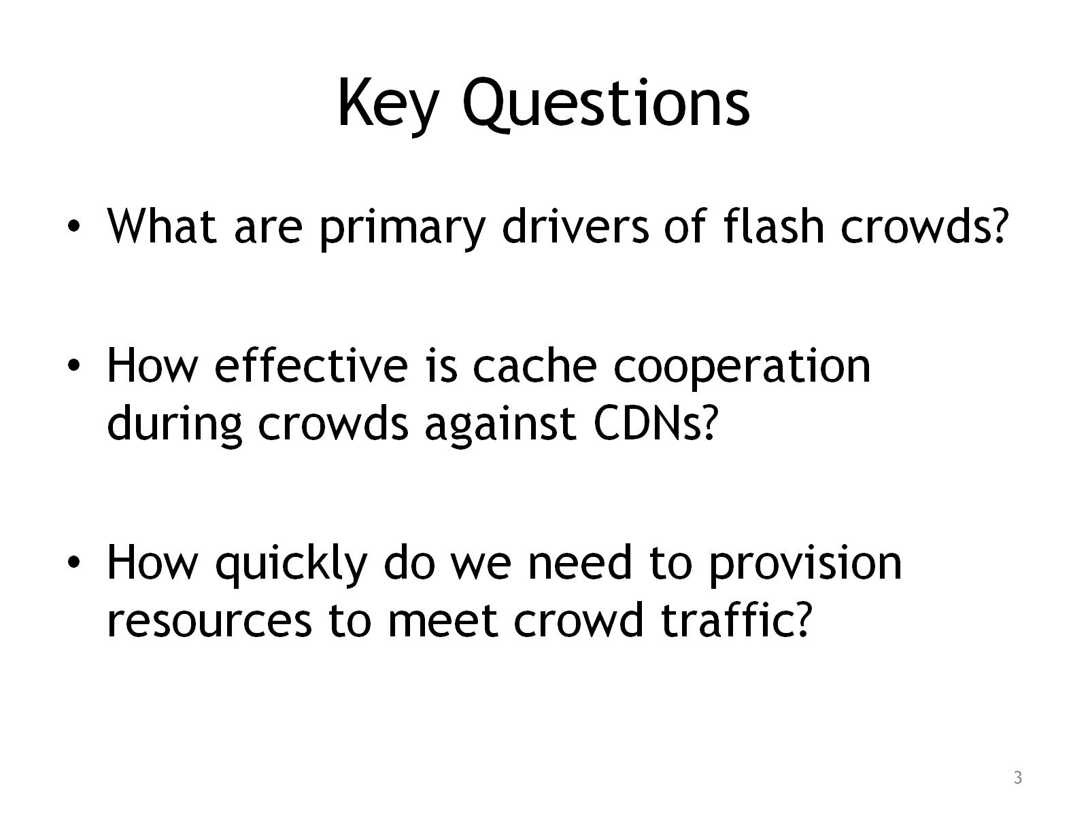
Key Questions

Slide 4
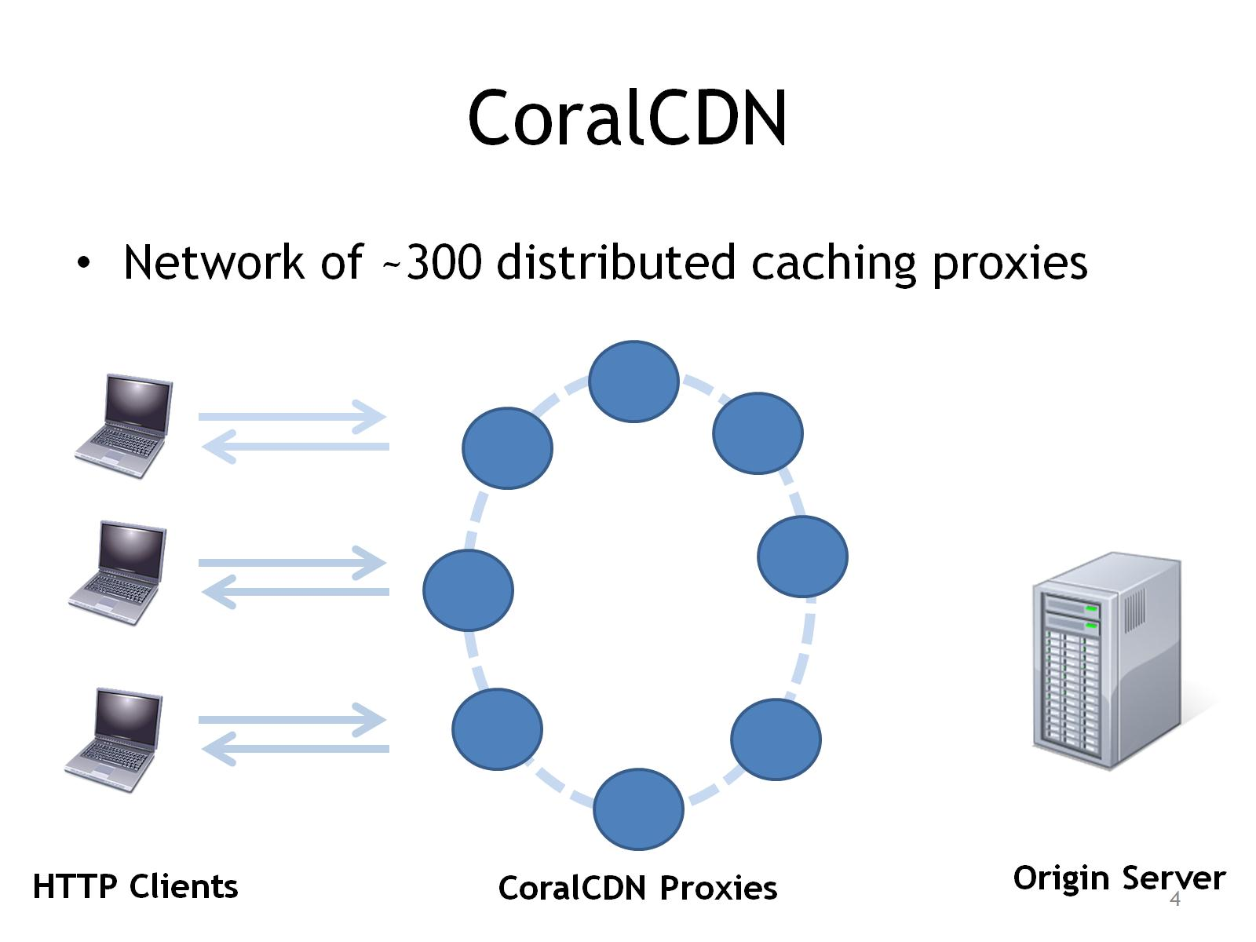
CoralCDN

Slide 5
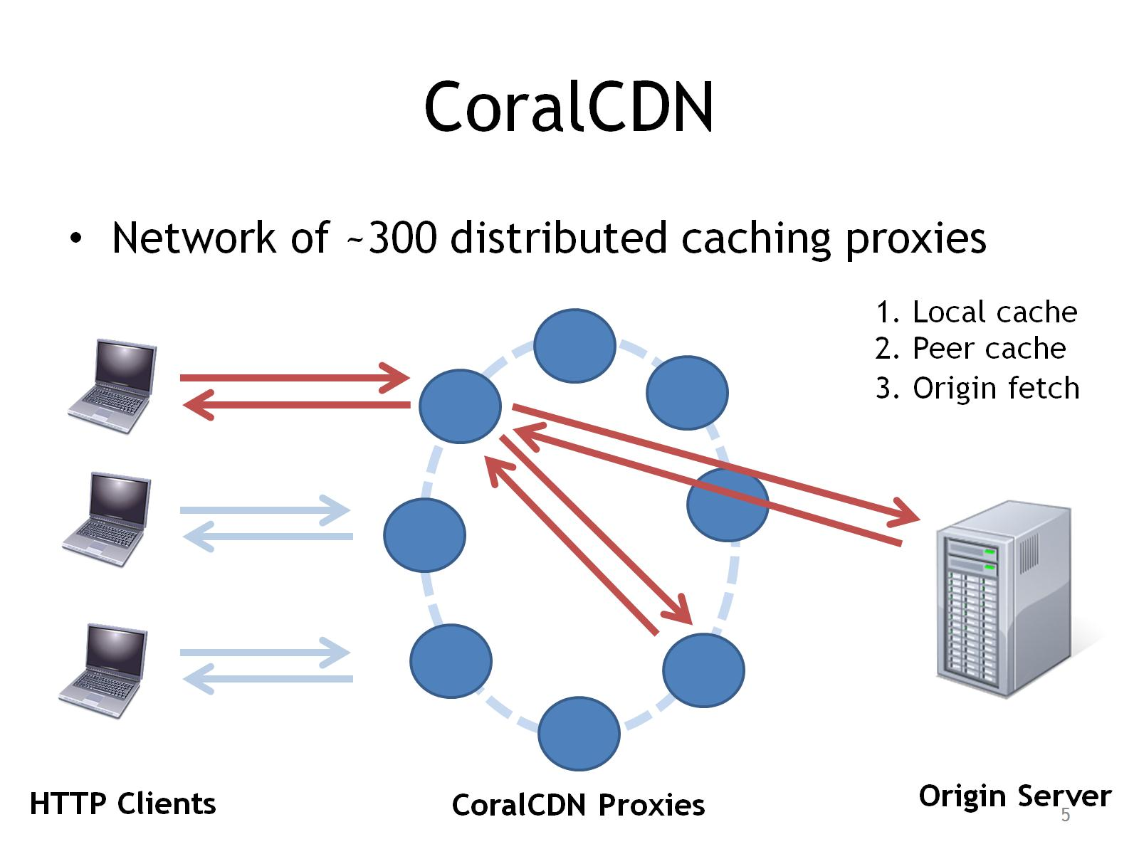
CoralCDN

Slide 6
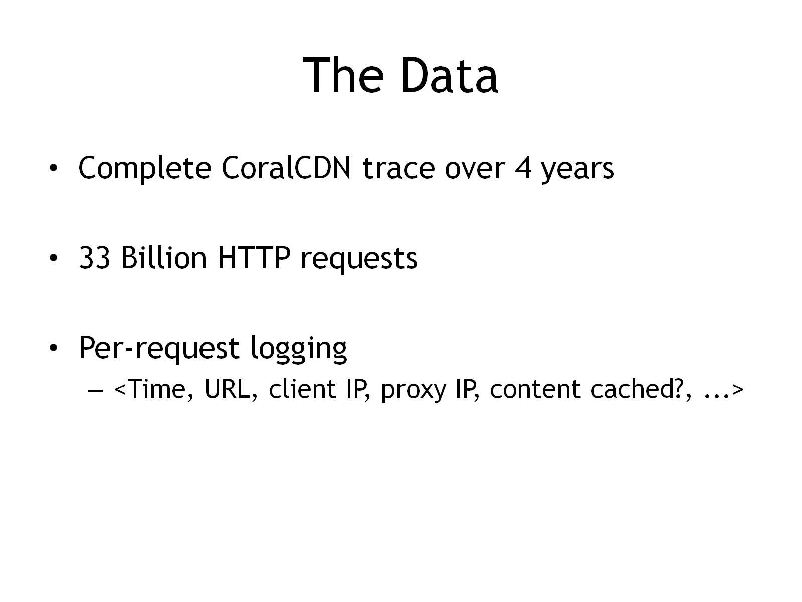
The Data

Slide 7
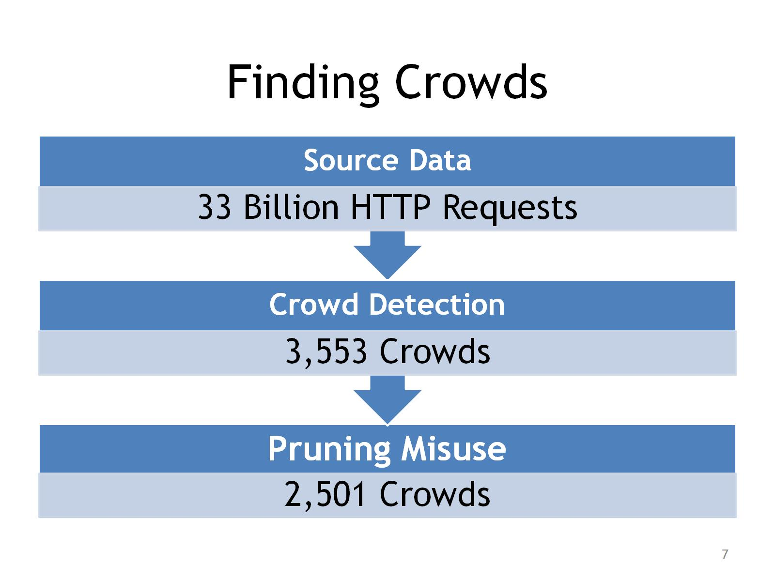
Finding Crowds

Slide 8

Crowd Sources

Slide 9
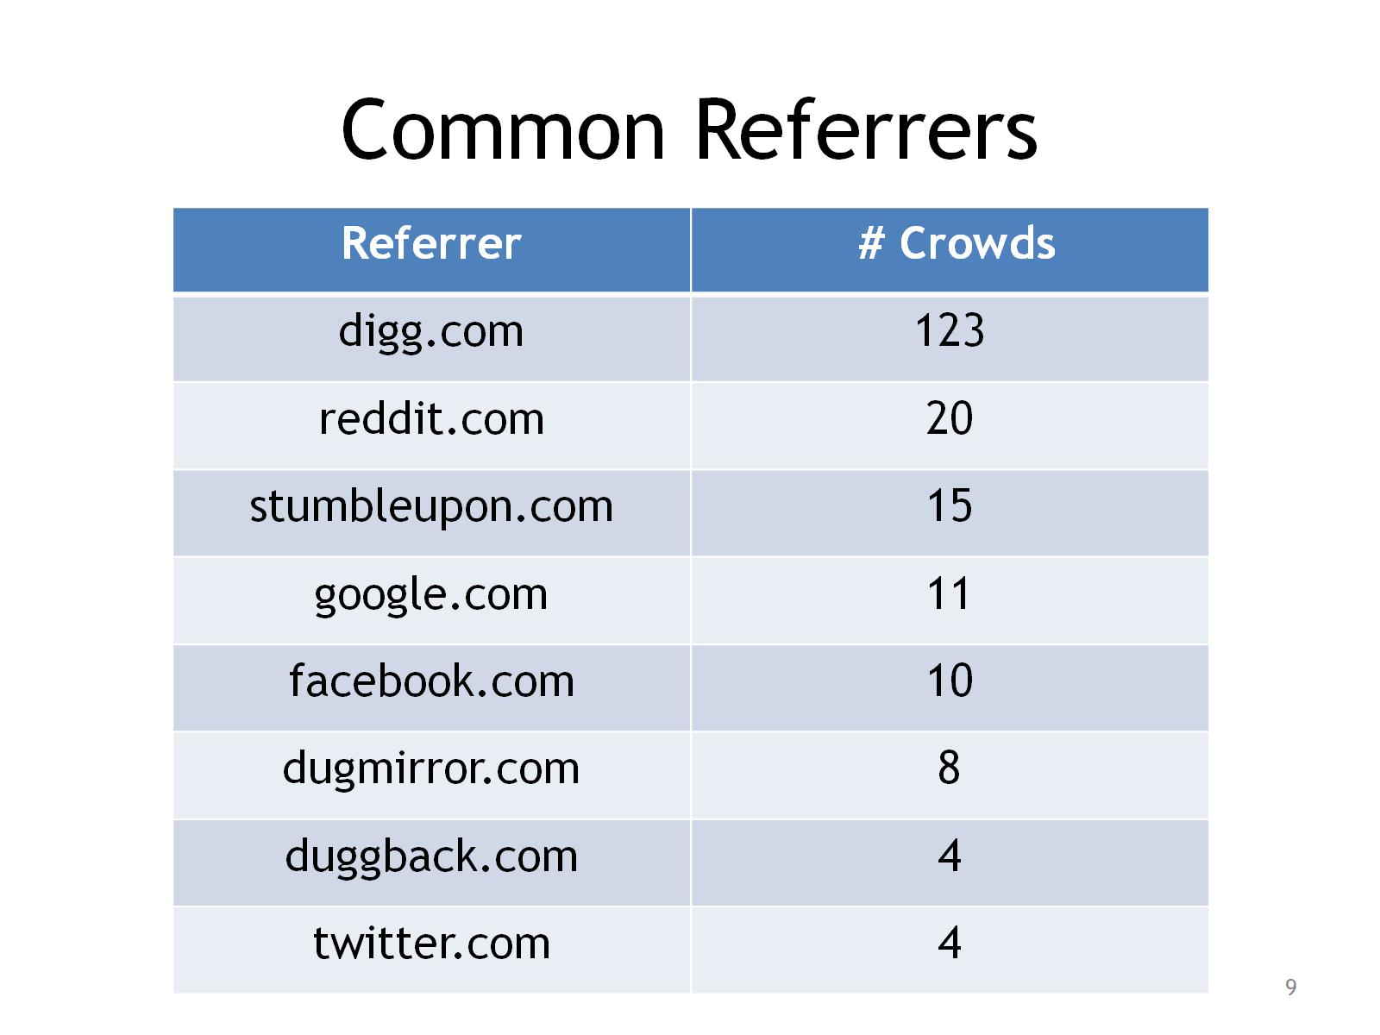
Common Referrers

Slide 10
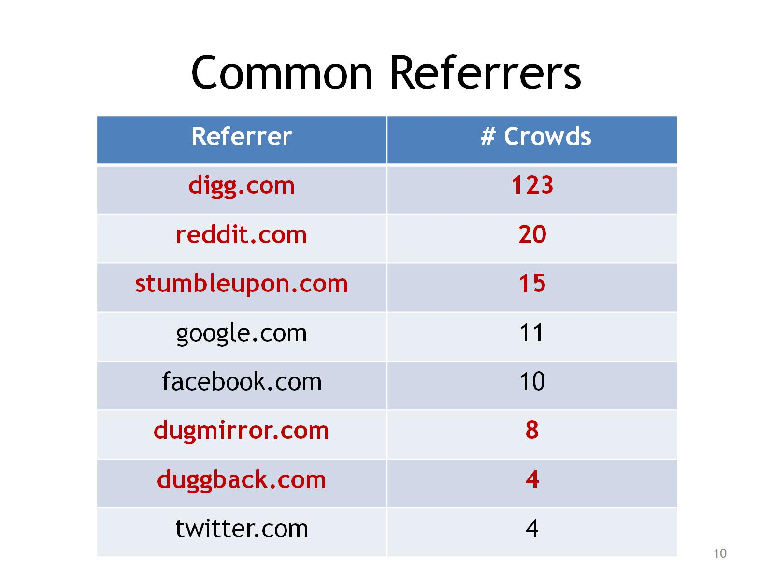
Common Referrers

Slide 11
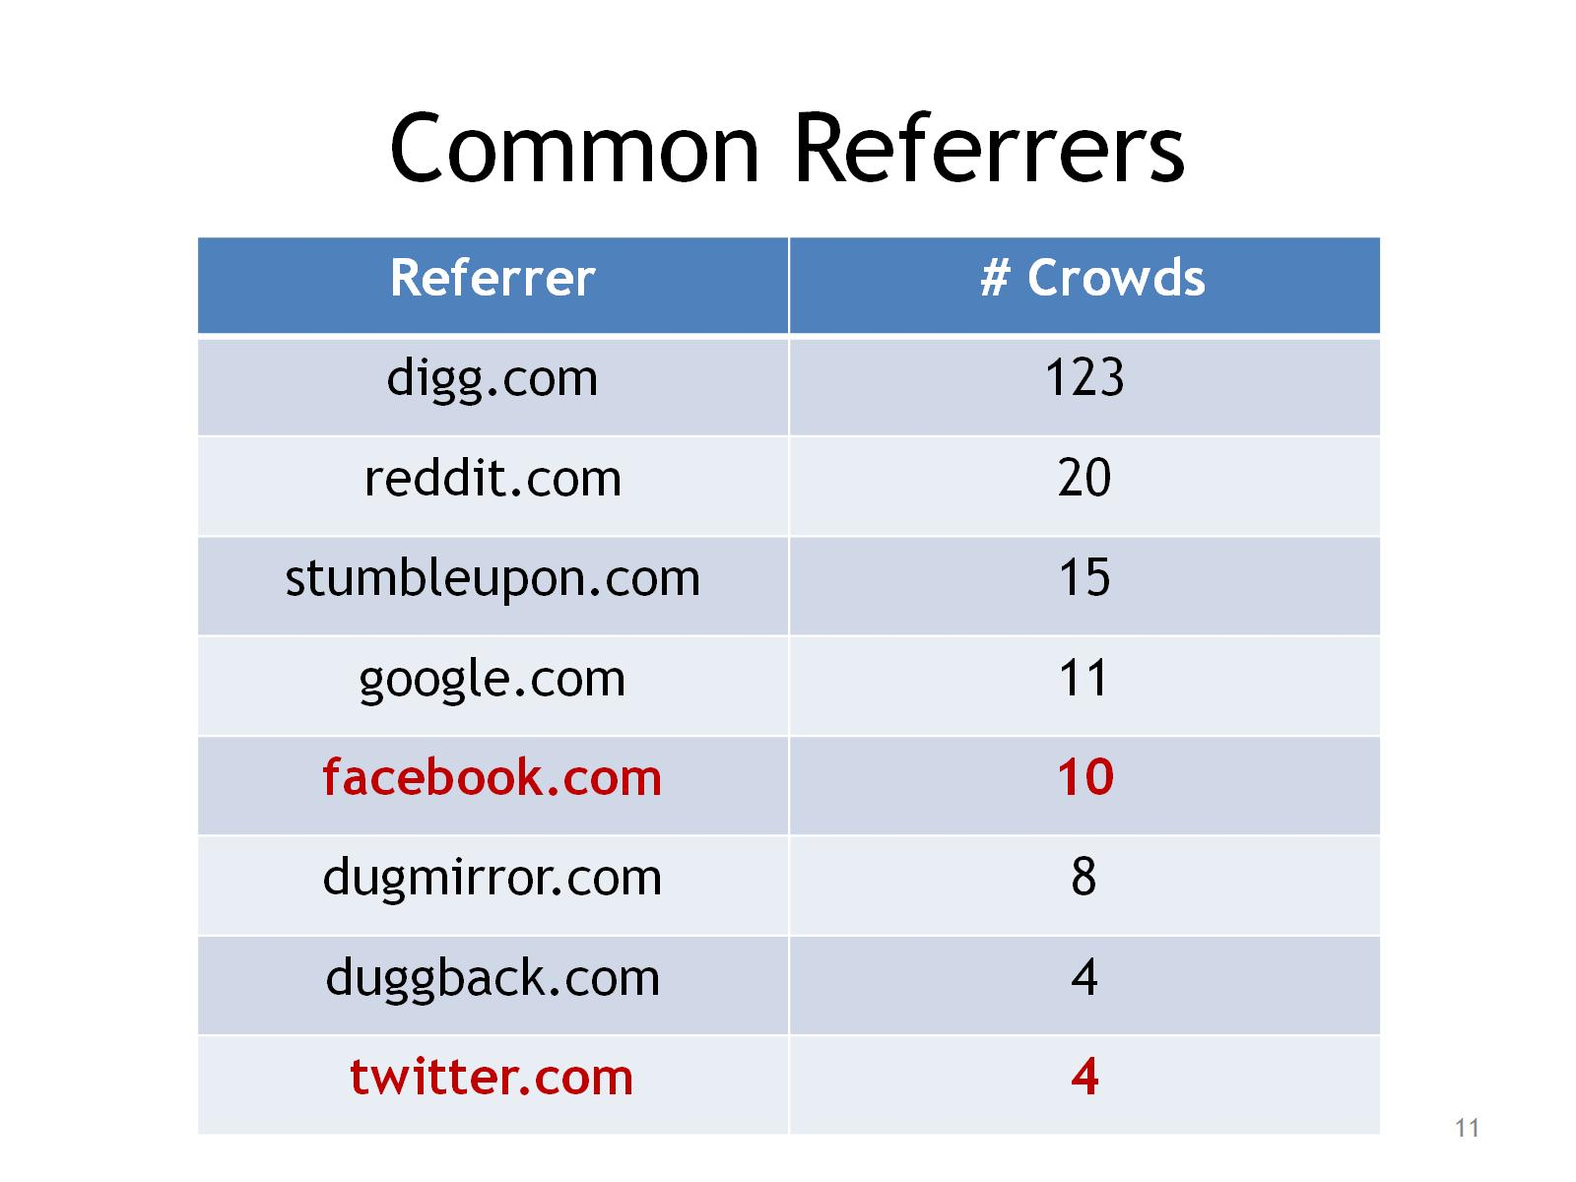
Common Referrers

Slide 12
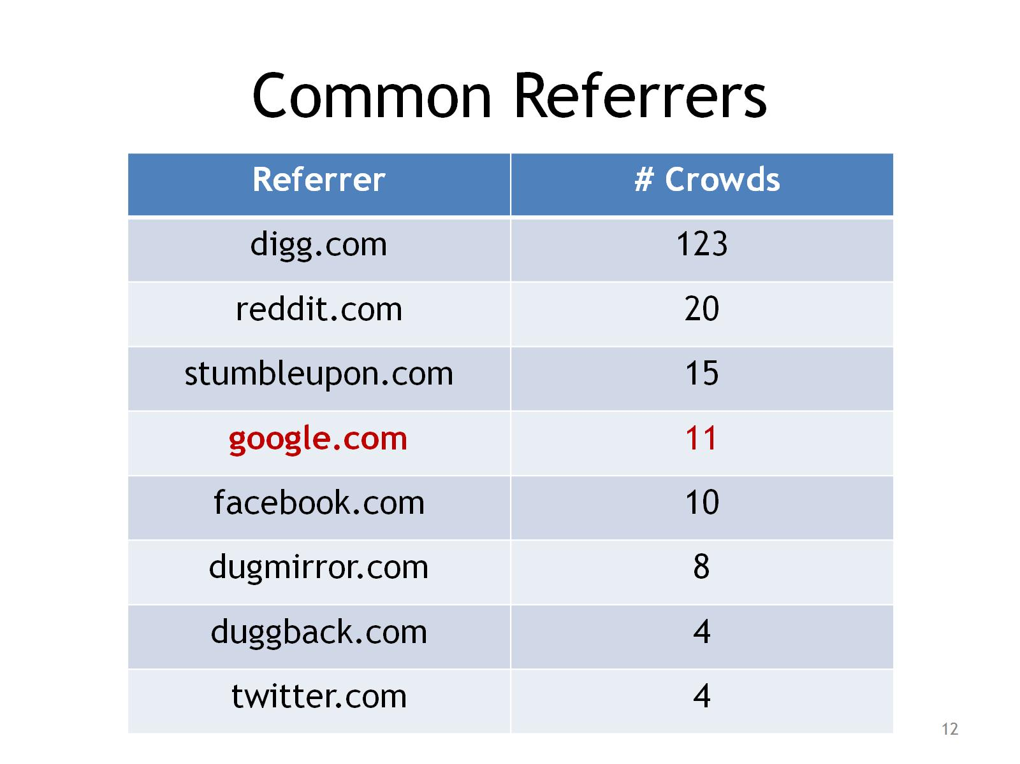
Common Referrers

Slide 13
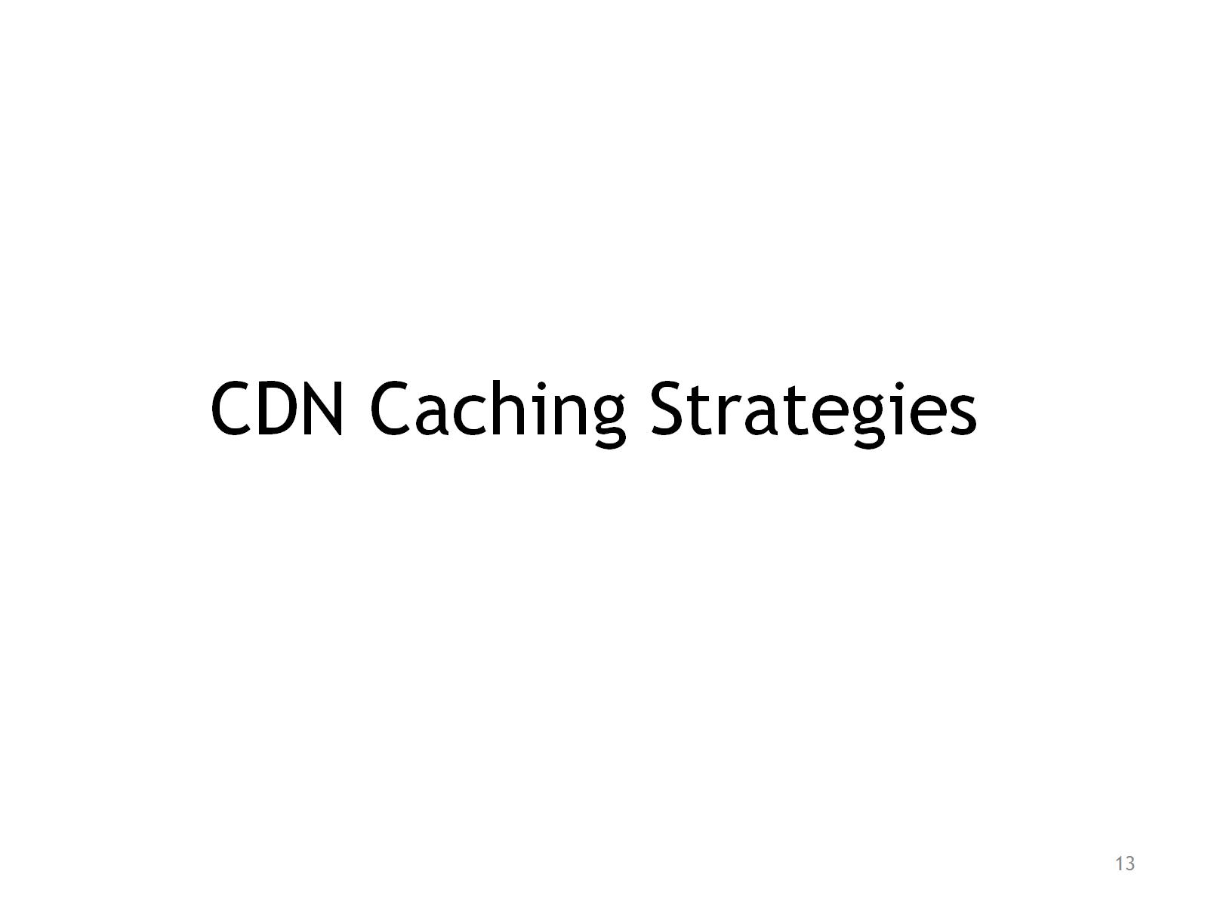
CDN Caching Strategies

Slide 14
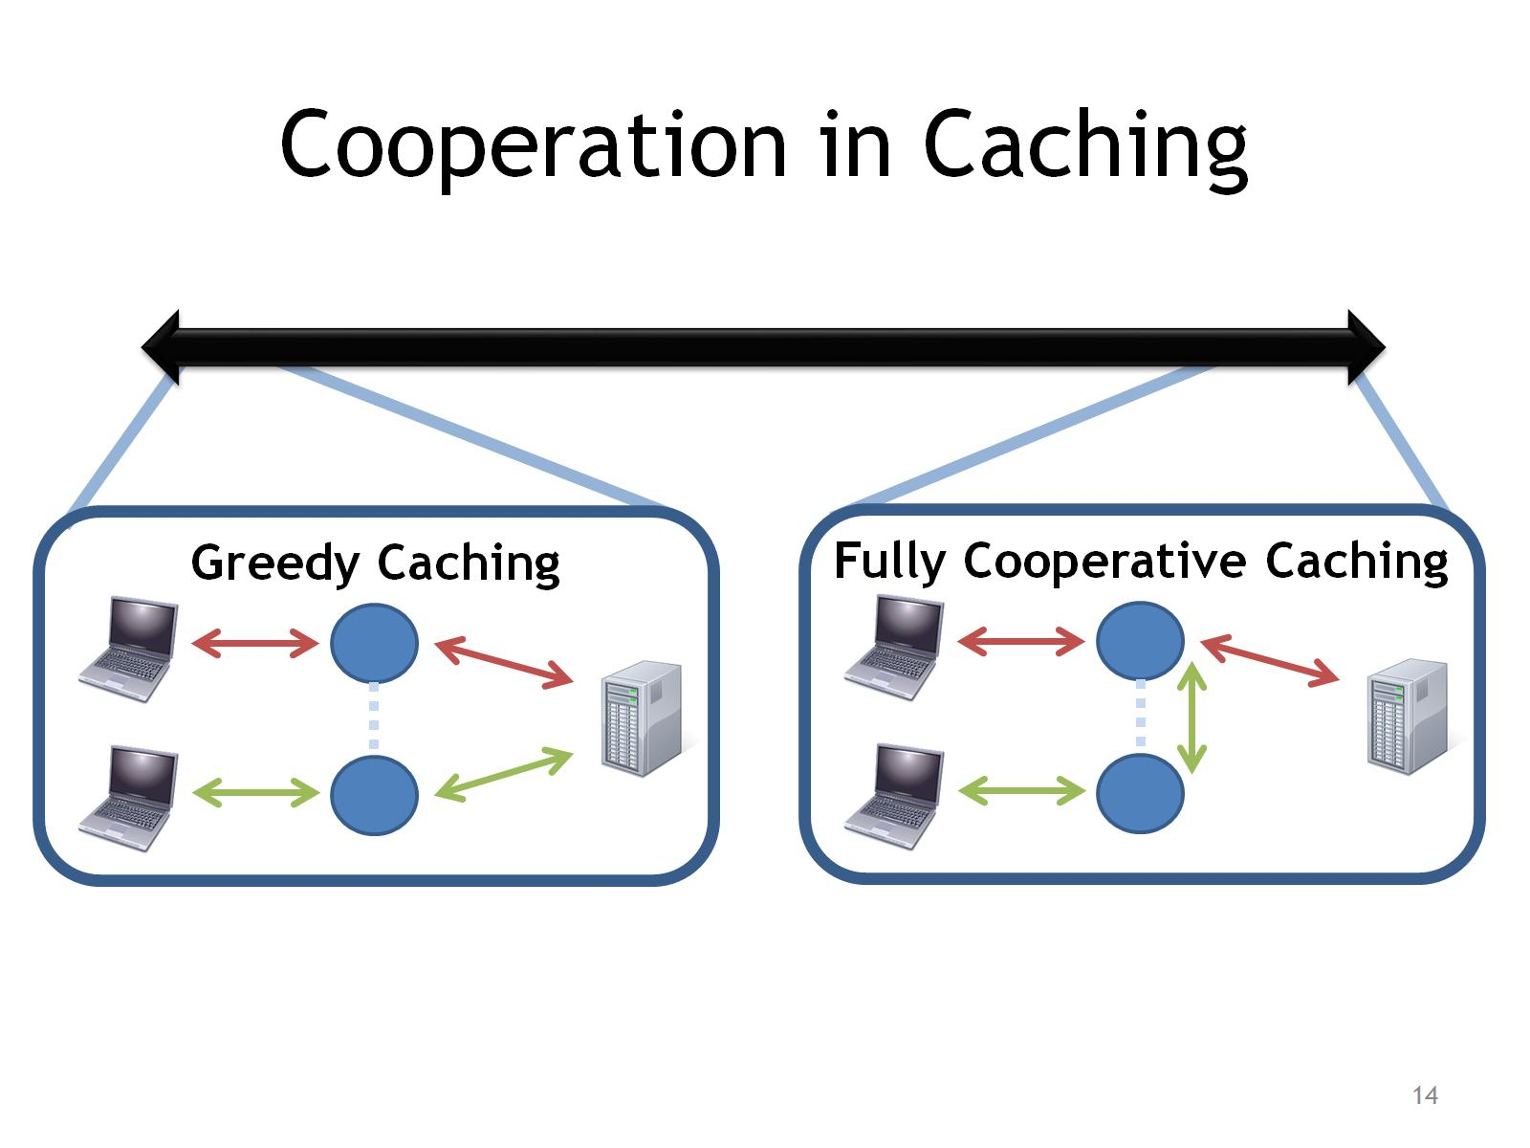
Cooperation in Caching

Slide 15
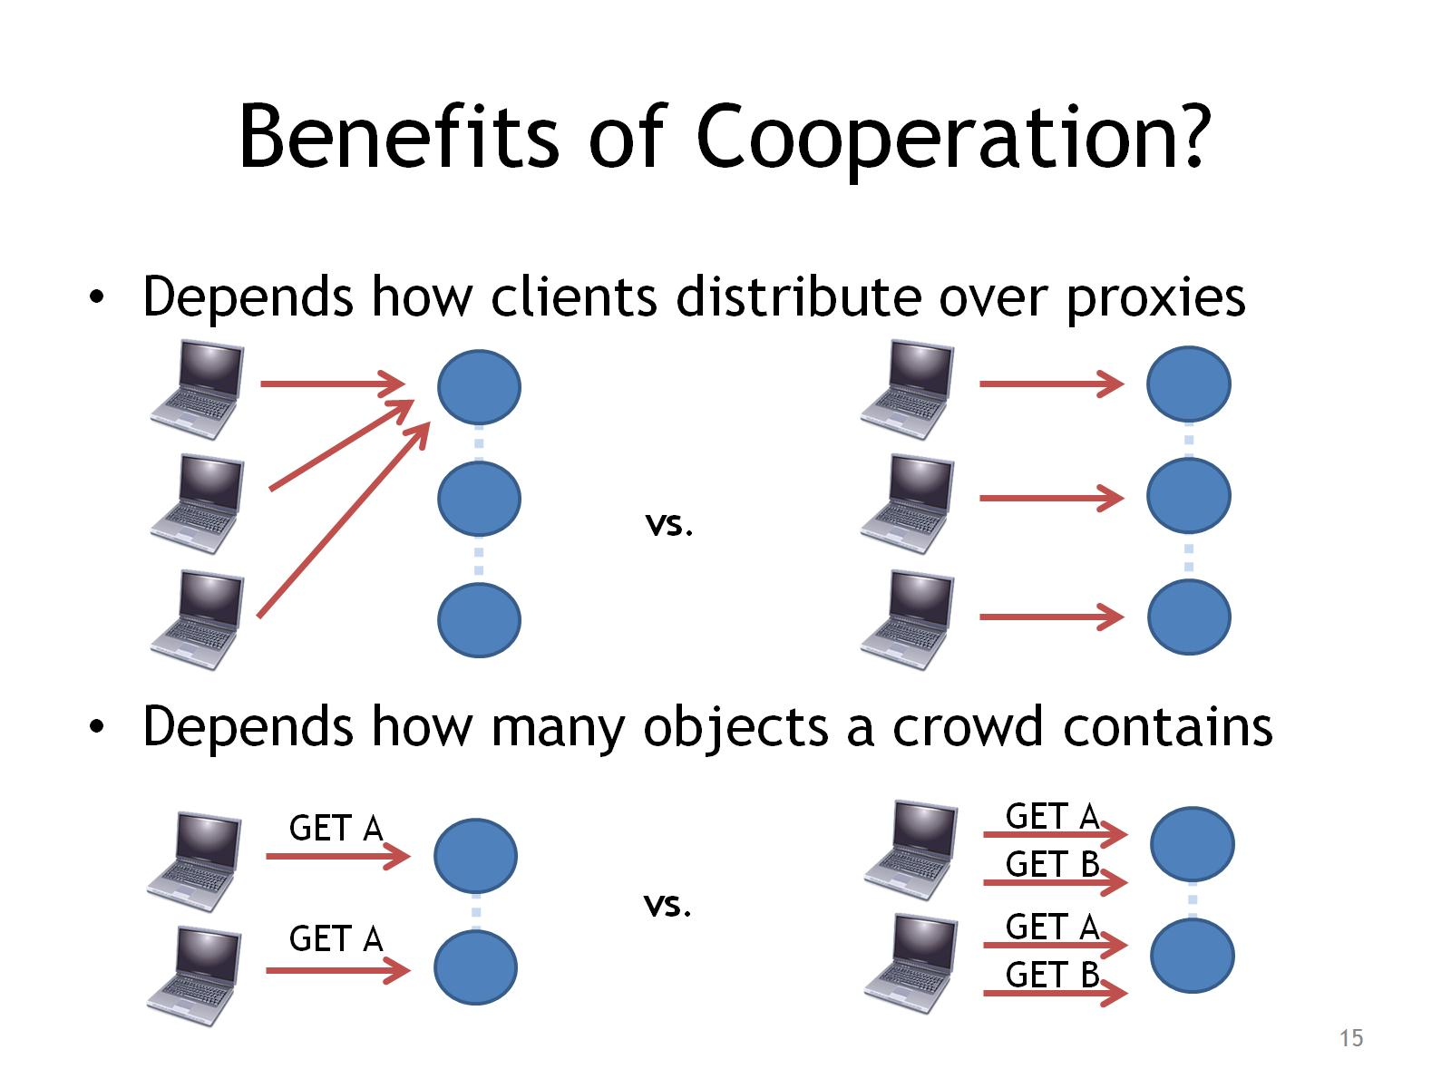
Benefits of Cooperation?

Slide 16
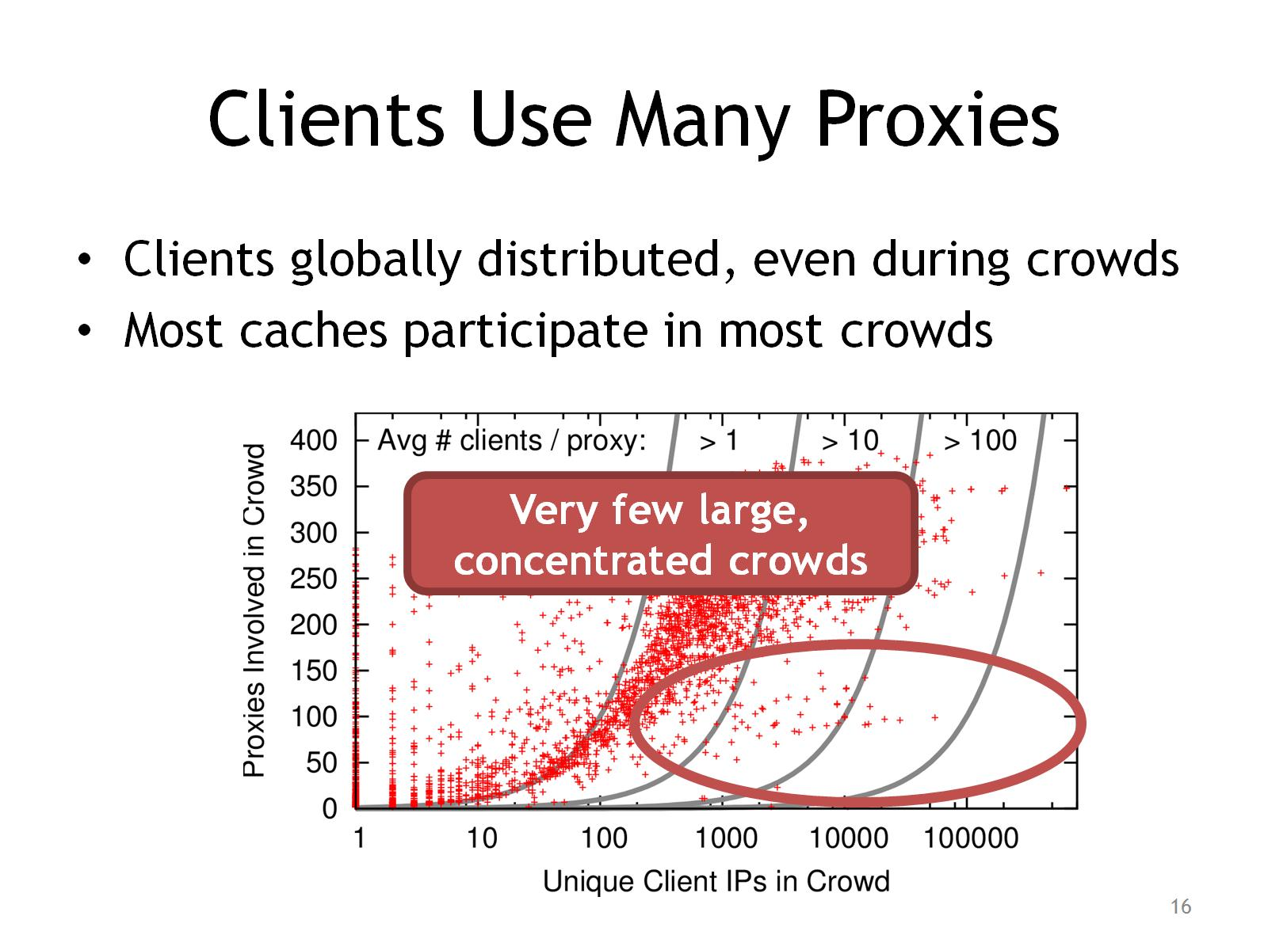
Clients Use Many Proxies

Slide 17
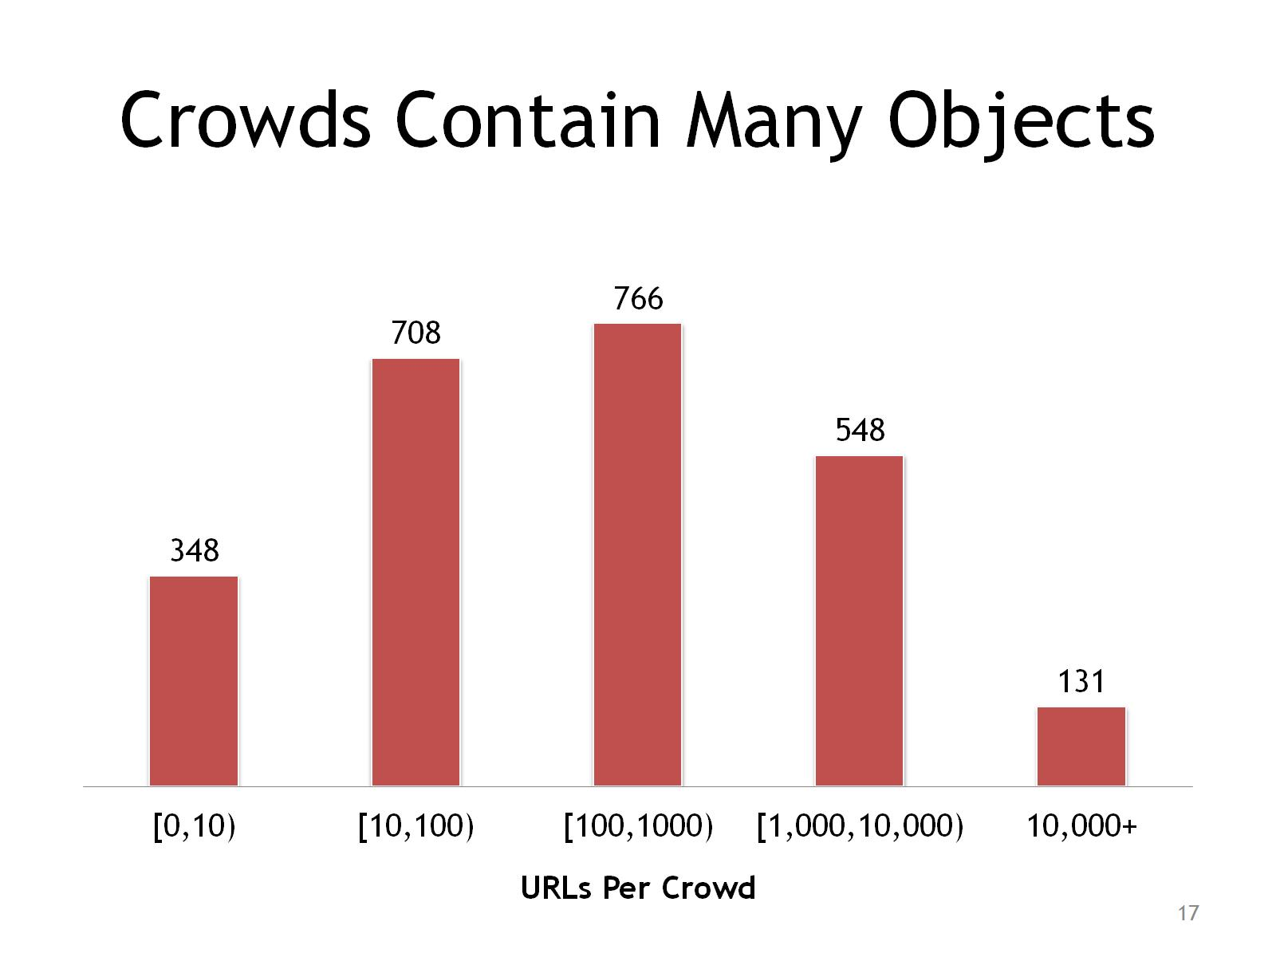
Crowds Contain Many Objects

Slide 18
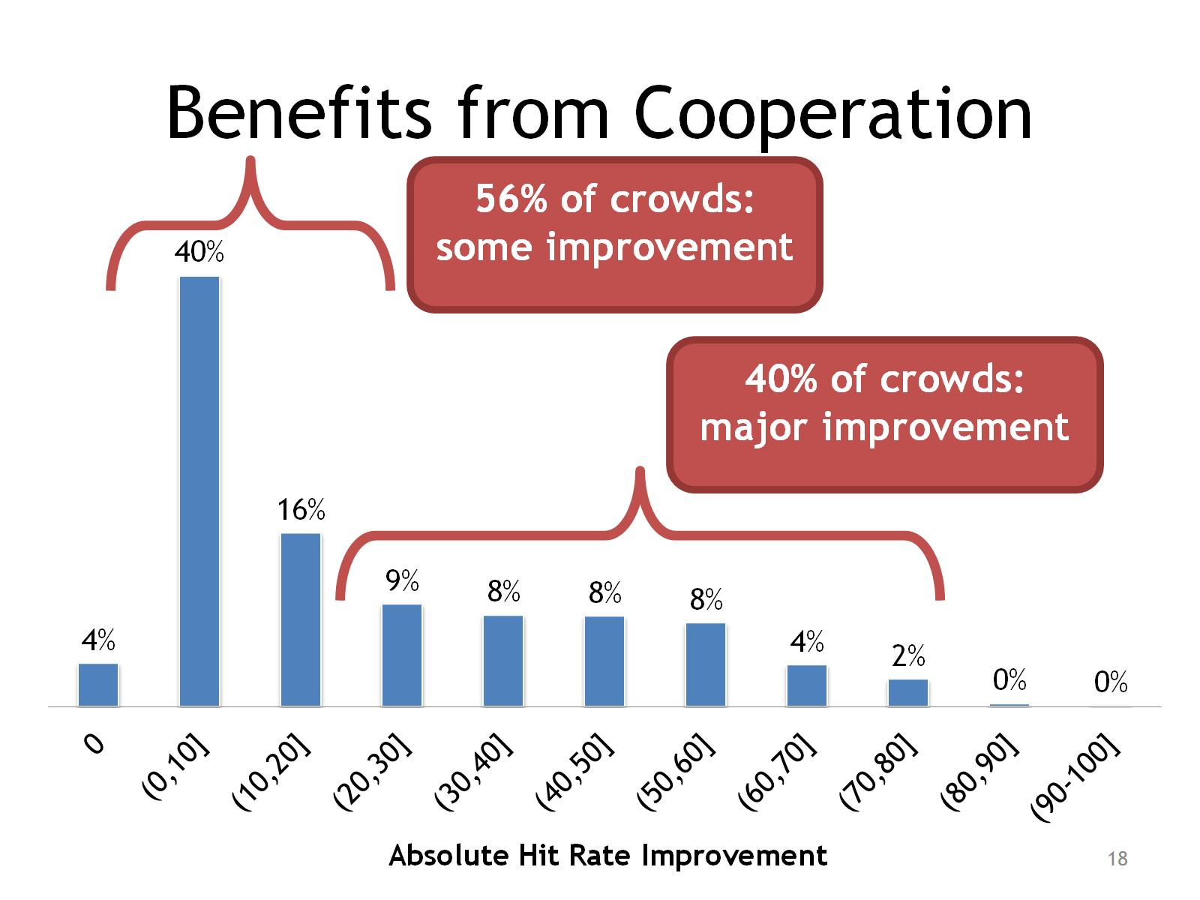
Benefits from Cooperation

Slide 19
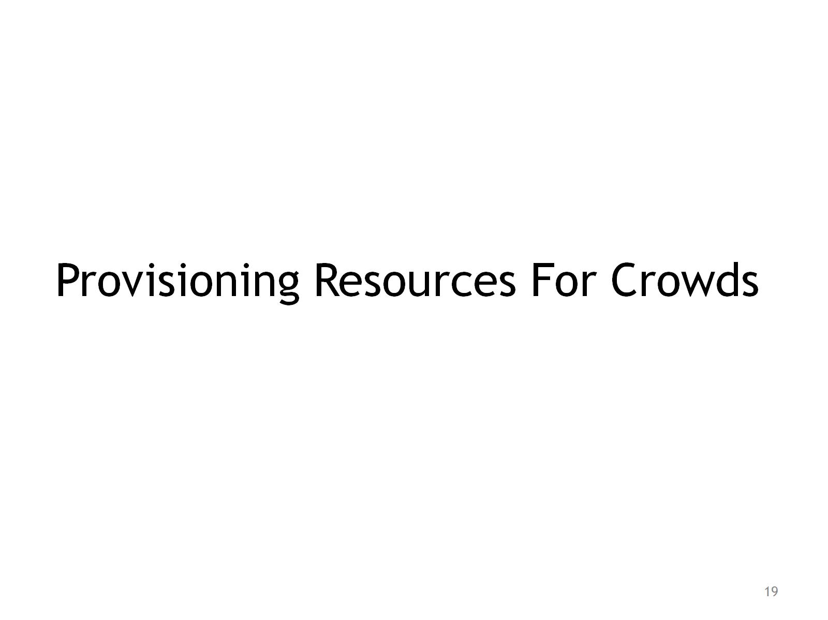
Provisioning Resources For Crowds

Slide 20
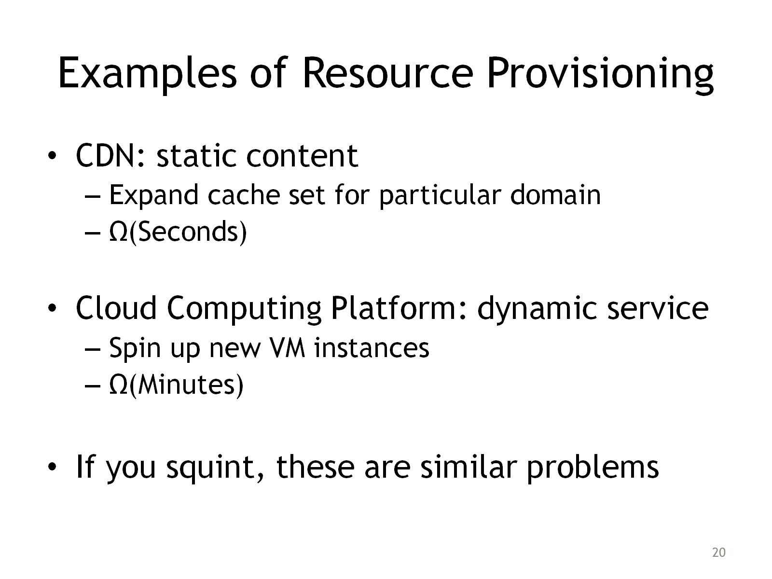
Examples of Resource Provisioning

Slide 21
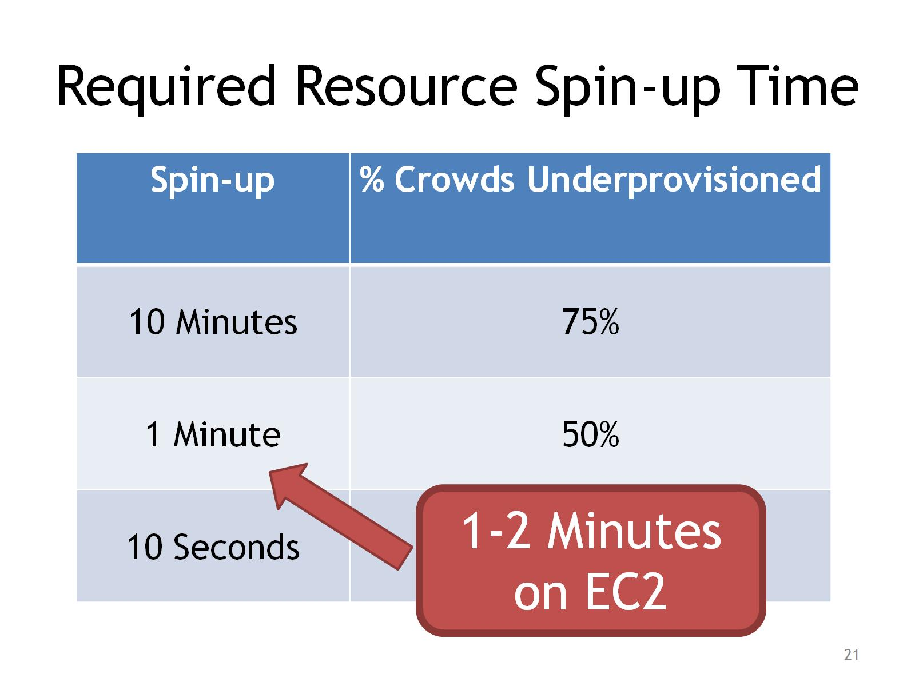
Required Resource Spin-up Time

Slide 22
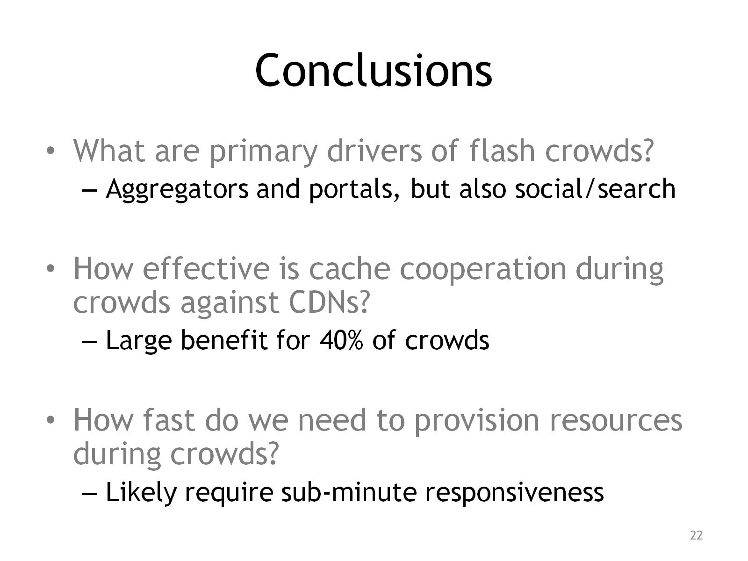
Conclusions

Slide 23
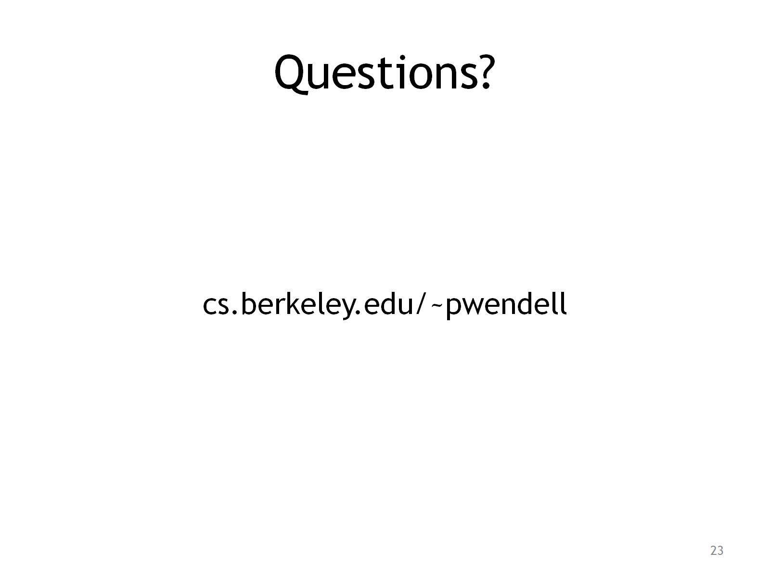
Questions?

Slide 24

Extra Slides / Charts

Slide 25
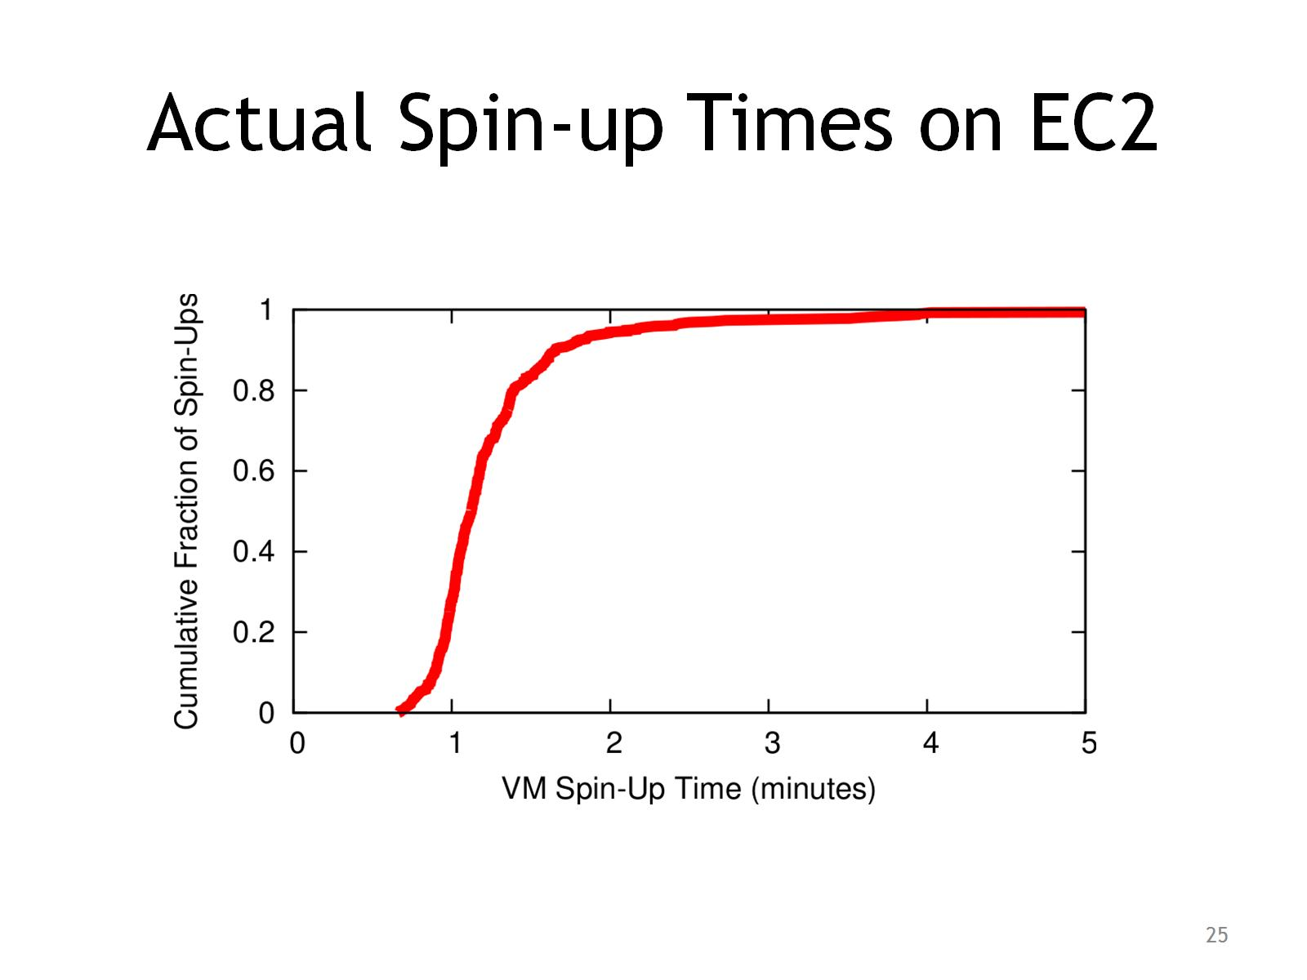
Actual Spin-up Times on EC2

Slide 26
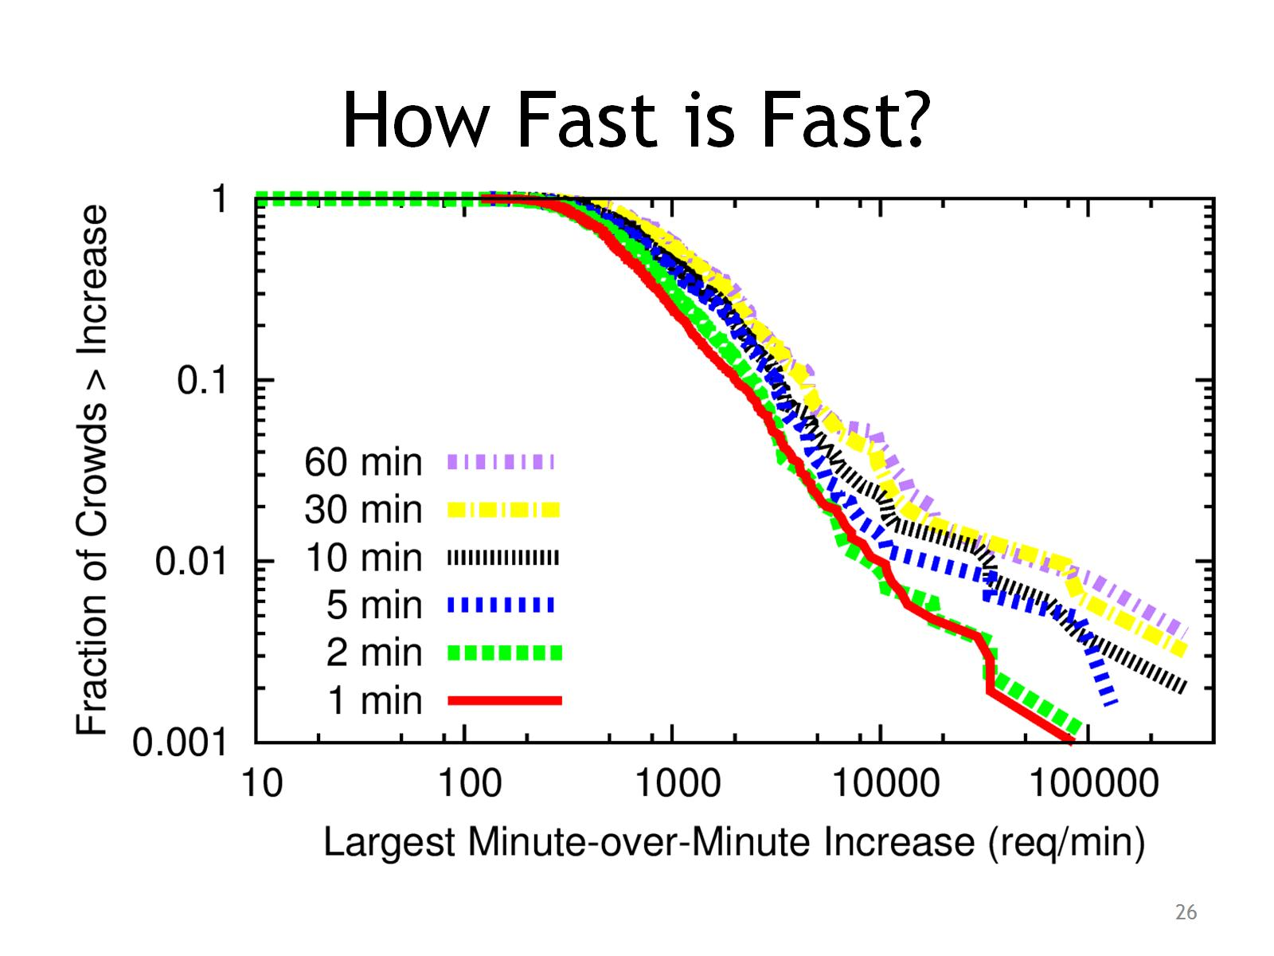
How Fast is Fast?

Slide 27
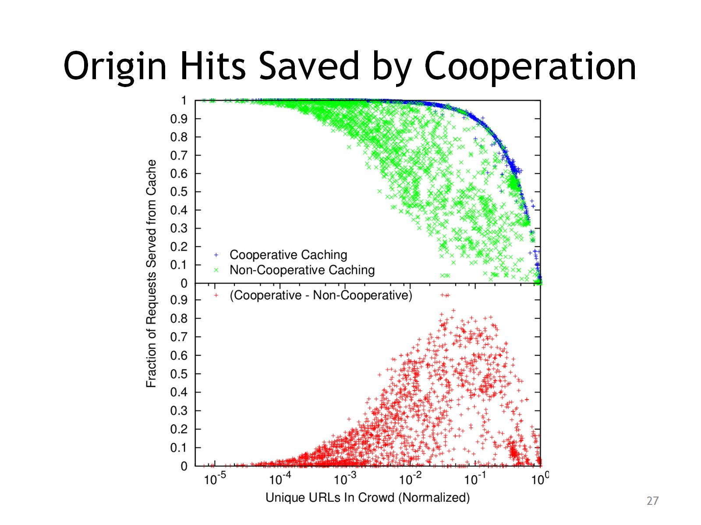
Origin Hits Saved by Cooperation

Slide 28
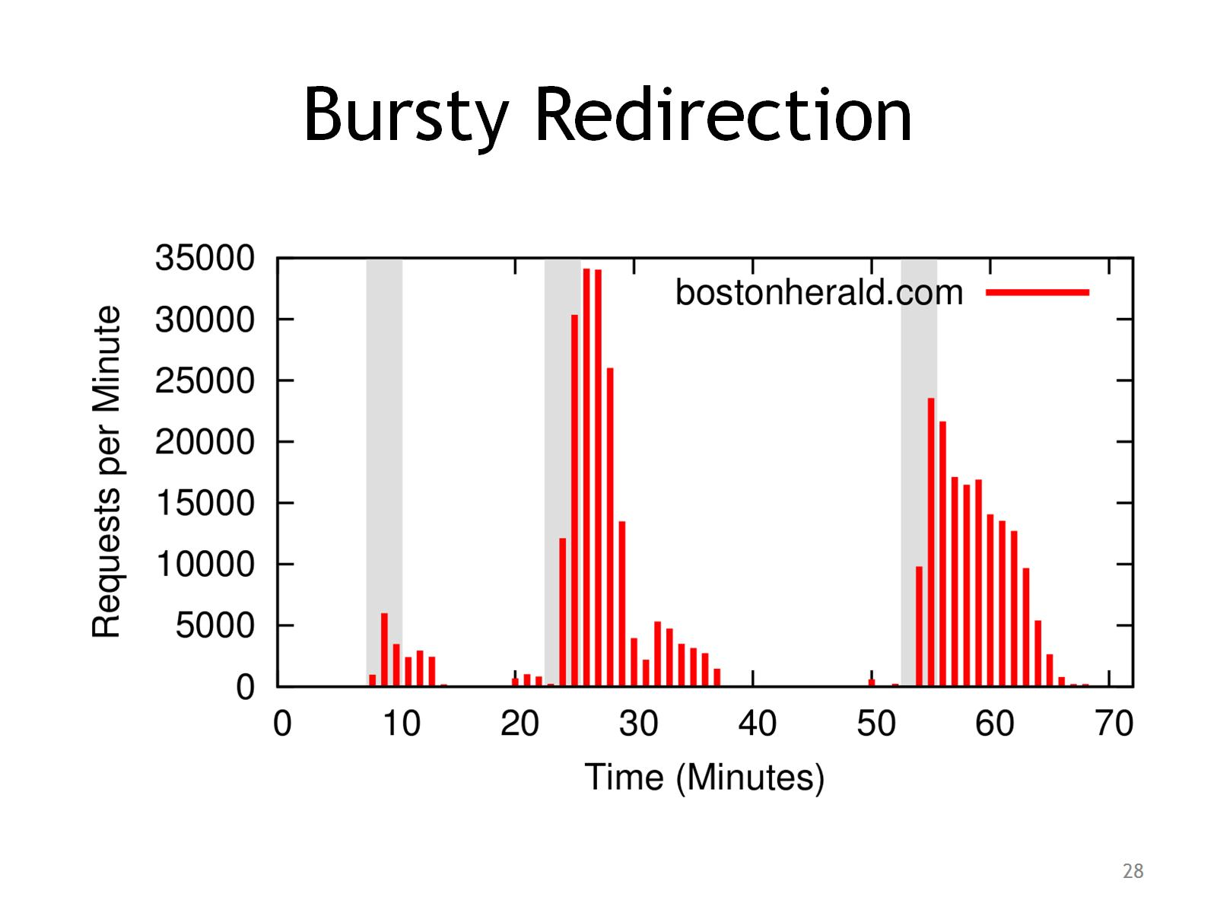
Bursty Redirection

Slide 29
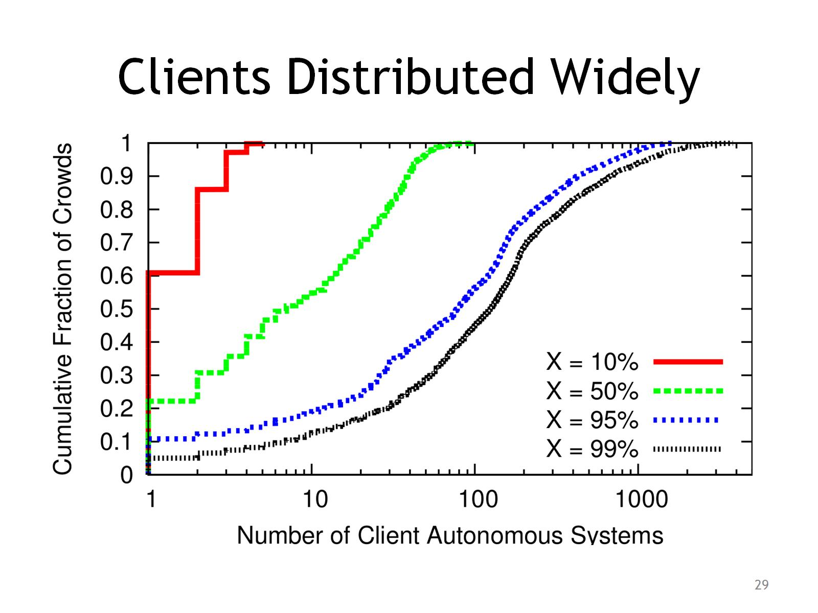
Clients Distributed Widely

Slide 30
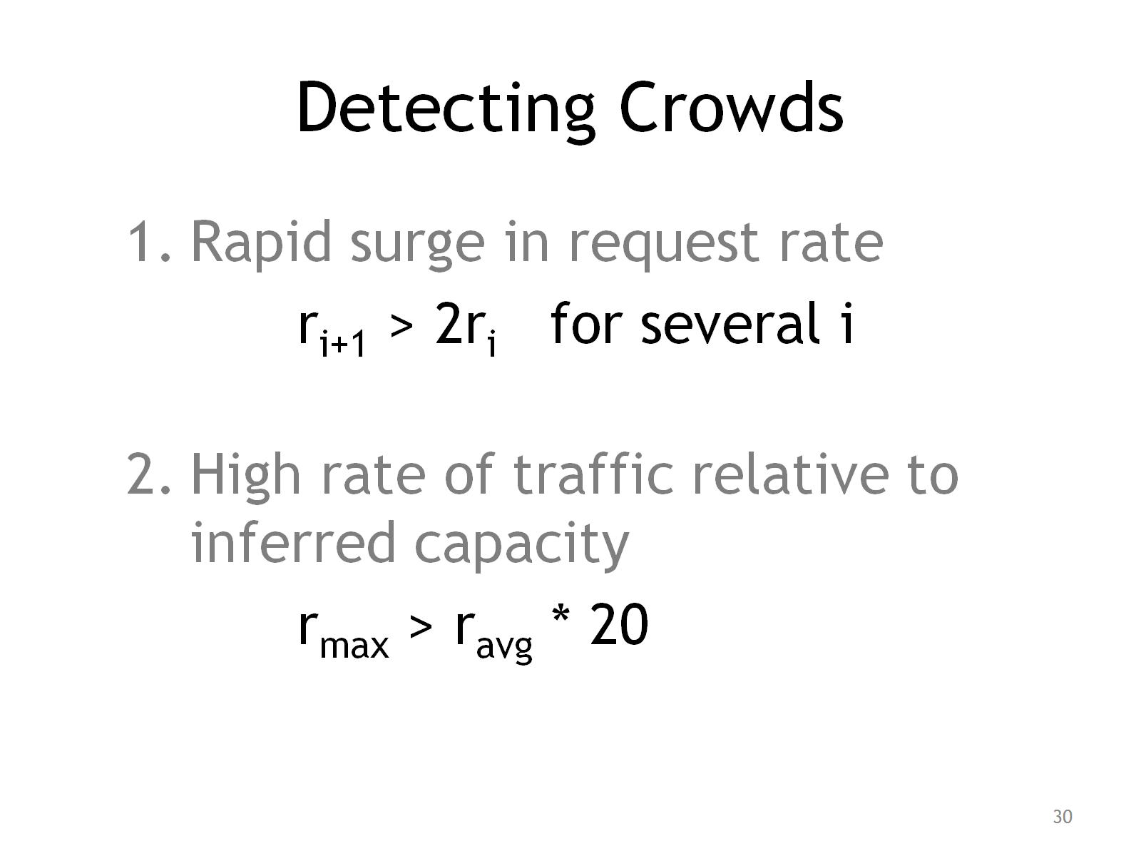
Detecting Crowds

Slide 31
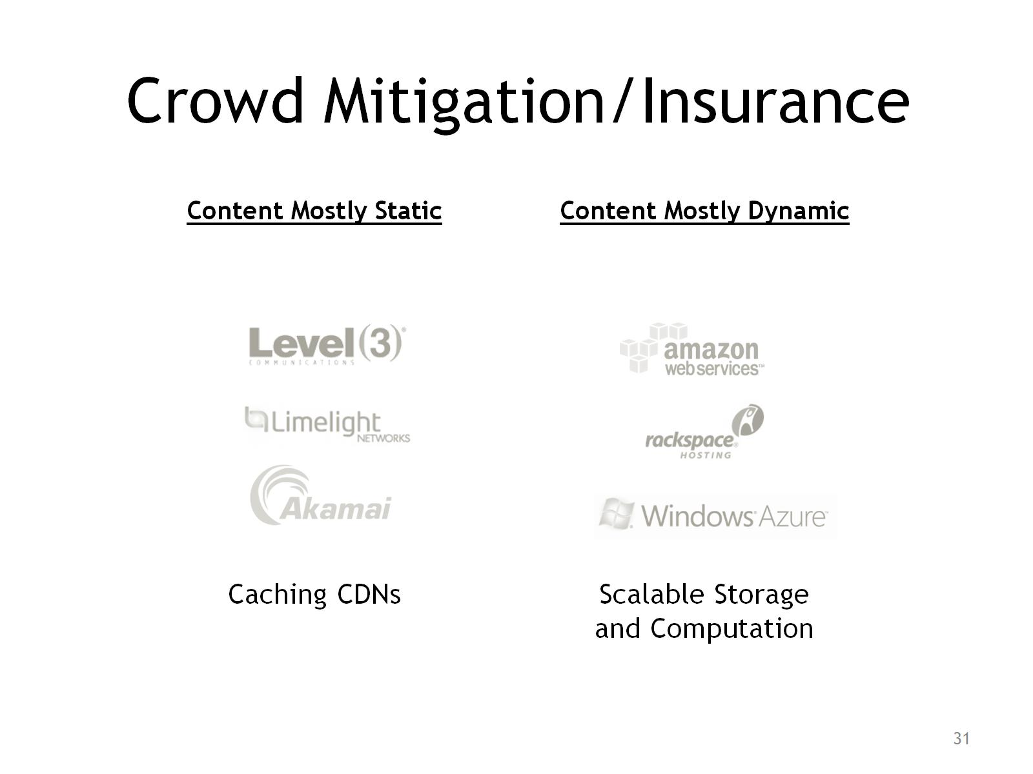
Crowd Mitigation/Insurance

