Slide 1
Living in King County, WA or
Sleepness in Seattle?

Slide 2
Introduction Part 1 – Stakeholder
Nicole Johnson
wants to buy a house that
  has a lively, central neighbourhood
  is in middle price range
  is at its dip (within a year)

Slide 3
Introduction Part 2 – Dataset
King County House Sales Dataset
  02/05/2014 - 27/05/2015
  ca. 20,000 tracked sales
  21 parameters (location, facilities, size, price, quality, ...)

Slide 4
Introduction Part 3 - Hypotheses
H1) the house will be older than 50 years and has not been renovated in the last 25 years (→ age)
H2) the house will has a below-average grade (→ quality)
H3) the house will has a below-average living square (→ size)

Slide 5
Linking requests to parameters
lively, central neighbourhood
  zip code
In middle price range
  40% - 60% percentile
time market (within a year)
  date

Slide 6
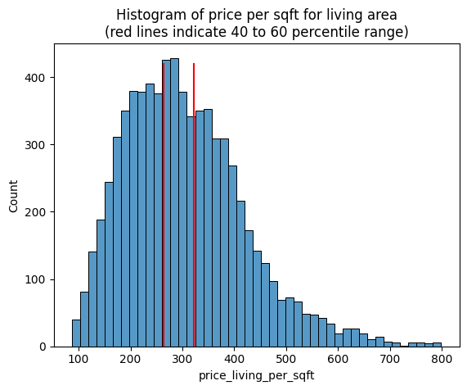
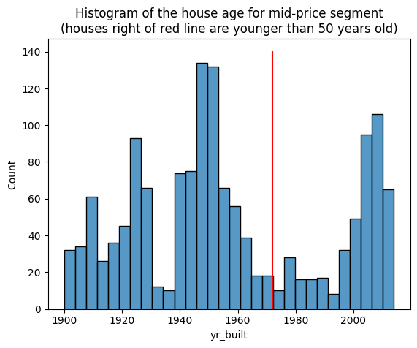
Results: H1 (older 50y, no renovation last 25y)

Slide 7
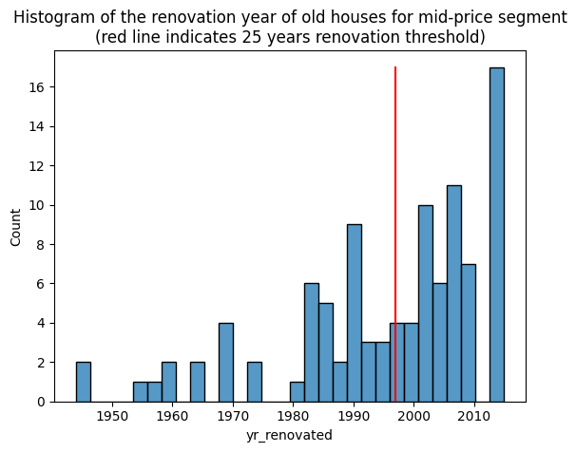
Results: H1 continued

Slide 8
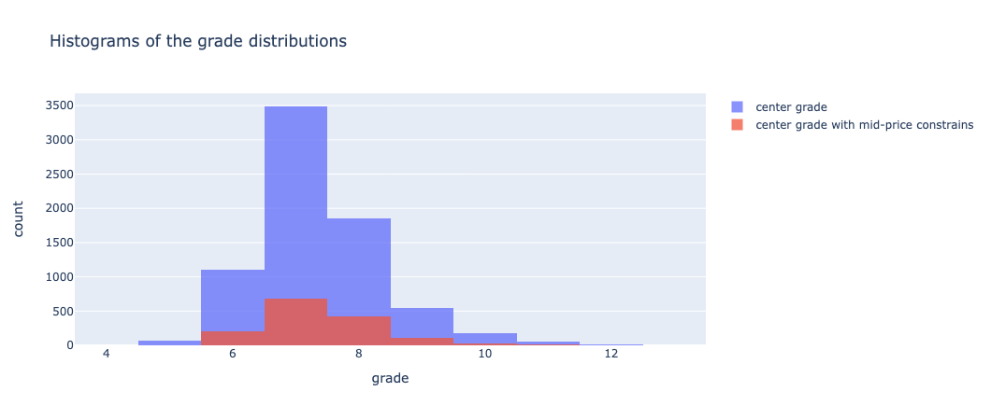
Results: H2 (below average grade)
grade mean: 7,34
grade mean: 7,37

Slide 9
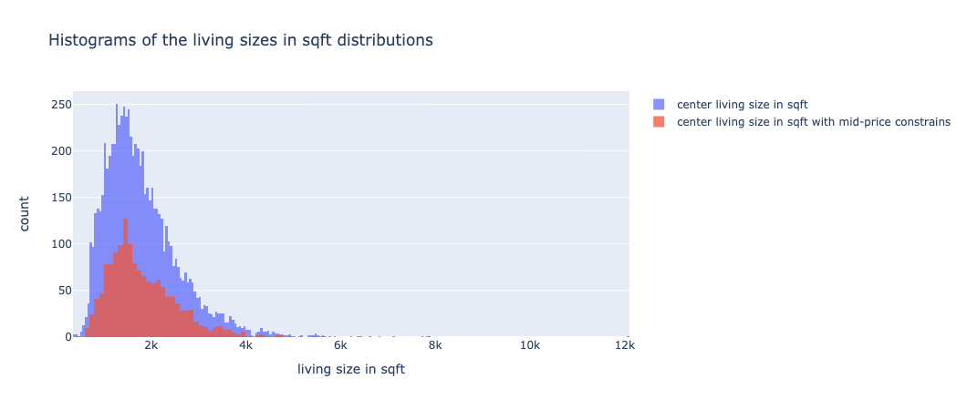
Results: H3 (below average living size)
living size mean: 1,799 ft²
living size mean: 1,813 ft²

Slide 10
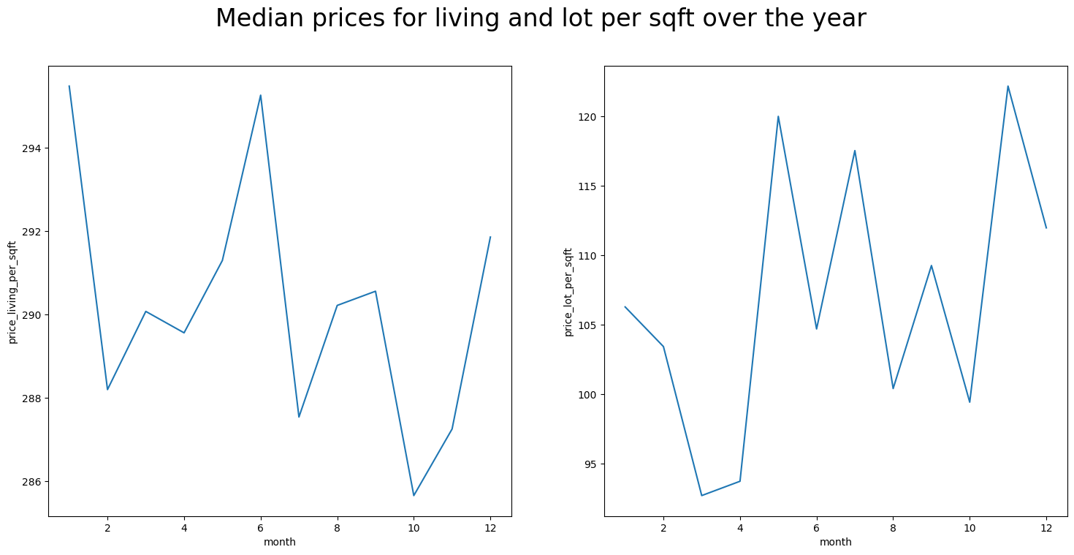
Results: Market Timing

Slide 11
Key take aways
an overall reasonable price in the mid-price segment for living area per square feet is between 263 USD and 321 USD
avoid buying in January and June and look for houses in October for maximizing living area
to maximize lot size, buy in march or April
the living area should have a size of about 1,800 square feet
the grade should at least be 7
most houses have been built 1940 - 1960 and 2000 - 2015. So when age is a criterium, look for houses in these built phases due to higher supply

