Slide 1
The Impact of Automation on Employment: Navigating the Future Workforce
Will automation ultimately lead to increase rather than decrease in job opportunities?

Slide 2

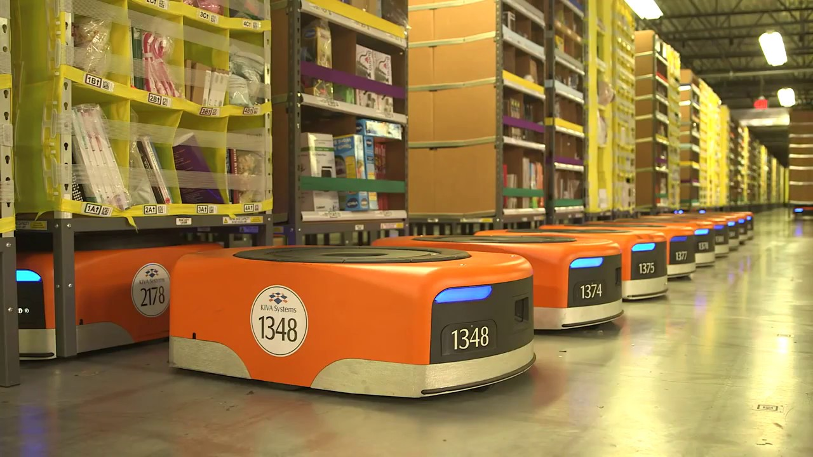
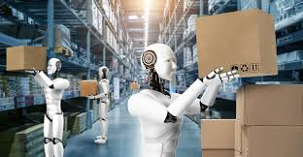

Automation and Employment
Definition of Automation
Impact on Employment
Opportunity and Challenge
is defined as the use of technology to operate without human intervention
By 2030, up to 800 million global workers could be displaced by automation
is becoming increasingly critical as countries recover from the economic effects of COVID-19 into everyday business operations
raises concerns about job loss and the widening skills gap
Technological advancements reshape the job market by displacing certain jobs
However, they also create new opportunities through innovation and economic growth

Slide 3
Arguments for Increased Job Opportunities
Historical Context of Automation
The Industrial Revolution in Britain marked a turning point in labor markets.
In the early 20th century, the mechanization of agriculture in America showcased how automation could transform industries.
Role of Social Policies in Mitigating Automation Effects
After World War II, nearly half (42%) of jobs in the UK were rendered redundant due to economic shifts.
The global financial crisis of 2008 and the COVID-19 pandemic highlight the importance of robust social and legal policies for economic stability
Proactive government intervention can counterbalance the disruptive effects of technological change and play a critical role in mitigating the adverse effects of automation and helping workers transition to new industries.

Slide 4
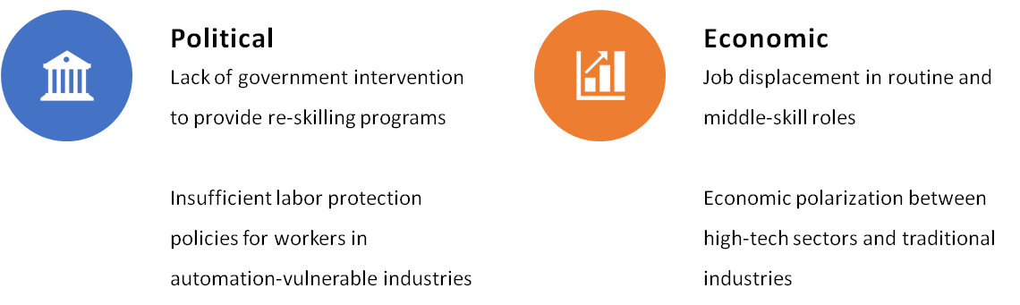
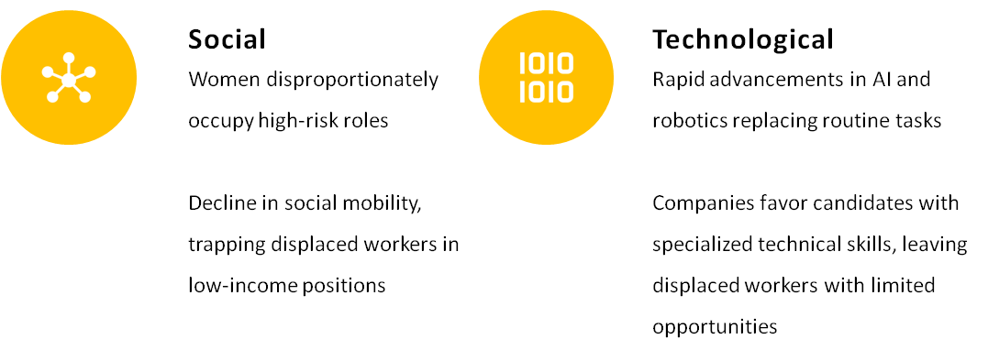
Arguments for decreased Job Opportunities

Slide 5
Personal Position on Automation and Employment
Innovation Catalyst: Automation drives innovation and enhances competitiveness across sectors by creating new job markets.
Education & Reskilling: The rise of educational technology presents opportunities for training displaced workers in high-demand fields.
Emergence of Hybrid Jobs: Automation is transforming traditional roles into hybrid jobs that require a mix of technical expertise and soft skills.

Slide 6
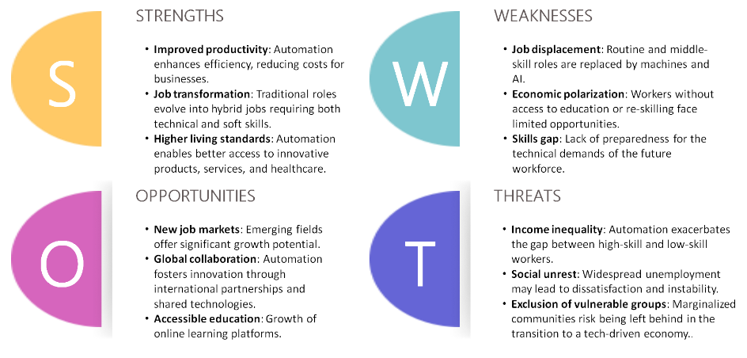
Social Impact of Automation

Slide 7

Conclusion
Job Creation Potential: Automation has the potential to create more jobs than it displaces if there is sufficient investment in innovation and education.
Education and Reskilling: Investing in partnerships to train displaced workers in high-demand fields is crucial.
Social Implications: Targeted policies are needed to prevent automation from worsening unemployment and inequality.

