Slide 1
USTLink

Slide 2

Overview
HKUST lacks a dedicated platform for student collaboration, especially for freshmen (pathadvisor)
To address gap, we develop "USTLink" mobile app, a dedicated forum designed for HKUST students
USTLink aims to be a vital platform for the HKUST community

Slide 3
Objectives
Secure login and registration for HKUST members.
A dynamic discussion forum for communication.
A deadline calendar for managing academic responsibilities.
An information page with useful links and resources.

Slide 4




Existing Solutions:

Slide 5
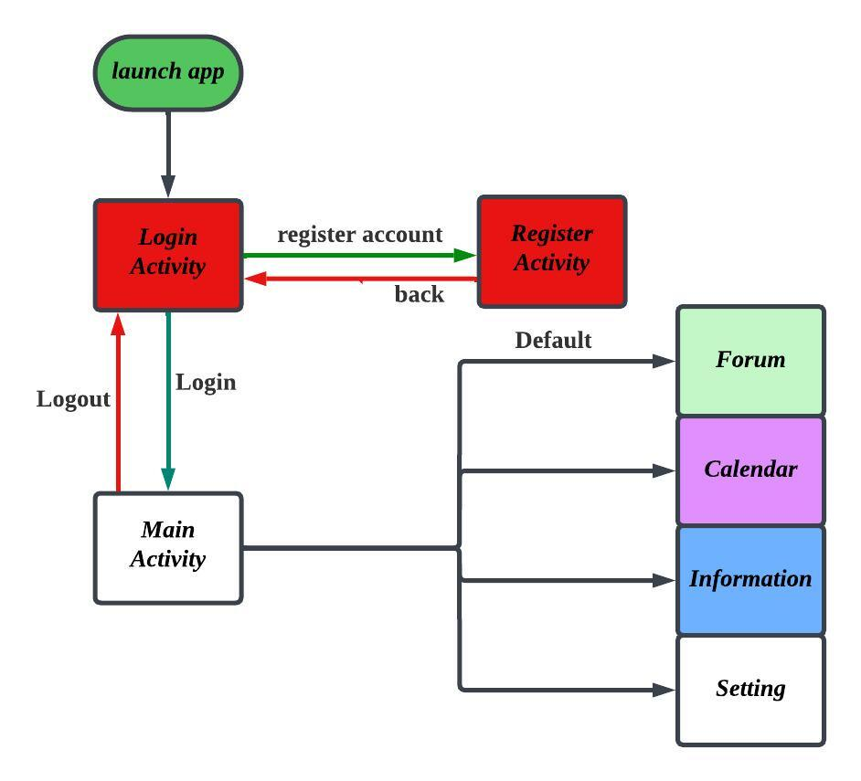






Overall Structure

Slide 6
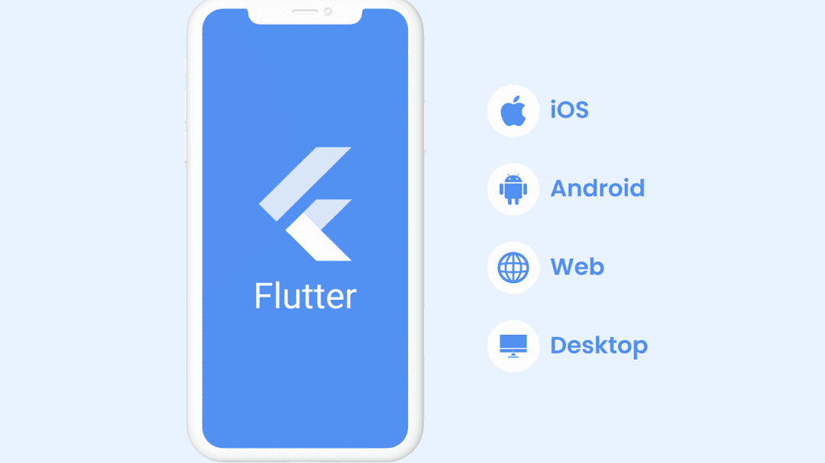
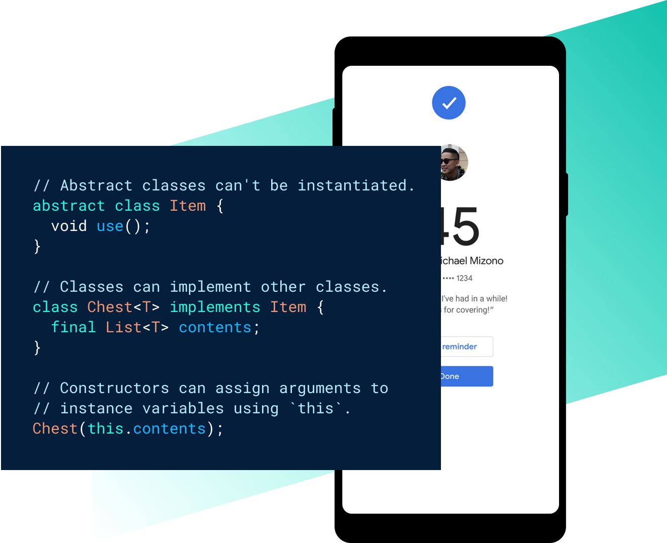


Slide 7
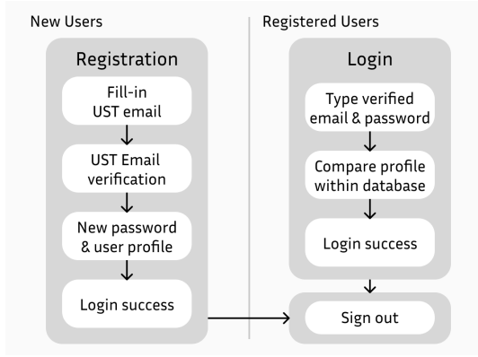

User Register/Login Function
Requires HKUST email verification.

Slide 8
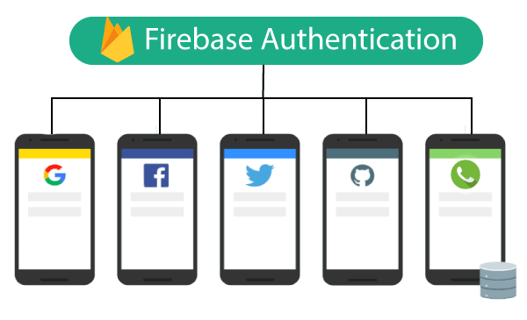
Database Design:
Uses Firebase for dynamic data access and security.
Accommodates basic forum functionalities like posts and comments.

Slide 9
UI Prototype
- **Forum Design:** - Features a searchable interface with likes, comments, and trending posts.
- **Deadline Calendar:** - Allows easy management of events with automatic reminders.
- **Information Page:** - Provides access to educational resources and HKUST updates.

Slide 10
chat

