Slide 2
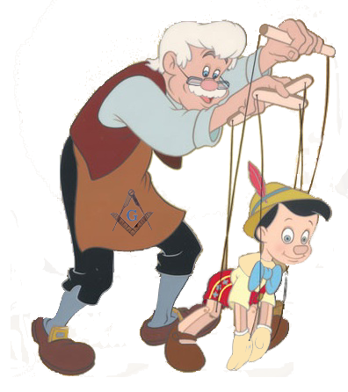
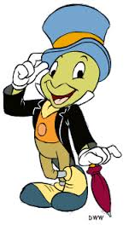
Why “Jiminy”?
Geppetto – “a language for the modeling of intelligent behavior”
Jiminy Cricket – Pinocchio’s wise (and comical) partner

Slide 3
Geppetto in a Nutshell

Slide 4
Caveats

