Slide 1
Amateur Radio General License Class
Based on July 1, 2019 –June 30, 2023 Question pool
Author- Jack Tiley AD7FO
Revision 1.8 – October 23, 2019
With March 15, 2019 errata

Slide 2
Amateur Radio General License Class
General Exam – G1 Questions
SUBELEMENT G1 – COMMISSION’S RULES
[5 exam Questions, one from each of 5 groups]

Slide 3
Question Pool Overview
SUBELEMENT G1 – COMMISSION’S RULES
[5 exam Questions, one from each of 5 groups]
SUBELEMENT G2 - OPERATING PROCEDURES
[5 Exam Questions- one from each of 5 Groups]
SUBELEMENT G3 – RADIO WAVE PROPAGATION
[3 Exam Questions - one from each of 3 Groups]

Slide 4

SUBELEMENT G4 - AMATEUR RADIO PRACTICES AND STATION SET-UP
[2 Exam Questions - one from each of 2 Groups]
SUBELEMENT G5 – ELECTRICAL PRINCIPLES
[3 Exam Questions - one from each of 3 Groups]
SUBELEMENT G6 – CIRCUIT COMPONENTS
[2 Exam Questions - one from each of 2 Groups]

Slide 5
SUBELEMENT G7 – PRACTICAL CIRCUITS
[3 Exam Questions - one from each of 3 Groups]
SUBELEMENT G8 – SIGNALS AND EMISSIONS
[3 Exam Questions - one from each of 3 Groups]
SUBELEMENT G9 – ANTENNAS AND FEED LINES
[4 Exam Questions - one from each of 4 Groups]

Slide 6

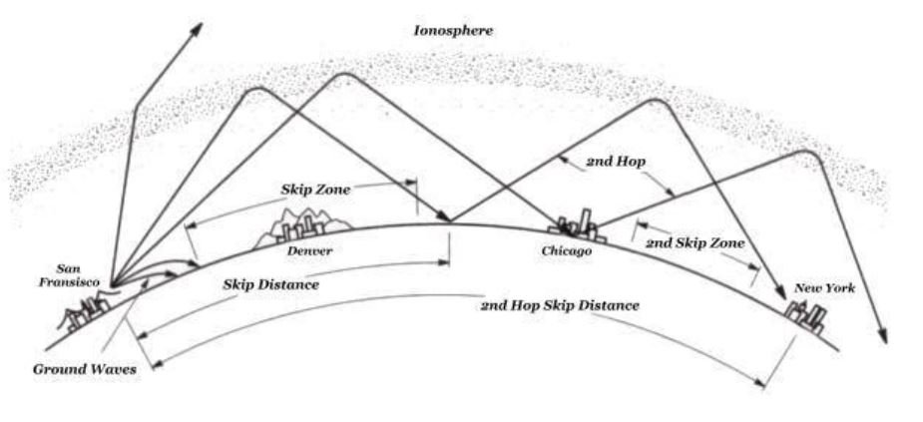
SUBELEMENT G0 – ELECTRICAL AND RF SAFETY
[2 Exam Questions - one from each of 2 Groups]

Slide 7
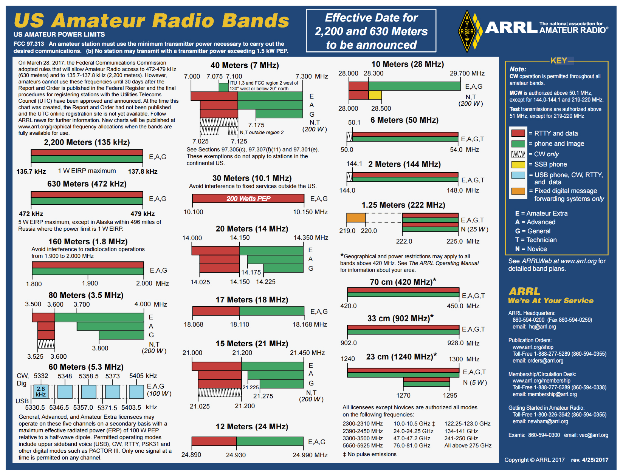

Slide 8


Slide 9
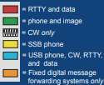
SUBELEMENT G1 – COMMISSION’S RULES [5 Exam Questions – 5 Groups]
G1A – General class control operator frequency privileges; primary and secondary allocations
G1A01 [97.301(d)]
On which HF/MF bands is a General class license holder granted all amateur frequency privileges?
160 meters, 60 meters, 30 meters, 17 meters, 12 meters, and 10 meters
G1A02 [97.305]
On which of the following bands is phone operation prohibited? 30 meters

Slide 10
G1A03 [97.305]
On which of the following bands is image transmission prohibited?
30 meters
See answer to G1A02
G1A04 [97.303 (h)]
Which of the following amateur bands is restricted to communication only on specific channels, rather than frequency ranges?
60 meters

Slide 11
G1A05 [97.301(d)]
Which of the following frequencies is in the General class portion of the 40-meter band (in ITU Region 2)? 7.250 MHz
G1A06 [97.301(d)]
Which of the following frequencies is within the General class portion of the 75-meter phone band? 3900 kHz

Slide 12
G1A07 [97.301(d)]
Which of the following frequencies is within the General class portion of the 20-meter phone band? 14,305 kHz
G1A08 [97.301(d)]
Which of the following frequencies is within the General class portion of the 80-meter band? 3560 kHz
3560 is in the RTTY portion of the band (red area).

Slide 13
G1A09 [97.301(d)]
Which of the following frequencies is within the General class portion of the 15-meter band? 21,300 kHz
G1A10 [97.301(d)]
Which of the following frequencies is available to a control operator holding a General class license?
A. 28.020 MHz
B. 28.350 MHz
C. 28.550 MHz
D. All these choices are correct

Slide 14
G1A11 [97.301]
When General class licensees are not permitted to use the entire voice portion of a band, which portion of the voice segment is generally available to them?
The upper frequency end
G1A12 [97.303]
Which of the following applies when the FCC rules designate the Amateur Service as a secondary user on a band?
Amateur stations can use the band only if they do not cause harmful interference to primary users
G1A13 [97.303(5)(h)(2)(j)]
What is the appropriate action if, when operating on either the 30-meter or 60-meter bands, a station in the primary service interferes with your contact?
Move to a clear frequency or stop transmitting

Slide 15
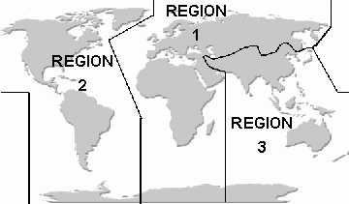
G1A14 [97.301(d)]
Which of the following may apply in areas under FCC jurisdiction outside of ITU Region 2? Frequency allocations may differ
ITU – International Telecommunications Union is divided into three regions; the US is in region 2.
G1A15 [97.205(b)]
What portion of the 10-meter band is available for repeater use?
The portion above 29.5 MHz
Note: this is not shown on the ARRL band plan but is shown in the repeater directory.

Slide 16
G1B – Antenna structure limitations; good engineering and good amateur practice; beacon operation; prohibited transmissions; retransmitting radio signals
G1B01 [97.15(a)]
What is the maximum height above ground to which an antenna structure may be erected without requiring notification to the FAA and registration with the FCC, provided it is not at or near a public use airport? 200 feet
G1B02 [97.203(b)]
With which of the following conditions must beacon stations comply?
There must be no more than one beacon signal transmitting in the same band from the same station location

Slide 17
G1B03 [97.3(a)(9)]
Which of the following is a purpose of a beacon station as identified in the FCC rules? Observation of propagation and reception
G1B04 [97.113(c)]
Which of the following transmissions is permitted? Occasional retransmission of weather and propagation forecast information from U.S. government stations
G1B05 [97.111((5)(b)]
Which of the following one-way transmissions are permitted?
Transmissions necessary to assist learning the International Morse code

Slide 18
G1B06 [97.15(b), PRB-1, 101 FCC 2d 952 (1985)]
Under what conditions are state and local governments permitted to regulate Amateur Radio antenna structures? Amateur Service communications must be reasonably accommodated, and regulations must constitute the minimum practical to accommodate a legitimate purpose of the state or local entity
G1B07 [97.113(a)(4)]
What are the restrictions on the use of abbreviations or procedural signals in the Amateur Service? They may be used if they do not obscure the meaning of a message

Slide 19
G1B08 [97.101(a)]
When choosing a transmitting frequency, what should you do to comply with good amateur practice?
A. Ensure that the frequency and mode selected are within your license class privileges
B. Follow generally accepted band plans agreed to by the Amateur Radio community
C. Monitor the frequency before transmitting
D. All these choices are correct
G1B09 [97.203(d)]
On what HF frequencies are automatically controlled beacons permitted?
28.20 MHz to 28.30 MHz
An amateur radio beacon is a radio beacon, whose purpose is the investigation of the propagation of radio signals.. They can be found on LF, MF, HF, VHF, UHF, and microwave frequencies. Go to www.ncdxf.org/beacon for more information

Slide 20
G1B10 [97.203(c)]
What is the power limit for beacon stations? 100 watts PEP output
G1B11 [97.101(a)]
Who or what determines “good engineering and good amateur practice,” as applied to the operation of an amateur station in all respects not covered by the Part 97 rules?
The FCC (Federal Communications Commission)
G1B12 [97.111(a)(1)]
When is it permissible to communicate with amateur stations in countries outside the areas administered by the Federal Communications Commission?
When the contact is with amateurs in any country except those whose administrations have notified the ITU that they object to such communications
Only Yemen and North Korea currently do not allow ham radio by its citizens.

Slide 21
G1C – Transmitter power regulations; data emission standards; 60-meter operation requirements
G1C01 [97.313(c)(1)]
What is the maximum transmitting power an amateur station may use on 10.140 MHz? 200 watts PEP output
PEP, Peak envelope power is the peak power of the voice (or other Modulation type). Single sideband power is a function of the modulation signal. The louder you talk the more peak power your transmission has (up to the limit of your transmitter).
G1C02 [97.313]
What is the maximum transmitting power an amateur station may use on the 12-meter band? 1500 watts PEP output

Slide 22
G1C03 (A) [97.303(h)(1)]
What is the maximum bandwidth permitted by FCC rules for Amateur Radio stations transmitting on USB frequencies in the 60-meter band? 2.8 kHz
G1C04 [97.313(a)]
Which of the following limitations apply to transmitter power on every amateur band? Only the minimum power necessary to carry out the desired communications should be used
G1C05 [97.313]
What is the limit for transmitter power on the 28 MHz band for a General Class control operator? 1500 watts PEP output

Slide 23
G1C06 [97.313]
What is the limit for transmitter power on the 1.8 MHz band? 1500 watts PEP output
G1C07 [97.305(c), 97.307(f)(3)]
What is the maximum symbol rate permitted for RTTY or data emission transmission on the 20-meter band? 300 baud
Maximum Symbol rates (baud)
Band Max Symbol Rate Signal Bandwidth
Below 10 Meters 300 baud 1 KHz
10 Meters 1200 baud 1 KHz
6 & 2 meters 19.6 K baud 20 KHz
1.25m to 70 cm 56 K baud 100 KHz
23 cm and above no limit no limit

Slide 24
G1C08 [97.307(f)(3)]
What is the maximum symbol rate permitted for RTTY or data emission transmitted at frequencies below 28 MHz? 300 baud
Band Max Symbol Rate Signal Bandwidth
10 Meters 300 baud 1 KHz
G1C09 [97.305(c) and 97.307(f)(5)]
What is the maximum symbol rate permitted for RTTY or data emission transmitted on the 1.25-meter and 70-centimeter bands? 56 kilobaud
Band Max Symbol Rate Signal Bandwidth
1.25m to 70 cm 56 K baud 100 KHz

Slide 25
G1C10 [97.305(c) and 97.307(f)(4)]
What is the maximum symbol rate permitted for RTTY or data emission transmissions on the 10-meter band? 1200 baud
Band Max Symbol Rate Signal Bandwidth
10 Meters 1200 baud 1 KHz
G1C11 [97.305(c) and 97.307(f)(5)]
What is the maximum symbol rate permitted for RTTY or data emission transmissions on the 2-meter band? 19.6 kilobaud
Band Max Symbol Rate Signal Bandwidth
6 & 2 meters 19.6 K baud 20 KHz

Slide 26
G1C12 [97.303(i)]
Which of the following is required by the FCC rules when operating in the 60-meter band? If you are using an antenna other than a dipole, you must keep a record of the gain of your antenna
G1C13 [97.309(a)(4)]
What must be done before using a new digital protocol on the air?
Publicly document the technical characteristics of the protocol

Slide 27
G1C14 [97.313(i)]
What is the maximum power limit on the 60-meter band?
ERP of 100 watts PEP with respect to a dipole
Effective radiated power is the sum of the transmitter outpower and any gain or loss in the path to the antenna. A 200-watt transmitter with 3 dB of cable loss would be an ERP of 100 watts into the antenna.
G1C15 (D) [97.313]
What measurement is specified by FCC rules that regulate maximum power output? PEP

Slide 28
G1D – Volunteer Examiners and Volunteer Examiner Coordinators; temporary identification; element credit
G1D01 [97.501, 97.505(a)]
Who may receive partial credit for the elements represented by an expired Amateur Radio license? Any person who can demonstrate that they once held an FCC-issued General, Advanced, or Amateur Extra class license that was not revoked by the FCC
G1D02 [97.509(b)(3)(i)]
What license examinations may you administer when you are an accredited VE holding a General class operator license? Technician only
G1D03 [97.9(b)]
On which of the following band segments may you operate if you are a Technician class operator and have a Certificate of Successful Completion of Examination (CSCE) for General class privileges? On any General or Technician class band segment

Slide 29
G1D04 [97.509(3)(i)(c)]
Which of the following is a requirement for administering a Technician class license examination? At least three General class or higher VEs must observe the examination
G1D05 [97.509(b)(3)(i)]
Which of the following must a person have before they can be an administering VE for a Technician class license examination? An FCC General class or higher license and VEC accreditation
G1D06 [97.119(f)(2)]
When must you add the special identifier "AG" after your call sign if you are a Technician class licensee and have a Certificate of Successful Completion of Examination (CSCE) for General class operator privileges, but the FCC has not yet posted your upgrade on its website? Whenever you operate using General class frequency privileges
As soon as your license appears on the FCC ULS Data base you do not need to use AG identifier.

Slide 30

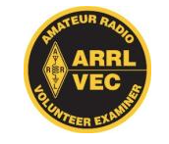
G1D07 [97.509(b)(1)]
Volunteer Examiners are accredited by what organization? A Volunteer Examiner Coordinator
G1D08 [97.509(b)(3)]
Which of the following criteria must be met for a non-U.S. citizen to be an accredited Volunteer Examiner? The person must hold an FCC granted Amateur Radio license of General class or above
G1D09 [97.9(b)]
How long is a Certificate of Successful Completion of Examination (CSCE) valid for exam element credit? 365 days
G1D10 [97.509(b)(2)]
What is the minimum age that one must be to qualify as an accredited Volunteer Examiner? 18 years

Slide 31
G1D11 [97.505]
What is required to obtain a new General class License after a previously held license has expired and the two year grace period has passed? The applicant must pass the current Element 2 exam
Element 2 is the Technician License Exam.
G1E – Control categories; repeater regulations; third-party rules; ITU regions; automatically controlled digital station
G1E01 [97.115(b)(2)]
Which of the following would disqualify a third party from participating in stating a message over an amateur station? The third party’s amateur license has been revoked and not reinstated

Slide 32
G1E02 [97.205(b)]
When may a 10-meter repeater retransmit the 2-meter signal from a station that has a Technician class control operator? Only if the 10-meter repeater control operator holds at least a General class license
G1E03 [97.221]
What is required to conduct communications with a digital station operating under automatic control outside the automatic control band segments?
The station initiating the contact must be under local or remote control
G1E04 [97.13(b), 97.303, 97.311(b)]
Which of the following conditions require a licensed Amateur Radio operator to take specific steps to avoid harmful interference to other users or facilities?
A. When operating within one mile of an FCC Monitoring Station
B. When using a band where the Amateur Service is secondary
C. When a station is transmitting spread spectrum emissions
D. All these choices are correct

Slide 33
G1E05 [97.115(a)(2),97.117]
What types of messages for a third party in another country may be transmitted by an amateur station? Only messages relating to Amateur Radio or remarks of a personal character, or messages relating to emergencies or disaster relief
G1E06 [97.301, ITU Radio Regulations]
The frequency allocations of which ITU region apply to radio amateurs operating in North and South America? Region 2
See answer for G1A14.
G1E07 [97.111]
In what part of the 13-centimeter band may an amateur station communicate with non-licensed Wi-Fi stations? No part
13 cm is the commercial wi-fi band around 2300 MHz.

Slide 34
G1E08 [97.313(j)]
What is the maximum PEP output allowed for Spread Spectrum Transmissions 10 watts
G1E09 [97.115]
Under what circumstances are messages that are sent via digital modes exempt from Part 97 third-party rules that apply to other modes of communication? Under no circumstances

Slide 35
G1E10 [97.101]
Why should an amateur operator normally avoid transmitting on 14.100, 18.110, 21.150, 24. 930 and 28.200 MHz? A system of propagation beacon stations operates on those frequencies
G1E11 [97.221]
On what bands may automatically controlled stations transmitting RTTY or data emissions communicate with other automatically controlled digital stations? Anywhere in the 6 meter or shorter wavelength bands, and in limited segments of some of the HF bands

