Slide 1
Amateur Radio General License Class
Based on July 1, 2019 –June 30, 2023 Question pool
Author- Jack Tiley AD7FO
Revision 1.8 – October 23, 2019
With March 15, 2019 errata

Slide 2
Amateur Radio General License Class
General Exam – G2 Questions
SUBELEMENT G2 - OPERATING PROCEDURES
[5 Exam Questions- one from each of 5 Groups]

Slide 3
Question Pool Overview
SUBELEMENT G1 – COMMISSION’S RULES
[5 exam Questions, one from each of 5 groups]
SUBELEMENT G2 - OPERATING PROCEDURES
[5 Exam Questions- one from each of 5 Groups]
SUBELEMENT G3 – RADIO WAVE PROPAGATION
[3 Exam Questions - one from each of 3 Groups]

Slide 4

SUBELEMENT G4 - AMATEUR RADIO PRACTICES AND STATION SET-UP
[2 Exam Questions - one from each of 2 Groups]
SUBELEMENT G5 – ELECTRICAL PRINCIPLES
[3 Exam Questions - one from each of 3 Groups]
SUBELEMENT G6 – CIRCUIT COMPONENTS
[2 Exam Questions - one from each of 2 Groups]

Slide 5
SUBELEMENT G7 – PRACTICAL CIRCUITS
[3 Exam Questions - one from each of 3 Groups]
SUBELEMENT G8 – SIGNALS AND EMISSIONS
[3 Exam Questions - one from each of 3 Groups]
SUBELEMENT G9 – ANTENNAS AND FEED LINES
[4 Exam Questions - one from each of 4 Groups]

Slide 6

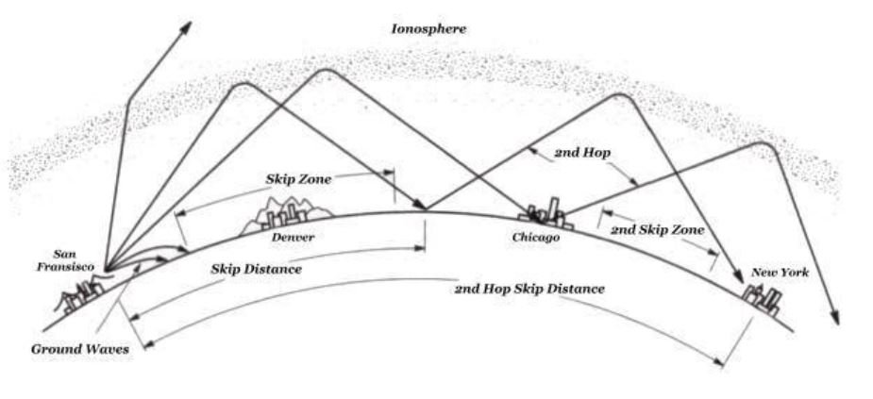
SUBELEMENT G0 – ELECTRICAL AND RF SAFETY
[2 Exam Questions - one from each of 2 Groups]

Slide 7
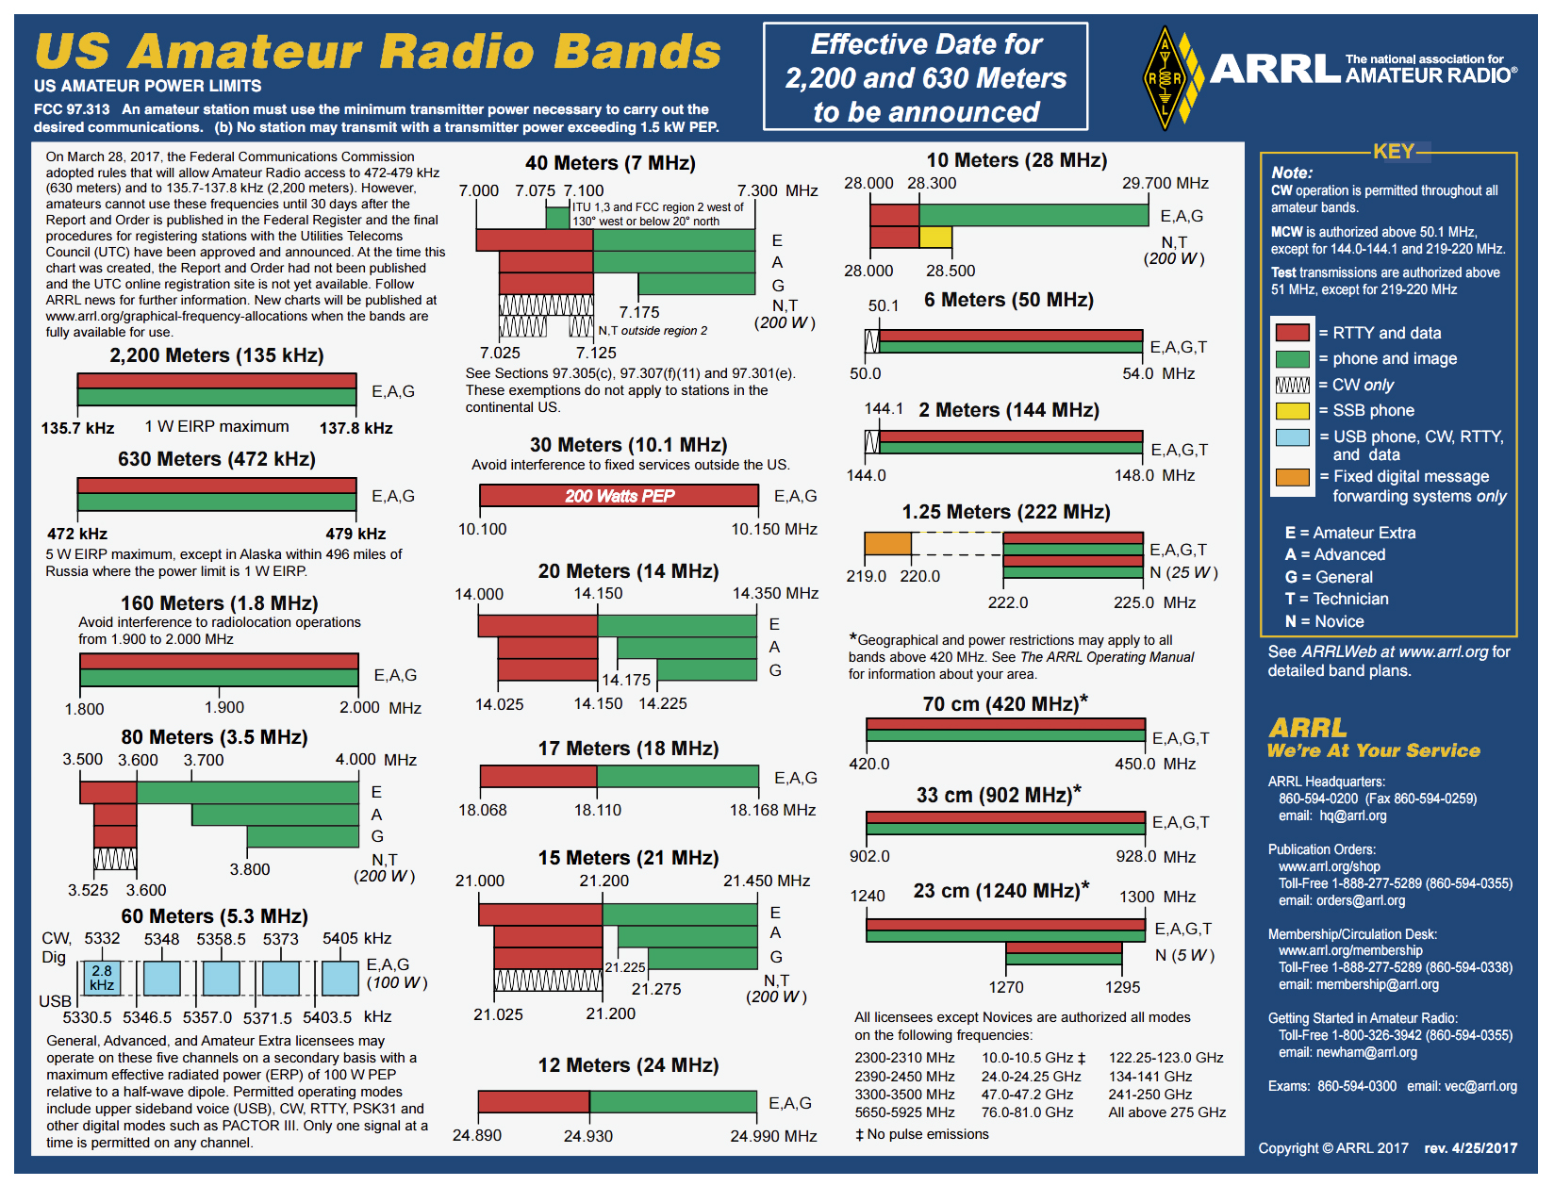

Slide 8


Slide 9
SUBELEMENT G2 – OPERATING PROCEDURES [5 Exam Questions – 5 Groups]
G2A – Phone operating procedures; USB/LSB conventions; breaking into a contact; VOX operation
G2A01
Which sideband is most commonly used for voice communications on frequencies of 14 MHz or higher? Upper sideband
Generally, we use upper sideband for all frequencies above 10 MHz and lower sideband for all frequencies below 10 MHz.

Slide 10
G2A02
Which of the following modes is most commonly used for voice communications on the 160-meter, 75-meter, and 40-meter bands? Lower sideband
These frequencies are all below 10 MHz, therefore LSB.
G2A03
Which of the following is most commonly used for SSB voice communications in the VHF and UHF bands? Upper sideband
These frequencies are all above10 MHz, therefore USB.
G2A04
Which mode is most commonly used for voice communications on the 17-meter and 12-meter bands? Upper sideband
These frequencies are all above10 MHz, therefore USB.

Slide 11
G2A05
Which mode of voice communication is most commonly used on the HF amateur bands? Single sideband
G2A06
Which of the following is an advantage when using single sideband, as compared to other analog voice modes on the HF amateur bands?
Less bandwidth used and greater power efficiency
SSB is an AM signal where the carrier is removed (suppressed) and only one of the two side bands is transmitted.
G2A07
Which of the following statements is true of the single sideband voice mode?
Only one sideband is transmitted; the other sideband and carrier are suppressed

Slide 12
G2A08
What is the recommended way to break into a phone contact? Say your call sign once
G2A09
Why do most amateur stations use lower sideband on the 160-meter, 75-meter, and 40-meter bands? It is good amateur practice
These frequencies are all below generally agreed on rule that below 10 MHz use LSB.

Slide 13
G2A10
Which of the following statements is true of voice VOX operation versus PTT operation? It allows “hands free” operation
VOX stands for Voice Operated Transmit. Whenever you voice is sensed the radio goes into transmit mode.
G2A11
Generally, who should respond to a station in the contiguous 48 states who calls “CQ DX”? Any stations outside the lower 48 states
G2A12
What control is typically adjusted for proper ALC setting on an amateur single sideband transceiver? Transmit audio or microphone gain

Slide 14
G2B – Operating courtesy; band plans; emergencies, including drills and emergency communications
G2B01
Which of the following is true concerning access to frequencies? Except during emergencies, no amateur station has priority access to any frequency
G2B02
What is the first thing you should do if you are communicating with another amateur station and hear a station in distress break in? Acknowledge the station in distress and determine what assistance may be needed
G2B03
What is good amateur practice if propagation changes during a contact and you notice interference from other stations on the frequency? Attempt to resolve the interference problem with the other stations in a mutually acceptable manner

Slide 15
G2B04
When selecting a CW transmitting frequency, what minimum separation should be used to minimize interference to stations on adjacent frequencies? 150 to 500 Hz
G2B05
When selecting an SSB transmitting frequency, what minimum separation should be used to minimize interference to stations on adjacent frequencies?
Approximately 3 kHz
G2B06
What is a practical way to avoid harmful interference on an apparently clear frequency before calling CQ on CW or phone? Send “QRL?” on CW, followed by your call sign; or, if using phone, ask if the frequency is in use, followed by your call sign
QRL is the Q signal for “Are you busy?” or “Is this frequency in use?”.

Slide 16
G2B07
Which of the following complies with good amateur practice when choosing a frequency on which to initiate a call? Follow the voluntary band plan for the operating mode you intend to use
This would be the ARRL Band Plan at the beginning of this Syllabus.
G2B08
What is the voluntary band plan restriction for U.S. stations transmitting within the 48 contiguous states in the 50.1 to 50.125 MHz band segment? Only contacts with stations not within the 48 contiguous states
This is not shown on the ARRL Band Plan.
G2B09 [97.407(a)]
Who may be the control operator of an amateur station transmitting in RACES to assist relief operations during a disaster? Only a person holding an FCC-issued amateur operator license

Slide 17
G2B10 [97.405(b)]
When is an amateur station allowed to use any means at its disposal to assist another station in distress? At any time during an actual emergency
G2B11 [97.405]
What frequency should be used to send a distress call? Whichever frequency has the best chance of communicating the distress message

Slide 18
G2C – CW operating procedures and procedural signals; Q signals and common abbreviations: full break-in
G2C01
Which of the following describes full break-in telegraphy (QSK)?
Transmitting stations can receive between code characters and elements
G2C02
What should you do if a CW station sends “QRS?” Send slower
G2C03
What does it mean when a CW operator sends “KN” at the end of a transmission? Listening only for a specific station or stations

Slide 19
G2C04
What does the Q signal “QRL?” mean? “Are you busy?” or “Is this frequency in use?”
G2C05
What is the best speed to use when answering a CQ in Morse code? The fastest speed at which you are comfortable copying, but no faster than the CQ
G2C06
What does the term “zero beat” mean in CW operation? Matching the transmit frequency to the frequency of a received signal
G2C07
When sending CW, what does a “C” mean when added to the RST report?
Chirpy or unstable signal

Slide 20
G2C08
What prosign is sent to indicate the end of a formal message when using CW?
AR
G2C09
What does the Q signal “QSL” mean? I acknowledge receipt
G2C10
What does the Q signal “QRN” mean? I am troubled by static
G2C11
What does the Q signal “QRV” mean? I am ready to receive messages

Slide 21
G2D – Volunteer Monitoring Program; HF operations
G2D01
What is the Volunteer Monitoring Program? Amateur volunteers who are formally enlisted to monitor the airwaves for rules violations
Volunteer Monitors are accredited by the ARRL Volunteer Monitoring Program Administrator and the FCC. These monitoring stations had been previously designated as Official Observer Stations.
G2D02
Which of the following are objectives of the Volunteer Monitoring Program?
To encourage amateur radio operators to self-regulate and comply with the rules
G2D03
What skills learned during hidden transmitter hunts are of help to the Volunteer Monitoring Program? Direction finding used to locate stations violating FCC rules

Slide 22
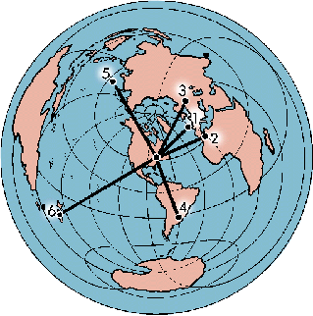
G2D04
Which of the following describes an azimuthal projection map? A map that shows true bearings and distances from a particular location
The azimuthal equidistant projection is an azimuthal map projection. It has the useful properties that all points on the map are at proportionally correct distances .

Slide 23
G2D05
Which of the following is a good way to indicate on a clear frequency in the HF phone bands that you are looking for a contact with any station? Repeat “CQ” a few times, followed by “this is,” then your call sign a few times, then pause to listen, repeat as necessary
G2D06
How is a directional antenna pointed when making a “long-path” contact with another station? 180 degrees from the station’s short-path heading

Slide 24
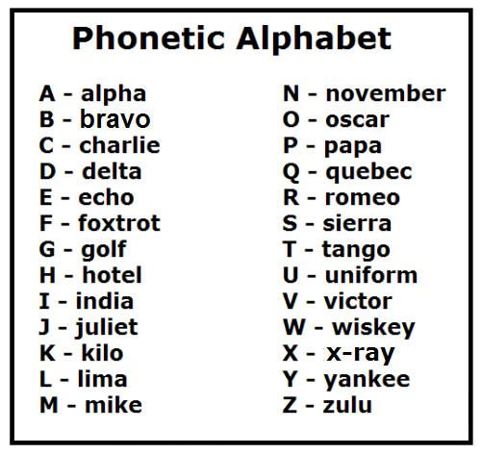
G2D07
Which of the following are examples of the NATO Phonetic Alphabet?
Alpha, Bravo, Charlie, Delta
G2D08
What is a reason why many amateurs keep a station log?
To help with a reply if the FCC requests information
G2D09
Which of the following is required when participating in a contest on HF frequencies? Identify your station per normal FCC regulations

Slide 25
G2D10
What is QRP operation? Low-power transmit operation
QRP is both a popular technical and operating challenge. Low power transmitters and transceivers (typically 5 watts) are widely popular construction projects. With power efficient modes like CW FT8 and PSK31, a skilled operator can work the globe!
G2D11
Which of the following is typical of the lower HF frequencies during the summer?
High levels of atmospheric noise or “static”

Slide 26
G2E – Digital operating procedures
G2E01
Which mode is normally used when sending RTTY signals via AFSK with an SSB transmitter? LSB
RTTY is Radio Teletype – AFSK is Audio Frequency Shift Keying, SSB is Single Sideband, LSB is lower sideband.
G2E02
How can a PACTOR modem or controller be used to determine if the channel is in use by other PACTOR stations? Put the modem or controller in a mode which allows monitoring communications without a connection

Slide 27
G2E03
What symptoms may result from other signals interfering with a PACTOR or WINMOR transmission?
A. Frequent retries or timeouts
B. Long pauses in message transmission
C. Failure to establish a connection between stations
D. All these choices are correct
G2E04
What segment of the 20-meter band is most often used for digital transmissions (avoiding the DX propagation beacons)? 14.070 - 14.112 MHz
G2E05
What is the standard sideband used to generate a JT65, JT9, or FT8 digital signal when using AFSK in any amateur band? USB
This does not follow the normal Upper or Lower SSB rule.

Slide 28
G2E06
What is the most common frequency shift for RTTY emissions in the amateur HF bands? 170 Hz
G2E07
What segment of the 80-meter band is most commonly used for digital transmissions? 3570 – 3600 kHz
G2E08
In what segment of the 20-meter band are most PSK31 operations commonly found? Below the RTTY segment, near 14.070 MHz

Slide 29
G2E09
How do you join a contact between two stations using the PACTOR protocol?
Joining an existing contact is not possible, PACTOR connections are limited to two stations
G2E10
Which of the following is a way to establish contact with a digital messaging system gateway station? Transmit a connect message on the station’s published frequency

Slide 30
G2E11
Which of the following is characteristic of the FT8 mode of the WSJT-X family? Typical exchanges are limited to call signs, grid locators, and signal reports
WSJT-X implements communication protocols or "modes" called FT4, FT8, JT4, JT9, JT65, QRA64, ISCAT, MSK144, and WSPR.
These modes were all designed for making reliable, confirmed QSOs under extreme weak-signal conditions.

Slide 31
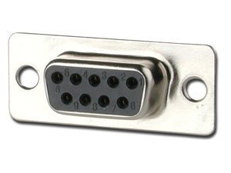
G2E12
Which of the following connectors would be a good choice for a serial data port?
DE-9
Sometimes referred to as a DB-9 connector.
G2E13
Which communication system sometimes uses the internet to transfer messages? Winlink
Winlink, also known as the Winlink 2000 Network, is a worldwide radio messaging system that uses amateur-band radio frequencies as well as government and commercial marine frequencies ^{[1]} to provide radio interconnection services that include email with attachments, position reporting, weather bulletins, emergency relief communications, and message relay.‎

Slide 32
G2E14
What could be wrong if you cannot decode an RTTY or other FSK signal even though it is apparently tuned in properly?
A. The mark and space frequencies may be reversed
B. You may have selected the wrong baud rate
C. You may be listening on the wrong sideband
D. All these choices are correct
G2E15
Which of the following is a requirement when using the FT8 digital mode? Computer time accurate within approximately 1 second

