Slide 1

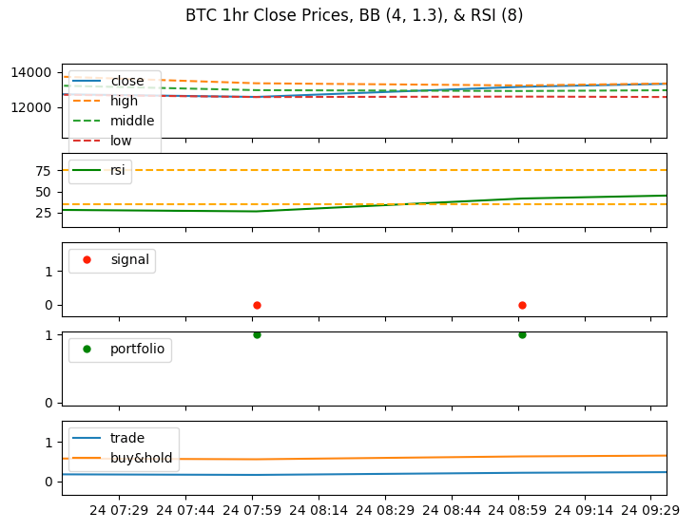
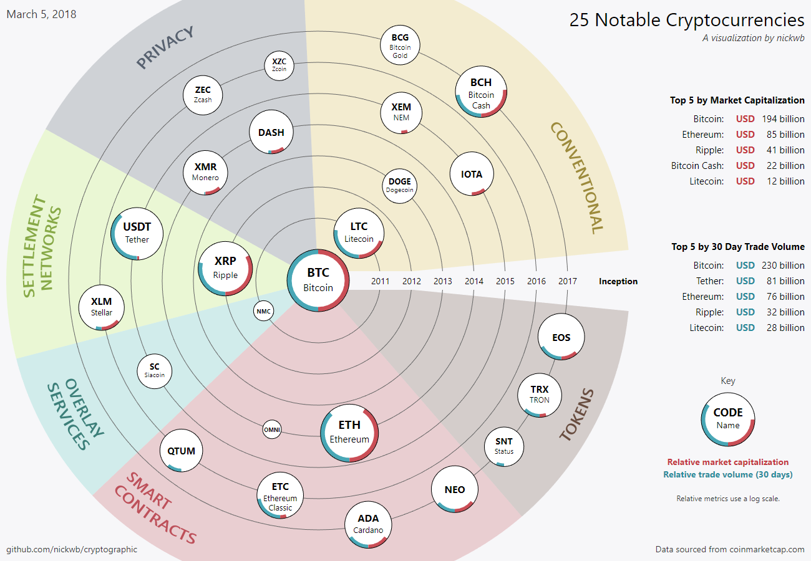
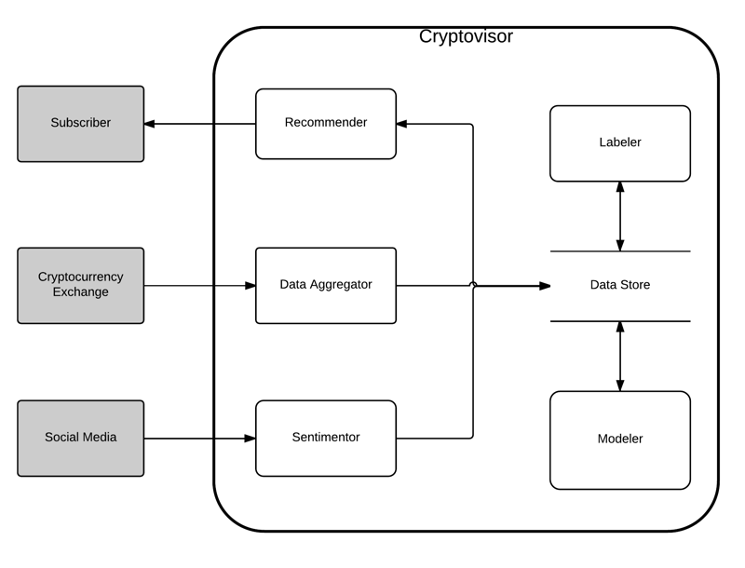
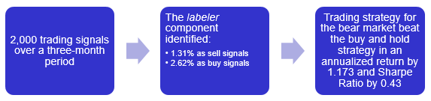
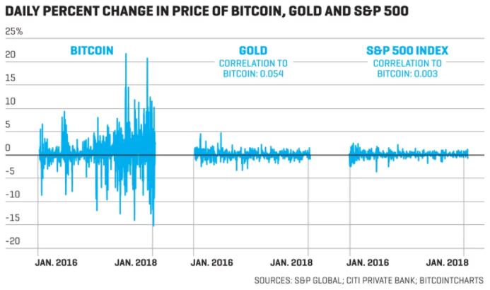
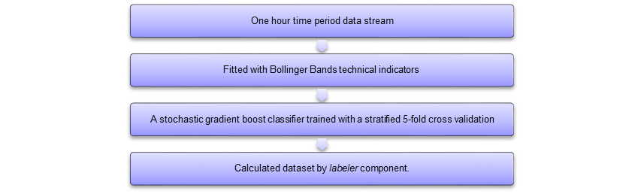
Cryptovisor: A Cryptocurrency Advisor Tool
Matthew Baldree, Paul Widhalm and Brandon Hill
Master of Science in Data Science
Southern Methodist University, Dallas, TX 75275, USA
DataScience@SMU
Cryptocurrency Investing
A New Investment Tool
Results
The cryptocurrency market is in its infancy, less than 10 years old!
Lots of new cryptocurrencies of different types arriving to the market
Market growth is phenomenal
By leveraging technical momentum indicators to provide buy, sell, and hold markers or labels, Cryptovisor performs as good or better than a buy and hold trading strategy in a bear market, bull market or both markets.
Output charts from labeler component.
  1st: Close price with BB
  2nd: RSI with buy and sell targets
  3rd: Sell signal points
  4th: portfolio strategy
  5th: Strategy results
How to Invest ???
How it Works
The cryptocurrency market is volatile due to its infancy and limited size making it difficult for investors to know when to enter, exit, or stay in the market.
Conclusions
Crypto-currency market is volatile and in its infancy making the environment risky for individual investors
Current tools these investors have to employ to help them make crypto-currency investment decisions is limited
Cryptovisor, that is 95.5% accurate with a standard deviation of 0.54% in determining the buy, sell or hold position for Bitcoin

Slide 2
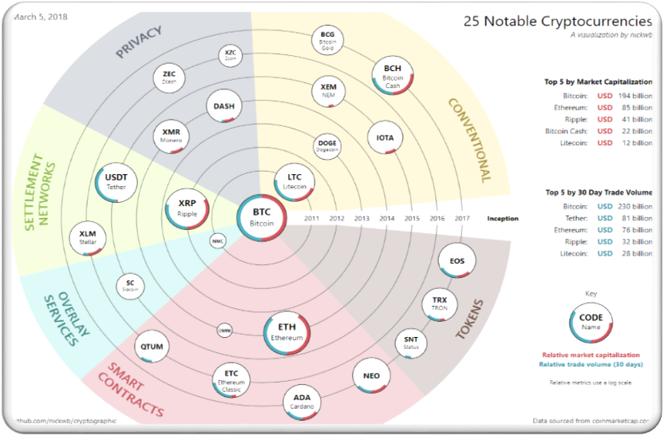
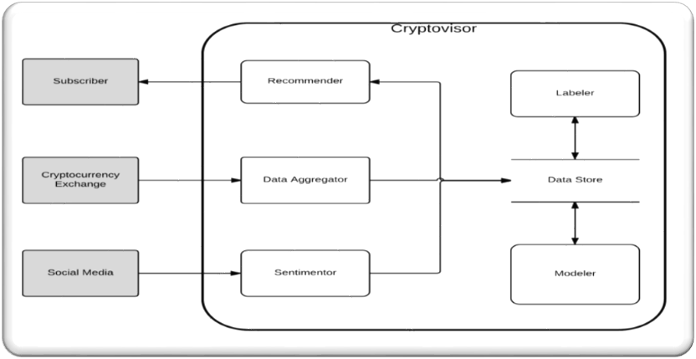
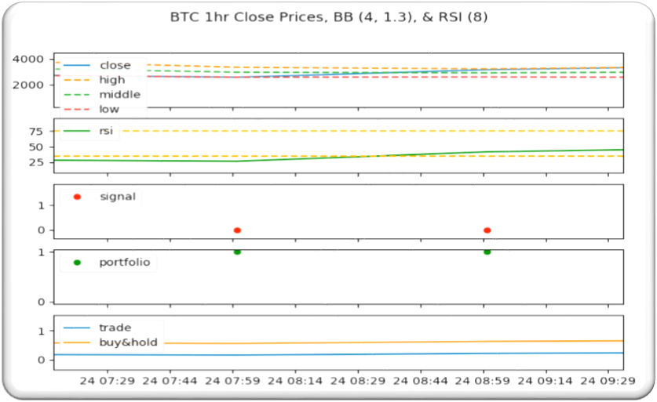
Cryptovisor: A Cryptocurrency Advisor Tool
Matthew Baldree, Paul Widhalm and Brandon Hill
Master of Science in Data Science
Southern Methodist University, Dallas, TX 75275, USA
DataScience@SMU
Cryptocurrency Investing
Pictures and Tables
Blockchain technology has created an explosive market for investing
The cryptocurrency market is in its infancy, less than 10 years old!
Lots of new cryptocurrencies of different types arriving to the market
Market growth is phenomenal
Figures: figures go great in the center column
Overlay: it’s OK to have the figures intrude into the surrounding boxes.
Tables: tables may go well in the center, off center or in place of one of these boxes
Balance: the biggest point of a poster is to balance this means the figures and tables but also the boxes
Text: text is great but an entire poster of text is really hard for someone to read and understand. I should understand the work reading only headers and figures and tables
Main Topics
What type of investment asset is Bitcoin?
Mining, Bitcoin mining
Current investor tools
Do as I Say
This is simply a representation of what you should have in your poster.
Follow the template.
Keep font sizes as they are.
Work and be creative within the confines of this hot mess
When in doubt, ask.
Problem
The cryptocurrency market is volatile due to its infancy and limited size making it difficult for investors to know when to enter, exit, or stay in the market.
Not as I Do
This is not a very good story.
Your goal is to make this pretty and informative.
Tell your story and break some eggs, but just make sure you have accomplished the task of a poster.\
http://fortune.com/2018/02/06/bitcoin-stock-volatility-vix-sec/
Conclusions
Crypto-currency market is volatile and in its infancy making the environment risky for individual investors
Current tools these investors have to employ to help them make crypto-currency investment decisions is limited
Cryptovisor, that is 95.5% accurate in determining the buy, sell or hold position for Bitcoin

Slide 3
