Slide 1
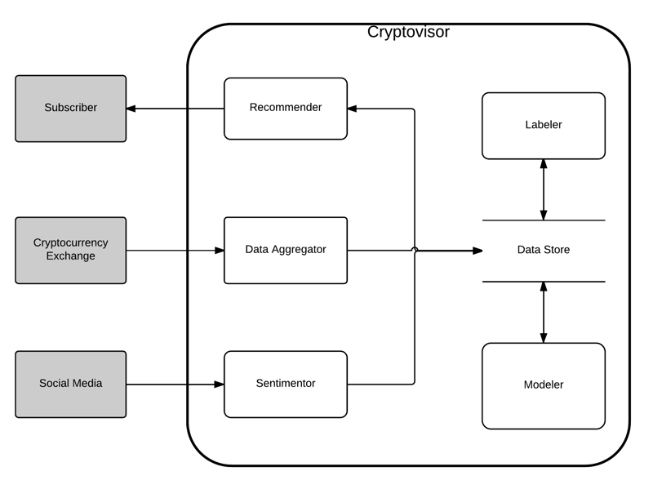
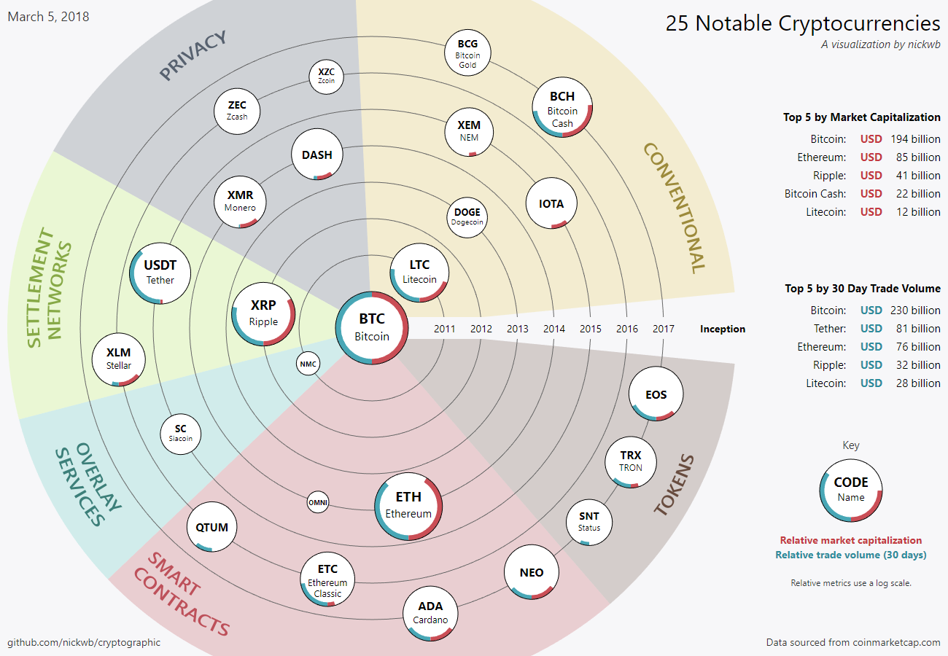
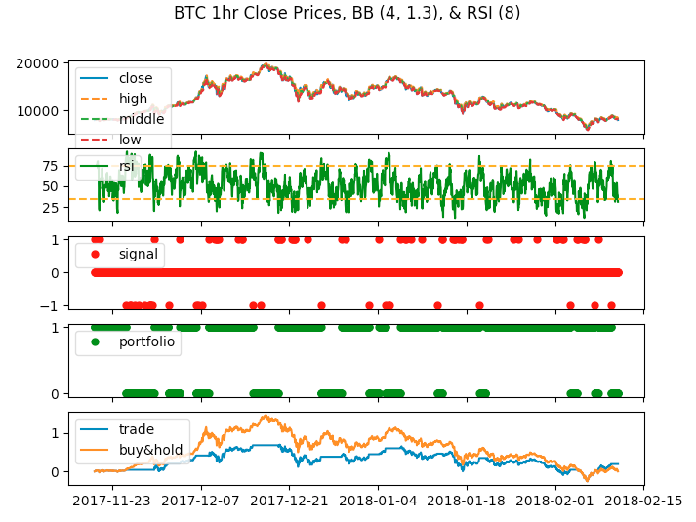
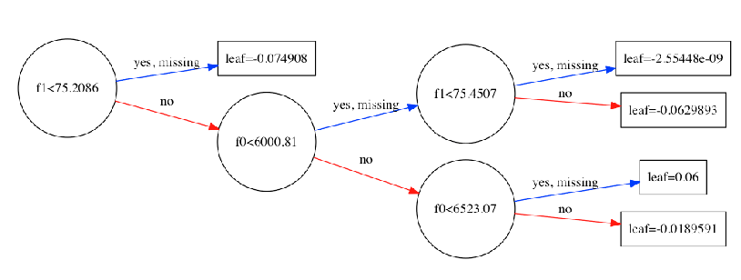
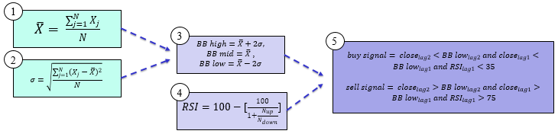
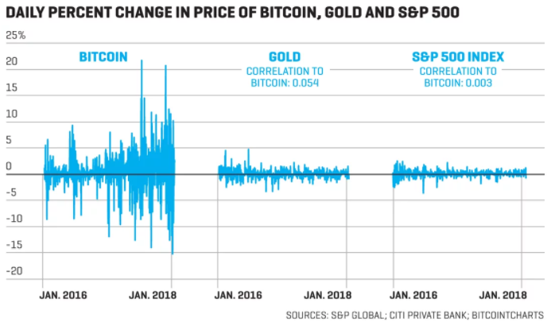

Cryptovisor: A Cryptocurrency Advisor Tool
Matthew Baldree, Paul Widhalm, Brandon Hill and Matteo Ortisi
Master of Science in Data Science
Southern Methodist University, Dallas, TX 75275, USA
DataScience@SMU
Cryptocurrency Investing
A New Investment Tool
Young, volatile and growing cryptocurrency market with over 1,500 cyrptos traded on 5,400 exchanges with $821B market capitalization at all time high in 2017.
We designed and partially built a cryptocurrency recommendation system—Cryptovisor. The tool can recommend a buy, sell or hold trading strategy for an investor based on market history.
How it Works
Labeler
For each time series data point, the moving average (1), standard deviation (2), Bollinger Bands (BB) (3), Relative Strength Indicator (RSI) are created. BB are volatility lines created from a close price moving average and its standard deviation. Relative Strength Indicator (RSI) is a momentum oscillator that measures speed and change of price movements between zero and 100. N is the average days up or down closes. Trading signals are generated followed by the returns and compared with a buy and hold strategy to ensure trading signals yield comparable results.
The Labeler reads in cryptocurrency exchange data and up samples or down samples it appropriately and labels data as a buy, sell, or hold signal based on algorithm. A grid of parameters are used to tune the algorithm for best Sharpe Ratio.
The Modeler
The Modeler reads in labeled data, cleans it and separates out features from the labeled target. A stochastic gradient boost classifier, XGBoost, is trained with a stratified 5-fold cross validation to determine accuracy. Feature are pruned to yield simples model without sacrificing accuracy for maximum usability. Simplified model is used as recommender.
How to Invest ???
Volatility makes the market impossible to forecast and difficult for an investor to know when to Buy, Sell or Hold cryptos.
Algorithm
Summary
Cryptovisor is 95.5% accurate with a standard deviation of 0.54% and outperformed buy and hold in a bear market.
Summary | Bull Trade | Bull B&H | Bear Trade | Bear B& H | Both Trade | Both B&H
Return | 13.66 | 16.78 | 1.18 | 0.007 | 5.17 | 5.96
Sharpe Ratio(Rf=0%) | 3.67 | 3.54 | 1.26 | 0.83 | 2.16 | 2.17

