Slide 1

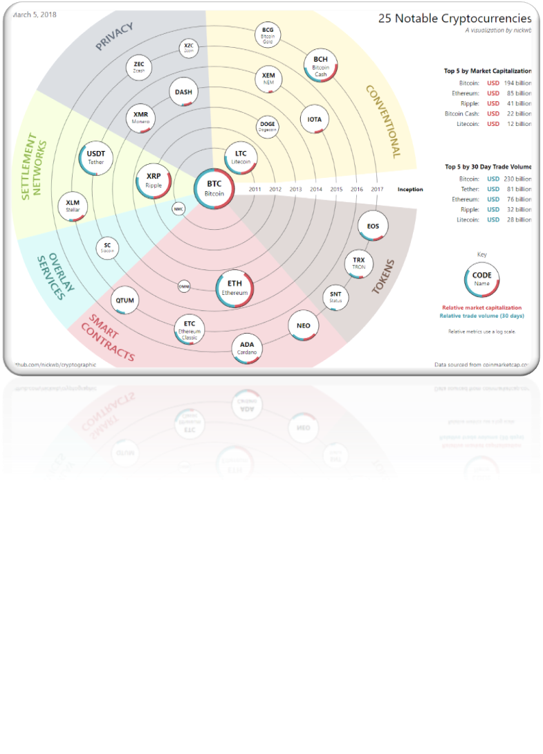
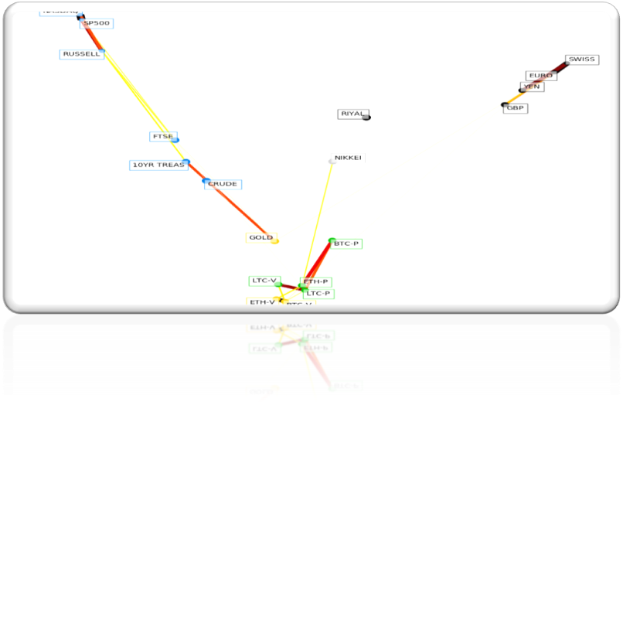
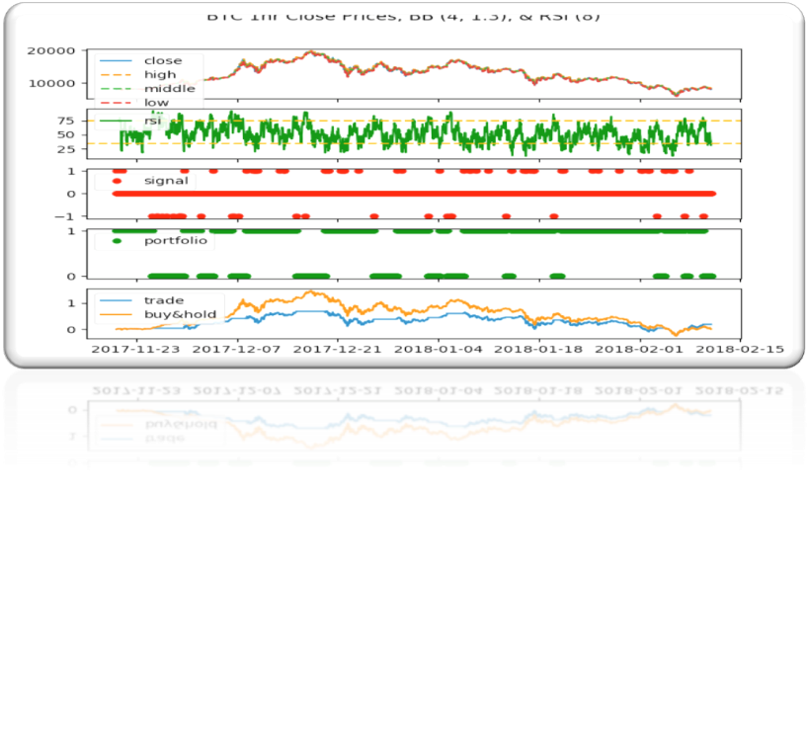
Cryptovisor: A Cryptocurrency Advisor Tool
Matthew Baldree, Paul Widhalm and Brandon Hill
Master of Science in Data Science
Southern Methodist University, Dallas, TX 75275, USA
DataScience@SMU
Cryptocurrency Investing
Pictures and Tables
Blockchain technology has created an explosive market for investing
The cryptocurrency market is in its infancy, less than 10 years old!
Lots of new cryptocurrencies of different types arriving to the market
Market growth is phenomenal
Figures: figures go great in the center column
Overlay: it’s OK to have the figures intrude into the surrounding boxes.
Tables: tables may go well in the center, off center or in place of one of these boxes
Balance: the biggest point of a poster is to balance this means the figures and tables but also the boxes
Text: text is great but an entire poster of text is really hard for someone to read and understand. I should understand the work reading only headers and figures and tables
Main Topics
What type of investment asset is Bitcoin?
Mining, Bitcoin mining
Current investor tools
Do as I Say
This is simply a representation of what you should have in your poster.
Follow the template.
Keep font sizes as they are.
Work and be creative within the confines of this hot mess
When in doubt, ask.
Problem
Investors don’t have what they need
Not as I Do
This is not a very good story.
Your goal is to make this pretty and informative.
Tell your story and break some eggs, but just make sure you have accomplished the task of a poster.
Contents Tell a Story
The contents that you do include must tell a complete story.
Note that all the details in your paper do not necessarily show up in your poster
Be sure to properly motivate your problem too
Conclusions
Conclusion 1 – don’t number your conclusions. Simply state them
Conclusion 2, each conclusion is its own bullet point
Conclusion 3 and be sure to have three. All good things come in threes including your primary conclusions from your work.

